Slide 1
User Interfaces that Entice People to Manage Better Information
David Karger
MIT

Slide 2
The Deeper Web:
Managing Information that isn’t on the Web (Yet)

Slide 3
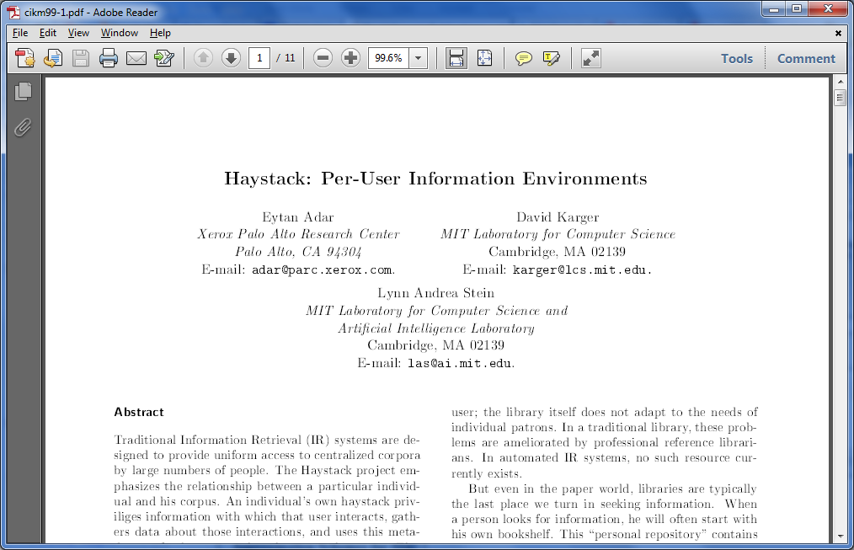
CIKM 1999

Slide 4
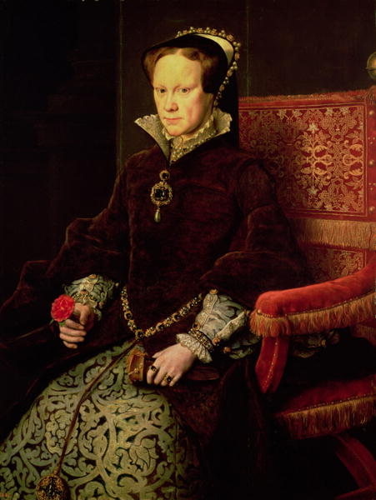

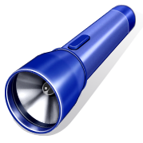
Current State of IKM

Slide 5
Thesis
We work hard to make computers do IKM well
People are better than computers at IKM
  They just don’t have the right tools
  Or the time/desire
Don’t assume passive IK consumers
Tools can encourage active engagement in IKM
  By deciding what users are capable of
  And minimizing effort to use
  And maximizing/exposing benefit

Slide 6
The Questions
In what ways can we give people the ability to manage more or better information?
How do we make them want to?

Slide 7
Examples
Capture more data digitally
Collaborate to understand lecture notes
Information filtering
Structured data authoring and visualization

Slide 8
Information Scraps
You can’t find it if it isn’t there
Bernstein, van Kleek, Karger, schraefel
37

Slide 9
The State of PIM
We have developed a vast array of powerful tools to help people manage their personal information
The result: everyone has a computer on their desk for PIM

Slide 10


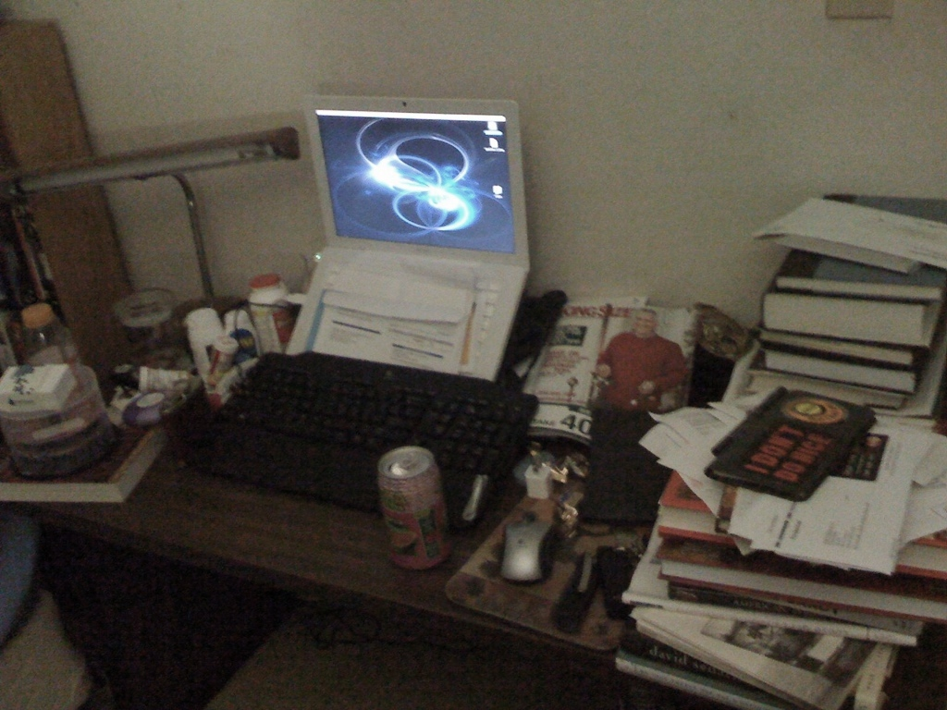

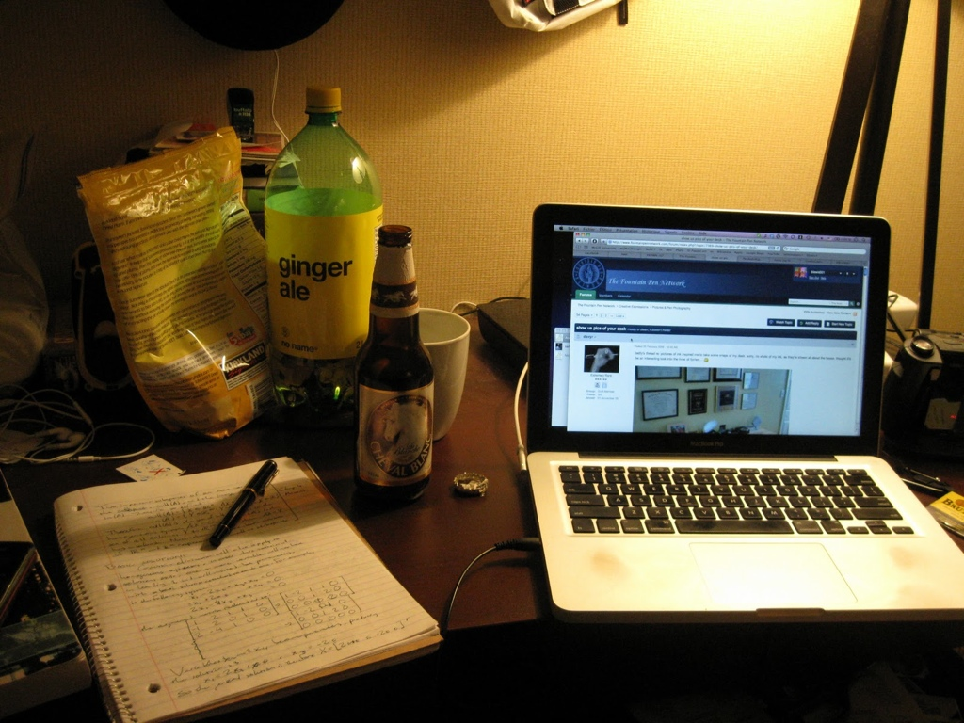
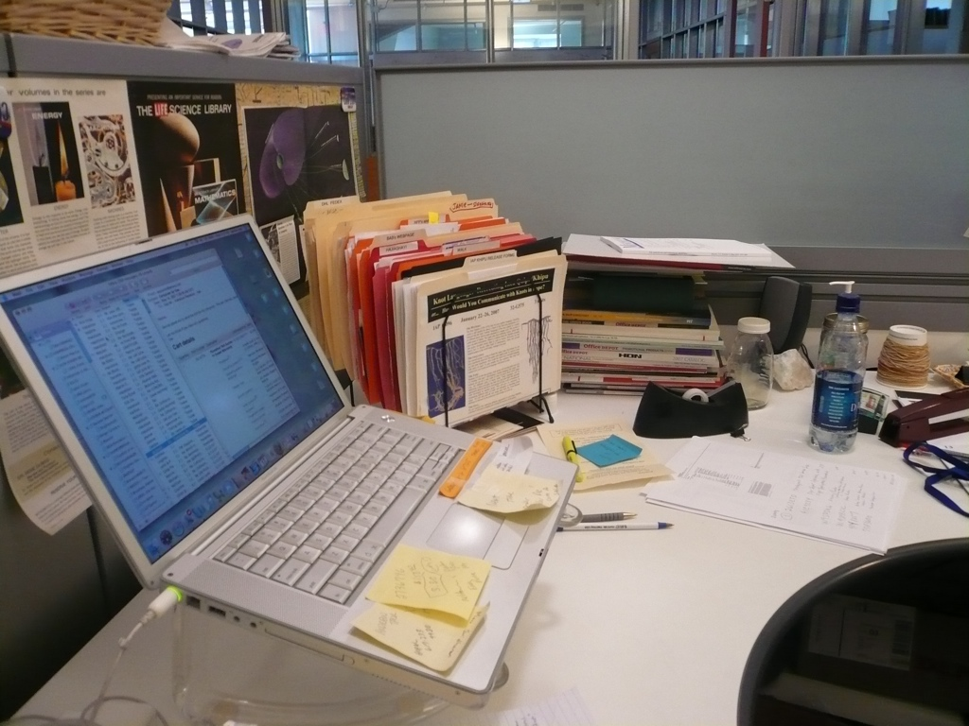

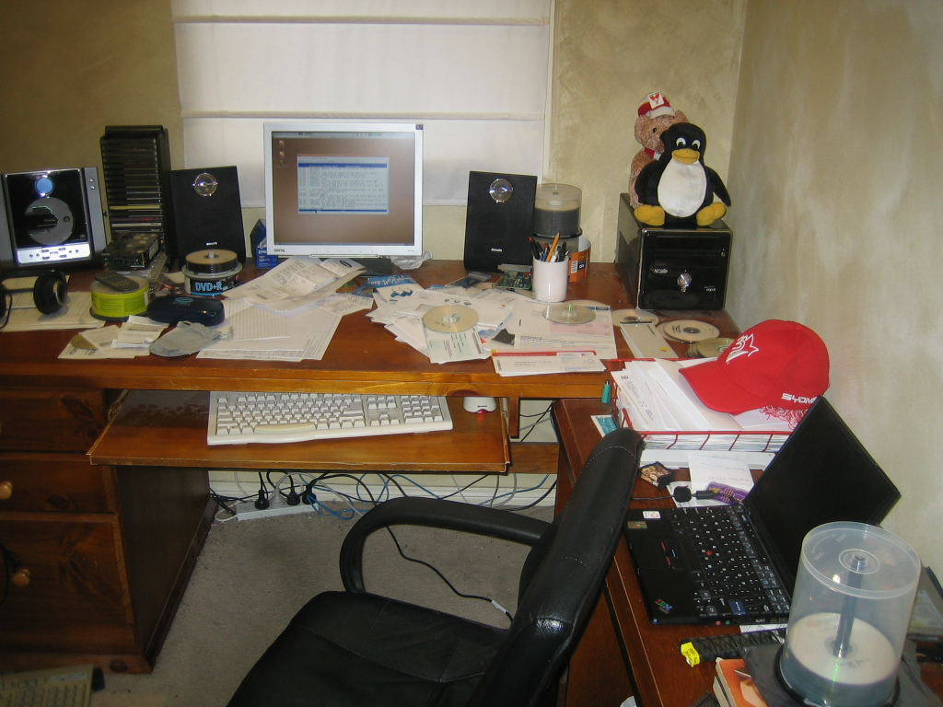
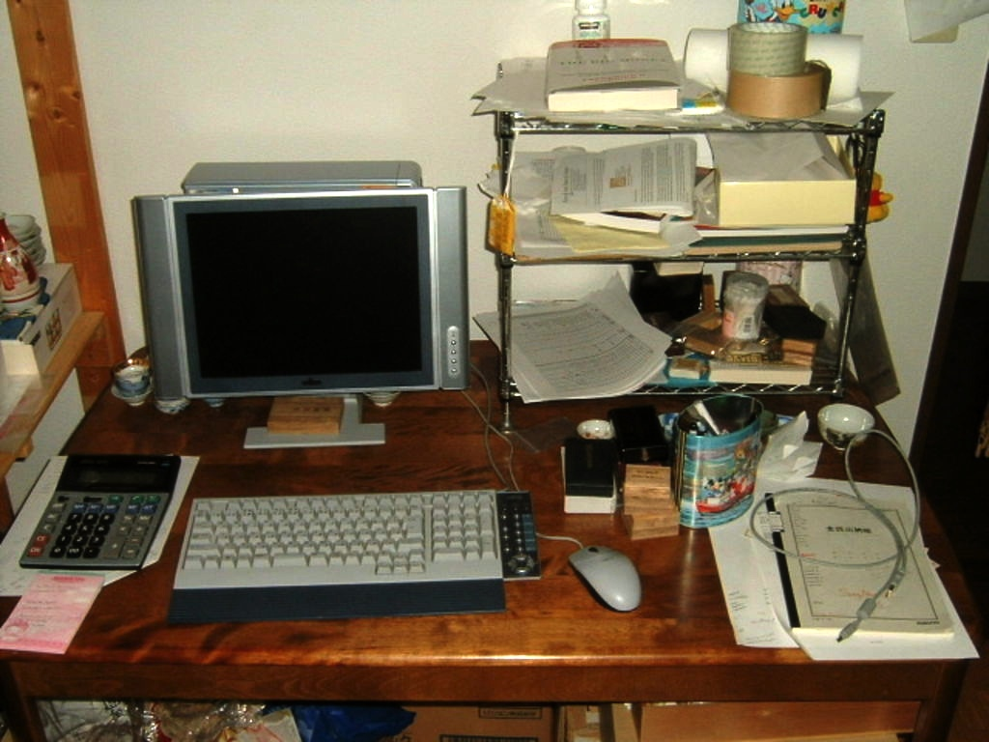
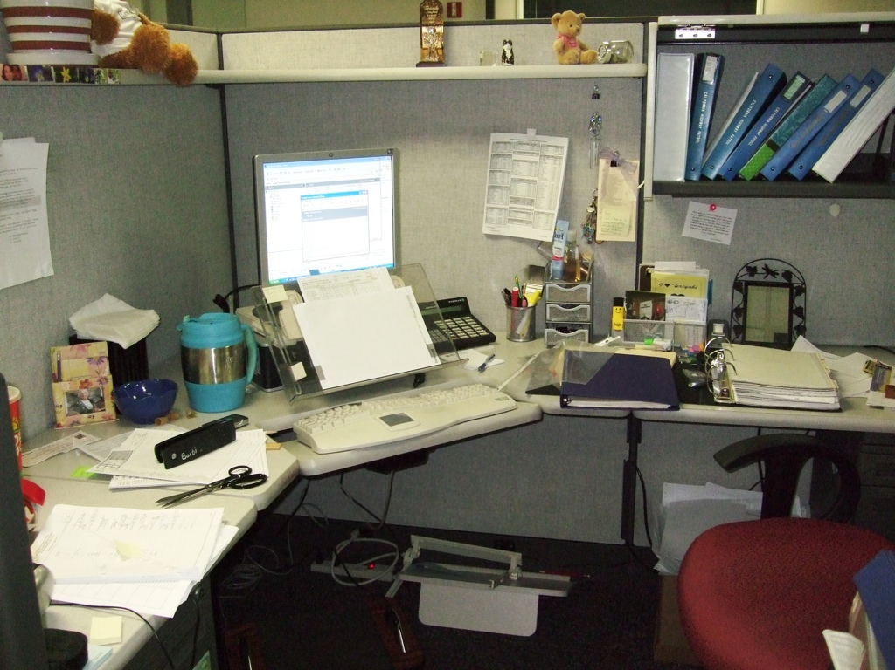
10

Slide 11
Information Scraps
Many tools for managing many info types
But lots of it never placed in computer
So cannot be managed by tools
  No matter how good they are
Why? (Ran a Study)
What can we do about it? (Built a Tool)

Slide 12
Info Scraps Study
Long Interview Study
  27 participants
  5 organizations
  1-hour semi-structured interviews
  and artifact examinations

Slide 13
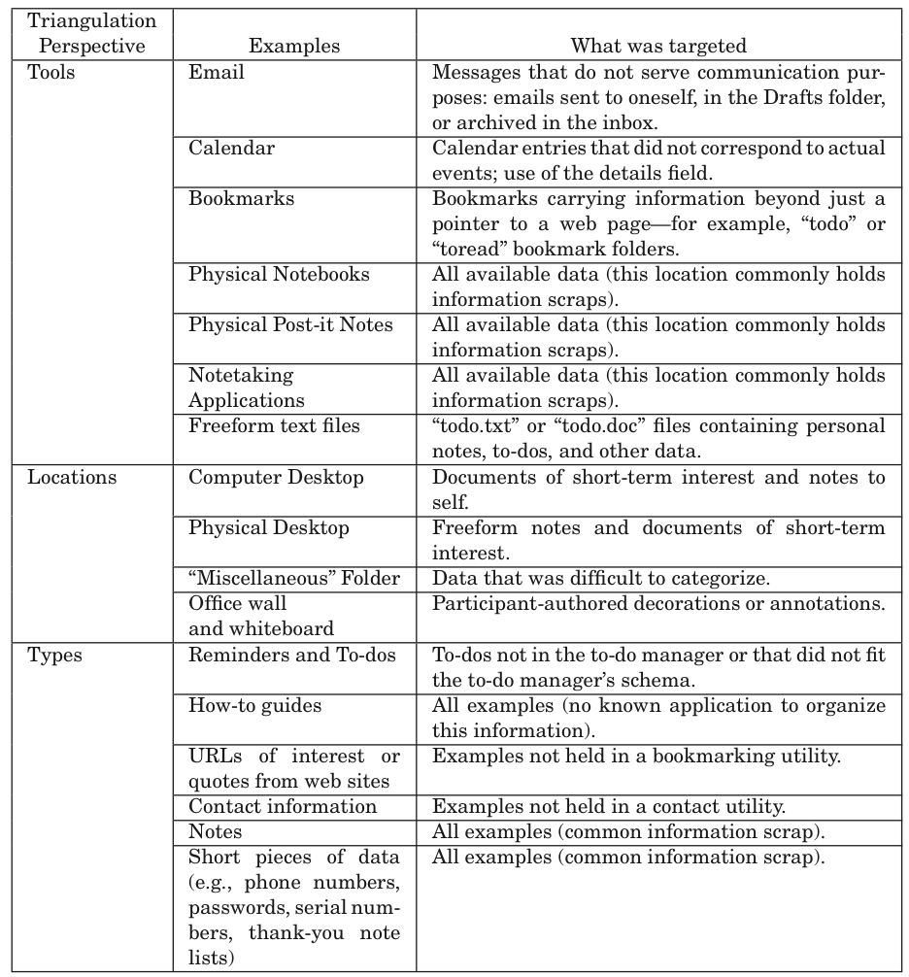

Slide 14
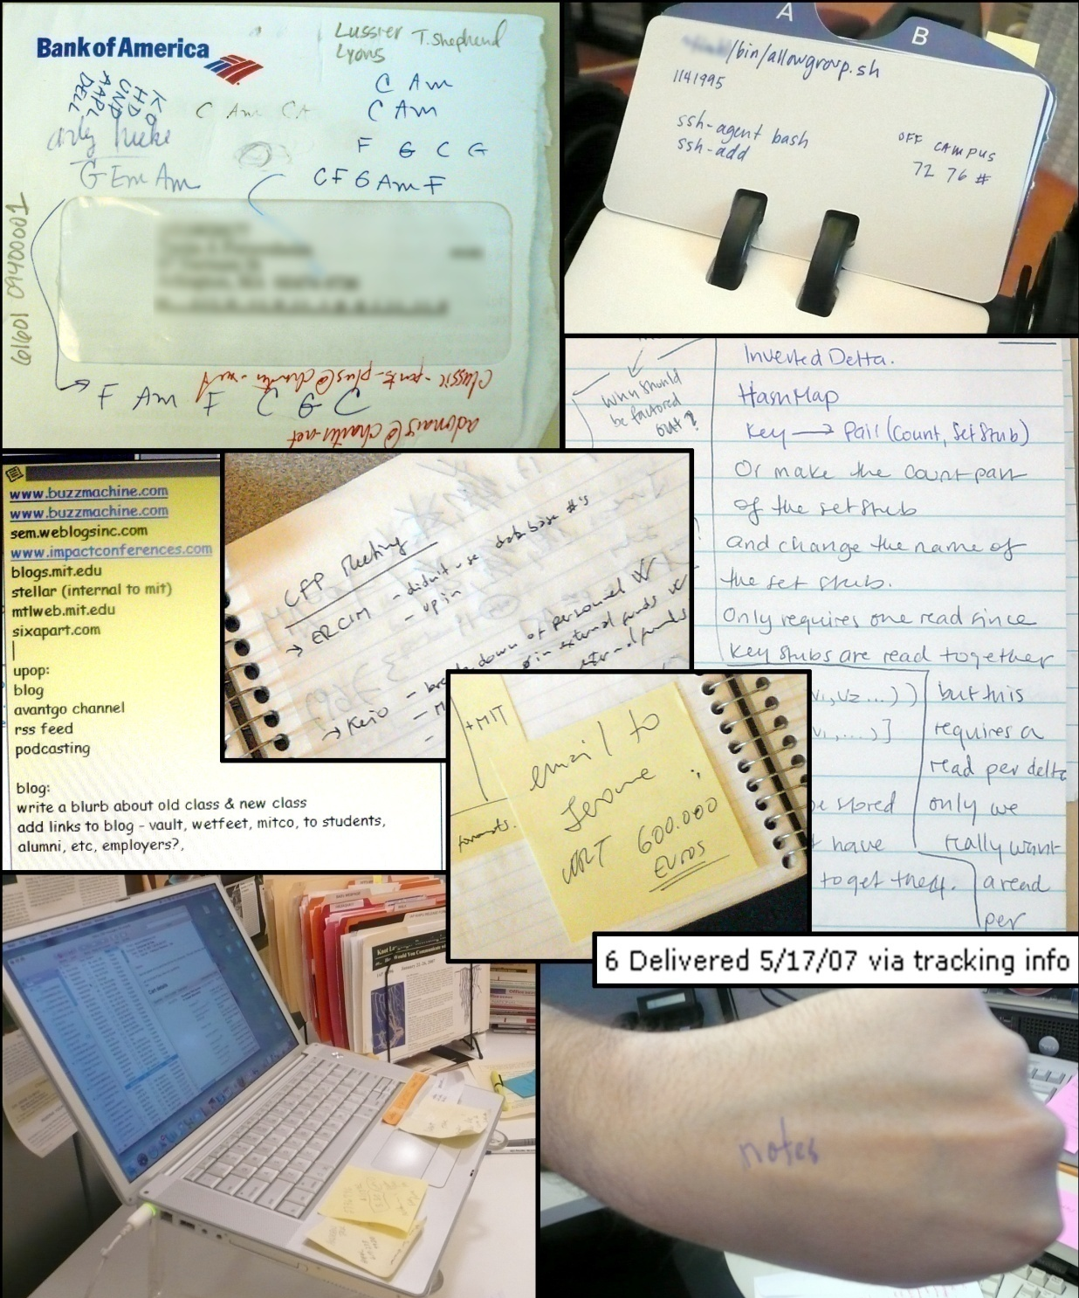
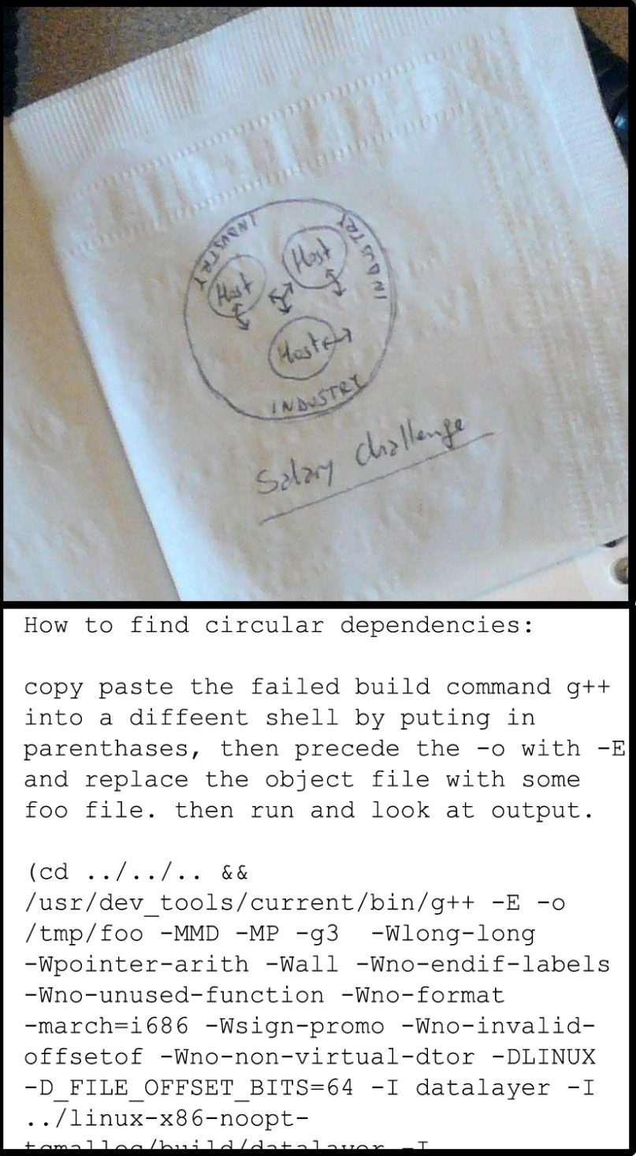
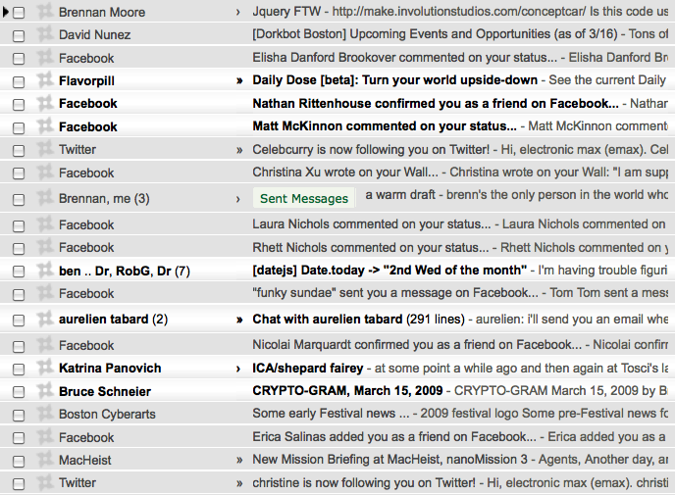
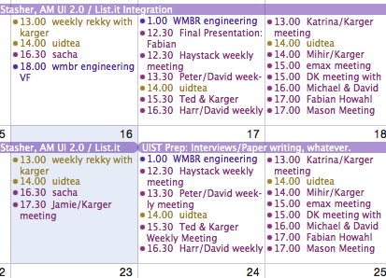
#1 – using computer is distracting/impossible

Slide 15
Flow
Ben Bederson, “Interfaces for Staying in the Flow”, Ubiquity 2004
A sense of focused task concentration
“First, by whatever name you call it - “the runner's high,” “being in the moment,” “in the zone”, “when time slows down,” “the opposite of writer's block,” flow has been studied and celebrated by mystics, athletes, artists and their coaches and guides for centuries.”
---Obama presidential campaign soliciation

Slide 16
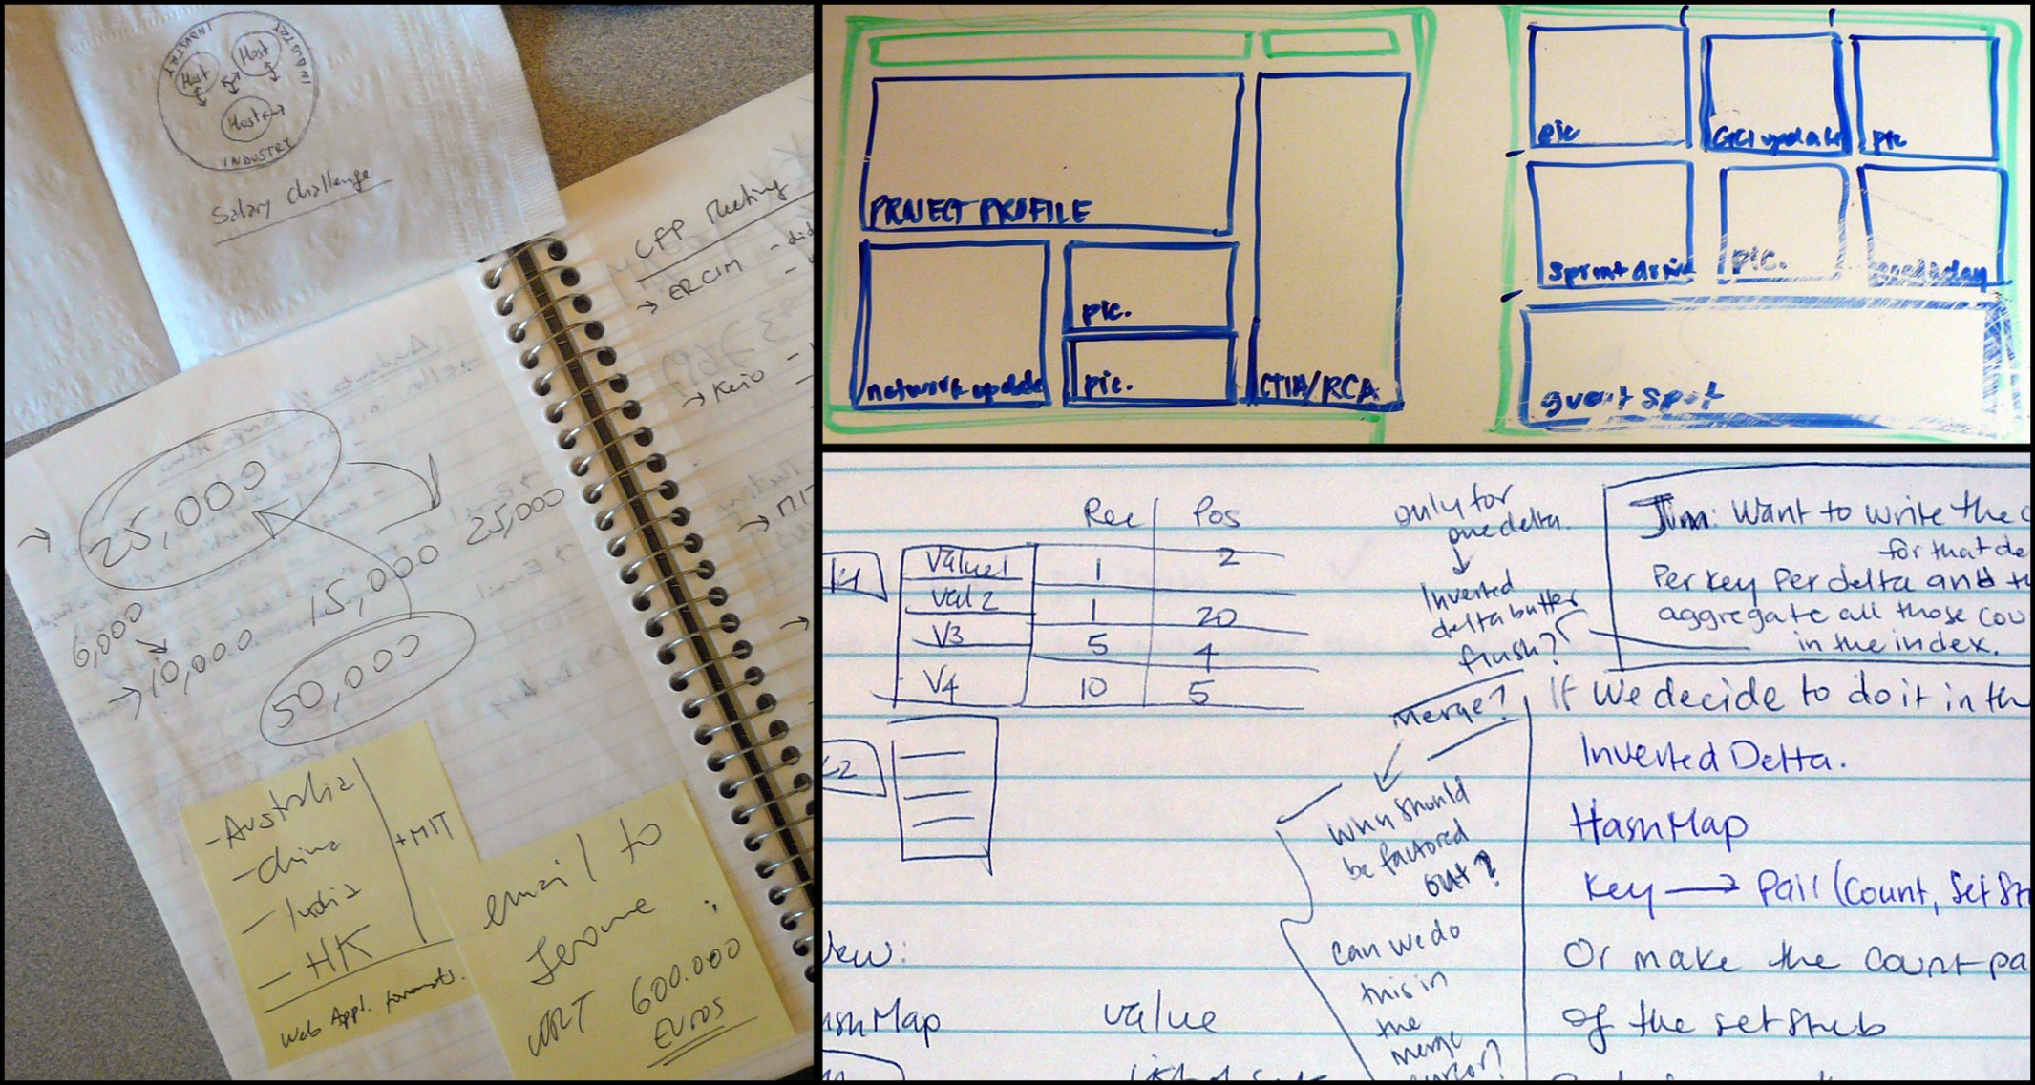
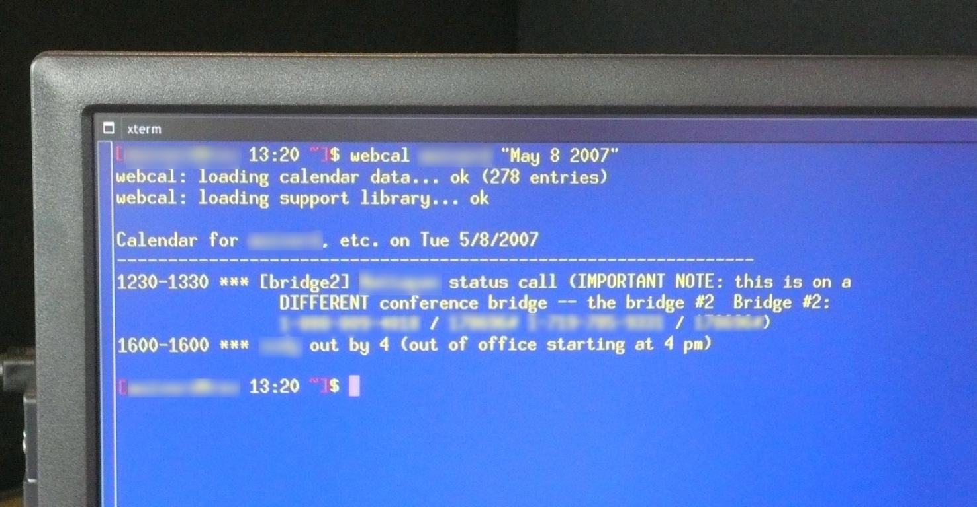
#2 – chimeras fight between apps
meeting notes contain to-dos, contacts, ref. bits, calculations;
calendar events share parts with contacts, bookmarks, maps
contacts double as reminders (to-contacts)

Slide 17
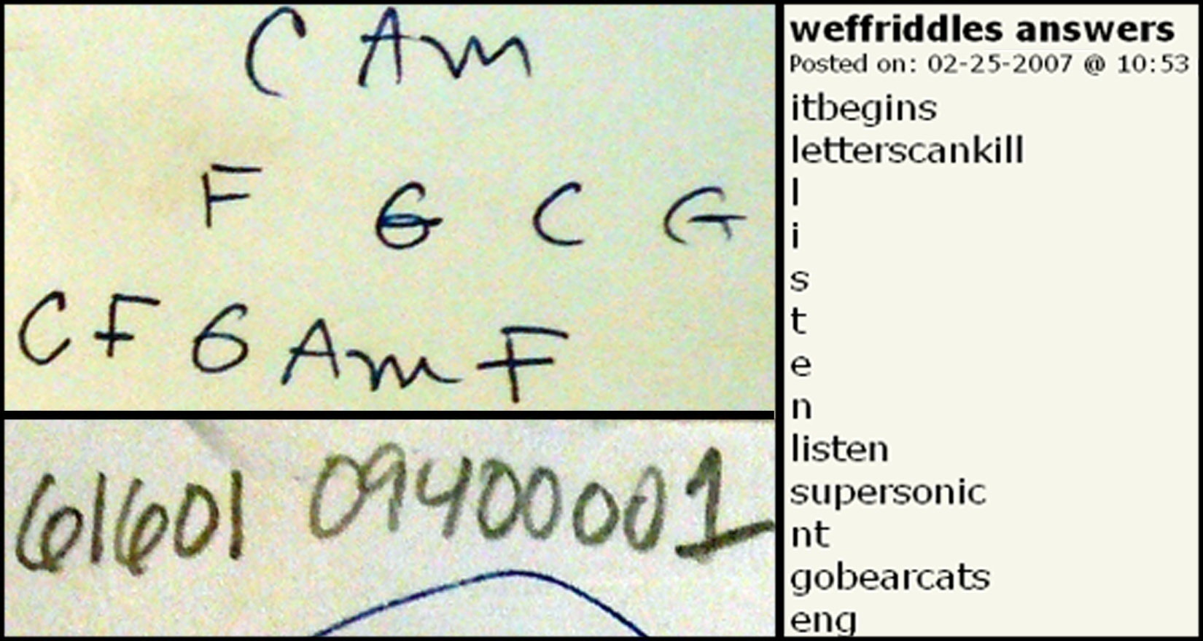
#3 - diverse information forms don’t fit apps

Slide 18
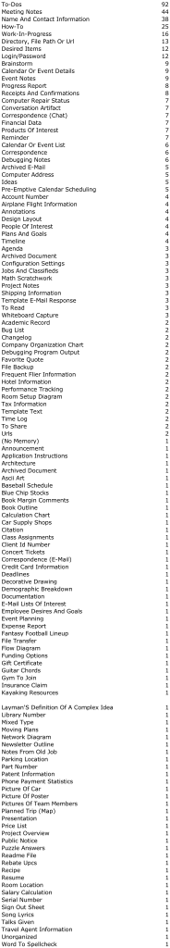

Slide 19
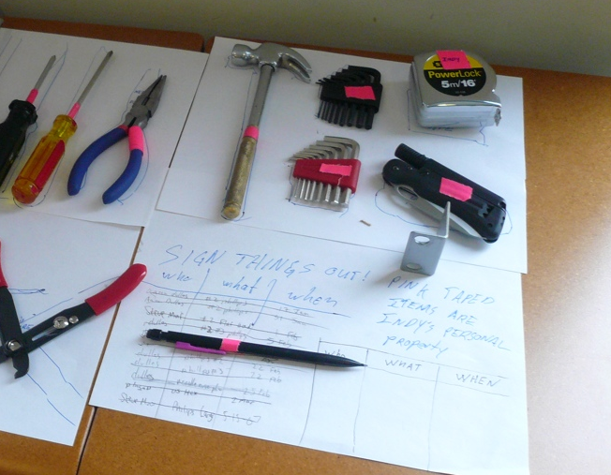
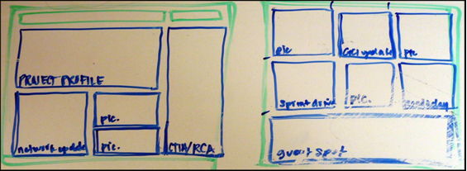
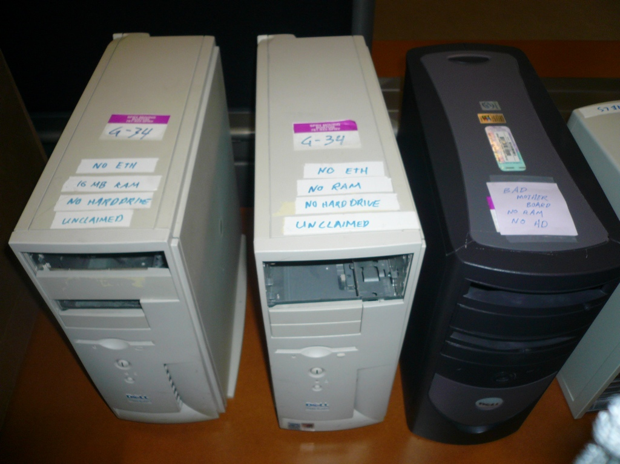
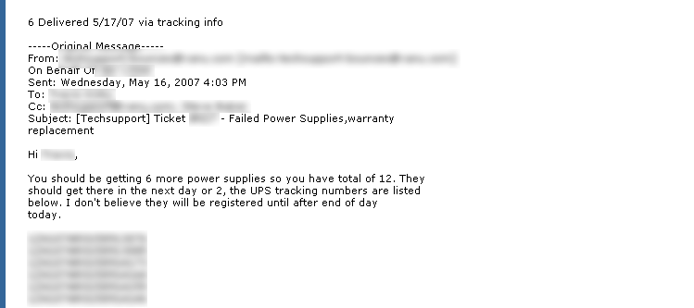
#4 – Want in view at right time---workflow integration

Slide 20
Interviews: Why do you information scrap?
1. Using computer distracting/impossible:
speed/effort
availability : (when you need tool)
2. Schema mismatch
3. No suitable place
4. In view at right time
“If it takes three clicks to get it down, it’s easier to e-mail.”- FIN1
“When I’m in meetings or run into someone in the hall” - ADMIN6
“I wanted to assign dates to notes, but Outlook would only allow dates on tasks.”- MAN3
“I don’t have a place to put MAC
addresses” - ENG6
“If it’s not in my face, I’ll forget about it” - ADMN3

Slide 21
Inhibitions to Digital Capture
Costs
  Effort to choose place
  Fight imposed schema
  Entry time/distraction
  Tool unavailable
Fixes
  No organization
  Plain text
  Browser + Hotkeys
  Cross-computer sync
  offline + online modes

Slide 22
List.it:
Lightweight note Capture
Van Kleek, Bernstein, Vargas, Panovich, Karger, schraefel
40

Slide 23
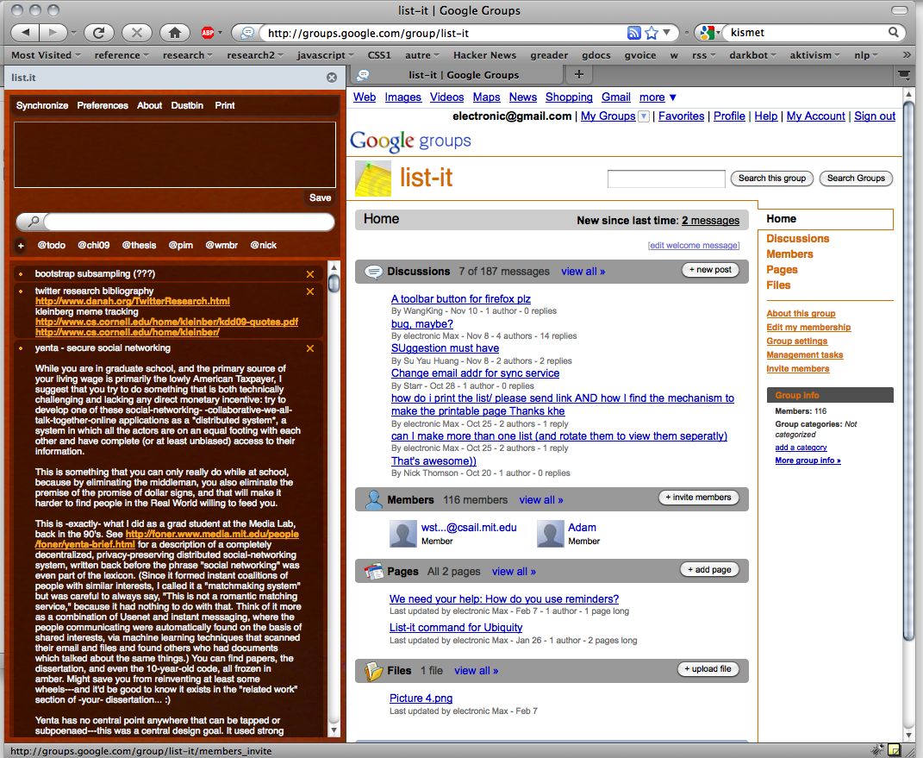
list.it
An open source
micro-note tool for Firefox
(Aug 2008-now)
http://code.google.com/p/list-it
http://listit.csail.mit.edu
http://addons.mozilla.org/en-US/firefox/addon/12737/
Rapid capture
Generic (text) content
No organization overhead

Slide 24
Note Entry
list.it
An open source
micro-note tool for Firefox
(Aug 2008-now)
http://code.google.com/p/list-it
http://listit.csail.mit.edu
http://addons.mozilla.org/en-US/firefox/addon/12737/
25,000+ downloads
16,625 registered users
920 volunteers
116,000 contributed notes
Text Search
Filtered Note List

Slide 25
teapot, power strip
email HW re vacation
talk to Brin re:ictd
make inspiration wall.
corkboard tiles.
ask dslr
deposit checks
sb at 8:15, 1111 Bent St
costco optometrist?
BGM wiki http://bg.xxxxx.xxx/wiki
renter's insurance
jshieh
4212B9
Thurs 11.30am - Fred fMRI
http://ec2.images-amazon.com/images/I/xxxx.jpg
Lynn, Tony, Dave(?); larry straw: 777-222-1111
Wasserbett nachfllen
Merlot proposal
Jack's retiremnt lunch Wed Feb 15 @2:30 in WXXX 811!
The United States has not caused this global meltdown. China and other export oriented countries did. It is their refusal to develop a domestic market willing and able to digest a large portion of the....
soy latte java
laptop at HMS (next week)
waiting on mechanic for AAA
Harp photos
meltmuck http://web.mit.edu/…
malt, malted vanilla
jimmy: (323) 668-xyzz
pacific auto service
talk at noon, 7 Div Av
bring tonight: laundry, dishes,
gas\N 8/12: $138.16\N 8/18:$89\N 8/23:$132.59
hotel for Reunions
mw 965 $100 shoemall.com
Play some more Rich King beta.
Egg Stain Removal from Clothing\N To remove an egg stain, cover the area with salt and let sit an hour before washing.\N (Homemaking, laundry, cleaning)
NABPB : \N\N Order Number 9999999
$Xx,XXX.XX with interest, and continuing at a Contract rate of yy% from 3/27/08; (through 4/25/08 in the amount of $zz,zzz.zz a per diem rate of $n.nnnnnn)
Mango Rhubarb Salsa: mince c rhubarb/2c mango/scallion/seeded jalapeno/T cilantro&mint&olvoil&lime/salt. Chill. Srv w tacos or grilled fish.

Slide 26
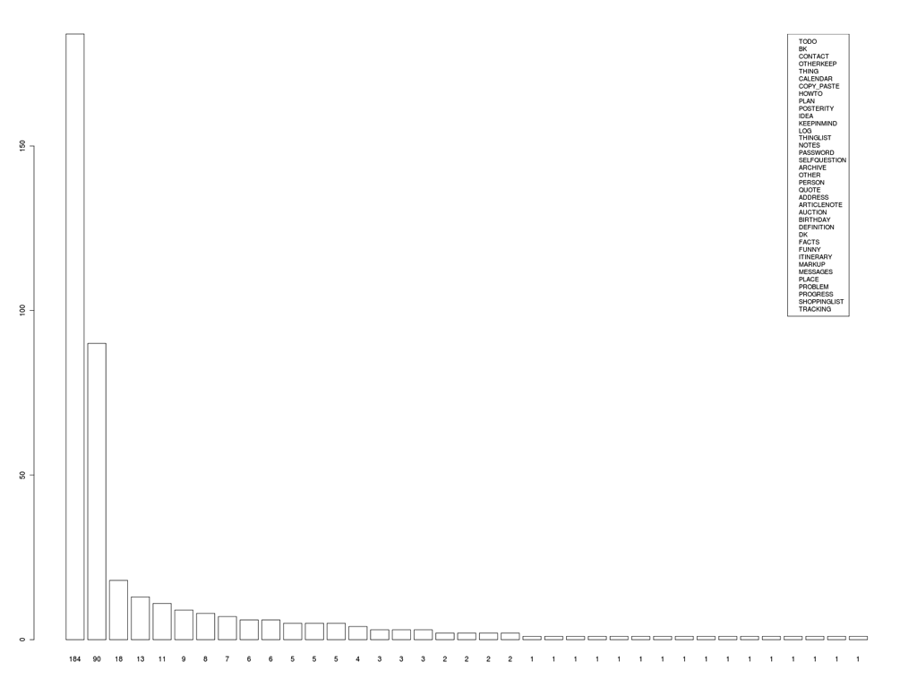
frequency of note forms
N=540
3 coders
48 categories:
Top Categories:
TODO: explicitly marked “to do”, or starting with a verb;
WEB BOOKMARK: URL alone or w/ label;
CONTACT: info about someone
OTHER- KEEP: codes, dates, non-word character sequences
THING: a single non-person entity (proper or common noun);
CALENDAR: calendar entry
COPY_PASTE: clipboard stuff
HOWTO: instructions how to do something
THINGLIST: multiple named or common nouns (e.g. “car, turnips, cat”);
;
26

Slide 27
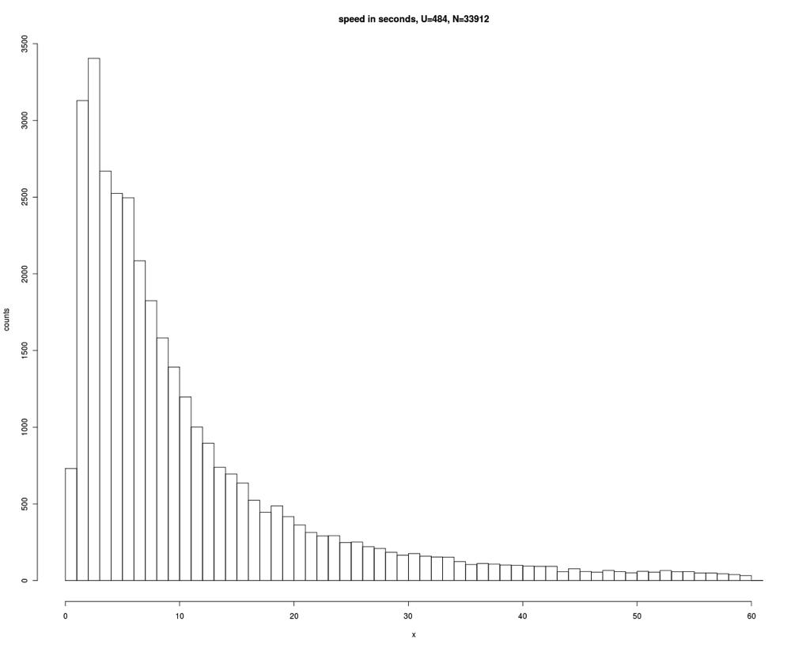
Speed In Seconds
U=484, N=33912
median: 7.4s
95% < 60s
27

Slide 28
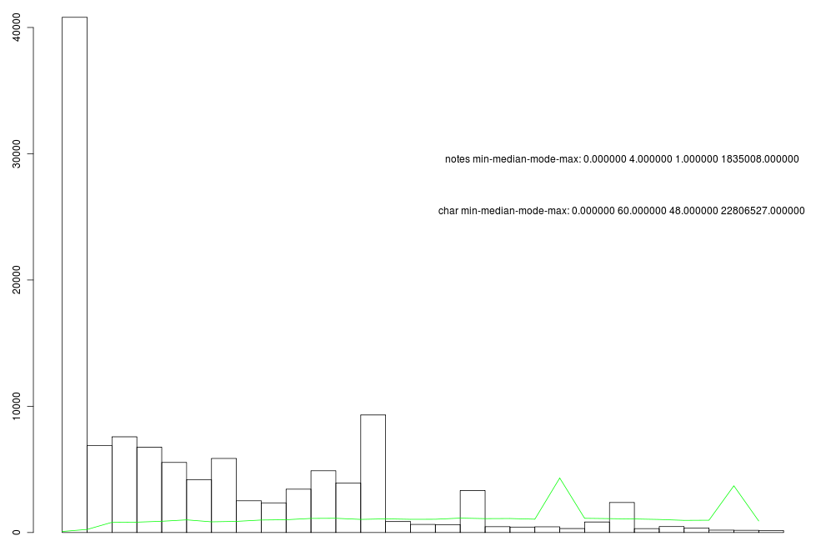
length
N: 33,912
lines:
median:4 (med)
characters:
median:48
28

Slide 29
List.it Contains Apps’ Data
structured PIM type | application
to-do list | tasks; remember the milk; todo managers
web bookmark | browsers; delicious
calendar event | gCal, iCal, Outlook
contact info | Outlook, Address Book, mobile phones
meeting notes | OneNote, EverNote, Word
cooking recipes | RecipeBank, RecipeManager
Because faster?
Because more flexible?

Slide 30
List.it Interviews
online survey
  225 respondents
e-mail interviews
  18 participants
Why do you use list.it?
  (35%) ease/speed
  (20%) simplicity
  (20%) “direct replacement for paper post-it”
  (15%) visibility and accessibility
  (5%) sync across machines
  (5%) nowhere else to put it

Slide 31
At first I tried using Evernote and found it too "veiled." Too laborious to load and to work with. [...] I was looking for a note-taking program that would really seem as if I were just doing that: typing onto a blank space of some sort and then going on to the next blank space.
I liked List-It for several reasons: the ease of use, the fact that the text typed (or pasted) in was so clearly visible and uppermost in function. I had hoped that List-It would replace [...] WordPad and/or NotePad. List-It proved ideal: I didn't have to open a new file; I didn't have to name this file; and I didn't have to wonder in which directory this file would end up once I had closed it.
It would be a great boon for me to have such a one click icon on my desk top to get me immediately into Link-It [sic] to make a note. At the moment I must open Firefox first - a two or so steps which can distract my stream of thought. The joy of yellow stickies is that it takes no time to grab the little stack and write.
I like that list-it is flexible. I often prefer to write notes that don't seem to pertain to anything important on paper because I'd feel silly seeing something unimportant in an organization program, amongst my *real* tasks.
I often use list-it to file stuff I want to look at later to see if I want to keep it or not.
Notes:
few features to learn
features are obvious, easy to understand
reduce upfront navigation, actions, decisions and categorization:
goes in the same place, in any way you like

Slide 32
Detour: Note Science
43

Slide 33
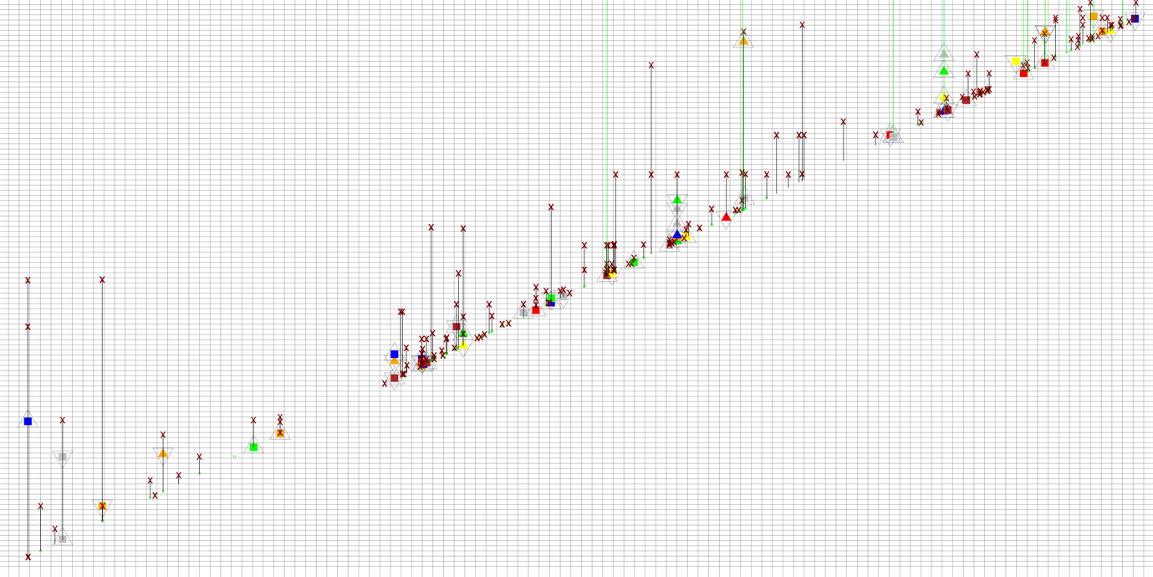
how
do people keep and access information in list-it?
note lifelines: a two year retrospective of list-it use

Slide 34
august 2010
august 2008
2 years

Slide 35
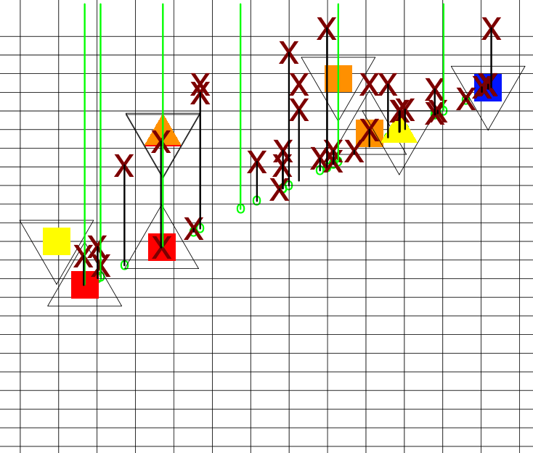
how do people keep notes?
deletion
edit shrink
note still alive
(remaining undeleted)
lifetime
creation line
edit growth
1 week
1 week
(inner colors - day of week of edit)

Slide 36
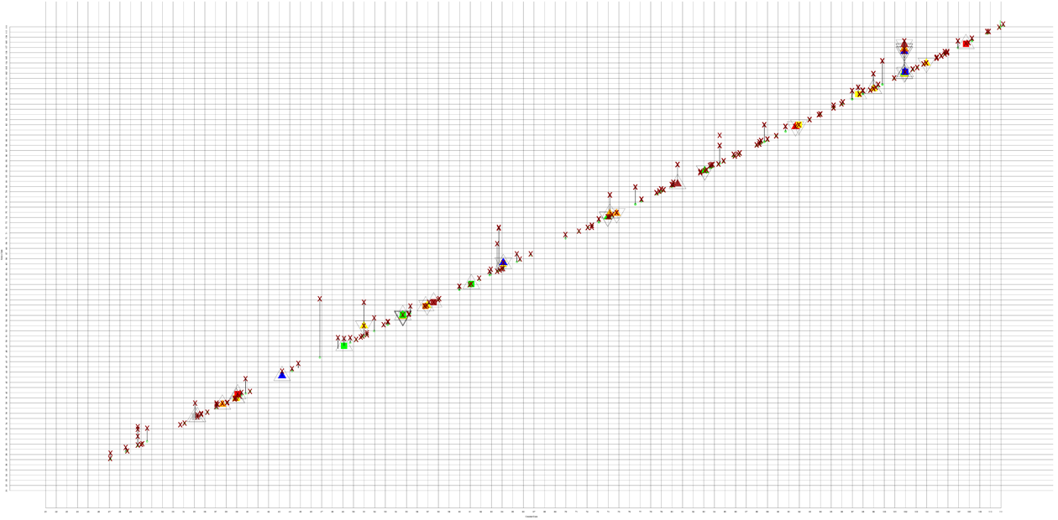
Minimalist

Slide 37
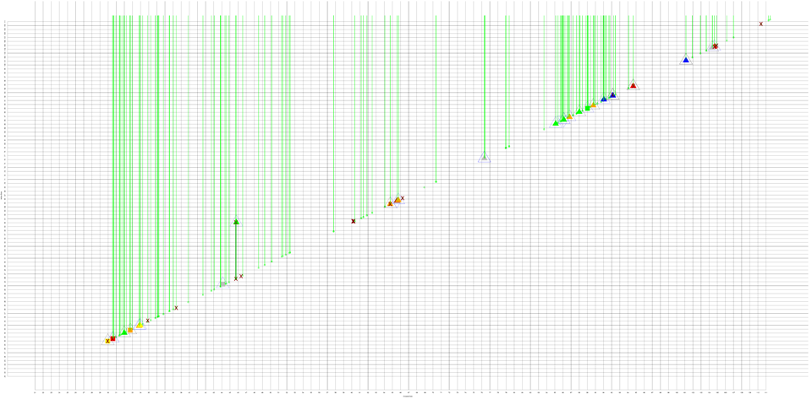
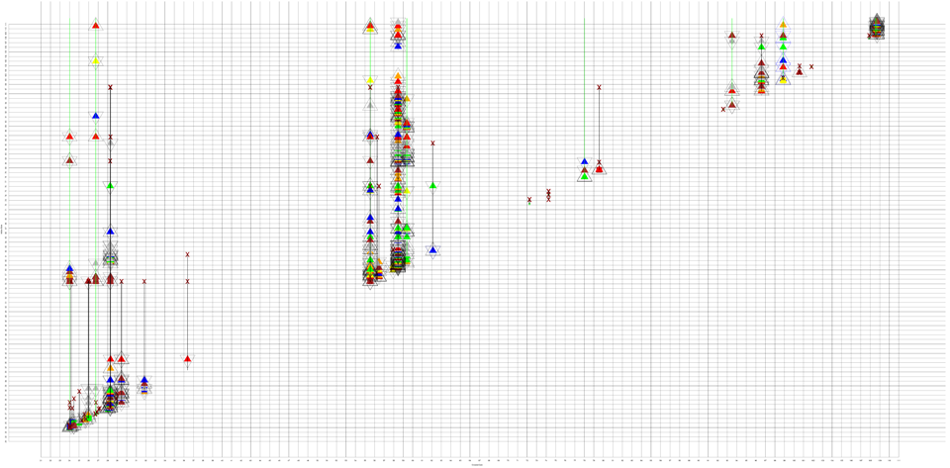
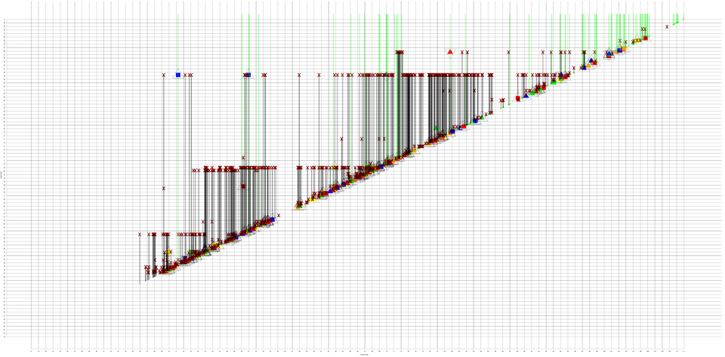
Packrat

Slide 38
Revisionist

Slide 39
Spring Cleaner

Slide 40
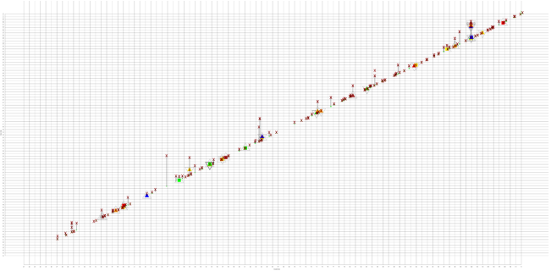

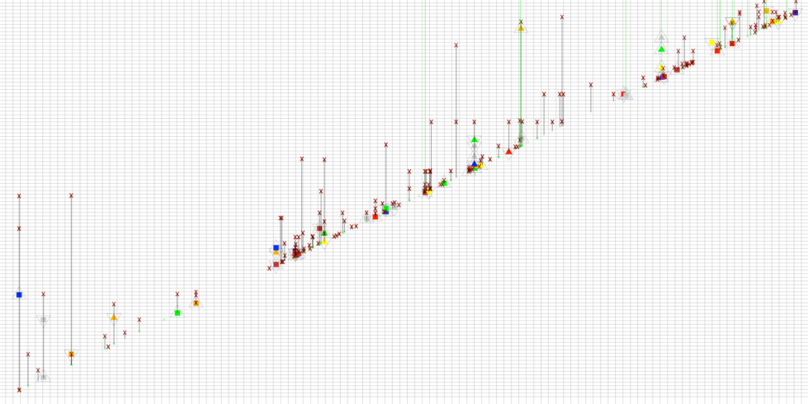
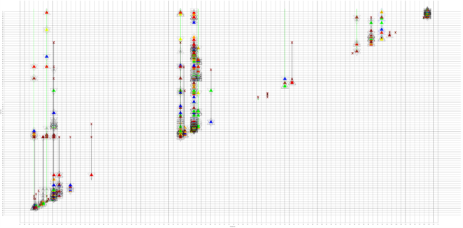

3 coders
first clustered, identified 4 archetypes
coded 420 users each
on <none, some, much> for each personality
much
minimalist
none
packrat
none
revisionist
K = 0.561 (moderate)
some
sweeper

Slide 41
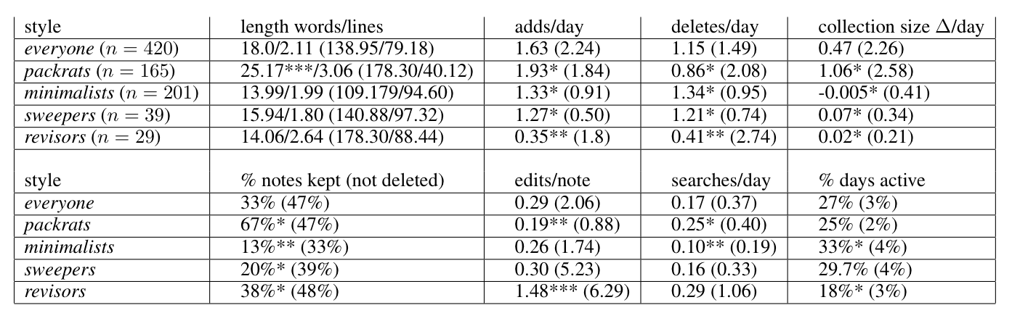
All tests rejected the null hypothesis indicating significant differences among keeping styles as follows: chars/note: F(4, 66146)=49.69 (p ≪ 0.001), words/note: F(4, 66146)=32.21 (p ≪ 0.001); edits/note: F(4,66146)=297.99 (p ≪ 0.001); added notes/day F(4,415)=6.16 (p < 0.01); deleted notes/day F(4,415)=2.95 (p < 0.05); note collection size change/day F(4,415)=10.41 (p ≪ 0.001); % notes kept F(4, 415)=10847.48 (p ≪ 0.001); searches/day F(4,415)=8.35 (p < 0.01); days active F(4,415)=5.87 (p < 0.01).
Results of pairwise Tukey-HSD post-hoc analysis indicated above with (***p ≪ 0.001, ** p < 0.01, *p < 0.05) for all features that exceeded pairwise significance.

Slide 42
Look for Yourselves
MISC
  MIT Information Scrap Corpus
Public domain collection of scraps
Donated (and categorized) by our users
Download:
  http://listit.csail.mit.edu/misc
Currently 2103 scraps
Working on getting the other 114,921
44

Slide 43
Encouraging Classroom Forum Contribution
43

Slide 44
Discussion Forums
Obvious benefits
  Students can ask questions when they have them
  And get answers from staff and other student
  Archival Q&A record for study by students/faculty
Costs
  Interrupt reading to visit forum
  Hunt for preexisting answers to your question
    When it might not even exist
  Describe question context (“on page 23…”)
  Hunt for questions you can answer
  Understand question context

Slide 45
MIT Forums
Stellar Classroom discussion tool
Spring 2010 data
50 most active classes made 3275 posts
  Max 415
  Average 68/class
  A few per student
Caveats:
  Bad system, maybe used alternatives
  Role in class not known

Slide 46
Nb: Forum In Context
Collaborative lecture-note annotation
Discussions occur in the margins

Slide 47
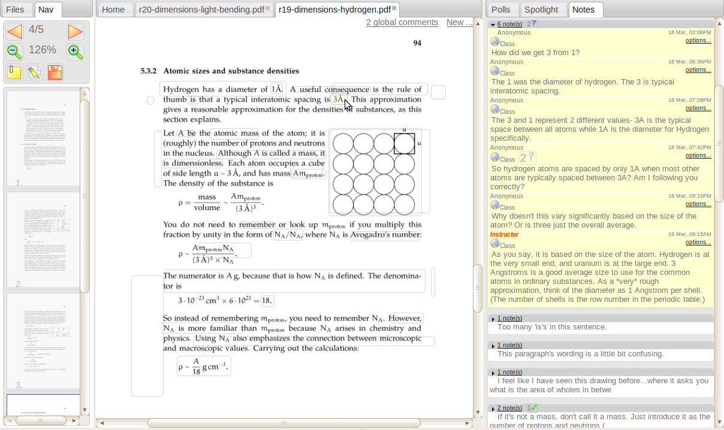
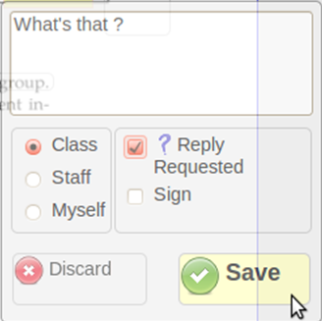
Implicit context

Slide 48
Benefits
Discuss as you read, without exiting note view
  Stay in the flow
See discussion of what you are reading now
  Answers that can help you
  Questions others want answered
Context is clear
  No need to explain in question
  No need to understand from question
Annotations form “heat map” of trouble spots

Slide 49
Nb Outcomes
Class | Comments | Per Student
6.055 | 14258 | 151
6.813 | 10420 | 83
Math 103 | 4436 | 61
ENGR 2410 | 1993 | 39
Physics 11b | 1254 | 17
CS225 | 880 | 40
Government 2001 | 580 | 9
Fysik B | 369 | 9
Estimation IS | 274 | 18
15 classes
4 universities
One class outdid top 50 MIT forums

Slide 50
Nb Outcomes
Class | Comments | Per Student
6.055 | 14258 | 151
6.813 | 10420 | 83
Math 103 | 4436 | 61
ENGR 2410 | 1993 | 39
Physics 11b | 1254 | 17
CS225 | 880 | 40
Government 2001 | 580 | 9
Fysik B | 369 | 9
Estimation IS | 274 | 18
15 classes
4 universities
One class outdid top 50 MIT forums

Slide 51
Assessment
50

Slide 52
Best Use Class
Annotation required
  But grew to double its required amount over term
  Voluntary usage after benefits demonstrated by force
Extensive in-depth discussions
73% questions resolved by other students
  Most students considered answers “timely”
  Meaning less than one hour
  Far faster than staff responses (one day)

Slide 53
Student Feedback
Substantial discussion
  “Never had this level of in-depth discussion before”
  “It was cool to see other people's comments on the material.”
  “The volume of discussion and feedback was much greater than in any other class.”
Collective intelligence
  “I was able to share ideas and have my questions answered by classmates”
  “I really enjoyed the collaborative learning. The comments that were made really helped my understanding of some of the material.”
  “Open questions to a whole class are incredibly useful. Everyone has their area of expertise and this is access to everyone's combined intelligence”

Slide 54
Student Feedback
Measuring stick
  “It's encouraging to see if I'm not the only one confused and nice when people answer my questions. I also like answering other people's questions.”
  “[NB] helps me see whether the questions I have are reasonable/shared by others, or in some cases, whether I have misunderstood or glossed over an important concept.”

Slide 55
Just a Forum?
All those results/quotes could be about any forum
Though it does indicate that no forum has succeeded in these students’ classes
Any evidence that the annotation approach was better?

Slide 56
NB-specific Benefits
Context sensitive comments
  “How does he get from 1 to 3 here?”
  “Why?”
  Easier to ask a question than standard forum
Responses synthesizing multiple geographically-close threads
  “The two threads to the left say….”
74% of students did not print notes
  Could have printed, read, checked forum later
  In-place benefits outweighed those of paper

Slide 57
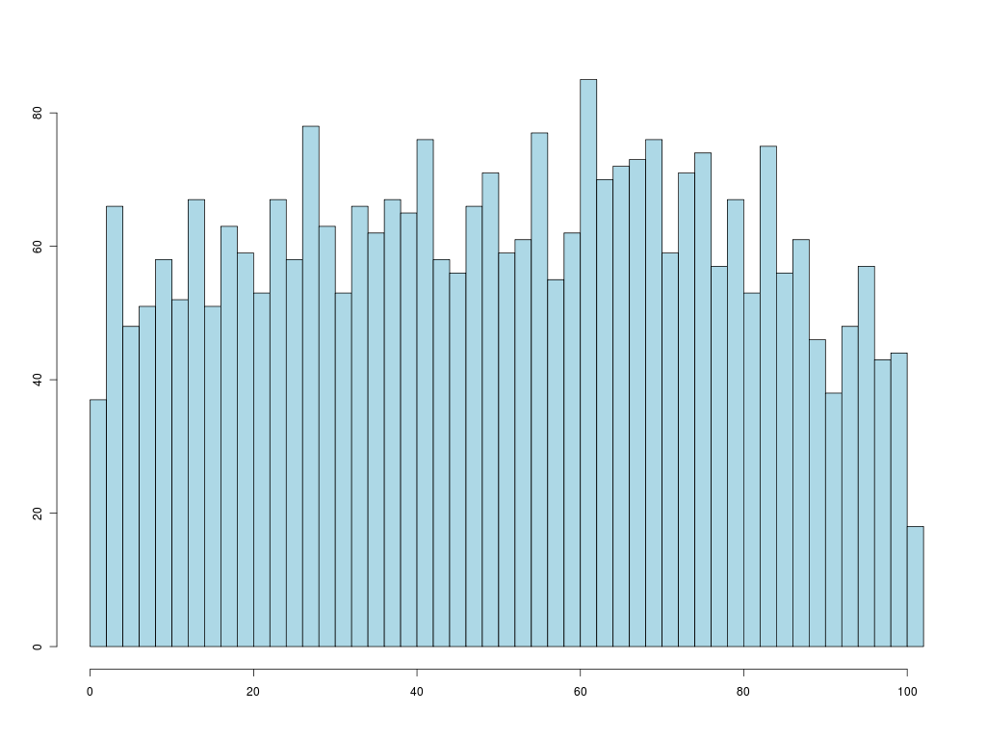
Discussion WHILE Reading
Logged all usage
Identified reading sessions (10 min-1 hour)
When in interval were replies to comments?
Evenly distributed throughout reading
Staying in the flow….
Hypothesis: this gave
critical mass for forum
to succeed

Slide 58
Contrast: Real World
In 2006, list of 14 social annotation tools
As of 2011, only one still exists
And it is sticky notes, not conversations
Lesson:
  Marginal annotations can work
  Very sensitive to unknown subtle details
  Still need to understand what they are
52

Slide 59
Feedme
Artificial Collaborative Filtering
[Bernstein, Marcus, Karger, Miller]
52

Slide 60
The Problem
Vast amounts of available content
And ever more appearing
We’d each like to see the “good” stuff

Slide 61
Machine Learning Recommenders
Idea: Users rate content they read
Content Recommendation
  Train a model of what words/terms the user likes
  Predict they’ll like other content with those words
Collaborative Filtering
  Find people with similar likes
  Predict they’ll like each others likes

Slide 62
Machine Learning Inhibitions
Effort
  Have to read lots of junk to train system
  Have to spend energy now for future benefit
  Many users won’t ever get started
Quality
  ML algorithms imperfect
  Waste time reading content you don’t like
  And worrying about what was missed

Slide 63
Alternative: People
Friends have always shared information
Often quite good at it
  Can assess quality as well as topic
  Know your interests
Make it happen more, better
  Study: determine inhibitors/incentives
  Build: tool to address them

Slide 64
E-mail is dominant
Notes:
(screw you new york times)

Slide 65
Recipients Trust Sharers & Want More
"Those who know my politics usually send me very pointed articles – no junk."
When asked to agree/disagree with:
“I would be interested in receiving more relevant links.”
Median = 6
1
2
3
4
5
6
7
Disagree
Agree

Slide 66
Sharers Reluctant to Spam
“I'm pretty conservative about invading
people's email space.” (interviewee)
Unsure of relevance
May have seen already
Too much effort (flow)
Sent too much already
Awkward
Questionable content
Notes:
Finance
Politics
Michael Jackson
(“because I am a great fan”)

Slide 67
Summary
Prefer to use email
Fear of sending irrelevant content
Fear of Spamming
Flow
Share content by email
Reassure sender that content is relevant
And that recipient isn’t overloaded
One-click sharing

Slide 68

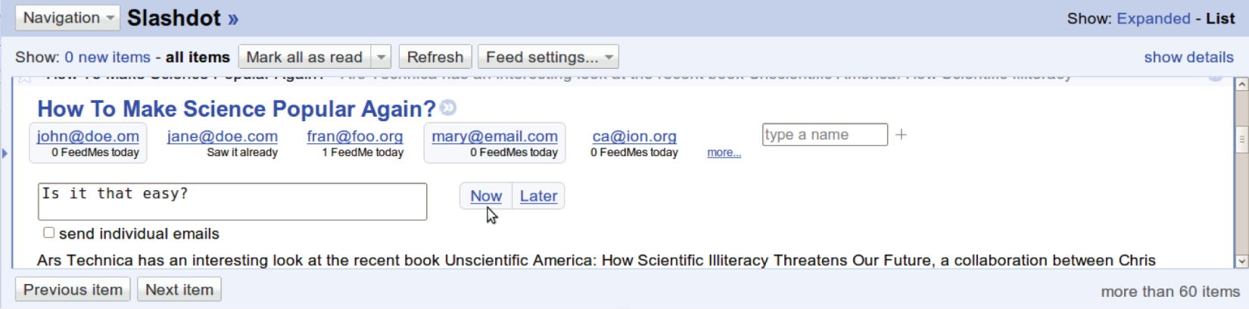
Firefox plugin
Recommend recipients to reduce time and effort for sharing
Load indicators check you aren’t spamming
Learn personalized models passively
Notes:
We do this with a sharing tool called FeedMe. FeedMe is a Greasemonkey plug-in for Google Reader that makes it easier to share as you’re reading posts.
It does this by recommending friends who might be interested in the article and making it easy to share with them. It tells you information that helps you moderate your sharing habits, like how much they’re receiving and whether they’ve received this post already. And by facilitating the ongoing sharing process, we can provide personalized recommendations without ever needing to ask anyone to train their own model or rate posts.

Slide 69
Recommendations
Feedme suggests friends who might be interested in the content

Slide 70
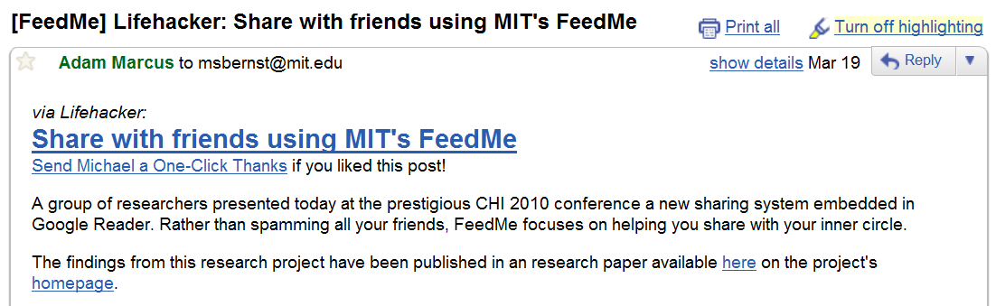
Recommendations
Lifehacker: Share with friends using MIT’s FeedMe
msbernst@mit.edu
rcm@mit.edu
karger@mit.edu
Type a name…
1 FeedMe today
0 FeedMes today
5 FeedMes today
Add an optional comment…
Share

Slide 71
Load indicators
rcm@mit.edu
rcm@mit.edu
rcm@mit.edu
0 FeedMes today
5 FeedMes today
Seen it already
Address concerns about volume:
“How much are we sending them?”
Give an indication of whether it’s old news
“Oh, somebody already sent it to them?”

Slide 72
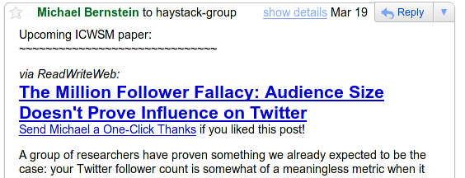
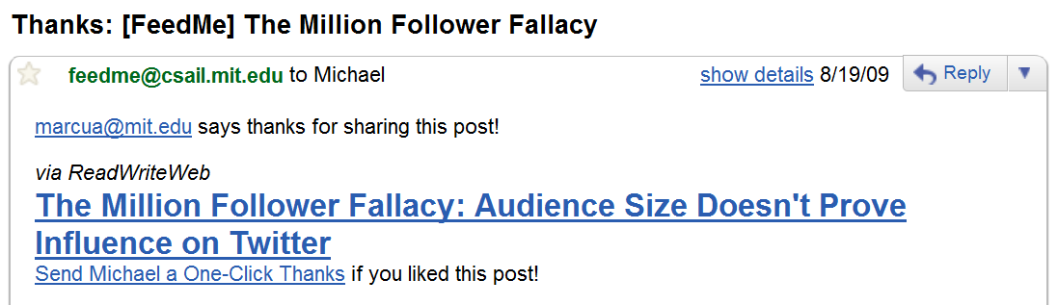
One-click thanks
Low-effort positive feedback from recipient

Slide 73

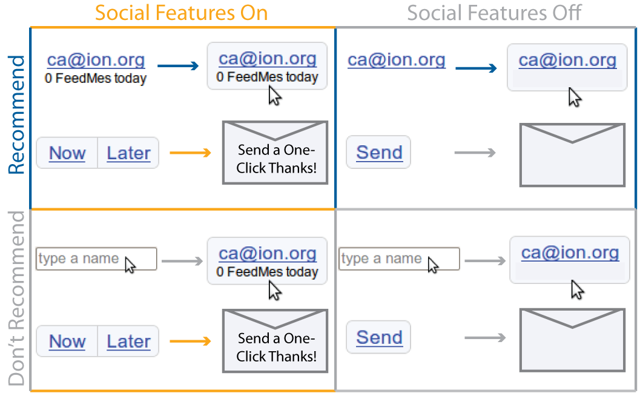

Implementation:
Building models without recipient involvement
MIT HCI
Research
rcm@mit.edu
FeedMe Profile
rcm@mit.edu
MIT HCI
Research
Computer Science Education
Computer Science Education
rcm@mit.edu

Slide 74
Recommendation Algorithm
Rocchio classifier
  Bag of words
  Vector for each document
  Sum positive examples to get class profile
Lamest classifier ever
But it doesn’t matter, because sharer decides
  Errors don’t hurt recipient
Mistakes are cheap
  Just don’t click share button
56

Slide 75
Assessment
56

Slide 76
Assessment
Two-week study for $30
60 Google Reader users recruited on blogs
Used Google Reader daily for two weeks with FeedMe installed
2x2 study:
  Half had “receiver load” warnings, half didn’t
  Half had recipient recommendations, half didn’t

Slide 77
Results
Viewed 84,667 posts; shared 713
Significant increase in sharing
  14 days prior to study, average 1.3 shares/day
  14 days of study, average 13/day
  (Likely Hawthorne effect)
Continued use in weeks after study
  Suggests liked something about it
94% of recipients were not using FeedMe
  Don’t need to be active user to benefit

Slide 78
Recipients Happy
Surveyed 64 recipients, who reported
on 160 shared posts
80.4% of posts contained novel content
Appreciative of having received the post

Slide 79
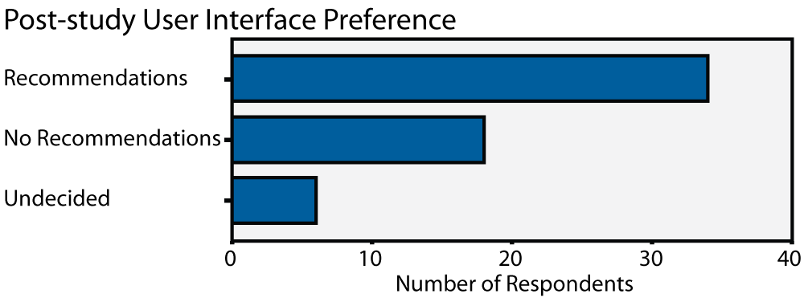
Recommendations Useful
Speed, Keyboard-Free
Visual Clutter

Slide 80
Do overload indicators help?
1/3 of subjects with them said they were favorite feature
1/2 of subjects without them re-invented and asked for them
Presence increased sharing (but not statistically significant)
rcm@mit.edu
rcm@mit.edu
5 FeedMes today
Saw it already

Slide 81
One-click thanks
30.9% of shares received a thanks
A user observed alternative was silence
since writing thanks was too much effort

Slide 82
Contrast
Machine filtering
Have to read stuff
That you might not like
To get benefit in future
With likely ML mistakes
Feedme
Sharer already read it
Now just clicks button
To feel good now about sharing
And get positive feedback via one-click thanks

Slide 83
Structured Data
[Huynh, Benson, Karger, Miller]
58

Slide 84
Structured Data
We all know structured data is good data
It supports
  Rich visualizations
  Sorting, filtering, and other queries
  Merger with other structured data
Must be useful
  Companies pay money to get these features

Slide 85
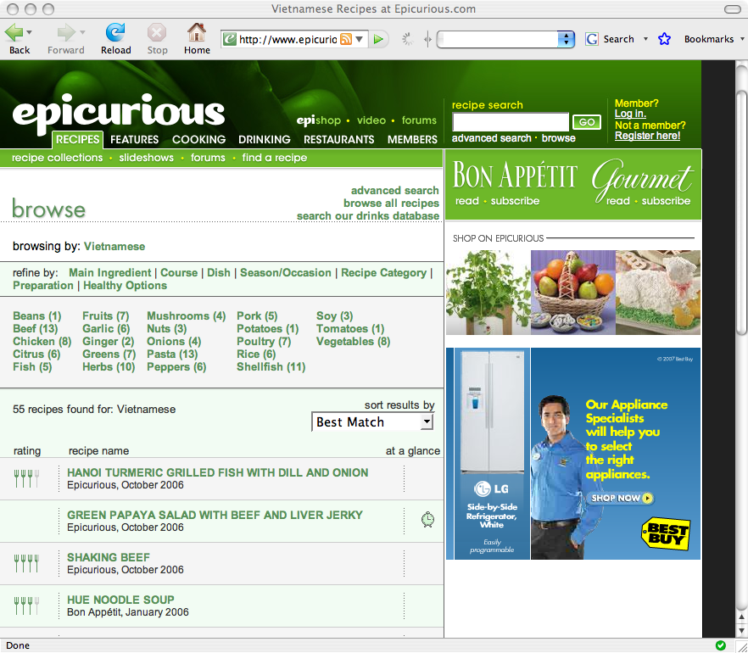
search
filter
sort
template

Slide 86
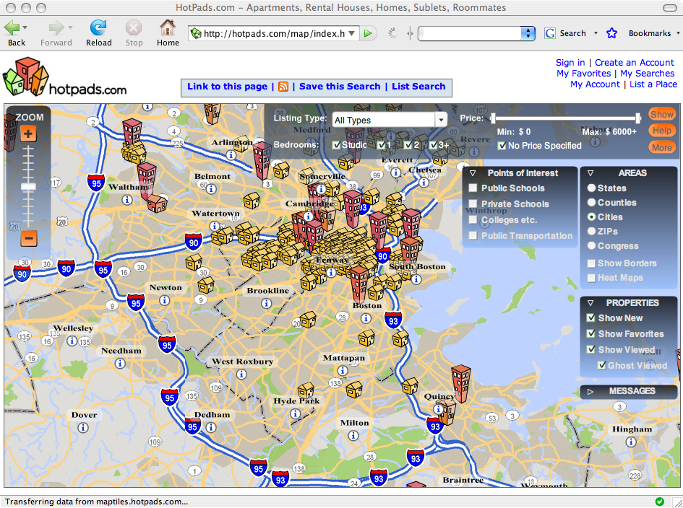
today

Slide 87
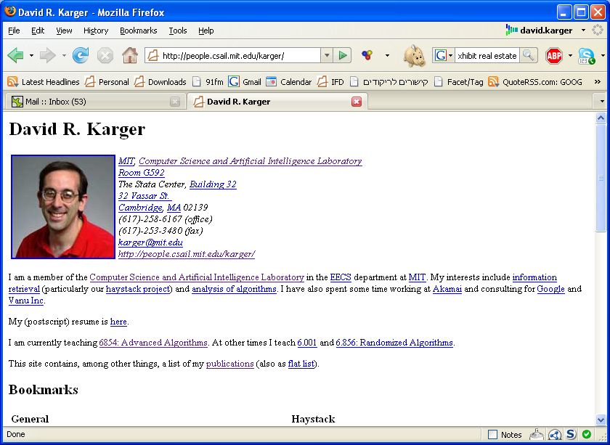
Mere mortals just write text or html

Slide 88
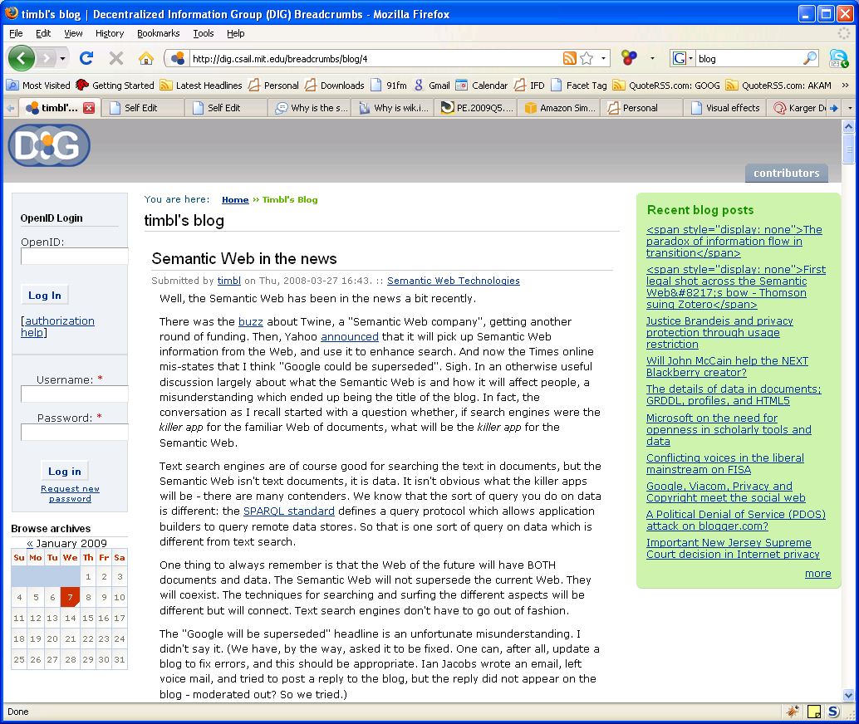
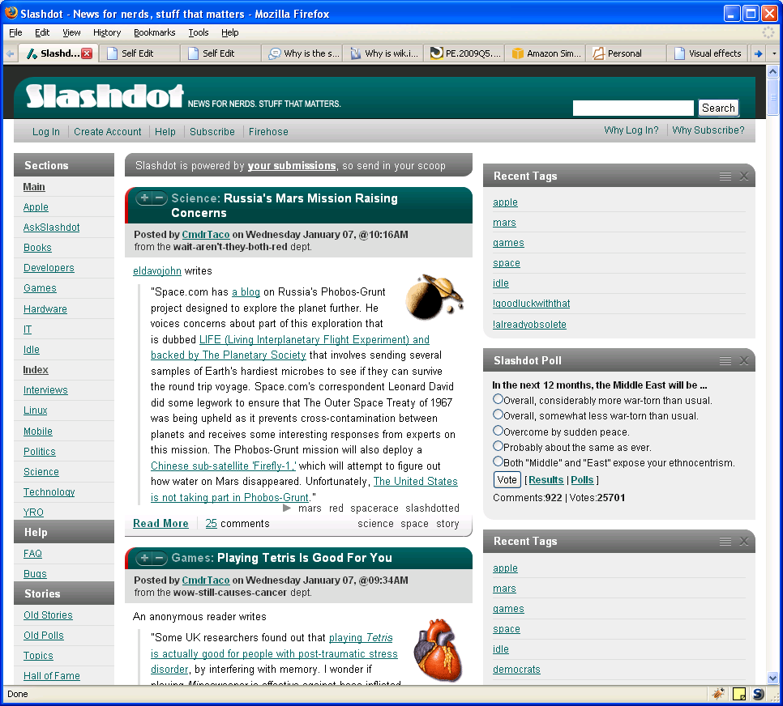

Wiki
Blog
Forum

Slide 89
Why?
Professional sites implement a rich data model
  Information stored in databases
  Extracted using complex queries
  Fed into templating web servers to create human readable content
Plain authors left behind
  Can’t install/operate/define a database
  Can’t write the queries to extract the data
  Limited to unstructured text pages (even in blogs and wikis)
  Less power to communicate effectively
  Less interest in publishing data

Slide 90
Coping: Information Extraction
Lots of useful data locked in the text
So lots of NLP/ML for information extraction
  Entity recognition
  Coreference
  Relationship extraction
Imperfect, so errors creep in
And end user still misses out on benefits
  Can’t manage their data as data
  Can’t present rich visualizations and interactions

Slide 91
Alternative
Give regular people tools that let them author structured data and visualizations themselves
So they can communicate as well as professional web sites
  their incentive
And their data is available in high fidelity for combination and reuse with other data
  social benefit

Slide 92
Do We Need This?
Analyzed 21 Blogs in 2009
  Top 10 and Trending 10 from Technorati
  Last 10 articles of each
18 of 21 blogs (30% of articles) had at least one article with a collection of data items
  Half described in text
  Half as html table or static info-graphic
  None had interactive data

Slide 93
Approach
HTML is the language of the web
Extend it to talk about data
Anyone authoring HTML should be able to author data and interactive visualization
Edit data-HTML in web pages, blogs and wikis to let authors create and visualize data
02

Slide 94

Like Spreadsheets
Put data in Spreadsheet
  Items are rows, properties are columns
Pick a chart type (visualization)
Specify which columns used in chart

Slide 95
Apply to Web
Publishing data is easy
  Just put a spreadsheet online
  Rows are items, columns are properties
Identify key elements of interactive visualizations
  Like spreadsheet charts
Add them to the HTML document vocabulary
  Insert them like images or videos today
Configure by binding them to underlying data
  Pick chart columns in spreadsheet

Slide 96
search
filter
sort
template

Slide 97
Image
HTML:
<img
src=…

Slide 99
Data
Items (Recipes)
Each has properties
  Title
  Source magazine
  Publication date
  Rating
  Ingredients
Publish as spreadsheet
  One item per row
  Columns for properties

Slide 100
Views
Show a collection
  Bar chart
  Sortable list (here)
  Map
  Thumbnail set
Bound to properties
  Sort by property?
  Plot which property?
HTML:
<div ex:role=“view”
ex:viewClass=“list”
ex:sort=“price”/>

Slide 101
Facets
Way to filter a collection
  Specify a property
  E.g. ingredient
  User clicks to pick
  Restrict collection to matching items
HTML:
<div ex:role=“facet”
ex:expression=“ingredient”/>

Slide 102
Templates
Format per item
HTML with “fill in the blanks”
HTML:
<div ex:role=“template”
<b>
<div ex:content=“title”/>
</b>
<div ex:content=“date”/>
</div>

Slide 103
Key Primitives of a Data Page
Data
  A spreadsheet
Templates
  Explain how to display a single item
  Describe what properties should be shown where
Views
  Ways of looking at collections of items
  Lists, Thumbnails, Maps, Scatter plots
  Specify which properties determine layout
Facets
  For filtering information based on its structure

Slide 104
Exhibit
Proof-of-concept implementation
05

Slide 105
Exhibit
Use vocabulary just outlined
Link to a javascript library that
  Loads the data
  Interprets the new data-HTML tags
  Implements the widgets they describe on the data
An interactive web site from 2 static files
  HTML + data-HTML describes presentation
  And links to data file: spreadsheet, CSV, XML, JSON…
Nothing to install or configure
  All runs in visitor’s browser

Slide 106
Demo

Slide 107
Outcomes
Open source project as of 2008
1800 web sites using exhibits
Reasonably large user community

Slide 108

Hobby Stores

Slide 109

Science

Slide 110

PhD Theses

Slide 111

Rental Apartments

Slide 112

Data.gov

Slide 113

NGOs

Slide 114

Newspapers

Slide 115

Libraries

Slide 116

Sports

Slide 117

Strange Hobbyists

Slide 118

Strange Hobbyists

Slide 119


Slide 120
Scalability
Javascript is slow, not designed for implementing DBs
Fast for < 1000 items
Some people have used 25000 items or more
Not a limitation per se
Plenty of small data sets

Slide 121
DATA EXPORT
08

Slide 122


Slide 123


Slide 124


Slide 125
Summary
Anyone who can write HTML can write a data-interactive web page
  Sorting, filtering, searching
  Lists, Maps, Timelines, Plots
  Item templates
Post it on the web and it works
Data is explicit, can be extracted for reuse
The visualization is the incentive

Slide 126
EXTENSIONS
What if you can’t write HTML?

Slide 127

Authoring by Copying
HTML describes visualization
Copy it, change the data
(Maybe change the presentation too)
oops!

Slide 128

Wibit
Collaborative Authoring in a Wiki
Exhibit is text file
Put it in a wiki
Combine data interaction and collaboration

Slide 129

Wibit
Collaborative Authoring in a Wiki
Wikitext to describe Exhibit

Slide 130

Exhibit in a Blog: Datapress
Wordpress plugin
Link to data source
Then WYSYWIG your visualization

Slide 131

WordPress + datapress
Notes:
Loop through a bunch of pictures of bloggers using plain exhibits.

Slide 132

Or Just a Document
DIDO --- Data Integrated Active Document
Javascript WYSIWYG Editor included with document
Edit in place and save

Slide 133
Conclusion
Ask not what your computer can do for you…

Slide 134
Conclusion
People can powerful information managers
  Capturing information scraps
  Discussing lecture notes
  Content recommendation/sharing
  Structured data authoring and visualization
In each case
  Consider what people are able to do
  And how to reduce deterrents and show benefits so they want to

Slide 135
List.it
People can capture more information
Major deterrents:
  Interruption of work to capture data
  Struggle to decide where to put it
  Rigid structure of apps
Resolve by:
  Minimizing capture effort
  Flat organization
  No required structure

Slide 136
NB
Students can collaborate to understand content
Deterrents from traditional forums:
  Interruption to use them
  Don’t know where/when to seek relevant Q&A
Resolve by:
  Placing discussion in margin
  Adjacent to relevant content
  See what’s relevant while you are reading
  Ask/answer without leaving

Slide 137
FeedMe
People can route information to beneficiaries
  With less work and higher quality than ML
Sharing deterrent:
  Effort to decide recipients
  Effort/distraction to share
  Fear of spamming friends
Resolve by:
  Suggesting recipients
  One-click share
  Signals that receiver wants content

Slide 138
Exhibit
People can author structured data and create rich interactive visualizations
Deterrent:
  Complexity of structured data management tools
Overcome by:
  Data as authoring (not programming)
  Embed in well-known tools
  Write HTML, or edit a wiki or blog

Slide 139
Wait, There’s More!
Related worksheets
  Help end users manage structured data
  By exposing in a spreadsheet metaphor
Atomate
  Help users translate their incoming social data streams into structured data
  And automate its management by writing rules in Controlled Natural Language English

Slide 140
Conclusion
We work hard to make computers do IKM well
People are better than computers at IKM
  They just don’t have the tools
  Or the time/desire
Don’t assume passive IK consumers
Tools can encourage active engagement in IKM
  By deciding what users are capable of
  And minimizing cost
  And maximizing/exposing benefit

Slide 141
Students and *Colleagues
*Mark Ackerman (NB)
Ted Benson (Datapress)
Michael Bernstein (List.it, Feedme)
Fabian Howahls (Wibit)
David Huynh (Exhibit)
Adam Marcus (Datapress, Feedme)
*Rob Miller (Exhibit)
Katrina Panovich (List.it, Feedme)
*mc schraefel (List.it)
Wolfe Styke (List.it)
Greg Vargas (List.it)
Max van Kleek (List.it)
Sacha Zyto (NB)

Slide 142
Try Them All
All at http://haystack.csail.mit.edu/blog/
http://listit.csail.mit.edu/
http://nb.mit.edu/
http://feedme.csail.mit.edu/
http://simile-widgets.org/exhibit
http://projects.csail.mit.edu/datapress
http://projects.csail.mit.edu/wibit

Slide 143
Contrast: WebAnn [Brush, 2001]
Similar system, but very different usage
  Students printed notes, annotated paper
  Returned much later to type in annotations
Result: far less/slower conversations
  Had to enforce separate “reply” requirement
Reason?
  Required browser plugin, wireless connectivity
    Neither ubiquitous in 2001
  Clunkier web UIs
  Students less comfortable online

Slide 144
Contrast: DBpedia
Wikipedia “infoboxes” are “structured data”
But are authored as text
DBpedia project
  Spiders Wikipedia
  Applies information extraction to infoboxes
  Stores results in queryable database
Challenges
  Sloppy infoboxes yield errors in database
  Parsed data not in wiki for users to view
  No rich visualization in Wikipedia

