Slide 1
Big Data for End Users

Slide 2
Goal
Increase population of effective data users by orders of magnitude
Understand the data problems of the data-99%
Help them fix those problems
Improvements benefit data-1%ers as well
Of the 3 V’s, the main one for end users is Variety
Though the perceive Velocity (hard to capture)
And Volume (hard to query)
Cannot nurture one tool for one dataset
End users needs ability to radically customize

Slide 3
HCI Methods
Interviews
Talk with subjects about their needs & experiences
Talk about potential improvements and how they would fit in
Wizard of Oz
Perform data work users want but cannot do themselves
Learn about the kind of work they want to do
Design tools that meet those needs
Tool and UI development and field studies
Design tools that meet hypothesized needs
Study their use in the field to validate hypotheses
Iterate

Slide 4
Interviews
Notes:
1 min

Slide 5
Interviews
Ask data users about what they do now
Figure out why they do it that way
Discover coping mechanisms for bad tools
Discover how they want to do things
Discover things they wish they could do but can’t
Speculate with them about what would be better
but this is unreliable
thus wizard of oz to see what they really do

Slide 6
Homebrew Databases
Fascinating interview work by Voida et al.
Users are still stuck with Excel, documents, even paper
They spend huge amounts of time transforming data
Data entry
Copying from paper forms into excel
Manually assembling reports by reading spreadsheets
Terrible problems with multiplicity of systems, version skews
Choosing not to use “better” tools
Good reasons why
(If we can understand them, we can make tools they’ll use)

Slide 7
Method
Semi-structured Interviews
23 Volunteer Coordinators
Variety of Job Titles, Locations within the Organization
Variety of Sizes (& Maturity) of Volunteer Programs
Variety of Domains for Nonprofit Work
Iterative, Inductive Data Analysis
Notes:
In this research, we conducted semi-structured interviews with 23 individuals who were responsible for the management of volunteers at nonprofit organizations. Participants managed a variety of sizes of volunteer programs, from a brand new nonprofit just ramping up its program to a local affiliate of a national nonprofit with over 2300 volunteers. Participants also worked for nonprofits engaged in a variety of domains of nonprofit work, from health to human services, environment to education.

Slide 8
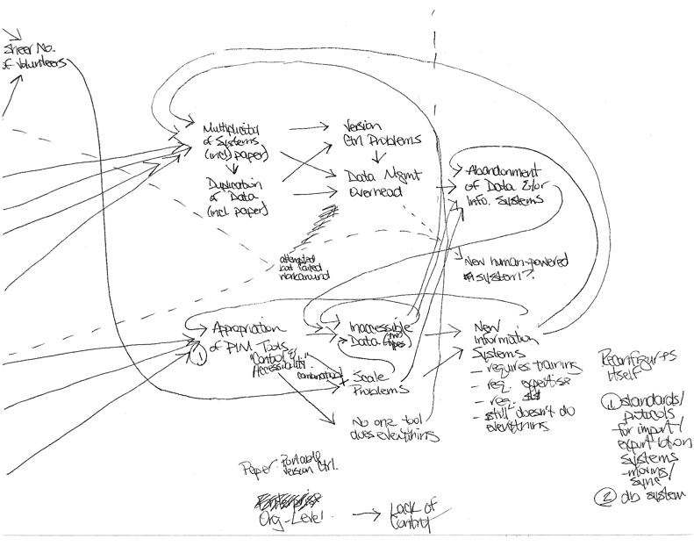

Slide 9
Types of Systems in the Homebrew Databases
Personal office applications as “databases”
Paper-based “databases”
Enterprise or custom databases
Notes:
Volunteer coordinators typically create their homebrew databases by drawing from three classes of systems: personal office applications, paper, and enterprise or custom databases. So in addition to the general challenges resulting from the use of multiple systems, each class of systems creates its own challenges for information management.

Slide 10
Personal Office Applications as Databases
The allure...
Readily available
Already familiar
Can be used flexibly
The problems that arise...
Failure to scale
Number of users
Number of records
Dimensions of data
Inaccessibility
Access and aggregation
From off-site locations
Notes:
The problems that arise from the use of personal office applications as “databases” center on issues of scale and inaccessibility. At some point, it becomes unwieldy to share information with too many users... shared files on a network server end up locked for editing so much of the time that people can’t update the information they are responsible for. And it becomes intractable to manage a lot of records as the volunteer program grows. One volunteer coordinator told us that her mass emails to volunteers were so large, they brought down the organization’s Exchange server...

Slide 11
Paper-Based Databases
The allure...
Supports collaboration
Easy capture
Tangible “master” copy doesn’t fall out of sync
Serves as a lowest common denominator
Provides a shared awareness of process
The problems that arise...
Failure to scale
Inaccessibility
...but magnified!
Notes:
Paper “databases” suffer from similar issues of scalability and inaccessibility as personal office applications, only magnified. Searching, sorting, and aggregation require that information either be processed manually or duplicated in the computer, both of which are incredibly time consuming tasks.

Slide 12
Enterprise or Custom Databases
The allure...
Ability to handle scalability of data and users
The problems that arise...
Overhead & setup cost
Developing the system
Training people to use the system
Initial data entry
Inaccessibility of the data
Ongoing overhead with data entry
Abandonment
Notes:
For the participants in this study, issues of scale were the primary motivators for making the transition to enterprise-level software.

Slide 13
Don’t Understand Databases
Once they’re all there [the information is in the database], I can make this beautiful Excel sheet of all their information…
- Volunteer Coordinator at a Youth Development Nonprofit (O1)
Notes:
4 min

Slide 14
Hate Data Entry
It’s like [my volunteer here]. He could be playing golf right now. The weather is perfect. And yet he’s here, you know, sitting doing the most boring task there is.
- Volunteer Coordinator at a Human Services Nonprofit (P2)

Slide 15
Multiplicity Kills
This is where we get crazy. This is nuts. We actually—we don't have a database of our volunteers…. I shouldn't say that. We have probably seven databases for volunteers. All of them have different information. It took us three to four months to even figure out who had what databases.
- Volunteer Coordinator at a Human Services Nonprofit (P1)
Notes:
<<quote>>

Slide 16
…and at the point when you have to do multiple entries is when you don’t do entries. You know, it just is so time-consuming and redundant that you have so many other things to do, that you just don’t have the time to enter it.
- Volunteer Coordinator at a Housing & Shelter Nonprofit (L2)
Notes:
<<quote>>

Slide 17
Continuing Work
New collaboration with Voida to study same users further
Voida focused on management (entry, organization)
We will explore query process
What do they want to know?
What is their mental model of their data?
How do they formulate the questions?
What kind of database tools would they like to use?
Interviews with big data users
Will have same problems (enlarged)
And some new ones

Slide 18
Wizard of Oz
Notes:
6 min

Slide 19
Wizard of Oz
We want people using data tools that don’t exist yet
To find out what they should look like, pretend they exist
Put a grad student behind the curtain
Give answers to “reasonable” (non-AI-complete) questions
Not “find something interesting here”
Rather, show me all X’s who’s Y has a Z, etc.
Build a diary of what they asked, how they thought
Design tools to fit their way of working

Slide 20
Users
Targets: journalists and government watchdogs
They work with new data sets for every story
Are really smart about the data
Willing to do huge amounts of manual labor
But often have little skill with data tools

Slide 21
Case Study: The Ethanol Czars/ Shadows in a Green Business

Slide 22
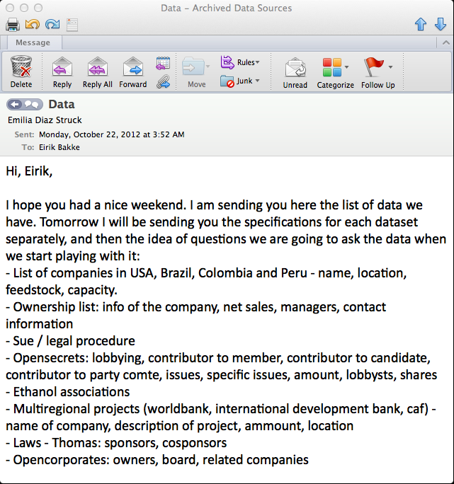

Slide 23
Ethanol Project Data Sources (as Emilia, the journalist, saw them)
 | http://ethanolrfa.org | Renewable Fuels Association | Used to get information about the companies that produce ethanol in the United States and statistics from the industry.
 | http://www.opensecrets.org | Center for Responsive Politics | Very important for the project as it gave access to the bulk lobbying data which was one of the pilars of the story.
 | http://www.ifc.org | IFC/World Bank | Used to review the information related to the loans given by the IFC (World Bank) to develop ethanol projects in Latin America.
 | http://www.iadb.org | Inter-American Development Bank | Used to review the information related to the loans given by the Inter-American Development Bank to develop ethanol projects in Latin America.
 | http://www.caf.com | The Development Bank of Latin America (CAF) | Used to review the reports of the loans given by the organization to help with the development of ethanol projects in Latin America.
 | http://www.consejoderedaccion.org | Consejo de Redacción | Used to get access to campaign contribution reports made by companies in Colombia.
 | http://www.eia.gov | U.S. Energy Information Administration | Used to get statistics about the industry.
 | http://usda.gov | Unites States Department of Agriculture | Used to get statistics about the industry.
 | http://www.sec.gov/edgar.shtml | Securities and Exchange Commission/Edgar | Used to access to financial reports made by the industry.
 | http://www.unica.com.br | Brazilian Sugarcane Industry Association (UNICA) | Used to get information about the ethanol industry in Brazil.
 | http://www.lexisnexis.com.ezproxy.bu.edu/us/lnacademic | Lexis Nexis Academic | Used to review information about the ethanol companies and the entrepreneurs who lead it.
 | http://www.tse.jus.br | Tribunal Superior Eleitoral/ Supreme Electoral Tribunal from Brazil | Used to get access to campaign contribution reports made by companies in Brazil.
 | http://www.minem.gob.pe | Energy Ministry of Peru | Used to get statistics and information about the industry in Peru.
 | http://www.aduanet.gob.pe | Customs Peru | Used to review customs information about the industry in Peru.
 | http://www.asocana.org | Asocaña | Used to access to statistics and information about the industry in Colombia.
 | http://www.fedebiocombustibles.com | Fedebiocombustibles | Used to access to statistics and information about the industry in Colombia.
 | http://www.defensoria.gob.pe | Advocacy office in Peru | Used to review reports about complaints from the people of Piura about irregularities related to ethanol companies.
 | http://www.cao-ombudsman.org | Compliance Advisor Ombudsman | Used to review the results of the evaluations made to projects that received loans from the IFC (World Bank) that received complaints.

Slide 24
Why Need a Programmer?
Data is too large to be opened in Excel
Data is unclean, and too large to be cleaned manually without at least some automation
Data consist of multiple large tables of data that need to be correlated ( joined ) in non-trivial ways
Data is available only through online search forms that do not by themselves support desired analytics
Want to build an interactive online “news app” story

Slide 25
Ethanol Project Queries As Initially Formulated by the Journalist
“The ethanol bill that received more lobbying money (amount paid by companies)”
“The companies that invest more money in ethanol lobby, and what they lobby for”
“The senators that received more money from the companies and if they promoted (sponsored/cosponsored) a bill”
“The lobbyists that receive more money from ethanol companies to lobby for the industry”
“Money invested by organizations (non-conventional companies)”
“How big is ethanol lobbying?”
"Crossing [joining] the information with the other databases”

Slide 26
Data Work for the Ethanol Project
Get all the relevant data into PostgreSQL
Clean up Emilia’s spreadsheets to make them perfectly tabular
Fix broken CSV files downloaded from OpenSecrets
Have Emilia go through 280 organizations in her spreadsheet and find the exact spelling of each organization name as it appeared in the OpenSecrets database; import to database
Have Emilia’s intern go through 1293 congressional bills with the word “ethanol” in them to make sure each one actually is an ethanol-related bill (was the case for 1196 of them).
Formulate/run SQL queries; export results to Excel
Verify integrity of results through independent sources

Slide 27
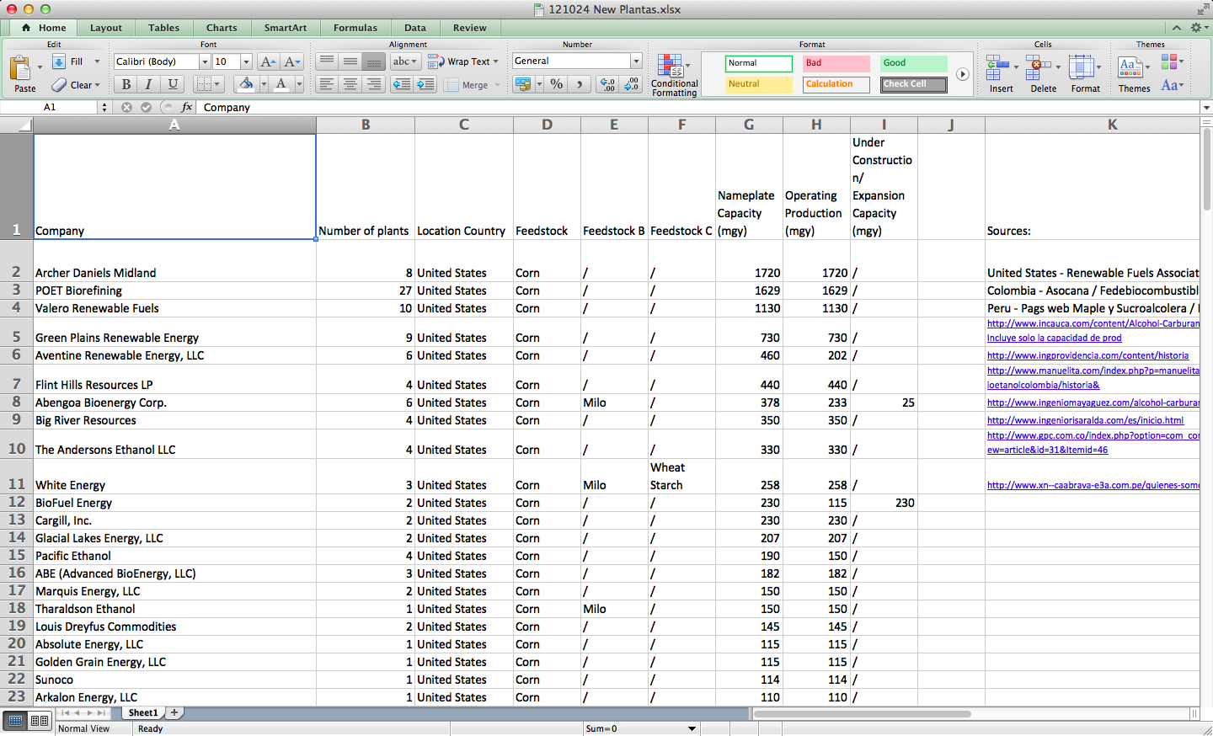
Spreadsheet Database Import

Slide 28
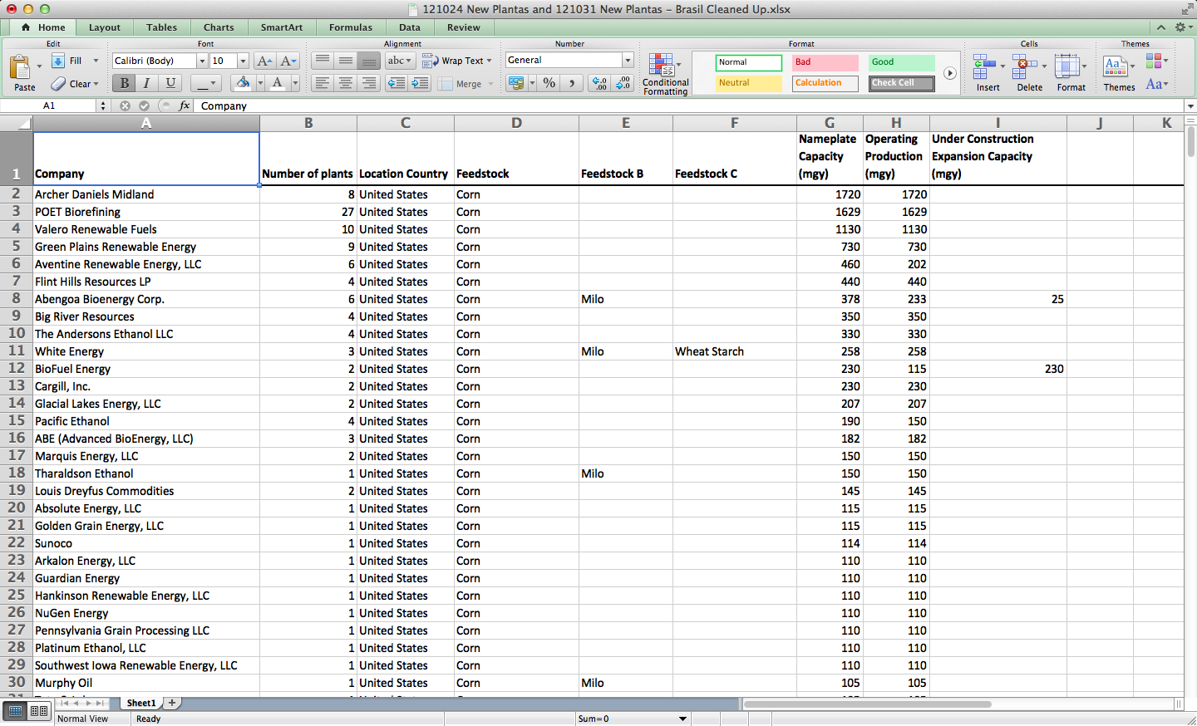
Spreadsheet Database Import

Slide 29
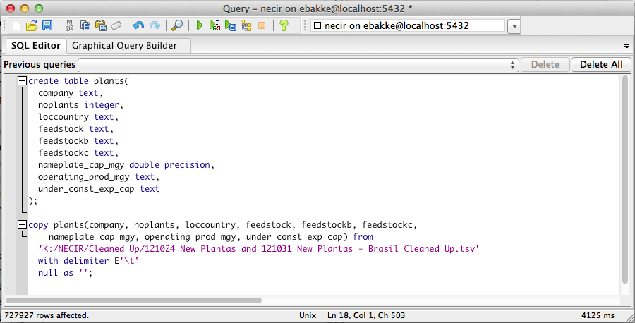
Spreadsheet Database Import

Slide 30
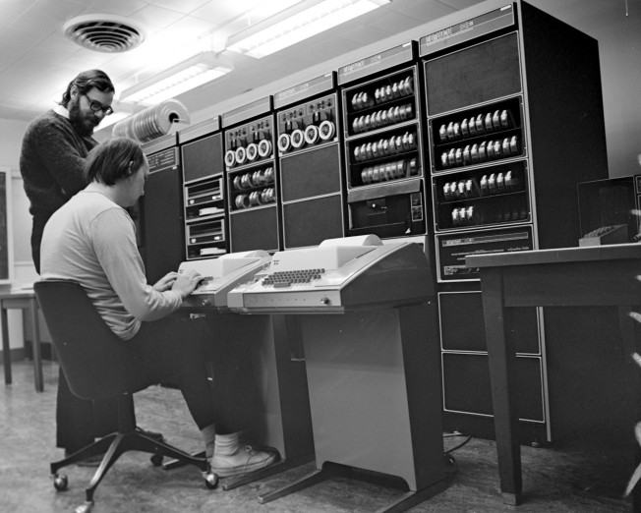
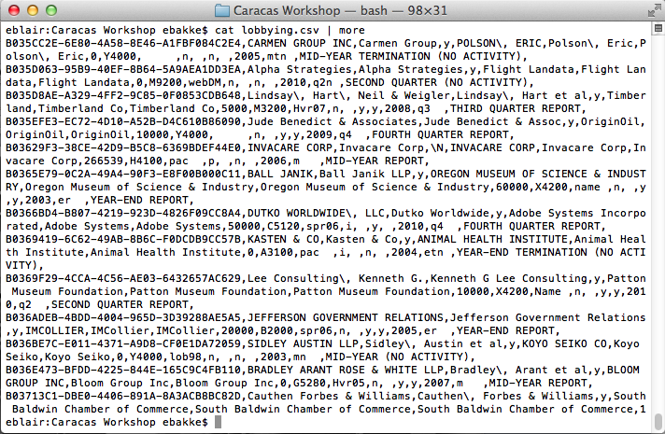
Broken CSV

Slide 31
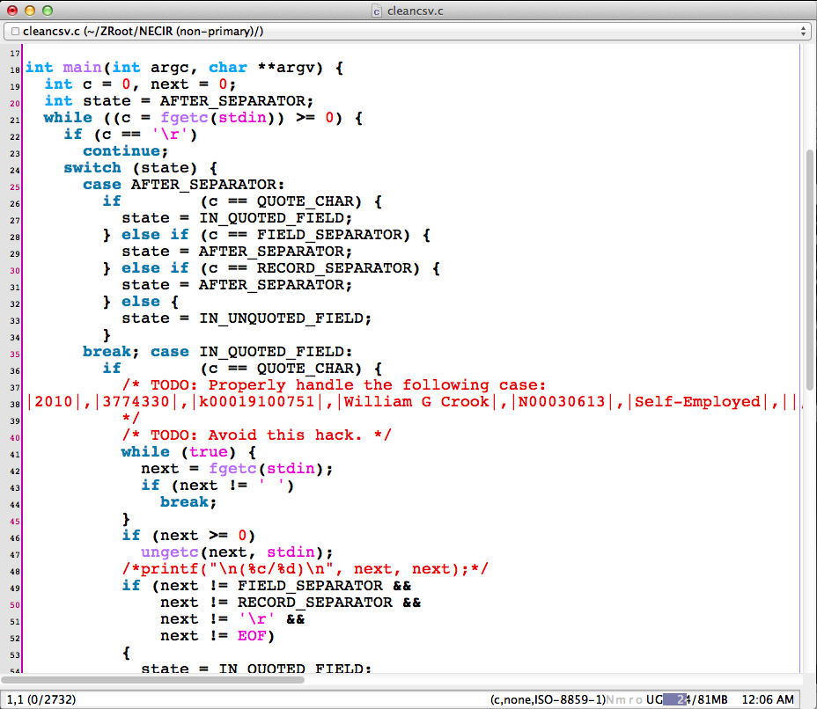
Custom Programming

Slide 32
Schema Issues
What does the raw data mean?
Examples from the “lobbying” table: What does “luse”, “ind”, and “ultorg” mean?
Understanding the raw data is absolutely critical to getting correct and meaningful results
How are entities (companies, people, contracts etc.) identified?
The name of an individual may be spelled in many ways
Multiple individuals may have the same name
Journalist will understand the data better than the programmer

Slide 33
One Actual SQL Query
create view v_lobbying as
select
uniqid, registrant_raw, registrant, isfirm, client_raw, client, ultorg,
(amount / (select cpiv from cpi c where lyear = c.cyear)) as amount,
amount as amount_unadjusted,
catcode, source, lself, IncludeNSFS, luse, ind, lyear, ltype, typelong,
affiliate
from lobbying
where luse != 'n'
and ind = 'y'
create view v_bill_contributions(
congno, bill_name, uniqid, client, ultorg, amount, amount_unadjusted, lself,
includensfs, lyear, specificissue, si_id, issueid) as
select lb.congno, lb.bill_name, l.uniqid, l.client, l.ultorg, l.amount,
l.amount_unadjusted, l.lself, l.includensfs, l.lyear,
li.specificissue, li.SI_ID, li.issueid
from v_lobbying l, lobbyissue li, lob_bills lb
where li.uniqID = l.uniqid
and lb.si_id = li.SI_ID
select eb.congno, eb.bill_name,
(select count(*) from (
select bc.client
from v_bill_contributions bc
where bc.congno = eb.congno and bc.bill_name = eb.bill_name
union
select bc.ultorg
from v_bill_contributions bc
where bc.congno = eb.congno and bc.bill_name = eb.bill_name
) t) as count_all_organizations,
(select count(*) from (
select bc.client
from v_bill_contributions bc
where bc.congno = eb.congno and bc.bill_name = eb.bill_name
and bc.client in (select opensecrets_name from associations_opensecrets)
union
select bc.ultorg
from v_bill_contributions bc
where bc.congno = eb.congno and bc.bill_name = eb.bill_name
and bc.ultorg in (select opensecrets_name from associations_opensecrets)
) t) as count_ethanol_organizations,
(select sum(amount) from (select distinct bc.uniqid, bc.amount
from v_bill_contributions bc
where bc.congno = eb.congno and bc.bill_name = eb.bill_name
) t) as sum_all_reports,
(select sum(amount) from (select distinct bc.uniqid, bc.amount
from v_bill_contributions bc
where bc.congno = eb.congno and bc.bill_name = eb.bill_name
and (bc.client in (select opensecrets_name from associations_opensecrets)
or bc.ultorg in (select opensecrets_name from associations_opensecrets))
) t) as sum_all_reports_ethanol_organizations,
eb.btitle
from v_ethanol_bills eb
order by sum_all_reports desc nulls last

Slide 35
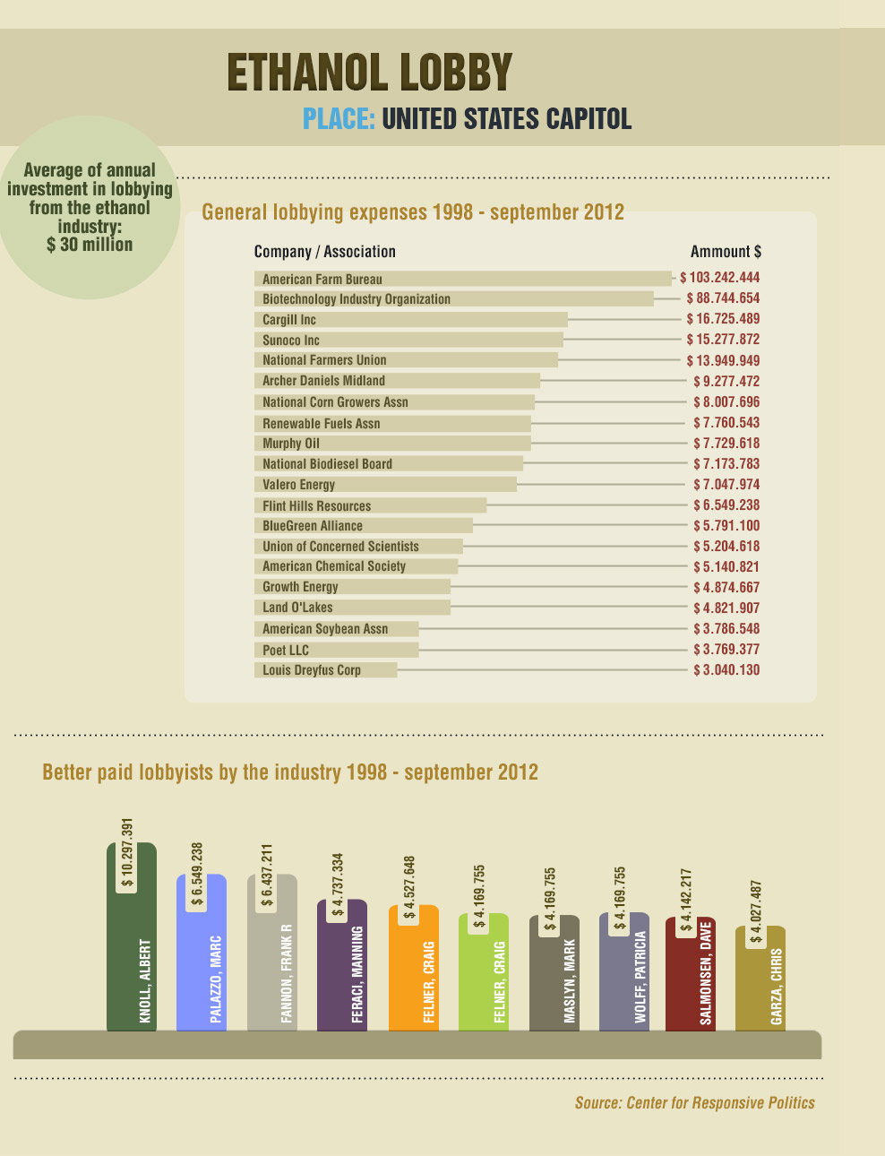

Slide 37
Moreland Commission
Formed by Cuomo in 2013
Root out corruption in NY State politics
Cooperative state offices
Subpoena power
Notes:
10 min

Slide 38
Data
From Joint Committee of Public Ethics.:
list of people or lobbying firms who have lobbied (in NY state, I believe).
One row per report from a client/lobbyist pair.
n Excel and CSV form.
From Office of State Comptroller: Procurement contracts
From Board of Election: campaign contributions.
Name, title, salary of every employee of the New York State.
Name of senators, when first elected, party.
Card swipe data for all NY legislators.
When they entered the government buildings
e.g. to correlate vs. claimed per diem payments for commuting to Albany

Slide 39
Questions
Project #1: Identifying whether entities seeking state contracts give large campaign contributions before or after the state awards the contract
Question: From 2007 to the present, did any corporations (or individuals associated with corporations) that received state contracts give contributions of $25,000 or larger to any New York State elected officials or candidates within two years prior to the contract award date or within one year after the award date?
Question: From 2007 to the present, did any lobbyists representing corporations identified in our first search make any contributions of $10,000 or larger to the same elected officials or candidates?
Question: From 2007 to the present, did any PACs make contributions of $10,000 or larger to the same elected officials or candidates.
(Because this universe is smaller, perhaps we can manually match PACs to corporations and individuals that might be affiliated with them.)

Slide 40
Questions
Project #2: Track lobbying revenues of entities who are also paid campaign consultants.
This would involve searching BoE records for expenditures on certain lobbyists (we have already identified them), identifying those lobbyists' clients using JCOPE, identifying what bills those clients lobbied for and whether those bills are associated with the relevant elected officials, and searching JCOPE to identify how much those clients paid the relevant lobbyists.
Question: From 2007 to the present, did any corporations (or individuals associated with corporations) that received state contracts give contributions of $25,000 or larger to any New York State elected officials or candidates within two years prior to the contract award date or within one year after the award date?
select osc._vendor_name, osc._contract_start_date, osc._contract_end_date, boe._cand_name, boe._e_year, boe._date1_10, cast(boe._amount_70 as float), boe._explanation_110 from deals._osc_contracts_v2_csv osc, boe_raw_data._senate_campaign_finance_data_all_schedules_2008_2014_csv boe where osc._vendor_name = boe._corp_30 and boe._transaction_code = 'A' limit 100; select osc._vendor_name, sum(cast(boe._amount_70 as float)) as total from deals._osc_contracts_v2_csv osc, boe_raw_data._senate_campaign_finance_data_all_schedules_2008_2014_csv boe where osc._vendor_name = boe._corp_30 and boe._transaction_code = 'A' group by osc._vendor_name order by total desc

Slide 41
A conversation
Them: If I can show any *hits* between names in the client field of the JCOPE client database and OSC state contracts database, that would be of interest. Can you send me the SQL query that would prompt that, and I can try running it?
Us: Could you please tell me which fields in the two tables need to be linked? (vendor_name from the 1st to which field in second)?
Them: vendor_ name in the first to client_name in the second.
Us: Which fields do you need in the output?
Them: Just client_name
Us: select distinct c._vendor_name from deals._osc_contracts_v2_csv as c, jcope._jcope_lobbyistdisclosure_csv as l where c._vendor_name = l._client_name;
Them: this is really great. For the commissioners, some of who are even less tech savvy than me, the idea that you can run a simple cross query to generate that will be good to show.

Slide 42
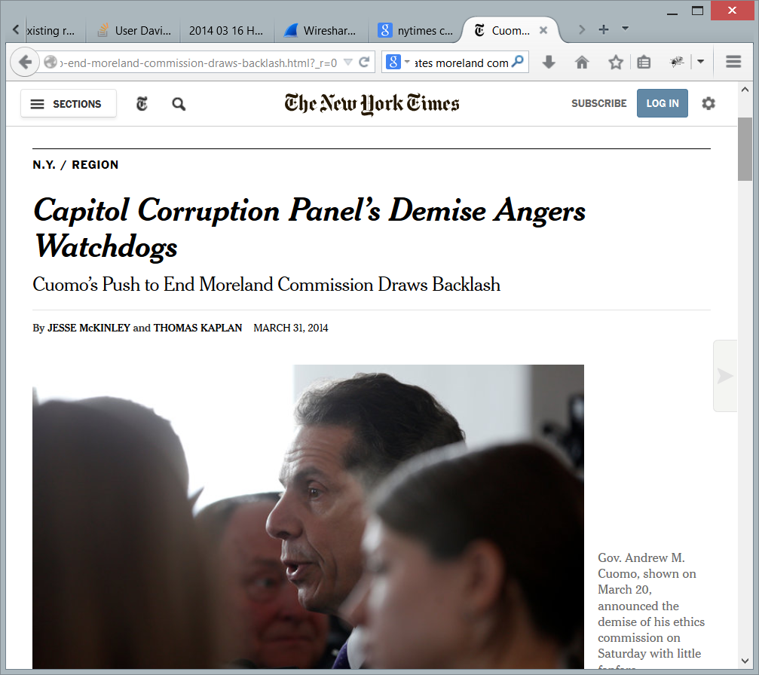
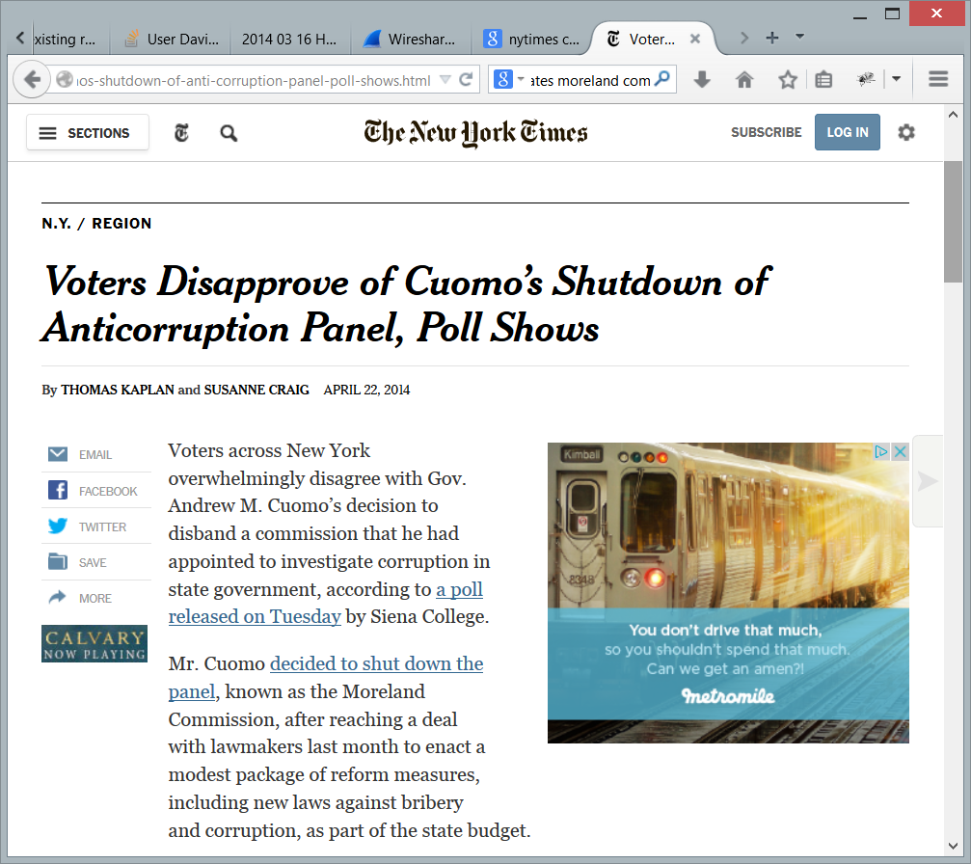
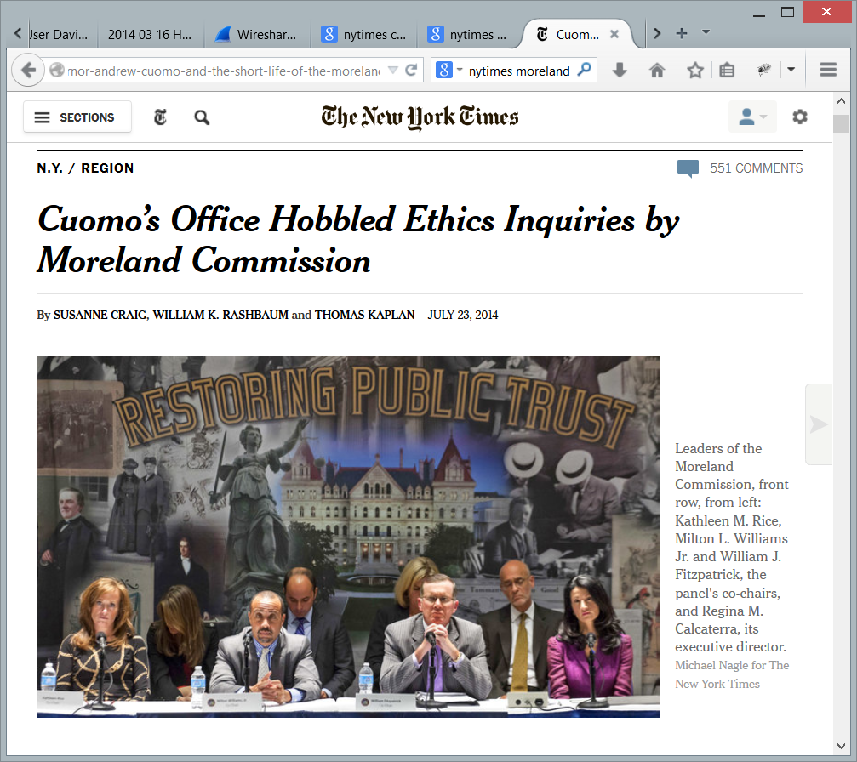
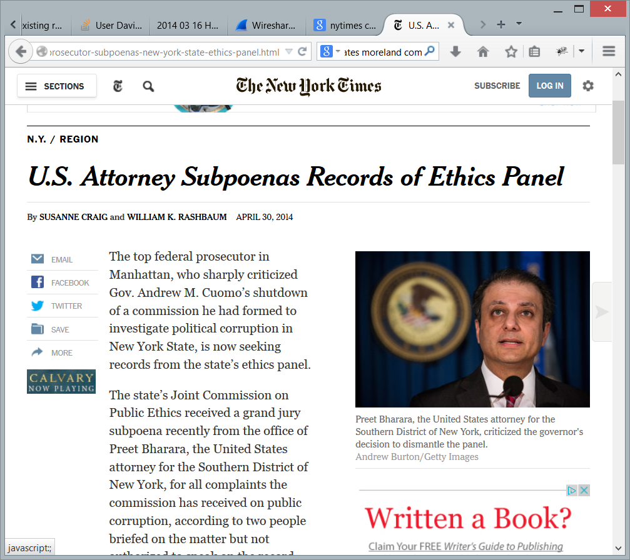
Going Great, Until

Slide 43
Going Forward
Commission liked our work
Recommended us to other government watchdogs
Journalists liked our work
Recommended us to other journalists
New collaborations are being developed

Slide 44
Paradox
The “hard” bits are easy for the domain experts
Formulating questions
Understand what data can answer the questions
Assessing correctness and value of answers
The “easy” bits defeat them
Entering data
Loading and transforming data
Extracting from behind APIs
Understanding the DB schema
DB query syntax

Slide 45
Tools & Deployments
Notes:
13 min

Slide 46
Problems To Address
Data variety
Working with a multiplicity of (new) data sets
Understanding connections
Can’t build a domain-specific application for each domain
Tool diversity leads to forking, version skew
Data capture, cleaning, transformation
Dull entry, need for general computational methods
Preference for office-like tools (good UIs)
Challenges in collaboration and sharing

Slide 47
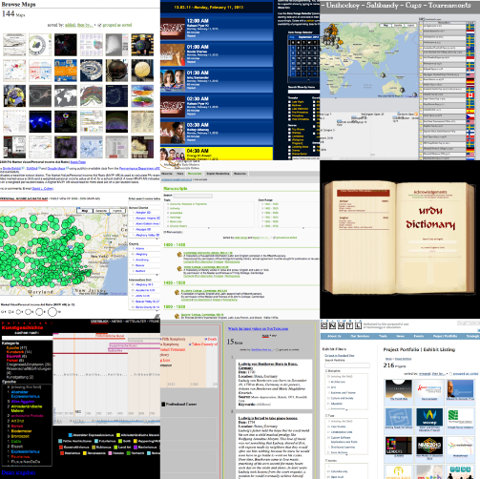
Exhibit
HTML-based domain-generic visualization authoring
Understand the kinds of visualizations and interactions users can/want to author
Field deployment
1800 sites
Interviews & usage analysis

Slide 48
Quilt
Ted Benson---UIST 2014

Slide 49
Spreadsheet Backed Apps
We’ve seen that spreadsheets are dominant data tool
Their UI is good for certain tasks
But it’s a painfully limited way to enter/visualize your data
(that’s why we have domain-specific applications)
Web pages offer a far richer UI
But unless you’re a programmer, no computation or storage
Idea: connect the two
Author an HTML “front end” for your application
Connect to a spreadsheet “back-end” for storage & computation
A supercharged version of Google Forms

Slide 50
Method
Extend HTML to connect elements of web page to elements of (Google) spreadsheet
<span connect=“cell A3”></span>
<input type=“checkbox” connect=“cell k9”/>
<ul connect=“spreadsheet rows”> <li connect=“each row”> <span connect=“column labeled ‘first name’”></span>
<div show-if=“cell b10”>conditional stuff</div>
Sync engine propagates changes
Edits to HTML inputs cause changes in spreadsheet
Which causes spreadsheet formulas to update their values
Changes to values propagate back to linked HTML nodes

Slide 51
Todo List

Slide 52
Todo List
<h1>TODO</h1>
<ul connect=rows>
<li>
<input connect=Done type="checkbox" />
<span connect=Task>Example Task</span>
</li>
</ul>
<form connect=rows>
<input connect=Task />
<button>Add</button>
</form>

Slide 53
Benefits
Users know how to “program” spreadsheets
Their reactive, stateless nature means users don’t have to think about sequences of steps, conditional execution, etc.
Users know how to author HTML
Nice WYSIWYG tools, but there’s still a lot of source editing
Gives all the pieces of an MVC application
Spreadsheet as (persistent) model
HTML as view and controller
Mockup driven design
The (HTML) “picture” of your application becomes the application when you connect the spreadsheet

Slide 54
User Study
15 HTML Beginners 40% hadn’t used <table> 66% hadn’t used <form>
15 Minutes learning session connect, show-if, hide-if
4 App building tasks

Slide 55
Mortgage Calculator
Todo List
Chat Room
Chat Room
Calculator

Slide 56
Task 1
Task 2
Task 3
Task 4
14/15
13/15
5/5
5/5
Notes:
Offered 3&4 to 7

Slide 57
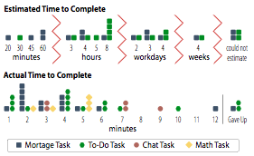

Slide 59
“It feels amazing. I thought it would take me three 8 hour days to do something like this. And then to be able to just do it with Google Docs which is something that I use so frequently, and for it to be so easy and to make so much sense, yeah, it’s really cool.”

Slide 60
Can this be Big?
Spreadsheets don’t scale
Except when they do (Berkeley System)
But spreadsheet is a good IDE for end users
Use it to develop your computations
Without ever loading full data set
But with a sample so you can see what your computations do
Google spreadsheets support join and filter formulas too
and custom programmatic formula widgets

Slide 61
Datahub
Anant Bardwaj
(Warning: mostly future work)
Notes:
17 min

Slide 62
Problems
Often, domain specific “real” work is masked/impeded by generic data grunt work
Data entry/capture/import
Learning APIs for new data sources
Format transformation
Understanding columns/values/schemas
Manual data cleaning
Developing automated cleaning/processing workflows
Entity resolution across data sets
Specifying simple application functionality
And each new user of a data set has to do it all over again

Slide 63
Datahub
A site to help tame data variety
And to help end users past the grunt work
And to capture result so next person doesn’t have to repeat it
Repository of many shared tables
Optimized to let end users create, share, edit, link, publish
Data, visualization, and workflows
Each user gets their preferred illusion of same data
csv, SQL database, programmatic API
A big SQL engine to provide computational heavy lifting
UI design tools to create front ends and basic applications
APIs to connect to other data sources and applications

Slide 64
Goal
A github-inspired community of users sharing data
Contributing data they collect
Unlocking data from sources with poor APIs
Cleaning, enhancing, and linking data shared by others
Sharing data workflows that can be checked and reused
Creating visualizations and applications over shared data
In a virtuous cycle that generates more shared data
Attract usage by offering hassle-free data acccess, produce more hassle-free data as a output of their work

Slide 65
Ingest
Upload CSV files
Data scraping tools (like Needlebase, Dabbledb)
Data cleaning tools (like Google Refine)
Load SQL tables
Write a connector to a data API
Content then proxied or cached as datahub tables

Slide 66
Workflows
Github inspired
Fork a copy of a table, edit it, submit pull request
Spreadsheet UIs for basic manual editing and computation
SQL command line for databasey things
Visual query tools
Editable metadata
What is this table for? What do the columns mean?
Workflow repository
This SQL/python will take data from this table and transform…
Search engine over databases, columns, workflows

Slide 67
Application Server
Typical application
Presents an initial data set
Accepts inputs to it
Computes consequences
Modifies/outputs data
Keep input and output data on datahub
Initial data can be any datahub tables
Output data becomes more datahub tables
Thrift RPC supports 20 programming languages
No need to learn a new API for each data set
No need to write an API for your own application’s data
Data on other site proxied/cached through datahub once someone learns the site API (once) and writes a connector

Slide 68
Other Features
Data versioning
Forking/Social Collaboration
Provenance
Traces of all data transformations
Visualization authoring with Exhibit
Application authoring with Quilt

Slide 69
Incentives
Providers
Upload data, get free programmable APIs
People can link to your data and workflows
Collaborate in open data ecosystem
Developers
Easy to use programmable APIs for application building
Easy and efficient query
Outsource heavy computation to database engine
End users
Simple browsing, querying, visualization
Access to others’ data, workflows

Slide 70
Current Status
Bare-bones system
CSV upload
SQL upload
SQL command line
Thrift APIs for applications wrapping datahub
Used (and useful) for Moreland experiment

Slide 71
Todo
Read Voida paper
Talk to us about interviews and wizard of oz studies
See Quilt (Ted Benson) and Datahub (Anant Bardwaj) at demo session

