Slide 1
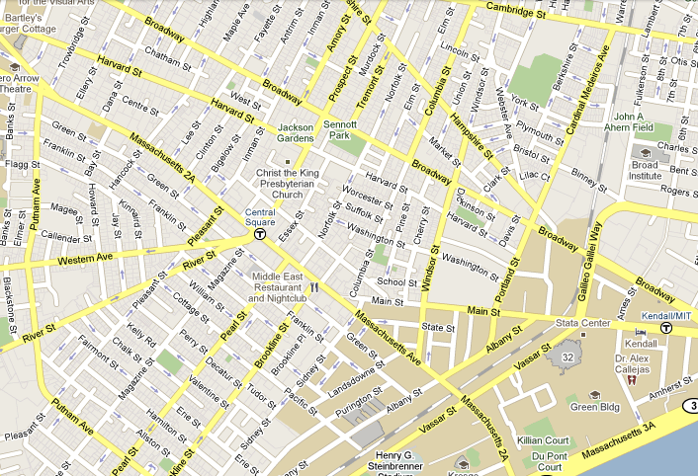
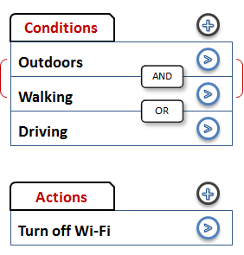
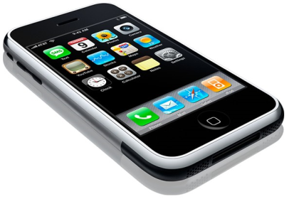
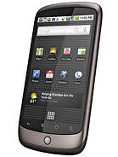
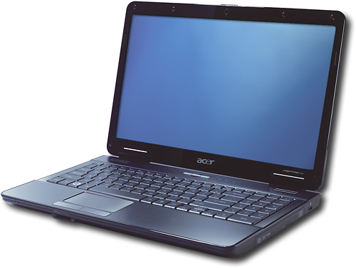
Code In The Air:
Simplifying Tasking on Smartphones
Lenin Ravindranath, Tiffany Chen, Anirudh Sivaraman, Hari Balakrishnan
Disable Wi-Fi when I am outdoors and moving
When I am driving, track and store movement tracks
Remind to fax document when I come to office
Tasking Applications
Run continuously, determine user context/activity and trigger actions
Often involves coordination between multiple users and devices
Send me a text message whenever my spouse leaves work
Notify me when my
friend is nearby
Make my phone silent when I am in the lab and I am meeting my advisor
Trivial for end-users to state but non-trivial to develop
Simple implementation can be energy-consuming
Code In The Air (CITA)
Activity Layer
Rapid development of tasking applications
Activity detection as primitives
CITA helps developers and end-users
Several inbuilt activities
InLocation, IsWalking, IsDriving, IsMoving, IsBiking, EnterPlace, LeavePlace, IsOutdoor
Developers
End-Users
Activity Composition Framework
Multi-phone programming
Write only server side scripts even for tasks involving
* multiple users and devices
* a variety of sensors/activities
Written in JavaScript
Compose complex activities by combining existing activities using predicates
State Condition-Action rules in UI
“Mix and match” activities and tasks
AND, OR NOT
WITHIN, FOR
I am in a Meeting AND
(John is in the Meeting OR
Alice in is the Meeting)
Energy-efficient execution of primitive and complex activities
Tasking Framework
Architecture
Program devices as objects
Automatic code partitioning, execution and coordination across multiple devices and users
Users/Developers
Tasking Framework
UI
Scripting
Web
Disable Wi-Fi when I am outdoors and walking
Users/Developers
Task
Task Runtime
p = getDevice(“Tiffany”);
function main() {
pred = getPredicate(“walking”)
pred = pred.and(“outdoors”);
p.watch(pred, “callback”);
}
function callback() {
p.wifi.disable();
}
Tasking Framework
Task Compiler
Sub task
Activity Layer
Tasks
(JavaScript)
Server
Push Service
CITA Server
Split-Task
Execution
Task Runtime
Push Client
Alert when my spouse leaves work
Activity Layer
Task
Coordination
Split-Task
Execution
Split-Task
Execution
Sensors
Phone
p = getDevice(“Alice”);
q = getDevice(“Jim”);
pred = getPredicate(“leaveWork”);
function main() {
p.watch(pred, “callback”);
}
function callback() {
q.vibrate();
q.alert(“Alice left work”);
}
CITA Client
CITA Client
CITA Client

