Slide 1
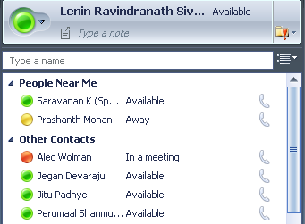
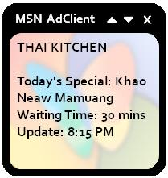
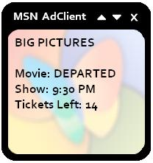
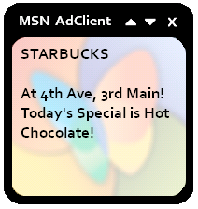
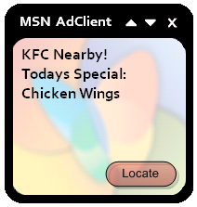
Neighborcast: Enabling communication among nearby clients
Communication among nearby nodes
Neighborcast
o Two clients are nearby if they hear a common AP
o Nearby nodes can be on different frequency channels
AP1
AP2
LAN/Internet
C2 hears AP1
00:0A:80:12:34:55
00:0B:80:12:34:56
00:0C:80:12:34:57
C1
C2
Info
C1 and C2 are neighbors
Existing group communication schemes won’t work:
  o 802.11 broadcast only within WLAN
  o IP broadcast spans entire subnet. No locality
  o 802.11 multicast only within WLAN
  o IP multicast has no locality. Requires neighbor discovery!
Multicast group for BSSID 00:0B:80:12:24:56
o Mapping from AP BSSID to Multicast group address
o Client joins group of every AP around it
o Client sends info on group of associated AP
Approaches
Applications
Using IP Multicast
LAN
Improved AP selection
Map APs BSSID into IP multicast address
228.xx.xx.xx where xx:xx:xx is the last 3 bytes of BSSID
LAN/Internet
Pros
o No infrastructure support
o Scalable: All traffic is local
Cons
o Limited IP multicast deployment
00:17:95:81:CA:30
AP1
AP2
IP Multicast group - 228.129.202.48
Decides to
switch to AP2
Using Application Level Multicast
RSSI, Load,
Performance
RSSI, Load,
Performance
Pros
o Works across subnets
o Scalable: Traffic is mostly local
Cons
o Need for rendezvous server
o Message overhead
LAN/Internet
Multicast group of AP1
Multicast group of AP2
00:17:95:81:CA:30
ALM Rendezvous server
Buddies Near Me
Unicast
o Neighbor discovery
o Estimate “Nearness”
Using RSS Feeds
http://webserver/00179581CA30.xml
Pros
o Works over internet
o Easily deployable
Cons
o Less scalable as traffic goes through server
Web server
hosting RSS
Location Sensitive Ads
00:17:95:81:CA:30
Ranveer Chandra, Jitu Padhye, Lenin Ravindranath

