Slide 1



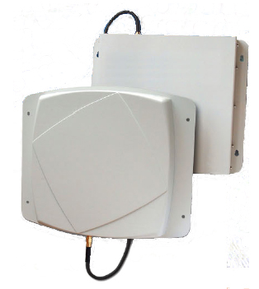
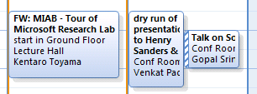
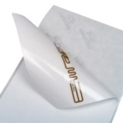
SixthSense: RFID-based Enterprise Intelligence
Lenin Ravindranath, Venkat Padmanabhan,
Piyush Agrawal (IIT Kanpur)
Camera
Enterprise
Presence
RFID Antennas
Calendar
People and objects tagged
Goal: Use RFID to capture rich interaction between people and their surroundings in an automated way
SixthSense Platform:
o Track people and objects
o Combine info from other Enterprise systems such as calendar, camera
o Make inferences automatically
o Expose these to applications
Architecture
Overview
Applications
API
Lookups
Callbacks
Processed Database
Inference Engine
Raw Database
o Person-Object differentiation
o Person Identification
o Object ownership interference
o Person-object interaction
o Multiple Tagging
Automated Inference
RFID Monitor
Other Enterprise Monitors
Object Interaction
o Misplaced object alert
o Annotated security video
o Semi-Automated image cataloging
o Enhanced calendar & IM presence
Applications
Mobility, Networks, and Systems
http://research.microsoft.com/research/mns

