Slide 1
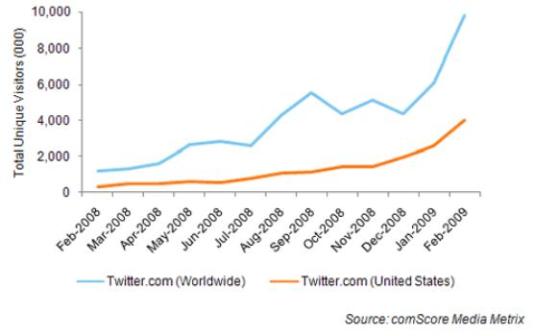
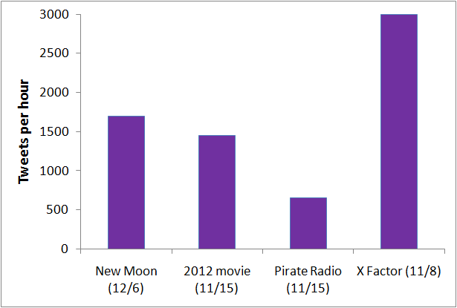
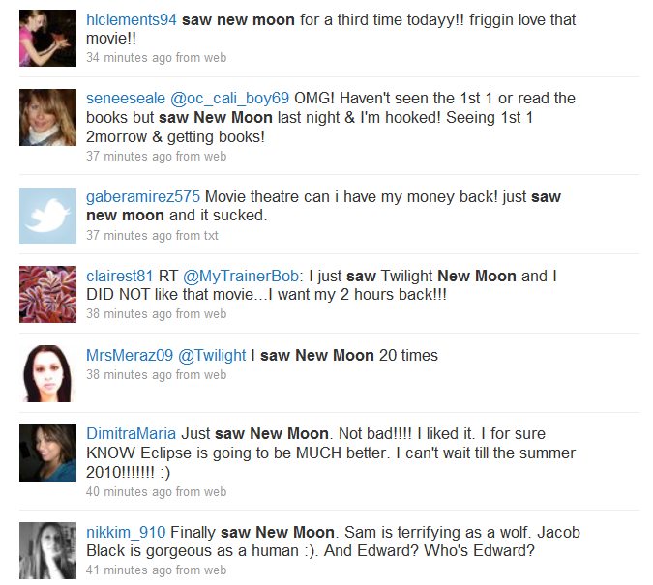
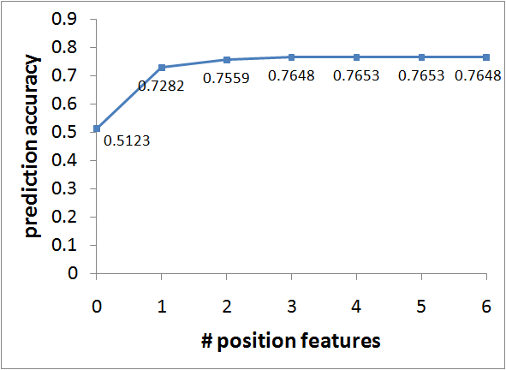
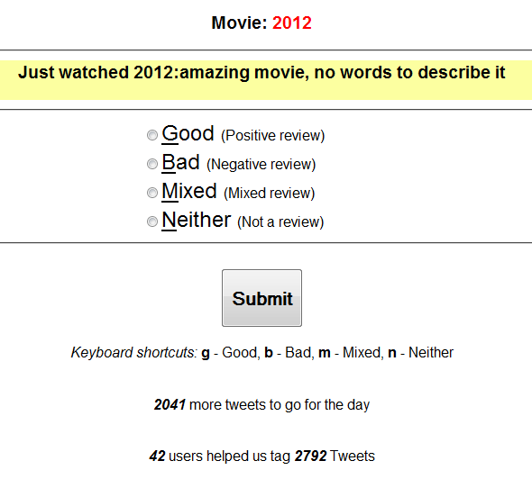
Opinion Mining From Twitter Feeds
Lenin Ravindranath Sivalingam
25 million users around the world
Tweet Extraction
Just saw 2012 – the movie was good, but not gr8… CG was awesum…
Lexicon
Over 10 million tweets a day
Twitter Keyword Search
Internet slang lexicon
Polarized Lexicon | # Positive words | # Negative words
Adjective | 74 | 67
Verb | 29 | 26
Nouns | 29 | 30
Adverbs | 26 | 11
Polarized lexicon
Tweet
Tweet Cleaning
People often express opinions!
Phrase Extraction
just saw MMM
the movie was good
but not great
CG was awesome
Results
Richest source of user opinions!
Internet Slang Translation
Approaches | Correct prediction
Bag of words | 39.24%
Adjectives | 44.27%
Polar words | 58.34%
Our approach (Negation + Polarity + Position) | 76.53%
Spelling Correction
Extracting movie reviews!
Cleaned phrases
Just/RB saw/VB MMM/NN
The/DT movie/NN was/VB good/JJ
But/CC not/RB great/JJ
CG/NN was/VB awesome/JJ
POS Tagging
Tagged phrases
Classes | Correct prediction
Positive review tweets | 80.84%
Negative review tweets | 69.03%
Mixed review tweets | 57.67%
No review tweets | 80.78%
Classifying subjective/objective tweets | 83.50%
Number of phrases to include as features
Sentiment Analysis on Tweets
Feature Extraction
MMM
good/JJ
not/RB great/JJ
awesome/JJ
MMM
POS-JJ
NEG-RB POS-JJ
POS-JJ
Just watched 2012, it was pretty good...
Positive review
(Polar Features)
Saw 2012…… worst movie
ever….. waste of time
Negative review
Polar Words Extraction
MMM
POS-JJ
NEG-JJ
POS-JJ
2012 – great effects, worst
acting, was ok.
Mixed review
Polarity Analysis
(Polarity Reversal)
Went to see 2012 with my
girlfriend
Not a review
Feature Encoding
(Phrase polarity, position)
1:0 2:0
3:1 4:0
5:0 6:1
7:1 8:0
Why errors?
Data Collection
Features
Ambiguous polar words
Couples Retreat was hilarious.
2012 was hilarious.
Crowd Sourcing
SVM Classifier
1:0 2:0 3:1 4:0 5:0 6:1 7:1 8:0
Too much slang
New moon was ahhwwesum..
3000 tweets tagged by 40 users
No polar words
I just saw 2012. I need my money back.
Review
Mixed review
Different context
I saw 2012 today with my girlfriend. I love her.

