Slide 1
Improving and Controlling User-Perceived Delays in Mobile Apps
By the time it loads, the church service is over. Too slow!!!
Slow responsiveness, long load time.
Slower than a snail.
So slow that my screen already dims before it's loaded
Lenin Ravindranath
MIT
horrifically slow. Uninstalled.
So slow. Did an intern write this app??

Slide 2
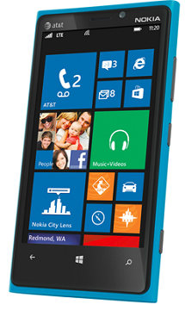

Slide 3
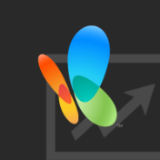
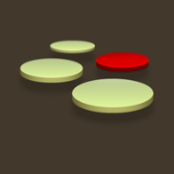

Slide 4
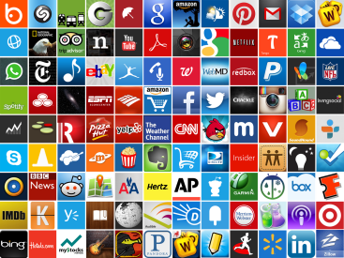
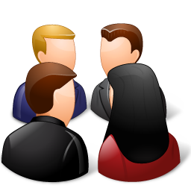
~ Two Million Apps
> 500,000 Developers

Slide 5
There’s an App
for that
But it’s slow
Too slow - killing the usefulness when you really need to go

Slide 6
“So slow. Did an intern write this app??”
“Slower than a snail even on 3G.”
“Slow and unresponsive like mud”
“Sluggish and freezes my HTC phone.”
“Very very slow compared to even browsing web.”
“Consistently 3 seconds behind where I touch.”
“Loading GPS data is *** slow”

Slide 7
Significant diversity in the wild
Diverse environmental conditions
Network connectivity, GPS signal quality,
Location, Sensor conditions etc.
Variety of hardware and OS versions
Wide range of user interactions and inputs
Hard for developers to test
Performance problems are inevitable in the wild

Slide 8
Need for improving and controlling performance
App store is brutally competitive
Response time matters
Users are impatient
100ms delay can cost substantial drop in revenue at Amazon
Similar observations from Google and Bing
Help app developers

Slide 9
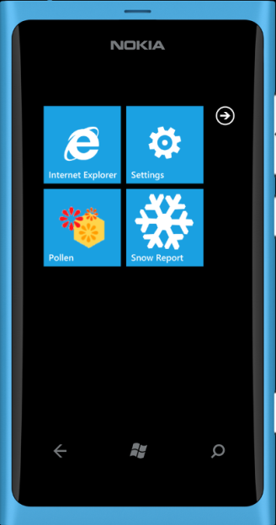
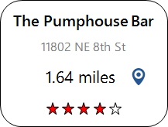
Find a bar

Slide 10
Monitor in the hands of user
User-perceived delay
Improve and control the user-perceived delay
User Interaction
Rendering

Slide 11
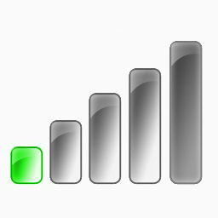
AppInsight
Monitor performance in the wild
OSDI ‘12
What is the user-perceived delay?
Developer
Feedback
Where is the bottleneck?
User Interaction
Rendering
Users with slow network
Poor Performance
Users with fast network
Not producing the best quality result

Slide 12
AppInsight
Monitor performance in the wild
OSDI ‘12
What is the user-perceived delay?
Developer
Feedback
Where is the bottleneck?
User Interaction
Rendering
Deal with uncontrolled variability

Slide 13
AppInsight
Monitor performance in the wild
OSDI ‘12
What is the user-perceived delay?
Developer
Feedback
Where is the bottleneck?
Tightly control user-perceived delay
High delays
Reduce
High delays
User Interaction
Adapt
Rendering
Runtime
Estimation
How much time has already been spent?
How much time will be spent?
SOSP ‘13
Timecard
Adapt processing to conditions in the wild

Slide 14
AppInsight
Monitor performance in the wild
OSDI ‘12
What is the user-perceived delay?
Developer
Feedback
Where is the bottleneck?
Tightly control user-perceived delay
Low delays
Improve result
Low delays
User Interaction
Adapt
Rendering
Runtime
Estimation
How much time has already been spent?
How much time will be spent?
SOSP ‘13
Timecard
Adapt processing to conditions in the wild

Slide 15
AppInsight
Monitor performance in the wild
OSDI ‘12
What is the user-perceived delay?
Developer
Feedback
Where is the bottleneck?
User Interaction
Rendering
Runtime
Estimation
How much time has already been spent?
How much time will be spent?
SOSP ‘13
Timecard
Adapt processing to conditions in the wild

Slide 16
AppInsight
Minimal developer effort
Readily deployable
- No changes to the OS or runtime
Negligible overhead
Used by dozens of developers
Timecard
Product Impact at Microsoft, Facebook

Slide 17
AppInsight
App
Automatic Binary Instrumentation
Instrumented
App
User Transaction Tracking
Monitor app execution
across async boundaries
in a light-weight manner
Timecard

Slide 18
AppInsight
Monitor performance in the wild
What is the user-perceived delay?
Developer
Feedback
Where is the bottleneck?
No platform support
Only option is to instrument your app
Manage your own logging infrastructure
Significant barrier for most app developers

Slide 19
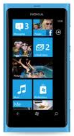
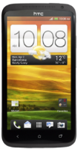
AppInsight
Improved
App
Developer
Feedback
Developer
Performance
Instrumenter
Instrumented
App
Analysis
App
Store
Server
Traces
Users

Slide 20
Monitoring App Performance is Challenging
Highly Asynchronous Programming Pattern
Highly interactive, UI centric
Single UI thread that should not be blocked
Most tasks are performed asynchronously
Asynchronous APIs for Network, Sensor, IO etc.
Computation performed on background threads
Tracing async code is challenging
Notes:
Blue color for title

Slide 21
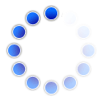
Mood Around Me
GPS
sad
Location
Internet
Nearby Tweets
“At last its sunny. But I have to sit and prepare my talk :(”
“Just got engaged :)”
“My life sucks”
“I am sad that there is no more how I met your mother”

Slide 22
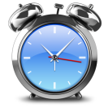
Hypothetical Synchronous Code
ClickHandler()
{
location = GPS.Sample();
url = GetUrl(location)
tweets = Http.Get(url);
result = Process(tweets);
UI.Display(result);
}
GetUrl(location)
{
...
}
Process(tweets)
{
...
}
LogStart();
Mood Around Me
sad
LogEnd();
Thread
ClickHandler
Start
ClickHandler
End
User-perceived Delay
User Interaction
Notes:
Hypothetical Synchronous Code

Slide 23
Asynchronous Code
ClickHandler()
{
GPS.AsyncSample(GPSCallback);
}
GPSCallback(location)
{
url = GetUrl(location);
Http.AsyncGet(url, DownloadCallback);
}
DownloadCallback(tweets)
{
result = Process(tweets);
UI.Dispatch(Render, result);
}
Render(result)
{
UI.Display(result);
}
GetUrl(location){ ... }
Process(tweets){ ... }
Network
GPS
System
Download
Callback
Process
UI
Dispatch
Background Thread
GPS
Callback
Background Thread
Async GPS Call
Async Http Call
Render
UI Thread
ClickHandler
Start
ClickHandler
End
User Interaction
Notes:
Asynchronous code

Slide 24
Network
GPS
System
User Transaction
Download
Callback
UI
Dispatch
Background Thread
GPS
Callback
Background Thread
Async GPS Call
Async Http Call
Render
UI Thread
ClickHandler
Start
User-perceived Delay
Transaction time
User Interaction
Notes:
Asynchronous code

Slide 25
User Transaction
Background Thread
Background Thread
UI Thread
Notes:
Asynchronous code

Slide 26
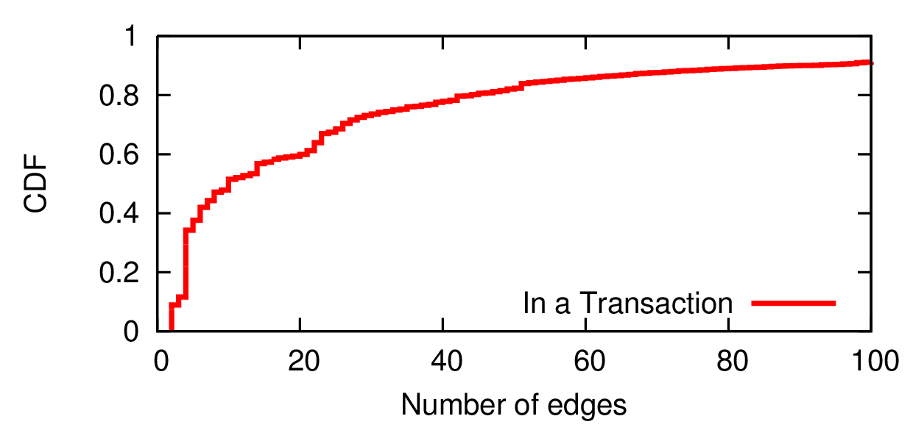
Where is the bottleneck?
Apps are highly asynchronous
30 popular apps
200,000 transactions
Up to 7000 edges
On average, 10 asynchronous calls per user transaction
There are apps with 8 parallel threads per transaction
Focus development efforts

Slide 27
Nearby Tweets
Mood Around Me
Nearby Posts
Twitter
Process Tweets
Callback
Fire
Background Thread
Facebook
Process Posts
Facebook
Callback
Fire
Background Thread
Twitter
GPS Callback
Aggregate
Background Thread
GPS
Thread Blocked
Thread Wakeup
UI Thread
Render
User Interaction
Notes:
Lets try to add a feature to our example app here.
Instead of making a single request, we want to make two requests and compare the rating.
Here is how the execution trace looks like.
This is still is a simple user transaction but it already contains 18 edges.
- Since most tasks need to be performed asynchronously, transactions quickly gets complicated with complex thread synchronization.
Here is a example of transaction which processes data from two http calls.
When the user interacts, it creates a background thread
And start two Http requests.
Then it blocks the thread.
The first response comes back, does some processing and informs the blocked thread that it has finished.
Later, the second response comes back, and fires the blocked thread
At this point the thread wakes up, does some processing and updates the UI
To get the transaction graph and the user perceived delay, you have to track all the causality between threads and thread synchronizations.
And the user perceived delay is from the start to the end.

Slide 28
Critical Path
Optimizing the critical path reduces the user perceived delay
Twitter
Process Tweets
Callback
Fire
Background Thread
Facebook
Process Posts
Facebook
Callback
Fire
Background Thread
Twitter
GPS Callback
Aggregate
Background Thread
GPS
Thread Blocked
Thread Wakeup
UI Thread
User Transaction
Render
User Interaction
Notes:
Lets try to add a feature to our example app here.
Instead of making a single request, we want to make two requests and compare the rating.
Here is how the execution trace looks like.
This is still is a simple user transaction but it already contains 18 edges.
- Since most tasks need to be performed asynchronously, transactions quickly gets complicated with complex thread synchronization.
Here is a example of transaction which processes data from two http calls.
When the user interacts, it creates a background thread
And start two Http requests.
Then it blocks the thread.
The first response comes back, does some processing and informs the blocked thread that it has finished.
Later, the second response comes back, and fires the blocked thread
At this point the thread wakes up, does some processing and updates the UI
To get the transaction graph and the user perceived delay, you have to track all the causality between threads and thread synchronizations.
And the user perceived delay is from the start to the end.

Slide 29
AppInsight
App
Developer
Feedback
Developer
Instrumenter
Instrumented
App
Analysis
App
Store
Server
Traces
Users

Slide 30
Capturing User Transactions
Instrumentation impacts app performance
They are already slow enough!!!
Scarce Resources
Compute, Memory, Network, Battery
User Transaction
Low Overhead
Background Thread
Background Thread
UI Thread

Slide 31
Capture
User Interactions
User Transaction
Background Thread
Background Thread
UI Thread
Event Handler
User Interaction

Slide 32
Capture
User Interactions
Thread Execution
User Transaction
Background Thread
DownloadCallback
Start
End
GPSCallback
Start
Background Thread
GPSCallback
End
UI Thread
ClickHandler
Start
ClickHandler
End
Render
Start
Render
End

Slide 33
Capture
User Interactions
Thread Execution
Async Calls and Callbacks
User Transaction
Background Thread
Download Callback
GPS Callback
UI Dispatch
Call
Background Thread
Async GPS Call
Async Http Call
UI Thread
UI Dispatcher
Callback

Slide 34
Capture
User Interactions
Thread Execution
Async Calls and Callbacks
UI Updates
User Transaction
Background Thread
Background Thread
UI Thread
UI Update

Slide 35
Capture
User Interactions
Thread Execution
Async Calls and Callbacks
UI Updates
Thread Synchronization
User Transaction
Background Thread
Fire
Background Thread
Fire
Background Thread
Thread Blocked
Thread Wakeup
UI Thread

Slide 36
Capture
User Interactions
Thread Execution
Async Calls and Callbacks
UI Updates
Thread Synchronization
User Transaction
Background Thread
Background Thread
UI Thread

Slide 37
Capturing Thread Execution
Trace every method
Prohibitive overhead
Enough to log thread boundaries
Log entry and exit of Upcalls
System
App
Background Thread
DownloadCallback
Start
End
GPSCallback
Start
Upcalls
Background Thread
GPSCallback
End
UI Thread
ClickHandler
Start
ClickHandler
End
Render
Start
Render
End

Slide 38
Identify Upcalls
Event Handlers are Upcalls
Function pointers point to potential Upcalls
Callbacks are passed as function pointers
ClickHandler()
{
GPS.AsyncSample(GPSCallback);
}
GPSCallback(location)
{
url = GetUrl(location);
Http.AsyncGet(url, DownloadCallback);
}
DownloadCallback(tweets)
{
result = Process(tweets);
UI.Dispatch(Render, result);
}
Render(result)
{
UI.Display(result);
}
<Button Click=“ClickHandler” />

Slide 39
Instrument Upcalls
ClickHandler()
{
Logger.UpcallStart(1);
GPS.AsyncSample(GPSCallback);
Logger.UpcallEnd(1);
}
GPSCallback(location)
{
Logger.UpcallStart(2);
url = GetUrl(location);
Http.AsyncGet(url, DownloadCallback);
Logger.UpcallEnd(2);
}
DownloadCallback(tweets)
{
Logger.UpcallStart(3);
result = Process(tweets);
UI.Dispatch(Render, result);
Logger.UpcallEnd(3);
}
Render(result)
{
Logger.UpcallStart(4);
UI.Display(result);
Logger.UpcallEnd(4);
}
GetUrl(location){ ... }
Process(tweets){ ... }
Rewrite app
Trace Upcalls
Low Overhead
7000 times less overhead
Background Thread
DownloadCallback
Start
End
GPSCallback
Start
Background Thread
GPSCallback
End
UI Thread
ClickHandler
Start
ClickHandler
End
Render
Start
Render
End

Slide 40
Async Calls and Callbacks
Background Thread
Download Callback
GPS Callback
UI Dispatch
Call
Background Thread
Async GPS Call
Async Http Call
UI Thread
UI Dispatcher
Callback

Slide 41
Async Calls and Callbacks
Log Callback Start
We capture start of the thread
Log Async Call
Match Async Call to its Callback
GPSCallback(location)
{
Http.AsyncGet(url, DownloadCallback);
Logger.AsyncCall(5);
}
DownloadCallback(tweets)
{
Logger.UpcallStart(3);
....
}
Download Callback
Async Http Call
Detour Callbacks

Slide 42
Callbacks
System
Http.AsyncGet
App
DownloadCallback
Async Call
DownloadCallback(tweets)
{
}

Slide 43
Detour Callbacks
System
Http.AsyncGet
obj.DetourCallback
App
DownloadCallback
Async Call
DownloadCallback(tweets)
{
}
while(...)
{
}
MatchId = 3
MatchId = 3
obj = new DetourObject(DownloadCallback, MatchId++);
Http.AsyncGet(url, DownloadCallback);
Http.AsyncGet(url, obj.DetourCallback);
class DetourObject
{
}
MatchId = 3
DetourCallback(tweets)
{
DownloadCallback(tweets);
}

Slide 44
Detour Callbacks
System
Http.AsyncGet
App
obj.DetourCallback
Async Call
DownloadCallback(tweets)
{
}
while(...)
{
}
MatchId = 4
MatchId = 4
obj = new DetourObject(DownloadCallback, MatchId++);
Http.AsyncGet(url, obj.DetourCallback);
class DetourObject
{
}
MatchId = 4
DetourCallback(tweets)
{
DownloadCallback(tweets);
}

Slide 45
Detour Callbacks
System
Http.AsyncGet
App
obj.DetourCallback
Async Call
DownloadCallback(tweets)
{
}
while(...)
{
}
MatchId = 5
MatchId = 5
obj = new DetourObject(DownloadCallback, MatchId++);
Http.AsyncGet(url, obj.DetourCallback);
class DetourObject
{
}
MatchId = 5
DetourCallback(tweets)
{
DownloadCallback(tweets);
}

Slide 46
Async Calls and Callbacks
Detour Callbacks
Delayed Callbacks
Track Object Ids
Event Subscriptions
Thread t = new Thread(foo);
...
...
t.Start();
void foo()
{
}
Low Overhead

Slide 47
Capture
User Interactions
Thread Execution
Async Calls and Callbacks
UI Updates
Thread Synchronization
User Transaction
Background Thread
Background Thread
UI Thread

Slide 48
Keeping the overhead low
Use app idle time
Garbage collect detour objects during idle time
Log to memory, write to disk during idle time
Compress log before sending to server
Delta encoding to achieve high compression
Background transfer after app quits

Slide 49
AppInsight
App
Developer
Feedback
Developer
Instrumenter
Instrumented
App
Analysis
App
Store
Server
Traces
Users

Slide 50
AppInsight
App
Developer
Feedback
Developer
Instrumenter
Instrumented
App
Analysis
App
Store
Server
Traces
Users

Slide 51
Aggregate Analysis
Group similar transactions
Same transaction graph
Outliers
Points to corner cases
Highlight common critical paths
Focus development effort
Root causes of performance variability
Highlight what really matters in the wild
Device
Network
GPS
Compute
Async GPS Call
Async Http Call

Slide 52
AppInsight
App
Developer
Feedback
Developer
Instrumenter
Instrumented
App
Analysis
App
Store
Server
Traces
Users

Slide 53
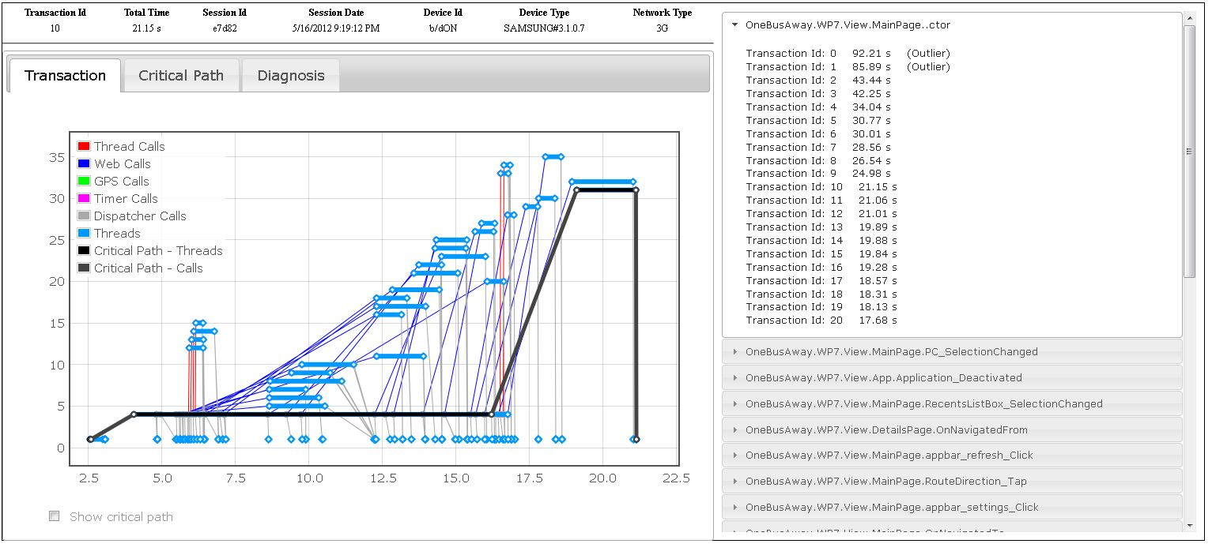
Developer Feedback
Web based Interface
Long User Transactions
Critical Path
Aggregate Analysis
Outliers
Common Case
Factors affecting

Slide 54
AppInsight
App
Developer
Feedback
Developer
Instrumenter
Instrumented
Deployment
App
Analysis
App
Store
Server
Traces
Users

Slide 55
Deployment
40 apps in the Windows Phone store
30 to few thousand users
6 months to 1 year of data
> Million user transactions

Slide 56
AppInsight Overhead
Compute
Memory
Network
Binary Size
Battery
0.02%
2%
4%
1.2%
<1%
Based on 6 months of data from 30 apps in the wild
Low Overhead
Impact on app performance is minimal
Low resource consumption

Slide 57
User Transactions and Critical Path
15% of the user transactions took more than 5 seconds!
30% took more than 2 seconds
Critical path analysis
Focus on less than half the edges for 40% of transactions
Top 2 edges responsible for 82% of transaction time
Aggregate analysis
Pointed to factors creating performance variability
GPS, Device, Network, Sensors
Focus development efforts

Slide 58
AppInsight
Improved
App
Developer
Feedback
Developer
Instrumenter
Instrumented
App
Analysis
App
Store
Server
Traces
Users

Slide 59
Developer Case Study
App: TwitReviews
Problem: UI hog
AppInsight:
High performance variability in UI thread
Abnormal latencies only at the start of the session
System loading DLLs in the critical path
Up to 1 second
Fix:
Preload the DLL asynchronously when the app starts
Dummy call to DLL

Slide 60
Developer Case Study
App: TwitReviews
Problem: Radio wakeup delay
AppInsight:
High performance variability before network call
Radio wakeup delay in critical path
Dominating when users are on cellular networks
More than 2 seconds
Fix:
Wakeup radio as the user starts typing before invoking the transactions

Slide 61
Developer Case Study
App: Bing App
Problem: Slow transactions
AppInsight:
Custom instrumentation in the critical path
Affecting user perceived delay

Slide 62
Developer Case Study
App: OneBusAway
Problem: Slow transactions
AppInsight:
Aggregate analysis showed cellular latencies significantly affecting critical paths
Majority of transactions happens when user is in cellular
Known issue but no quantitative data
Current caching policy insufficient
Fix:
Change caching policy?

Slide 63
AppInsight
App
Developer
Feedback
Developer
Instrumenter
Instrumented
App
Analysis
App
Store
Server
Traces
Users

Slide 64
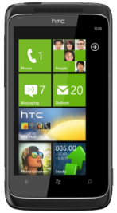
Server-based User Transactions
Core processing of the user transaction is at the server
Core processing
Server
Network
Network
Input and
sensors
Parse and
render
Send
request
Receive
response
App
App
User Interaction

Slide 65
Server-based User Transactions
Joint app-server instrumentation
Azure services
Server
Request Handler Start
Request Handler End
Network
Network
Network + Server
UI Dispatcher
Download Callback
GPS Callback
Click
Handler
Http Request
GPS Start

Slide 66
Server-based User Transactions
Server Threads
Send Response
Request
Handler
Spawn Workers
Server
HTTP[“x-AppInsight-Id”]
Network
Network
UI Dispatcher
Download Callback
GPS Callback
Click
Handler
Http Request
GPS Start
Identify and fix bottlenecks at the app and the server

Slide 67
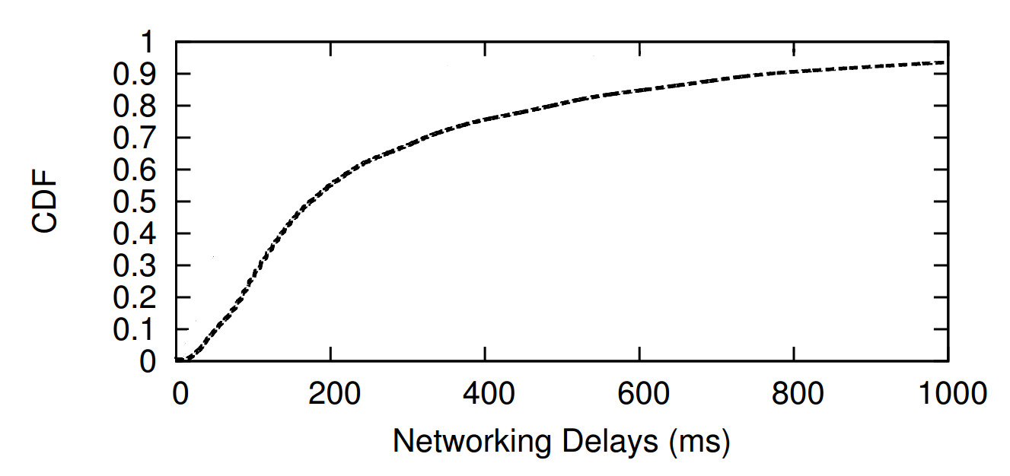
Uncontrollable and Variable Delays
Server
Device type
Network
Network
Reading sensors
(3G, 4G, WiFi, LTE, ..)
RTT, tput, TCP, DNS
Device type
App
App
User Interaction
Radio state
Rendering
Notes:
Let’s take this transaction here. Once you get rid of all the controllable bottlenecks, our goal is to tightly control the user-perceived delay.
To tightly control the user-perceived delay, the one place of control you have is at the server where the core logic of the processing is. Today developers do put in a lot of effort to tightly control the server delay.

Slide 68
Uncontrollable and Variable Delays
Server
Device type
Network
Network
Reading sensors
(3G, 4G, WiFi, LTE, ..)
RTT, tput, TCP, DNS
Device type
App
App
User Interaction
Radio state
Rendering
Significant variability in user-perceived delays
Notes:
Let’s take this transaction here. Once you get rid of all the controllable bottlenecks, our goal is to tightly control the user-perceived delay.
To tightly control the user-perceived delay, the one place of control you have is at the server where the core logic of the processing is. Today developers do put in a lot of effort to tightly control the server delay.

Slide 69
Uncontrollable and Variable Delays
Server
Users with high uncontrollable delays
Poor user-perceived delays
Users with low uncontrollable delays
Not producing the best quality result
Device type
Network
Network
Reading sensors
(3G, 4G, WiFi, LTE, ..)
RTT, tput, TCP, DNS
Device type
App
App
User Interaction
Radio state
Rendering
Significant variability in user-perceived delays
Notes:
Let’s take this transaction here. Once you get rid of all the controllable bottlenecks, our goal is to tightly control the user-perceived delay.
To tightly control the user-perceived delay, the one place of control you have is at the server where the core logic of the processing is. Today developers do put in a lot of effort to tightly control the server delay.

Slide 70
Uncontrollable and Variable Delays
Adapt to conditions in the wild
Server
Device type
Network
Network
Reading sensors
(3G, 4G, WiFi, LTE, ..)
RTT, tput, TCP, DNS
Device type
App
App
User Interaction
Radio state
Rendering
Tightly control user-perceived delays
Notes:
Let’s take this transaction here. Once you get rid of all the controllable bottlenecks, our goal is to tightly control the user-perceived delay.
To tightly control the user-perceived delay, the one place of control you have is at the server where the core logic of the processing is. Today developers do put in a lot of effort to tightly control the server delay.

Slide 71
Adapt to conditions in the wild
Trade-off on quality or quantity of the result
Adapt
Do less or more processing
Send less or more data
Server
Network
Network
App
App
User Interaction
Rendering
Meet end-to-end deadline
Tightly control user-perceived delays
Notes:
Let’s take this transaction here. Once you get rid of all the controllable bottlenecks, our goal is to tightly control the user-perceived delay.
To tightly control the user-perceived delay, the one place of control you have is at the server where the core logic of the processing is. Today developers do put in a lot of effort to tightly control the server delay.

Slide 72
Controlling the Server Delay
Server processing
Request
Response
Server
Deadline

Slide 73
Controlling the Server Delay
Worker
Worker
Worker
Worker
Worker
Request
Response
Server
Deadline

Slide 74
Controlling the Server Delay
Worker
Worker
Worker
Worker
Worker
Request
Response
Server
Better result
Deadline

Slide 75
Controlling the Server Delay
Server processing
Server
Deadline
Servers keep fixed deadlines
No visibility into external delays

Slide 76
Adapt to conditions in the wild
Adapt
Server
Network
Network
App
App
User Interaction
Rendering
Tightly control user-perceived delays
Notes:
Let’s take this transaction here. Once you get rid of all the controllable bottlenecks, our goal is to tightly control the user-perceived delay.
To tightly control the user-perceived delay, the one place of control you have is at the server where the core logic of the processing is. Today developers do put in a lot of effort to tightly control the server delay.

Slide 77
Timecard
GetElapsedTime();
PredictRemainingTime(responseSize);
Server
App
App
Time elapsed since
user interaction
Predicted downlink & app processing delay

Slide 78
Timecard
GetElapsedTime();
PredictRemainingTime(responseSize);
Adapt Processing Time
Server
App
App
Desired user-perceived delay

Slide 79
Timecard
GetElapsedTime();
PredictRemainingTime(responseSize);
Adapt Processing Time
Server
Trade-off on
quality of the result
App
App
Desired user-perceived delay

Slide 80
Timecard
GetElapsedTime();
PredictRemainingTime(responseSize);
PredictRemainingTime(5KB)
PredictRemainingTime(10KB);
Server
PredictRemainingTime(15KB);
Adapt Response
App
App
Desired user-perceived delay

Slide 81
Timecard
GetElapsedTime();
PredictRemainingTime(responseSize);
Server
Adapt Response
App
App
Desired user-perceived delay

Slide 82
Timecard
GetElapsedTime();
PredictRemainingTime(responseSize);
Server
Better
quality result
App
App
Desired user-perceived delay

Slide 83
Timecard
GetElapsedTime();
PredictRemainingTime(responseSize);
Server
App
App
Analysis of 4000 apps
80% of them are single request-response transactions

Slide 84
Challenges
Server
App
App

Slide 85
Challenges
Server
Highly asynchronous
App
App
Background Thread
GPS Callback
Http Request
Download Callback
UI Dispatcher
Click
Handler
UI Thread
GPS Start

Slide 86
Challenges
Server Threads
Send Response
Spawn Workers
Server
Request
Handler
Highly asynchronous
App
App
Background Thread
GPS Callback
Http Request
Download Callback
UI Dispatcher
Click
Handler
UI Thread
GPS Start

Slide 87
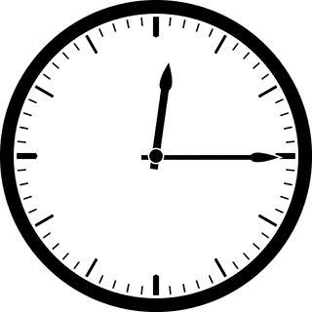
Challenges
GetElapsedTime();
PredictRemainingTime(responseSize);
No single reference
clock
Variable network delays
and processing delays
Server
Highly asynchronous
App
App
Transaction

Slide 88
Timecard
GetElapsedTime();
PredictRemainingTime(responseSize);
TimeSync
Delay Predictors
Server
Transaction Tracking
App
App
Transaction

Slide 89
Timecard
Developer
App
Service
Timecard.dll
GetElapsedTime();
PredictRemainingTime
(responseSize);
App Instrumenter
Desired user-perceived delay
Instrumented
App
App
Store

Slide 90
Timecard
GetElapsedTime();
PredictRemainingTime(responseSize);
TimeSync
Delay Predictors
Server
Transaction Tracking
App
App
Transaction

Slide 91
Transaction Tracking
Server Threads
Send Response
Spawn Workers
Server
Request
Handler
App
App
Background Thread
GPS Callback
Http Request
Download Callback
UI Dispatcher
Click
Handler
UI Thread
GPS Start
Transaction

Slide 92
Transaction Tracking
GetElapsedTime();
TC
Server Threads
TC
TC
Send Response
TC
Spawn Workers
Server
Request
Handler
App
App
TC
Background Thread
TC
GPS Callback
Http Request
Download Callback
UI Dispatcher
Click
Handler
TC
UI Thread
TC
GPS Start
TC
Transaction context (TC) attached to every thread
Carry along timestamps, transaction information

Slide 93
Timecard
GetElapsedTime();
PredictRemainingTime(responseSize);
TimeSync
Delay Predictors
Server
Transaction Tracking
App
App
Transaction

Slide 94
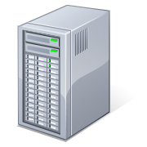
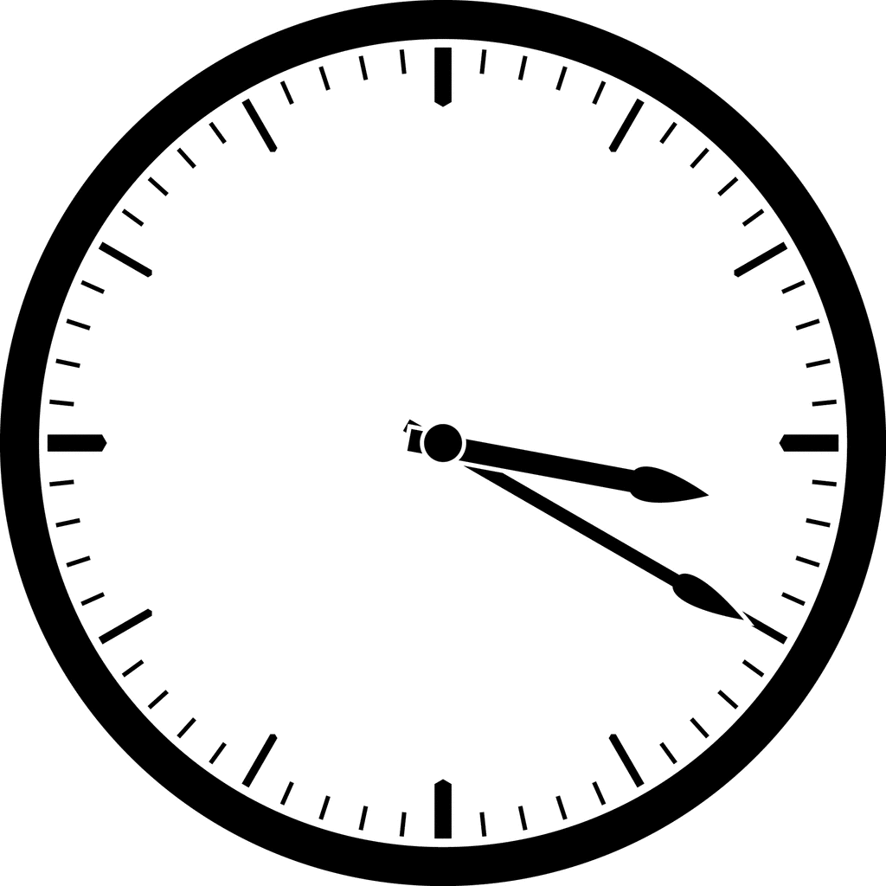
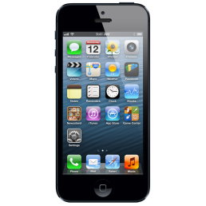
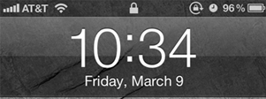
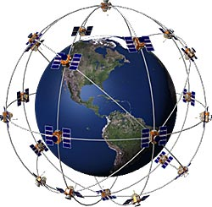
TimeSync
Sync with Cell Tower
Off my several seconds to minutes
GPS
Does not work indoors
Probing
Probe
GPS

Slide 95
TimeSync
Typical probing techniques don’t work well
Radio wakeup delays and queuing delays
Errors more than 100ms
Energy inefficient (network radio tail energy)
Radio-aware, network-aware probing
Probes when radio is active and network is idle

Slide 96
TimeSync in Timecard
Server
App
App

Slide 97
TimeSync in Timecard
Probe
App
Background Thread
GPS Callback
Http Request
Click
Handler
UI Thread
~5ms error
GPS Start
Energy efficient

Slide 98
Timecard
GetElapsedTime();
Server
App
App
Time elapsed since
user interaction

Slide 99
Predicting Remaining Time
PredictRemainingTime(responseSize);
Server
App
App
Downlink delay
App processing delay

Slide 100
Predicting Downlink Delay
Analysis of 4000 apps
Most transfers are short
Median – 3KB
90% percentile – 37KB
TCP window state
Response size
Latency
Cellular networks
High-bandwidth, rare-loss, high-latency,
Throughput
Loss rate
99% transfers over HTTP
TCP window state matters -> multiple RTTs

Slide 101
Predicting Downlink Delay
TCP Window
1 extra RTT

Slide 102
Predicting Downlink Delay
TCP parameters
Response size
Determined by
RTT
Number of round trips
Latency

Slide 103
Predicting Downlink Delay
RTT
Use recent estimate of RTT
Use time sync probes
Read TCP window state
Number of round trips
Middlebox
TCP window state
Read TCP window state at server
Do not work with middleboxes
Split-TCP connection
TCP window state at the middlebox matters
No easy way to estimate
Build an empirical data-driven model

Slide 104
Predicting Downlink Delay
PredictRemainingTime(responseSize);
Data-driven model
Response size
Recent RTT
Network provider
Bytes already transferred in the TCP connection
Proxy for TCP window state at the middlebox
Downlink Delay Predictor
Middlebox
Learn
Wi-Fi
Median error - 12 ms, 90th percentile - 31ms
Cellular
Median error - 17 ms, 90th percentile - 86 ms

Slide 105
Predicting App Processing Delay
PredictRemainingTime(responseSize);
Server
App
App
Parsing and rendering delay
Correlated with response size
Correlated with device type

Slide 106
Timecard
GetElapsedTime();
PredictRemainingTime(responseSize);
Server
App
App
Time elapsed since
user interaction
Predicted downlink & app processing delay

Slide 107
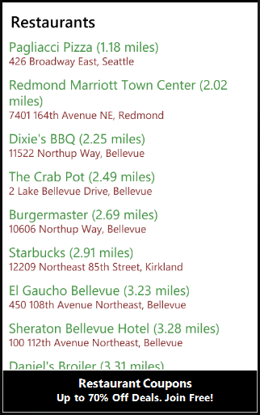
Mobile Ads Service
Contextual ads to mobile apps

Slide 108
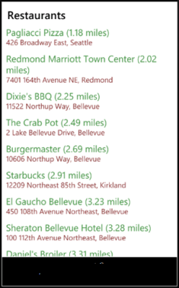
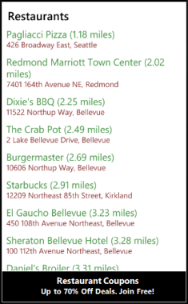
Mobile Ads Service
Fetch and process ads for keywords
Send keywords
Extract keywords
Render ad
Ad

Slide 109
Mobile Ads Service
Ad provider
Ad provider
Keywords
Ad provider
Ad provider
Ad provider
A
Send keywords
Extract keywords
Render ad
Ad

Slide 110
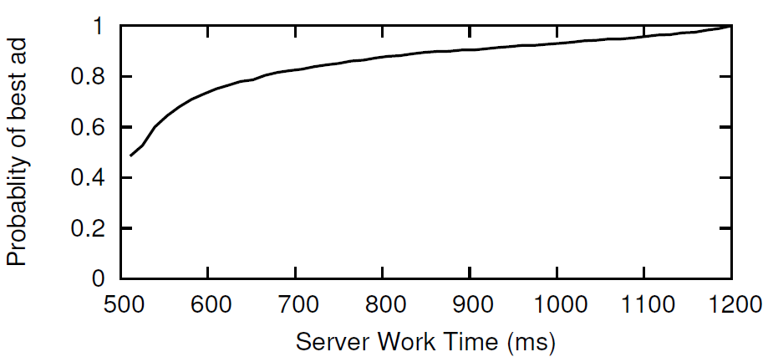
Mobile Ads Service
Send keywords
Extract keywords
Render ad
Ad

Slide 111
Mobile Ads Service
GetElapsedTime();
PredictRemainingTime(responseSize);
Adapt Processing Time
Send keywords
Extract keywords
Render ad
Ad

Slide 112
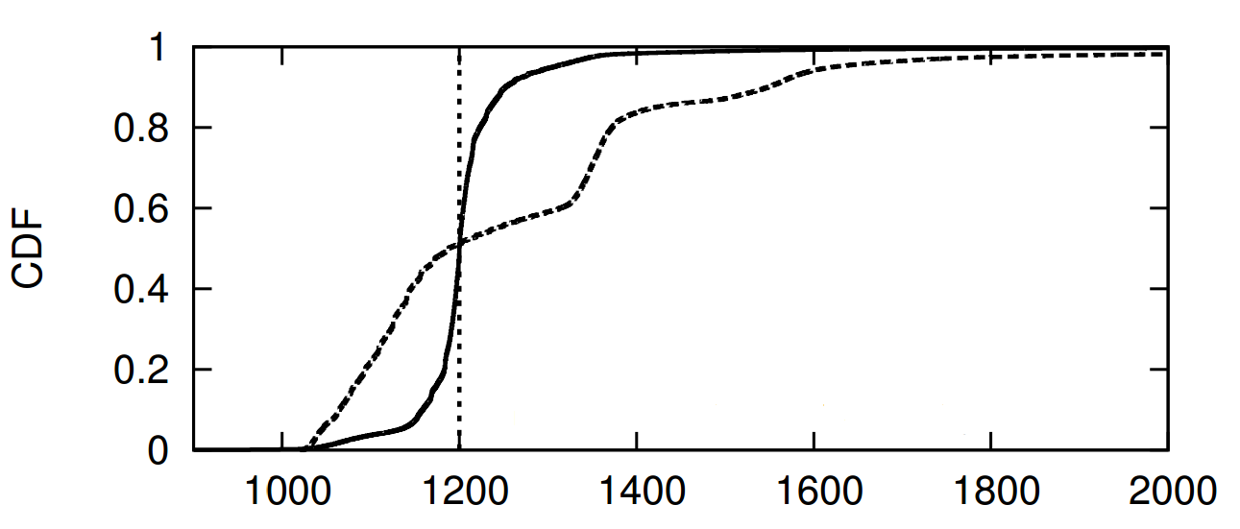
Mobile Ads Service
~200,000 transactions
With Timecard
Target
delay
Without Timecard
User-perceived delay (ms)
Within 50ms of the target delay 90% of the time

Slide 113
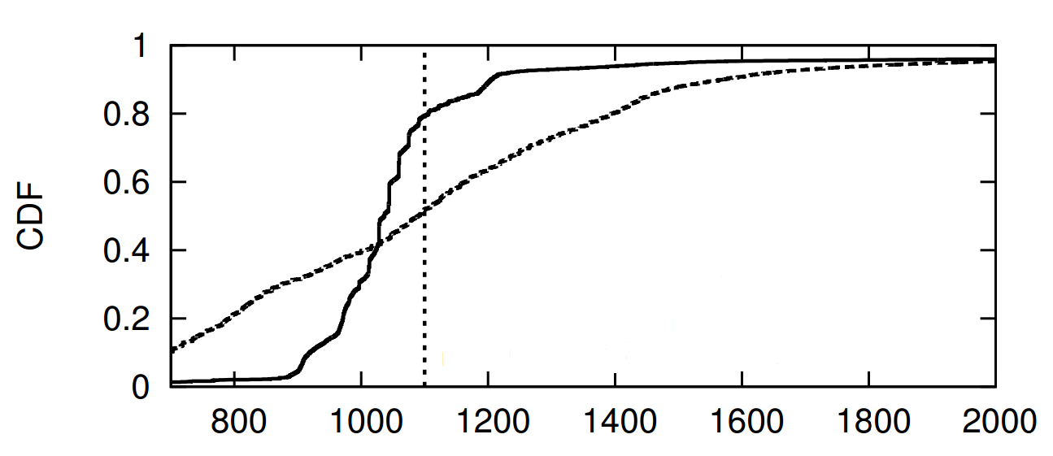
Twitter Analysis App and Service
Adapt server processing time in steps of 150ms
Adapt response from 10KB to 60KB
With Timecard
Target
delay
Without Timecard
User-perceived delay (ms)

Slide 114
Timecard
GetElapsedTime();
PredictRemainingTime(responseSize);
Adapt Resources Used
Server
App
App
Desired user-perceived delay

Slide 115
Timecard
GetElapsedTime();
PredictRemainingTime(responseSize);
Request Prioritization
Server
App
App

Slide 116
AppInsight
Identify performance bottlenecks
Critical path analysis
Control user-perceived delays
Elapsed time estimation
Remaining time prediction
User transaction tracking
Asynchrony, Time Sync
Timecard

Slide 117
By the time it loads, the church service is over. Too slow!!!
Slow and Crashes often. Fix. I will give 5 stars instead of 1.
Slow responsiveness, long load time, and crashity crash crash.
Crashed 3 times before
I gave up
Slow or no network crashes
the app immediately.
So slow that my screen already dims before it's loaded
Crashes every time. DO NOT
DOWNLOAD. RIP-OFF!!
Too slow - killing the usefulness when you really need to go
Crashes all the time.
Should be called Crashing News.
horrifically slow.
Uninstalled.

Slide 118
App Crashes
Exception
DownloadCallback()
at GetSentiment()
Background Thread
GPSCallback()
App Store
Background Thread
Stack trace
GetSentiment()
…
…
DownloadCallback()
ClickHandler()
Http.AsyncGet(url)
Slow and Crashes often. DO
NOT DOWNLOAD. RIP-OFF!!
UI Thread
GPS.AsyncSample()
Need to uncover crashes before the app is released
User Interaction
Exception Path

Slide 119
VanarSena
MobiSys ‘13
App testing as a service
Upload app to our service
After a short time, obtain a detailed report of potential crashes
Fix issues before submitting to app store
Key techniques:
Binary instrumentation and user transaction tracking

Slide 120
Built on insights from real-world crash reports
Analysis of 25 million Windows Phone crash reports
from over 100,000 Windows Phone apps reported in 2012
Top 10% crash buckets cover 90% of the crashes
Crash bucket: Unique exception type and system call
VanarSena tests apps for common faults…
Most crashes due to externally-inducible root causes such as network failures
… that are externally inducible…
Dominant root causes affect many different execution paths in the app
… as thoroughly as possible…

Slide 121
VanarSena
Dynamic testing using an army of monkeys
Greybox testing
Binary instrumentation of app binaries
To obtain detailed insight into app runtime behavior
Significantly reduces testing time
Fast UI automation
4 – 40x reduction in testing time
Efficient fault injection
38 sec vs. ~1 hour

Slide 122
Key Results
~3,000 unique crashes in 1,100 apps
Unique exception type + stack trace
Note that, these are apps in the App Store
Presumably well tested
Compared to Windows Phone crash database
19 out of 20 top exceptions covered
Ongoing Product Impact at Microsoft

Slide 123
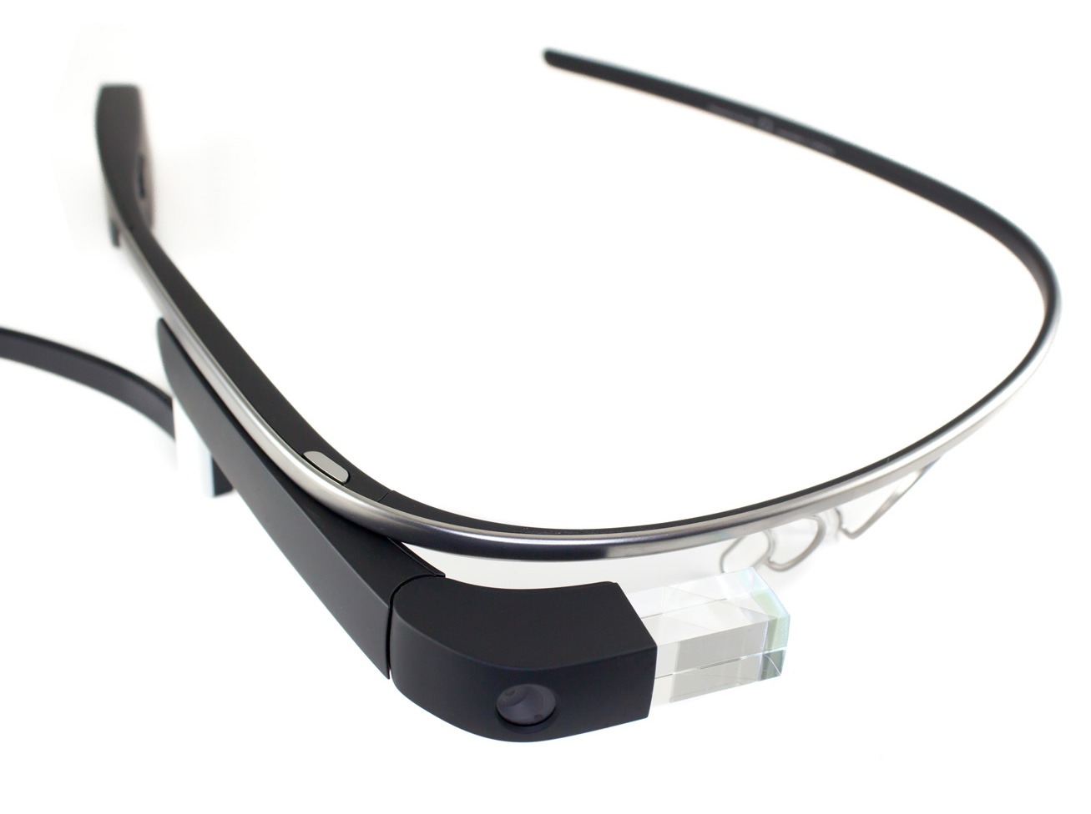
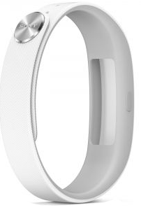
Apps
VanarSena
MobiSys ‘14
Procrastinator
MobiSys ‘14
SmartAds
MobiSys ‘13
Wearables
AppInsight
OSDI ‘12
Timecard
SOSP ‘13
Nectar
OSDI ‘10
OS
App—aware Operating Systems
Mobile Support
Sensors
Network
CodeInTheAir
HotMobile ‘12
VTrack
SenSys ‘09
CTrack
NSDI ‘11
Wireless ESP
NSDI ‘11
Best Paper
Best Paper Nominee

Slide 124
Backup

Slide 125
Timecard Overhead
0.1% runtime overhead
Less than 1% memory overhead
Less than 1% network overhead
Negligible battery overhead

Slide 126
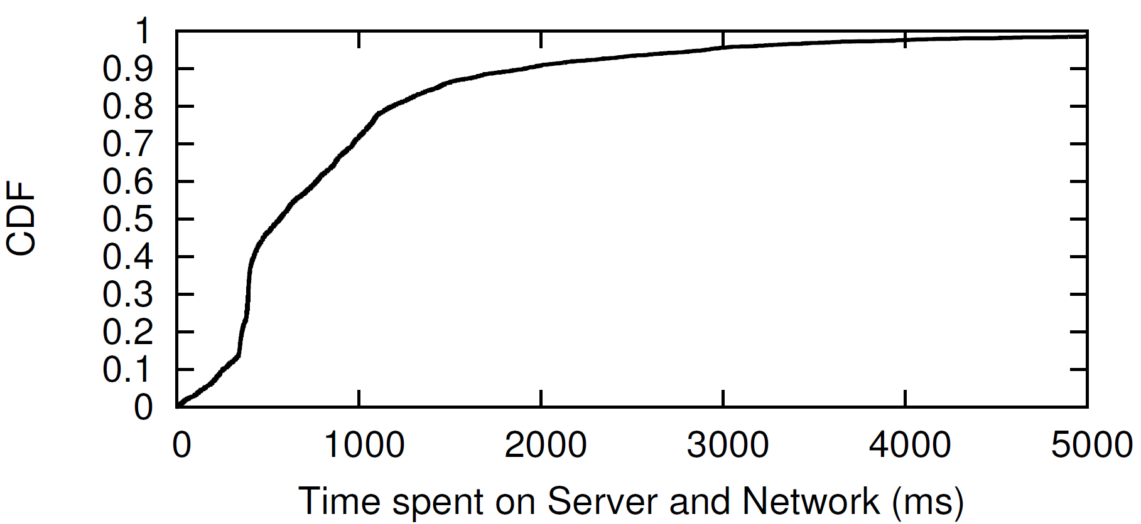

Slide 127
VanarSena
MobiSys ‘13
App testing as a service
Automatic dynamic testing
Using an army of monkeys
Fast UI automation
Based on transaction tracking
4x - 40x reduction in testing time
Uncovered ~3000 crash bugs
in 1100 apps in the app store

