Slide 1
AppInsight: Mobile App Performance Monitoring in the Wild
Lenin Ravindranath, Jitu Padhye, Sharad Agarwal,
Ratul Mahajan, Ian Obermiller, Shahin Shayandeh
Microsoft Research

Slide 2
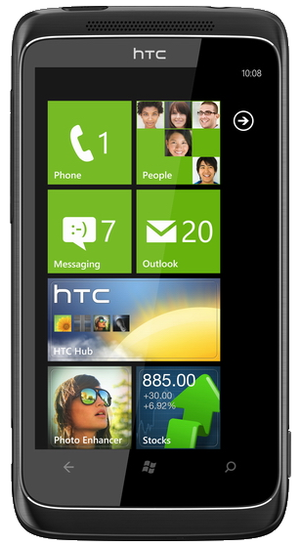

Slide 3
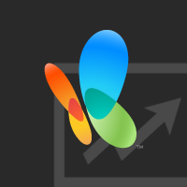
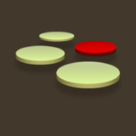
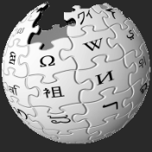

Slide 4
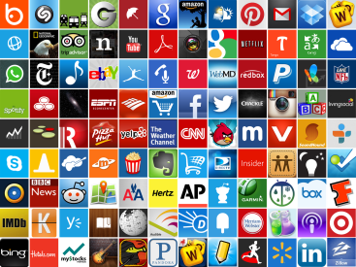
> One Million Apps
> 300,000 Developers

Slide 5
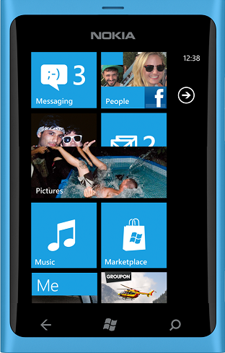
There’s an App
For That
But its slow
“… Too slow - killing the usefulness when you really need to go.”

Slide 6
“So slow. Did an intern write this app??”
“Slower than a snail.”
“Slow and unresponsive like mud”
“Sluggish and freezes my HTC phone.”
“Very very slow compared to even browsing web.”
“Consistently 3 seconds behind where I touch.”
“Loading GPS data is *** slow”

Slide 7
“So slow. Did an intern write this app??”
“Slower than a snail.”
Diverse environmental conditions
Network connectivity, GPS signal quality, etc
Variety of hardware and OS versions
Wide range of user interactions
“Slow and unresponsive like mud”
“Sluggish and freezes my HTC phone.”
“Very very slow compared to even browsing web.”
Hard to emulate in the lab
“Consistently 3 seconds behind where I touch.”
“Loading GPS data is *** slow”
Performance problems are inevitable in the wild

Slide 8
What is the user-perceived delay?
Monitor Performance in the Hands of Users
Where is the bottleneck?
Little platform support
Only option is to instrument your app
Manage your own logging infrastructure
Significant barrier for most app developers
Notes:
Two sub bullets
Goal, How?

Slide 9
AppInsight
What is the user-perceived delay?
Where is the bottleneck?
Automatic App Instrumentation
Zero developer effort
Binary Instrumentation
Readily deployable
No changes to the OS or runtime
Low overhead
Notes:
Does not need any app specific information

Slide 10
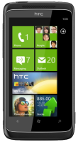
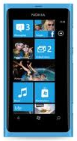
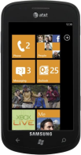
Developer
Feedback
App
Developer
Instrumenter
Analysis
Server
Instrumented
App
Traces
Downloads
App Store

Slide 11
Developer
Feedback
App
Developer
Instrumenter
Analysis
Server
Instrumented
App
Traces
Downloads
App Store

Slide 12
Developer
Feedback
App
Developer
Instrumenter
Analysis
Server
Instrumented
App
Traces
Downloads
App Store

Slide 13
App Instrumentation is Challenging
Instrumentation impacts app performance
They are already slow enough!!!
Limited Resources
Network, Battery, Memory
Notes:
Make it a bullet, everything is black

Slide 14
App Instrumentation is Challenging
Highly Asynchronous Programming Pattern
Highly interactive, UI centric
Single UI thread that should not be blocked
Most tasks are performed asynchronously
Asynchronous APIs for Network, Sensor, IO etc.
Computation performed on background threads
Tracing async code is challenging
Notes:
Blue color for title

Slide 15
Mitt
Rating
Mitt
Rating
Mitt Romney
Internet
53%
Tweets
“If I had a nickel for every time Mitt Romney said something stupid I'd be in his tax bracket”
“Mitt Romney might vote for Obama as well”
“We recommend Mitt Romney for president”
“I would definitely trust Mitt Romney with my money.”

Slide 16
Hypothetical Synchronous Code
Mitt
Rating
ClickHandler()
{
tweets = HttpGet(url);
rating = ProcessTweets(tweets);
display.Text = rating;
}
ProcessTweets(tweets)
{
...
}
53%
LogStart();
LogEnd();
Thread
Click Handler
Start
Click Handler
End
User Perceived Delay
Notes:
Hypothetical Synchronous Code

Slide 17
Asynchronous Code
Mitt
Rating
ClickHandler()
{
AsyncHttpGet(url, DownloadCallback);
}
DownloadCallback(tweets)
{
rating = ProcessTweets(tweets);
UIDispatch(DisplayRating, rating);
}
DisplayRating(rating)
{
display.Text = rating;
}
ProcessTweets(tweets)
{
...
}
53%
System
Download
Callback
UI Dispatch
Background Thread
ProcessTweets
Async Get Call
UI Thread
ClickHandler
End
ClickHandler
Start
Display
Rating
User Click
Notes:
Asynchronous code

Slide 18
Mitt
Rating
53%
User Transaction
System
Download
Callback
UI Dispatch
Background Thread
Async Get Call
UI Thread
ClickHandler
Start
User Perceived Delay
Transaction time
Display
Rating
Notes:
Dotted lines

Slide 19
Get Rating
53%
User Transaction
Background Thread
UI Thread
Transaction time

Slide 20
Mitt
Rating
53%
User Transaction
Background Thread
UI Thread
7 edges

Slide 21
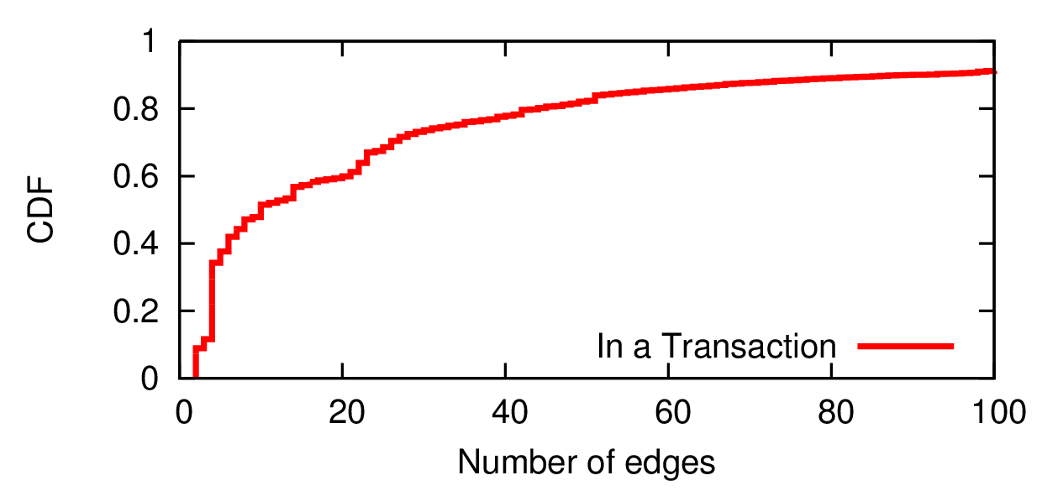
Where is the bottleneck?
Apps are highly asynchronous
30 popular apps
167,000 transactions
Up to 7000 edges
On average, 19 asynchronous calls per user transaction
On average, 8 parallel threads per user transaction
Focus development efforts

Slide 22
Tweets
Mitt
Rating
47%
Posts
Twitter
Process
Tweets
Callback
Fire
Background Thread
Facebook
Process
Posts
Callback
Fire
Background Thread
Facebook
Twitter
Background Thread
Thread Blocked
Thread Wakeup
UI Thread
User Click
User Transaction
Display
Notes:
Lets try to add a feature to our example app here.
Instead of making a single request, we want to make two requests and compare the rating.
Here is how the execution trace looks like.
This is still is a simple user transaction but it already contains 18 edges.
- Since most tasks need to be performed asynchronously, transactions quickly gets complicated with complex thread synchronization.
Here is a example of transaction which processes data from two http calls.
When the user interacts, it creates a background thread
And start two Http requests.
Then it blocks the thread.
The first response comes back, does some processing and informs the blocked thread that it has finished.
Later, the second response comes back, and fires the blocked thread
At this point the thread wakes up, does some processing and updates the UI
To get the transaction graph and the user perceived delay, you have to track all the causality between threads and thread synchronizations.
And the user perceived delay is from the start to the end.

Slide 23
Critical Path
Optimizing the critical path reduces the user perceived delay
Twitter
Process
Tweets
Callback
Fire
Background Thread
Facebook
Process
Posts
Callback
Fire
Background Thread
Facebook
Twitter
Background Thread
Thread Blocked
Thread Wakeup
UI Thread
User Click
User Transaction
Display
Notes:
Lets try to add a feature to our example app here.
Instead of making a single request, we want to make two requests and compare the rating.
Here is how the execution trace looks like.
This is still is a simple user transaction but it already contains 18 edges.
- Since most tasks need to be performed asynchronously, transactions quickly gets complicated with complex thread synchronization.
Here is a example of transaction which processes data from two http calls.
When the user interacts, it creates a background thread
And start two Http requests.
Then it blocks the thread.
The first response comes back, does some processing and informs the blocked thread that it has finished.
Later, the second response comes back, and fires the blocked thread
At this point the thread wakes up, does some processing and updates the UI
To get the transaction graph and the user perceived delay, you have to track all the causality between threads and thread synchronizations.
And the user perceived delay is from the start to the end.

Slide 24
AppInsight
What is the user-perceived delay?
Where is the bottleneck?
Automatically instruments the app to track
user transactions and critical path

Slide 25
Developer
Feedback
App
Developer
Instrumenter
Analysis
Server
Instrumented
App
Traces
Downloads
App Store

Slide 26
Capturing User Transaction
Should not impact app performance
Limited Resources
Low Overhead
User Transaction
Background Thread
UI Thread

Slide 27
User Transaction
Background Thread
UI Thread

Slide 28
Capture
UI Manipulations
User Transaction
Background Thread
UI Thread
Event Handler
User Click

Slide 29
Capture
UI Manipulations
User Transaction
Background Thread
UI Thread

Slide 30
Capture
UI Manipulations
Thread Execution
User Transaction
User Transaction
Callback
Start
Callback End
Background Thread
UI Thread
Click Handler
Start
Click Handler
End
Update UI
Start
End

Slide 31
Capture
UI Manipulations
Thread Execution
User Transaction
Background Thread
UI Thread

Slide 32
Capture
UI Manipulations
Thread Execution
Async Calls and Callbacks
User Transaction
Download
Callback
UI Dispatch Call
Background Thread
Async Get Call
UI Thread
UI Dispatch
Callback

Slide 33
Capture
UI Manipulations
Thread Execution
Async Calls and Callbacks
User Transaction
Background Thread
UI Thread

Slide 34
Capture
UI Manipulations
Thread Execution
Async Calls and Callbacks
UI Updates
User Transaction
User Transaction
Background Thread
UI Thread
UI Update

Slide 35
Capture
UI Manipulations
Thread Execution
Async Calls and Callbacks
UI Updates
User Transaction
Background Thread
UI Thread

Slide 36
Capture
UI Manipulations
Thread Execution
Async Calls and Callbacks
UI Updates
Thread Synchronization
User Transaction
Fire
Background Thread
Fire
Background Thread
Background Thread
Thread
Blocked
Thread
Wakeup
UI Thread

Slide 37
Capture
UI Manipulations
Thread Execution
Async Calls and Callbacks
UI Updates
Thread Synchronization

Slide 38
Capture
UI Manipulations
Thread Execution
Async Calls and Callbacks
UI Updates
Thread Synchronization
User Transaction
Background Thread
UI Thread

Slide 39
Capture
UI Manipulations
Thread Execution
Async Calls and Callbacks
UI Updates
Thread Synchronization
User Transaction
User Transaction
Callback
Start
Callback End
Background Thread
UI Thread
Click Handler
Start
Click Handler
End
Update UI
Start
End

Slide 40
Capturing Thread Execution
Trace every method
Prohibitive overhead
Enough to log thread boundaries
Log entry and exit of Upcalls
System
App
Callback
Start
Callback End
Background Thread
Upcalls
UI Thread
Click Handler
Start
Click Handler
End
Update UI
Start
End

Slide 41
Identify Upcalls
Event Handlers are Upcalls
Function pointers point to potential Upcalls
Callbacks are passed as function pointers
ClickHandler()
{
AsyncHttpGet(url, DownloadCallback);
}
DownloadCallback(tweets)
{
rating = ProcessTweets(tweets);
UIDispatch(DisplayRating, rating);
}
DisplayRating(rating)
{
display.Text = rating;
}
ProcessTweets(tweets)
{
...
}
<Button Click=“ClickHandler” />

Slide 42
Instrument Upcalls
ClickHandler()
{
Logger.UpcallStart(1);
AsyncHttpGet(url, DownloadCallback);
Logger.UpcallEnd(1);
}
DownloadCallback(response)
{
Logger.UpcallStart(2);
rating = ProcessTweets(tweets);
UIDispatch(DisplayRating, rating);
Logger.UpcallEnd(2);
}
DisplayRating(rating)
{
Logger.UpcallStart(3);
display.Text = rating;
Logger.UpcallEnd(3);
}
ProcessTweets(tweets)
{
...
}
Rewrite app
Trace Upcalls
Low Overhead
7000 times less overhead
Callback
Start
Callback End
Background Thread
UI Thread
Click Handler
Start
Click Handler
End
Update UI
Start
End

Slide 43
Capture
UI Manipulations
Thread Execution
Async Calls and Callbacks
UI Updates
Thread Synchronization
User Transaction
Download
Callback
UI Dispatch Call
Background Thread
Async Get Call
UI Thread
UI Dispatch
Callback

Slide 44
Async Calls and Callbacks
Log Callback Start
We capture start of the thread
Log Async Call
Any call that accepts a function pointer
Match Async Call to its Callback
ClickHandler()
{
AsyncHttpGet(url, DownloadCallback);
Logger.AsyncCall(5);
}
DownloadCallback(tweets)
{
Logger.UpcallStart(2);
....
}
Callback
Async Get Call

Slide 45
Matching Async Call to its Callback
A method could be a callback to many async calls
Replicate the callback for each Async call [Hirzel’01]
Async call called in a loop (e.g. download list of URLs)
Cannot be matched correctly
Solution: Detour Callbacks

Slide 46
Callbacks
System
AsyncHttpGet
App
DownloadCallback
Async Call
DownloadCallback(response)
{
}

Slide 47
Detour Callbacks
System
AsyncHttpGet
obj.DetourCallback
App
DownloadCallback
Async Call
DownloadCallback(response)
{
}
while(...)
{
}
MatchId = 3
MatchId = 3
obj = new DetourObject(DownloadCallback, MatchId++);
AsyncHttpGet(url, GetCallback);
AsyncHttpGet(url, obj.DetourCallback);
class DetourObject
{
}
MatchId = 3
DetourCallback(response)
{
DownloadCallback(response);
}

Slide 48
Detour Callbacks
System
AsyncHttpGet
App
obj.DetourCallback
Async Call
DownloadCallback(response)
{
}
while(...)
{
}
MatchId = 4
MatchId = 4
obj = new DetourObject(DownloadCallback, MatchId++);
AsyncHttpGet(url, obj.DetourCallback);
class DetourObject
{
}
MatchId = 4
DetourCallback(response)
{
DownloadCallback(response);
}

Slide 49
Detour Callbacks
System
AsyncHttpGet
App
obj.DetourCallback
Async Call
DownloadCallback(response)
{
}
while(...)
{
}
MatchId = 5
MatchId = 5
obj = new DetourObject(DownloadCallback, MatchId++);
AsyncHttpGet(url, obj.DetourCallback);
class DetourObject
{
}
MatchId = 5
DetourCallback(response)
{
DownloadCallback(response);
}

Slide 50
Matching Async Call to its Callback
Detour Callbacks
Event Subscriptions
Delayed Callbacks
Track Object Ids
Low Overhead
Download
Callback
UI Dispatch Call
Background Thread
Async Get Call
UI Thread
UI Dispatch
Callback

Slide 51
Capture
UI Manipulations
Thread Execution
Async Calls and Callbacks
UI Updates
Thread Synchronization
User Transaction
Background Thread
UI Thread

Slide 52
Developer
Feedback
App
Developer
Instrumenter
Analysis
Server
Instrumented
App
Traces
Downloads
App Marketplace

Slide 53
Developer
Feedback
App
Developer
Instrumenter
Analysis
Server
Instrumented
App
Traces
Downloads
App Marketplace

Slide 54
Analysis
Critical Path
Aggregate Analysis
Exception Path

Slide 55
Critical Path
Bottleneck path in the user transaction
Optimizing the critical path reduces user perceived delay
Critical Path
UI Update
User Manipulation
Multiple UI updates
Timers, Sensors

Slide 56
Analysis
Critical Path
Aggregate Analysis
Exception Path

Slide 57
Aggregate Analysis
Group similar transactions
Same transaction graph
Outliers
Points to corner cases
Highlight common critical paths
Focus development effort
Root causes of Performance Variability
Highlight what really matters in the wild

Slide 58
Analysis
Critical Path
Aggregate Analysis
Exception Path

Slide 59
Failures in the wild
Exception
DownloadCallback()
at parseXML()
Background Thread
ThreadCallback()
Stack trace
parseXML()
…
…
DownloadCallback()
Background Thread
ClickHandler()
AsyncHttpGet(url)
UI Thread
ThreadStart()
User
Manipulation
Exception Path

Slide 60
Analysis
Critical Path
Aggregate Analysis
Exception Path

Slide 61
Developer
Feedback
App
Developer
Instrumenter
Analysis
Server
Instrumented
App
Traces
Downloads
App Store

Slide 62
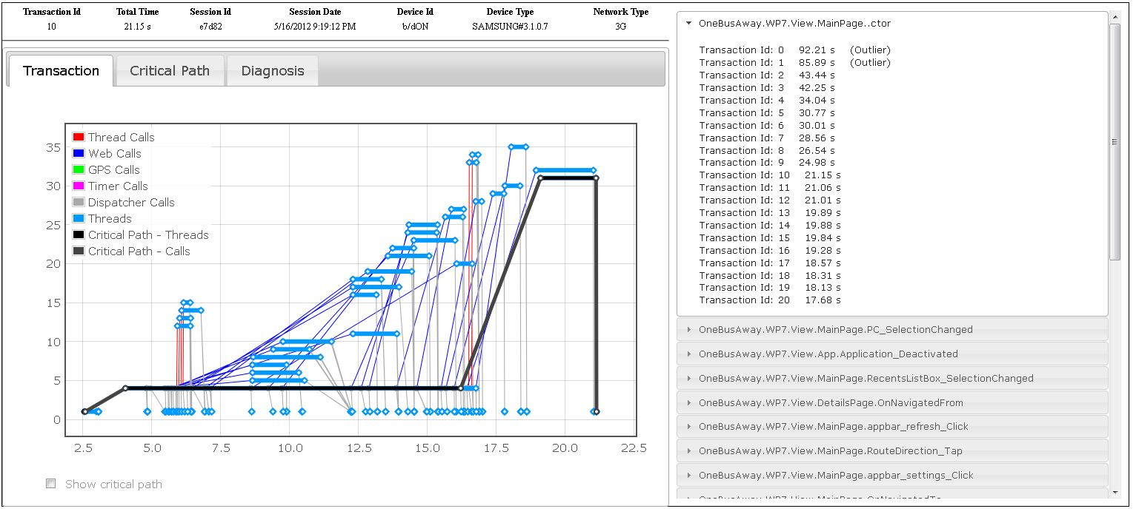
Developer Feedback
Web based Interface
Long User Transactions
Critical Path
Aggregate Analysis
Outliers
Common Case
Factors affecting
Crashes - Exception Path

Slide 63
Developer
Feedback
App
Developer
Instrumenter
Analysis
Deployment
Server
Instrumented
App
Traces
Downloads
App Store

Slide 64
Deployment
30 Windows Phone apps
30 Users
Over 4 months of data
6750 app sessions
33,000 minutes in apps
167,000 user transactions

Slide 65
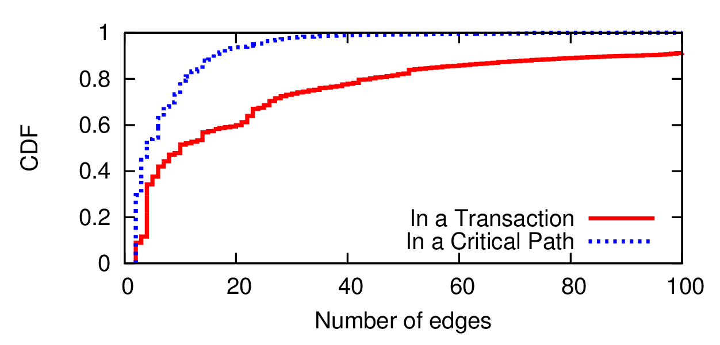
User Transactions and Critical Path
15% of the user transactions take more than 5 seconds
Apps are highly asynchronous
Up to 7000 edges
# edges in the critical path << # edges in the transaction
Top 2 edges responsible for 82% of transaction time
App developer can focus on optimizing these edges
Key reason why a system like AppInsight is needed

Slide 66
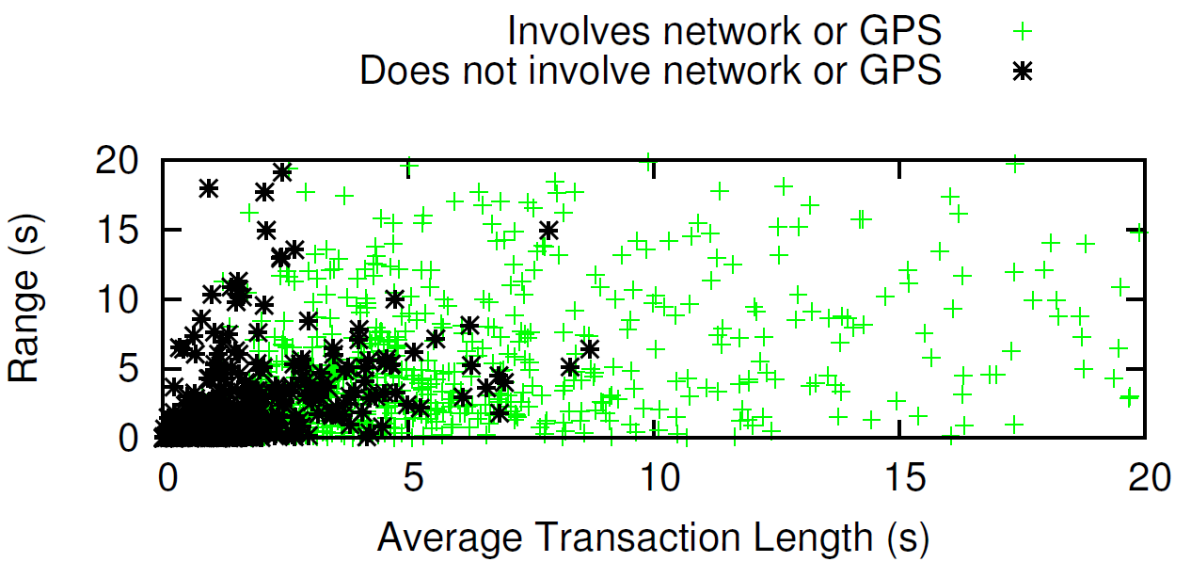
Aggregate Analysis
High variability in the wild
29% transaction groups has multiple critical paths
Network, GPS state, Device model, User
all affects performance
Key reason why performance monitoring in the wild is important
Notes:
You would think that critical path remains the same

Slide 67
AppInsight Overhead
Compute
Memory
Network
Binary Size
Battery
0.02%
2%
4%
1.2%
<1%
Negligible Overhead
Impact on app performance is minimal
Our users reported no cases of performance degradation
Low resource consumption
Notes:
For any system like this, the question is what is the overhead

Slide 68
Developer
Feedback
App
Developer
Instrumenter
Analysis
Server
Instrumented
App
Traces
Downloads
App Store

Slide 69
Improved
Developer
Feedback
App
Developer
Instrumenter
Analysis
Server
Instrumented
App
Traces
Downloads
App Store

Slide 70
Developer Case Study
App: My App
Problem: UI Hog
AppInsight:
Aggregate analysis showed high performance variability
Attributed to UI thread
Abnormal latencies only at the start of the session
System loading DLLs in the critical path

Slide 71
Developer Case Study
App: Popular App
Problem: Slow Transactions
AppInsight:
Aggregate analysis showed 3G latencies significantly affecting critical paths
Known issue but no quantitative data
Current caching policy insufficient
Quantitative data

Slide 72
Developer Case Study
App: Professional App
Problem: Slow Transactions
AppInsight:
Custom instrumentation in the critical path
Affecting user perceived delay

Slide 73
AppInsight
Helps app developers understand performance bottlenecks in the wild
Automatically tracks User Transactions
Identifies Critical Paths and Exception Paths
Aggregate Analysis highlights factors affecting performance
Extremely low overhead
Zero developer effort
Readily deployable

Slide 74
FAQ
Who cares about Windows Phone. Can you do it for Android and iPhone?
This was done in 1982. Don’t you read related work?
Are you one of those who don’t care about user privacy?
Sounds too good. Are there any limitations?
Are you going to release it? Or is it a one off paper?
I totally don’t get why you are doing this!?

Slide 75
Limitations
AppInsight can miss certain causal relationships
Does not track data dependencies
Two threads communicating through a shared variable
One thread polling
Uses heuristics to warn the developer
Will miss implicit casual relationships
Resource contention
Does not track that state left behind
Dependencies resulting from such state

