Slide 1
Adaptive Application Analytics
MCRC

Slide 2
What is App Analytics?
Gives app developers insight into how their app is running “in the wild”
Typical information gathered:
Where and when the app was used
Who is using the app (phone id)
Length of “session”
Application errors
Helps app developers improve quality of their apps, and target their development efforts

Slide 3
How does it work?
App developers sign up with a “analytics” service provider
A small agent is added to the app
Binary re-writing or DLL linking
When the app runs certain data is uploaded to a server
Start and end time, location, errors etc.
The developer can access this data and use it to market and refine the app

Slide 4
Commercial Solutions
Android, iPhone
Flurry
Google Analytics
Localytics
Windows Phone
PreEmptive
Localytics

Slide 5
Shortcomings in existing solutions
Mostly basic analytics
Difficult to use
Requires developers to select instrumentation points
Requires installation of tools
Static instrumentation
No way to change or add instrumentation points
Cannot fine-tune instrumentation based on field data
“Third party” nature limits the kind of information that can be gathered

Slide 6
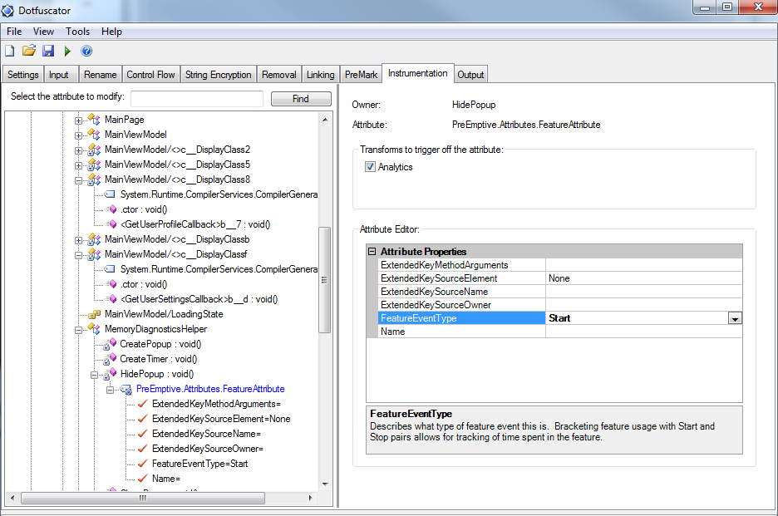
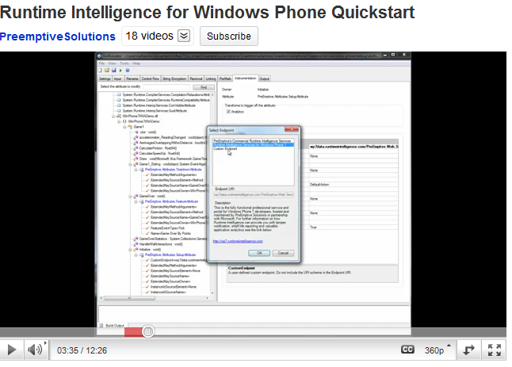

Slide 7
AppLogger
Detailed instrumentation
In addition to basic information (location, session etc.)
Per function information: Counters, Timers, Traces
Monitor program variables and dependent system info
Automatic and easy to use
XAP rewritten to add instrumentation points
Few mouse clicks
Adaptive
Driven by developer feedback
Automatic analysis
Integrated with Windows Phone
Currently built as “third party”

Slide 8
How does it work?
Developer uploads XAP to marketplace
Select Instrumentation Type
Basic
Automatic
Custom
XAP unpacked, instrumented based on developer choice, re-packed and sent to Marketplace

Slide 9
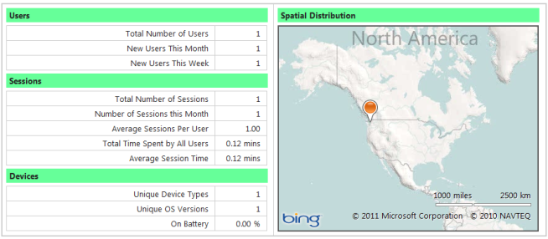
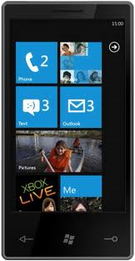
Basic Mode
Developer
“at least once” semantics to deal with disconnections
Trickle Store
Memory
Location, Session, User, Phone Info

Slide 10
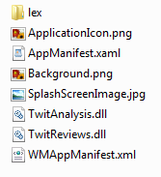
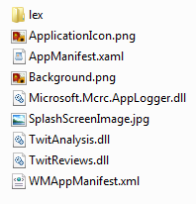
XAP Rewriting
Rewrite Manifests
Include DLL entry
Include capabilities
Find Functions
Rewrite DLLs
Launching, Closing
Activated, Deactivated
Inject IL code

Slide 11
But basic mode is not enough
Developer will need some performance information
which functions are called most often
How long certain functions take
Log some custom app data (e.g. search terms used, or user input)
Sometimes, it may be better to “sample” this data
no need to collect from all phones
Use statistical sampling to provide “coverage”

Slide 12
Custom Mode
Includes Basic
Choose functions to instrument
For each function, developer can instrument
Counter
Duration
Trace
Specify sampling parameters

Slide 13
Custom Mode
Counter
Simply tells you how often a function is called
Only one instrumentation point per function
Efficient – increment variable
Timer
How long the function took to run
Requires several instrumentation points per function
One for entry, and one for each possible exit
Tagged timers to handle timing across functions

Slide 14
Custom Mode
Trace
Log custom information in functions
e.g. stack trace, user input, global/local state
We currently allow instrumentation only at the beginning of the function

Slide 15
Custom Mode
Developer can change instrumentation parameters anytime
Change sampling rate
Disable and enable instrumentation points

Slide 16
Custom Mode
Developer
“at least once” semantics to deal with disconnections
Trickle Store
Memory
Location, Session, User, Phone Info
Function Info
Client
bit vector
“mothership”

Slide 17
Custom Mode
Developer can change instrumentation parameters anytime
Change sampling rate
Disable and enable instrumentation points
However, developer cannot select new functions to log
XAP has already been instrumented!

Slide 18
Automatic Mode
All functions are instrumented with counter and duration and traces
“mothership” service enables and disables them
The service selects a small number of functions to get data from for this instance
Based on past data
Need to minimize overhead but maximize coverage
“understanding” of program structure and dependencies
Randomized, un-biased sampling techniques
Over multiple phones and multiple runs, a fuller picture of app performance emerges

Slide 19
Automatic Mode
Instrument system libraries
ETW traces
Modify the CLR to avoid “if” penalty
On the fly instrumentation in JIT
Related work
Ajaxscope

Slide 20
Backup

Slide 21
Performance hit
Time
Counter: 0.0024ms
Timer: 0.1ms
Trace: 0.04ms (with no extra information)
Need to measure
Impact on XAP size
App memory consumption
Network load

