Slide 1
Code In The Air: Simplifying Tasking on Smartphones
Lenin Ravindranath, Arvind Thiagarajan,
Hari Balakrishnan, Sam Madden
Massachusetts Institute of Technology

Slide 2
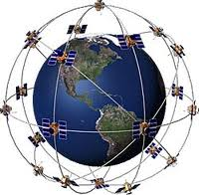
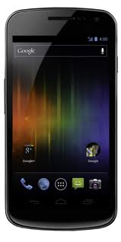
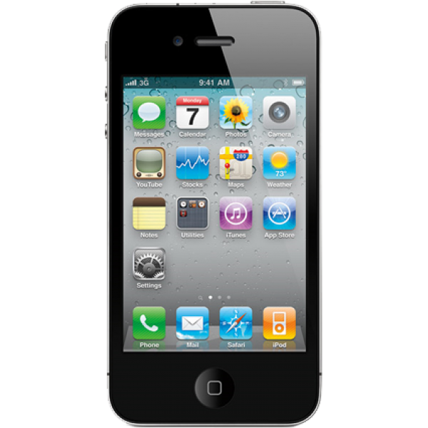
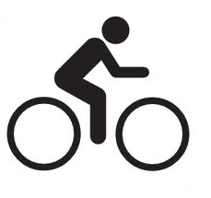
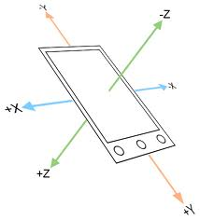
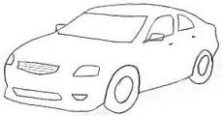
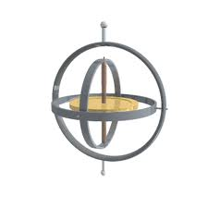
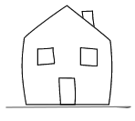
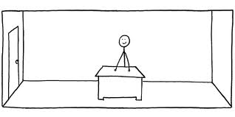
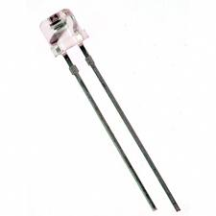
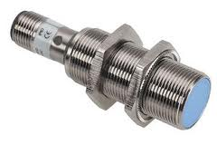
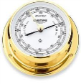
GPS
WiFi
Cell
Walking
Running
Sitting
Infer
Accl
Gyro
Biking
Driving
Compass
Mic
Indoors
Outdoors
AtHome
AtOffice
Light
Proximity
Barometer
A growing class of smartphone applications
Tasking Applications
Notes:
Application developers have recently taken advantage of this fact

Slide 3
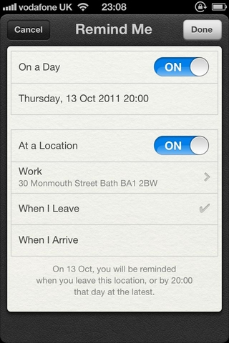
Tasking Applications
Run continuously
In the background
Often require no user input
Infer user context and activity
Process data from multiple sensors
Trigger actions when right conditions are met
Often involve coordination between multiple users or devices

Slide 4
Alert me when my wife leaves her work
Alert me when my wife leaves her work
Make my phone silent when I am in the lab and meeting my advisor
Make my phone silent when I am in the lab and meeting my advisor
Put my laptop to sleep if I am not nearby for 10 minutes
Put my laptop to sleep if I am not nearby for 10 minutes
Disable Wi-Fi when I am outdoors and walking
Disable Wi-Fi when I am outdoors and walking
Turn-on bluetooth when I start driving
Turn-on bluetooth when I start driving
Trivial for end-users to state
As condition-action rules
Non-trivial or extremely difficult to develop

Slide 5
Today they are difficult to develop…
Poor abstractions
Requires grappling with low level sensor data
For example: “is walking” – process accelerometer data
An ideal solution: isWalking primitive
Poor programming support
Tasking applications are often inherently distributed
Involves writing server-side and smartphone code
A better approach: Macroprogramming approach
No end-user support
End-users have no interest or ability to write code
Solution: A easy way to combine existing capabilities to create tasks
Simple implementations can be energy consuming

Slide 6
Code In The Air (CITA)
A system that significantly lowers the barrier for programming and executing tasking applications
Developers
End-Users
Activity detection as primitives
For example: IsWalking, IsBiking, etc.
Programming model
Write centralized code even for tasks involving multiple devices
Automatic partitioning and coordination
Significantly reduces coding and deployment effort
UI to program condition-action rules
“Mix and match” existing activities and tasks to create new tasks

Slide 7
CITA Architecture
Developers
Users
Tasks
Activity Layer
UI
Raises the abstraction - “activities”
isDriving
isBiking
isNearby
Accurate and energy-efficient recognition
Tasking Framework
Tasks
Task Compiler
Sub task
Task runtime
CITA Server
Activity Layer
Tasking Framework
Sub task
Sub task
Developer writes task
JavaScript
Compile into sub-tasks
Server-side code
Mobile code
Manages task execution run-time and coordination
UI for end-users
Task runtime
Task runtime
Activity Layer
Activity Layer
Sensors
Sensors
CITA Client
UI

Slide 8
Activity Layer
Raises the abstraction from “raw sensor data hacking” to activities and “activity composition”
Several inbuilt user activity detectors
enterPlace
leavePlace
inPlace
isNearby
isWalking
isBiking
isDriving
isMoving
isOutdoors
isIndoors
isStatic
Extensible activity layer: Build and deploy new activity detectors

Slide 9
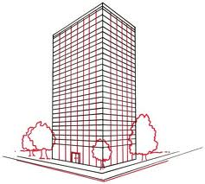
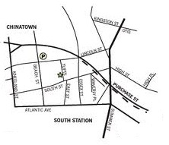
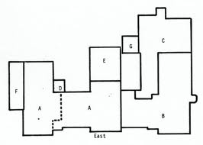
Place Hierarchies
Energy-efficient detection of activities

Slide 10
Activity Composition
Compose lower-level activities using logical predicates to create higher-level activities
Reuse activities created by others to create complex activities
isOutdoors AND isWalking
Disable Wi-Fi when user is outdoors and walking
isBiking OR isDriving
NOT isOutdoors
leave(Work) AND isDriving WITHIN 5 min
NOT isNearby(p, l) FOR 1 min
Put my laptop to sleep if I am not nearby for 10 minutes
isPlace(Home) NEXT isPlace(Work)

Slide 11
Activity Composition
Lenin.inMeeting
NOT in (Office)
nearby (Lenin)
AND
AND
in (StataBuilding)
NOT Lenin.inMeeting
AND
Alert me to “pay him for the movie”
nearby (Hari) FOR 2 min
OR
nearby (Sam) FOR 2 min
Energy-efficient detection of composed activities

Slide 12
CITA Architecture
Developers
Users
Scripts
Activity Layer
UI
Raises the abstraction - “activities”
isDriving
isBiking
isNearby
Accurate and energy-efficient recognition
Tasking Framework
Tasks
Task Compiler
Sub task
Task runtime
CITA Server
Activity Layer
Tasking Framework
Sub task
Sub task
Developer writes task
JavaScript
Compile into sub-tasks
Server-side code
Mobile code
Manages task execution run-time and coordination
UI for end-users
Task runtime
Task runtime
Activity Layer
Activity Layer
Sensors
Sensors
CITA Client
UI

Slide 13
Tasking Framework
ecosystem
Developers
End-Users
Programming Model
User Interface
Developers write scripts to build tasking applications
Activities and tasks are added to the UI for end users to use
UI allows users to specify “condition-action” tasks
Activities and tasks are reused to build complex tasks

Slide 14
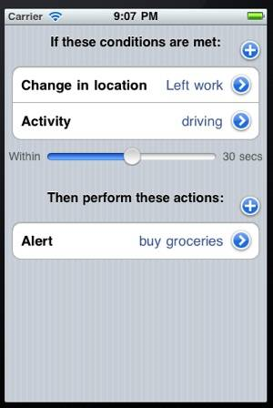
Code In The Air UI

Slide 15
Programming Model
Tasks are written as JavaScript programs
Devices are exposed as objects
A developer can simply call methods on the object to manipulate it
Work with multiple phones in a single script
CITA automatically partitions the task into sub-tasks, executes and coordinates them across devices
p = getDevice(‘Lenin’, ‘Android’)
p.ringer.setMode(SILENT);
q = getDevice(‘Arvind’, ‘Default’)
r = q.ringer.getMode();
p.ringer.setMode(r);

Slide 16
Example: Single-Device Task
Disable Wi-Fi when outdoors and moving
p = getDevice(param_user, param_phone);
p.registerCallback(“outdoor_walking", "trueAction", "falseAction");
function trueAction(e)
{
oldState = p.wifi.getState();
store.add(“oldState”, oldState);
p.wifi.disable();
}
function falseAction(e)
{
p.wifi.setState(store.remove(“oldState”));
}
true
outdoor AND walking
false

Slide 17
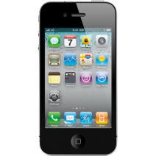
Example: Multi-Device Task
Alert me when Hari comes to his office
p = getDevice(“hari”, default);
q = getDevice(“lenin”, default);
p.registerCallback(“enter(hari.office)", "trueAction");
function trueAction()
{
q.alert(“Hari is here");
}
CITA Server
hari
lenin
Call: lenin.phone.trueAction
function trueAction()
{
this.alert(“Hari is here");
}
this.registerActivityCallback(“enter(office)", “lenin.phone:trueAction");
Notes:
Specific task

Slide 18
Example: Cloud-Enabled Task
Store GPS tracks in server when biking
p = getDevice(param_user, param_phone);
p.registerActivityCallback("biking", "trueAction", "falseAction");
function trueAction(e)
{
params = new Object();
params.samplePeriod = 1;
params.tag = getUniqueId();
p.registerDataCallback("gps.data", "dataAction", params);
}
function falseAction(e)
{
p.unregisterCallback("gps.data", "dataAction");
}
function dataAction(e)
{
Server.store.add("bikingTracks", e.tag, e.data.time, e.data.lat, e.data.lng);
}

Slide 19
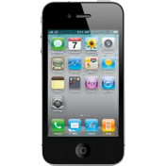
Code Partitioning
Function level partitioning
p.registerCallback()
F1
{
p.foo()
}
F2
{
p.foo()
q.foo()
}
F3
{
a = b + c;
}
Even a random partitioning
Does not affect the correctness of the execution
Calls and callbacks are delegated appropriately

Slide 20
Challenges
Push Mechanism
Dial-to-Deliver
Handle disconnections
Calls and callbacks can be delayed or dropped
Developer can set policies
Privacy
User policies
Energy
Enforce energy budget
User policies

Slide 21
Related Work
Tasking applications
Locale, Tasker, TouchDevelop
Programming frameworks
AppInventor – Visual programming interface
PhoneGap, Appcelerator – HTML/JavaScript framework
AppMakr – Web based feeds
PRISM – Sensing applications
mCrowd – Crowd sourcing applications
SeeMon – Composition framework for activities

Slide 22
Code In The Air
A system that significantly lowers the barrier for programming and executing tasking applications
Developers: JavaScript based
End Users: UI based
Status
Energy-efficient activity detectors
Android client
iPhone client
Windows laptop client
Plan to release by this Fall

Slide 23
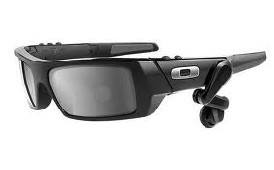
CITA
If I am leaving home and the weather forecast is rainy,
alert me to take an umbrella
Notes:
Grand Vision

Slide 24
Backup

Slide 25
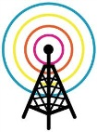
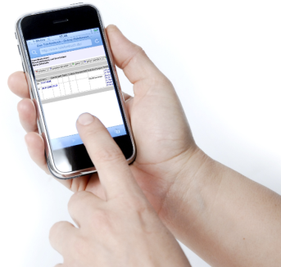
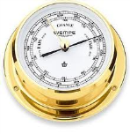
Place Hierarchies
SSID
Named Location
Location Hierarchy
- Room level
- Floor level
- Building level
- Box (Map)

Slide 26
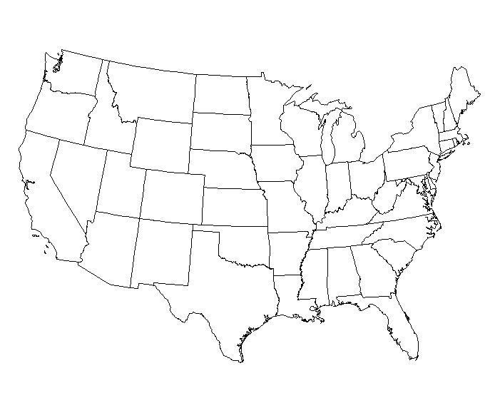
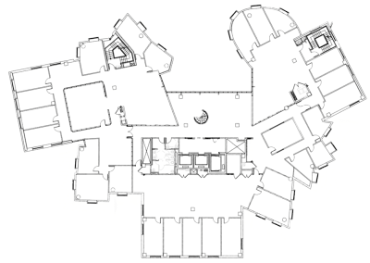
Energy Efficient Detection
in (Seattle)
In (Hari.Office)
Lenin’s Office
Hari’s Office
Measure of distance?
Which sensor to use?
Sample only when moved
How often to sample?
Rate of movement

Slide 27
Activity Detection
Divide and run individual activity detectors in the respective devices
If activity spans multiple devices, coordinate at the server.
Energy efficient execution
Cost modeling predicates
Low energy cost execution plan
isOutdoors AND isWalking

Slide 28
Handling Disconnections
When devices are disconnected
Calls and callbacks cannot be delivered in real-time
GPS
Alert
Bob
Alice
Delayed
Dropped after some time
Developers can set policies on how to deal with disconnections
Task-wide policies
Callback specific policies

Slide 29
Energy-Efficient Detection
APs
GPS
Accl
Predict Speed
From rate of change
- Access Points
- Cell Towers
Cell towers
Gyro

Slide 30
Today they are difficult to develop…
Poor abstractions
Requires grappling with low level sensor data
For example: “is walking” – process accelerometer data
An ideal solution: isWalking primitive
Poor programming support
Tasking applications are often inherently distributed
Involves writing server-side and smartphone code
A better approach: Macroprogramming approach
No end-user support
End-users have no interest or ability to write code
Solution: A easy way to combine existing capabilities to create tasks

Slide 31
Today they are difficult to develop…
Poor abstractions
Requires grappling with low level sensor data
For example: “is walking” – process accelerometer data
Poor programming support
Tasking applications are often inherently distributed
Involves writing server-side and smartphone code
No end-user support
End-users have no interest or ability to write code
No way to put together an application

