Slide 1
End-to-End Performance Analytics For Mobile Apps
Lenin Ravindranath, Jitu Padhye, Ratul Mahajan
Microsoft Research

Slide 2
Apps are Slow
“So slow. Did an intern write this app??”
“Slower than a snail.”
“Slow and unresponsive like mud”
“Sluggish and freezes my HTC phone.”
“Very very slow compared to even browsing web.”
“Consistently 3 seconds behind where I touch.”

Slide 3
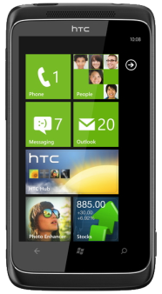
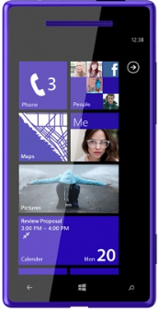
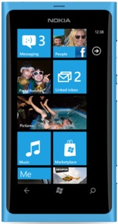
Most Mobile Apps talk to the Cloud
Cloud
Services
Mobile
Apps
Notes:
People do everything from apps
Apps are adaptable

Slide 4
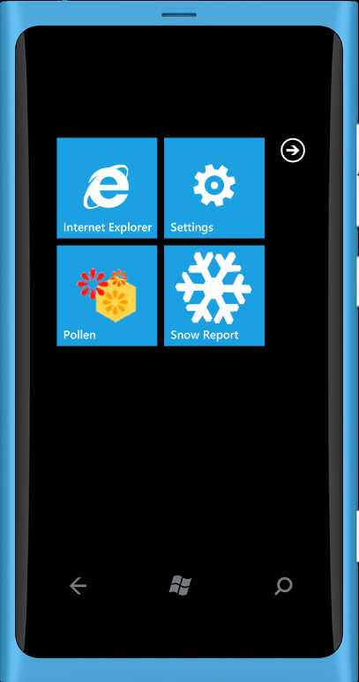
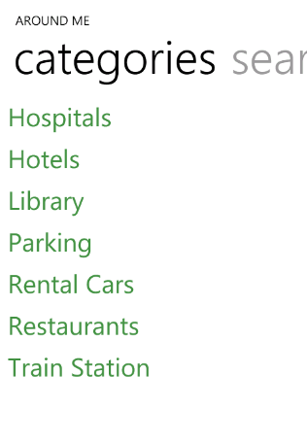
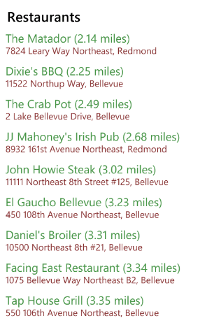
Location
Cloud Service
Restaurants

Slide 5
AppInsight
Automatic
Instrumentation
ClickHandler()
{
[Instrument]
LocationStart(LocationCallback);
}
LocationCallback(location)
{
[Instrument]
url = GetRequestUrl(location);
[Instrument]
WebRequest(url, WebResponseCallback);
}
WebResponseCallback(data)
{
[Instrument]
list = ParseData(data);
[Instrument]
UIDispatch(Display, list);
}
Display(list)
{
[Instrument]
UIListBox.DataContext = list;
}
App
Instrumenter
Instrumented
App

Slide 6
AppInsight
Web Request
delay
GPS
delay
Parsing and Rendering
delay
User
click
Web Request
Web Response
User Perceived Delay
Notes:
As we showed in AppInsight, high variability in the wild

Slide 7
AppInsight
Where is the bottleneck?
Network?
Server?
Uplink? Downlink?
DB?
User
click
Web Request
Web Response
User Perceived Delay
Notes:
As we showed in AppInsight, high variability in the wild

Slide 8
End-to-End Insight
Server
delay
Query Processing
delay
DB
Server
GPS
delay
Parsing and Rendering
delay
Uplink
delay
Downlink
delay
User
click
Web Request
Web Response
User Perceived Delay
Notes:
As we showed in AppInsight, high variability in the wild

Slide 9
EndInsight
Joint App and Server Instrumentation
Windows Phone Apps, ASP .NET Services
Automatic Instrumentation
Zero developer effort
Binary Instrumentation
Readily deployable
No changes to the OS, runtime or platform
Low overhead

Slide 10
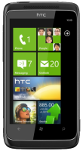
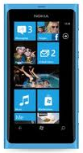
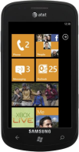
Developer
Developer Feedback
App
Service
App Instrumenter
Service Instrumenter
Cloud
Traces
Analysis Server
Instrumented
Instrumented
App
Service
Traces
Downloads
App Store

Slide 11
App Instrumentation
Using AppInsight
Web Request
delay
GPS
delay
Parsing and Rendering
delay
User
click
Web Request
Web Response
Notes:
As we showed in AppInsight, high variability in the wild

Slide 12
AppInsight Recap
Track User Transactions
From user click to UI rendering
Across asynchronous thread boundaries
UI dispatch
Background thread
GPS fix Callback
Background thread
Response
Callback
GPS Start
Web Request
UI Thread
App
User request
UI Update
Automatically track
UI manipulation
Threads, asynchronous calls
Web calls, Sensor APIs
UI update (dispatcher events)

Slide 13
Server Instrumentation
Automatic Instrumentation of .NET binaries
Azure services
Web APIs, ASPX pages, MVC, WCF
class AroundMeController: ApiController
{
public Result Get(type, location)
{
[Instrument]
return GetList(type, location);
[Instrument]
}
public Result GetList(type, location)
{
[Instrument]
result = DBQuery(type, location);
[Instrument]
return result;
}
}
Automatically track
Request-Response entry points
DB queries
Network calls
Across asynchronous boundaries
Similar to app instrumentation

Slide 14
Server Instrumentation
Server
delay
Query Processing
delay
DB
Request
Response
Request Processing Delay

Slide 15
Putting them together?
Server Performance
Server
delay
Query Processing
delay
DB
Request
Response
App Performance
Web Request
Web Response

Slide 16
Matching App and Server Traces
Pass a Unique Id from App to Server
Add a new HTTP header in web requests
x-EndInsight-Id
App Instrumentation
Instrument HTTP request calls
Generate unique Id when app makes a web request
Add x-EndInsight-Id header in web requests
Server Instrumentation
Log the unique id and remove the extra header at the request entry point

Slide 17
Matching App and Server Traces
Log and Remove header
[x-EndInsight-Id]
DB
Server
Add header
[x-EndInsight-Id] = “59bc73e4-9251-4618-97a7-41ac86c6c039”
User
click
Web Request
Web Response

Slide 18
Finding Network Delays
DB
Request
Response
Server Request Processing Delay
App Web Request Delay
Web Request
Web Response
Network Delay = [App Web Request Delay]
– [Server Request Processing Delay]

Slide 19
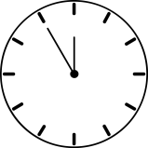
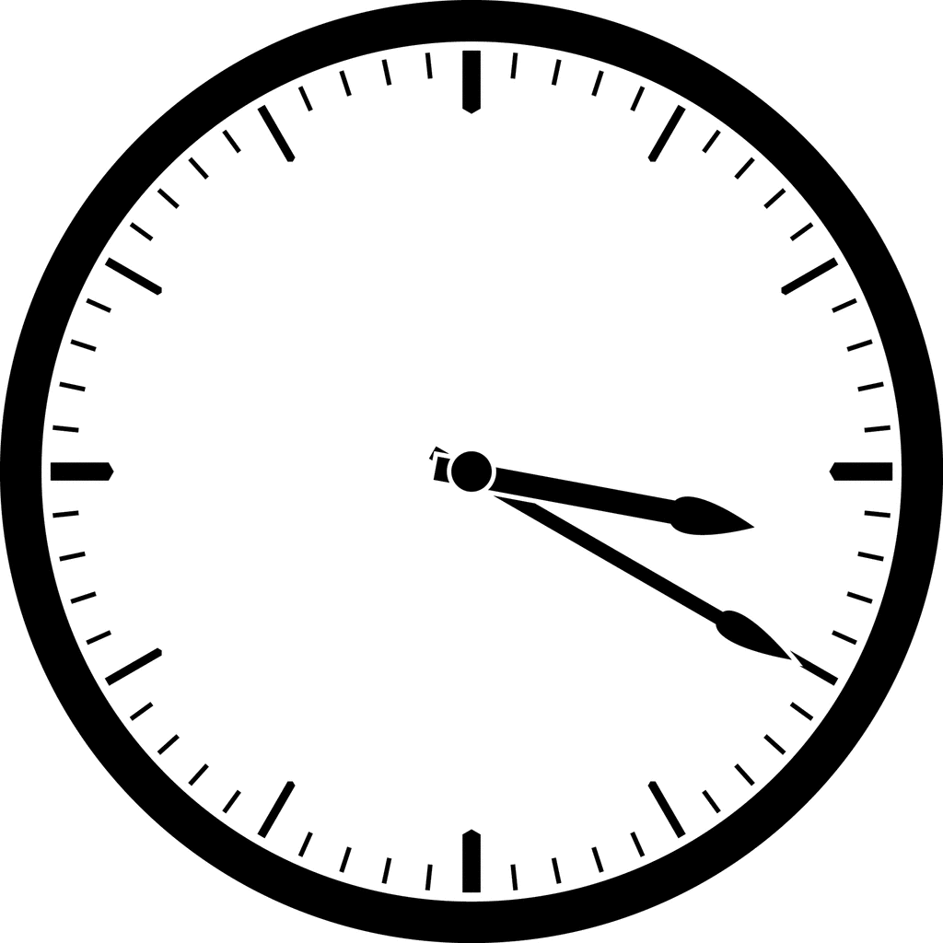
Separating Uplink and Downlink Delays
Different
Clocks
DB
Timestamp
Server
Uplink
delay
Downlink
delay
Timestamp
Requires knowing the clock offset and drift
between Client and Server

Slide 20
Finding Clock Offset and Drift
NTP-like Technique
Probes from client timestamped by the server
Timestamp s
Timestamp t_{s}
Timestamp t_{e}
Clock Offset = s – ((t_{s} + t_{e}) / 2)
Clock Drift = Slope of linear regression of many such probes
More probes, better estimate
Notes:
Timesync – one slide

Slide 21
Probing
Automatic Instrumentation of App
To send periodic probes to server
Automatic Instrumentation of Server
Open up API to timestamp probes
Efficient technique for probing
Aware of the radio state and traffic
Minimal extra delays
Energy efficient
Notes:
Timesync – one slide

Slide 22
Analysis
Automatic analysis of end-to-end transaction delays
App Delays
App processing
Sensor processing
Parsing/Rendering
Radio wakeup
Disk access
Server Delays
Server Processing
Query Processing
Network Delays
Uplink
DNS
Connection setup
Downlink

Slide 23
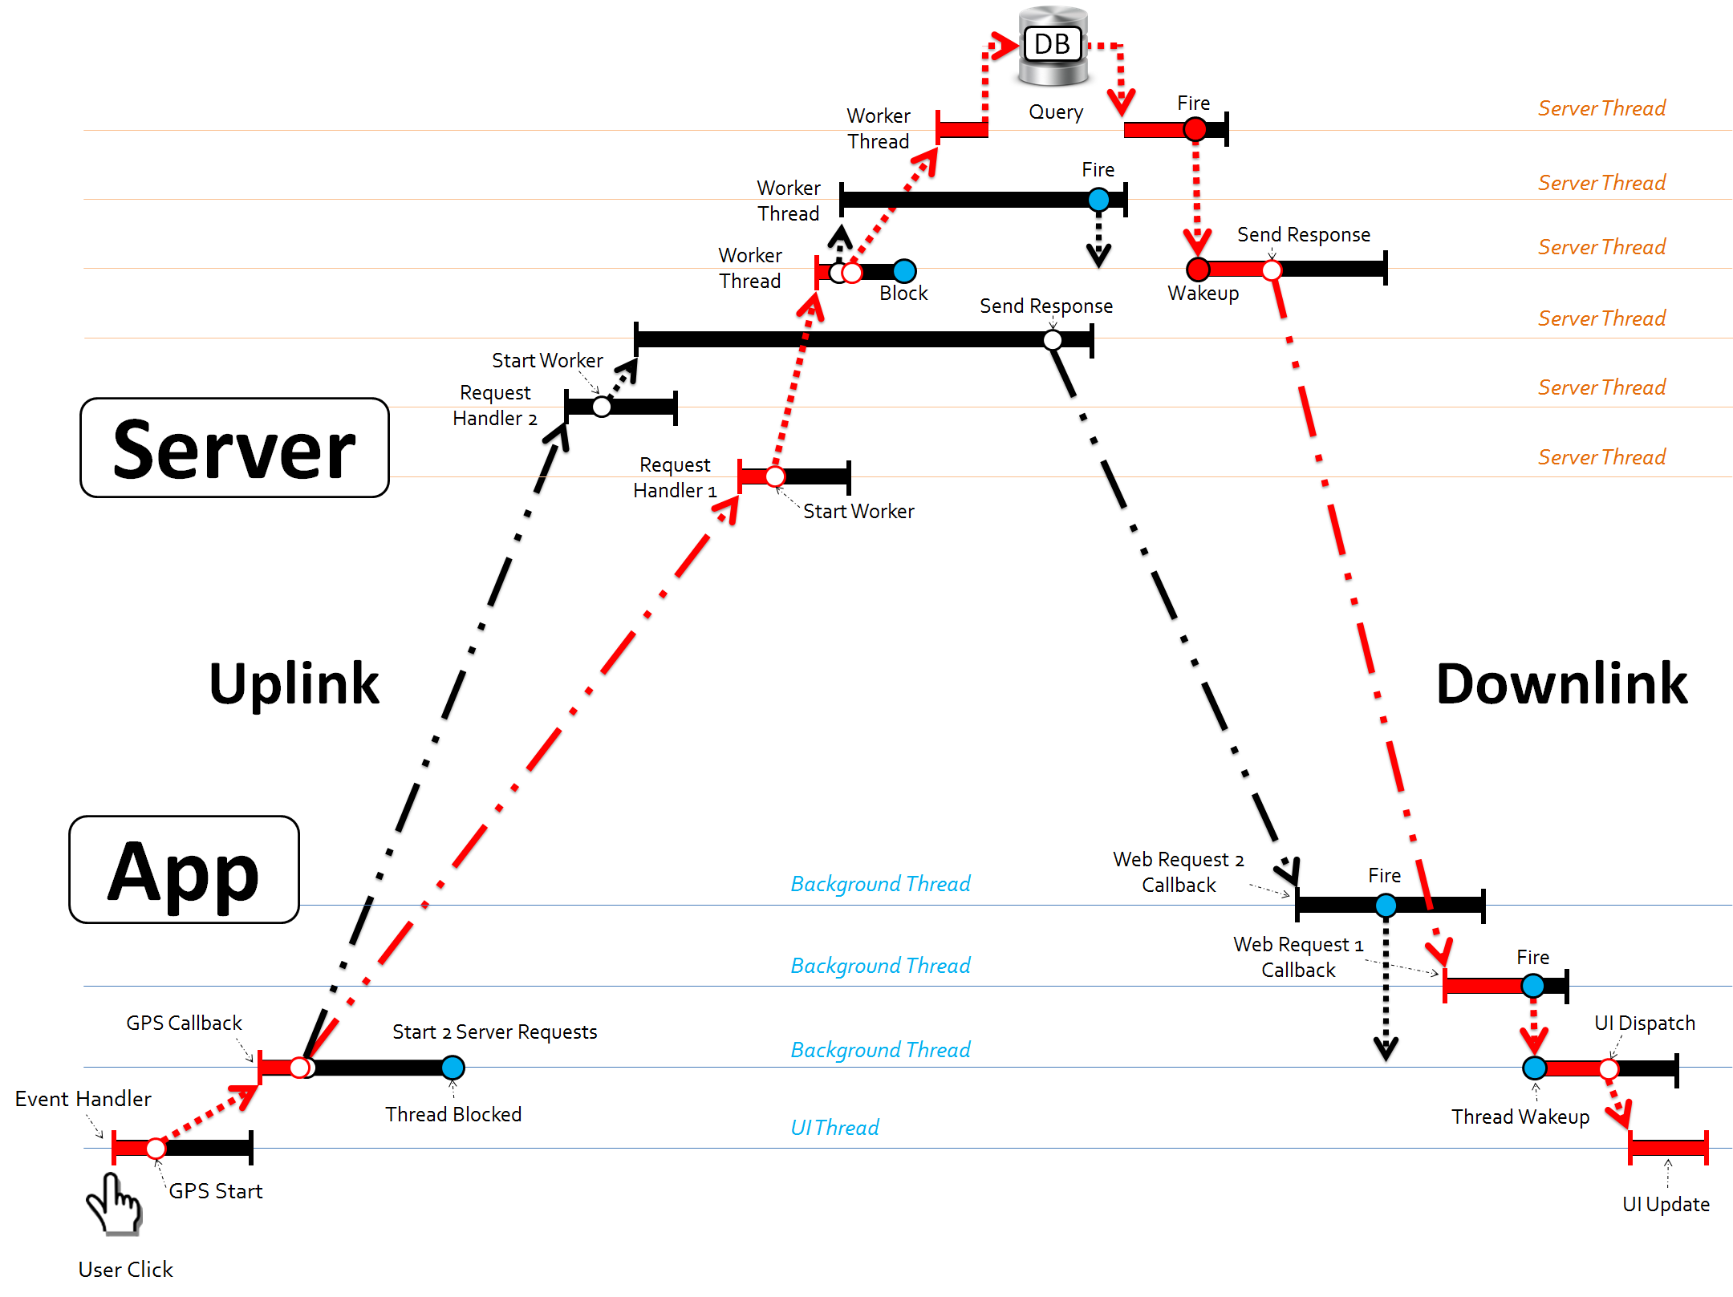
Critical Path Analysis

Slide 24
Aggregate Analysis
Group similar transactions
Outliers
Points to corner cases
Highlight common critical paths
Focus development effort
Root causes of Performance Variability
Highlight factors affecting performance

Slide 25
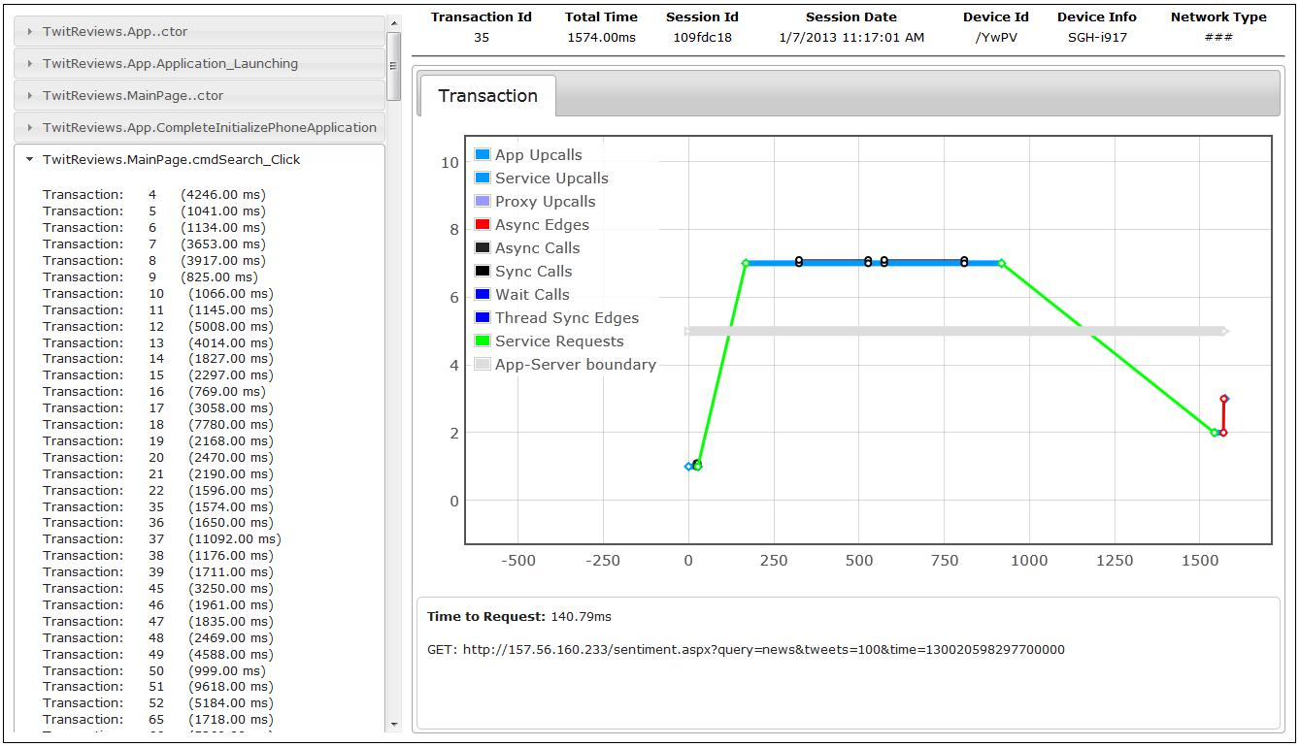
Developer Feedback
Web based Interface

Slide 26
EndInsight Overhead
Compute
Memory
Network
Battery
<0.1%
2%
4%
low
Impact on app and server performance is minimal
Low resource consumption
Notes:
For any system like this, the question is what is the overhead

Slide 27
Timecard: Controlling End-to-End Delays

Slide 28
Servers Control Variability in Response Times
Deadline
Server processing
Request
Response
Fixed deadlines
Trade-off quality for response time
More time to compute, better quality results
Flexible Services

Slide 29
The elephant is outside the room
Server processing
Request
Response

Slide 30
The elephant is outside the room
Server processing
Request
Response
Server
Uplink
Downlink
App
App
User
click
Notes:
As we showed in AppInsight, high variability in the wild

Slide 31
Servers have no visibility into delays outside
Unaware of end-to-end delays
Clients with non-trivial external delays
Poor end-to-end response times
Client with minimal external delays
Do not produce the best quality result
Could adapt differently for different users

Slide 32
Timecard
GetElapsedTime();
PredictDownstreamTime
(responseSize);
Server
App
App
Time elapsed since
user request
Predicted downlink + app processing delay
Notes:
There is variability in the app processing delay because reading data from a sensor, say GPS could take different amounts of time

Slide 33
Timecard
GetElapsedTime();
PredictDownstreamTime
(responseSize);
Adapt Processing Time
Server
App
App
App
Desired end-to-end delay
Notes:
There is variability in the app processing delay because reading data from a sensor, say GPS could take different amounts of time

Slide 34
Timecard
GetElapsedTime();
PredictDownstreamTime
(responseSize);
Server
Adapt Response
App
App
App
Desired end-to-end delay
Notes:
There is variability in the app processing delay because reading data from a sensor, say GPS could take different amounts of time

Slide 35
Timecard
GetElapsedTime();
PredictDownstreamTime
(responseSize);
Server
App
App
Desired end-to-end delay
Notes:
There is variability in the app processing delay because reading data from a sensor, say GPS could take different amounts of time

Slide 36
Timecard
Online Transaction Tracking
Time Synchronization
Downstream Delay Predictor
Downlink delay
App processing delay
Notes:
Timecard – Design

Slide 37
Timecard Implementation
Automatic Instrumentation
WP Apps
ASP .NET services
Data Collection
APIs
Predictor
Server
Transaction
Tracking
App
App
Transaction
Tracking
Time Sync
Logging

