Slide 1
Mobile services based on landmarks
Mohit Gupta, Prashanth Mohan, Lenin Ravindranath

Slide 2
Motivation
Location gives us a lot of context
Of people and their relationships
Mobile devices are ubiquitous
With lots of sensors
Not much intelligent use of them
Location -> GPS
GPS based devices are not common
GPS is power hungry

Slide 3
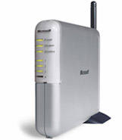
Landmarks
For many apps absolute location (GPS) is not required
Landmarks
Access Points BSSID
GSM Tower ID

Slide 4
Tagging landmark information
Automatically tagging information published with landmarks
Query based on landmarks
Number of applications

Slide 5
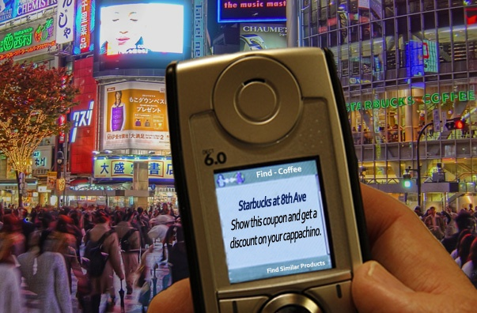
Location Sensitive Ads
Receive ads and coupons from nearby shops

Slide 6
Location sensitive search
Search for Starbucks
Should give nearby starbucks info
Give suggestions other coffee shops

Slide 7
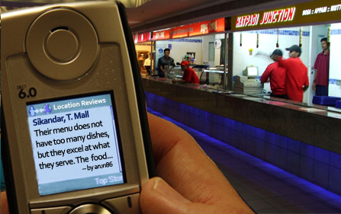
Comments and Reviews
Post comments and reviews

Slide 8
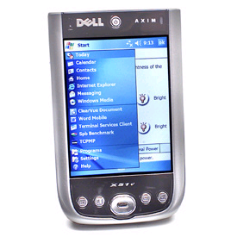
Neighborhood GPS
Dynamically help neighbors leverage GPS data from other phones
Cloud/Server
GPS
computed-location

Slide 9
Post-its

Slide 10
People Near Me

Slide 11
Other Applications
Social Networking
Where did I go and whom all did I meet today
Dating service
Location based profiles
Location based reminders
Game pairing
Enhanced presence

Slide 12
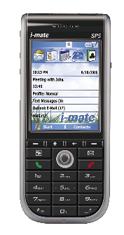
Technique
Cloud/Server
GSM Tower GSM1
Tower ID: XX1
Access Point AP1
BSSID: 00:11:22:33:44:55
Search
(query, AP BSSID, GSM ID)
Publish
(info, AP BSSID, GSM ID)

Slide 13
Precise Location
Use Signal Strength
Different cards report it different values
Rank Access points
Find nearest neighbor
Rank posts based on nearness

Slide 14
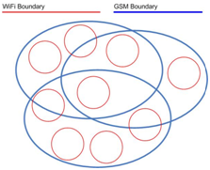
Radio Maps
GSM has a larger range than WiFi
Build radio map
Go multi-hop
Richer Information

Slide 15
Advantages
No war driving required
No client/AP/infrastructure modification
Readily deployable
Less power consumption (switch-on Wi-Fi just to scan)
Will work indoors and outdoors

