Slide 1
SixthSense
RFID based Enterprise Intelligence
Lenin Ravindranath, Venkat Padmanabhan
Interns: Piyush Agrawal (IITK), SriKrishna (BITS Pilani)

Slide 2
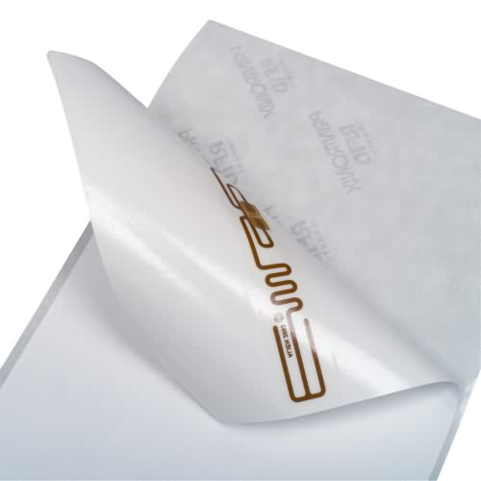
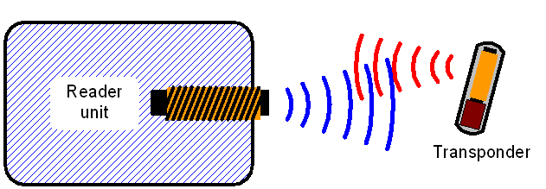
RFID
Radio Frequency Identification
Components
  RFID Reader with Antennas
  Tags (Active and Passive)
Electromagnetic waves induce current
Tag responds
  Globally unique ID
  Data

Slide 3
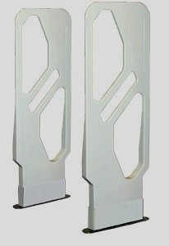
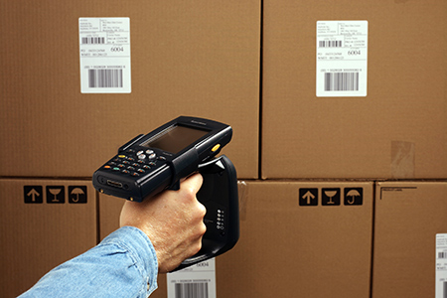
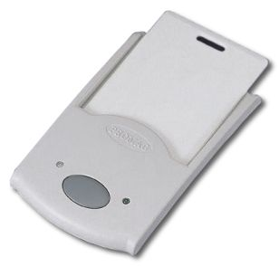
RFID
Applications
  Tracking
  Inventory
  Supply Chain
  Authentication
Mainly an Identification Technology

Slide 4
SixthSense Overview
Goal
Use RFID to capture the rich interaction between people and their surroundings
Setting
Focus on Enterprise Environment
People and their interesting objects are tagged
Methodology
Track people and objects
Infer their inter-relationship and interaction
Combine with other Enterprise systems/sensors (Camera, WiFi, Presence, Calendar)
Provide Useful Services

Slide 5
Challenges
Manual input is error prone and is best avoided
  Erroneous mapping
  Passive Tags are fragile
RFID Passive tags are inherently unreliable
  Tag Orientation
  Environment (Metal, Water)

Slide 6
Key Research Tasks
Addressing Challenges
  Take human out of the loop/Verify manual input
    Person-Object Differentiation
    Object Ownership Inference
    Person Identification
    Person-Object Interaction
  Reliability
    Multiple Tagging

Slide 7
Person-Object Differentiation
Identify tags which cause movement of other tags
  Objects moves with owner (person)
  Person may move without objects
Co-Movement based Heuristic
  At each node calculate conditional probability
  M_{cm}(i,j) = N_{ij} / N_{i}
  N_{ij} - no. of times tag i and tag j moved from one zone to another together
  N_{i} - no. of times tag i moved across any two zones
Model as a directed weighted graph
Incoming degrees and outgoing degrees at each node

Slide 8
Person-Object Differentiation
Person
1
1
0.4
1
0.9
3
2
Laptop
Cell Phone

Slide 9
Object Ownership Inference
Find all person nodes connected to an object node
The node with the highest edge weight is the owner of the object
No Information about owner in terms of movement (static objects)
Co-Presence
  M_{cp}(i,j) = N_{ij} / N_{i}
  N_{ij} = no. of times tag i and tag j are found together
  N_{i} = no. of times tag i is found
Build a graph similar to Co-Movement graph

Slide 10
Person Identification
Find Workspace
  Zone where the tag spent most of its time
Log Desktop Login/Active Events
Temporal Correlation
  Trace of person entering workspace zone
  Trace of desktop login/active events

Slide 11

Person Identification
xyz@microsoft
abc@microsoft
534
1
1
12
1

Slide 12
Person Object Interaction
Identify interaction between person and objects
  A person lifted an object
  A person turned an object (orientation change)
Multiple tags in different orientations
Monitor the variation is Received Signal Strength from tags
2
1
1
2

Slide 13
Ensuring Reliability - Multiple Tagging
Multiple Tags on a object in Orthogonal Directions
Automatic inference of cluster of tags belonging to the same object
Elimination Algorithm
  Each tag – one node (Entity graph)
  Initially edge between every pair of nodes (one connected component)
  Every time interval t, all antennas report
    Tag IDs
    Zone
Eliminate edge between two tags if found in different zone at same time
Connected components - Objects

Slide 14
Applications
Lost object Finder
Annotated Security Video
Enhanced Calendar and IM Presence
RFID based WiFi-Calibration

Slide 15
Lost Object Finder
Inferred object ownership
Inferred workspace
Raise alarm
  When object misplaced and owner moving without it
Query for lost object information
  I had the object in the evening but not with me right now

Slide 16
Annotating Videos with Events
Security Camera – Video Feed
Tagging videos with interesting RFID events
  Person lifted an object
  Person entered workspace
Rich video database
Support rich queries
  Give me all videos where Person A interacted with Object B

Slide 17
Enhanced Calendar/Presence
Automatic Conference Room booking
  If conference room not booked
  And bunch of people go into the conference room
Enhanced Presence
  Learn trajectory from one location to another
    E.g. Workspace to Conference Room
  Trajectory Mapping
  Enhanced User Presence
    On the way
    Lost

Slide 18
RFID-Assisted Wi-Fi Calibration
Wi-Fi for intrusion detection systems
Wi-Fi Signal Fluctuates
  When people move around
Using RFID as ground truth for people movement
Characterize Wi-Fi fluctuation
  Calibrate to detect human movement

Slide 19
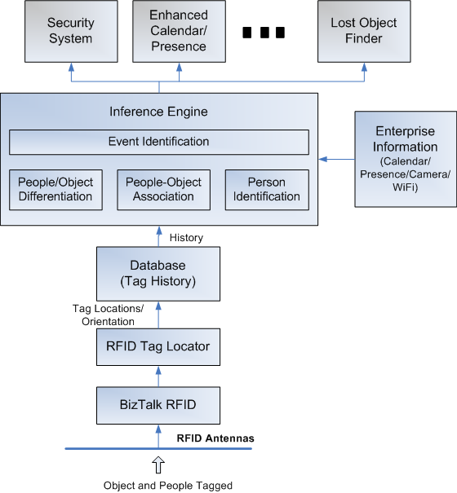
Architecture
BizTalk RFID
Tag Locator
Database
Inference Engine
  Person Differentiation
  Object Ownership
  Person Identification
  Event Identification
Enterprise Information
  Calendar
  Presence
  Camera
Applications
  Security System
  Enhanced Calendar/IM
  Object Tracker

Slide 20
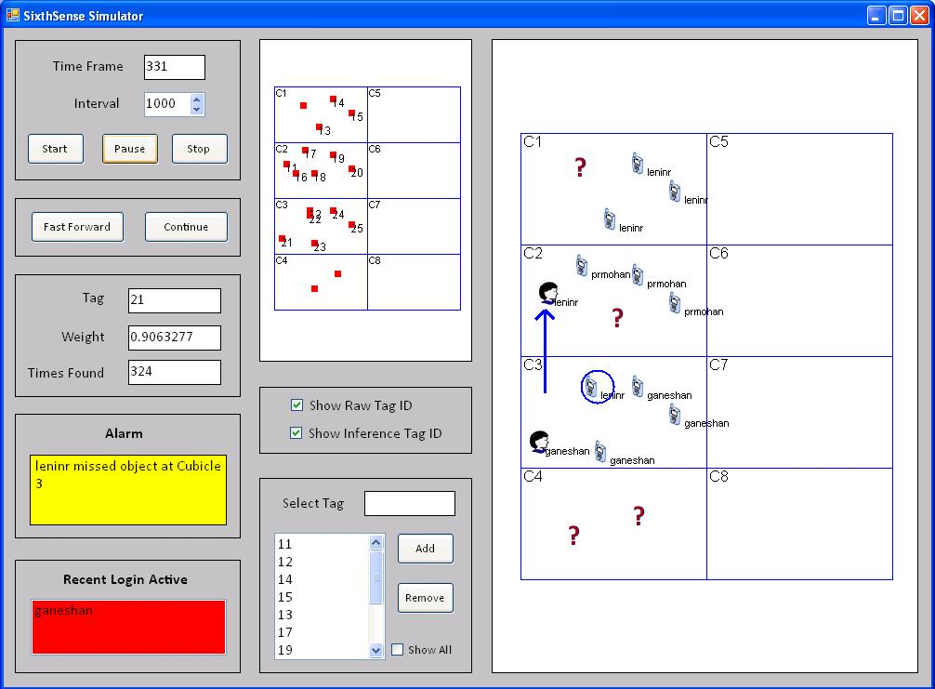
SixthSense Visualizer

Slide 21
Relevance to Microsoft
BizTalk RFID (MS IDC)
  Person Object Interaction
    Walmart
      Tracking User Interaction with Products
      Purchase Behavior
  Provide APIs on top of basic Reader APIs

Slide 22
Backup

Slide 23
Privacy – Tag ID Hopping
Read Tags using Pass Code
  Pass Code – Easy to crack
Tag ID Hopping
  Tag ID can be changed using Kill Code
  Kill Code – Secret Code
  Change Tag IDs of Tags frequently
  Server maintains the mapping

Slide 24
Related Work
Ferret
  RFID Localization for Pervasive Multimedia
I sense a disturbance in the force
  Unobtrusive detection of Interactions with RFID-tagged Objects
Marked-up maps
  Combining paper maps and electronic information resources
Fusion of RFID and Computer Vision
  On Interactive Surfaces for Tangible User Interfaces
LANDMARC
  Indoor Location Sensing Using Active RFID

