Slide 1
Automatic and Scalable Fault Detection for Mobile Applications
Lenin Ravindranath, Suman Nath, Jitu Padhye, Hari Balakrishnan
Notes:
Hi, I am Lenin. I am graduate student working Hari. The general theme of my work is to build systems and tools that can help mobile app developers build better apps.
Today, I will talk about our most recent work on that theme. A system that we built to help app developers uncover problems or crashes in their apps before their submit to the app store. It is joint work with Suman and Jitu from Microsoft Research and Hari.

Slide 2
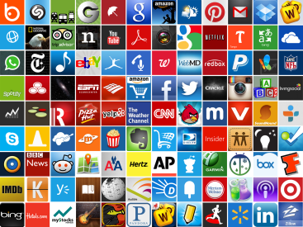
~ Two Million Apps
> 500,000 Developers

Slide 3
App Crashes are Common In-the-wild
Diverse environmental conditions
Network connectivity, GPS signal quality, etc
Wide range of user interactions, inputs, sensor readings
Variety of hardware and OS versions
Testing for these issues is hard or impossible for most app developers

Slide 4
Crashed right away.
Useful app. But crashes often. Fix for 5 stars.
For some reason crashes all the time. Horrible!!!
Crashes any time I press the home button when the page is loading
Great app. But it keeps crashing and
I loose all my notes ☹ Please fix!

Slide 5
Our Goal: App Testing as a Scalable Service
Submit app to a service
After a short time, obtain a detailed report
Crashes in the app, stack trace
Trace of interactions and inputs
Fix issues before submitting to app store
Use in nightly & weekly regression test
Should work fast
Easy to use
Completely automated

Slide 6
Analysis of Real-world Crashes
Windows Phone Error Reporting (WPER) system
25 million crash reports
From over 100,000 Windows Phone apps in 2012

Slide 7
Root Causes of App Crashes
Partition crashes into crash buckets
Exception type and crash method in the framework
Find root cause for crash buckets
Data mining techniques to discover patterns
Manually search various developer forums
stackoverflow.com
social.msdn.microsoft.com
Determined root cause for 40 out of top 100 buckets

Slide 8
Findings
A small number large buckets cover most of the crashes
Top 10% buckets cover more than 90% crashes
A significant number of crashes can be mapped to well-defined externally-inducible root causes
Deterministically inducible
E.g. Improper handling of HTTP 404
The dominant root causes affect many different execution paths in an app
E.g. network errors can affect many different execution paths
Invalid input in text boxes
Memory pressure
Unexpected sensor values
Bad data from network
HTTP 404, 401, 405
HTTP 502
Network disconnections
Impatient User
...

Slide 9
VanarSena
Easy to use, automated system to tests apps
For common, externally-inducible faults
As thoroughly as possible
In a scalable way
“Greybox” testing
Instrument app binary
Detailed insight into app runtime behavior
Minimizes testing time
Returns results to developer as quickly as possible

Slide 10
VanarSena
Monkeys
Spawn
Test Manager
App,
Config
Instrumented
App
Crash Logs
Instrumenter
Developer Feedback
Submit app,
login/text inputs
App
Developer

Slide 11
Monkey
Phone Emulator
Interactions
UI
Automator
Instrumented App
App Runtime
Callbacks
Fault Inducer
Faults

Slide 12
Monkey
Phone Emulator
Interactions
UI
Automator
Instrumented App
App Runtime
Callbacks
Fault Inducer
Faults

Slide 13
Monkey
Interactions
UI
Automator
App Runtime

Slide 14
Monkey
Interactions
UI
Automator
App Runtime

Slide 15
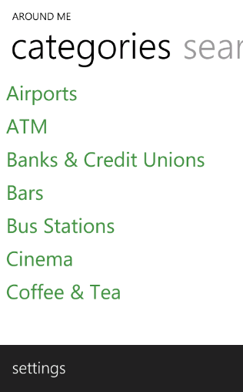
Monkey
Interactions
UI
Automator
App Runtime

Slide 16
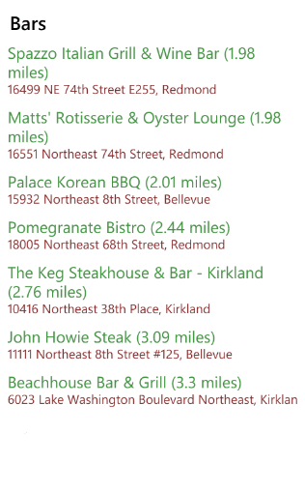
Monkey
Interactions
UI
Automator
App Runtime

Slide 17
Monkey
Interactions
UI
Automator
App Runtime

Slide 18
Monkey
Interactions
UI
Automator
App Runtime

Slide 19
Monkey
Interactions
UI
Automator
App Runtime

Slide 20
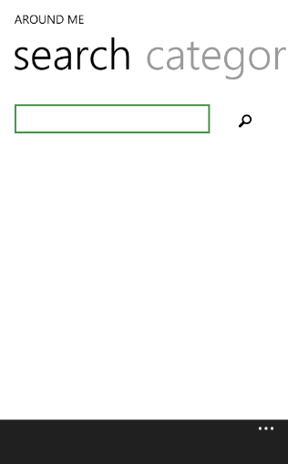
Monkey
Interactions
UI
Automator
App Runtime

Slide 21
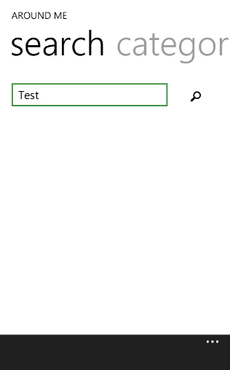
Monkey
Interactions
UI
Automator
App Runtime

Slide 22
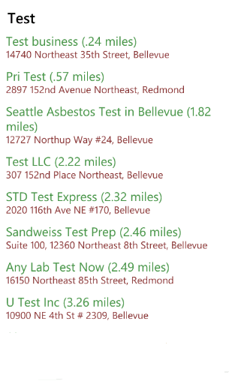
Monkey
Interactions
UI
Automator
App Runtime

Slide 23
Monkey
Interactions
UI
Automator
App Runtime

Slide 24
Monkey
Interactions
UI
Automator
App Runtime
Maximizes Coverage
Minimizes Testing Time

Slide 25
Monkey
Interactions
UI
Automator
App Runtime
Hit Testing
Transaction Tracking
Randomization
Concurrent Monkeys

Slide 26
Hit Testing
Which controls to interact with?
Many controls are non-interactable
Shouldn’t waste time interacting
Certain controls lead to “same” or “similar” execution path
Shouldn’t waste time interacting with all of them

Slide 27
Hit Testing
Interactable controls
[Event Handler]
void category_Click(object sender, EventArgs e)
{
CatIndex = e.SelectedItem;
GPS.Start(gpsCallback);
}
void gpsCallback(GPSArgs e)
{
string url = getUrl(CatIndex, e.Location);
WebRequest.Fetch(url, webCallback);
}
...
Event handlers unique identify transactions [AppInsight, OSDI ‘12]

Slide 28
Hit Testing
Instrumentation
[Event Handler]
void category_Click(object sender, EventArgs e)
{
if (HitTest.IsEnabled == true)
{
HitTest.MethodInvoked(“category_Click”);
return;
}
CatIndex = e.SelectedItem;
GPS.Start(gpsCallback);
}
...

Slide 29
Hit Testing
HitTest.IsEnabled = true
[None]
[None]
Choose only one
in each bucket
category_Click
category_Click
category_Click
category_Click
Fetch businesses nearby and go to business listing page
category_Click
category_Click
category_Click
catPage_Swipe
Go to search page
settings_Click
Go to settings page
Significantly reduces testing time
Notes:
We showed in our previous work

Slide 30
Monkey
Interactions
UI
Automator
App Runtime
Hit Testing
Transaction Tracking
Randomization
Concurrent Monkeys

Slide 31
Transaction Tracking
When to interact next?
Interact
Wait for some time
Interact next
How long to wait?
Short wait time
UI in transient state
Long wait time
Slows down testing time
Optimal
Wait till processing of an interaction is completed

Slide 32
Transaction Tracking
When to interact next?
Web Callback
UI Dispatch
Background Thread
Web Call
GPS Callback
Background Thread
Start GPS
UI Thread
[Event Handler]
category_Click
Rendering
UI in transient state
UI in settled state
Processing
Started
Transaction
Processing
Completed
Significantly reduces testing time

Slide 33
Monkey
Phone Emulator
Interactions
UI
Automator
Instrumented App
App Runtime
Callbacks
Fault Inducer
Faults

Slide 34
Monkey
Phone Emulator
Interactions
UI
Automator
Instrumented App
App Runtime
Callbacks
Fault Inducer
Faults

Slide 35
Fault Inducer
Fault Inducer Modules (FIMs)
Impatient User
Bad Network Data
Proxy
Web Errors
HTTP 404
Poor Network Conditions
Sensor Errors
Invalid Text Input

Slide 36
Impatient User
Fault Inducer Modules (FIMs)
Impatient User
Interact again
- Interact with the same control
- Interact with another control
- Press back button

Slide 37
VanarSena
Monkeys
Spawn
Test Manager
App,
Config
Instrumented
App
Crash Logs
Instrumenter
App

Slide 38
Evaluation
3,000 apps from the Windows App Store
Randomly picked 500 apps from each rating bucket (0 – 5 average user ratings)
10 concurrent monkeys for each run
Each run - one of 8 FIMs and one with no FIM
270,000 monkeys
4,500 machine hours
2.5 million interactions
400,000 app pages

Slide 39
Key Results
2,969 unique crashes in 1,108 apps
Unique exception type + stack trace
Note that, these are apps in the App Store
Presumably well tested
1,227 crashes not in the WPER database
Compared to WPER
19 out of 20 top exceptions covered
16 out of 20 crash buckets covered

Slide 40
FIMs and Crashes
FIM | #Crashes | #Apps | Example
No FIM | 506 | 429 | NullReferenceException
Text Input | 215 | 191 | FormatException
Impatient User | 384 | 323 | InvalidOperationException
HTTP 404 | 637 | 516 | WebException
HTTP 502 | 339 | 253 | EndPointNotFoundException
HTTP Bad Data | 768 | 398 | XmlException
Poor Network | 93 | 76 | NullReferenceException
GPS | 21 | 19 | ArgumentOutOfRangeException
Accelerometer | 6 | 6 | FormatException

Slide 41
Coverage
No easy way to find ground truth
Static analysis may under- or over-estimate
Compare Monkeys to Humans!
Recruited 3 people, gave them 35 apps to explore comprehensively
26 out of 35 apps, 100% coverage
5 out of rest 9 apps, more than 75% coverage
Other apps, cannot provide app-specific info
Login, Passwords, Text, Camera Gestures

Slide 42
Benefits of Hit Testing
Only 33% of the controls are Interactable
Only 18% lead to unique event handlers
In turn unique transactions
With and without hit testing
Same coverage for 95.7% apps
For the rest, 80% median coverage
Up to 20 times reduction in testing time
e.g.: 38 seconds vs. 782 seconds

Slide 43
Limitations and Future Work
Faults because of aggregated state
Hardware-dependent faults
Games and Gestures
Record and Replay framework
Combination of faults
Future work

Slide 44
VanarSena
Monkeys
Spawn
Test Manager
App,
Config
Instrumented
App
Crash Logs
Instrumenter
Developer Feedback
Submit app,
login/text inputs
App
Developer

Slide 45
Backup

Slide 46
Compatibility Issues
Run WP7 apps on WP8
Behavior of many APIs changed
No longer supports FM Radio
Changes to camera APIs
etc.
221 crashes due to compatibility issues
In 212 apps
For e.g., RadioDisabledException

Slide 47
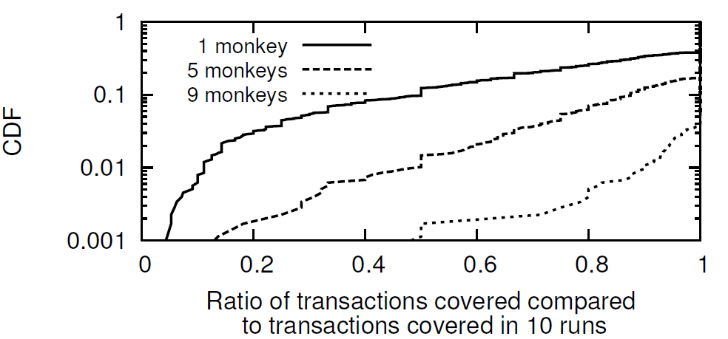
Multiple Concurrent Monkeys Are Useful
New monkeys help discover more transactions
85% apps need only one monkey for full coverage
But, more monkeys, more unique sequence of transactions explored

Slide 48
Multiple Concurrent Monkeys Are Useful
We ran each FIM only 10 times!
Picked 12 apps from 3000 apps
With most crashes in the WPER system
Ran them 100 times with each FIM
87 new unique crashes compared to
60 discovered before

