Slide 1
Improving Wireless Network Performance using Sensor Hints
Lenin Ravindranath
Calvin Newport, Hari Balakrishnan, Sam Madden
Massachusetts Institute of Technology
Notes:
I will talk about Wireless ESP. Its about using sensors to develop better network protocols. Its joint work with Calvin Newport, Hari and Sam at MIT.

Slide 2
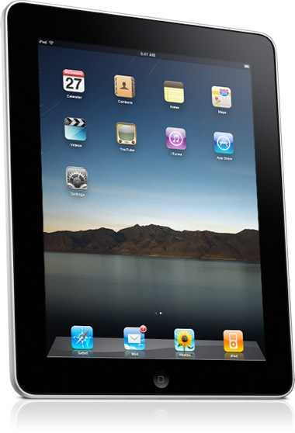
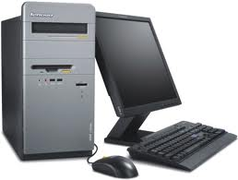
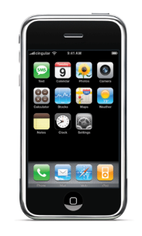
Big Changes in Access Devices
297M smartphones sold worldwide in 2010
31% of US phone market; 50% by this year
Smartphones and tablets exceeding PC sales
Notes:
Over the past decade, they has been big changes in the usage of internet access devices. We initially moved from desktops to laptops and over the last 2-3 years, there has been a phenomenal increase in the usage of smartphones and tablets.

Slide 3
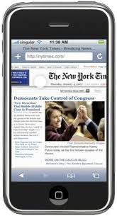
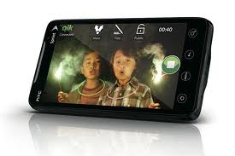
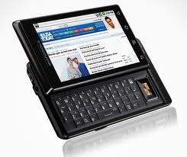
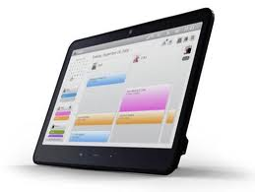
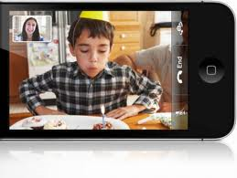
Big Changes in Access Devices
Dominant mode of data access in the future

Slide 4
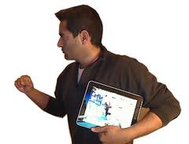
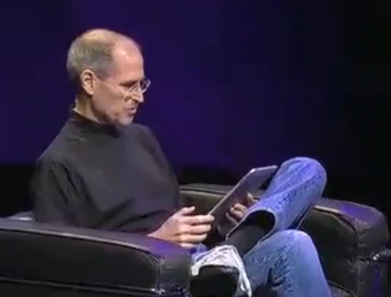
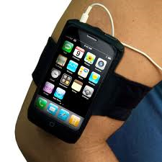
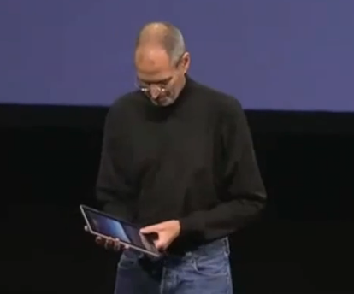
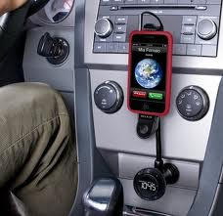
“Truly Mobile” Devices
Often switch between static and mobile
Exhibit a variety of mobility modes
Move through different environments

Slide 5
The Problem
Protocols need to adapt to different settings
Mobility mode impacts wireless performance
Most protocols optimized for static settings
They perform poorly during mobility

Slide 6
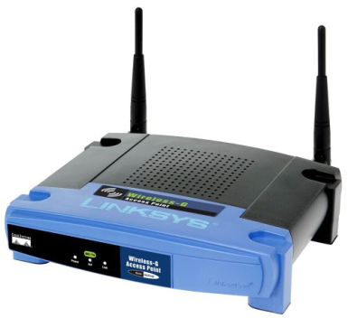
Static vs. Mobile
Channel constantly changing
Channel assessments quickly outdated
Protocols should not maintain long histories
Channel relatively stable
Protocols can average estimates
Ignore short-term variations

Slide 7
Static vs. Mobile
Topology changing rapidly
Probe for links more often
Compute routes over shorter time scales
Topology is hardly changing
Probe for links less frequently
Compute routes over long time scales

Slide 8
Current Wireless Protocols
Do not differentiate between mobility modes
Attempt to adapt to different settings implicitly using measurements of packet loss, SNR, BER
… leading to poor performance
Lack of explicit knowledge about prevalent mobility mode

Slide 9
Proximity
Sensor
Camera
Accelerometer
Compass
Gyro
GPS
Ambient Light
Sensor
Microphone
Notes:
And the answer is yes, because with the proliferation of smartphones and tablets, we have an opportunity here.

Slide 10
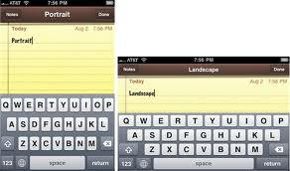
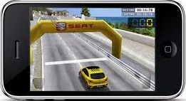
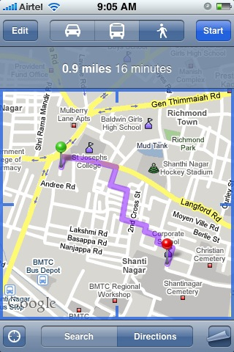
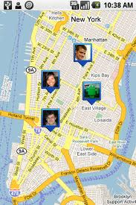
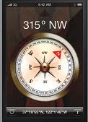
Proximity
Sensor
Camera
Accelerometer
Compass
Gyro
GPS
Ambient Light
Sensor
Many, many, applications…
Microphone

Slide 11
Proximity
Sensor
Camera
Accelerometer
Ignored by Protocols!
Compass
Gyro
GPS
Ambient Light
Sensor
Microphone
Notes:
And the answer is yes, because with the proliferation of smartphones and tablets, we have a opportunity here.

Slide 12
Proximity
Sensor
Camera
Wireless Protocol Stack
Application
Transport
Accelerometer
Network
Ignored by Protocols!
Compass
MAC
Gyro
PHY
GPS
Wireless Radio
Ambient Light
Sensor
Microphone

Slide 13
Wireless Protocol Stack
Application
Transport
Accelerometer
Network
Compass
MAC
Gyro
PHY
GPS
Wireless Radio

Slide 14
Wireless Protocol Stack
Application
GPS
Transport
Compass
Hints
Network
Sensor
Info
Accl
MAC
Gyro
PHY
Wireless Radio

Slide 15
Wireless Protocol Stack
Application
Movement
Direction
Speed
GPS
Transport
Compass
Hints
Network
Accl
MAC
Use hints to adapt to different mobility modes differently
Gyro
PHY
Wireless Radio
Notes:
Add position

Slide 16
Wireless Protocol Stack
Application
Movement
Direction
Speed
GPS
Transport
Compass
Hints
Network
Accl
Mobility hint
MAC
Use hints to adapt to different mobility modes differently
Gyro
PHY
Wireless Radio

Slide 17
Wireless Protocol Stack
Application
Movement
Direction
Speed
GPS
Transport
Compass
Hints
Network
Accl
MAC
Use hints to adapt to different mobility modes differently
Gyro
PHY
Wireless Radio
Adapt to hints from neighbors
Hints Protocol

Slide 18
Wireless Protocol Stack
Speed
Application
GPS
Vehicular Routing
Transport
Compass
Heading
Network
AP Association
Accl
Walking
MAC
Rate Adaptation
Gyro
Movement
PHY
Wireless Radio

Slide 19
Wireless Protocol Stack
Speed
Application
GPS
Vehicular Routing
Transport
Compass
Topo Maintenance
Heading
Network
AP Association
Accl
Walking
MAC
Rate Adaptation
Gyro
Movement
PHY
Wireless Radio

Slide 20
Wireless Protocol Stack
Network Monitoring
Speed
Application
GPS
Location
Vehicular Routing
Transport
Compass
Topo Maintenance
Heading
Network
AP Association
Accl
Walking
MAC
Rate Adaptation
Gyro
Movement
PHY
Packet Scheduling
Speed
Adapt Cyclic Prefix
Wireless Radio
Power Saving

Slide 21
Wireless Protocol Stack
Speed
Application
GPS
Vehicular Routing
Transport
Compass
Heading
Network
AP Association
Accl
Walking
MAC
Rate Adaptation
Gyro
Movement
PHY
Wireless Radio

Slide 22
GPS
Speed
Compass
Heading
Accl
Walking
Gyro
Movement

Slide 23
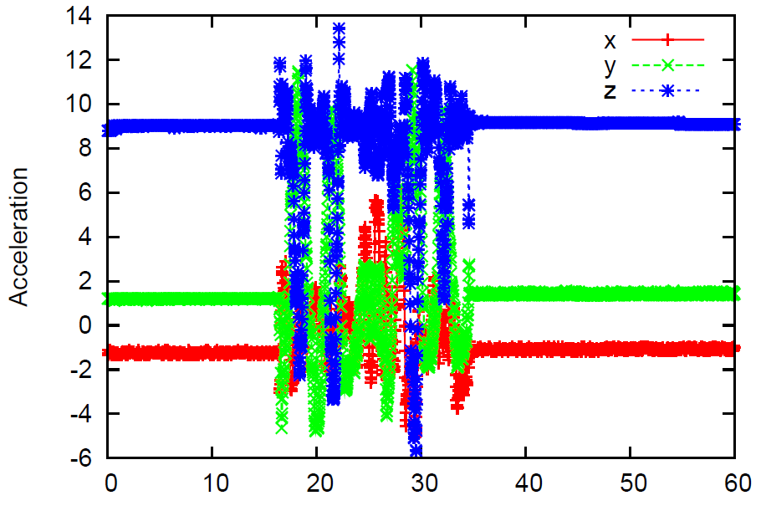
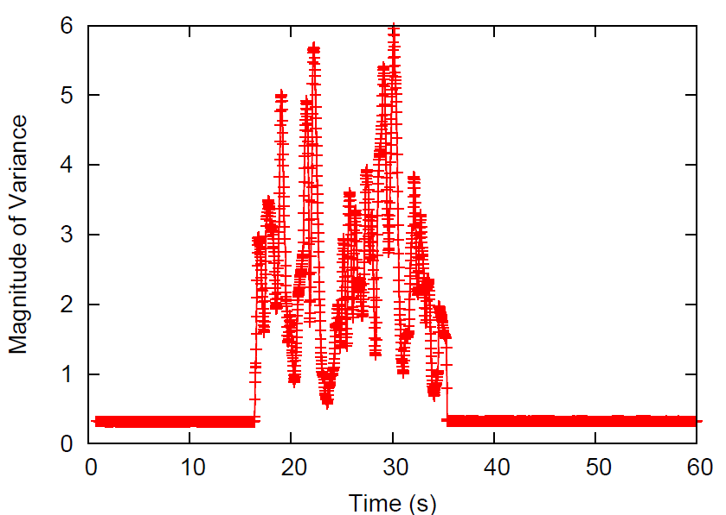
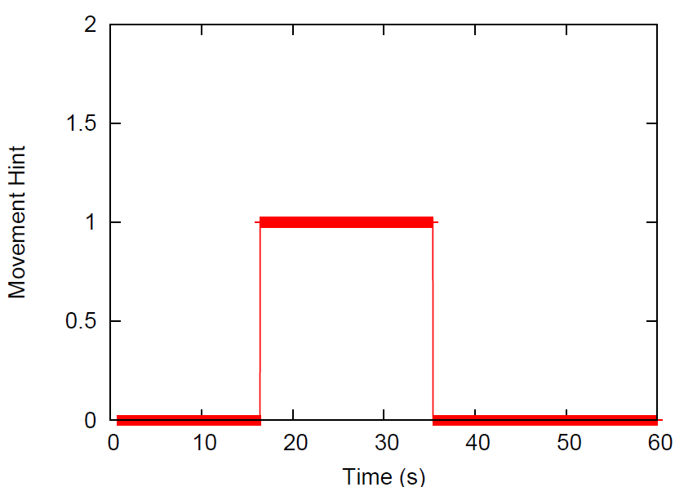
Is the device
static or moving?
Accl
Movement
Reliably detect movement
within 10-100ms

Slide 24
Walking Hint
Accelerometer
Transitgenie (Sensys ‘10)
GPS
Speed
Heading
Outdoor - GPS
Indoor – Compass + Gyro + Accelerometer
Compass
Heading
Accl
Walking
Gyro
Movement
Speed
Outdoor - GPS
Indoor – Accelerometer?

Slide 25
Wireless Protocol Stack
Speed
Application
GPS
Vehicular Routing
Transport
Compass
Heading
Network
AP Association
Accl
Walking
MAC
Rate Adaptation
Gyro
Movement
PHY
Wireless Radio

Slide 26
Wireless Protocol Stack
Application
GPS
Transport
Compass
Network
Accl
MAC
Rate Adaptation
Gyro
Movement
PHY
Wireless Radio

Slide 27
Rate Adaptation in Wireless Networks
802.11a bit rates
6 Mbps
9 Mbps
12 Mbps
18 Mbps
24 Mbps
36 Mbps
48 Mbps
54 Mbps
Packet encoded at a particular bit rate
Rate Adaptation:
Finding the best bit rate to transmit a packet

Slide 28
Static vs. Mobile Performance
Static
Sample Rate | 85 – 99%
RRAA | 80 – 97%
RBAR | 70 – 80%
CHARM
Static and walking traces
Cycle through bit rates
3 different environments
60 traces
Trace-driven simulation
TCP throughput
Moving
Sample Rate | 33 – 59%
RRAA | 45 – 63%
RBAR | 60 – 75%
CHARM
Compare to
best post-processed
throughput

Slide 29
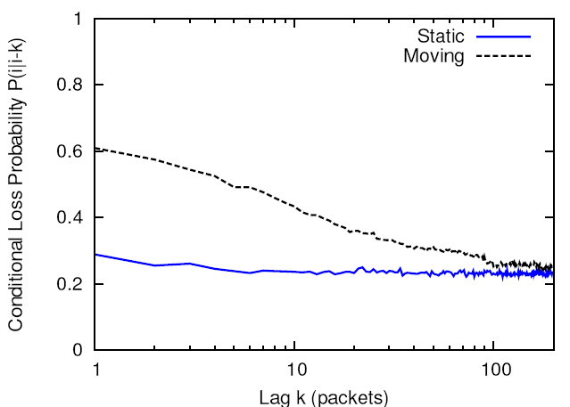
Static vs. Mobile Loss Patterns
Probability that packet i is lost given packet i-k is lost
Losses are more bursty when a node is mobile than when a node is static

Slide 30
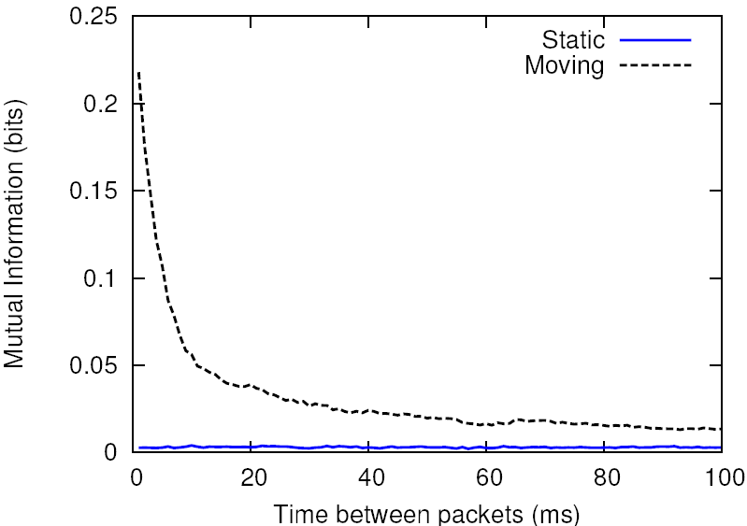
Mutual Information between success/failure events
Static vs. Mobile
10 ms

Slide 31
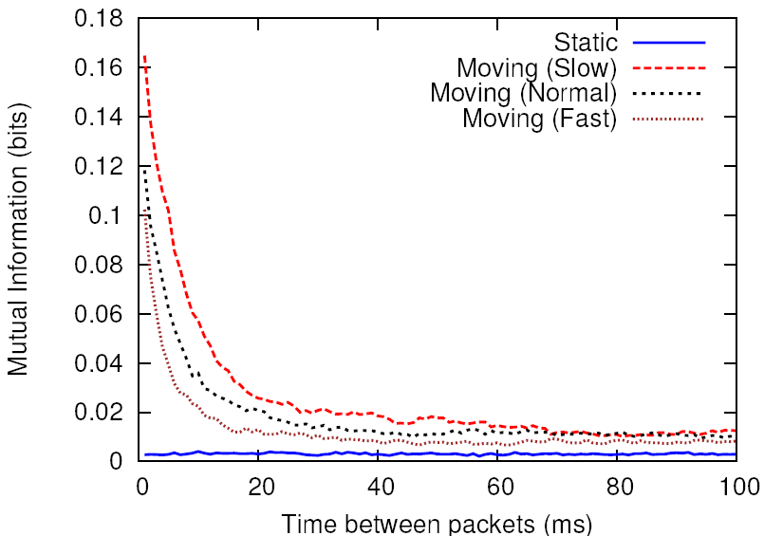
Mutual Information between success/failure events
Different walking speeds
10 ms – 20ms

Slide 32
RapidSample: Rate Selection for Moving Nodes
1. After a single loss
Reduce rate
6 Mbps
9 Mbps
12 Mbps
18 Mbps
24 Mbps
36 Mbps
48 Mbps
54 Mbps
6 Mbps
9 Mbps
12 Mbps
18 Mbps
24 Mbps
36 Mbps
48 Mbps
54 Mbps
6 Mbps
9 Mbps
12 Mbps
18 Mbps
24 Mbps
36 Mbps
48 Mbps
54 Mbps
2. Short history (10 ms)
Don’t retry a failed rate
Or any higher rate
[failed – within last 10ms]
3. Channel not degrading, probably improving
After few successes, sample higher rate not failed
If incorrect, come back to the original rate
[failed – within last 10ms]

Slide 33
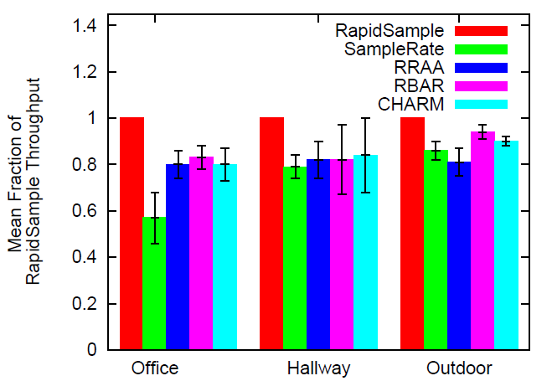
RapidSample, when Device is Moving
Trace-driven (ns3)
30 traces
3 environments
Office
Hallway
Outdoor
TCP throughput
16% to 75% better throughput than other protocols

Slide 34
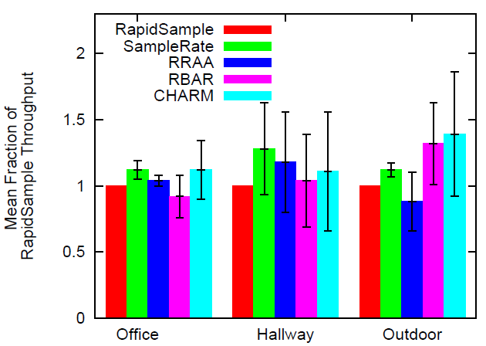
But when Static…
Trace-driven (ns3)
30 traces
3 environments
Office
Hallway
Outdoor
TCP throughput
Up to 28% lower throughput than other schemes

Slide 35
Hint-Aware Rate Adaptation
Wireless Protocol Stack
Application
RapidSample when moving
SampleRate when static
Transport
Network
Accl
Rate Adaptation
Movement
PHY
Wireless Radio
Movement

Slide 36
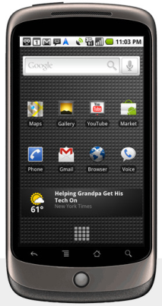
Implementation and Evaluation
1000 byte packets (at a bit rate)
ACK
Movement hint
Linux (Click)
Android
SampleRate
RRAA
RapidSample
Hint-Aware

Slide 37
Implementation and Evaluation
2 environments
Office
Hallway
10 movement patterns
Static + Moving
45 – 90 sec long
Average 3 back-to-back trials

Slide 38
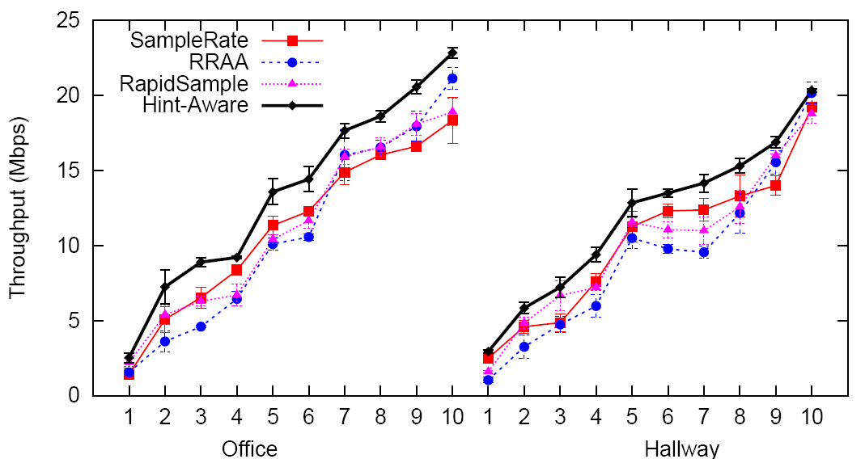
Hint-Aware Rate Adaptation
20%, 17% better than SampleRate on average
22%, 37% better than RRAA on average

Slide 39
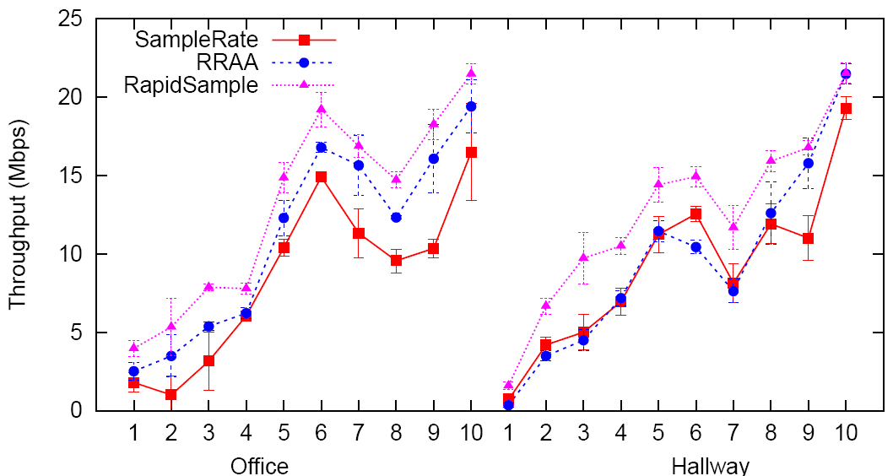
when device is moving
Hint-aware
61%, 40% better than SampleRate on average
16%, 39% better than RRAA on average

Slide 40
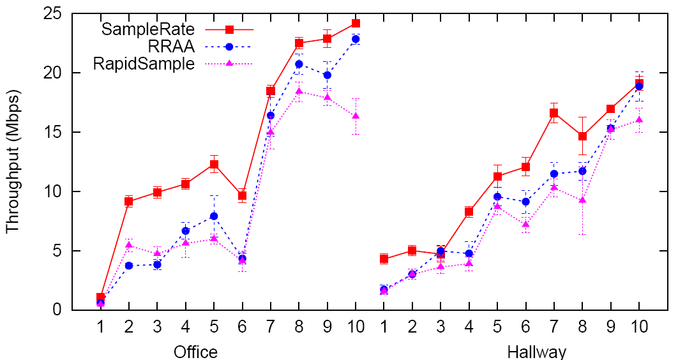
when static…
Hint-aware
24%, 35% better than RRAA on average
43%, 57% better than RapidSample on average

Slide 41
Critique
Aren’t PHY layer techniques (SoftRate) better?
Requires PHY changes
Hint-aware: On traces, ~90% of SoftRate
Isn’t continuous adaptation a better design?
Cf. mutual information graph
Hard to measure speed indoors
Is RSSI variation a good indicator for mobility?
Large variations even when a node is static
Depends on environment, device, time, RSSI
Sensitive to movement in environment
Notes:
fix

Slide 42
Wireless Protocol Stack
Speed
Application
GPS
Vehicular Routing
Transport
Compass
Heading
Network
AP Association
Accl
Walking
MAC
Rate Adaptation
Gyro
Movement
PHY
Wireless Radio

Slide 43
Wireless Protocol Stack
Application
GPS
Transport
Compass
Heading
Network
AP Association
Accl
Walking
MAC
Gyro
PHY
Wireless Radio

Slide 44
AP Association: Picking the best AP
Maximize throughput
File download
Minimize handoffs (scans)
VOIP – minimize disruptions

Slide 45
AP Association: Picking the best AP
Scan
Scan
Infrequent scans

Slide 46
AP Association: Picking the best AP
Static

Slide 47
Walking-Aware Association
Maximize throughput
1. Static – Stop Scanning
2. Walking – Scan Periodically
3. Walking to Static – Scan once

Slide 48
Heading-Aware Association
Minimize Handoff
Training-based approach
Background Android application
Training: WiFi scans + Heading hint
Query the model with current AP and heading hint
Heading

Slide 49
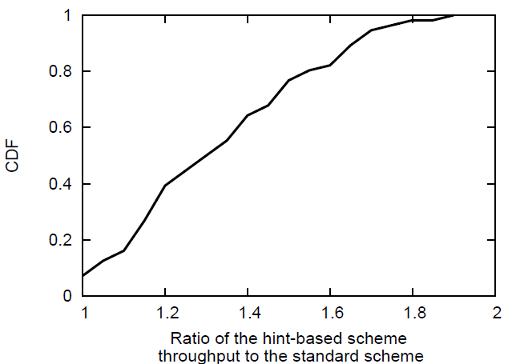
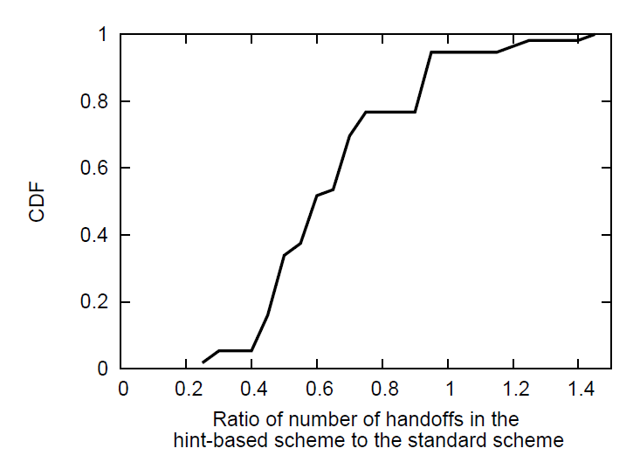
Hint-Aware Association
Android implementation
30 traces; Static + Moving
Throughput
# handoffs
30% higher median throughput
40% median reduction in handoffs

Slide 50
Wireless Protocol Stack
Speed
Application
GPS
Vehicular Routing
Transport
Compass
Heading
Network
AP Association
Accl
Walking
MAC
Rate Adaptation
Gyro
Movement
PHY
Wireless Radio

Slide 51
Wireless Protocol Stack
Speed
Application
GPS
Vehicular Routing
Transport
Compass
Heading
Network
Accl
MAC
Gyro
PHY
Wireless Radio

Slide 52
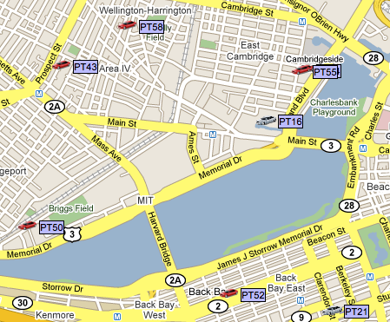
Routing in Vehicular Mesh Networks
“V2V”

Slide 53
Routing in Vehicular Mesh Networks
Longevity of links useful – avoids expensive repairs
Connection Time Estimate (CTE)
Use heading and speed to predict connection duration
Link between nodes heading in the similar direction tend to last longer

Slide 54
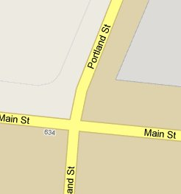
Routing in Vehicular Mesh Networks
Longevity of links useful – avoids expensive repairs
Connection Time Estimate (CTE)
Use heading and speed to predict connection duration
Link between nodes heading in the similar direction tend to last longer

Slide 55
Routing in Vehicular Mesh Networks
Longevity of links useful – avoids expensive repairs
Connection Time Estimate (CTE)
Use heading and speed to predict connection duration
Link between nodes heading in the similar direction tend to last longer
Speed is inversely correlated to connection duration
Empirical evaluation on taxi traces
15 networks, 100 vehicles each
Links with large CTE lasted 4 to 5 times longer
than the median duration over all links

Slide 56
Wireless Protocol Stack
Speed
Application
GPS
Vehicular Routing
Transport
Compass
Heading
Network
AP Association
Accl
Walking
MAC
Rate Adaptation
Gyro
Movement
PHY
Wireless Radio

Slide 57
Wireless Protocol Stack
Network Monitoring
Speed
Application
GPS
Location
Vehicular Routing
Transport
Compass
Topo Maintenance
Heading
Network
AP Association
Accl
Walking
MAC
Rate Adaptation
Gyro
Movement
PHY
Packet Scheduling
Speed
Adapt Cyclic Prefix
Wireless Radio
Power Saving

Slide 58
Wireless Protocol Stack
Speed
Application
Hint Aware Protocols
GPS
Location
Transport
Compass
Heading
Network
Accl
Walking
MAC
Gyro
Movement
PHY
Speed
Wireless Radio

Slide 59
Hint-Aware Protocol Architecture
Sensor Library
GPS
Hint Aware Protocols
Compass
Accl
Gyro

Slide 60
Hint-Aware Protocol Architecture
Sensor Library
GPS
Hint Aware Protocols
Compass
Accl
Gyro
Hint Transport Layer
UDP
MAC
UDP Packets
802.11 Frames

Slide 61
Hint-Aware Protocol Architecture
Hint Service
Sensor Library
GPS
Hint Aware Protocols
Compass
Query
REGISTER
Sensor
Hint Manager
SEND
Accl
Hints
Hints
Gyro
Hints
Received Hints
Hint Transport Layer
- Android Service
UDP
MAC
- Linux Click Module
UDP Packets
802.11 Frames

Slide 62
Limitations
Energy
Accelerometer, Compass is cheap but GPS is not.
Dynamically adapt sample rates
Triggered sensing
Low cost sensing - training based
Calibration across device types
Movement hint required no calibration
Walking hint required tuning
Privacy

Slide 63
Related Work
Wireless power saving
WakeOnWireless: Low power radio
Cell2Notify: GSM radio to wakeup WiFi
Blue-Fi: Bluetooth and GSM to predict WiFi
AP selection
Mobisteer: Location and speed to select AP and antenna orientation
Breadcrumbs: Use location to build a HMM
Rate Adaptation
CARS: Train using speed and heading from GPS

Slide 64
Take-Away Message
Truly mobile devices will soon be dominant
Variety of mobility modes poses problems for wireless protocols
Sensors on these devices give us a new opportunity to develop network protocols
Protocol architecture using sensor hints can significantly improve MAC, link, network layers

Slide 65
Backup

Slide 66
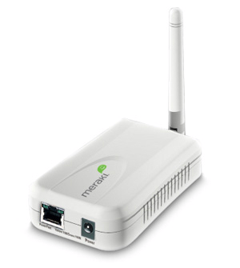
Probing
Delivery Probability
ETX, ETT
Probes
How frequently should nodes probe?

Slide 67
Infrequent Probing
Inaccurate link estimation leads to
poor throughput

Slide 68
Frequent Probing
Probing wastes bandwidth

Slide 69
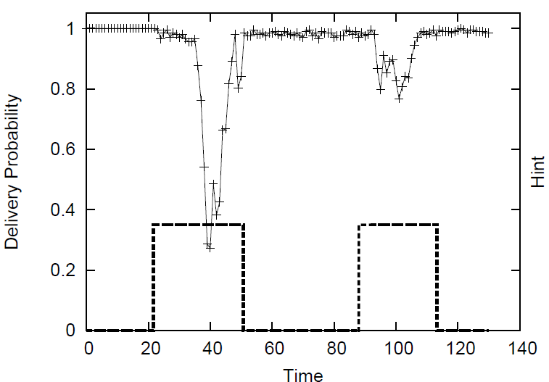
Delivery Probability
Mobility causes delivery probability to
fluctuate with bigger jumps

Slide 70
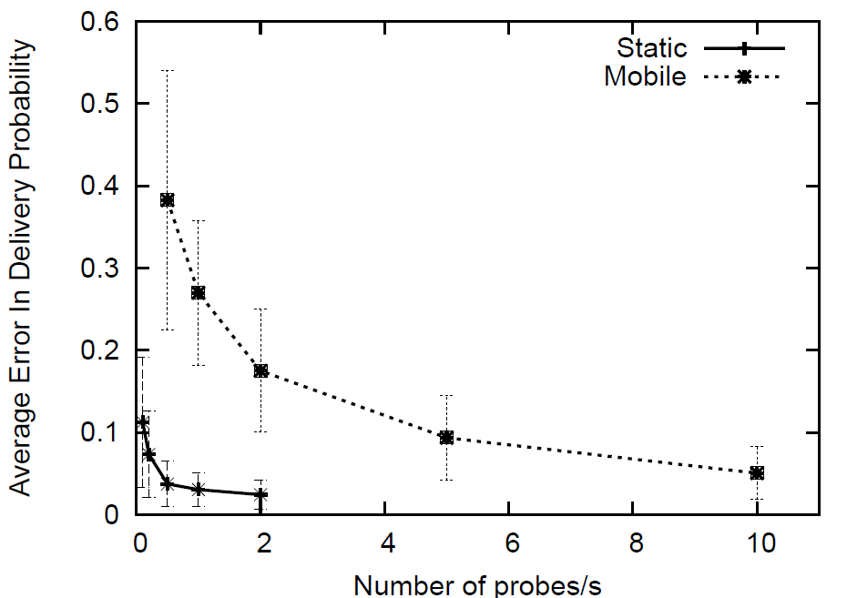
Static vs. Mobile
Mobile case requires 20x more probes
to maintain acceptable estimation error

Slide 71
Adaptive Probing Protocol
Adapt probing based on movement hints
When a node is static
Probe infrequently (1 probe every 2 seconds)
When a node is mobile
Probe frequently (10 probes per second)

Slide 72
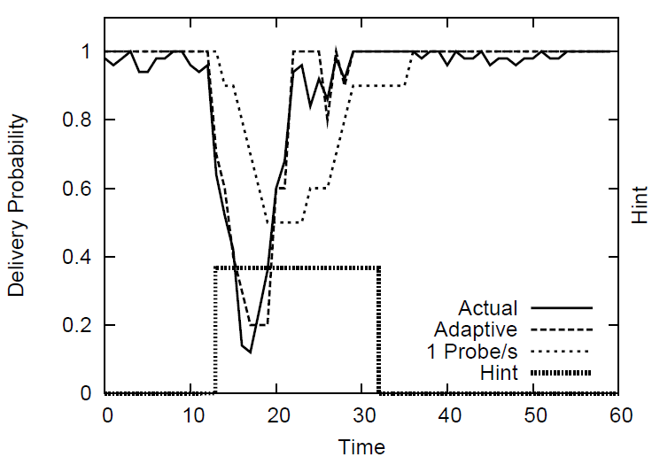
Adaptive Probing
Tracks the link accurately with fewer probes

Slide 73
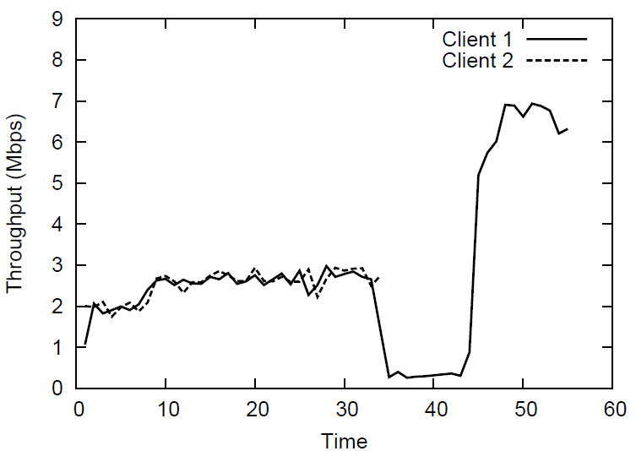
Pruning association

Slide 74
AP Association
Scan
Scan
Scan
Infrequent scans

Slide 75
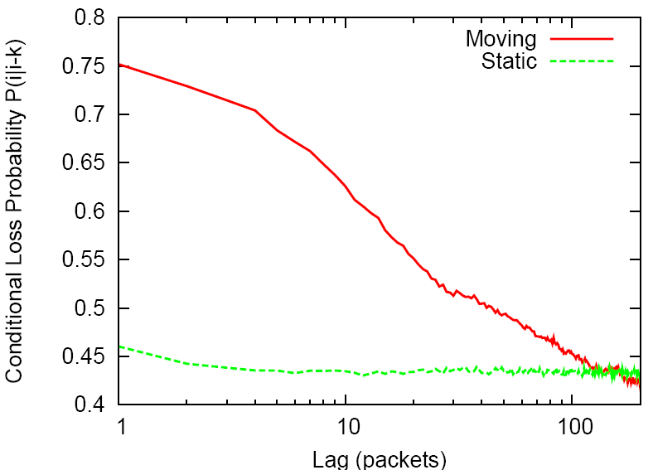
Static vs. Mobile Loss Patterns
Probability that packet i+k is lost given packet i is lost
Losses are more bursty when a node is mobile than when a node is static

Slide 76
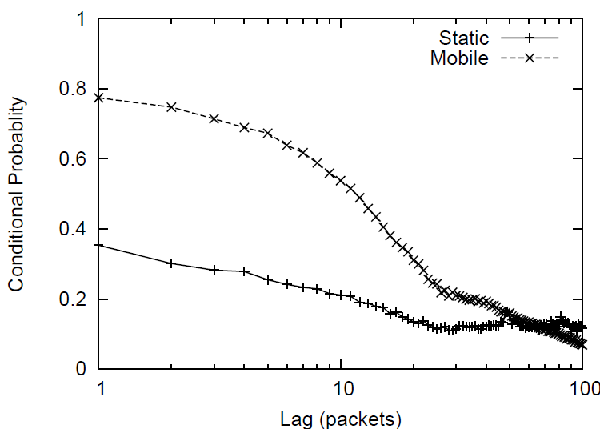
Static vs. Mobile Loss Patterns
Probability that packet i+k is lost given packet i is lost
10 ms
k
Losses are more bursty when a node is mobile than when a node is static

Slide 77
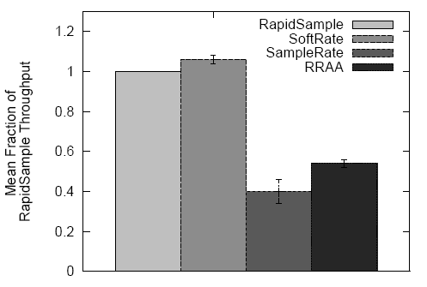
RapidSample vs. SoftRate
Sigcomm 2009
10 traces
Moving
TCP throughput
Comparable throughput to Softrate

Slide 78
Wireless Protocol Stack
Application
GPS
Transport
Improve throughput
Compass
Heading
AP Association
Accl
Walking
Reduce
handoffs
MAC
Gyro
PHY
Wireless Radio
Notes:
Get rid of this

Slide 79
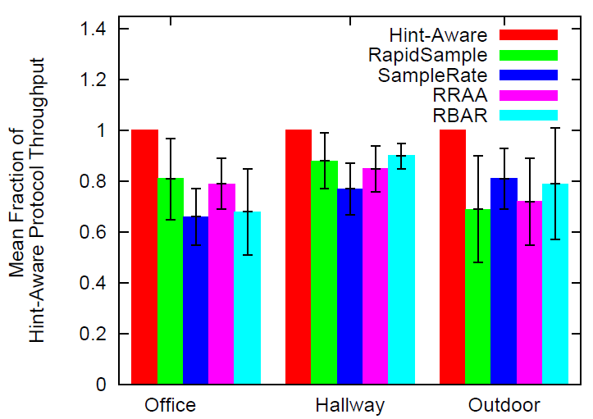
Hint-Aware Rate Adaptation
Trace driven (ns3)
30 traces
3 environments
Static + Moving
TCP throughput
52%, 30%, 22% better than SampleRate on average
27%, 17%, 39% better than RRAA on average
47%, 11%, 27% better than RBAR on average
Notes:
Delete this

Slide 80
Hint-Aware Rate Adaptation
Wireless Protocol Stack
Application
GPS
Transport
Compass
Network
Improve throughput
Accl
Rate Adaptation
Gyro
Movement
PHY
Wireless Radio
Movement
Notes:
Get rid

Slide 81
Wireless Protocol Stack
Speed
Application
GPS
Transport
Predict link duration and quality
Compass
Heading
V Routing
Accl
MAC
Better routing
Gyro
PHY
Wireless Radio

Slide 82
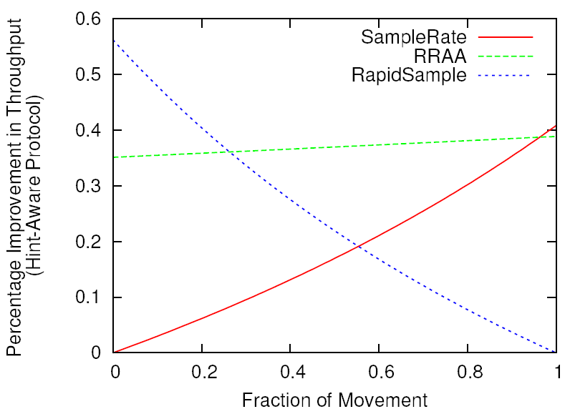
Hint-Aware Protocol Throughput

Slide 83
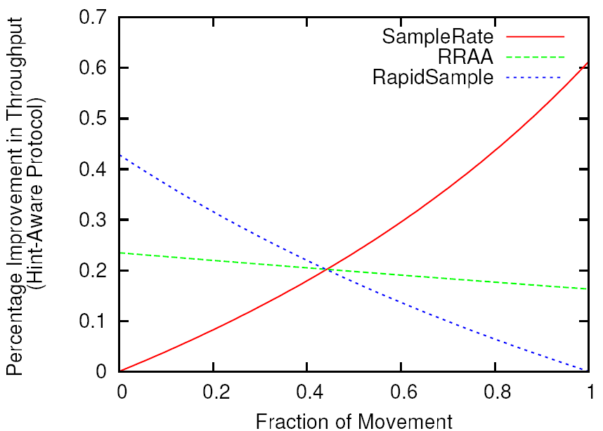
Hint-Aware Protocol Throughput

Slide 84
$$I\left(X;Y\right)= \sum_{y∈\{0, 1\}}{\sum_{x∈\{0, 1\}}{p\left(x, y\right)\log\left(\frac{p(x,y)}{p_{1}(x)p_{2}(x)}\right)}}$$

