Slide 1
Recursive Composition in Computer Vision
Leo Zhu
CSAIL MIT

Slide 2
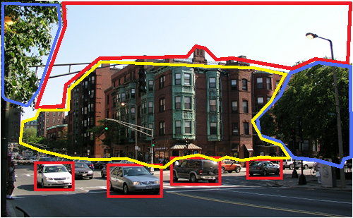
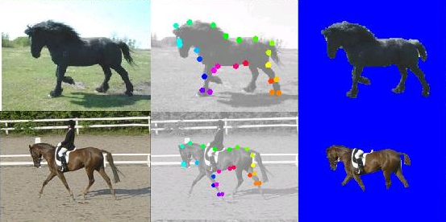
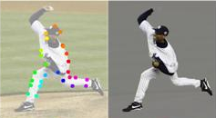
Ideas behind
Recursive Composition
A principle for constructing models of the visual world
A general framework for different vision tasks
Three aspects:
  Modeling : Compact
  Inference : Rapid
  Learning : Efficient
  Pattern Theory. Grenander 94
  Compositionality. Geman 02
  Stochastic Grammar. Zhu and Mumford 06
Notes:
The key assumption to
address these problems is that the visual world is recursively
compositional.
Compact representation: dimension reduction, better generalization
Rapid inference: polynomial-learning time inference
Learning: polynomial-time learning; fewer training examples.

Slide 3
Basic Setup
x: input image; y: interpretation of x
Generative Method:
Discriminative Method:
The representation of Energy Function:
f, g: potentials (sufficient statistics)
Notes:
Generative: Joint
Discriminative: Conditional
The major difference is the normalization term Z.
We focus on the representation (the form) of the potentials (sufficient statistics).

Slide 4

Example I: flat MRF Representation for Deformable Object
y: states of nodes, e.g. position of object parts (unobservable)
Spatial deformation
Image features
Deformable Template. Yuille 91
POP. Yali et al. 02
Constellation Model. Perona et al. 03
Active Basis. Wu et al. 07.
x : Image
Notes:
Two Sufficient Statistics

Slide 5
Three Aspects:
Modeling-Inference-Learning
Modeling:
  Forms of sufficient Statistics
  Graphical structure: loops, layers
  Complexity: numbers of parameters, nodes, edges.
Inference: (recognition/matching)
Learning:
  Estimate the parameters
  Induce the structures

Slide 6
Why flat MRF is not good enough?
Sparse nodes and less long-range correlation
=> less representation power
More nodes and edges
=> more computational issues
?

Slide 7
RCM-1: the Probabilistic Formulation
(position, scale, orientation)
Multiple-level abstraction
Same, low dimension
More nodes and long-range correlation

Slide 8
RCM-1: the Recursive Formula
Recursion
Recursive formula reflects the independency.
Self-similar definition

Slide 9
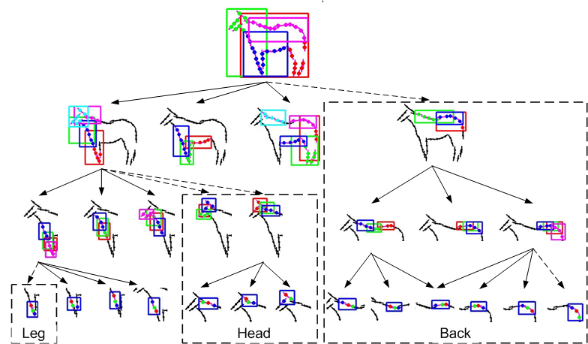
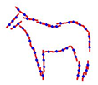
Notes:
a large template consists of a small number of sub-templates, and a sub-template consists of a small number of sub-sub-templates, and so on
Put spatial

Slide 10
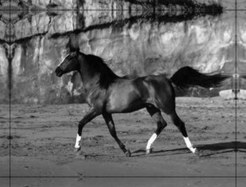
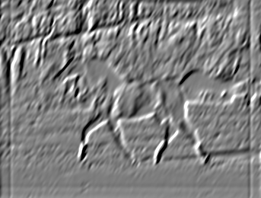

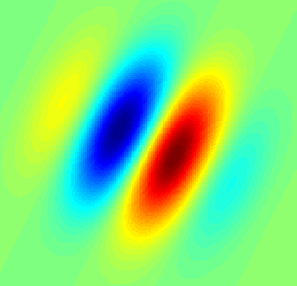

RCM -1: multi-level potentials
Data terms: image features (edge, Gabor…)
*
=
Prior terms: triplet-shape descriptors
  Gaussian potential
  Translation, rotation, scale invariant
Position,
Scale,
Orientation

Slide 11
Modeling-Inference-Learning
Task: given the model (potentials and parameters are known), find the best y (max posterior) :
Recursive Optimization:
Recursion
Polynomial-time Complexity:

Slide 12
Modeling-Inference-Learning
Supervised (discriminative): given the structure and labeled ground truth, estimate the parameters.
Unsupervised (generative): induce the structure and estimate the parameters without ground truth
L Zhu et al.CVPR 08

Slide 13
Structure-Perceptron Learning
Binary: y = +1, -1. (Rosenblatt 1962)
Multi-class: y =1 .. K. (Freund and Schapire 99)
y is a vector: structure-perceptron (Collins 02)
where

Slide 14
Structure-Perceptron Training
Input: a set of training images with ground truth . Initialize parameter vector.
Training algorithm:
  Loop over training samples: i = 1 to N
  Step 1: find the best using inference:
  Step 2: Update the parameters:
  End of Loop.
Inference is critical for perceptron learning

Slide 15
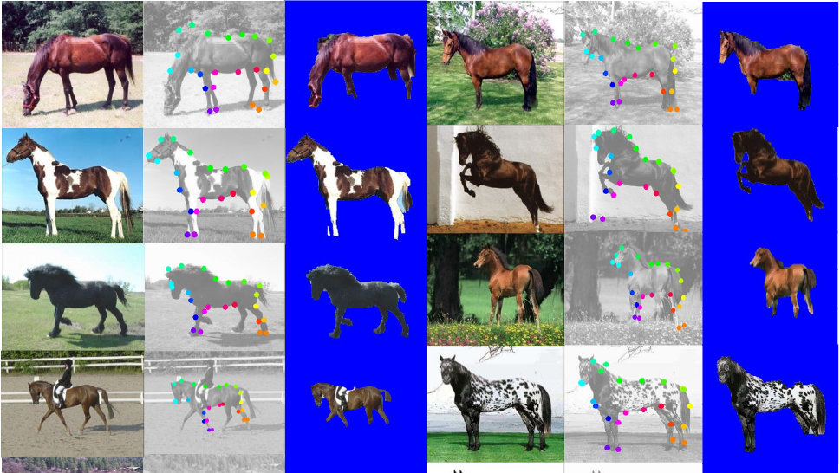

Slide 16
Deformable Object Segmentation and Parsing
Segmentation (Accuracy of pixel labeling)
  The proportion of the correct pixel labels (object or non-object)
Parsing (Average Position Error of matching)
  The average distance between the positions of leaf nodes of the ground truth and those estimated in the parse tree
Methods | Testing | Segmentation | Parsing | Speed
RCM-1 | 228 | 94.7 | 16 | 23s
Ren (Berkeley) | 172 | 91
Winn (LOCUS) | 200 | 93
Levin and Weiss | N/A | 95
Kumar (OBJ CUT) | 5 | 96

Slide 17
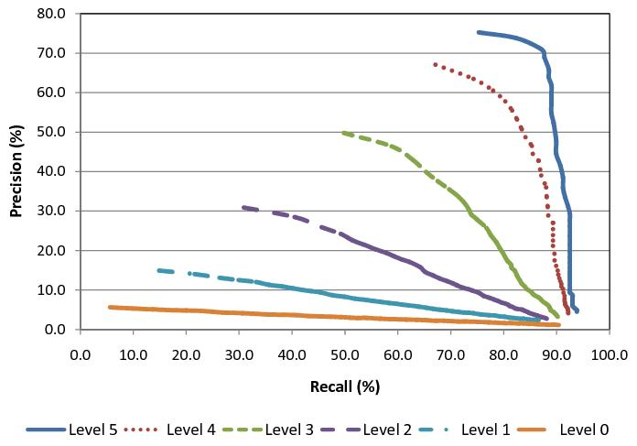
Performance Contribution of
Multi-Level Object Parts
Precision-Recall curves quantify the recognition performance
High-level regularity (more parts) help recognition.

Slide 18
Why Recursive Composition?
Compact representation:
  Low dimension
  Simple potential (low-order sufficient statistics)
  More representation power (more nodes, long-range correlation)
Rapid inference: recursive optimization
Efficient supervised learning
Next: efficient unsupervised learning

Slide 19
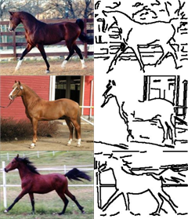
Modeling-Inference-Learning
Unsupervised Learning (Generative)
  No labeling, no alignment.
  Induce the structure (vertexes and edges)
  Estimate the parameters.
Combinatorial Explosion problem
?
L Zhu et al. ECCV 08

Slide 20
Recursive Learning
Task: find a small dictionary (sparse coding).
Recursive Learning Procedure: (layer-wise greedy)
Initialization: D^0 = {oriented edgelets} ; L=1
Repeat .. until no new models are formed.
initialize D^L with a default (NULL) model at level L.
propose new models by compositions and clustering
suspicious coincidence: add new models if they beat the default model.
competitive exclusion: similar models compete to survive (the best one is kept).
Barlow 94.

Slide 21
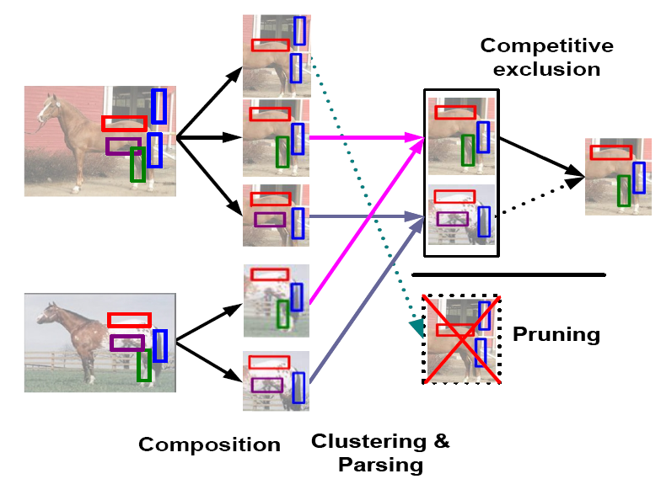
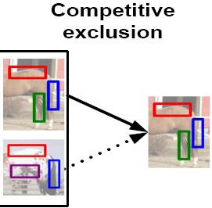
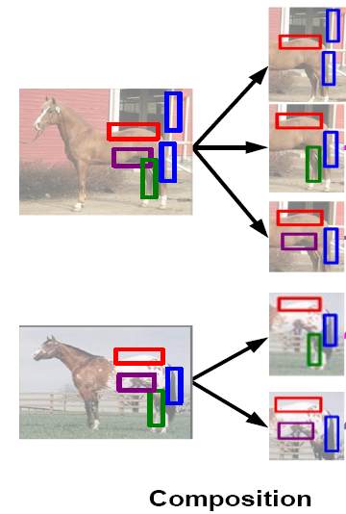
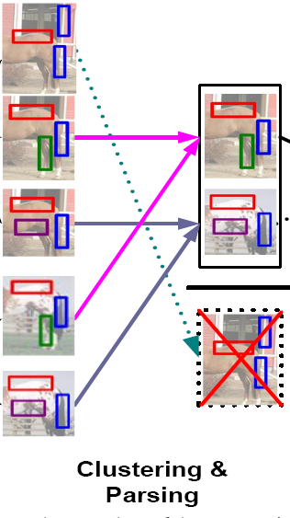
Recursive Learning

Slide 22
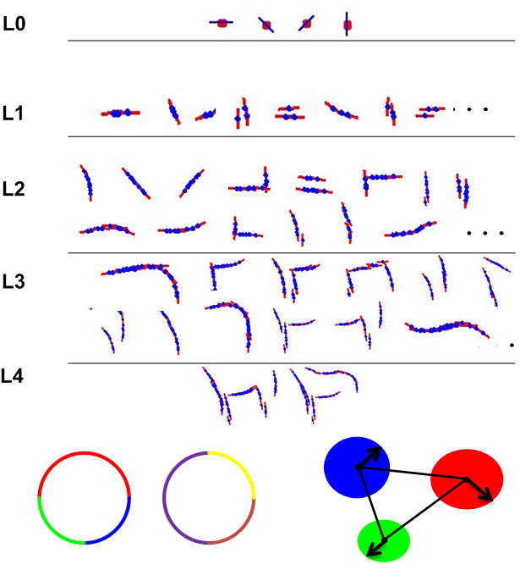

Slide 23
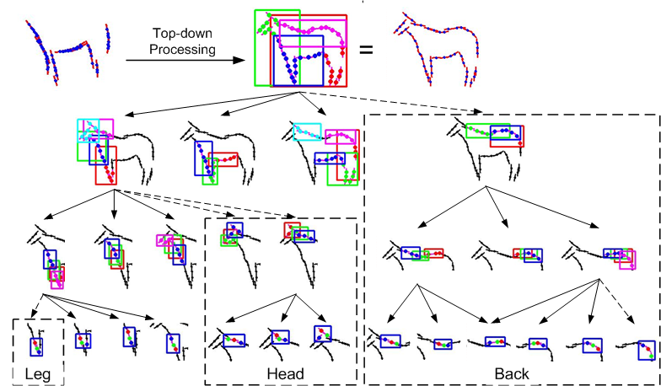
Top-down refinement
From top level L to 1, examine every node of model M:
Initialize a default submodels at level L-1.
propose new models from D^L-1
suspicious coincidence: keep new models if they beat the default model.
competitive exclusion: similar models compete to survive. (the best one is kept)

Slide 24
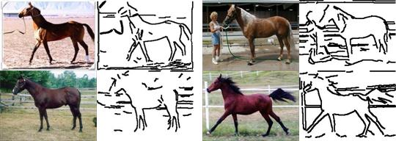
10 images for training

Slide 25
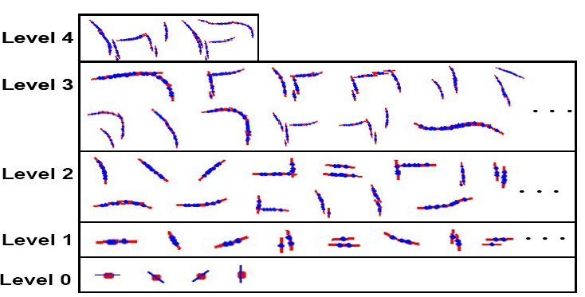
From Generic Features to
Object Structures
Unified descriptors (RCMs)
Unified learning: bridge the gap between the generic features and specific object structures

Slide 26
Template Matching

Slide 27
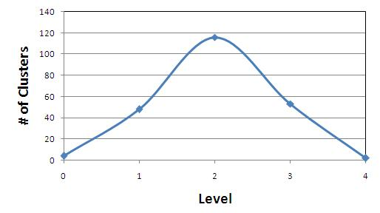
Multi-Level
Computational Complexity
Explore a huge number of candidate models
Level | Composition | Clusters | Suspicious Coincidence | Competitive Exclusion | Seconds
0 |  |  |  | 4 | 1
1 | 167,431 | 14,684 | 262 | 48 | 117
2 | 2,034,851 | 741,662 | 995 | 116 | 254
3 | 2,135,467 | 1,012,777 | 305 | 53 | 99
4 | 236,955 | 72,620 | 30 | 2 | 9

Slide 28
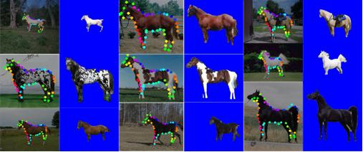
Comparisons
Methods | Testing | Segmentation | Parsing | Speed
Unsupervised | 316 | 93.3 |  | 17s
Structure-Perceptron | 228 | 94.7 | 16 | 23s

Slide 29

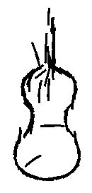



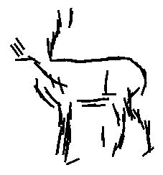
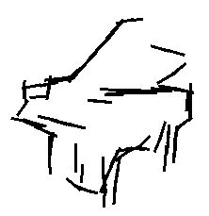
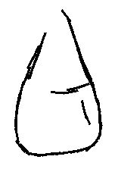
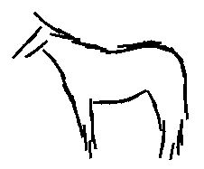

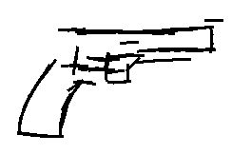
More Objects

Slide 30
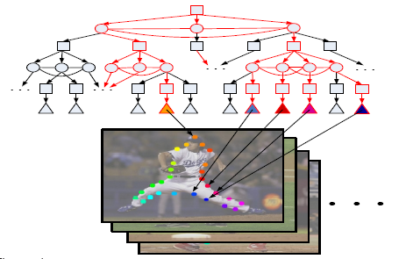
RCM-1 for Articulated Object
AND/OR graph for enormous articulated poses
Structure-SVM learning: need rapid inference
Human body parsing
ORing
ANDing
L Zhu et al. CVPR 08

Slide 31
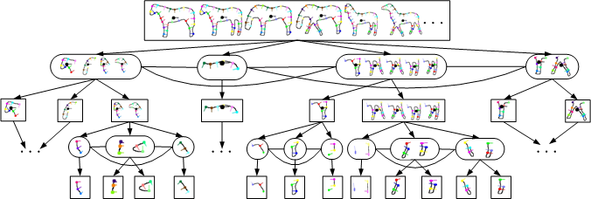
RCM-1 for Horse
mixture of poses

Slide 32
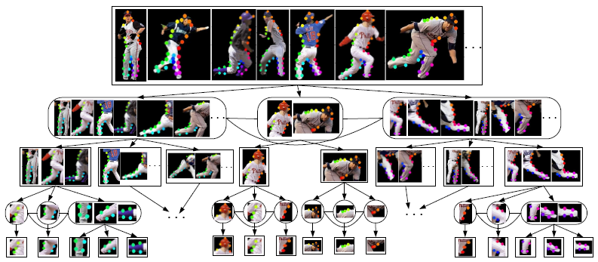
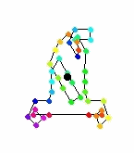
RCM-1 for Human Body

Slide 33
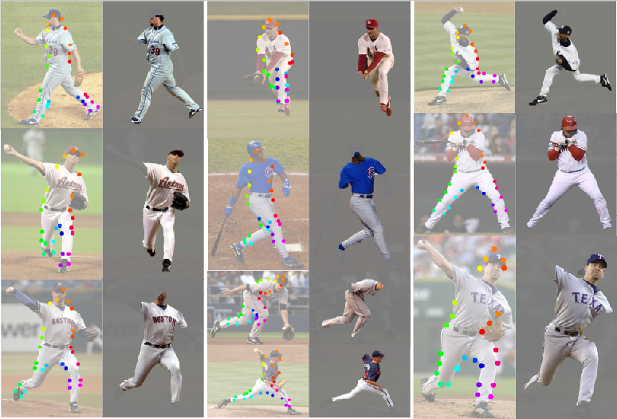

Slide 34
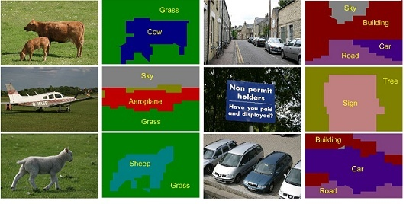
Example II: Scene Parsing
Recursive Composition is General?
Task: Image Segmentation and Scene Labeling
Representation: MRF

Slide 35
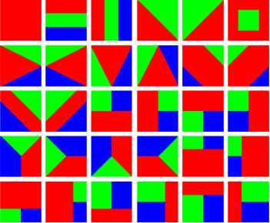

Image Representation:
Recursive Composition
Flat MRF: single recognition(object) labeling.
Joint segmentation-recognition template
L Zhu et al. NIPS 08

Slide 36
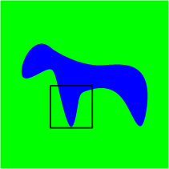
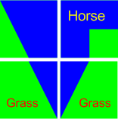
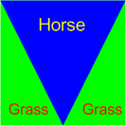
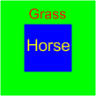
Segmentation and Recognition Template
(segmentation, object) pair: chicken-and-egg of segmentation and recognition.
Multi-level coarse-to-fine abstraction
Global:
gist of scene
Local: concurrent
shape and appearance

Slide 37


RCM-2: Scene Parsing
Recursion
y=(segmentation, object)
appearance likelihood | object layout prior
homogeneity | Layer-wise consistency
object texture color | object co-occurrence
 | segmentation prior
Horse
Grass
Notes:
The form of y is critical. The design is art or science.
Y is a summarization /abstract of image.

Slide 38

Inference and Learning
State space:
  C=21 classes; D=30 templates;
  K=3 classes / per template
Inference (recursive optimization):
Supervised learning (structure-perceptron )

Slide 39
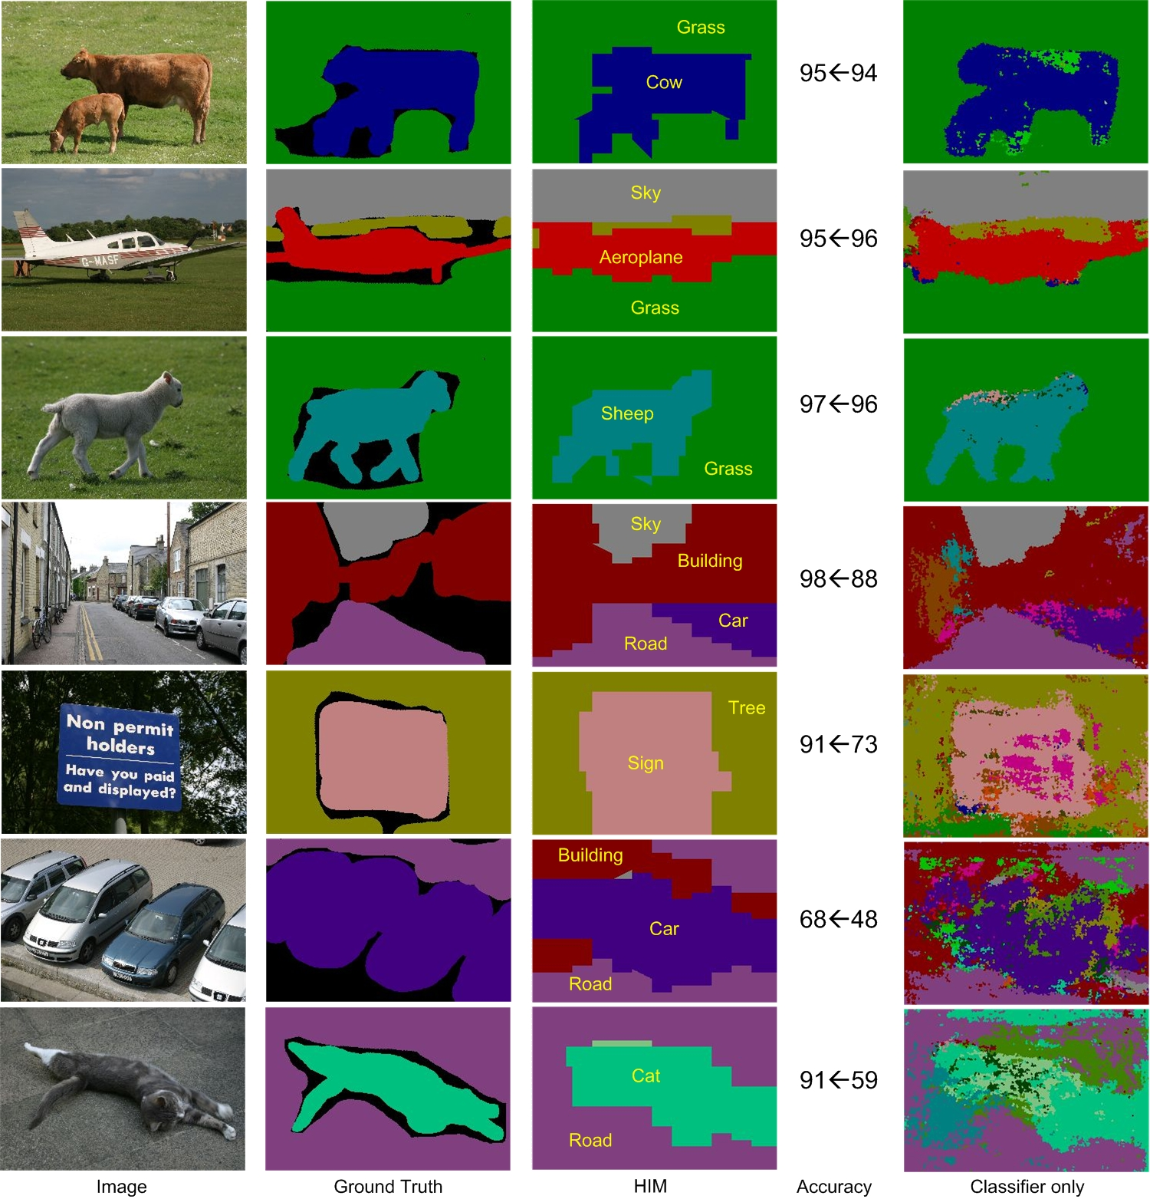

Slide 40
Comparisons
Implementation Details
Comparisons
Dataset | Classes | Size | Training Size | Training Time | Testing Time
MSRC | 21 | 591 | 45% | 55h | 30s
 | TextonBoost Shotton et al. 04 | PLSA-MRF Berbeek and Trigg | AutoContext Tu 08 | Classifier only | HIM (RCM-2)
Average | 57.7 | 64 | 68 | 67.2 | 74.5
Global | 72.2 69 (Classifier) | 73.5 | 77.7 | 75.9 | 81.4

Slide 41
Complete Image Understanding
Scaling up: RCM-?
It is all about the representation of y, i.e. visual patterns.
Low dimension; simple sufficient statistics.
Notes:
What is recursive composition
A small number of “subpatterns” which are regular
Dimensionality
Image complexity

Slide 42
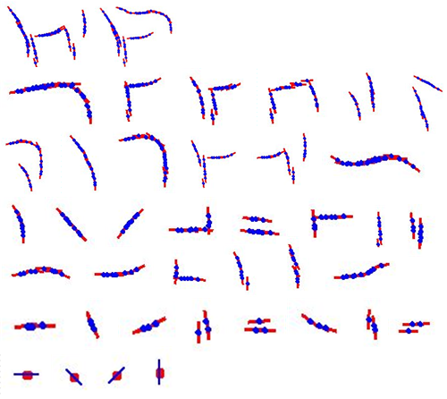
Conclusions
Principle: Recursive Composition
RCMs for Object and Scene Parsing
Compact modeling, rapid inference, efficient learning
Future: Practical Image Understanding System

