Slide 1
Recursive Composition in Computer Vision
Leo Zhu
CSAIL MIT

Slide 2
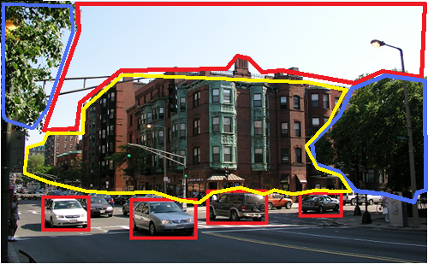
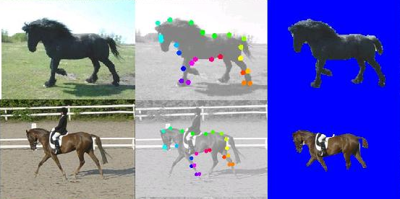
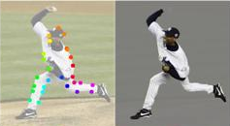
Ideas behind Recursive Composition
A principle for constructing models of the visual world
A general framework for different vision tasks
Three ingredients:
Modeling : compact, rich
Inference : rapid
Learning : efficient
Pattern Theory. Grenander 94
Compositionality. Geman 02, 06
Stochastic Grammar. Zhu and Mumford 06
Notes:
The key assumption to
address these problems is that the visual world is recursively
compositional.
Compact representation: dimension reduction, better generalization
Rapid inference: polynomial-learning time inference
Learning: polynomial-time learning; fewer training examples.

Slide 3
Outline
Task 1: Deformable Object Parsing
Modeling: Recursive Compositional Models
Inference: Recursive optimization
Learning: Supervised and Unsupervised
Task 2: Articulated Object Parsing
Task 3: Scene Parsing

Slide 4
Basic Setup
x: input image; y: interpretation of x
Generative Method:
Discriminative Method:
The representation of Energy Function:
f, g: potentials (sufficient statistics)
parameters (weights of potentials)
Notes:
Generative: Joint
Discriminative: Conditional
The major difference is the normalization term Z.
We focus on the representation (the form) of the potentials (sufficient statistics).

Slide 5
Task 1: flat MRF Representation for Deformable Object
Graph = (Nodes, Edges).
a, b : index of node.
(a,b): edge connecting a,b.
x: image; y: states of nodes.
: state of node a (position).
f: appearance potential on nodes
g: shape potentials on edges.
Deformable Template. Yuille 91
Constellation Model. Perona et al. 03
Composition Machine. Jin and Geman 06.
Active Basis. Wu et al. 07.
Notes:
Two Sufficient Statistics

Slide 6
Three Aspects: Modeling-Inference-Learning
Modeling:
Complexity: numbers of parameters, nodes, edges.
Graphical structure: loops, layers
Forms of sufficient statistics (potentials)
Inference: recognition/matching
Learning:
Estimate the parameters
Induce the structures

Slide 7
The Deficiency of Flat MRF
Modeling: limited representation power
sparse nodes
less long-range correlation
Inference and learning:
More loops if adding nodes and edges
?

Slide 8
Outline
Task 1: Deformable Object Parsing
Modeling: Recursive Compositional Models
Inference: Recursive optimization
Learning: Supervised and Unsupervised
Task 2: Articulated Object Parsing
Task 3: Scene Parsing

Slide 9
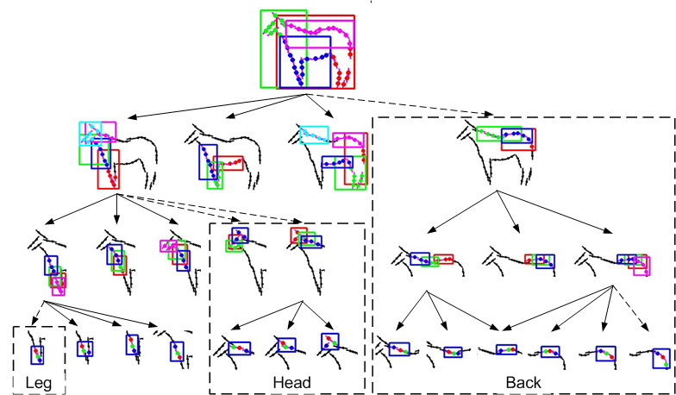
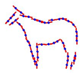
Recursive Compositional Models: RCM-1 for Horse
Notes:
a large template consists of a small number of sub-templates, and a sub-template consists of a small number of sub-sub-templates, and so on
Put spatial

Slide 10
Recursive Compositional Models: RCM-1
(position, scale, orientation)
Multi-level low- dimensional abstraction
Invariant abstraction across the hierarchy
More nodes and long-range correlation

Slide 11
RCM-1: the Recursive Formula
Recursion
Recursion reflects the vertical independency
Self-similar definition

Slide 12
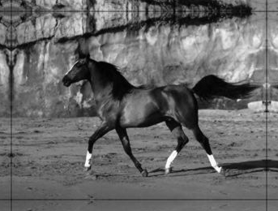
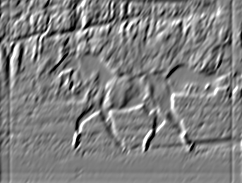
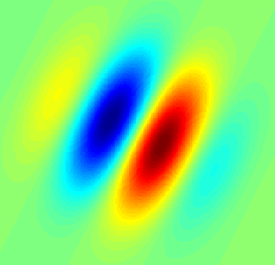
RCM-1: Multi-level Potentials
Potentials for appearance
[
Gabor,
Edge,
…]
*
=
Potentials for shape: triplet descriptors
Gaussian potential
Translation, rotation, scale invariant
position,
scale,
orientation

Slide 13
Outline
Task 1: Deformable object parsing
Modeling: Recursive Compositional Models
Inference: Recursive Optimization
Learning: Supervised and Unsupervised
Task 2: Articulated object
Task 3: Scene parsing

Slide 14
Inference
Task: given the model (potentials and parameters are known), find the best y (max posterior) :
Recursive Optimization:
Recursion
Polynomial-time Complexity:

Slide 15
Outline
Task 1: Deformable Object Parsing
Modeling: Recursive Compositional Models RCM-1
Inference: Recursive Optimization
Learning: Supervised and Unsupervised
Task 2: Articulated Object Parsing
Task 3: Scene Parsing
L Zhu et al.CVPR 08

Slide 16
Supervised Learning
Task: given the structure, potentials and labeled ground truth, estimate the parameters.
Different discriminative loss functions:
Perceptron (Collins 02)
Max margin (Structure-SVM) (Taskar et al. 04))
Conditional Random Field (MLE) (Lafferty et al. 01)
Graph is fixed; Correspondence
is known

Slide 17
Perceptron Learning for Structured Prediction
Binary: y = +1, -1. (Rosenblatt 1962)
Multi-class: y =1 .. K. (Freund and Schapire 99)
y is a vector (large state space). (Collins 02)
where

Slide 18
Perceptron Learning Algorithm
Input: a set of training images with ground truth . Initialize parameter vector.
Training algorithm:
Loop over training samples: i = 1 to N
Step 1: find the best using inference:
Step 2: Update the parameters:
End of Loop.
Inference is critical for learning

Slide 19
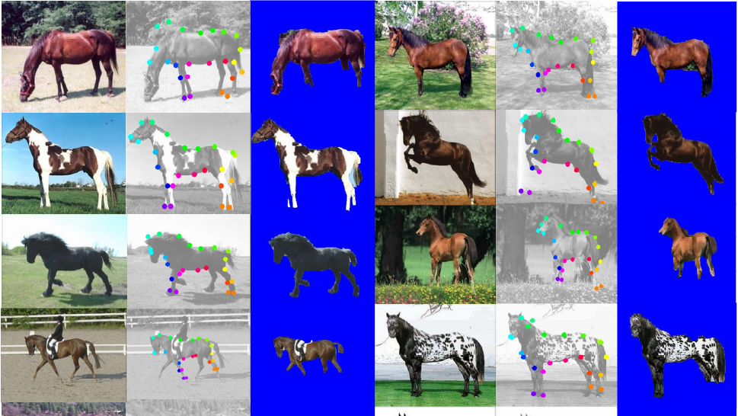
The Inference Results after Supervised Learning

Slide 20
Evaluations: Segmentation and Parsing
Segmentation (Accuracy of pixel labeling)
The proportion of the correct pixel labels (object or non-object)
Parsing (Average Position Error of matching)
The average distance between the positions of leaf nodes of the ground truth and those estimated in the parse tree
Methods | Testing | Segmentation | Parsing | Speed
RCM-1 | 228 | 94.7 | 16 | 23s
Ren (Berkeley) | 172 | 91
Winn (LOCUS) | 200 | 93
Levin and Weiss | N/A | 95
Kumar (OBJ CUT) | 5 | 96

Slide 21
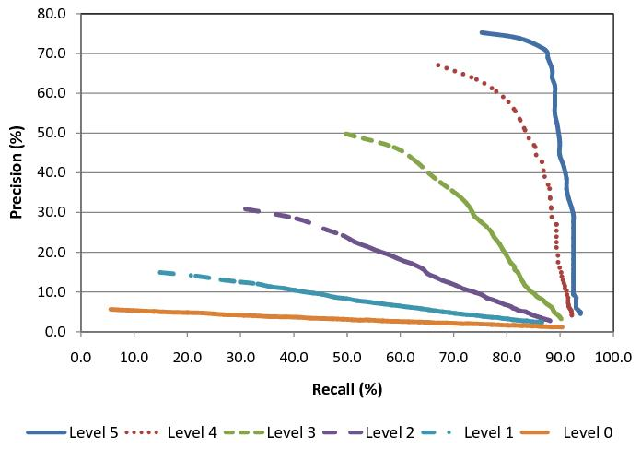
Performance Contribution of Multi-level Object Parts
Multi-level Precision-Recall curves quantify the recognition performance of object parts.
High-level regularity (more parts) help recognition.

Slide 22
Outline
Task 1: Deformable object parsing
Modeling: Recursive Compositional Models
Inference: Recursive Optimization
Learning: Supervised and Unsupervised
Task 2: Articulated Object Parsing
Task 3: Scene Parsing
L Zhu et al. ECCV 08

Slide 23
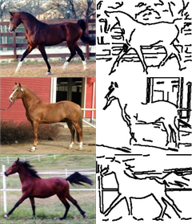
Unsupervised Learning
Task: given 10 training images, no labeling, no alignment
Induce the structure (nodes and edges)
Estimate the parameters.
Correspondence is unknown
?
Combinatorial Explosion problem

Slide 24
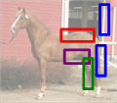
Recursive Dictionary Learning
Suspicious Coincidence
Composition
Clustering
Competitive
Exclusion

Slide 25
Recursive Dictionary Learning
Task: find a small dictionary (sparse coding).
Recursive Learning Procedure: (layer-wise greedy)
Initialization: D^0 = {four oriented edgelets} ;
Repeat L=1, 2, .. until no new models are formed.
initialize D^L with a default (NULL) model at level L.
propose new models by composition and clustering
suspicious coincidence: add new models if they beat the default model.
competitive exclusion: similar models compete to survive (the best one is kept).
Barlow 94.

Slide 26
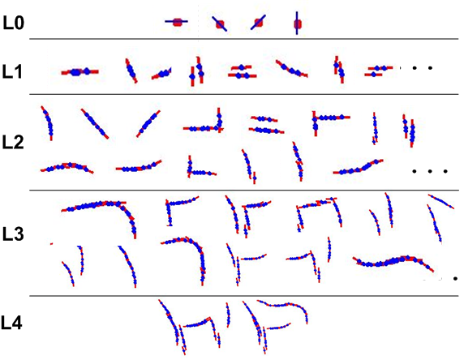
The Dictionary: From Generic Parts to Object Structures
Unified representation (RCMs) and learning
Bridge the gap between the generic features and specific object structures

Slide 27
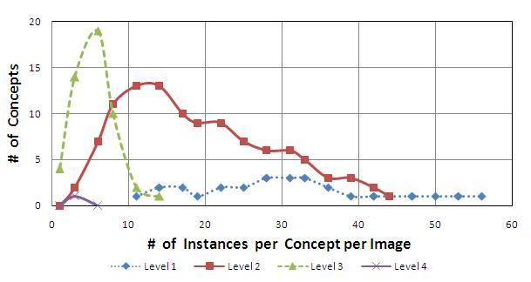
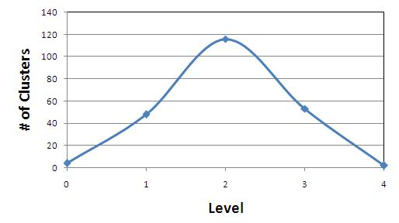
Dictionary Size, Part Sharing and Computational Complexity
Level | Composition | Clusters | Suspicious Coincidence | Competitive Exclusion | Seconds
0 |  |  |  | 4 | 1
1 | 167,431 | 14,684 | 262 | 48 | 117
2 | 2,034,851 | 741,662 | 995 | 116 | 254
3 | 2,135,467 | 1,012,777 | 305 | 53 | 99
4 | 236,955 | 72,620 | 30 | 2 | 9
More Sharing

Slide 28
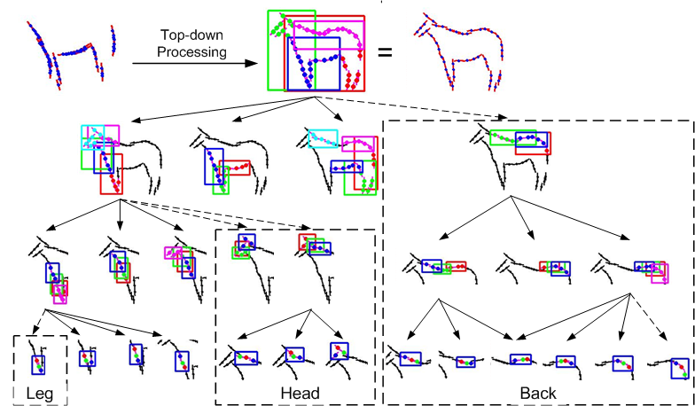
Top-down refinement
From top level L to 1, examine every node of model M:
Initialize a default submodel at level L-1.
propose new models from the subdictionary D^L-1
suspicious coincidence: keep new models if they beat the default model.
competitive exclusion: similar models compete to survive. (the best one is kept)

Slide 29
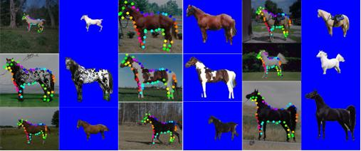
Evaluations of Unsupervised Learning
Methods | Testing | Segmentation | Parsing | Speed
Unsupervised | 316 | 93.3 |  | 17s
Supervised | 228 | 94.7 | 16 | 23s

Slide 30
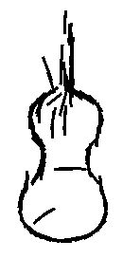
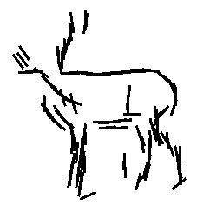
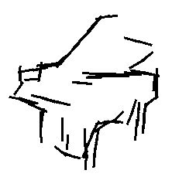
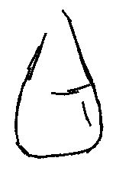
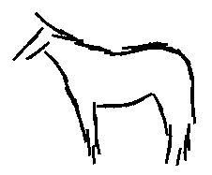
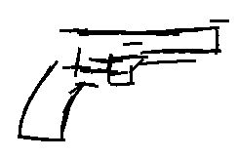

Slide 31
Outline
Task 1: Deformable object parsing
Modeling: Recursive Compositional Models
Inference: Recursive optimization
Learning: Supervised and Unsupervised
Task 2: Articulated Object Parsing
Task 3: Scene Parsing
L Zhu et al. CVPR 08

Slide 32
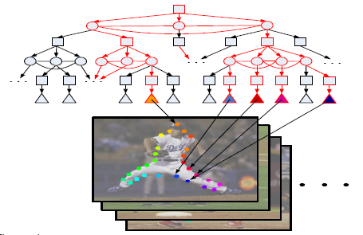
Task 2: RCM-2 for Articulated Object
Enormous articulated poses
Structure-SVM learning: need rapid inference
ANDing
ORing

Slide 33
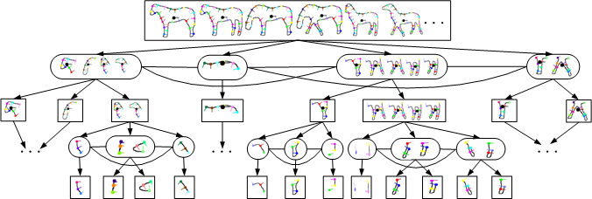
RCM-2 for Horses
switchable to multiple poses

Slide 34
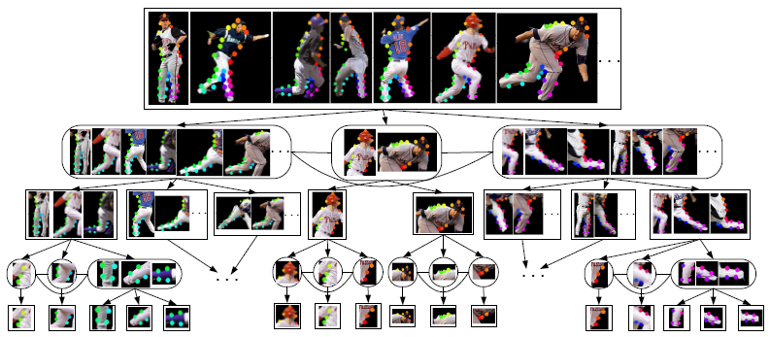
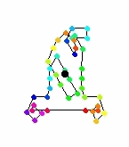
RCM-2 for Human Body

Slide 35
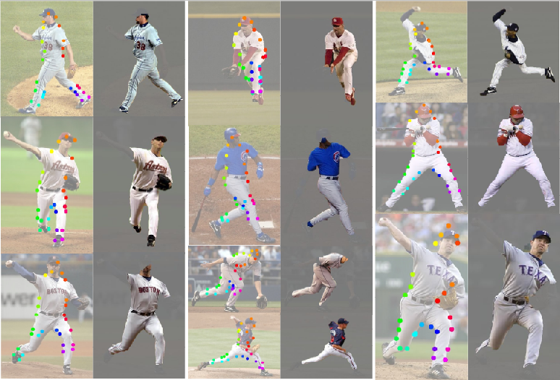

Slide 36
Outline
Task 1: Deformable Object Parsing
Modeling: Recursive Compositional Models
Inference: Recursive optimization
Learning: Supervised and Unsupervised
Task 2: Articulated Object Parsing
Task 3: Scene Parsing
L Zhu et al. NIPS 08

Slide 37
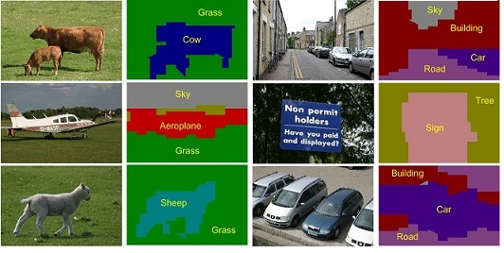
Task 3: Scene Parsing Recursive Composition is General? !
Task: Image Segmentation and Scene Labeling
Representation: MRF

Slide 38
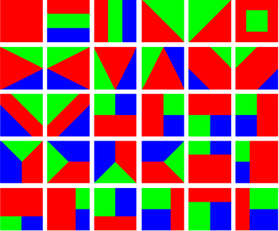
Scene Modeling: RCM-3
Flat MRF: object labeling (recognition only).
Joint segmentation-recognition template
Geman and Geman 84.
L Zhu et al. NIPS 08

Slide 39
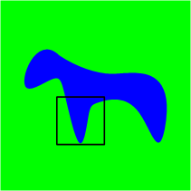
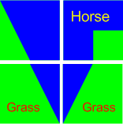
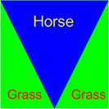
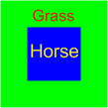
Segmentation and Recognition Template
(segmentation, object) pair: chicken-and-egg of segmentation and recognition.
Multi-level low-dimensional abstraction
coarse to fine
Global: gist of scene
object layout
Local: concurrent
shape and appearance

Slide 40
Unified RCMs: Object vs. Scene
RCM-1&2: shape of object parts
RCM-3: shape of object classes
Triplets of Parts Curve vs. Region Triplets of Segments

Slide 41
RCM-3: Scene Parsing
Recursion
y=(segmentation, object)
appearance likelihood | object layout prior
homogeneity | layer-wise consistency
object texture color | object co-occurrence
 | segmentation prior
Horse
Grass

Slide 42
RCM-3: Inference and Learning
State space:
C=21 classes; D=30 templates;
K=3 classes / per template
Inference (recursive optimization):
Supervised learning (perceptron )

Slide 43
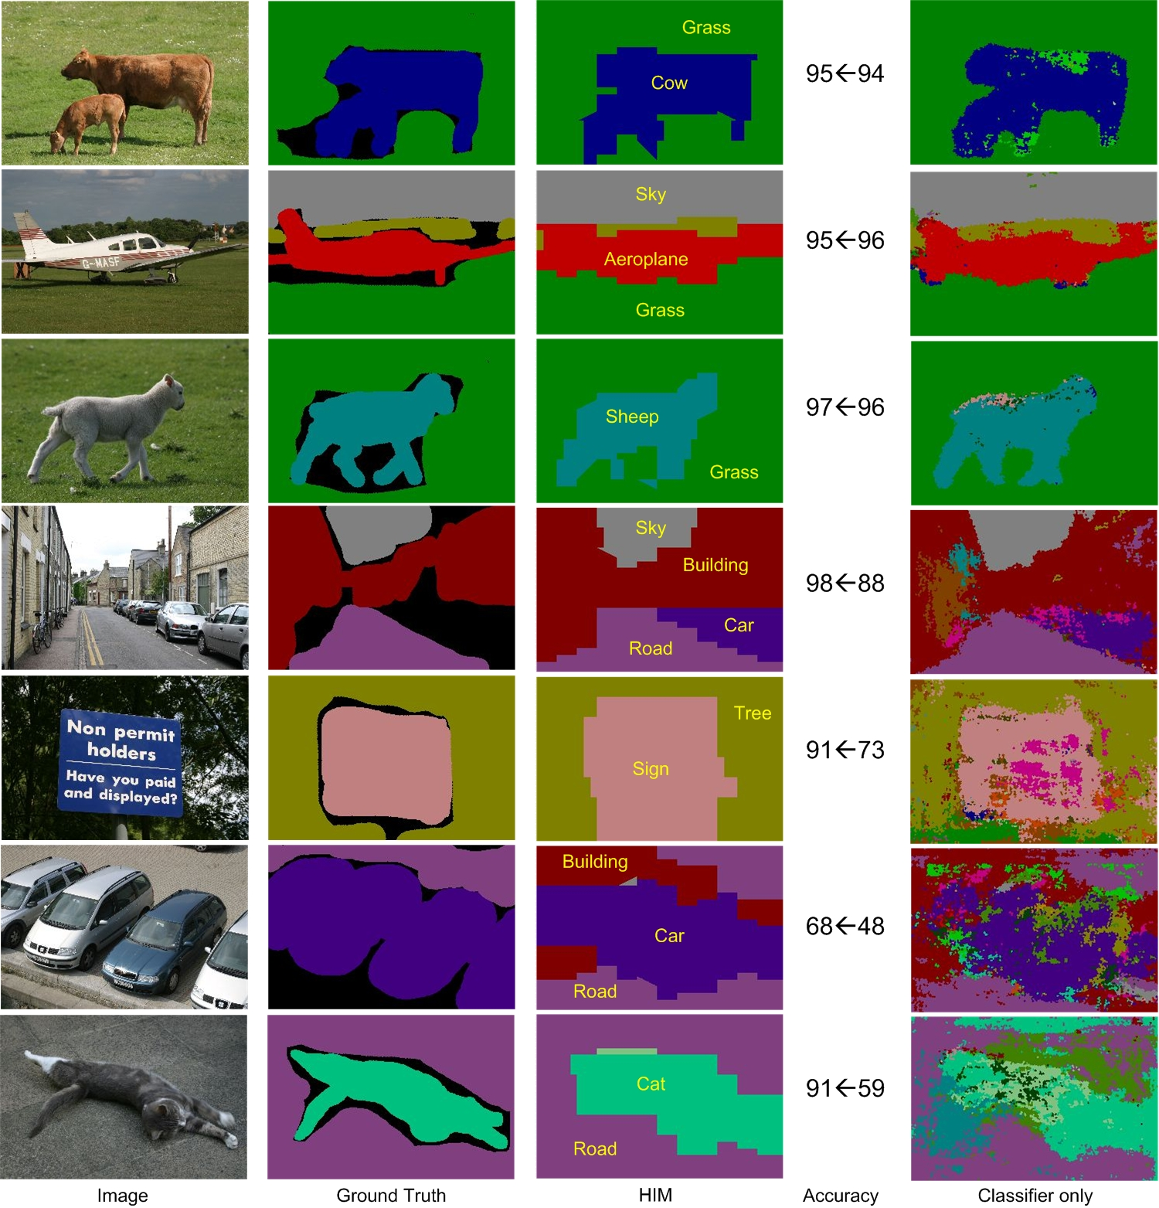

Slide 44
Evaluations of RCM-3
Implementation Details
Comparisons
Dataset | Classes | Size | Training Size | Training Time | Testing Time
MSRC | 21 | 591 | 45% | 55h | 30s
 | TextonBoost Shotton et al. 04 | PLSA-MRF Berbeek and Trigg | AutoContext Tu 08 | Classifier only | RCM-3
Average | 57.7 | 64 | 68 | 67.2 | 74.5
Global | 72.2 69 (Classifier) | 73.5 | 77.7 | 75.9 | 81.4

Slide 45
Complete Image Understanding Scaling up: RCM-?
One formula for different tasks.
Key: the representation of y, i.e. visual patterns.
Low dimension, simple sufficient statistics.

Slide 46
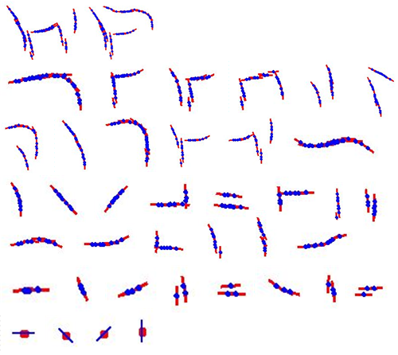
Conclusions
Principle: Recursive Composition
RCMs for Object and Scene Parsing
Compact modeling, rapid inference, and efficient learning
Future: Practical Image Understanding System

