Slide 1
Recursive Composition in Computer Vision
Leo Zhu
CSAIL MIT

Slide 2
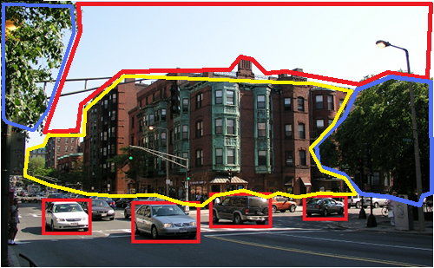
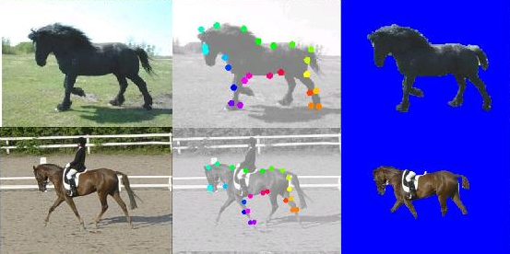
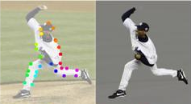
Ideas behind Recursive Composition
A principle for constructing models of the visual world
A general framework for different vision tasks
Three aspects:
  Modeling : Compact (simple)
  Inference : Rapid recognition
  Learning : Efficient
  Pattern Theory. Grenander 94
  Compositionality. Geman 02
  Stochastic Grammar. Zhu and Mumford 06
Notes:
The key assumption to
address these problems is that the visual world is recursively
compositional.
Compact representation: dimension reduction, better generalization
Rapid inference: polynomial-learning time inference
Learning: polynomial-time learning; fewer training examples.

Slide 3
Basic Setup
x: input image; y: interpretation of x
Generative Method:
Discriminative Method:
The representation of Energy Function:
f, g: potentials (sufficient statistics)
Notes:
Generative: Joint
Discriminative: Conditional
The major difference is the normalization term Z.
We focus on the representation (the form) of the potentials (sufficient statistics).

Slide 4

Example I: flat MRF Representation for
Deformable Object
y: states of nodes, e.g. position of object parts (unobservable)
spatial
deformation
image
features
x : Image
Deformable Template. Yuille 91
POP. Yali et al. 02
Constellation Model. Perona et al. 03
Active Basis. Wu et al. 07.
Notes:
Two Sufficient Statistics

Slide 5
Three Aspects:
Modeling-Inference-Learning
Modeling:
  Forms of sufficient statistics
  Graphical structure: loops, layers
  Complexity: numbers of parameters, nodes, edges.
  Inference (recognition/matching)
    Large state space of y (pose)
  Learning
    Estimate the parameters
    Induce the structures

Slide 6
Why flat MRF is not good enough?
Spare nodes and less long-range correlation
=> less representation Power
More nodes and edges
=> more computational issues
?

Slide 7
RCM-1: the Probabilistic Formulation
Recursion
(position, scale, orientation)
Multiple-level abstraction
Same, low dimension
More nodes and long-range correlation

Slide 8
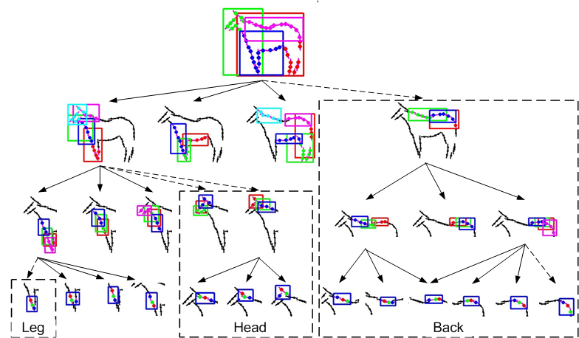
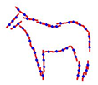
Notes:
a large template consists of a small number of sub-templates, and a sub-template consists of a small number of sub-sub-templates, and so on
Put spatial

Slide 9
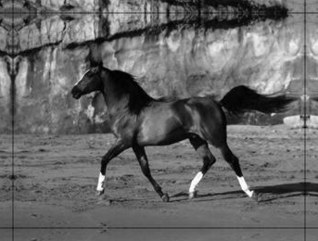
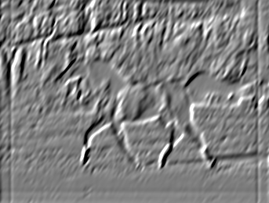

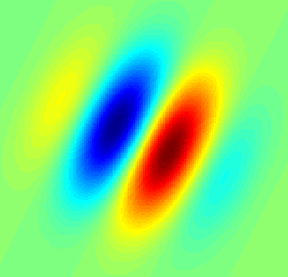

RCM -1: multi-level potentials
Data terms: image features (edge, Gabor…)
*
=
Prior terms: triplet-shape descriptors
  Gaussian potential
  Translation, rotation, scale invariant
Position,
Scale,
Orientation

Slide 10
Modeling-Inference-Learning
Task: given the model (potentials and parameters are known), find the best y (max posterior) :
Recursive Optimization:
Recursion
Polynomial-time Complexity:

Slide 11
Modeling-Inference-Learning
  Supervised (discriminative): given the structure and labeled ground truth, estimate the parameters.
    Structure-Perceptron learning
    Max-margin learning (Structured SVM)
    Maximum Likelihood Estimation (CRF)
  Unsupervised (generative): induce the structure and estimate the parameters without ground truth.
L Zhu et al.CVPR 08

Slide 12
Structure-Perceptron Learning
Binary y : {+1, -1}. (Rosenblatt 1962)
Multi-class y: {1 .. K}. (Freund and Schapire 99)
y is a vector: structure-perceptron (Collins 02)
where

Slide 13
Structure-Perceptron Training
Input: a set of training images with ground truth . Initialize parameter vector.
Training Algorithm:
  Loop over training samples: i = 1 to N
  Step 1: find the best using inference:
  Step 2: Update the parameters:
  End of Loop.
Inference is critical for perceptron learning

Slide 14
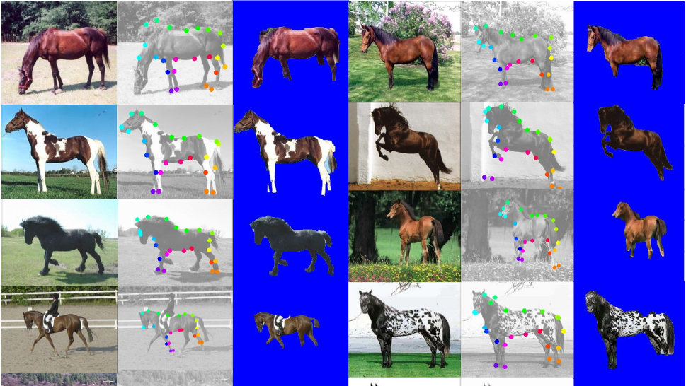

Slide 15
Segmentation and Parsing
Segmentation (Accuracy of pixel labeling)
  the proportion of the correct pixel labels (object or non-object)
Parsing (Average Position Error of matching)
  the average distance between the positions of leaf nodes of the ground truth and those estimated in the parse tree
Methods | Testing | Segmentation | Parsing | Speed
RCM-1 | 228 | 94.7 | 16 | 23s
Ren (Berkeley) | 172 | 91
Winn (LOCUS) | 200 | 93
Levin and Weiss | N/A | 95
Kumar (OBJ CUT) | 5 | 96

Slide 16
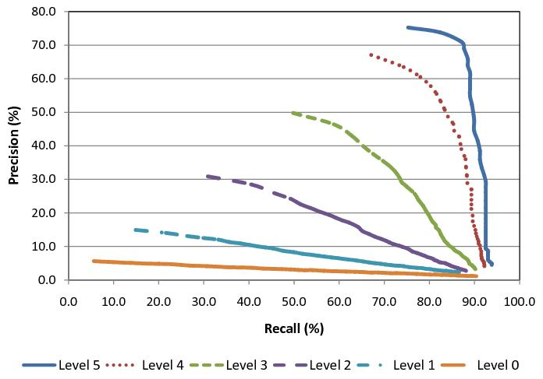
Performance Contribution of
Multi-Level Object Parts
Precision-Recall curves quantify the recognition performance
High-level regularity (more parts) help recognition.

Slide 17
Why Recursive Composition?
  Compact representation:
    simple potential (low-order sufficient statistics)
    More representation power (more nodes, more long-range correlation)
  Rapid inference: recursive optimization
  Efficient supervised learning
  Next: efficient unsupervised learning

Slide 18
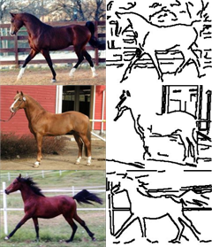
Modeling-Inference-Learning
Unsupervised Structure Learning (Generative)
  No labeling, no alignment.
  Induce the structure (vertexes and edges)
  Estimate the parameters.
Combinatorial Explosion problem
?
L Zhu et al. ECCV 08

Slide 19
Recursive Learning
Task: find a small dictionary (sparse coding).
Recursive Learning Procedure: (layer-wise greedy)
Initialization: D^0 = {oriented edgelets} ; L=1
Repeat .. until no few models are formed.
initialize D^L with a default model at level L.
propose new models by clustering
suspicious coincidence: add new models if they beat the default model.
competitive exclusion: similar models compete to survive (the best one is kept).

Slide 20
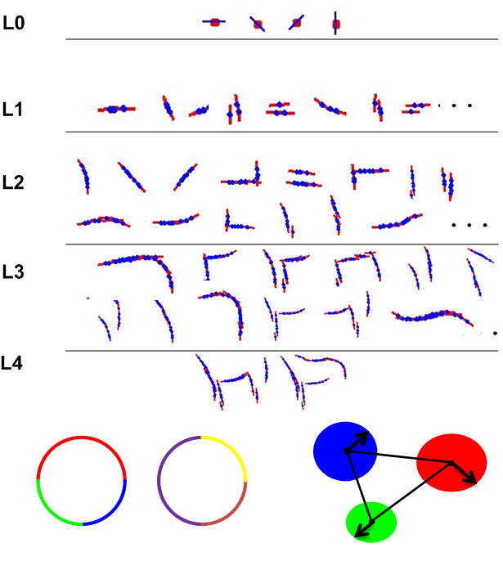

Slide 21
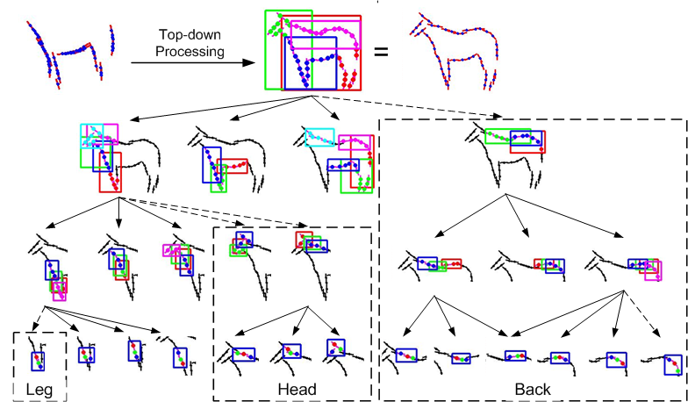
Top-Down model refinement: filling in missing parts
From level L to 1, examine every node of model M:
Initialize a default submodel at level L-1.
propose new models by clustering
suspicious coincidence: keep new models if beat the default model.
competitive exclusion: similar models compete to survive. (the best one is kept)

Slide 22
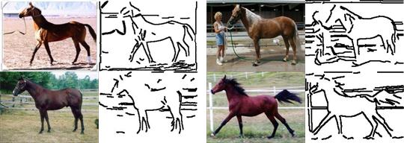
10 images for training

Slide 23
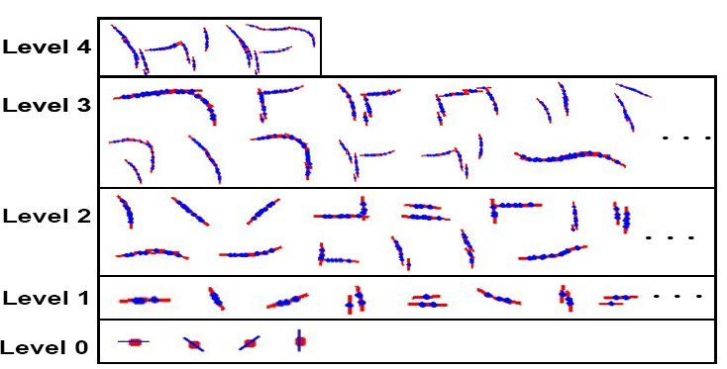
From Generic Features to
Object Structures
Unified descriptors (RCMs)
Unified learning: bridge the gap between the generic features and specific object structures

Slide 24
Template Matching

Slide 25
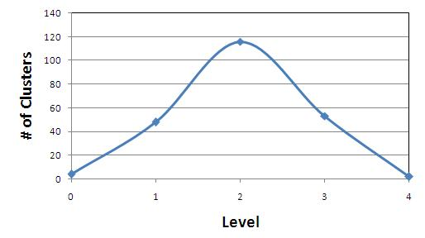
Multi-Level Computational Complexity
Explore a huge number of candidate models
Level | Composition | Clusters | Suspicious Coincidence | Competitive Exclusion | Seconds
0 |  |  |  | 4 | 1
1 | 167,431 | 14,684 | 262 | 48 | 117
2 | 2,034,851 | 741,662 | 995 | 116 | 254
3 | 2,135,467 | 1,012,777 | 305 | 53 | 99
4 | 236,955 | 72,620 | 30 | 2 | 9

Slide 26
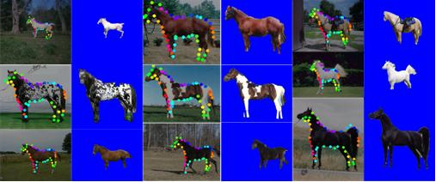
Comparisons
Methods | Testing | Segmentation | Parsing | Speed
Unsupervised | 316 | 93.3 |  | 17s
Structure-Perceptron | 228 | 94.7 | 16 | 23s

Slide 27
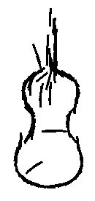

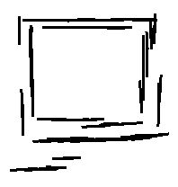

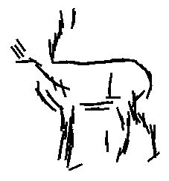
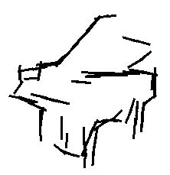
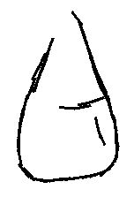
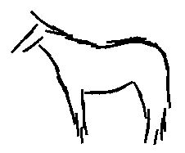


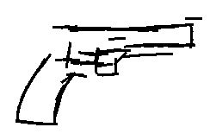

Slide 28
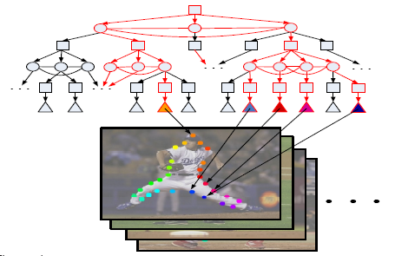
RCM-1 for Articulated Object
A novel AND/OR graph for enormous articulated poses.
Structure-SVM Learning: need rapid inference.
Human Body Parsing
ORing
ANDing
L Zhu et al. CVPR 08

Slide 29
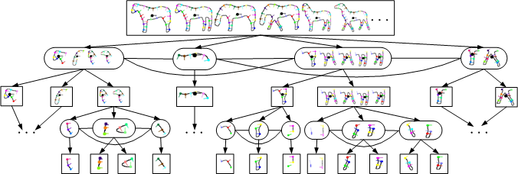
AND/OR Graph for Horse
Recursion
mixture

Slide 30
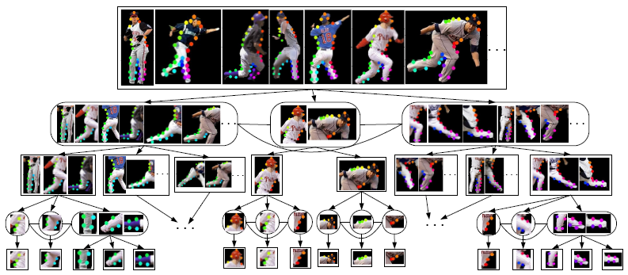
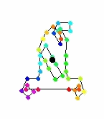
AND/OR Graph for Human Body

Slide 31
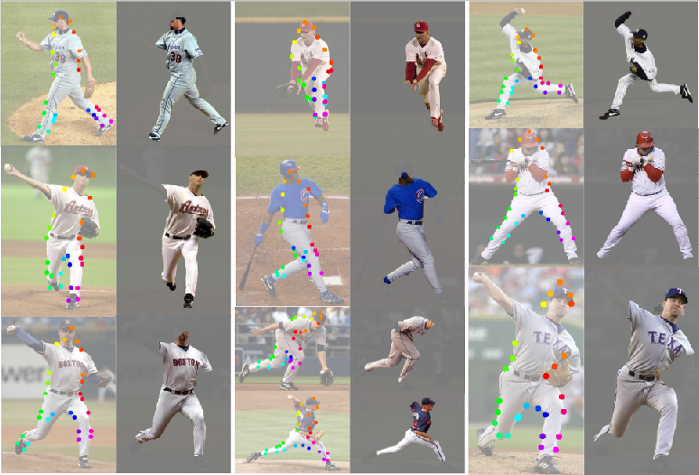

Slide 32
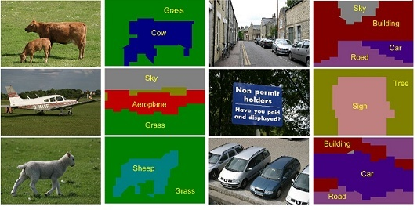
Example II: Scene Parsing
Recursive Composition is General?
Task: Image Segmentation and Scene Labeling
Representation: MRF

Slide 33
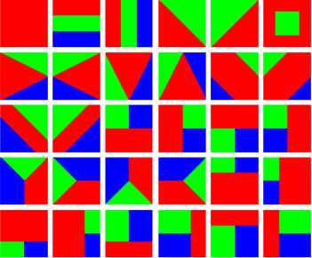

Image Representation:
Recursive Composition
  Flat MRF: single recognition(object) labeling.
  Joint segmentation-recognition template
L Zhu et al. NIPS 08

Slide 34
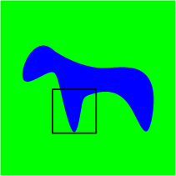
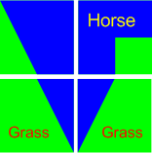
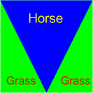
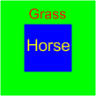
Segmentation and Recognition Template
(segmentation, object) pair: chicken-and-egg of segmentation and recognition.
Local: concurrent shape and appearance
Global: gist of scene (spatial layout)
Multi-level coarse-to-fine abstraction

Slide 35


RCM-2: Scene Parsing
Recursion
y=(segmentation, object)
appearance likelihood | object layout prior
homogeneity | Layer-wise consistency
object texture color | object co-occurrence
 | segmentation prior
Horse
Grass
Notes:
The form of y is critical. The design is art or science.
Y is a summarization /abstract of image.

Slide 36

Modeling-Inference and Learning
State space:
  C=21 classes; D=30 templates;
  K=3 classes / per template
Inference (recursive optimization):
Supervised learning (structure-perceptron )

Slide 37
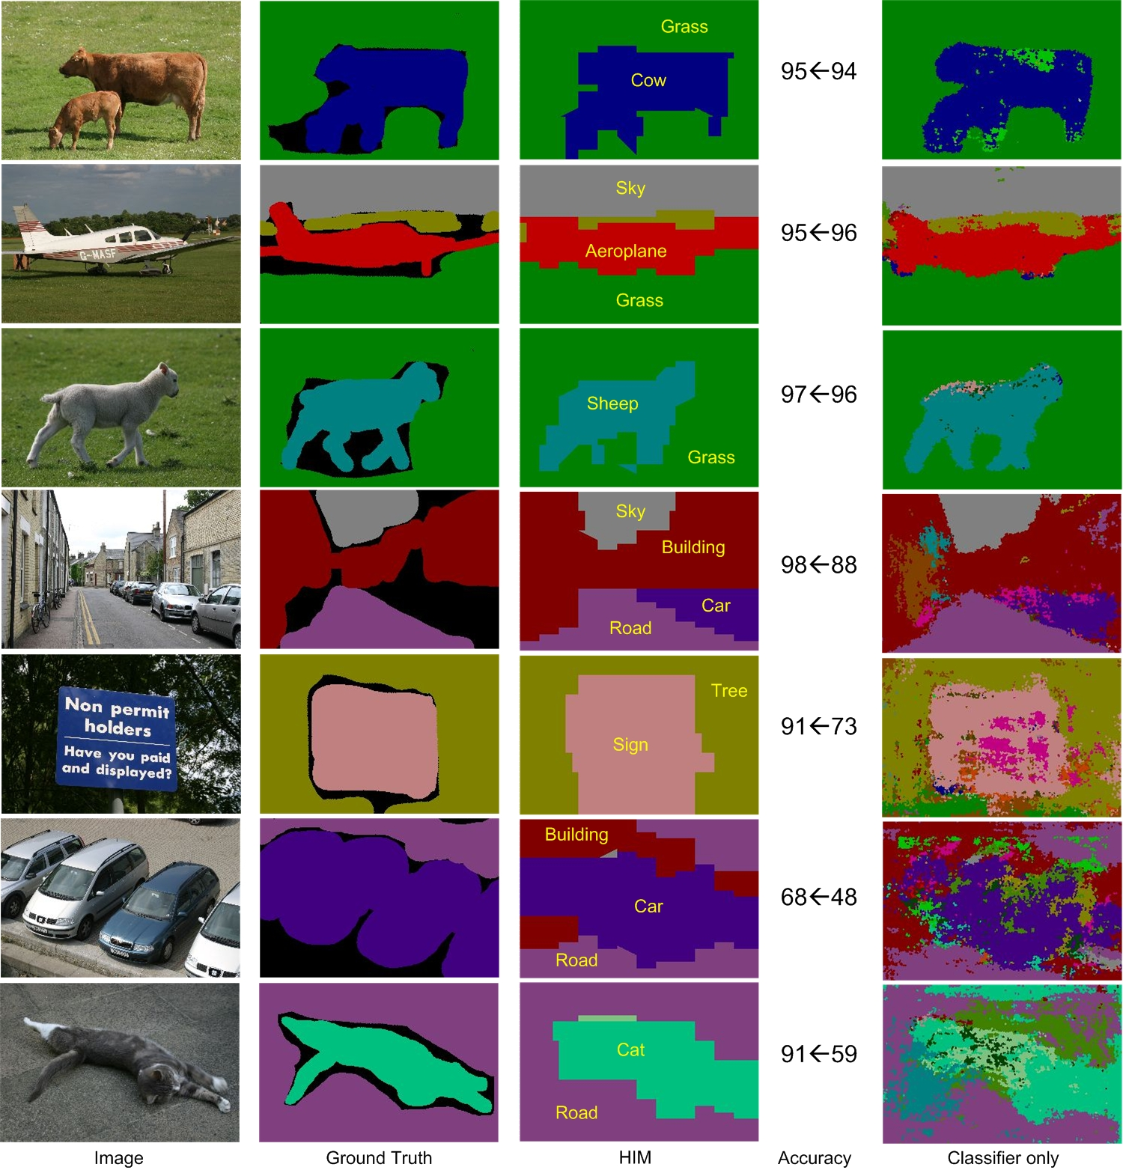

Slide 38
Comparisons
Implementation Details
Comparisons
Dataset | Classes | Size | Training Size | Training Time | Testing Time
MSRC | 21 | 591 | 45% | 55h | 30s
 | TextonBoost Shotton et al. 04 | PLSA-MRF Berbeek and Trigg | AutoContext Tu 08 | Classifier only | HIM (RCM-2)
Average | 57.7 | 64 | 68 | 67.2 | 74.5
Global | 72.2 69 (Classifier) | 73.5 | 77.7 | 75.9 | 81.4

Slide 39
Complete Image Understanding
Scaling up: RCM-?
  It is all about the representation of y, i.e. visual patterns.
  Low dimension; simple sufficient statistics.
Notes:
What is recursive composition
A small number of “subpatterns” which are regular
Dimensionality
Image complexity

Slide 40
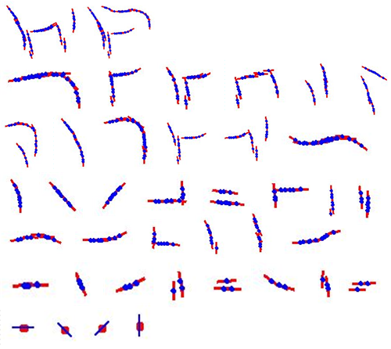
Conclusions
Principle: Recursive Composition
RCMs for Object and Scene Parsing
Compact modeling, rapid inference, efficient learning
Future: Practical Image Understanding System

