Slide 1
Recursive Composition for Deformable Object Parsing
Leo Zhu
CSAIL MIT
Oct. 2008
Notes:
Thanks!
Why computer vision?
Vision is a pre-eminent pattern theoretic problem. The difficulty of
vision arises from the complexity and ambiguity of natural images
The importance, and difficulty, of visual perception can be appreciated by realizing
that the optic nerve is the largest nerve in the body and
the visual cortex is estimated to be roughly half the size of the entire
cortex. Hence designing a system that can perform the main tasks of
vision – detecting and recognizing objects and interpreting images
and scenes – is equivalent to a computational understanding of at
least half the cortex.
But how is vision possible? learn to decode the complexity of real world images?
It has been argued that vision, and other cognitive tasks, can be
formulated in terms of probabilistic inference on structured
Representations.
But how can these representations and
probability distributions be learnt in an unsupervised way from real
images? How can we perform efficient inference on these probability
distributions? How can the system scale to deal with the large
numbers of different objects in the world and the enormous variety
of images and visual scenes? These are critical questions that we
address in this thesis.

Slide 2
Related Work
Geoffrey Hinton (Toronto): Deep Belief Nets
Tomaso Poggio (MIT): HMAX
Stuart Geman (Brown): Compositionality
Shimon Ullman (Weizmann): Hierarchy
Yali Amit (Chicago): POP
Narendra Ahuja (UIUC): Hierarchy
Songchun Zhu (UCLA): Grammar, AND/OR
Machine Learning and Natural Language Processing

Slide 3
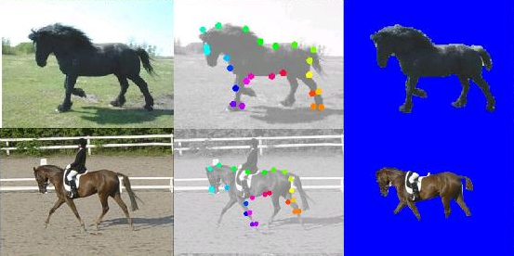
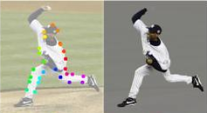
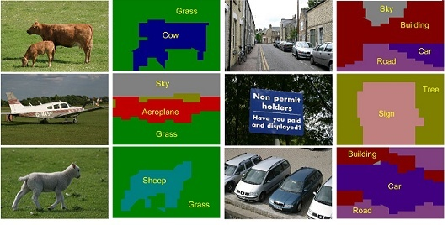
Vision Tasks
Object Categorization, Segmentation and Recognition
  Caltech-101
Deformable Object Detection, Segmentation and Parsing
  Weizmann Horse
  Multi-view Face Alignment
Articulated Object Parsing
  Berkeley Baseball Human Body
Image Parsing: scene labeling
  Microsoft Research Cambridge 21-Class
Notes:
Predict the boundary of the object, recognize the pose of the object, locate the object parts.
We will provide a general method which is able to solve these problems together.
Our principle will address all these issues.
Vision is so complex.

Slide 4
Recursive Composition
One Assumption: Recursive Composition
Three aspects:
  Modeling
  Inference
  Learning
Notes:
the two-dimensional nature of images makes it
much hard to design efficient image understanding systems and the
form of the representations is also unclear.
The key assumption to
address these problems is that the visual world is recursively
compositional.

Slide 5
Outline
Part I: Deformable Object Parsing
  Recursive Deformable Template Model
  Compositional Inference
  Supervised Learning
  Unsupervised
Part II: Image Parsing (Segmentation and Scene Labeling)
  Hierarchical Model, DP, and Perceptron Learning
Notes:
By introducing
elementary visual constituents of recursion properties, we design
recursively compositional systems for two basic image understanding
problems, deformable object parsing and image parsing.

Slide 6
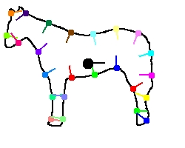
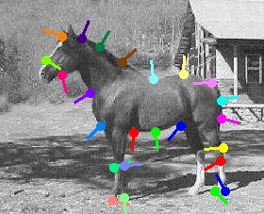
Deformable Object Parsing
Task: Find the locations y of parts of object given an image x
Difficulties
  Cluttered Background
  Large Shape Variation
  Occlusion
  Appearance

Slide 7
MRF Representation
Model:
Flat (single layer)
  Large state space of y
Inference Algorithm:
  Dynamic Programming (Coughlan CVIU2000, Felzenswalb PAMI)
  Belief Propagation (Coughlan ECCV2002)

Slide 8
Limitations
Representation Power
  Sparse
  Less Long-range correlation
Computational Issues
  Large state space
  More Nodes (Edges) →More loops & larger cliques.

Slide 9
Why Hierarchy ?
Recursive Composition
  Recursive Composition
  Dense Representation (Hierarchy)
  Multi-level Shape Deformation (simple long-range correlation)
  Inference: Dynamic Programming (Polynomial-time)
  Efficient Learning

Slide 10
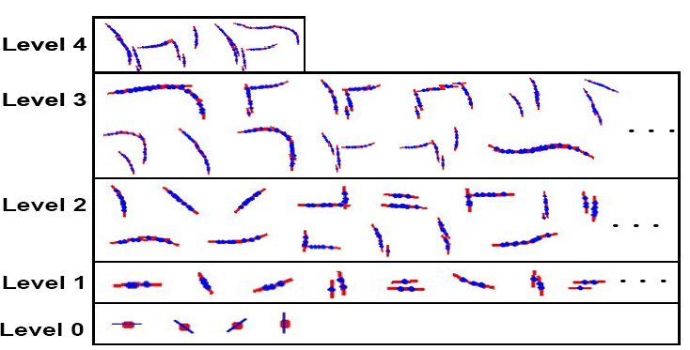
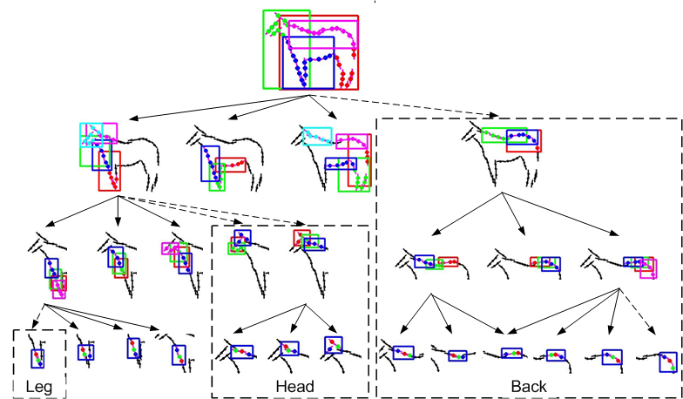
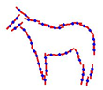
Recursive Deformable Template Model
What is Recursive Composition?
Notes:
a large template consists of a small number of sub-templates, and a sub-template consists of a small number of sub-sub-templates, and so on
Put spatial

Slide 11
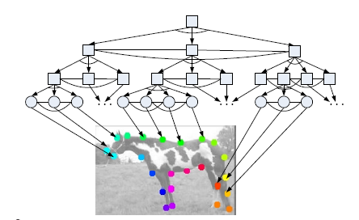
The Probabilistic Formulation
Input Image: State: (configuration of a Tree )
Hierarchical Log-Linear Form
Notes:
1. X is the input image Y is a tree 2. triplet descriptor and gaussian dist. 3. gradient 4. exponential form 5. multi-level deformation

Slide 12
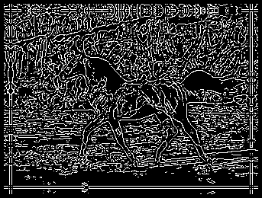

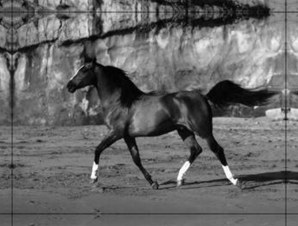
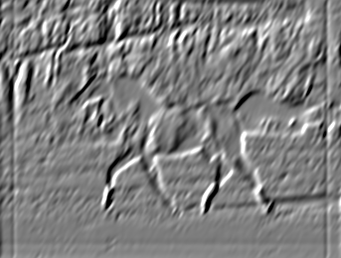

Image Features
Gray Image
Gradient
Gabor Filter
Canny Edge
*
=

Slide 13
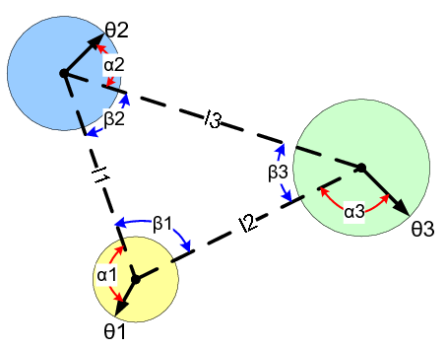

Multi-Level Shape Descriptors
Triplet Feature
Multi-Level Descriptors
  Short range
  Long range

Slide 14
Compositional Inference:
Parsing the Object
The model (structure and parameters) is given
Task:
Dynamic Programming (y is a tree)
State space per node:
  S = px * py * scale * orientation
Complexity: O(S^K*H)
  K<5: # of child nodes
  H: # of nodes
Some heuristics in practice

Slide 15
Speeding up: Heuristic
  Competitive Exclusion: Non Maximum Suppression in a local window
  Coincidence Pruning
  Compositionality: recover missing parts according to the geometrical relationship.
Notes:
Local window: ( x(+/- 5 ) * y(+/-5)* size (0.8~1.2) * rotation (+/-PI/6)
Leaf Node: scale (None); rotation (set by intensity gradient)

Slide 16
Suspicious Coincidence: Pruning
Pruning by the threshold (energy score) such that Recall = 95%
# of proposal <=200 after NMS
The range of the scale and rotation
  Scale: 0.5~1.5; Rotation: -PI/3~PI/3
The relative scale and rotation between the parent and child nodes
  Scale 1.5; rotation PI/4
The relative scale and rotation between any two child nodes
  Scale: 0.5~1.5; Rotation: -PI/3~PI/3

Slide 17
Inference: matching the templates

Slide 18
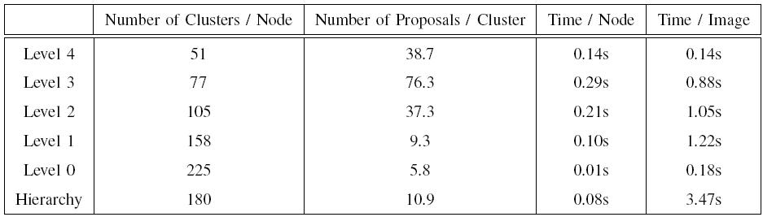
Complexity Analysis

Slide 19
Modeling-Inference-Learning
Model: Recursive Composition
Inference: Dynamic Programming
Learning:
  Supervised: Given the hierarchy, estimate the parameters.
    Structure-Perceptron
    Max-margin (Structured SVM)
  Unsupervised: induce the structure and estimate the parameters.

Slide 20
Structure-Perceptron Learning
Perceptron Learning for binary classification
Perceptron Learning for multi-class classification (Freund and Schapire 1999)
Structure-Perceptron Learning for structured prediction (Collins 2002)

Slide 21
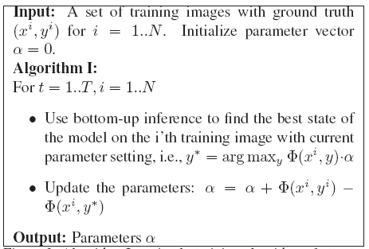
Structure-Perceptron Training

Slide 22
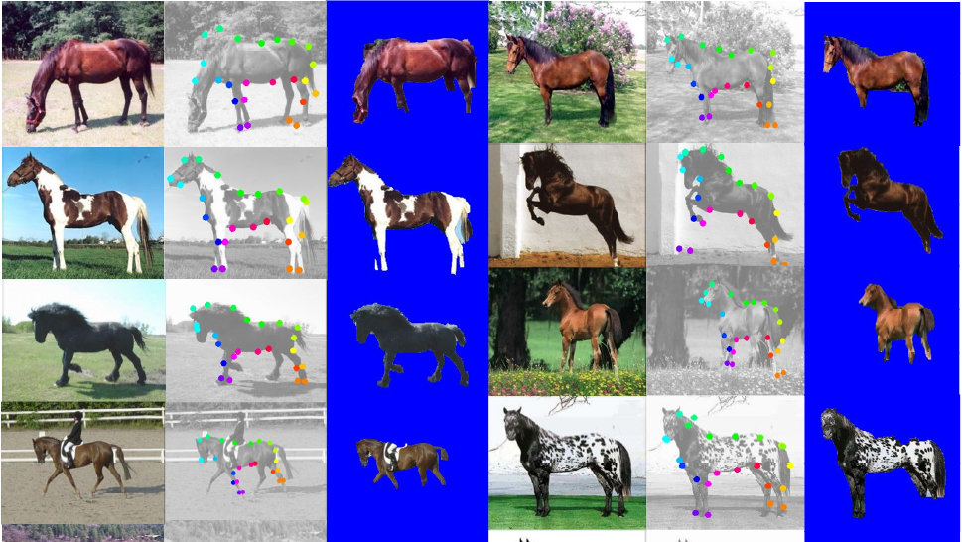
Parsing and Segmentation

Slide 23
Segmentation and Parsing
Segmentation (Accuracy)
  the proportion of the correct pixel labels (object or non-object)
Parsing (Average Position Error)
  the average distance between the positions of leaf nodes of the ground truth and those estimated in the parse tree
Methods | Testing | Segmentation | Parsing | Speed
Hierarchical Model | 228 | 94.7 | 16 | 23s
Ren (Berkeley) | 172 | 91
Winn (LOCUS) | 200 | 93
Levin and Weiss | N/A | 95
Kumar (OBJ CUT) | 5 | 96

Slide 24
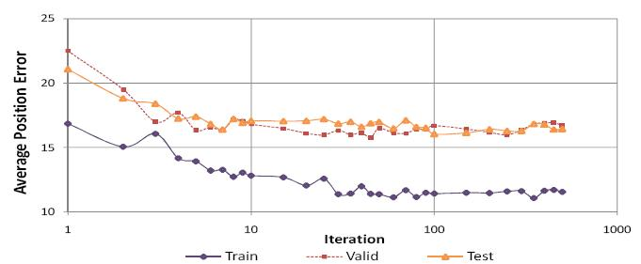
Convergence and Generalization

Slide 25
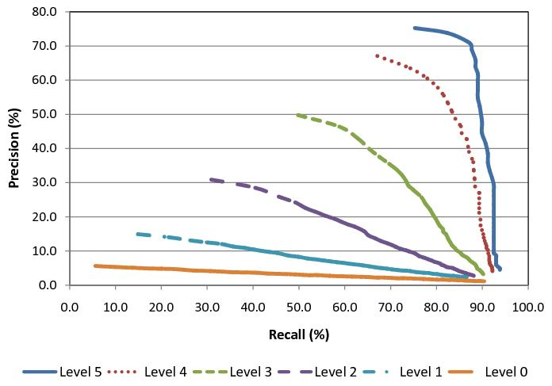
Performance Contribution of
Multi-Level Object Parts

Slide 26
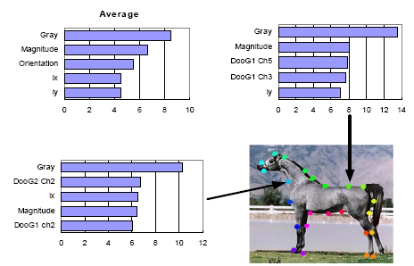
Analysis: Feature Selection

Slide 27
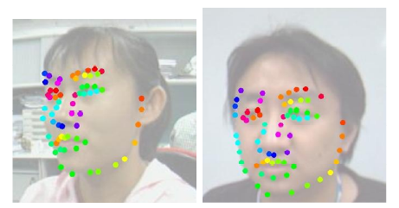
Multi-view Face Alignment
Show the versatility of our framework
Alignment: AAM (5.7) vs. Our method(6.0)

Slide 28
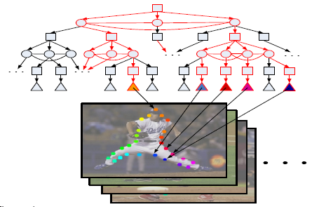
AND/OR Graph Learning
A novel AND/OR graph for enormous articulated poses.
Supervised Learning (Structure-SVM)
Human Body Parsing

Slide 29
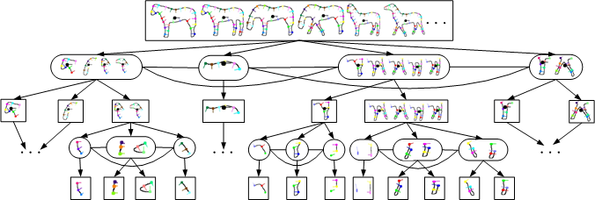
AND/OR Graph for Horse

Slide 30
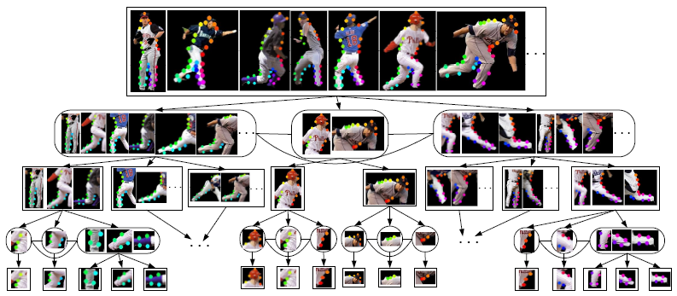
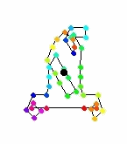
AND/OR Graph for the Human Body

Slide 31
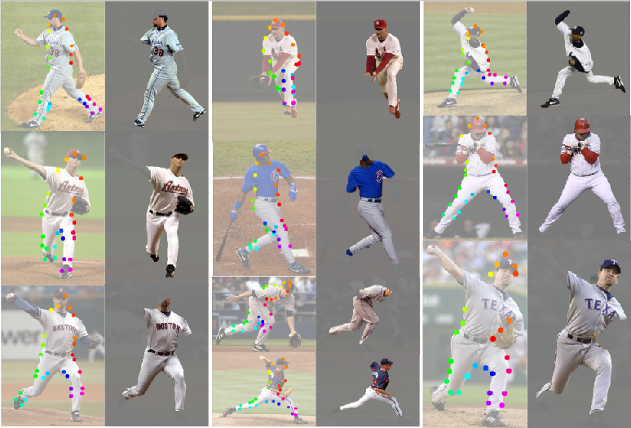
Human Body Parsing

Slide 32
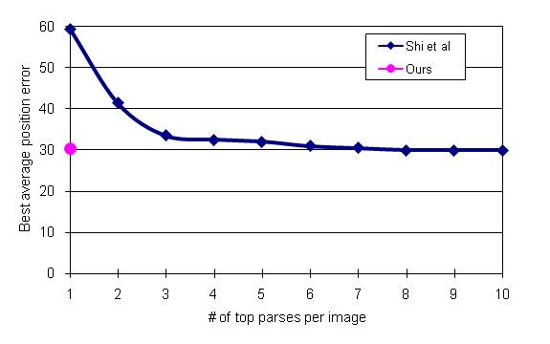
Comparisons

Slide 33
Modeling-Inference-Learning
Model: Hierarchical Composition
Computing: Compositional Inference
Learning:
  Supervised: Given the model structure, estimate the parameters.
  Unsupervised: induce the structure and estimate the parameters.

Slide 34
Unsupervised Structure Learning
Unsupervised Structure Learning: induce a structure (vertexes and edges) and estimate its parameters
Combinatorial Explosion Problem
  M=150 object features
  N =5000 total features
  Big Ambiguity: Edgelets
  Naïve brute force enumerations: O(M^N)
  Greedy method:
    Sparseness: M=6, N=100
    Low ambiguity: more powerful features

Slide 35
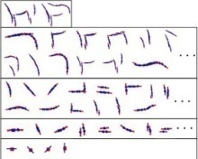
Unsupervised Structure Learning
Procedure: Bottom-Up and Top-Down
Assumption: Recursive Composition
  combine elementary structures (danger combinatorial explosion)
Two principles:
  Suspicious Coincidence
  Competitive Exclusion

Slide 36
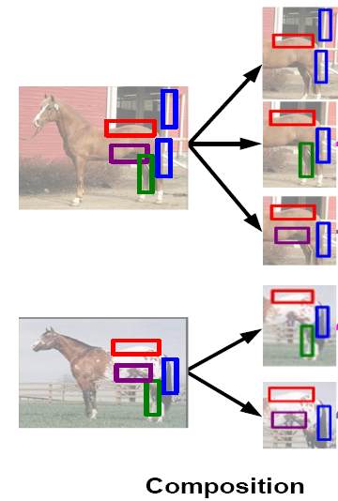
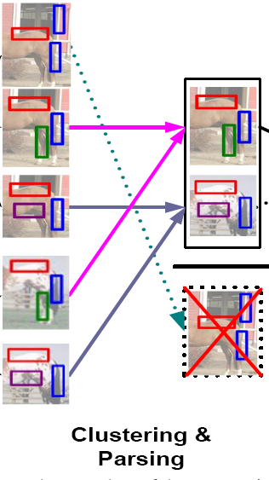
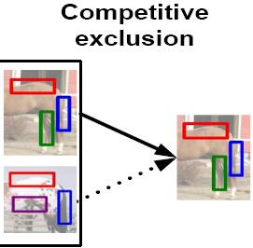
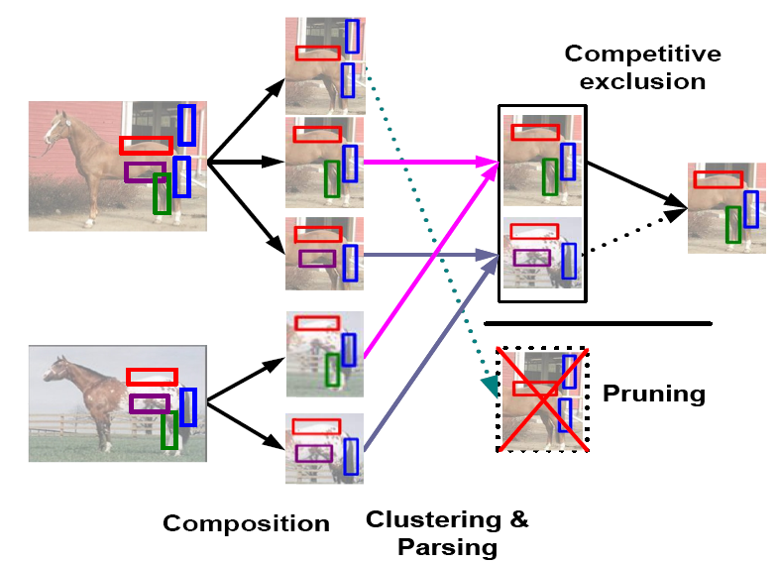
Bottom-Up Learning
Initialization for Level 0
Repeat from low levels to high levels
Composition: combine instances from level L
Clustering: compose concepts at level L+1
Parsing: get responses of concepts
Suspicious Coincidence: prune out non-frequent concepts
Competitive Exclusion: prune out the similar concepts
Until no new compositions are formed (The number of layers is automatically decided by the algorithm)

Slide 37
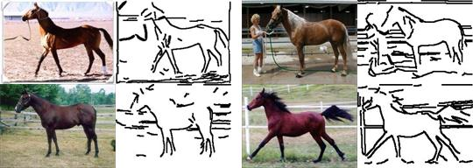
10 images for training

Slide 38
From Generic Features to Object Structures
Unified descriptors
Unified learning: bridge the gap between the generic features and specific object structures

Slide 39
Templates learnt by the bottom-up procedure

Slide 40
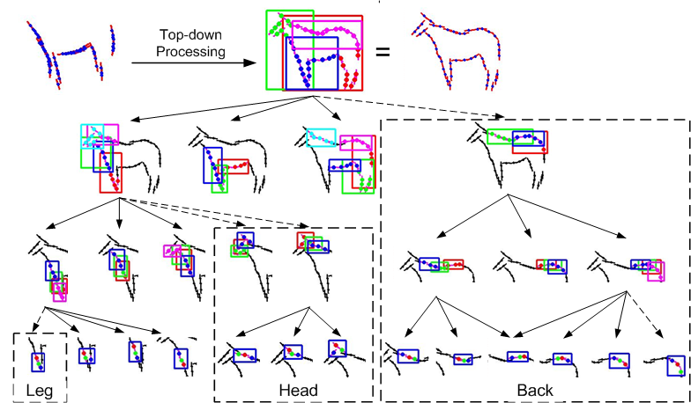
Top-Down Learning
Fill in the missing parts caused by 1) competitive exclusion 2) suspicious coincidence.
Examine every node from top to bottom.

Slide 41
Top-Down Processing
From Level L to 1
  Given the instances of Level L and Level L-1
  Composition
  Clustering
  Suspicious Coincidence (Pruning)
  Competitive Exclusion

Slide 42
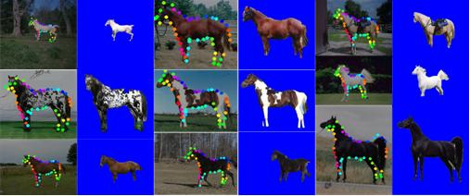
Results

Slide 43
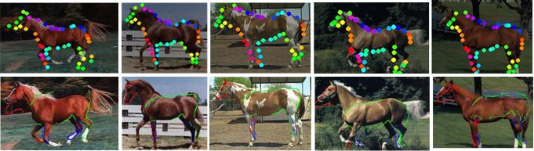
Comparisons
Methods | Testing | Segmentation | Parsing | Speed
Unsupervised | 316 | 93.3 |  | 17s
Structure-Perceptron | 228 | 94.7 | 16 | 23s
Ren (Berkeley) | 172 | 91
Winn (LOCUS) | 200 | 93
Levin and Weiss | N/A | 95
Kumar (OBJ CUT) | 5 | 96

Slide 44
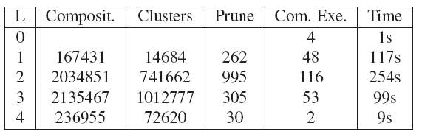
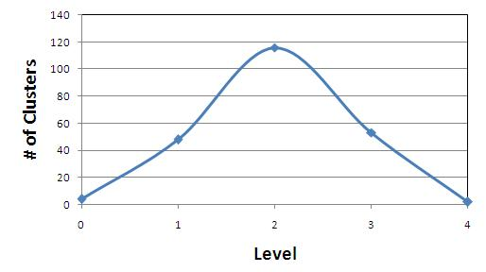
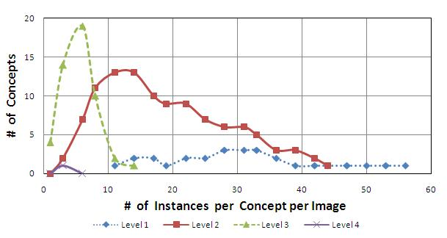
Multi-Level Computational Complexity
Explore a huge number of candidate concepts

Slide 45
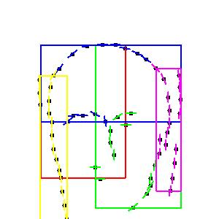

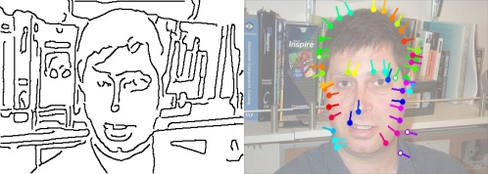
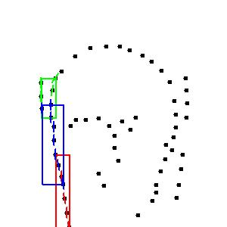
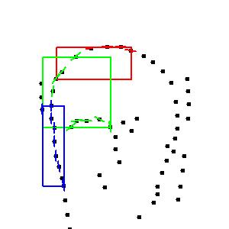
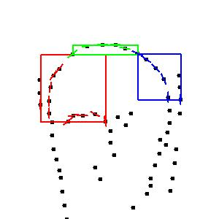
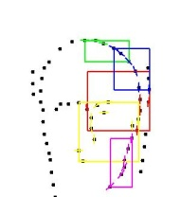
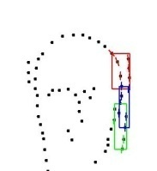
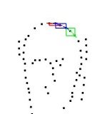
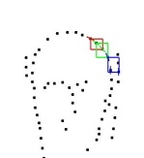
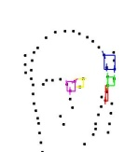
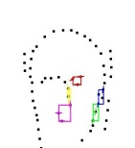
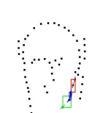









More Objects

Slide 46
Feasibility of scaling up
Short-term goal: 100 objects and 1000 images
CPU and memory costs:
  10 images: 5 minutes , 320 Megabytes
  20 images: 10 minutes , 550 Megabytes
  50 images: 60 minutes, 1900 Megabytes
  1000 images: 2 days, 40 gigabytes (Prediction)

Slide 47

Summary I
One Assumption: Recursive Composition
Two Principles: Suspicious Coincidence and Competitive Exclusion
Three Aspects:
  Modeling: Recursive deformable template (general representation for different tasks)
  Inference: Dynamic Programming
  Learning: Structure-perceptron and Unsupervised Learning

Slide 48
Outline
Part I: Deformable Object Parsing
  Recursive Deformable Template Model
  Compositional Inference
  Supervised Learning
  Unsupervised: Bottom-up and Top Down
Part II: Image Parsing (Segmentation and Scene Labeling)
  Recursive Segmentation and Recognition Template, DP, and Perceptron Learning

Slide 49
Image Parsing
Task: Image Segmentation and Scene Labeling
MRF Representation

Slide 50

Image Representation
Representation
  Recursive Composition
  Segmentation-Recognition Template Dictionary
short- and long- range dependency

Slide 51

Segmentation and Recognition Template
S-R pair: chicken-and-egg of Seg. and Rec.
Local: Shape and Appearance of object part
Global: Gist of scene (Spatial layout);
Multi-level coarse-to-fine

Slide 52

The Image Model
Input Image: State: (Tree structure)
Hierarchical Log-Linear Form
object appearance
appearance homogeneity
layer consistence
co-occurrence of objects
Prior of template and object
Notes:
1. X is the input image Y is a tree 2tion

Slide 53
Inference and Learning
Tree Structure
State space:
  M=21 classes; D=30 templates; K=3 classes/templ.
Inference (Model is known):
  Dynamic Programming with Pruning
  H: size of Hierarchy
Supervised Learning (parameter estimation)
  Structure-Perceptron Learning

Slide 54

Results

Slide 55
Comparisons
Implementation Details
Comparisons
Dataset | Classes | Size | Training Size | Training Time | Testing Time
MSRC | 21 | 591 | 45% | 55h | 30s
 | TextonBoost Shotton et al. | PLSA-MRF Berbeek and Trigg | AutoContext Tu | Classifier only | HIM
Average | 57.7 | 64 | 68 | 67.2 | 74.5
Global | 72.2 69 (Classifier) | 73.5 | 77.7 | 75.9 | 81.4

Slide 56

Confusion Matrix

Slide 57

The function of S-R pair
Shape modeling

Slide 58
Summary II
One Assumption: Recursive Composition
Two Principles: Coincidence Pruning and Competitive Exclusion
Three Aspects:
  Modeling: Segmentation and Recognition Template
  Inference: Dynamic Programming
  Learning: Structure-Perceptron

Slide 59



The Track of Our Research Program
 | 200 5 NIPS | 2006 NIPS | 2007 NIPS | 2008 CVPR, ECCV, NIPS
Model | Hierarchical Composition | Triplet Shape Descriptor Grammar+MRF | Recursive Template AND/OR Graph | Segmentation-Recognition Template
Inference | Non-Maximum Suppression | DP | DP | DP
Learning | Human Design | Structure Induction | Human Design | Structure-perceptron Max-Margin Suspicious Coincidence Competitive Exclusion
Tasks | Shape Matching | Categorization | Object Parsing | Object Classification Segmentation Parsing Image Parsing

