Slide 1



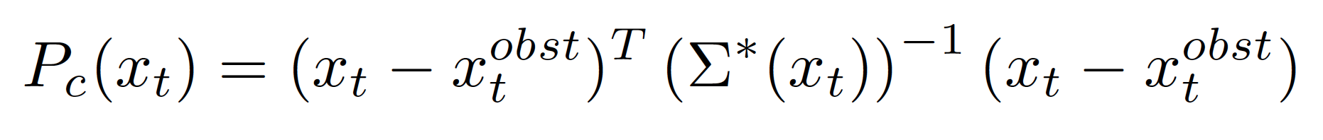
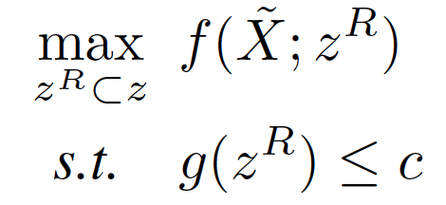
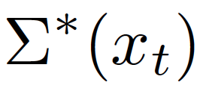
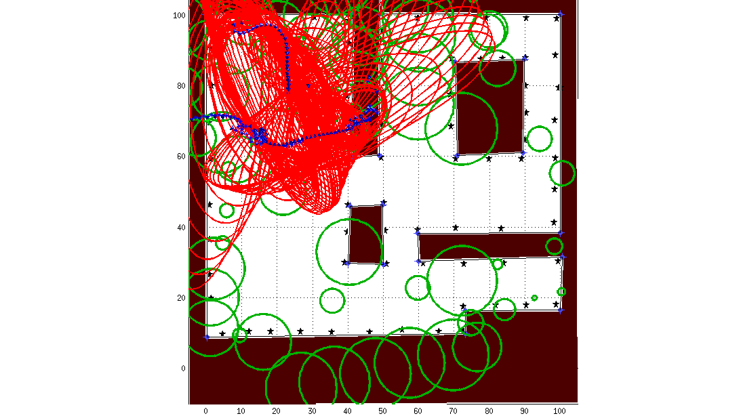
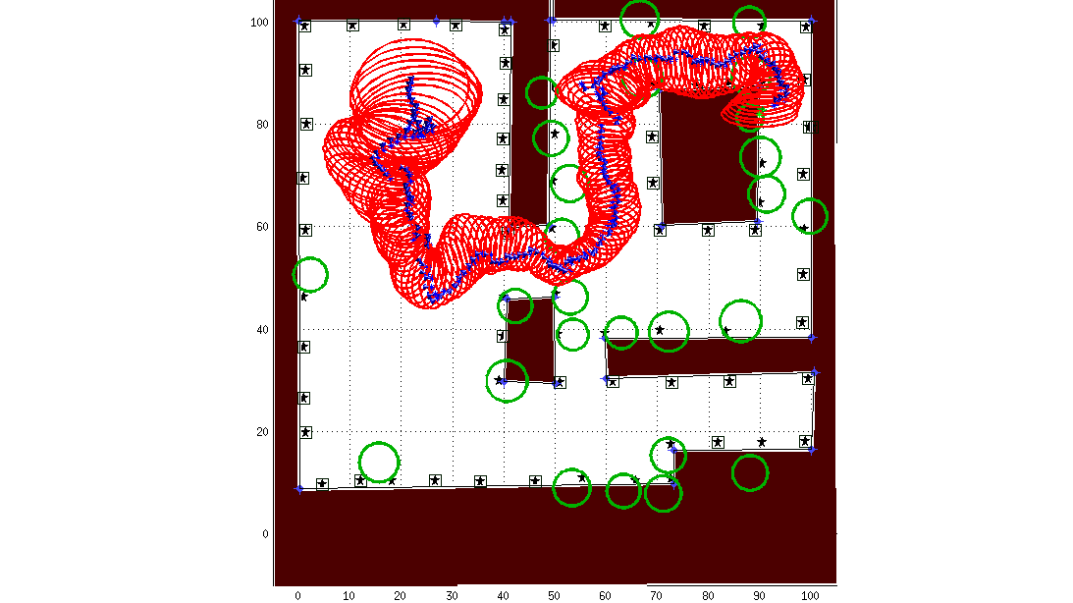
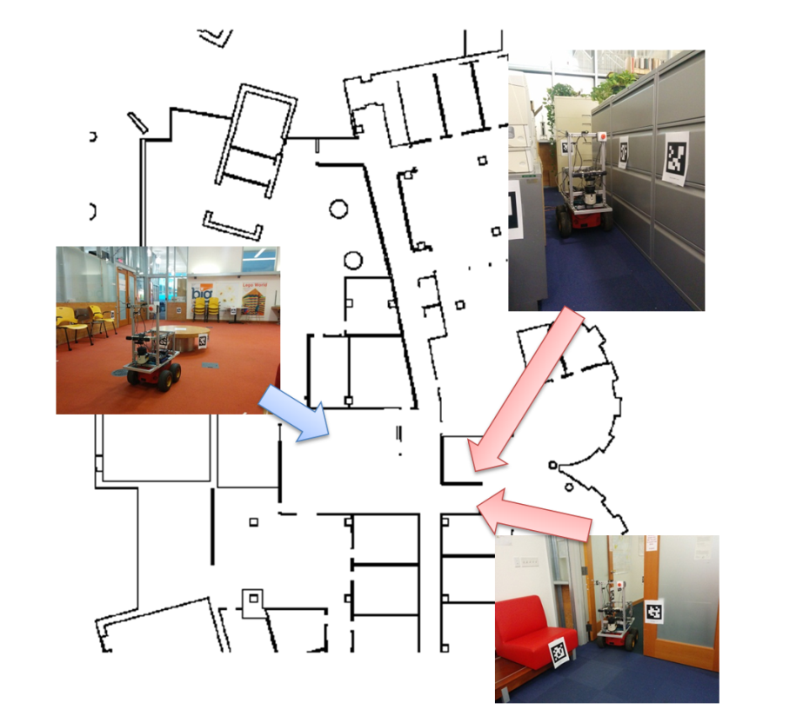
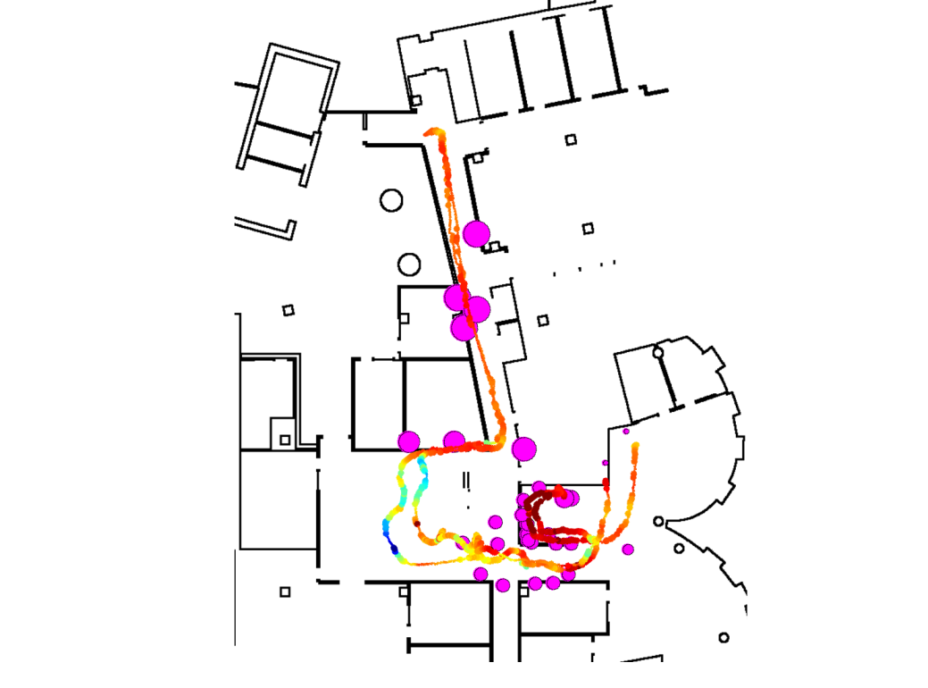
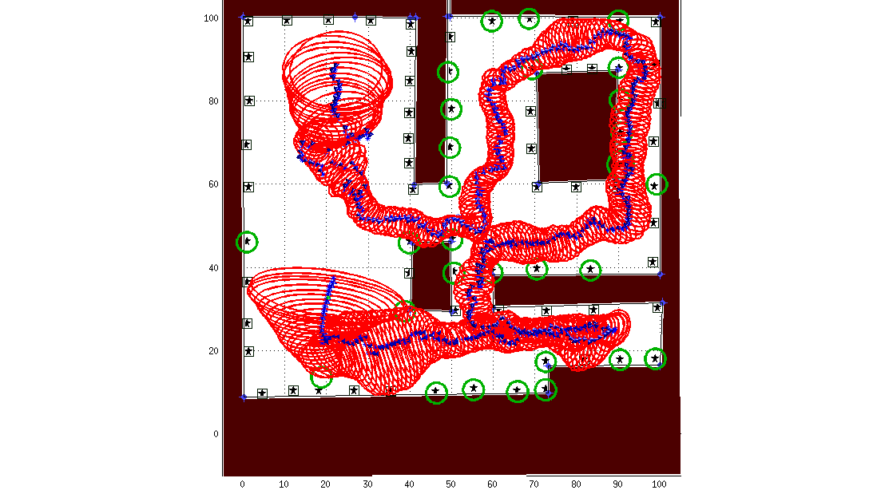
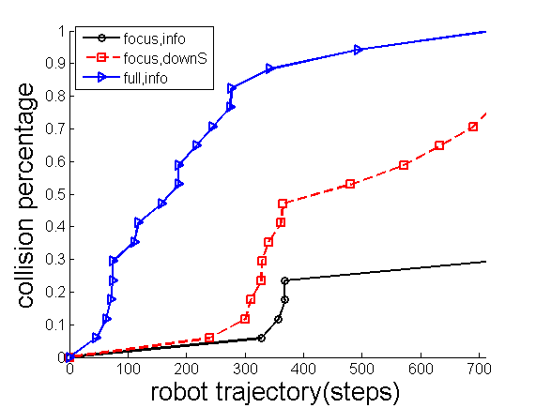
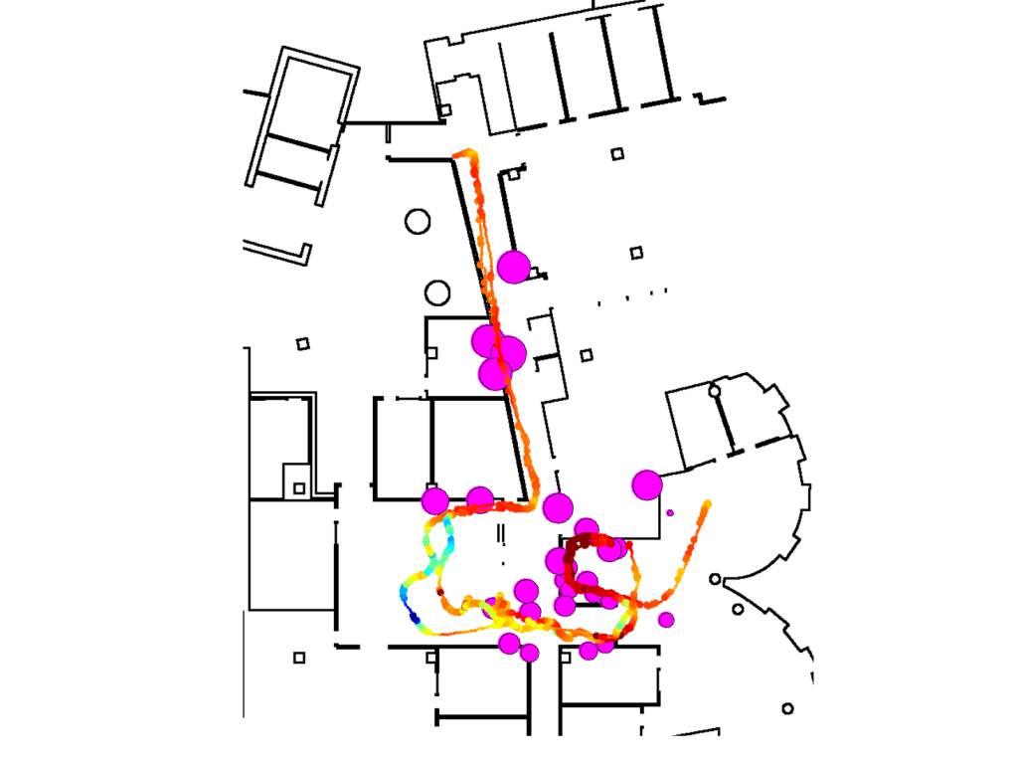
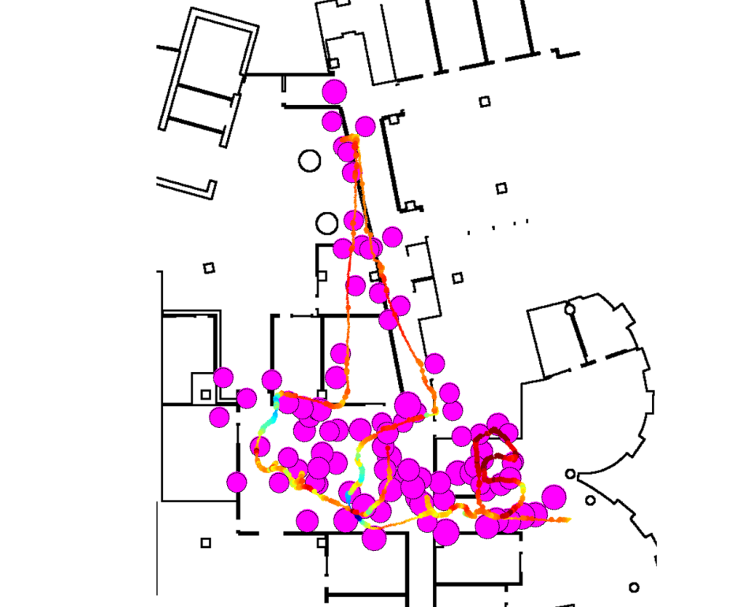
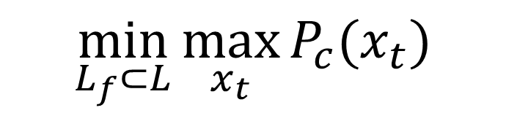

Two-Stage Focused Inference for Resource-Constrained Collision-Free Navigation
Beipeng Mu, Ali-akbar Agha-mohammadi, Liam Paull, Matthew Graham, John Leonard, Jonathan How
Massachusetts Institute of Technology
Introduction
  Modern sensor produces large amounts of data, identify millions of features
  Not all of them are important
  Limited on-board resources
Collision-free navigation
Two stage focused inference
Data Collection
Operate robot in the environment to gather initial dataset
Feature Selection
Keep landmarks that are important to robot tasks (navigation)
Measurement Selection
Maximize information on focused landmarks
Low accuracy in open space
High accuracy in narrow passages
Map Building
Solve slam with reduced landmarks and measurements
Task Execution
Navigate with map
Feature selection
  Task specific
  Approximate collision probability
  Select landmarks that minimize collision probability
  Priority function
    Mapping from all features to focused features
Measurement selection
Greedily select next best measurement that maximize information gain
information gain
(entropy reduction)
“Focused” features
: Solution to steady state Riccati equation
Reduced measurement set
$$\min_{L_{f}⊂L}{\max_{x_{t}}{P_{c}(x_{t})}}$$
Resource budget
Full measurement set
$$\tilde{X}=w(X)$$
Simulation
Hardware
Use all features, select measurements. Fail to form loop closures
Use focused features, downsample measurements. Bigger uncertainty
Open space and narrow passages
Two-stage focused selection
Two-stage selection. Closest to ground truth
Two-stage has smallest collision probability
Focused landmarks,
downsample measurements
Full landmarks,
select measurements

