Slide 1


Appearance-based Object Reacquisition for Mobile Manipulation
Matthew R. Walter¹
Yuli Friedman²
Matthew Antone²
Seth Teller¹
Presenter: Mark Keck²
¹MIT CSAIL ²BAE Systems AIT

Slide 2
Presentation Outline
Motivation: task autonomy
System-level concept
Reacquisition method
Experiments and results
Discussion

Slide 3
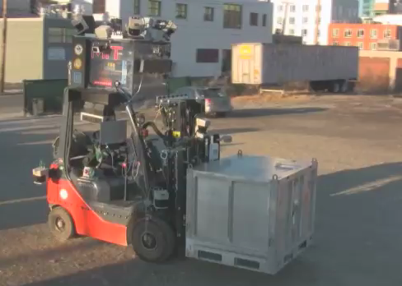
Problem Domain
Developing robotic forklift
  Capable of autonomous single-pallet outdoor transport
  Previously required user intervention throughout
Goal of work is to enable task-level autonomy
  Higher-level command strings
  Implies need to reacquire previously seen objects upon revisit
Notes:
One example in forklift context:
Previously:
User indicates pallet on tablet display
Commands the forklift to pick it up
Indicates where it is to be moved
Indicates where it is to be placed
Commands the forklift to put it down
Better:
Motivation is to allow user to specify higher-level command strings
“move pallet 1 to location A, move pallet 2 to location B, …”
Implication is that robot has to find the object again (reacquire it) when it returns from each sub-task despite having potentially different viewpoint, lighting, etc.
This is just one example of object-level reacquisition that enables autonomy
Many other examples beyond our task domain

Slide 4
Overview and Goals
Use sensing to increase autonomy
  Move from atomic tasks to task sequences
  Reduce interruptions to user workflow
Employ visual descriptions of manipulands
  Learn appearance of each user-selected object
    Object “model” consists of multiple “views”
    Each view captures appearance at unique pose
  Reacquire object locations automatically upon revisit
Challenges: varying lighting, viewpoint over time

Slide 5
Related Work
Visual object recognition (category classification)
  Invariant descriptors and constituent parts
  Recognize object categories rather than instances
  Offline training w/ many samples
  e.g., Nister06, Hoiem07, Savarese07
Multiple-view model matching
  Learn model offline from controlled viewpoints
  e.g., Lowe01, Gordon06, Collet09
Vision for gesture-based HRI
  Person detection and face recognition
  Body and hand gesture tracking
  e.g., Nickel07, Haasch05
Notes:
Object recognition methods:
Requires invariance to viewpoint and lighting
Often use collections of local descriptors
Generic object classification rather than reacquisition of specific instances
We can additionally incorporate contextual cues from the surround
Multi-view matching methods:
Requires “brute-force” acquisition of views spanning complete set of aspects
In contrast to our work that acquires views opportunistically and as needed
HRI-vision:
TODO

Slide 6
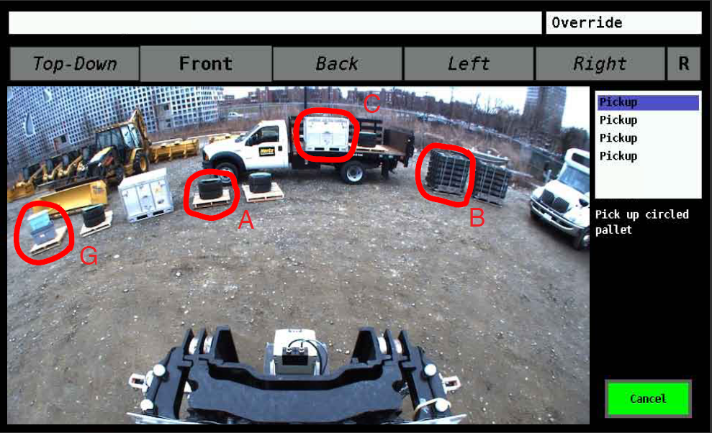
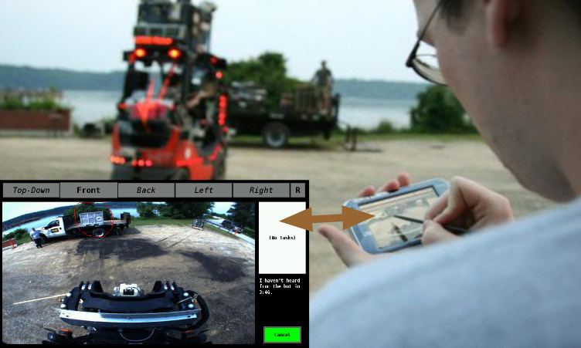
Task-Level Command Interface
Human supervisor provides commands
  Pick up, transport, place palletized cargo
  Speech and stylus gestures from handheld tablet
  Previously, supervisor specified one task at a time
Notes:
After popup: Want to specify all four objects and speak their destinations at once, freeing the user for other tasks
When the robot returns, our goal is to recognize the objects again, localize them, and re-synthesize the user’s gestures for the next task

Slide 7
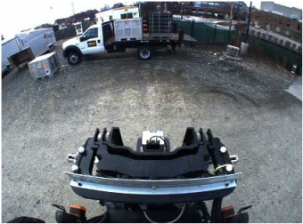
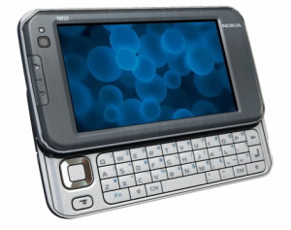
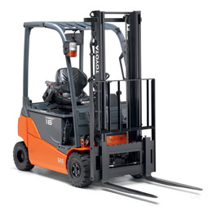
Reacquisition System Overview
video stream
feature
constellations
onboard
Image Feature Extraction
Single-View Matching
wireless
user gestures
detections
Model Construction
Multiple-View Reasoning
Visual Models
tablet interface
initial views
new views
navigation, manipulation, task controls
Planning and Control
virtual gestures
robot
Notes:
Video from robot-mounted camera
Wirelessly streamed to remote user to see “bot’s eye view” and select objects of interest
Streamed onboard through feature extraction module
User indicates several different objects and tasks (e.g., pallets and destinations) via tablet interface
Stylus gestures select region of interest and combine with feature constellations to form initial appearance models
Future images undergo feature extraction; objects of interest are located via appearance matching to models
Confident detections from new viewpoints augment the visual model for robustness
Multiple detections from multiple views are fused to form single decision per object
Detections feed task/manipulation planners which control robot to execute task
Robot later returns to same area, reacquires next object, and is able to execute next task without human intervention

Slide 8
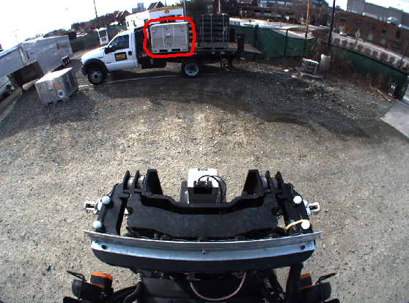
User Initiates Visual Appearance Model
User circles object of interest via tablet
Bot’s-eye view of scene

Slide 9
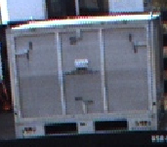
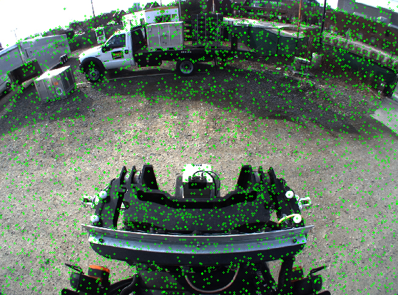
Initial View Consists of Feature Constellation
Initial model M contains single view V
All SIFT features F extracted from initial view image

Slide 10
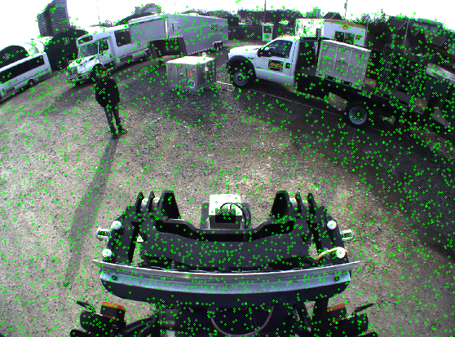
Single-View Matching: Feature Extraction
SIFT features extracted from new image
Notes:
After initial model creation, the system continuously searches for objects that match the visual appearance of the model
Exhaustive correspondence of SIFT keypoints in model to keypoints in new image
Runs in time proportional to the number of keypoints in the model and the number of keypoints in the image

Slide 11
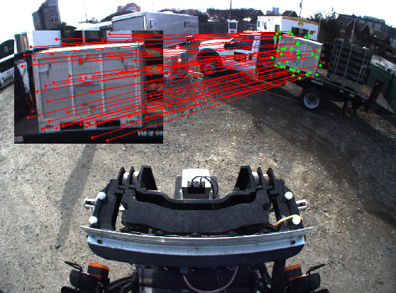
Single-View Matching: Homography+RANSAC
Robustly match to single view after application of geometric constraints
Notes:
Robust estimation using geometric constraints (plane projective homography) and random sample consensus to suppress outliers and false local point correspondences

Slide 12
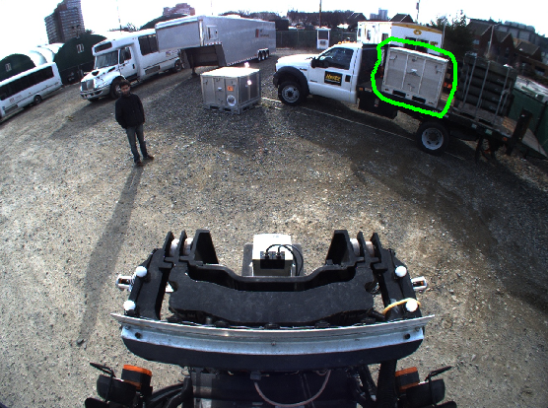
Single-View Matching: Final Object Detection
Initial selection gesture
User’s initial selection gesture transformed to new image
via estimated homography
Detection of object location in new image

Slide 13
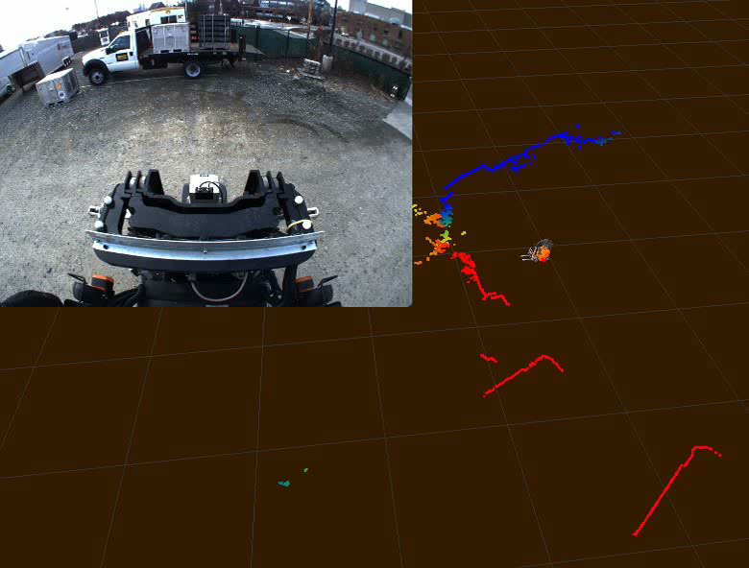
Single-View Matching: Example Video

Slide 14
Multiple-View Reasoning
Each object appearance model has many views
  Multiple views capture different aspects, distances
  Increase robustness to pose and lighting variation
Matching produces multiple hypotheses
  Several matches per image and per model
  Want to produce at most one coherent hypothesis
Reasoning component resolves ambiguity
  Examines hypotheses and likelihoods
  Voting produces at most one detection per model
Notes:
Single-view matching is limited to a small range of viewpoint and lighting change
Incorporating multiple views helps alleviate this limitation

Slide 15
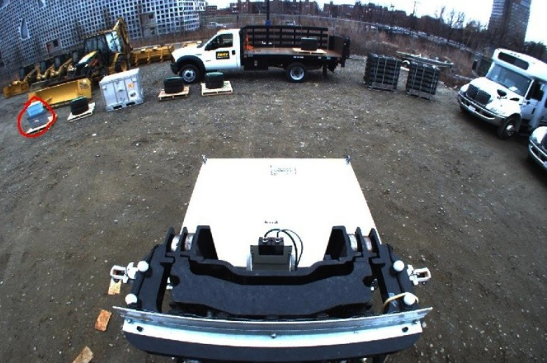
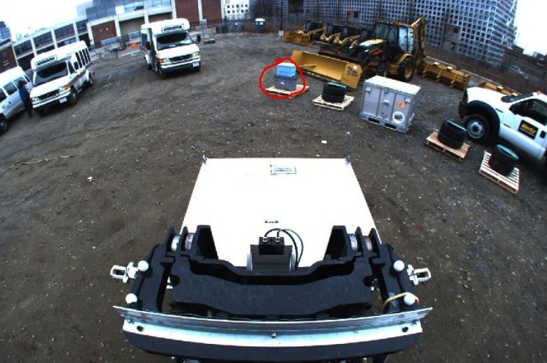
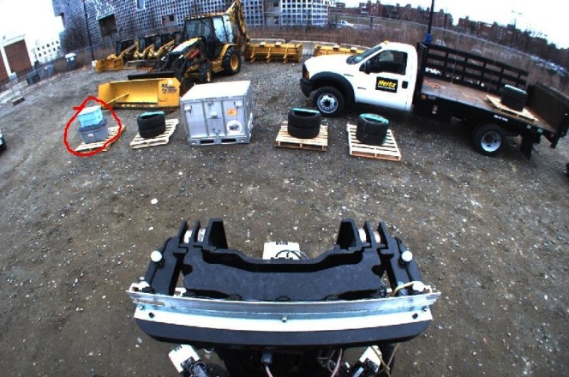
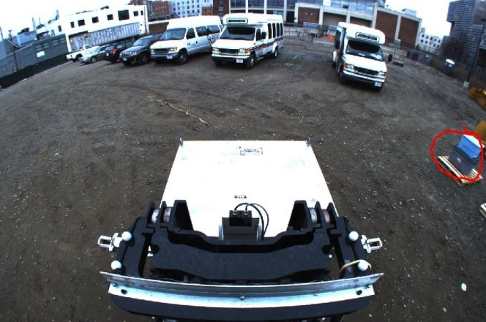
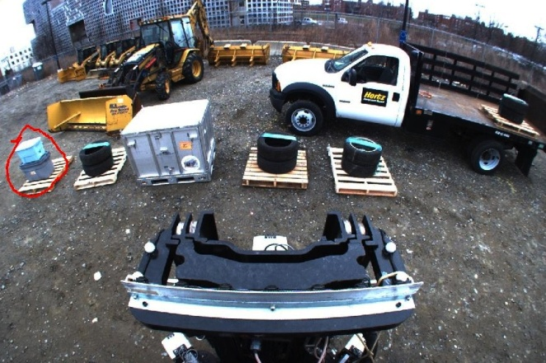
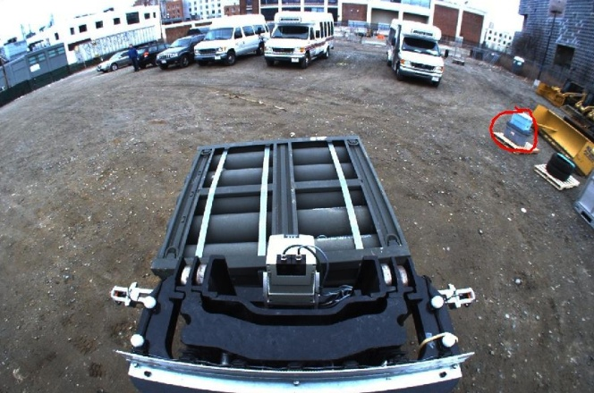
Model Augmentation
New views opportunistically added to model
  Addition requires high-confidence single-view match
  Views added only when object aspect/distance is distinct
More robust to viewpoint, illumination variation
Notes:
Several views were matched and added after one or more revisits

Slide 16
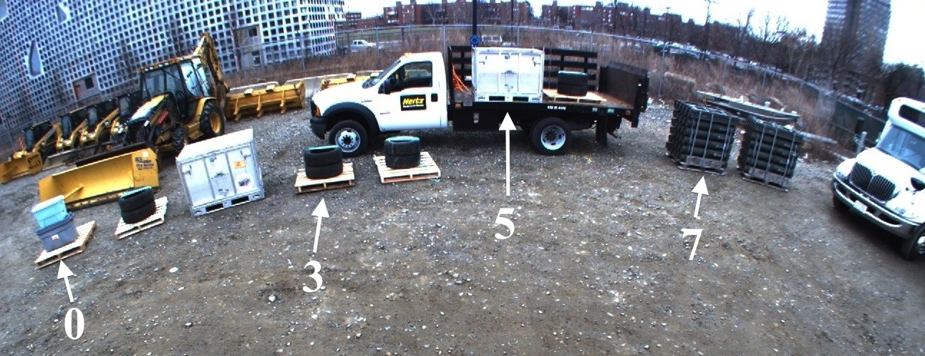
Experimental Setup
Preliminary experiments devised to test concept
  Variety of loaded pallets placed within camera view
  Loads have both similar and differing appearances
  User selected four pallets for pickup and transport
Counted false detections and missed detections
  Ground truth generated via manual annotation
View from forward-looking forklift camera
Notes:
Some similar-looking pallets placed next to one another to introduce potential ambiguity
Forklift engaged and moved each pallet one at a time
Video stream was processed to detect pallets at each frame

Slide 17
Single vs. Multiple View Detection
Distance of novel viewpoint from original viewpoint (m)
(False detection rate was very low, in XX trials -- verify)
Notes:
Why is multi-view worse at 1m range?
[TODO: address]
Missed detection rate was below 20% out nearly 6 meters
There were no false detections in our experiments (verify)

Slide 18
Model Augmentation Over Time
Number of model views
Time from start (seconds)
Notes:
Algorithm tended to collect about one novel view per minute, with proportionally more views added earlier as model is first built up.
Gray corresponds to times when pallets were outside view of camera

Slide 19
Conclusions and Discussion
Vision-based matching method
  Motivated by real-world robotics task
  Matches objects and their visual context
  Multiple views used to increase persistence
Limitations:
  Scalability: exhaustive matching; models persist
  Homography assumes dominant planar surface
  Matching fails for very distant novel viewpoints

Slide 20
Future Work
Possible extensions to improve robustness
  Incorporate LIDAR
    Object/context segmentation
    Metrical distance of SIFT keypoints
  Relax planar object assumption
    Constellation graph matching
    Bag-of-words recognition
  Explicitly incorporate visual context
Currently extending this approach
  More accurate matching using quasi-3D descriptors
    Multiple frames more closely coupled
    Create local scene maps in vicinity of manipuland

Slide 21

Thank You. Questions?
Notes:
Video from front-facing camera used for vision processing
Re-synthesized gestures from four user-specified pallets shown in blue
Numbers: N/M (N=number currently being matched, M=number of views in each model)

