Slide 1

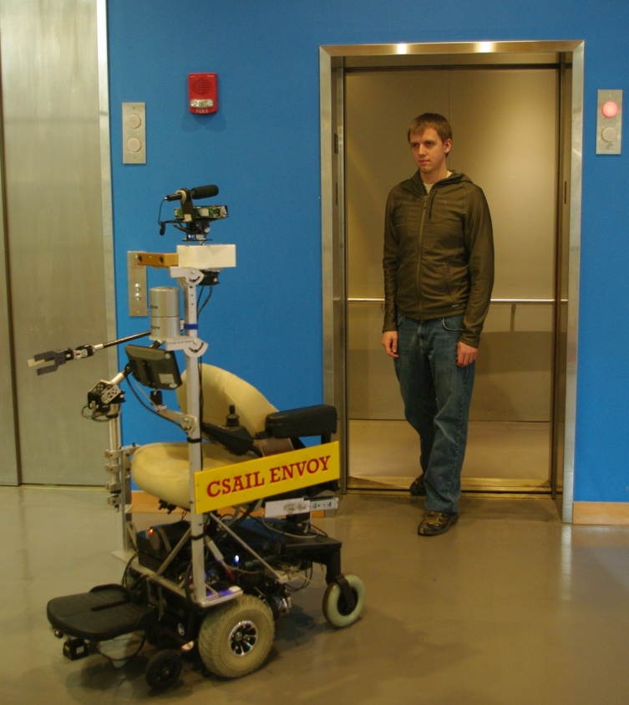
Envoy: Cloud-enabled Robot Assistant
Matthew Walter, Seth Teller, Jim Glass, Nicholas Roy
Sachithra Hemachandra, Ross Finman, Sudeep Pillai
Cloud Robotics
Limited onboard resources
Utilize cloud for non-safety tasks
  Speech recognition
  Map database
  Object learning and detection
  Manipulation learning
Fault-tolerant cloud integration
  Seamless transition to local resources
  Gradual capabilities degradation
  Capabilities transparent to user
Take me to the conference room
Please follow me to the conference room
Natural Interaction
Intuitive user interface
  Interprets natural language speech
  Synthesizes speech
Safe interaction with bystanders
  Executes predictable behaviors
Knowledge & intent transparency
  Panning head follows user
  External tablet conveys state
  Robot speaks actions
  Projector indicates knowledge & intent
Greets visitors
Escorts people through multi-floor buildings
Retrieves and delivers objects
Key capabilities:
  Situational awareness
  Natural interaction with people
  Asking for assistance
Situational Awareness
Rich semantic map
Object-level awareness
  Depth & color segmentation
  One-shot reacquisition
  Pose tracking
Human detection and tracking
Knowledge acquisition
  Learns map via human-guided tour
  Builds semantic map from speech
Asking for Assistance
Requests help for unachievable tasks
  Opening doors
  Operating elevators
Learns from user to perform tasks
  Increases independence over time
  Interactive guided tour of manipulation

