Slide 1
RCTA PI Meeting
H4-2 Dialogue Management for Robust HRI
H2-4 Human Implications for Evaluating and Explaining Performance
11 – 13 September 2012

Slide 2
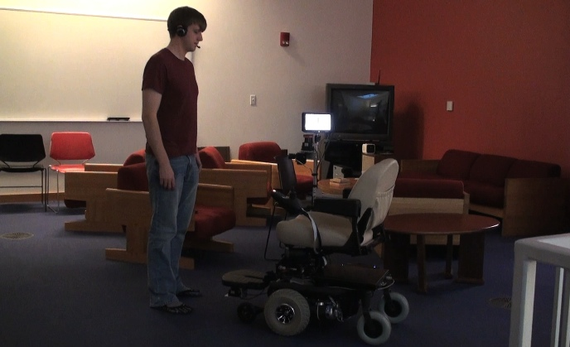
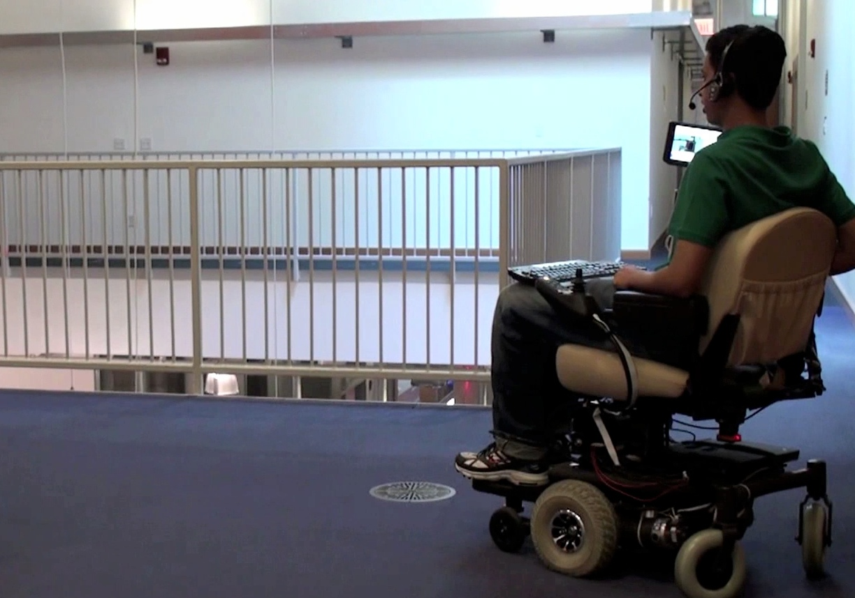
Context & Rationale for Research (Template 1 of 3)
OBJECTIVE & BENEFITS
Objective: Enable robots to formulate rich semantic maps from narrated, user-guided tours.
Interpret natural language descriptions of spaces shared by people and robots.
Fuse language with onboard sensor streams.
Infer hybrid metric-topological semantic maps.
Benefit: Facilitate effective interaction with people through an awareness to higher-level human-centric information related to space.
“There is a kitchen down the hall”
STATE OF THE ART & BARRIERS
State of the art: Existing methods focus almost exclusively on low-level sensor data. Their ability to incorporate user-provided information is limited.
Barriers:
Grounding: Associate ambiguous, natural language descriptions with the robot’s environment model.
Fuse high-level concepts that language conveys with low-level sensor streams.
“Take me to the kitchen”

Slide 3
Technical Approach & Progress (Template 2 of 3)
TECHNICAL APPROACH
Maintain a joint distribution over the environment’s topology and the underlying metric structure.
Infer local metric information from low-level sensors and topological structure from language.
Maintain multinomial over landmark labels.
Utilize probabilistic model to ground language using Generalized Grounding Graphs.
Employ Rao-Blackwellized particle filter for estimation of a factored distribution.
Map without language
EXPERIMENTATION & METRICS
Evaluations consider human-guided tours of mixed indoor and outdoor environments where typical mapping algorithms fail.
Metrics include:
Metric and topological map accuracy.
Number of valid loop closures.
Ability for people to interpret/use maps.
Current results indicate significant a significant improvement in accuracy over state of the art.
Map with language

Slide 4
Future Plans and Transition (Template 3 of 3)
PLANS FOR COMPLETION OF CURRENT RESEARCH EFFORT
Schedule:
Summer’12: Demonstrate initial model.
Fall’12: Extend model to reason over more complex and diverse language.
Next steps in technical effort:
Reduce assumptions of linguistic expressions.
Eliminate need for explicit global metric map.
Upcoming experiments:
Apply model to narrated tour corpus.
Evaluate utility of semantic map for user tasks including navigation, interaction, and control.
“The copy room is down the hall to the right, past the kitchen.”
TRANSITION
Perform integrated research with UW effort.
Our model associates a symbolic representation for parsed language with sensor data.
UW group learns the mapping from spoken language to this symbolic representation.
Reason over frame-of-reference
Accommodate multiple landmarks (e.g., “hall”, “kitchen”) that may be within view but are yet unknown (not labeled or not visited).
Incorporate object co-occurrence models.

