Slide 1
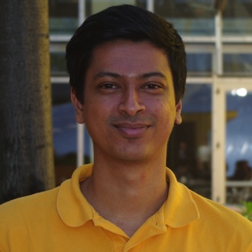
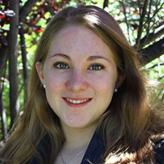


Learning Semantic Maps from Natural Language Descriptions
24 June 2013
Matthew Walter¹, Sachithra Hemachandra¹, Bianca Homberg, Stefanie Tellex, & Seth Teller
CSAIL / MIT
¹The first two authors contributed equally

Slide 2
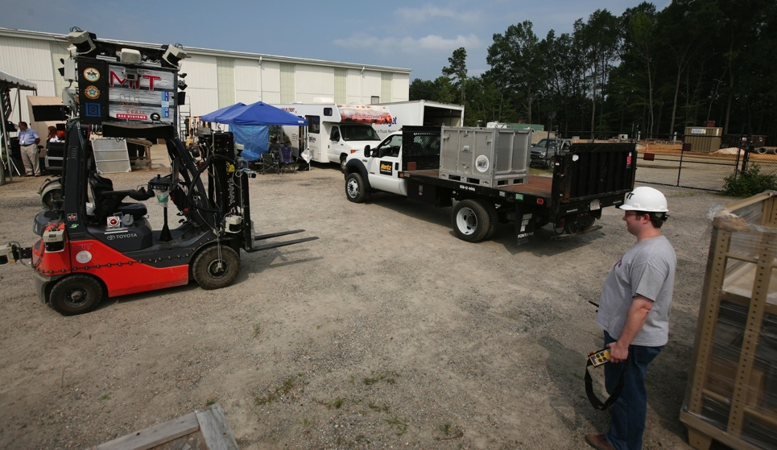
Introduction
Goal: Robots that people can efficiently command
Shared situational awareness is key to effective interaction
  Objects
  Actions
  Locations
Take me to the room across from the cafeteria
Move the pallet to receiving
Notes:
Our lab is developing robots that people can efficiently command, whether it’s a wheelchair that you can speak to as if there was a nurse pushing the chair or a UAV that you can control using gestures
A key component to interpreting these commands is to endow robots with a model of their state and action space that is as close as possible to our own.
To achieve this, we have developed a robot’s ability to learn human-centric models of objects, actions, and, as this paper describes, semantic maps of their environment.

Slide 3
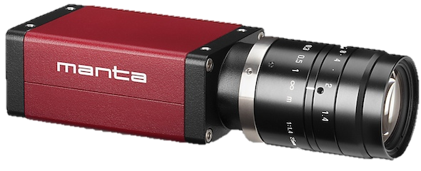
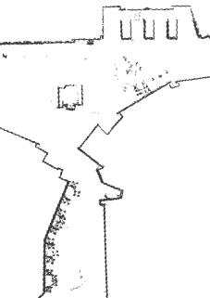
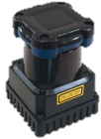
Semantic Mapping
Formulate human-centric models of the environment
Existing solutions: Augment SLAM map with semantic layer
  Incorporate scene classification and object detection^{2,3}
  Information flows up from the metric layer, not down
hallway
kitchen
Semantic
lobby
Topological
Metric
²Zender et al. 2008; ³Pronobis et al. 2010
Notes:
Our goal is to enable robots to learn human-centric maps of their environment.
There is a lot of good work in this area.
The current state-of-the art is to take a metric map built using SLAM and augment it with layers that encode topological and semantic properties.
To populate the semantic layer, people frequently use cameras mounted to the robot to do scene classification and object detection

Slide 4
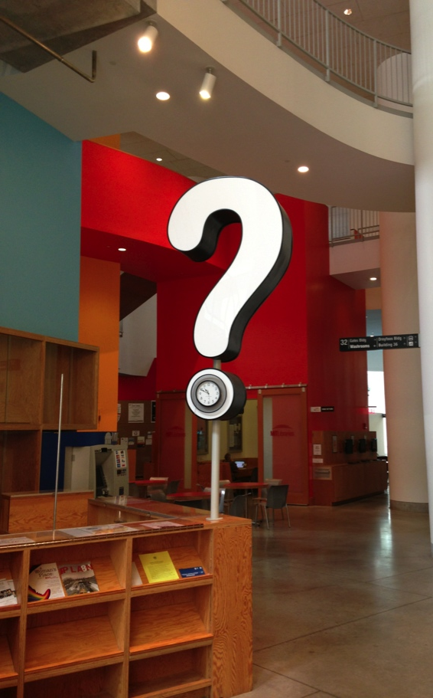
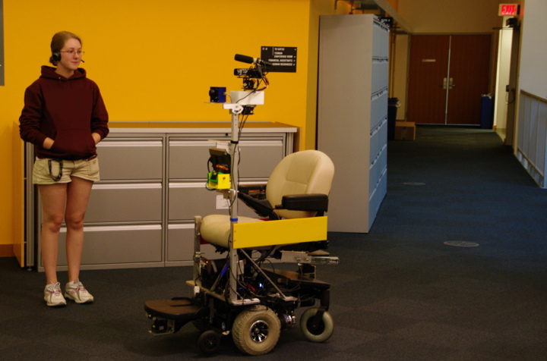
Semantic Mapping
Colloquial names
Spatial relations
Regions distant from the robot
Regions that were never visited
The information desk is down the hall
Notes:
There is a lot of semantic information that robots can’t perceive
For example, it would be difficult for a robot to infer that the question in my building indicate that this is the information center
Yet people often use it as a reference point.
If the robot could integrate human speech, for example, as part of a guided tour, it could infer concepts like colloquial names and spatial relations for regions nearby and distant from the robot.

Slide 5
Learning semantic maps from speech
Learn from natural language speech
Interpret free-form descriptions
Fully integrate linguistic information
cafeteria
hallway
info desk
lobby
Semantic
Metric
Metric
Topological
Notes:
We developed an algorithm that allows robots to build semantic maps of their environment from descriptions spoken using natural language
There are two primary contributions of this method
Firstly, the algorithm interprets free-form spoken descriptions of the environment
Secondly, we deeply integrate language into the mapping framework, allowing information from any layers in the map to influence each of the others.

Slide 6
Posterior over Semantic Graphs
Notes:
- The challenge is to fuse the robot’s low-level metric sensor data with language, which is abstract and often ambiguous

Slide 7
Posterior over Semantic Graphs
Topology

Slide 8
Posterior over Semantic Graphs
Topology
Place poses

Slide 9
Posterior over Semantic Graphs
Topology
Semantic labels
Place poses

Slide 10
Posterior over Semantic Graphs
Sensor stream
Odometry
Language
Topology
Semantic labels
Place poses

Slide 11
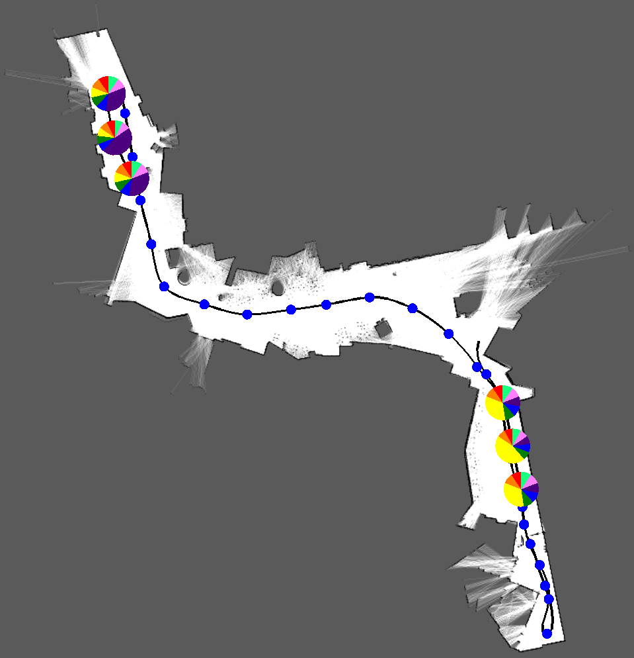
Incorporating natural language
“The gym is down the hallway”
Lobby
?
?
?
Hallway
?
Notes:
What hallway does the language refer to and what nodes are “down” from it?

Slide 12
Incorporating natural language
“The gym is down the hallway”
Generalized Grounding Graph⁴
Lobby
?
?
?
Hallway
?
⁴AAAI 2011
Notes:
We have a probabilistic model to infer correspondence between speech and the robot’s world model
This Generalized Grounding Graph allows the robot to interpret references to concepts like spatial relations and places in the environment.

Slide 13
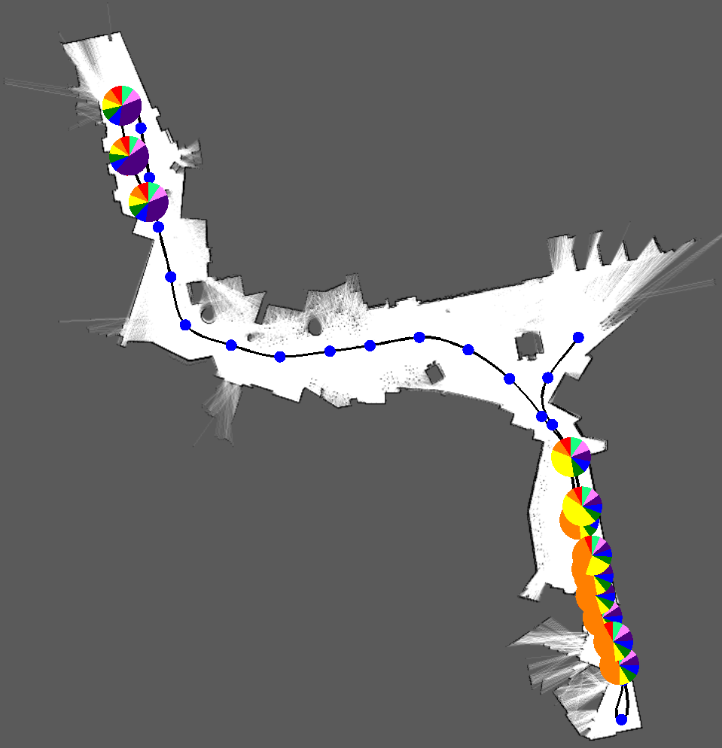
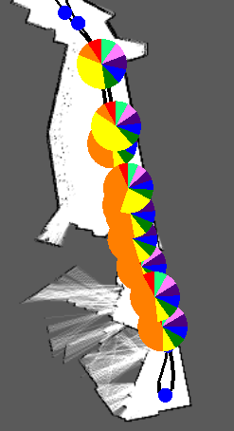
Incorporating natural language
“The gym is down the hallway”
Lobby
?
?
?
Hallway
Gym
?
Notes:
Less wordy
We have a probabilistic model to infer correspondence between speech and the robot’s model of the environment.

Slide 14
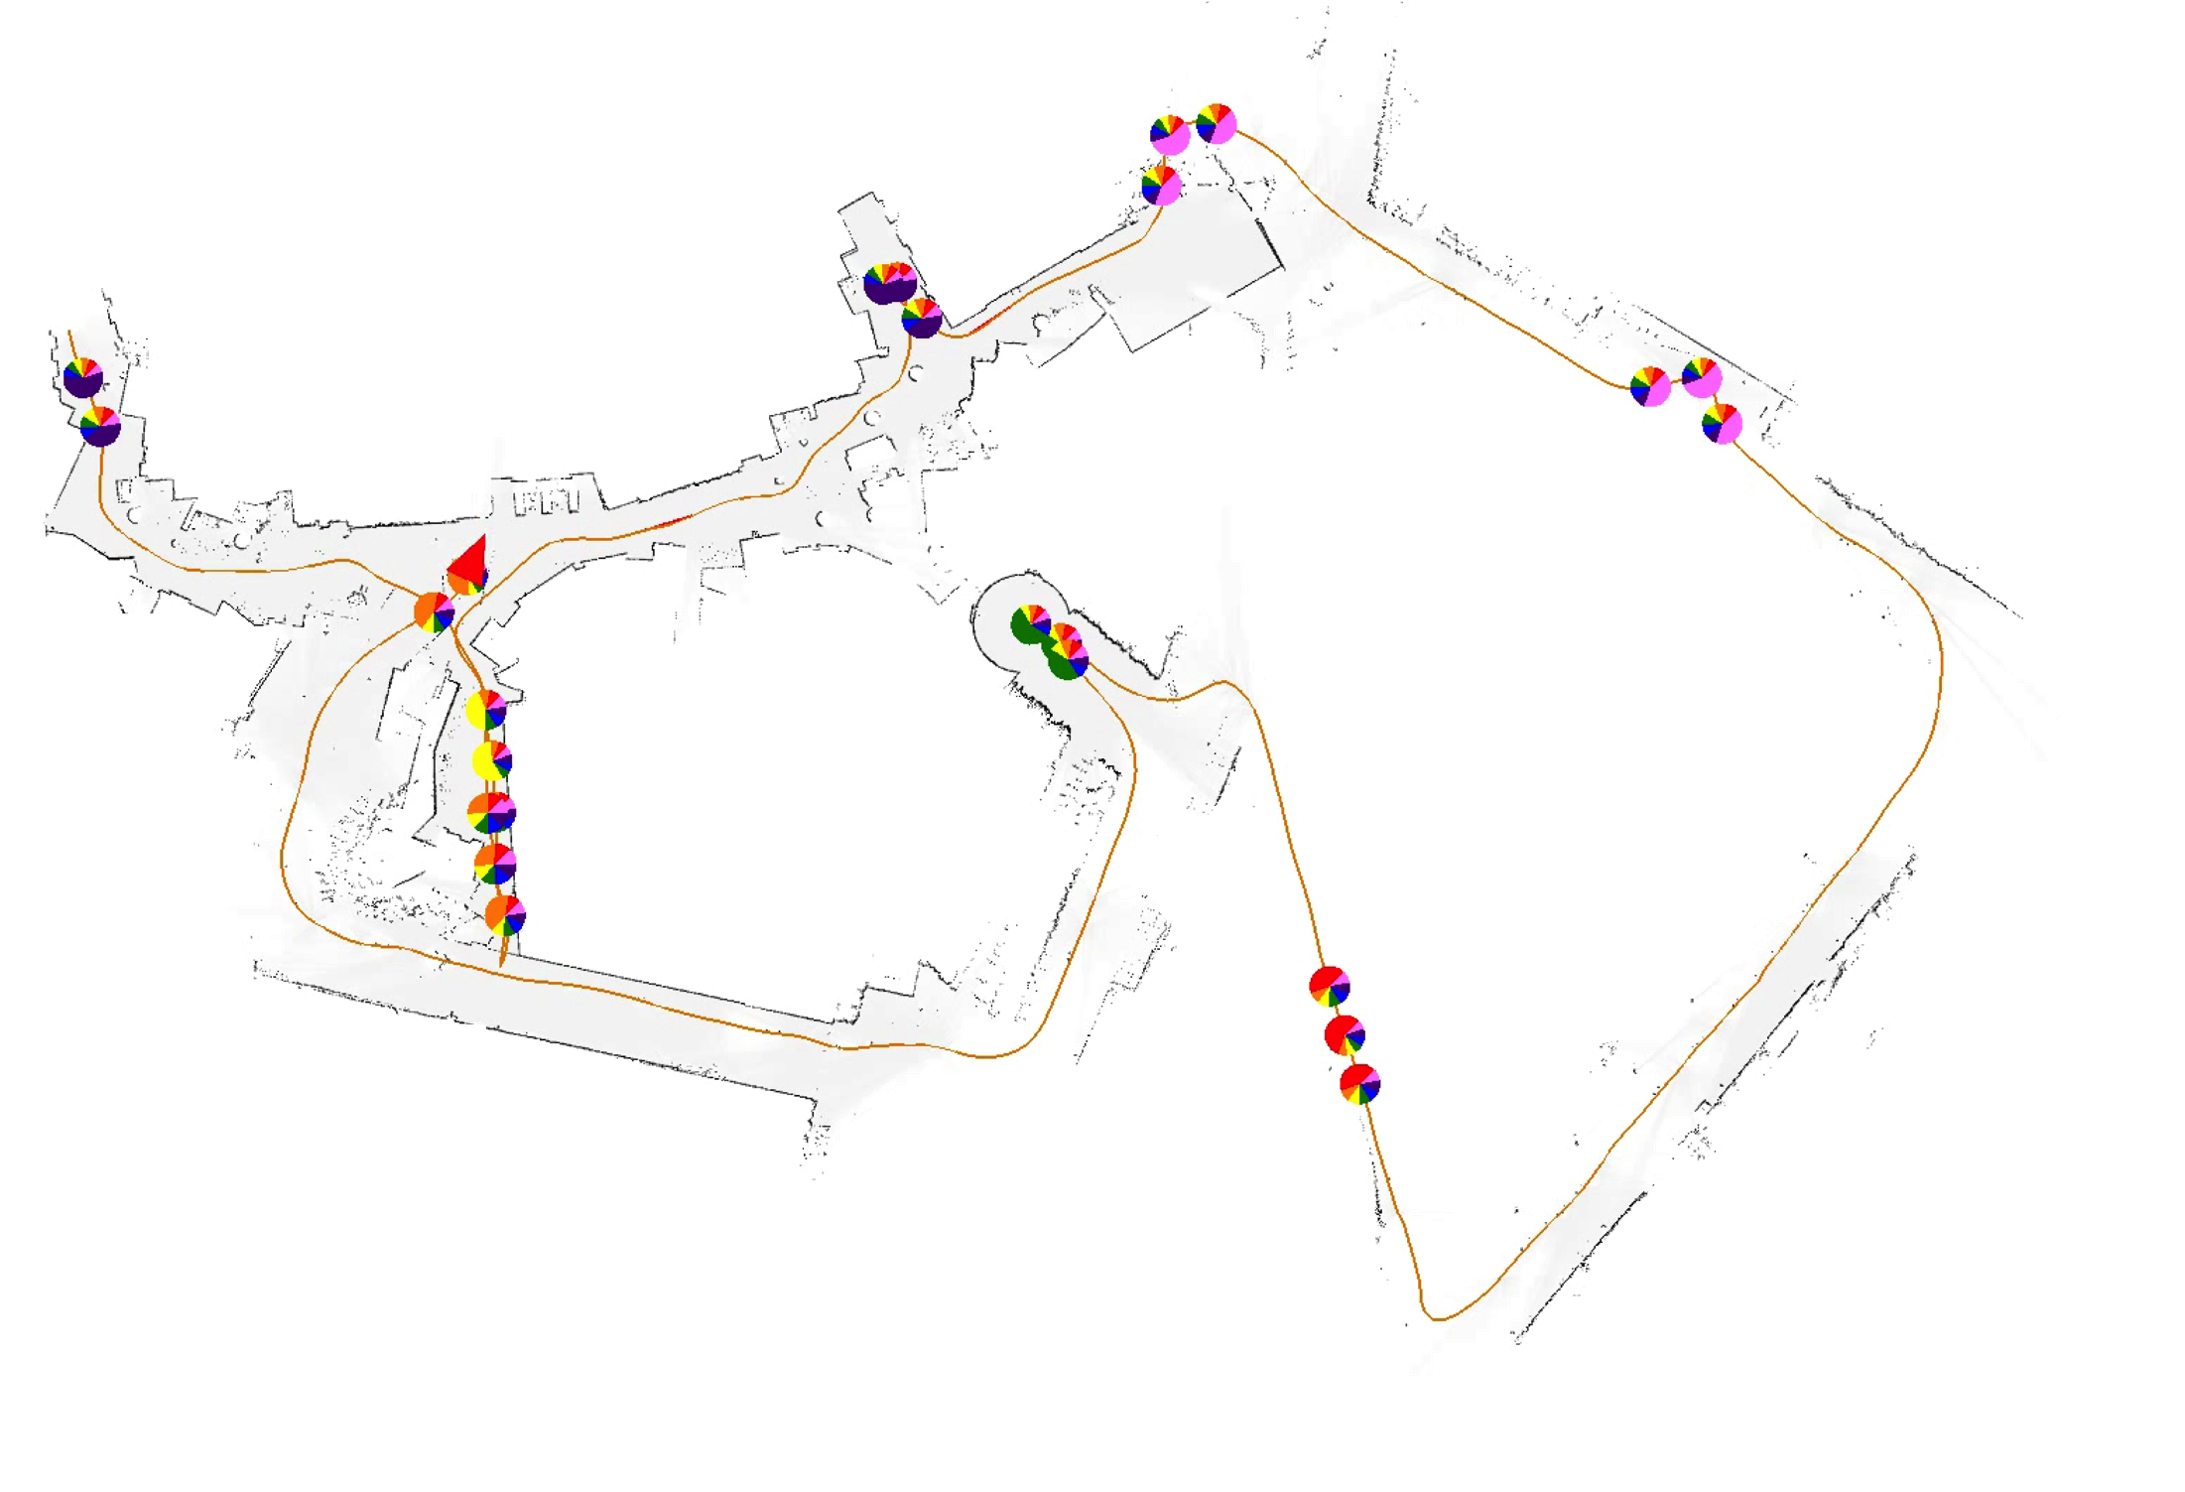
Language-based loop closures
Same gym

Slide 15
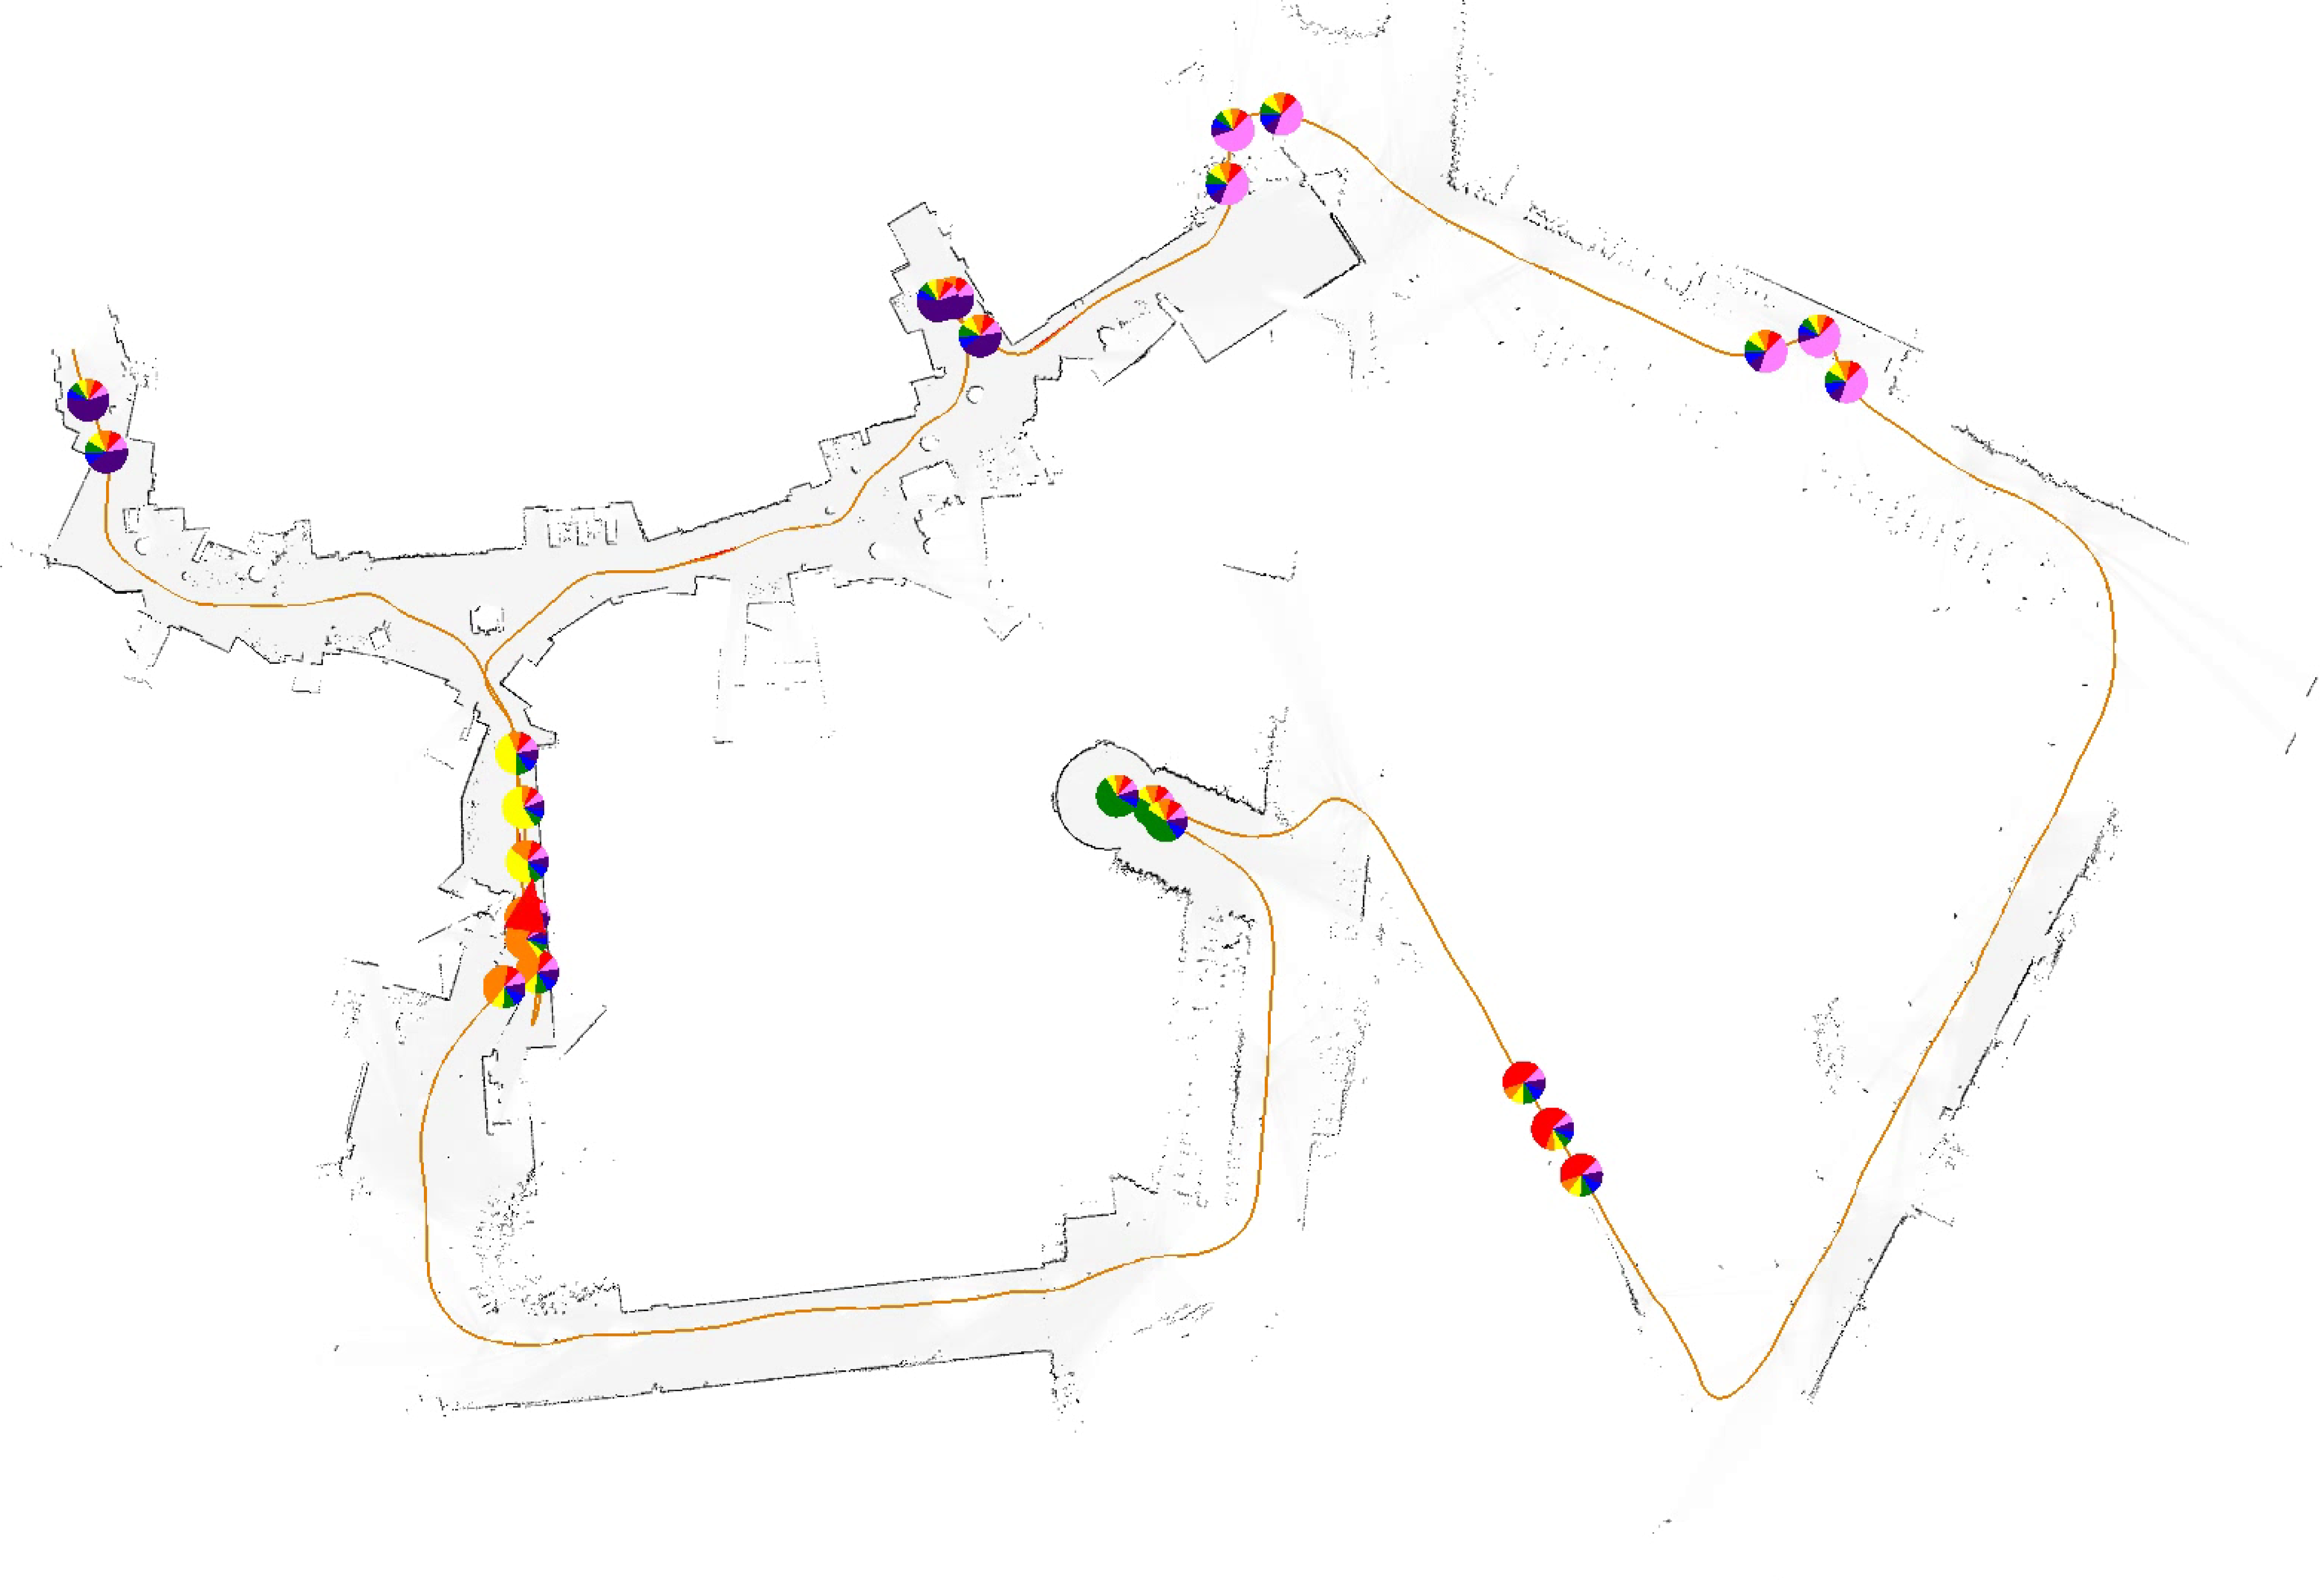
Language-based loop closures
Loop closure

Slide 16
Narrated tour results
Notes:
- Labeled 16 places in the environment

Slide 17
Narrated tour results: Baseline

Slide 18
Narrated tour results: Semantic Graph
Loop
Closures

Slide 19
Contributions
Learn semantic maps from free-form spoken descriptions
Use semantic information to improve metric and topological maps
See it in action at our poster!

Slide 20
Supplementary Material

Slide 21
Posterior over Semantic Graphs
Sample-based representation
Notes:
- Space of loop closures is combinatorial

Slide 22
Posterior over Semantic Graphs
Gaussian (canonical form)

Slide 23
Posterior over Semantic Graphs
Semantic
Metric
Topological

Slide 24
Posterior over Semantic Graphs
Metric
Topological
Notes:
The space of possible graphs is combinatorial, so we represent the distribution over graphs as a set of particles, each hypothesizing different semantic and spatial edges in the graph.
Much like a pose graph in SLAM, each graph induces a Markov Random Field over the node locations.
The first two work without language (cite Ranganathan, mention pose graph).

Slide 25
Posterior over Semantic Graphs
Semantic
Metric
Topological
Dirichlet
Notes:
We add a factor that incorporates language to allow for loop closure
We maintain the sample-based and two analytical distributions over time as new sensor and language data arrive using Rao-Blackwellization

Slide 26
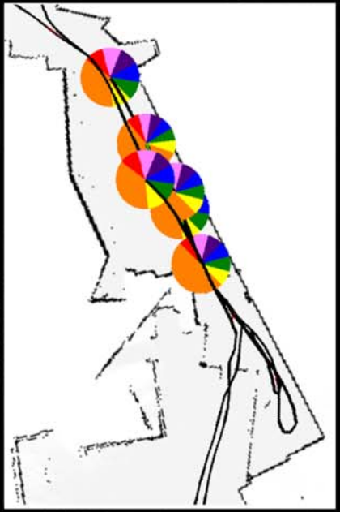
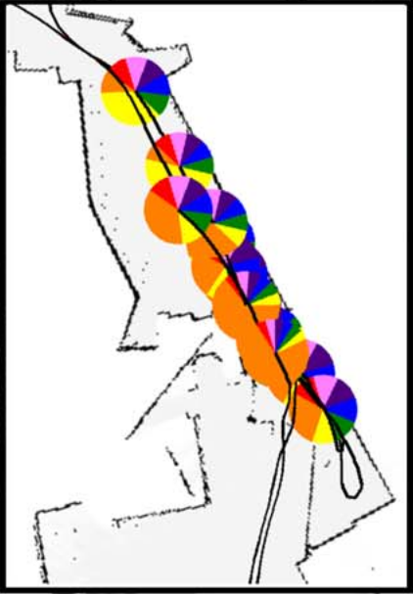
Language Integration
Simple language vs. Complex language
Simple language expressions contain less uncertainty due to the localized nature of the expressions.
Complex language can have higher uncertainty depending on spoken phrases.

Slide 27
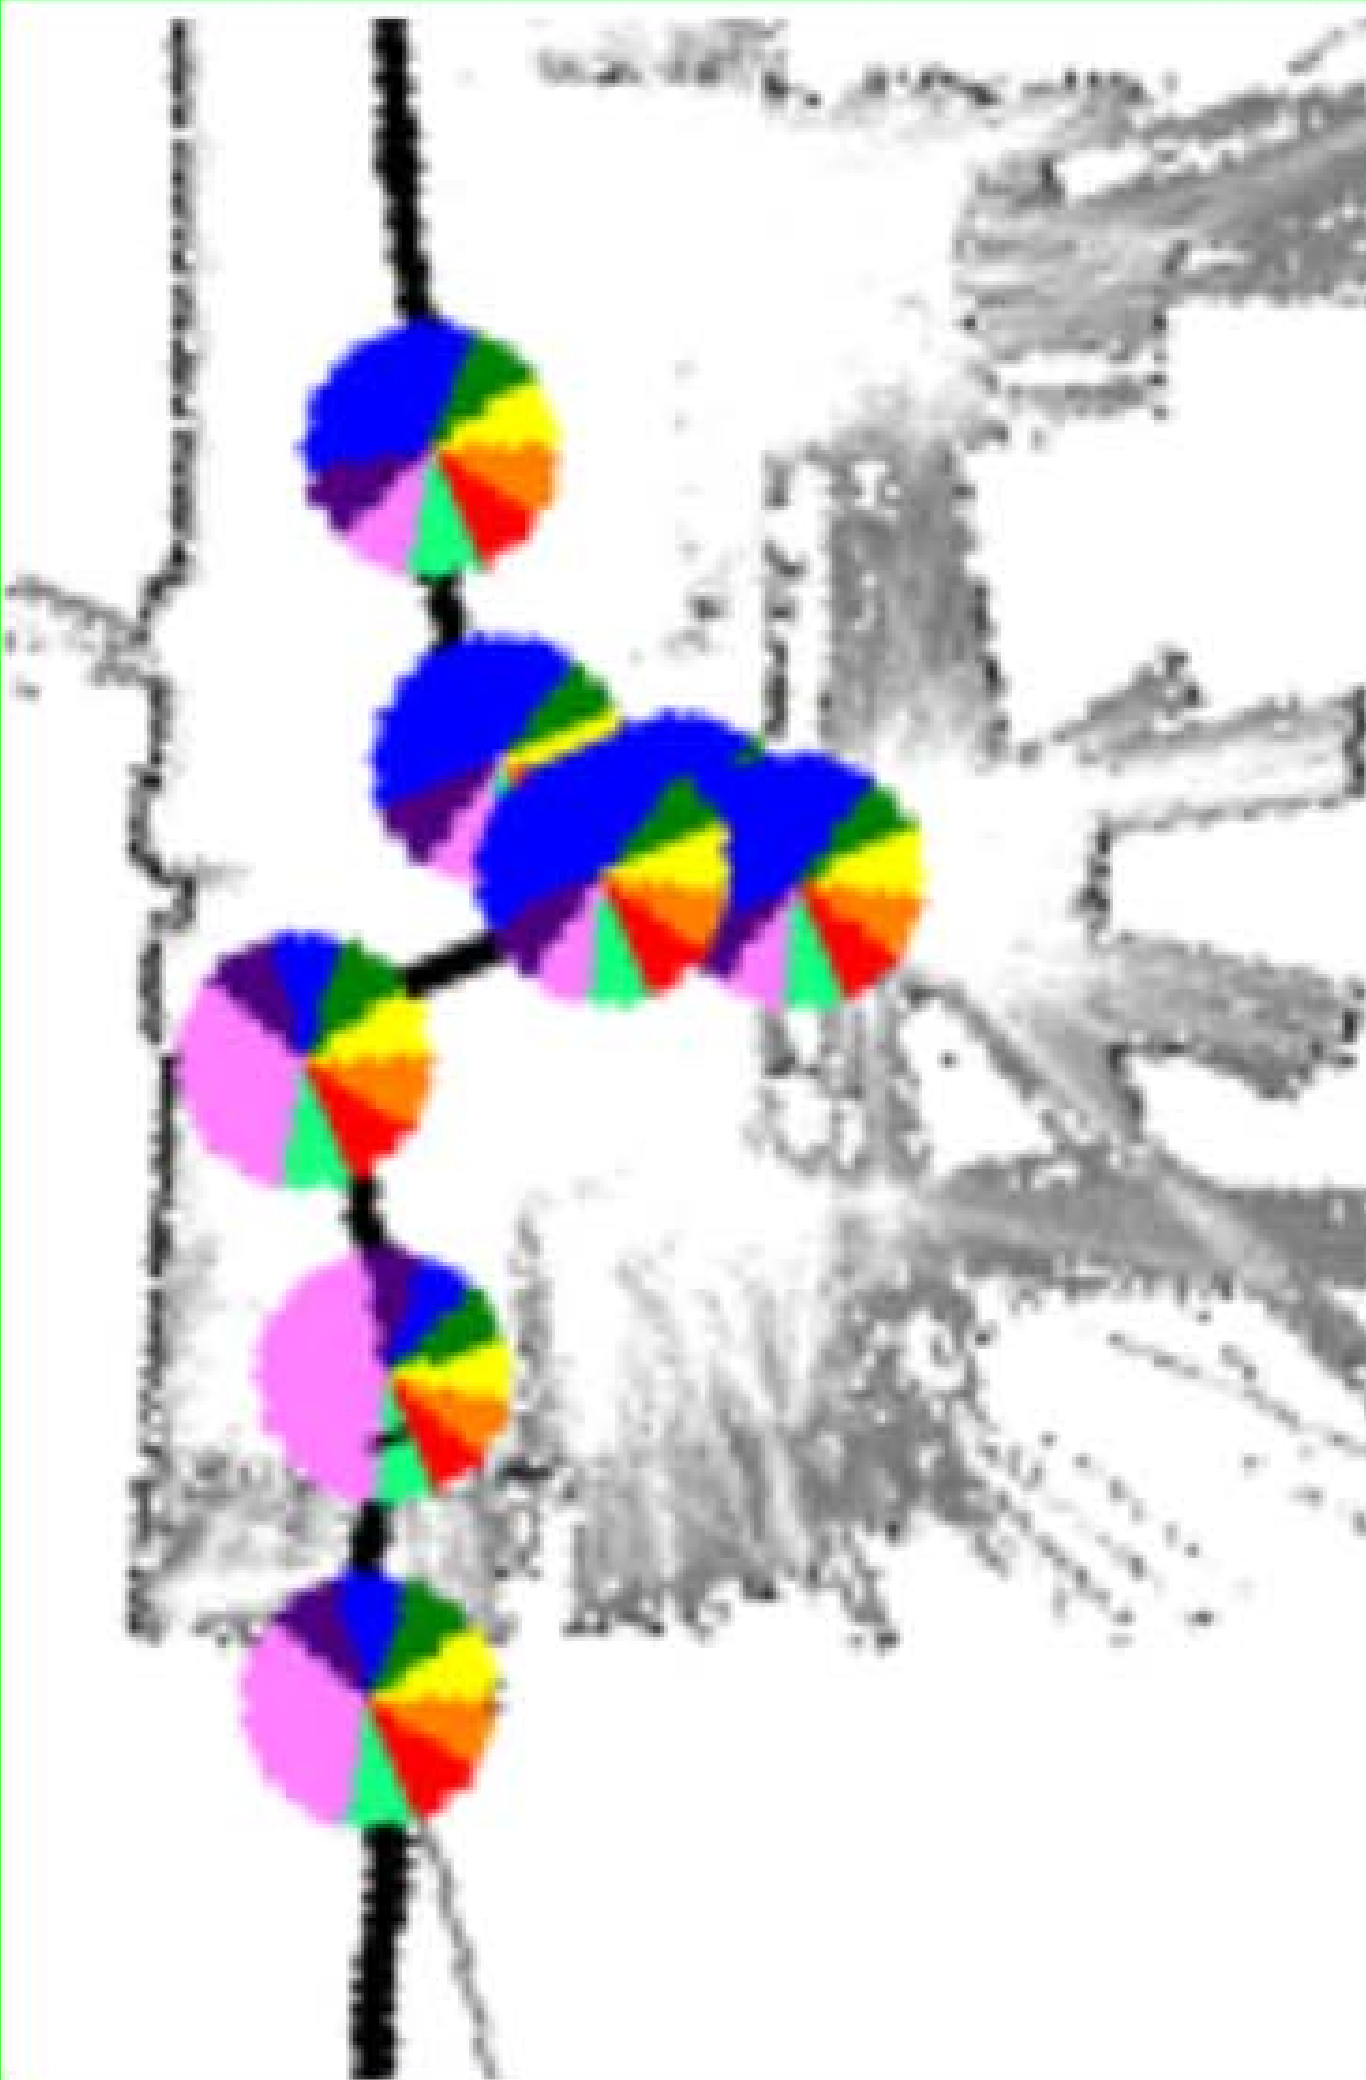
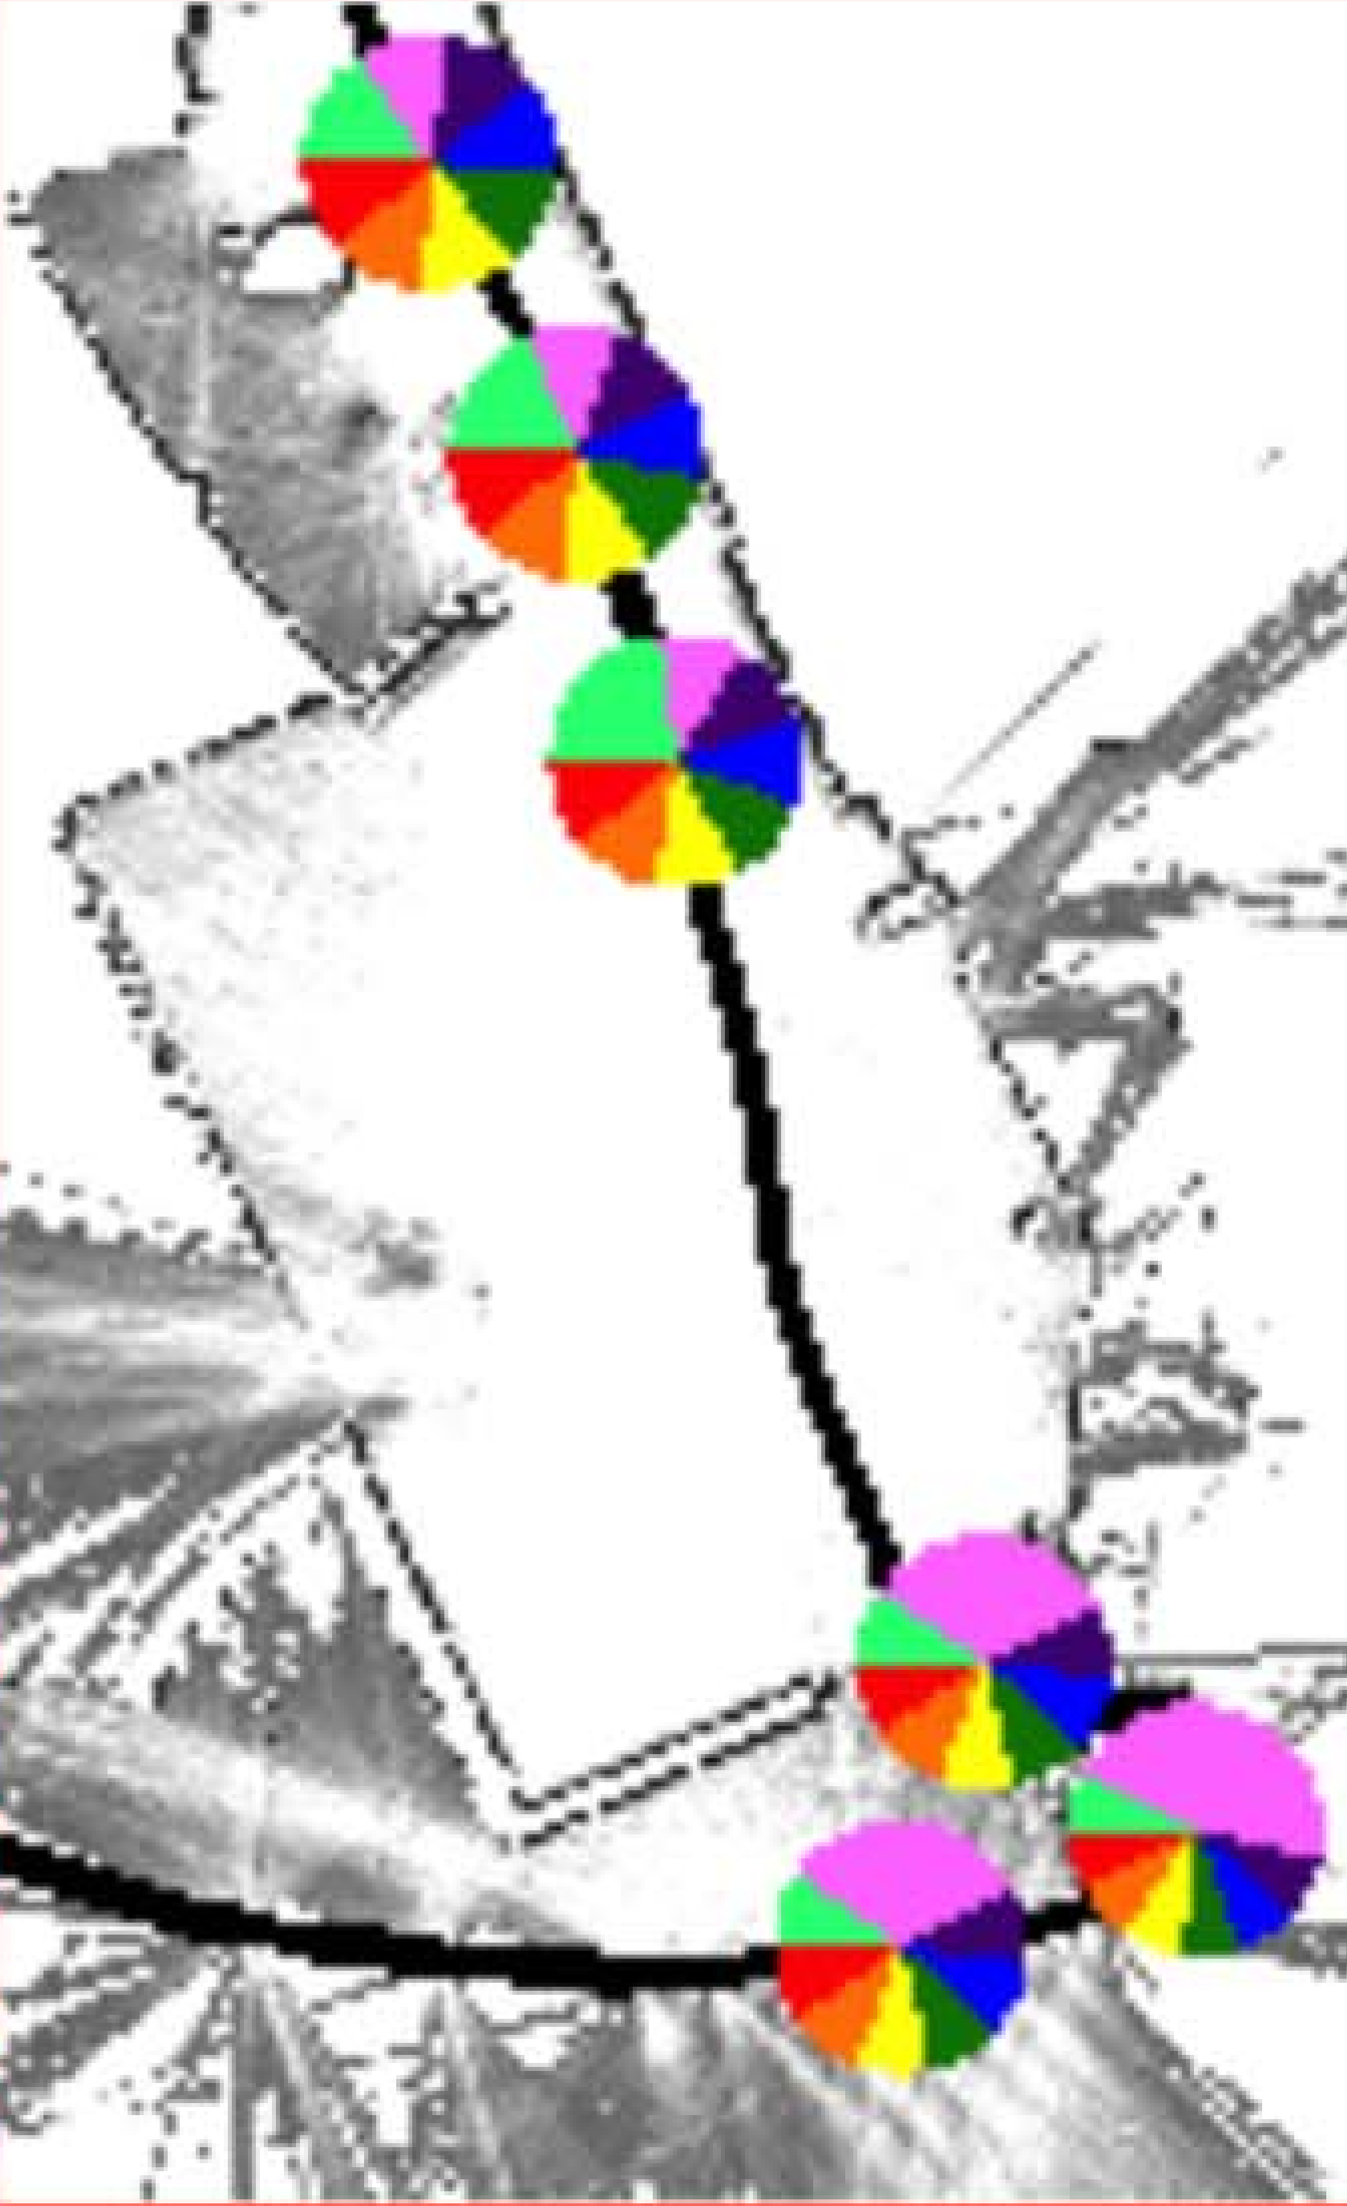
Complex Language Instances
Hall
Hall
Cafeteria
Gym
Entrance
Entrance
“The gym is down the hall”
“The cafeteria is near the entrance”
“The lobby is through the entrance”

Slide 28
Future Work
Non-situated speech & explorative grounding
Reason over generalized descriptions (“Men’s and women’s rooms are on opposite floors”)
Dialog

