Slide 1

Localization
Rapid Robotics
2013 MIT Short Program
NAME (EMAIL)
ORGANIZATION
5-9 August 2013

Slide 2
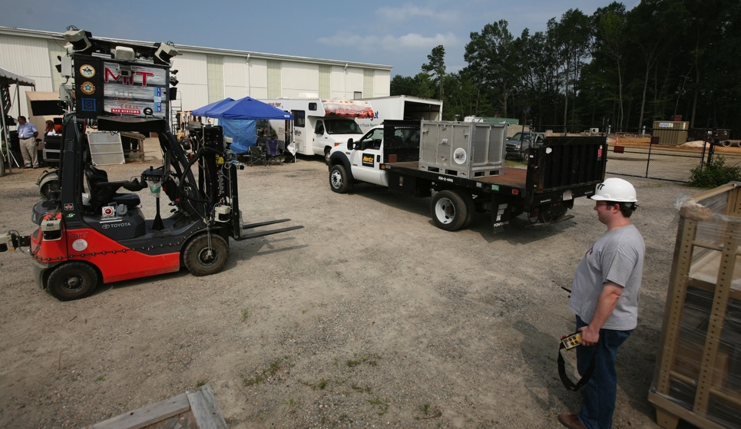
Introduction
Goal: Robots that people can efficiently command
Shared situational awareness is key to effective interaction
  Objects
  Actions
  Locations
Take me to the room across from the cafeteria
Move the pallet to receiving
Notes:
Our lab is developing robots that people can efficiently command, whether it’s a wheelchair that you can speak to as if there was a nurse pushing the chair or a UAV that you can control using gestures
A key component to interpreting these commands is to endow robots with a model of their state and action space that is as close as possible to our own.
To achieve this, we have developed a robot’s ability to learn human-centric models of objects, actions, and, as this paper describes, semantic maps of their environment.

Slide 3
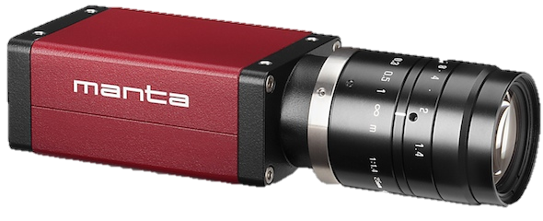
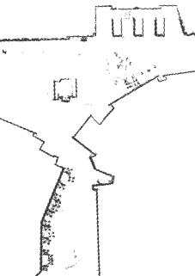
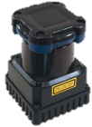
Semantic Mapping
Formulate human-centric models of the environment
Existing solutions: Augment SLAM map with semantic layer
  Incorporate scene classification and object detection^{2,3}
  Information flows up from the metric layer, not down
hallway
kitchen
Semantic
lobby
Topological
Metric
²Zender et al. 2008; ³Pronobis et al. 2010
Notes:
Our goal is to enable robots to learn human-centric maps of their environment.
There is a lot of good work in this area.
The current state-of-the art is to take a metric map built using SLAM and augment it with layers that encode topological and semantic properties.
To populate the semantic layer, people frequently use cameras mounted to the robot to do scene classification and object detection

Slide 4
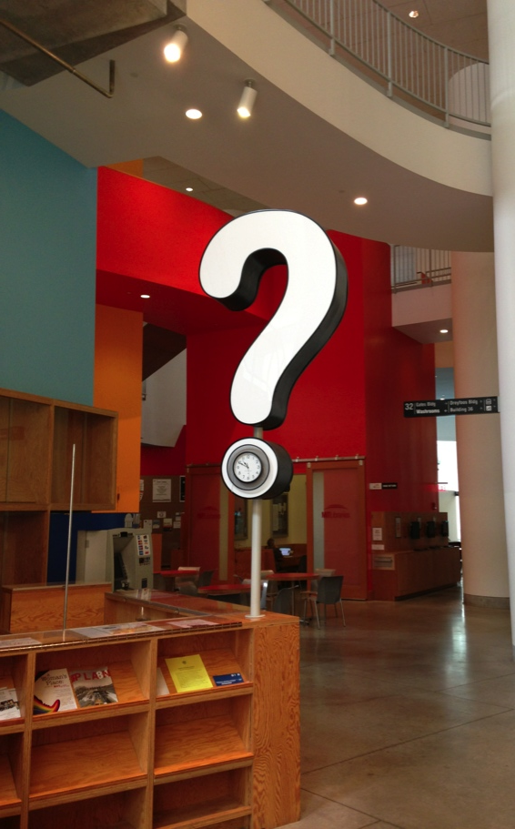
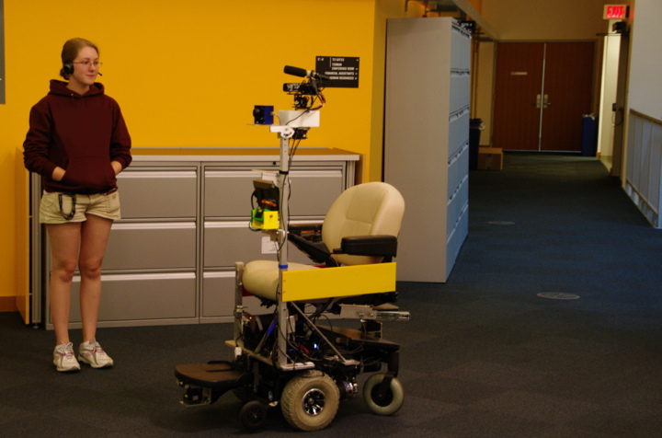
Semantic Mapping
Colloquial names
Spatial relations
Regions distant from the robot
Regions that were never visited
The information desk is down the hall
Notes:
There is a lot of semantic information that robots can’t perceive
For example, it would be difficult for a robot to infer that the question in my building indicate that this is the information center
Yet people often use it as a reference point.
If the robot could integrate human speech, for example, as part of a guided tour, it could infer concepts like colloquial names and spatial relations for regions nearby and distant from the robot.

