Slide 1

Simultaneous Localization and Mapping using Monocular cameras
Presenter: Kuan-Ting Yu
Advisor: Li-Chen Fu
Notes:
Hello everyone, I’m Kuan-Ting Yu from computer science department. I’m now a master student under the supervision of Prof. Fu.
In this talk, I will be showing you how we tackle simultaneous localzation and mapping (a.k.a SLAM) using low cost monocular cameras.

Slide 2
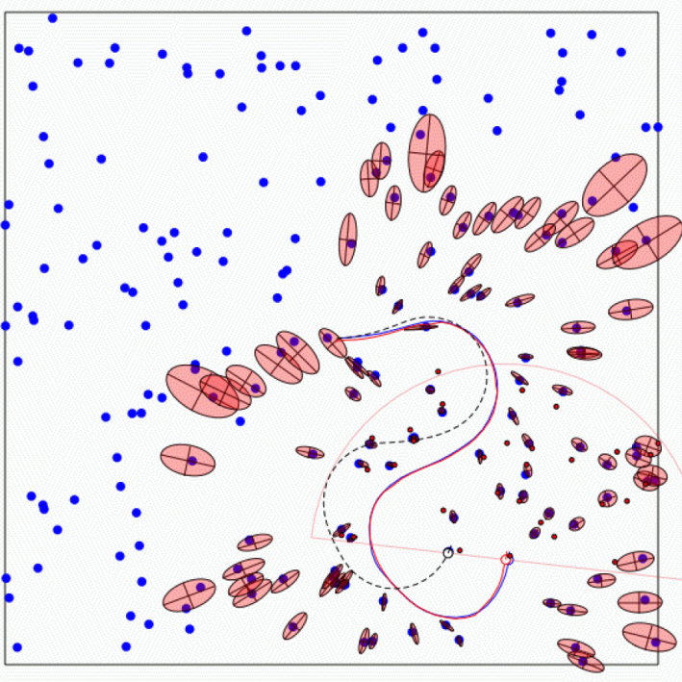
The SLAM Problem
A robot is exploring and unknown, static environment.
Given:
- The robot’s controls
- Observations of nearby features
Estimate:
- Map of features
- Trajectory of the robot
Notes:
SLAM problem is important in robotics. Why? Because the robot gets into a new environment, the robot need to explore the unknown world. Here, we assume the environment is static.
So, given the robot’s controls, and observations of nearby features.
We want to estimate the map of features and the trajectory of the robot
This problem has a really important property
Localization -> Need a map
Build a map -> Need good localization
Chicken and egg problem
Use dead reckoning / odometery to build map
But as we all know, the odometry has errors. The accumulation of little noise would cause a huge error in localization and mapping
Challenge: uncertainty in measurement
Probabilistic framework: EKF

Slide 3
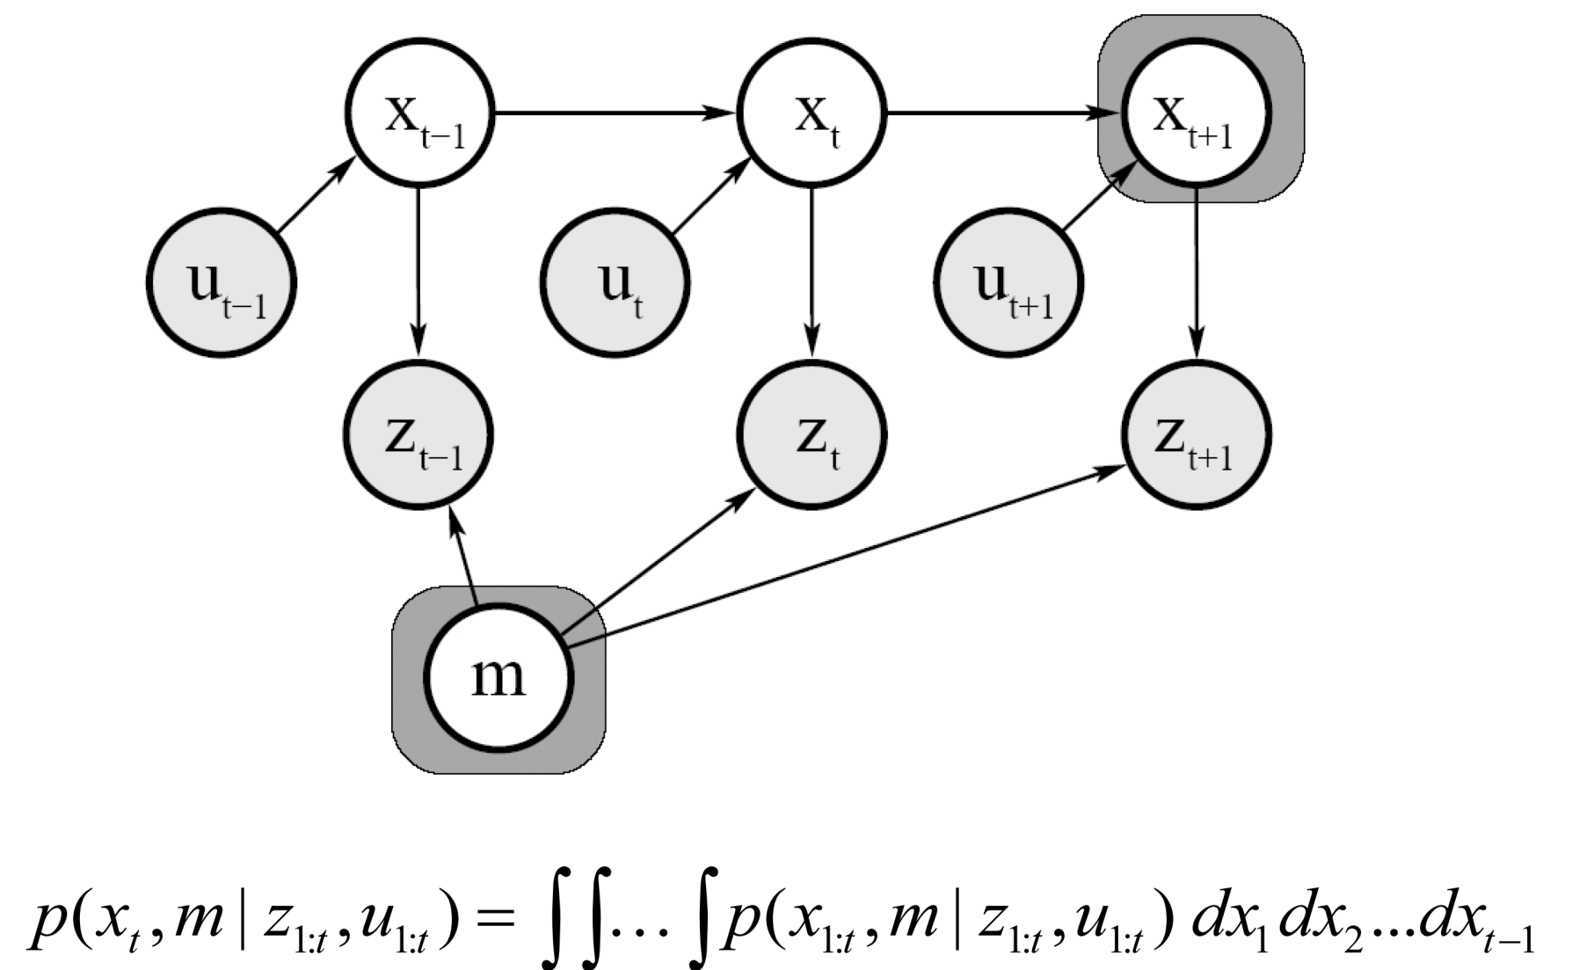
Graphical Model of Online SLAM
Notes:
Here is the graphical model of an online SLAM process
x indicates the robot pose, u is the control, z is the measurement, m is the feature map
Light color nodes are what we want to estimate and
Gray color nodes are observed variables
EKF is a Recursive updating which is based on markov assumption
That is the state at the time stamp t only depends on the last time stamp.

Slide 4
Recall Kalman Filter Algorithm
Correction (Measurement Update)
Prediction (Time Update)
(1) Compute the Kalman Gain
(1) Project the state ahead
K = P⁻_{t}H^{T}(HP⁻_{t}H^{T} + R)⁻¹
x⁻_{t} = Ax_{t-1} + Bu_{t-1}
(2) Update estimate with measurement z_{t}
(2) Project the error covariance ahead
x_{t} = x⁻_{t} + K(z_{t} - H x⁻_{t} )
P⁻_{t} = AP_{t-1}A^{T} + Q
(3) Update Error Covariance
P_{t} = (I - KH)P⁻_{t}
Notes:
Multivariate Gaussian distribution
Covariance matrix
Notice that the kalman filter assume the system is Linear.
For our SLAM process, the motion model and measurement model is not linear
So we linearize the them by using jacobian so that the Kalman Filter can be applied to our problem

Slide 5
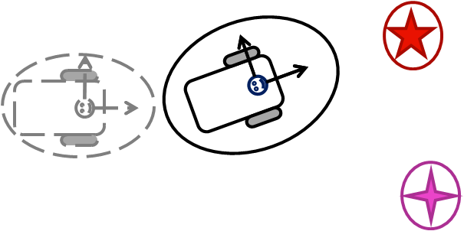
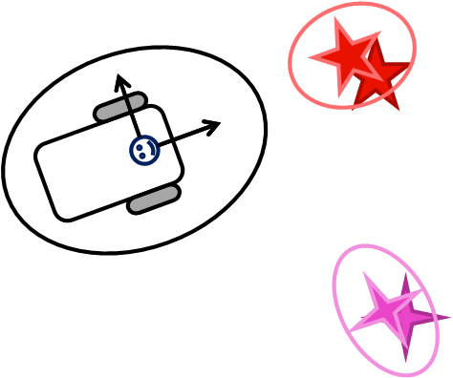
Method (1/2)
Using EKF for Monocular SLAM
  1) EKF predict
    Use motion model
  2) Feature extraction
    Determine bearing angles of features relative to robot
  3) Data association
    Calculate the Euclidean distance
Notes:
Motion model
Extract features
Calculate the eu dist. Of the feature descriptor
which describe the appearance of visual features

Slide 6
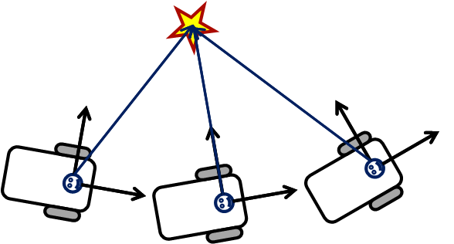
Method (2/2)
Using EKF for Monocular SLAM
  4) EKF update
    By observing the initialized landmarks,
      robot pose & map features are updated
  5) Landmark initialization
    As well-conditioned[1] pair occurs in measurements,
    new initialized landmark is added to the state vector
[1] T. Bailey, “Constrained initialisation for bearing-only SLAM,” in ICRA, 2003.
Notes:
As more measurement are collected, well-conditioned pair will occurs. This time, the landmark will be initialized and put in the feature vector.

Slide 7
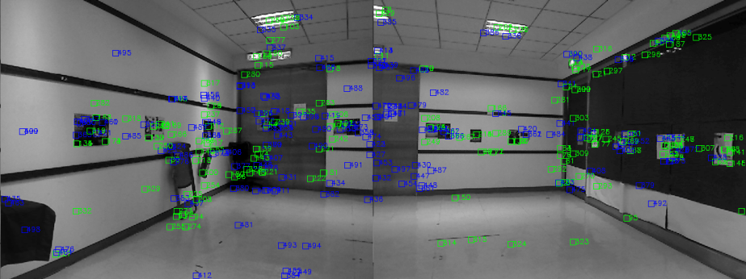
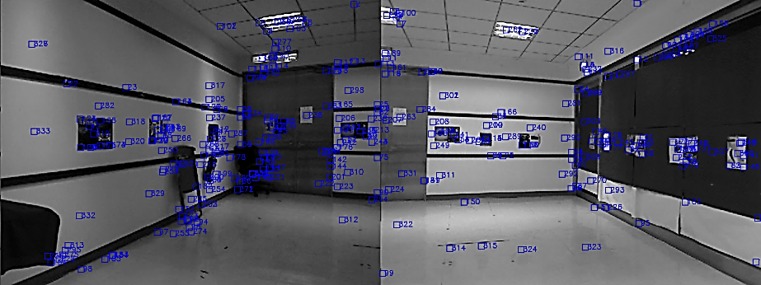
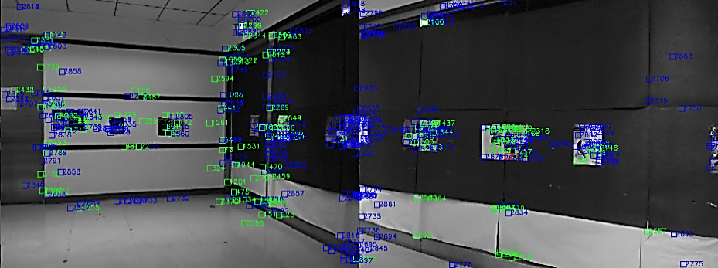
Measurement of Visual SLAM
Feature Extraction using corner features
  Speeded Up Robust Feature (SURF) ¹
  Scale Invariant Feature Transform (SIFT) ²
  ¹ Lowe. Object recognition from local scale-invariant features. ICCV 1999.
  ² Bay et al. SURF: Speeded Up Robust Features. ECCV 2006.
Notes:
Here is an example of the measurement step of visual slam.
In our system we have two cameras to enlarge the field of view of the robot.
Coner features

Slide 8
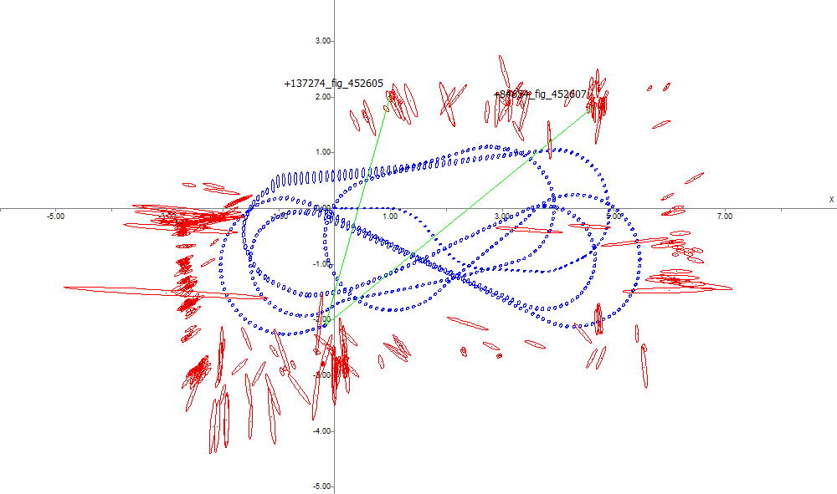
Experiment

Slide 9

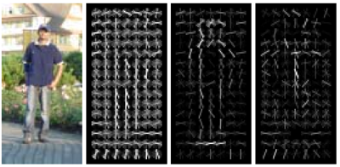
Sematic mapping
Human context in office
  Concentrating
  Relaxed
  Tired
  Neutral
Posture is important
Histogram of Gradient
Dalal-Triggs 2005
Notes:
Traditional mapping is basically for robot navigation
Recently roboticsts proprosed to fill in the map with some semantic meaning. For example, the objects category for further manipulation
Here, in my master thesis we want to push this idea further to encoporate human-context in the map.
That is, we want to associate human situation with spatial and temporal domain.
We define 4 cat in office env
And we all know that by looking at the posture of human , we somehow can tell
So, we employ a feature called histogram of gradient, which was proposed to detect pedestrian
The feature first take the gradient process on the image, so edge information will be extracted.
And by doing histograms we can allow small translation variation.
As you can see given a human picture. After the HOG process. We can obtain an feature describing the contour of human.

Slide 10
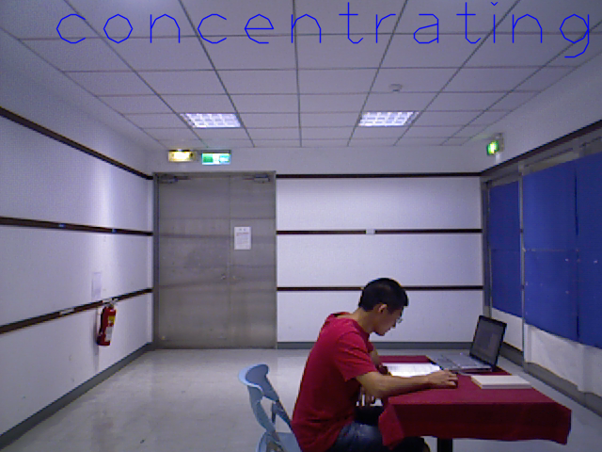

Slide 11
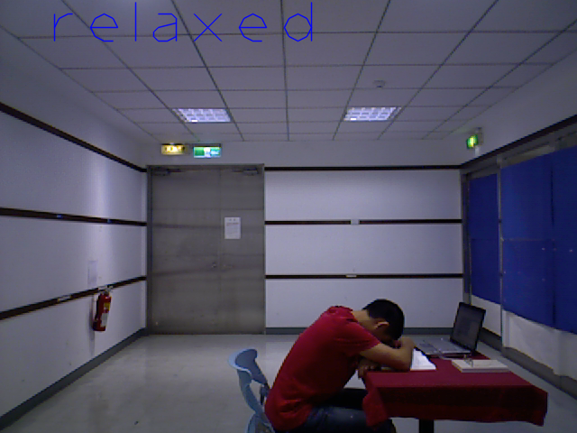

Slide 12
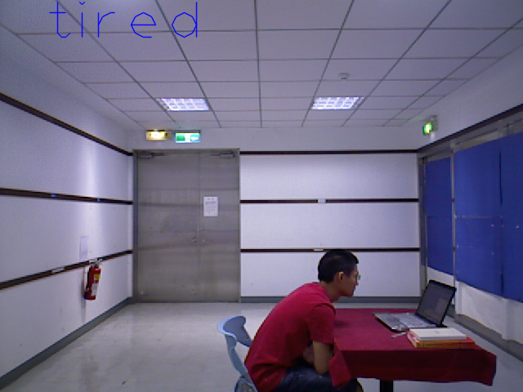

Slide 13
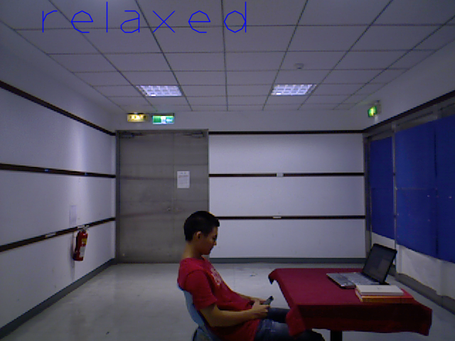

Slide 14
