Slide 1
DogBOT
Team 6 –
Kuan-Ting Yu
Wei How Mo
Ping-Che Shiao
Issue Lee

Slide 2
Outline
Gesture recognition - Kinect
Human following - laser range finder
Chase ball - color camera
Facial expression - emotion

Slide 3
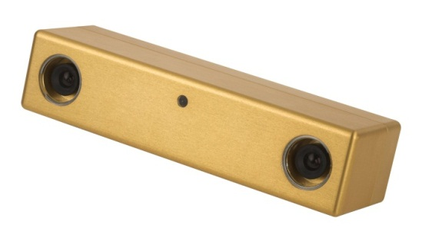
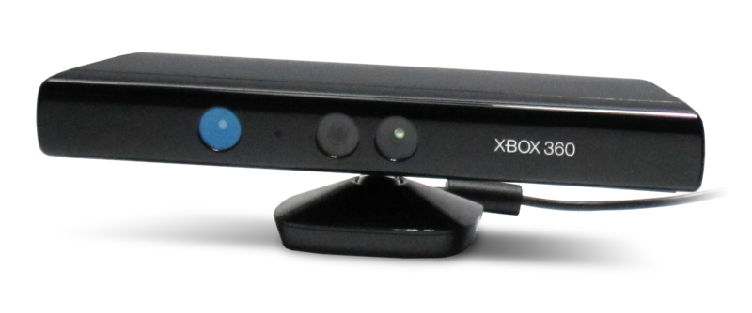
Gesture
Stereo Vision
Compare two images to extract 3D info.
But, depth image become broken for area with less texture
Alternative: Kinect Sensor

Slide 4
Kinect
Kinect is an active sensor which projects structured infrared light on objects.
use the dot pattern to derive 3D information
with built-in body parts tracker
http://boingboing.net/2010/11/23/dancing-with-invisib.html
Notes:
depth image is much more complete
interprets 3D scene information from a continuously-projected infrared structured light

Slide 5
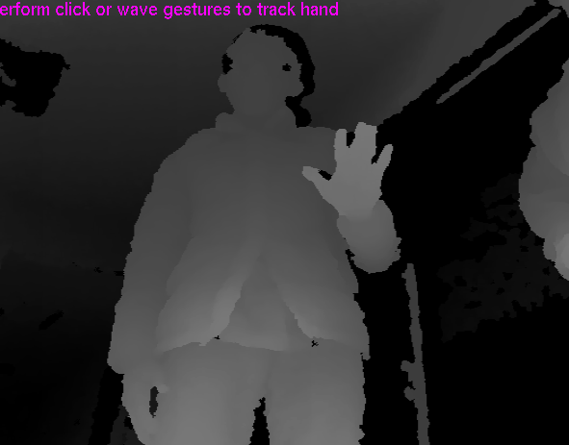
Stereo v.s. Kinect

Slide 6
Gesture Recognition
We have designed the finite state machine to recognize the 5 gestures for interaction.
But, later we utilize Kinect’s built-in gesture recognizer.
Gestures | State 1 | State 2 | State 3 | State 4 | Complete
HELLO
INTRODUCTION
COME
CHASE
STOP

Slide 7
Human Following
Laser Scanner
High precision and scan rate
Invariant to different lighting conditions, perspective change, etc
Flow Chart:
Human legs detection
Filtering
(with cues from Kinect)
robot navigation
(not yet ready)
(done)
Notes:
Our human following is based on laser scanner, because laser has high precision and scan rate, and it is Invariant to different lighting conditions or perspective change,
This is the flow chart of our human following system
first we detect the human legs, and we want to fuse laser with Kinect to locate human more precisely, and in the next step we move the dogbot.

Slide 8
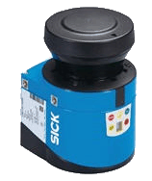
Human Following
Human detection using laser scanner
Detection position : lower legs
Sensing Field
Lower leg
Notes:
In our human legs detecting, we detect human lower legs, and list all the possible of human leg's pattern to classify it as a human.

Slide 9
Human Following
Obstacle Avoiding:
Laser based
Front of pioneer, degree 45 to degree 135
Notes:
And next is the obstacle Avoiding: it’s laser based, our detecting region is front of pioneer about 60cm, degree 45 to degree 135,

Slide 10
Ball chasing
calculate hue histogram of the ball
back projection on current image
thresholding and finding contour
coordinate transform from image to base

Slide 11
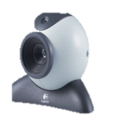
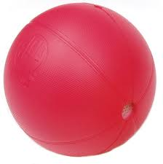
Coordinate transform
To achieve higher level planning, precise target localization is a plus.
z
y
z
x
y
x
Notes:
{ }^{base} p = { }^{base}T_{cam}{ }^{cam}T_{img}{ }^{img}{p}

Slide 12
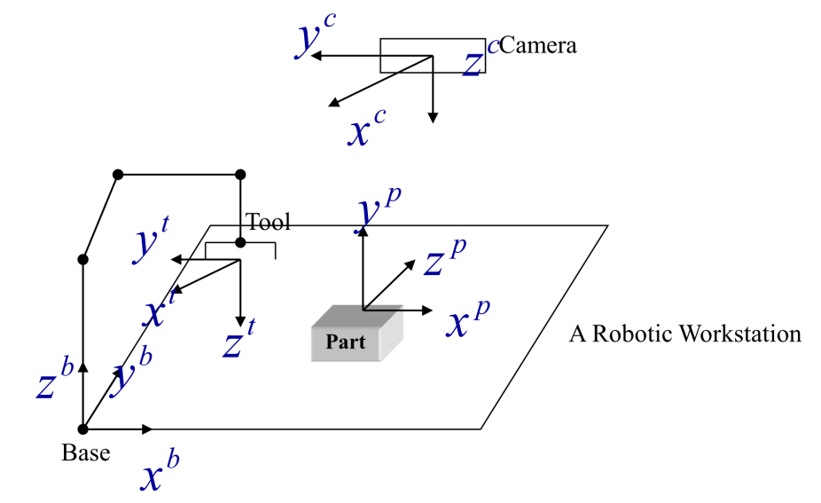
Recall
Depth is not fixed in our case!

Slide 13
Our solution (1/2)
is measured by calibration tool as extrinsic parameter.
is measured by hand.
z
y
z
y
x
z
x
x
y
Notes:
{ }^{base} p = { }^{base}T_{cam}{ }^{cam}T_{img}{ }^{img}{p}

Slide 14
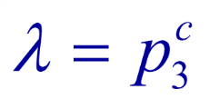
Our solution (2/2)
, the inverse perspective transform, can be solved by extending the constraint of fixed depth, , to a general plane equation of the ground:
z
y
z
z
y
x
x
x
y
Notes:
(\mathbf{p}-\mathbf{o}_{board})\cdot \overrightarrow{n}=0

Slide 15
Experimental result
The system can locate ball within 5m from camera with precision around 10cm.

Slide 16
Summery
Gesture recognition - Kinect
Human following - laser range finder
Chase ball - color camera
Facial expression - emotion

