Slide 1
Is Glyphosate the ‘Safe’ Chemical that’s Making Us All Sick?
Stephanie Seneff
MIT CSAIL
Friday Nov. 30, 2018
Notes:
This is the same file as Seneff_Wholefoods_2018.pptx

Slide 2
Download These Slides
http://people.csail.mit.edu/seneff/2018/
Seneff_Wholefoods_2018.pptx

Slide 4
“A truth’s initial commotion is directly proportional to how deeply the lie was believed... When a well-packaged web of lies has been sold gradually to the masses over generations, the truth will seem utterly preposterous and its speaker, a raving lunatic.”
- Dresden James

Slide 5
Outline
Introduction
The California lawsuit: Glyphosate and non-Hodgkin’s Lymphoma
Glyphosate and the Gut
Glyphosate Activism
A Failed System and a Growing Food Movement
How to Safeguard Yourself and Your Family
Summary

Slide 6
Introduction

Slide 7
Roundup and GMO Crops
GMO Roundup-Ready corn, soy, canola, sugar beets
cotton, tobacco and alfalfa
What is glyphosate?

Slide 8
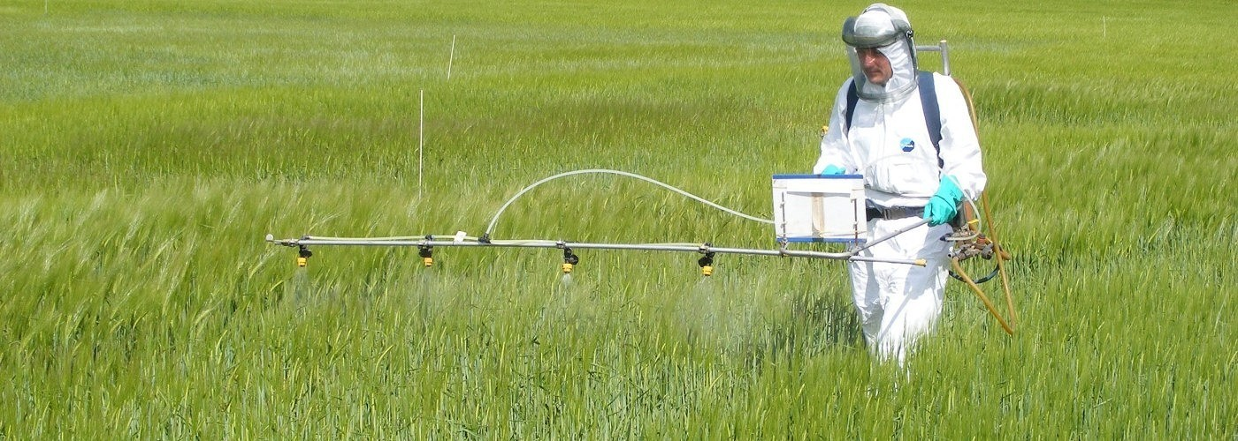
Roundup as a Desiccant/Ripener just before Harvest
Wheat, Oats, Barley, Rye, Sugar cane, Beans, Lentils, Peas, Flax, Sunflowers, Pulses, Chick Peas

Slide 9
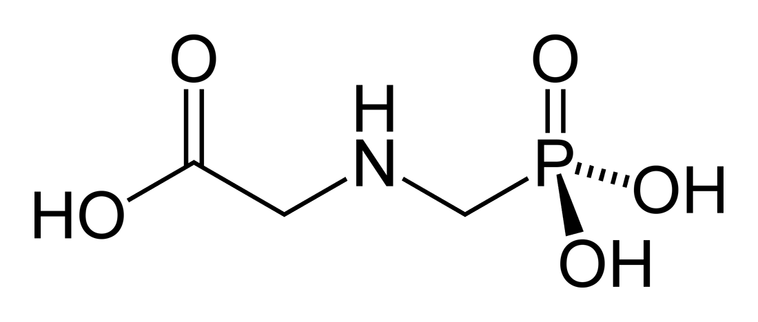
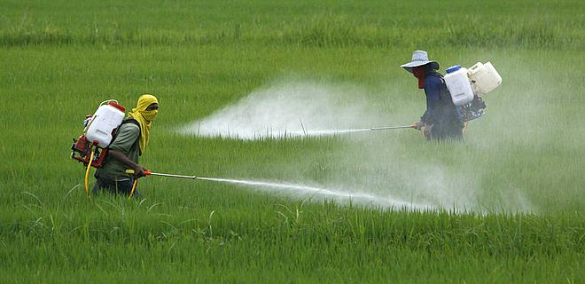
Glyphosate!!
Glyphosate is now the #1 herbicide in use in the U.S. and is increasingly used around the world
Developed and patented by Monsanto in the 1970’s
Introduced into the US food chain in 1974
Came out from under patent in 2000
Inhibits an enzyme in the shikimate pathway involved in the synthesis of tyrosine, tryptophan and phenylalanine (the three aromatic amino acids)
Huge expansion of GMO corn, soy, cotton and canola crops has led to sharp increases in the last two decades
Notes:
WIKI

Slide 10
Shikimate Pathway Disruption
Phenylalanine, tryptophan, tyrosine
shikimate
Glyphosate
Neurotransmitters,
thyroid hormone
chorismate
vitamin K
folate

Slide 11
Glyphosate vs. Other Pesticides: Usage in the United States*
Glyphosate
*http://sustainablepulse.com/wp-content/uploads/GMO-health.pdf

Slide 12
Environmental Working Group Results*
*www.ewg.org/childrenshealth/glyphosateincereal/

Slide 13
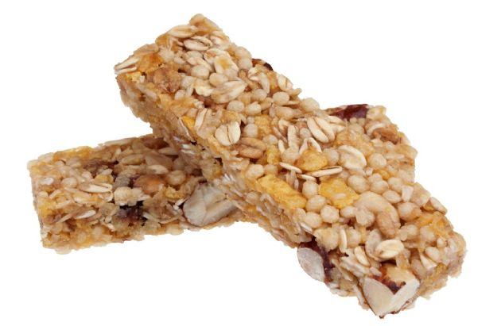
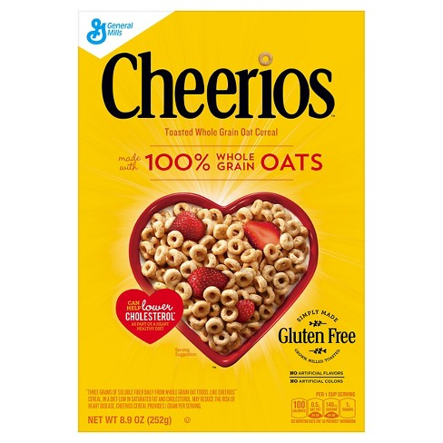
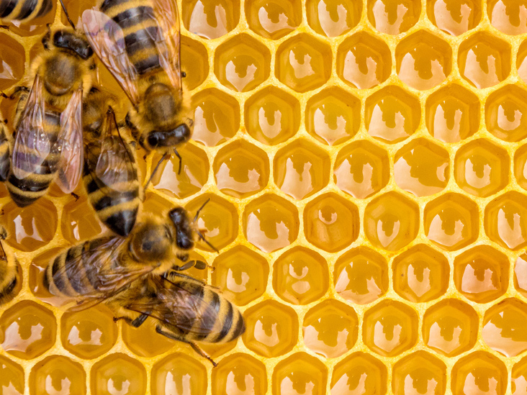
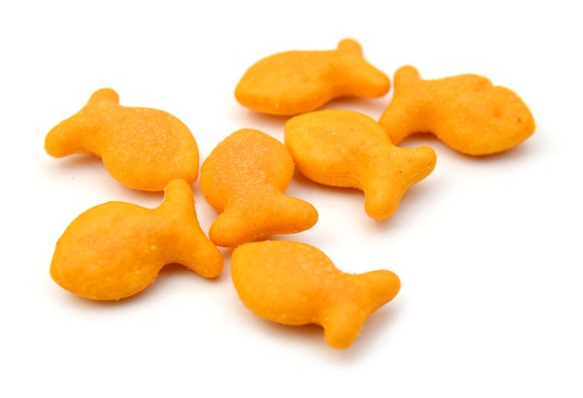
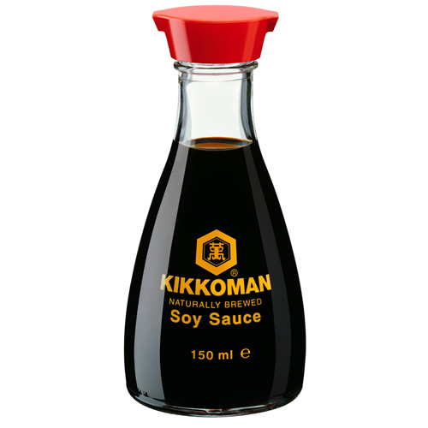
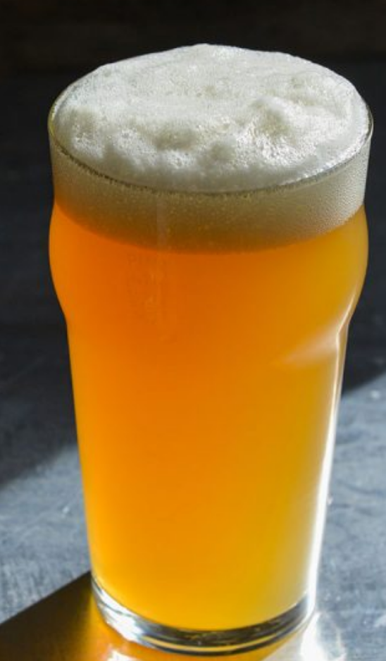
Some Foods Containing Glyphosate
Notes:
glyphosate_residues_in_honey_corn_soy_sauce_2014.pdf
Ten out of twenty eight (36%) soy sauce samples contained glyphosate at a concentration above the method LOQ (75 ng/mL) with a range between 88-564 ng /mL and a mean of 242 ng /mL

Slide 14
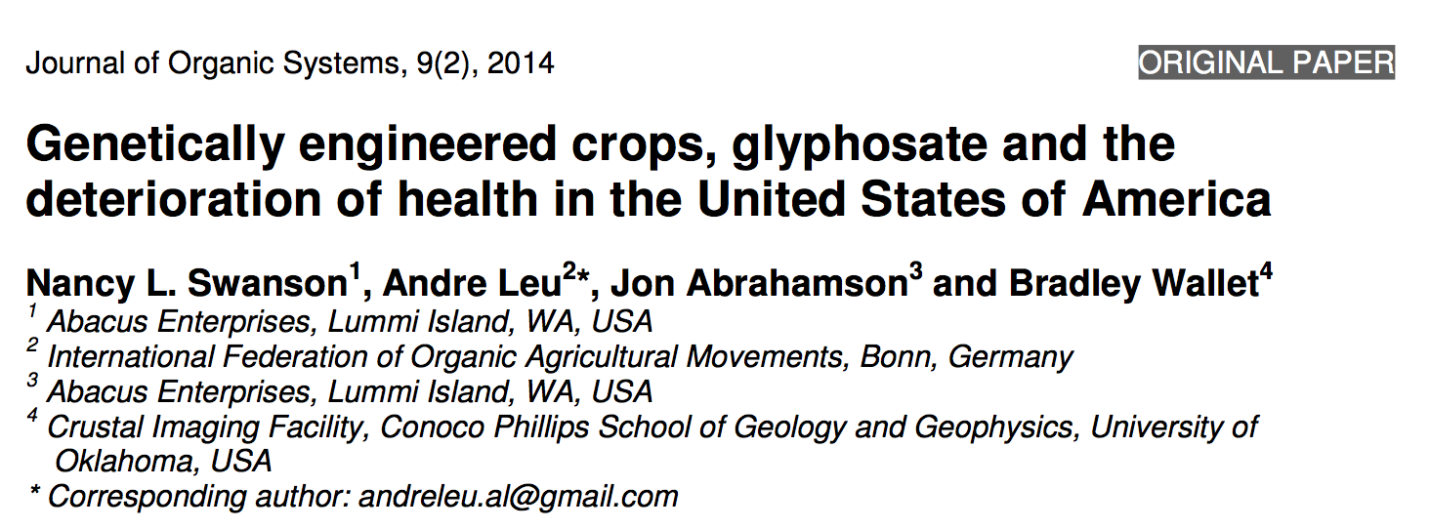
Paper Showing Strong Correlations between Glyphosate Usage and Chronic Disease

Slide 15
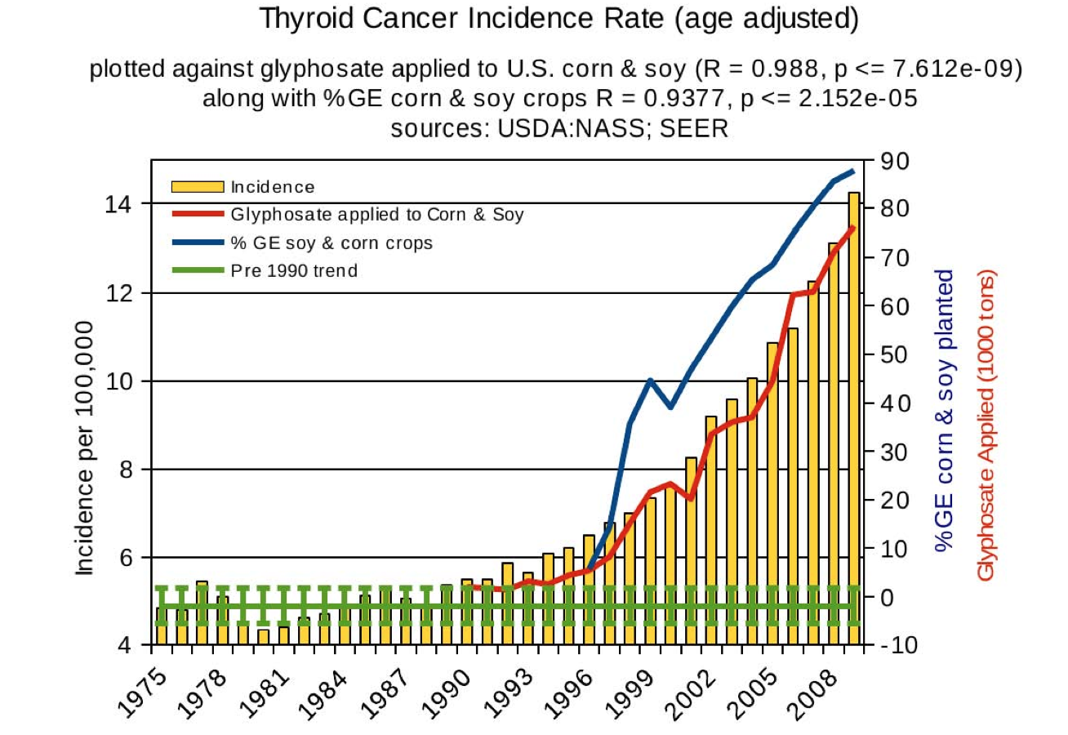
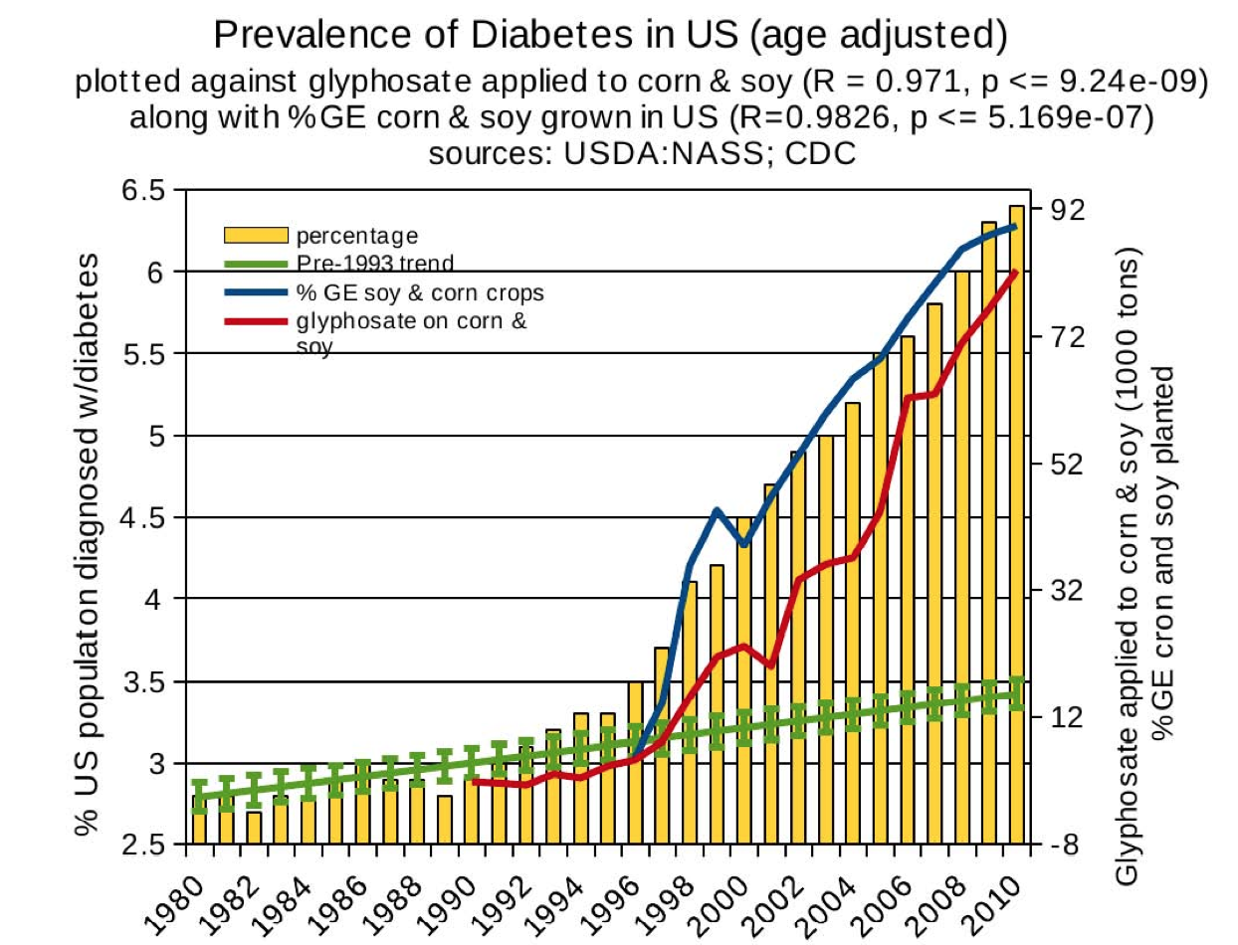
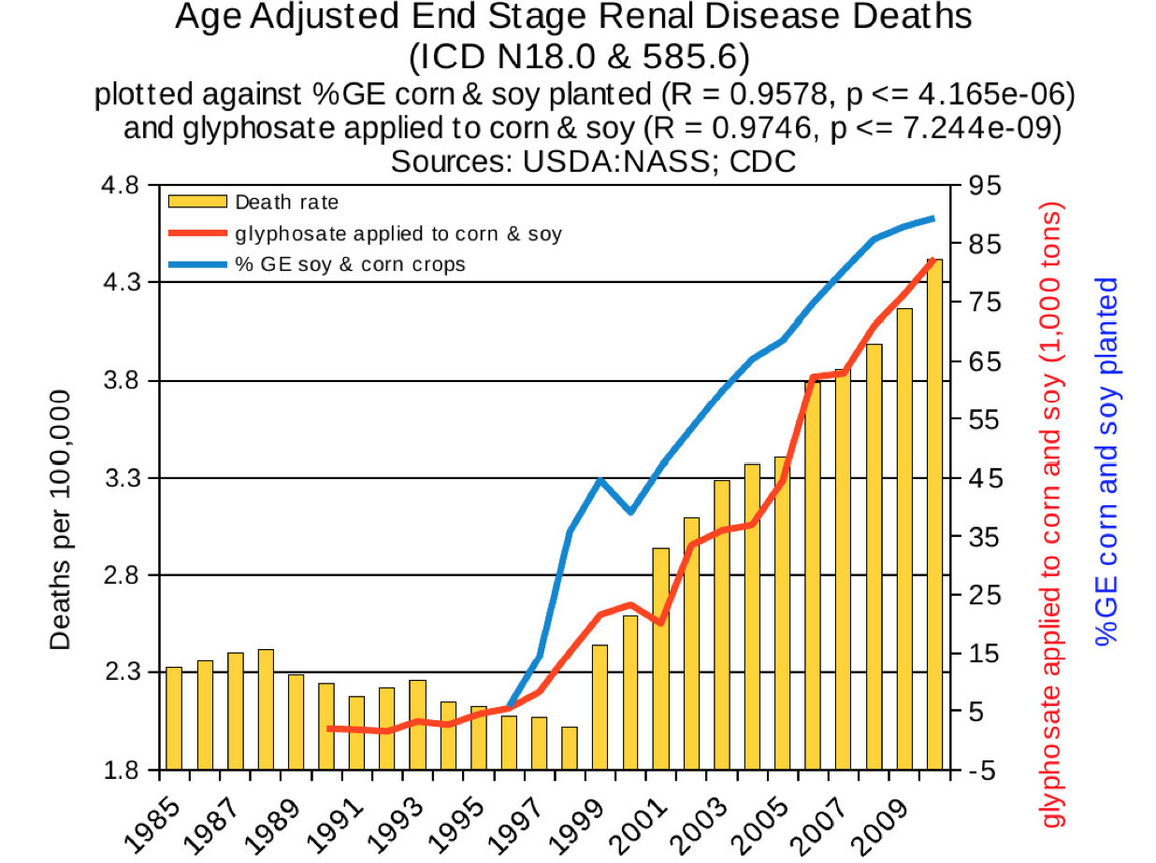
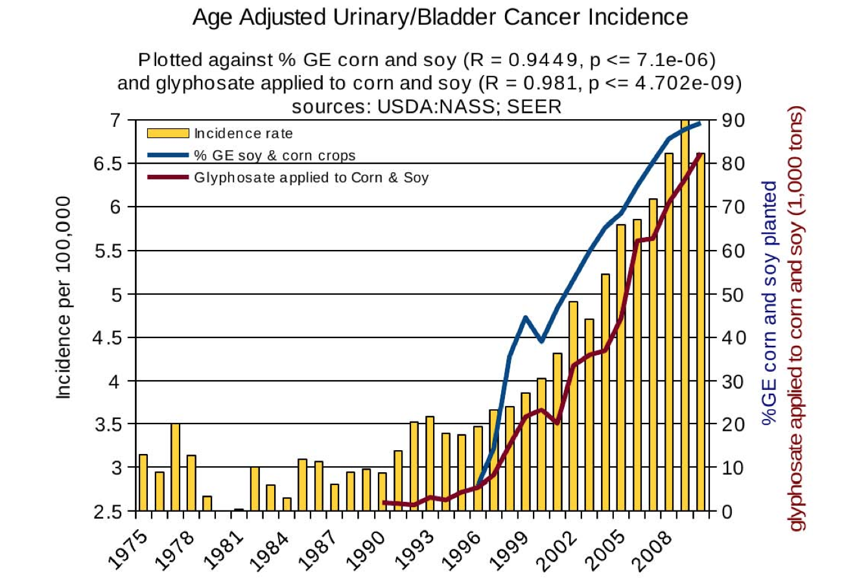
Thyroid cancer
Diabetes
End stage
renal disease
Urinary/bladder
cancer

Slide 16
Thyroid cancer
Diabetes
In 2015, WHO IARC declared glyphosate a “probable carcinogen”
End stage
renal disease
Urinary/bladder
cancer
Notes:
International agency for research on cancer

Slide 17
Quote from the Conclusion*
“Although correlation does not necessarily mean causation, when correlation coefficients of over 0.95 (with p-value significance levels less than 0.00001) are calculated for a list of diseases that can be directly linked to glyphosate, via its known biological effects, it would be imprudent not to consider causation as a plausible explanation.”
*NL Swanson et al. Journal of Organic Systems 9(2), 2014, p. 32,

Slide 18
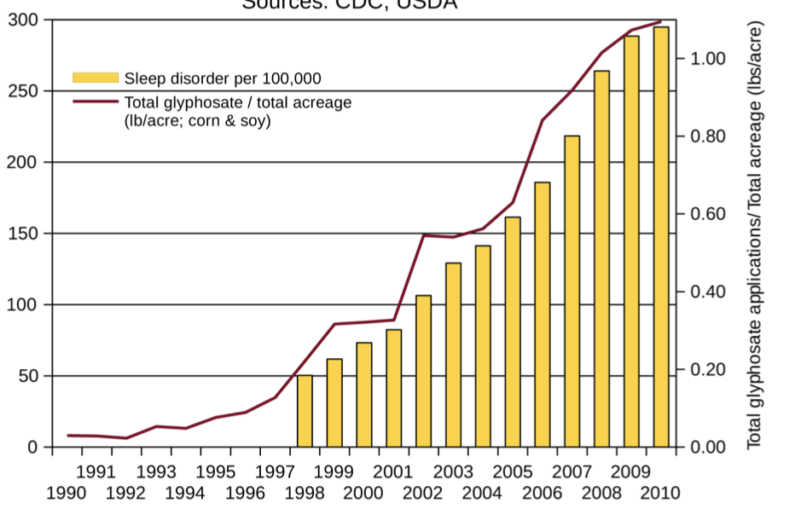
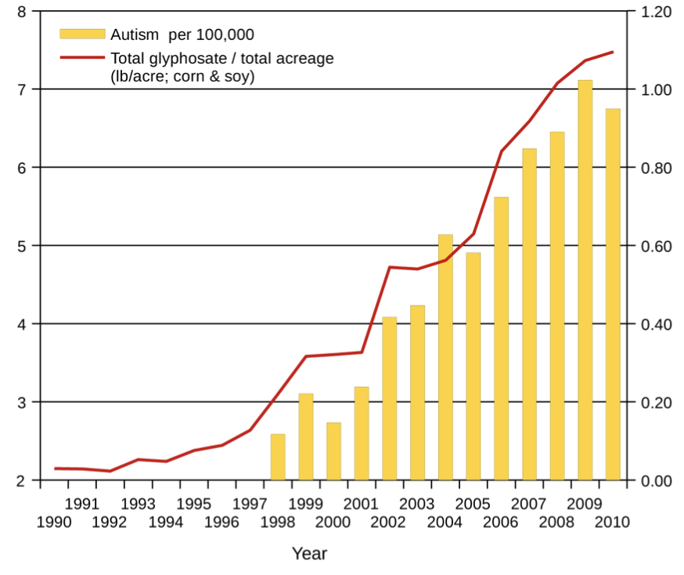
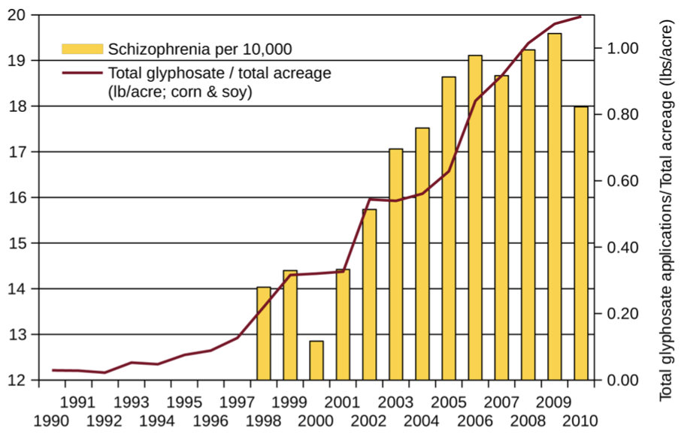
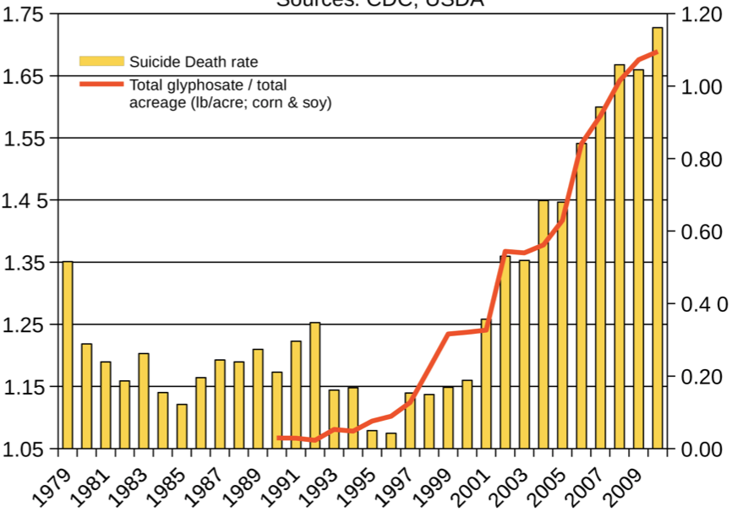
Autism
Sleep Disorder
Schizophrenia
Death by Suicide
*Seneff et al. Agricultural Sciences 2015; 6: 42-70.
Notes:
Hospital discharge diagnoses per 100,000

Slide 19
List Compiled by Prof. Don Huber

Slide 20
Decreasing IQ scores after 1975*
“scores increased by almost 3 percentage points each decade for those born between 1962 to 1975 -- but then saw a steady decline among those born after 1975.”
“What specific environmental factors cause changes in intelligence remains relatively unexplored.”
*Rory Smith, CNN.
https://www.cnn.com/2018/06/13/health/falling-iq-scores-study-intl/index.html

Slide 21
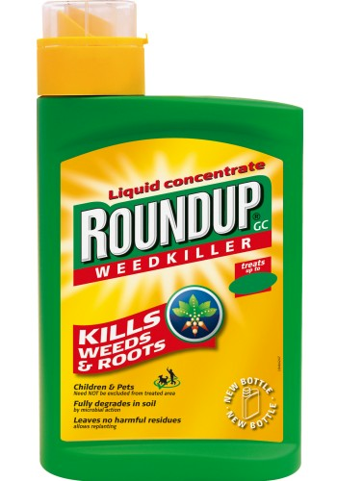
Decreasing IQ scores after 1975*
“scores increased by almost 3 percentage points each decade for those born between 1962 to 1975 -- but then saw a steady decline among those born after 1975.”
“What specific environmental factors cause changes in intelligence remains relatively unexplored.”
Glyphosate was introduced on the market in 1975
*Rory Smith, CNN.
https://www.cnn.com/2018/06/13/health/falling-iq-scores-study-intl/index.html

Slide 22
US
Notes:
http://www.commonwealthfund.org/interactives-and-data/chart-cart/report/2017-mirror-mirror/mortality-amenable-to-health-care

Slide 23
Glyphosate in Human Urine: U.S. Southern California*
*PJ Mills et al. JAMA 2017; 318(16): 1610-1611.
Notes:
./JAMA_glyphosate_urine_US_2018.pdf

Slide 24
Glyphosate reduces sperm motility and sperm count*
Sperm motility (%)
Sperm count x 10⁶
Control (no glyphosate) vs increasing levels of glyphosate exposure
*FO Owagboriaye et al. Experimental and Toxicologic Pathology 2017 Sep 5;69(7):461-468.
Notes:
Glyphosate/Glyphosate_Reproductive toxicity of Roundup herbicide exposure in male albino rat.pdf
Male albino rats
Sperm motility (%) and sperm count (×106 cells/ml) in rats exposed to Roundup at different concentrations of glyphosate.

Slide 25
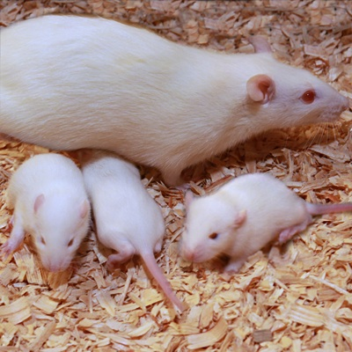
Glyphosate Damages Second Generation*
Pregnant rats exposed to glyphosate starting at day 9 of gestation
Two exposure levels (low, high), both levels considered to be safe according to regulators
Neither the rats nor their offspring showed any obvious effects
The second generation offspring from both exposed groups showed delayed growth, lower fetal weight and length and a higher incidence of abnormally small fetusus
Most surprising: there were three cases (each from a different mother) among the second generation offspring with major fetal abnormalities (conjoined fetuses and abnormal limb development)
*MM Milesi et al. Archives of Toxicology June 9, 2018 [Epub ahead of print]
Notes:
glyphosate/Milesi_glyphosate_reproduction_rats_2018.pdf
https://www.gmwatch.org/en/news/latest-news/18363-glyphosate-based-herbicide-impairs-female-fertility-new-study
The second generation offspring from both glyphosate herbicide-exposed groups showed delayed growth, evidenced by lower foetal weight and length, and a higher incidence of abnormally small foetuses.
Also, to the authors' surprise, malformations (conjoined foetuses and abnormally developed limbs) were detected in the second generation of offspring from the higher dose of glyphosate herbicide group. Foetal abnormalities were found in 3 out of 117 foetuses, each one from different mothers within the first generation of offspring (i.e. 3 out of 13 litters were affected). A statistically significant correlation was found between glyphosate herbicide exposure and foetal malformations.

Slide 26
America’s Children are in Trouble!
It is now "normal" for a kindergarten child to have 12 colds every year and for a baby to have nine
Fourfold increase in childhood obesity
Double the asthma rate since the 1980's
"Chronic illnesses" rose from 1.8% in 1960 to 7% in 2004
Today, 43% of US children are chronically ill
1 in 6 children in the USA has a neurodevelopmental disability
1 in 38 boys are autistic
US has the worst neonatal death rate of all industrialized countries
Today's children in the US will have a shortened life span compared to their parents
Source: http://www.vaccineviolence.com/
Notes:
https://www.facebook.com/groups/1409306052710440/
./TheOutliers.text
Page removed!!
— Joanna Karpasea Jones

Slide 27
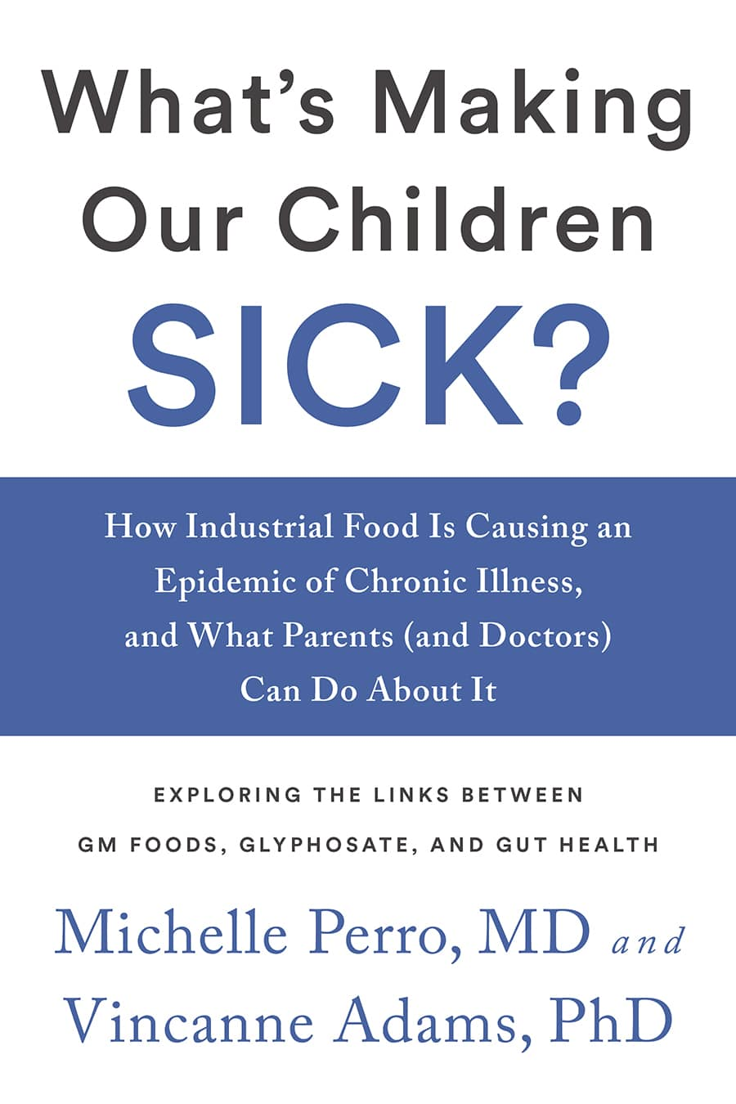
Source: http://www.vaccineviolence.com/
Notes:
https://www.facebook.com/groups/1409306052710440/
./TheOutliers.text
Page removed!!
— Joanna Karpasea Jones

Slide 28
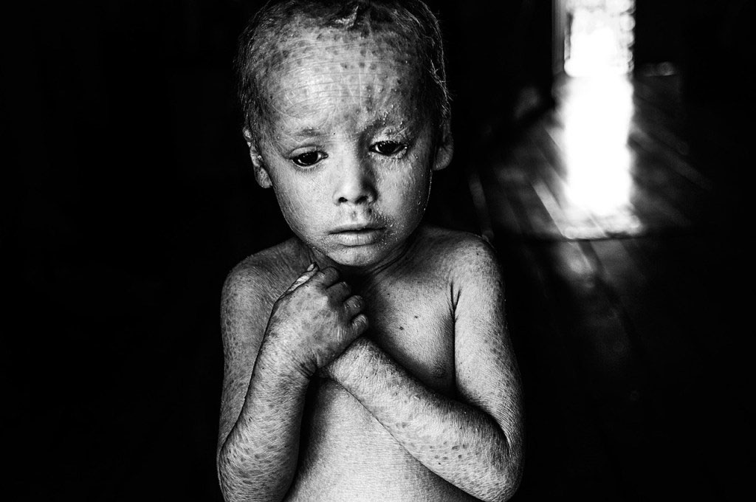
Genetically Modified Children

Slide 29
The California Lawsuit:
Glyphosate and
non-Hodgkin’s Lymphoma

Slide 30
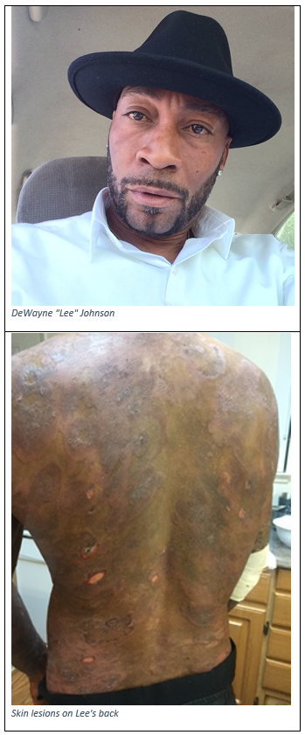
Dewayne “Lee” Johnson vs Monsanto: Glyphosate & Non-Hodgkin’s Lymphoma*
*https://www.cnn.com/2018/06/17/us/
monsanto-roundup-dewayne-johnson-trial/index.html
Notes:
./CNN_Monsanto_lawsuit.text
https://www.cnn.com/2018/06/17/us/monsanto-roundup-dewayne-johnson-trial/index.html

Slide 31
Details of the Lawsuit*
Johnson was a groundskeeper for the school district in Benicia, CA, just north of San Francisco
He was diagnosed with non-Hodgkin’s lymphoma (NHL) in 2014, at age 42.
In 2015, WHO's IARC classified glyphosate as "probably carcinogenic to humans"
Donna Farmer, Monsanto's "product protection lead" said in email to colleagues:
"You cannot say that Roundup does not cause cancer."
Timothy Litzenburg, one of Johnson's lawyers, said:
"so much of what Monsanto has worked to keep secret is coming out."
www.theguardian.com/business/2018/jul/09/
monsanto-trial-roundup-weedkiller-cancer-dewayne-johnson
Notes:
https://www.theguardian.com/business/2018/jul/09/monsanto-trial-roundup-weedkiller-cancer-dewayne-johnson

Slide 32
“We’re going to see for the first time evidence that nobody has seen before, evidence that has been in Monsanto’s files that we’ve obtained from lawyers and the people in Monsanto… I don’t think it’s a surprise after 20 years Monsanto has known about the cancer-causing properties of this chemical and has tried to stop the public from knowing it, and tried to manipulate the regulatory process.”
-- Robert F Kennedy, Jr.
Co-counsel for Johnson

Slide 33
“We’re going to see for the first time evidence that nobody has seen before, evidence that has been in Monsanto’s files that we’ve obtained from lawyers and the people in Monsanto… I don’t think it’s a surprise after 20 years Monsanto has known about the cancer-causing properties of this chemical and has tried to stop the public from knowing it, and tried to manipulate the regulatory process.”
-- Robert F Kennedy, Jr.
Co-counsel for Johnson
” If we get a large award in this case, it could easily threaten the future financial viability of the company.”
-- Robert F Kennedy, Jr.

Slide 35
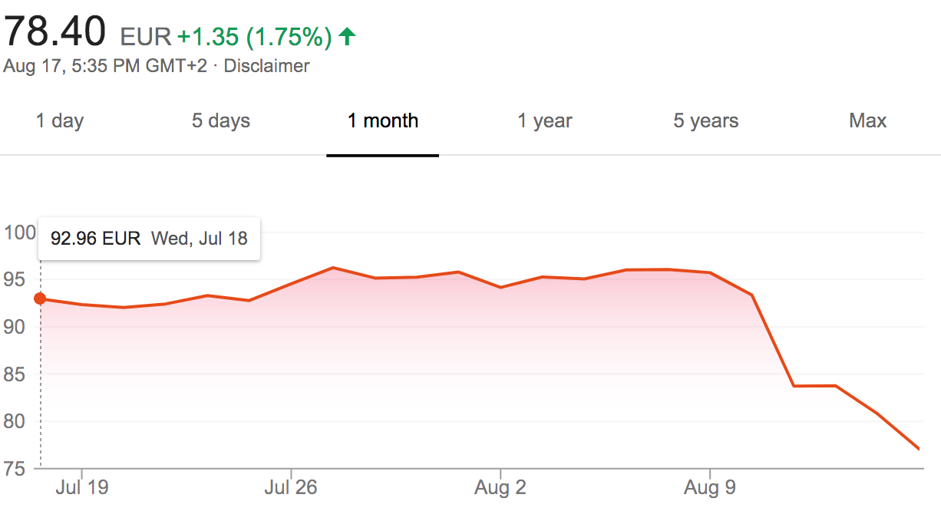
Bayer Stock Prices
Johnson Verdict

Slide 36
Verdict Upheld in Higher Court: October 22, 2018
Damages reduced to $78 Million

Slide 37
Bayer to sell businesses, cut jobs after Monsanto deal*
“Chief Executive Werner Baumann is under pressure to boost Bayer’s share price after a drop of more than 35 percent so far this year, dragged down by concern over more than 9,000 lawsuits it faces over an alleged cancer-causing effect of Monsanto’s Roundup weed killer.”
Ludwig Burger
November 29, 2018
*https://www.reuters.com/article/us-bayer-strategy/
bayer-to-sell-businesses-cut-jobs-after-monsanto-deal-idUSKCN1NY1SI

Slide 38
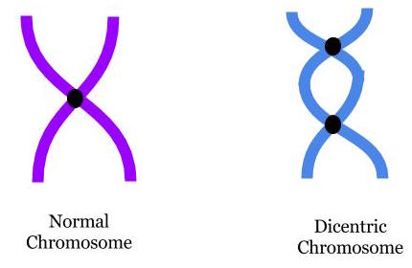
“In vitro evaluation of genomic damage induced by glyphosate on human lymphocytes”*
In vitro exposure of human lymphocytes to glyphosate at levels of 0.5, 0.1, 0.050, 0.025 and 0.0125 μg/ml
0.5 is considered an "acceptable daily exposure level”
Chromosomal aberrations and micronuclei frequencies were significantly high at all except the lowest exposure levels.
*A Santovito et al. Environ Sci Pollut Res Int 2018;25(34):34693-700.
Notes:
https://link.springer.com/article/10.1007%2Fs11356-018-3417-9

Slide 39
“In vitro evaluation of genomic damage induced by glyphosate on human lymphocytes”*
In vitro exposure of human lymphocytes to glyphosate at levels of 0.5, 0.1, 0.050, 0.025 and 0.0125 μg/ml
0.5 is considered an "acceptable daily exposure level”
Chromosomal aberrations and micronuclei frequencies were significantly high at all except the lowest exposure levels.
Lymphocytes are the cell type that transforms into cancer cells in non-Hodgkin’s lymphoma
*A Santovito et al. Environ Sci Pollut Res Int 2018;25(34):34693-700.
Notes:
https://link.springer.com/article/10.1007%2Fs11356-018-3417-9

Slide 40
Glyphosate and the Gut

Slide 41
Imbalanced
Gut Microbiome
Inflammatory bowel disease, autoimmune arthritis, obesity and metabolic syndrome, and nonalcoholic fatty liver disease can all be traced to imbalances in gut microbiome*
*Figure 1. RS Goldszmid and G Trinchieri. Nat Immunol 2012;13(10):932-8.
Notes:
Book/autoimmune/price_of_immunity_2012.pdf
Figure

Slide 42
Glyphosate and the Gut: Pathogen Overgrowth
Glyphosate is an antimicrobial agent that preferentially kills beneficial microbes, allowing pathogens to flourish in the gut*
Immune cells invade the gut and release inflammatory cytokines
This causes increased risk to inflammatory bowel diseases such as Crohn’s, ulcerative colitis as well as Celiac disease (gluten intolerance)
* Samsel and Seneff. Entropy 2013; 15: 1416-1463.

Slide 43
Inflammatory Bowel Disease
*Figure 20, NL Swanson et al. Journal of Organic Systems 9(2), 2014, p. 25.

Slide 44
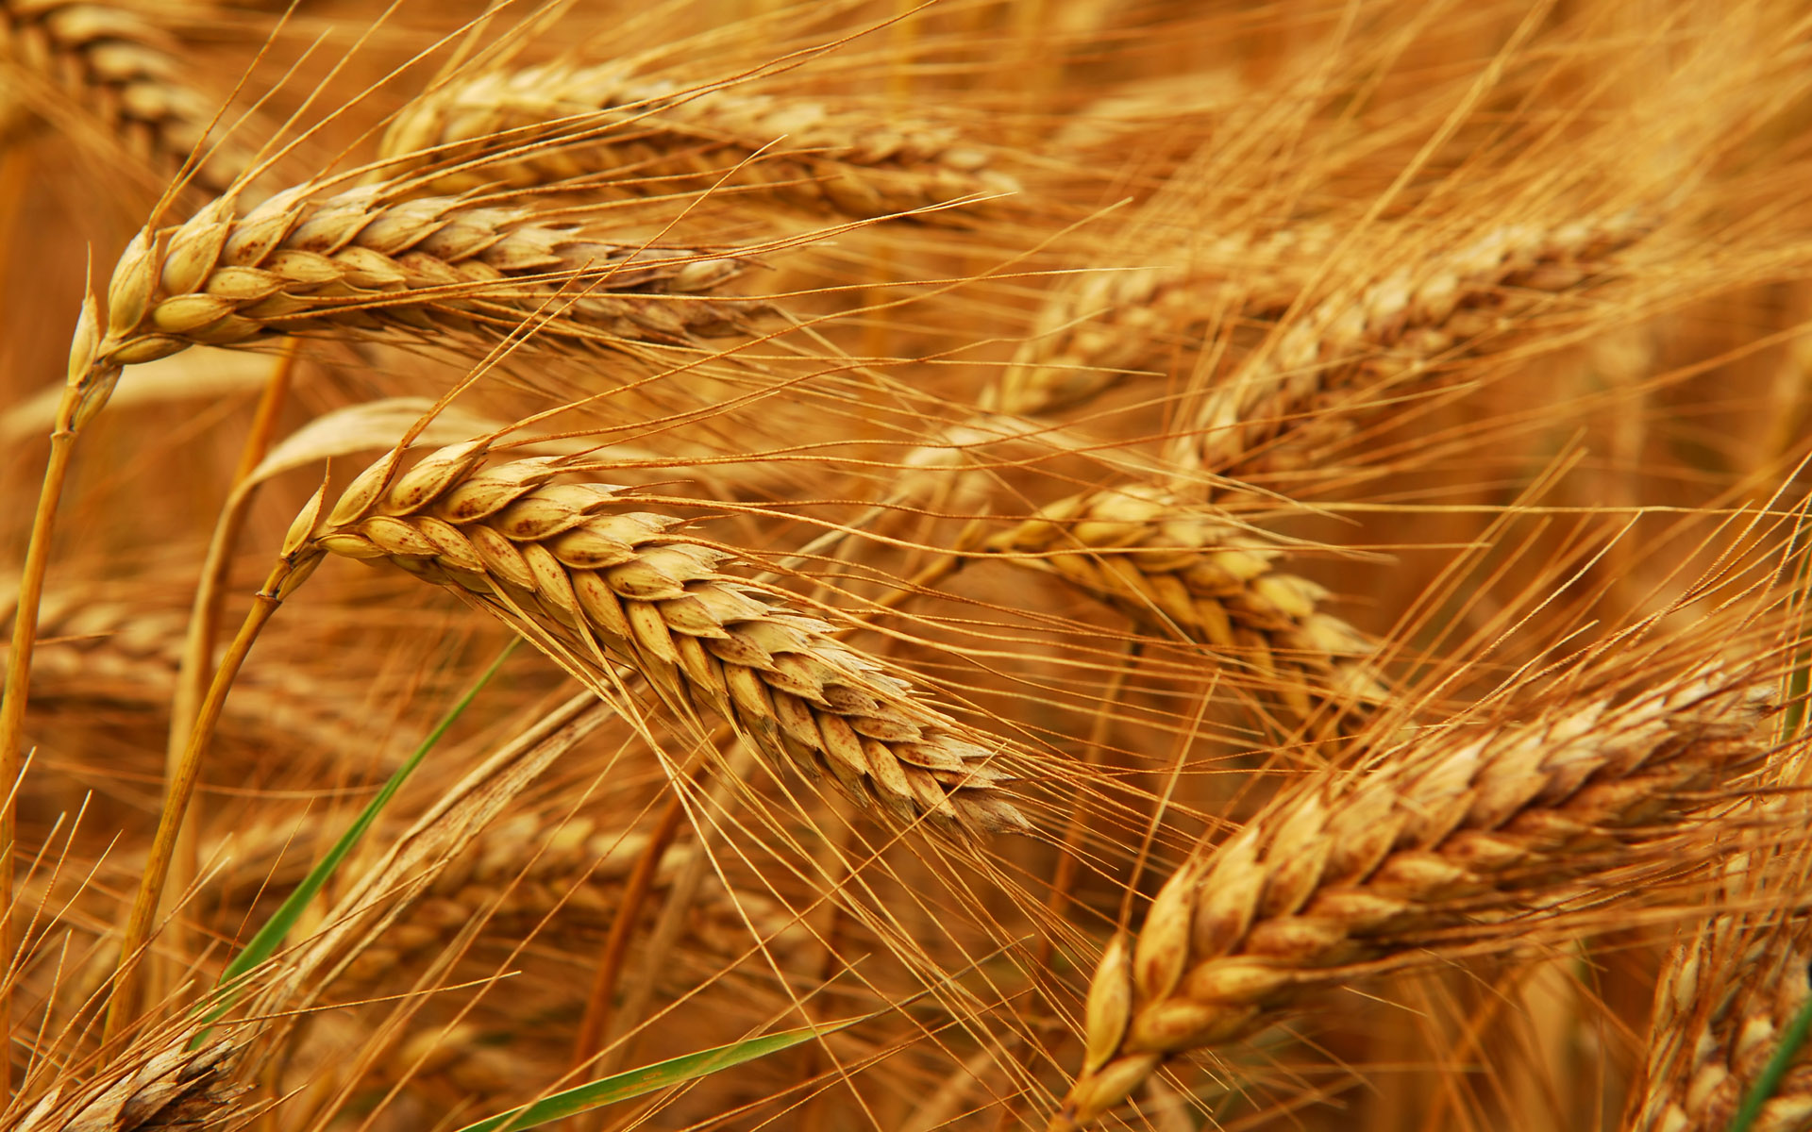
Glyphosate and Celiac Disease*
Glyphosate
Use on wheat
Celiac disease
*Samsel and Seneff, Interdiscip Toxicol. 2013;6(4): 159–184.

Slide 45
Impaired Digestive Enzymes
Glyphosate has been found as a contaminant in digestive enzymes trypsin, pepsin and lipase*
Trypsin impairment prevents proteins like gluten in wheat from being digested
Undigested proteins induce release of zonulin which opens up gut barrier**
Undigested proteins in the general circulation induce autoimmune disease
*A Samsel and S Seneff. J Biol Phys Chem 2017;17:8-32
** JJ Gildea et al. J Clin Nutr Diet. 2017, 3:1.
Notes:
Glyphosate/ZachBushPaper_tight_junctions_glyphosate_2017.pdf

Slide 46
Celiac Disease, Glyphosate and Non Hodgkin’s Lymphoma
Glyphosate preferentially kills Bifidobacteria*
Bifidobacteria are depleted in Celiac disease**
Celiac disease is associated with increased risk to non Hodgkin’s lymphoma***
Glyphosate itself is also linked directly to non Hodgkin’s lymphoma****
*A.A. Shehata et al., Curr Microbiol. 2013 Apr;66(4):350-8.
** M. Velasquez-Manoff, NY Times Sunday Review, Feb. 23, 2013.
*** C. Catassi et all, JAMA. 2002 Mar 20;287(11):1413-9.
****M. Eriksson et al., Int J Cancer. 2008 Oct 1;123(7):1657-63.
Notes:
**./ bifidobacteria_celiac_disease.text
Cancer/Celiac_disease_increases_hodgkins_lymphoma.text
./Celiac_and_bacteria.text

Slide 47
Pathogen Overgrowth in Poultry Microbes Exposed to Glyphosate*
Clostridia
Salmonella
Bifidobacteria
*Plot provided by Dr. Martin Michener
Notes:
From Marty Michener!
Sheehata paper.

Slide 48
Evidence linking autism to Clostridia overgrowth*
14 autistic children with gut disorder compared to 21 controls
Significant increase in Clostridia species in the gut in autistic children
Associated with reduced tryptophan levels and increased expression of inflammatory markers
Tryptophan is a product of the shikimate pathway, which glyphosate blocks
Macrophages in inflamed tissue take up tryptophan, reducing bioavailability to the brain
Proposed role for antibiotics
Glyphosate is a patented antimicrobial agent (2010)
*RA Luna et al., Cellular and Molecular Gastroenterology and Hepatology 2017;3(2): 218-230

Slide 49
*
Triplets: two boys, one girl. Both boys have autism and girl has seizure disorder
Very high levels of glyphosate in urine in all three
Clostridia overgrowth due to glyphosate disruption of gut microbes
Clostridia produce toxins which block the conversion of dopamine to norepinephrine.
Damage to neurons in the brain through oxidative stress
*W. Shaw. Integrative Medicine 2017;16(1);50-57.
Notes:
./Shaw_on_glyphosate_triplets_autism.text

Slide 50
Recapitulation
Glyphosate contamination in digestive enzymes makes them defective
Undigested proteins induce leaky gut barrier
Studies on poultry confirm glyphosate disrupts gut microbes
Celiac disease is associated with increased risk to non-Hodgkin’s lymphoma, which is also linked to glyphosate exposure.
Glyphosate induces overgrowth of Clostridia species in gut
Clostridia release toxins that induce an inflammatory response and prevent dopamine metabolism
Clostridia overgrowth can lead to autism
Inflammation in the brain and excessive neurostimulation by dopamine damages neurons

Slide 51
Glyphosate Activism

Slide 52
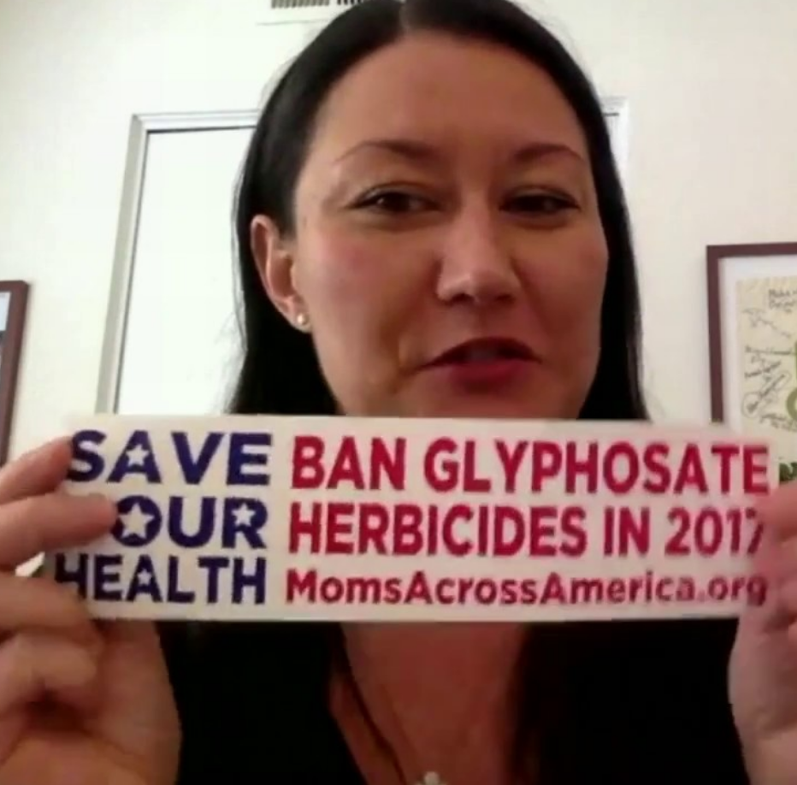
Zen Honeycutt

Slide 53
Tony Mitra: Canadian Activist
Notes:
It is heartbreaking to see how this toxic, dangerous and unnecessary technology can strong arm its way into every facet of a supposedly democratic system and pollute its science, regulatory mechanism, academia, media, and the widest imaginable swath of political process, leaving virtually no clear avenue for the people to correct this wholesale chemical attack on society and an assault on nature.

Slide 54
Tony Mitra speaking to crowds of Indian Farmers and Villagers
Villagers in Bankura, West Bengal, Inda.
North Dinajpur in Northern Bengal, India.
Notes:
TonyMitraIndia.pdf .

Slide 55
Local Activism*
*https://theintercept.com/2018/09/15/oregon-pesticides-aerial-spray-ban/
Notes:
wrote an ordinance banning the aerial spraying of pesticides in western Oregon last year aren’t professional environ- mental advocates.
./ragtag_group.pdf
https://theintercept.com/2018/09/15/oregon-pesticides-aerial-spray-ban/

Slide 56
Local Activism*
A small group of activists succeeded in getting a law passed banning aerial spraying of glyphosate in the forests of western Oregon despite tremendous industry-funded campaigns
*https://theintercept.com/2018/09/15/oregon-pesticides-aerial-spray-ban/
Notes:
wrote an ordinance banning the aerial spraying of pesticides in western Oregon last year aren’t professional environ- mental advocates.
./ragtag_group.pdf
https://theintercept.com/2018/09/15/oregon-pesticides-aerial-spray-ban/

Slide 57
A Failed System and
A Growing Food Movement

Slide 58
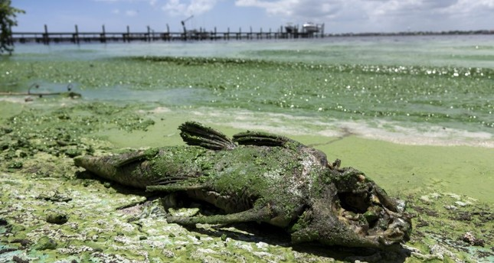
“Is Agriculture’s Use of Glyphosate Feeding Lake O’s Explosive Algae Blooms?”*
Sugar cane agriculture is extensive all around Lake Okeechobee in S. Florida, and glyphosate is used both to control weeds and as a desiccant
Cyanobacteria can break down the C-P bond in glyphosate and use its phosphorus atom as a fuel source**
*Prof. Geoffrey Norris.
https://jacquithurlowlippisch.com/tag/
is-sugarcane-field-glyphosate-feeding-lake-os-blue-green-algae-blloms
**D Drzyzga et al. Environ Microbiol 2017 Mar;19(3):1065-1076
Notes:
,/RedTide_algae_blooms_manmade.pdf
Glyphosate/Zhang_glyphosate_water_cyanobacterium_2016.pdf
Geoffrey Norris:
https://jacquithurlowlippisch.com/tag/is-sugarcane-field-glyphosate-feeding-lake-os-blue-green-algae-blloms/

Slide 59
Cyanobacteria Feed Red Tide Algae
“Both the coastal red tide and the inland blue-green algae have beset South Florida through the summer, killing vast numbers of fish and other wildlife, including dozens of dolphins, manatees, sea turtles, sharks and eels.” *
Cyanobacteria feed off of glyphosate (phosphorus source) and produce nitrates from nitrogen
Red Tide algae flourish, supplied with nitrates produced by cyanobacteria **
*https://www.nbcnews.com/news/us-news/
toxic-red-tide-florida-researchers-investigate-what-s-making-it-n900771
**https://www.sailorsforthesea.org/programs/ocean-watch/nutrients-feed-red-tide
Notes:
https://www.nbcnews.com/news/us-news/toxic-red-tide-florida-researchers-investigate-what-s-making-it-n900771
https://www.sailorsforthesea.org/programs/ocean-watch/nutrients-feed-red-tide

Slide 60
Test of Glyphosate Levels in Florida Waterways*
Water sample taken from the coast of Cape Coral, at the mouth of the Caloosahatchee River, where cyanobacteria were present
*https://www.momsacrossamerica.com/orange_juice_postive_for_glyphosate_again
Notes:
https://www.momsacrossamerica.com/orange_juice_postive_for_glyphosate_again

Slide 61
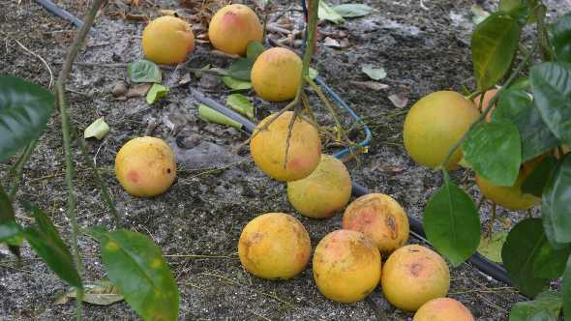
Concerns about Glyphosate and Citrus*
Chief among these concerns are:
Increased crop sensitivity to diseases
Reduced availability of micronutrients to crops through chelation by glyphosate
Inhibition of root growth
Citrus fruit drop
“As citrus weed management programs have continued to rely more heavily on glyphosate, the occurrence of citrus fruit drop resulting from glyphosate application has become an increasing grower concern over the years.”
*http://citrusindustry.net/2018/09/05/how-to-handle-glyphosate-related-fruit-drop/
Notes:
http://citrusindustry.net/2018/09/05/how-to-handle-glyphosate-related-fruit-drop/
./glyphosate_and_citrus.text

Slide 62
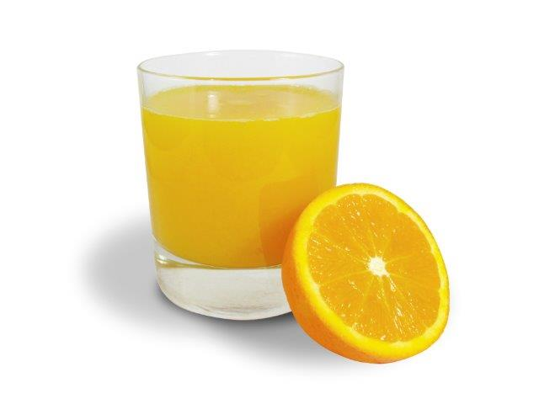
Concerns about Glyphosate and Citrus*
Chief among these concerns are:
Increased crop sensitivity to diseases
Reduced availability of micronutrients to crops through chelation by glyphosate
Inhibition of root growth
Citrus fruit drop
“As citrus weed management programs have continued to rely more heavily on glyphosate, the occurrence of citrus fruit drop resulting from glyphosate application has become an increasing grower concern over the years.”
Moms Across America founder Zen Honeycutt has found glyphosate in multiple samples of orange juice produced from Florida orange groves
*http://citrusindustry.net/2018/09/05/how-to-handle-glyphosate-related-fruit-drop/
Notes:
http://citrusindustry.net/2018/09/05/how-to-handle-glyphosate-related-fruit-drop/
./glyphosate_and_citrus.text

Slide 63
https://www.theguardian.com/environment/2017/oct/18/
warning-of-ecological-armageddon-after-dramatic-plunge-in-insect-numbers
Notes:
https://www.theguardian.com/environment/2017/oct/18/warning-of-ecological-armageddon-after-dramatic-plunge-in-insect-numbers

Slide 64
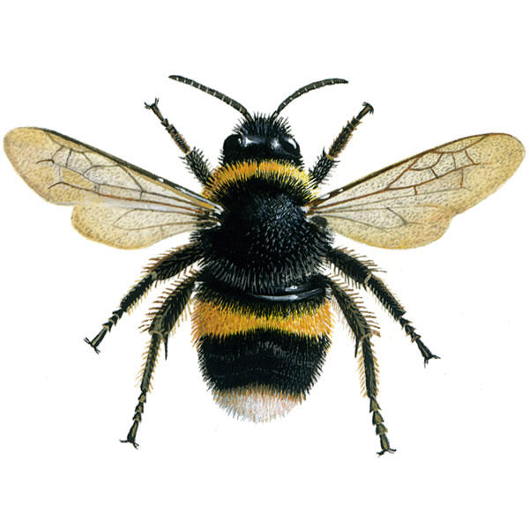
Prof. Don Huber on Bee Colony Collapse Syndrome*
Glyphosate chelates minerals making them unavailable, especially manganese
Glyphosate kills Lactobacillus and Bifidobacter which interferes with digestion of honey and bee bread by larvae
Makes bees more susceptible to mites and viruses
Acting as an endocrine disruptor, glyphosate causes brain fog in the bees, and they can't find their way back to the hive after foraging
Neonicotinoids have a similar, synergistic effect
Glyphosate is a contaminant even in organic honey because it is pervasive
Probiotics + mineral solutions counter glyphosate's effects remarkably
*personal communication

Slide 65
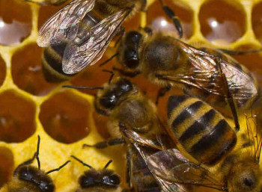
Successful Treatment Protocol for Bees*
Average loss rates in bee hives in the U.S. for the winter of 2015-2016 was 38%
Slide Ridge Honey had only a 5% loss rate
Their success was attributed to mineral supplements and probiotics
*biomineralstechnologies.com/save-the-bees/honeybee-update-2017
Notes:
http://biomineralstechnologies.com/save-the-bees/honeybee-update-2017
Bio Minerals Technologies

Slide 66
Glyphosate was found in 59% of Honey Samples*
USA
*F Rubio et al., J Environ Anal Toxicol 2014, 5:1
Notes:
..glyphosate_in_honey_2014.pdf
*F Rubio et al., J Environ Anal Toxicol 2014, 5:1
Figure 5: Concentration of glyphosate (ng/g) in honey samples listed by honey origin and the allowance of GMO use: (A) Brazil, (B) Canada, (C) China, (D) Germany, (E) Greece, (F) Hungary, (G) India, (H) Korea, (I) blend of Mexico, Brazil, and Uruguay, (J) New Zealand, (K) Spain, (L) Taiwan, (M) blend of Ukraine and Vietnam, (N) USA, (O) blend of USA and Argentina, (P) blend of USA, Argentina and Canada, (Q) blend of USA, South America, (R) unknown origin. Dashed line represents LOQ of method (15 ng/g). ). Error bars represent concentrations obtained during duplicate analysis.

Slide 67
Superweeds Are Now a Huge Problem*
76.8% of samples submitted to a U of Illinois Plant Clinic from 10 states across the Midwest showed glyphosate resistance
“GM crops are on the edge of failure in the U.S. as farmers are asked to fork out more and more money on herbicides to try to control the superweeds. We simply can’t afford it! It is near the end of the road for these crops and many of my friends in the Midwest are on the edge of turning back to conventional farming methods.”
Bill Giles, an Illinois farmer
*sustainablepulse.com/2017/02/04/farmers-losing-midwest-superweeds-
fight-as-glyphosate-resistance-reaches-over-75/#
Notes:
http://sustainablepulse.com/2017/02/04/farmers-losing-midwest-superweeds-fight-as-glyphosate-resistance-reaches-over-75/#

Slide 68
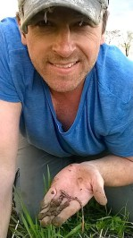
Fixing the Soil*
Dirt is inert; soil is alive
Missouri farmer JR Bollinger grew corn and soy on a former coal mine
“We tried … all kinds of goodies: humates, … sea minerals, microbes, fish meal and biochar powder.”
Earthworms till the soil
Soil microbes are crucial for soil health
Greatly reduce fertilizer needs and improve yield
JR Bollinger
*ecofarmingdaily.com/wormhole-customizing-biological-methods-large-scale-farming/
David Yarrow
Down the Wormhole: Customizing Biological Methods for Large Scale Farming
Belize Ag Report 2017;34:5-17.
Notes:
Missouri reclaimed coal mine

Slide 69
Solving Global Climate Change through Agriculture*
“Agriculture, with its unique ability to sequester carbon on … billions and billions of acres, is the only industry poised to reverse global warming. Improved management of cropping and grazing heals land, boosts soil fertility, prevents flooding, enhances drought resilience, increases the nutritional content of food and restores wildlife habitat — while sequestering carbon.
*http://www.rutlandherald.com/articles/using-soil-to-fight-climate-change/

Slide 70
Regenerative Agriculture*
The Goal: Improving soil health
The more plants that grow, the better the soil
Use adaptive high stock density (AHSD) grazing, the way the bison did it
*https://joyce-farms.com/blogs/news/
joyce-farms-regenerative-agriculture-program-an-introduction
Notes:
Regenerativeagriculture.pdf
fretz.karen <fretz.karen@gmail.com>

Slide 71
Regenerative Agriculture*
"Regenerative agriculture is a phenomenal system that has always been here, activated by the sunshine and the rain. It not only restores our land in terms of biodiversity and soil health, but also produces incredibly nutrient dense, vibrantly flavored food."
The Goal: Improving soil health
The more plants that grow, the better the soil
Use adaptive high stock density (AHSD) grazing, the way the bison did it
*https://joyce-farms.com/blogs/news/
joyce-farms-regenerative-agriculture-program-an-introduction
Notes:
Regenerativeagriculture.pdf
fretz.karen <fretz.karen@gmail.com>

Slide 72
Dirt to Soil*
Gabe Brown inherited a 5,000 acre farm from his father-in-law that grew wheat, oats and barley, conventionally
His crop failed due to drought for four straight years
He let it lie fallow and let the weeds grow
The soil improved dramatically: earthworms started to appear
He used less glyphosate to control weeds only because he couldn't afford it
He eventually converted it to a certified organic farm, with animals playing a central role
Profitable organic farm produces beef, lamb, eggs, broilers, pigs, honey, vegetables, fruit , corn, and wheat.
*Gabe Brown. Dirt to Soil. Chelsea green Oct. 11, 2018.
Notes:
Csail/2018/Books/DirtToSoi_eGalley.pdf
./DirtToSoil.text

Slide 73
Dirt to Soil*
Gabe Brown inherited a 5,000 acre farm from his father-in-law that grew wheat, oats and barley, conventionally
His crop failed due to drought for four straight years
He let it lie fallow and let the weeds grow
The soil improved dramatically: earthworms started to appear
He used less glyphosate to control weeds only because he couldn't afford it
He eventually converted it to a certified organic farm, with animals playing a central role
Profitable organic farm produces beef, lamb, eggs, broilers, pigs, honey, vegetables, fruit , corn, and wheat.
*Gabe Brown. Dirt to Soil. Chelsea green Oct. 11, 2018.
Notes:
Csail/2018/Books/DirtToSoi_eGalley.pdf
./DirtToSoil.text

Slide 74
Small Organic Farms are the Answer
Bluebird Hill Organic Farm, North Carolina

Slide 75
How to Safeguard Yourself
and Your Family

Slide 76
Go Organic!*
*https://www.wholefoodsmarket.com/organic

Slide 77
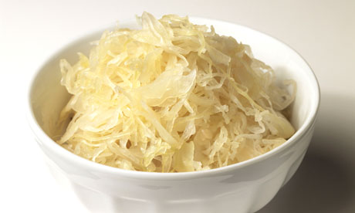
Eat Natural Probiotic Foods
Sauerkraut and apple cider vinegar contain Acetobacter, one of the very few microbes that can metabolize glyphosate
Kombucha and kimchi do too!

Slide 78
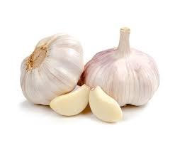
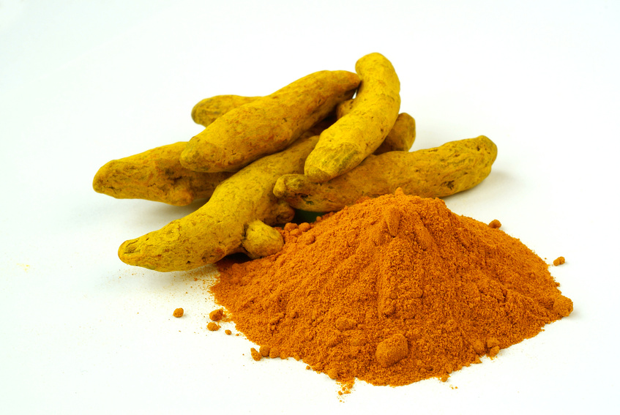
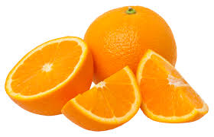
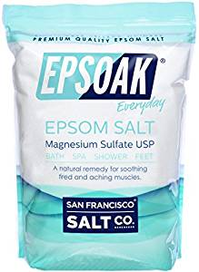
Some Important Nutrients
Curcumin
Garlic
Vitamin C
Methyl tetrahydrofolate
Cobalamin
Glutathione
Taurine
Epsom salt baths

Slide 79
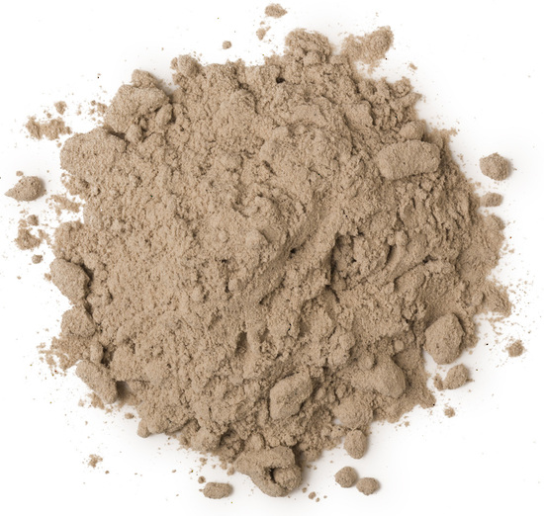
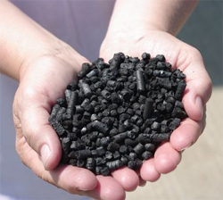
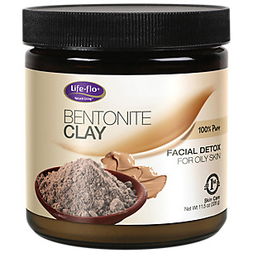
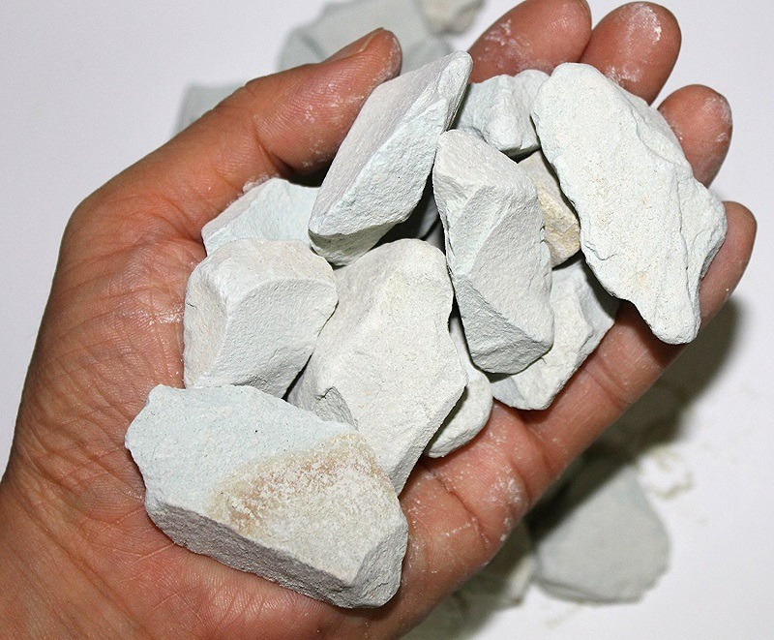
Biochar, Bentonite and Zeolite to maintain healthy microbial distribution in poultry*
*TP Prasai et al. PLoS ONE 11(4): e0154061.
Notes:
Moore\ et\ al\ 2016\ Biochar,\ bentonite\ and\ zeolite\ supplemented\ feeding\ for\ layer\ chickens\ alters\ intestional\ microbiota.pdf .
Reduce need for antibiotics
Redistribute gut microbes

Slide 80
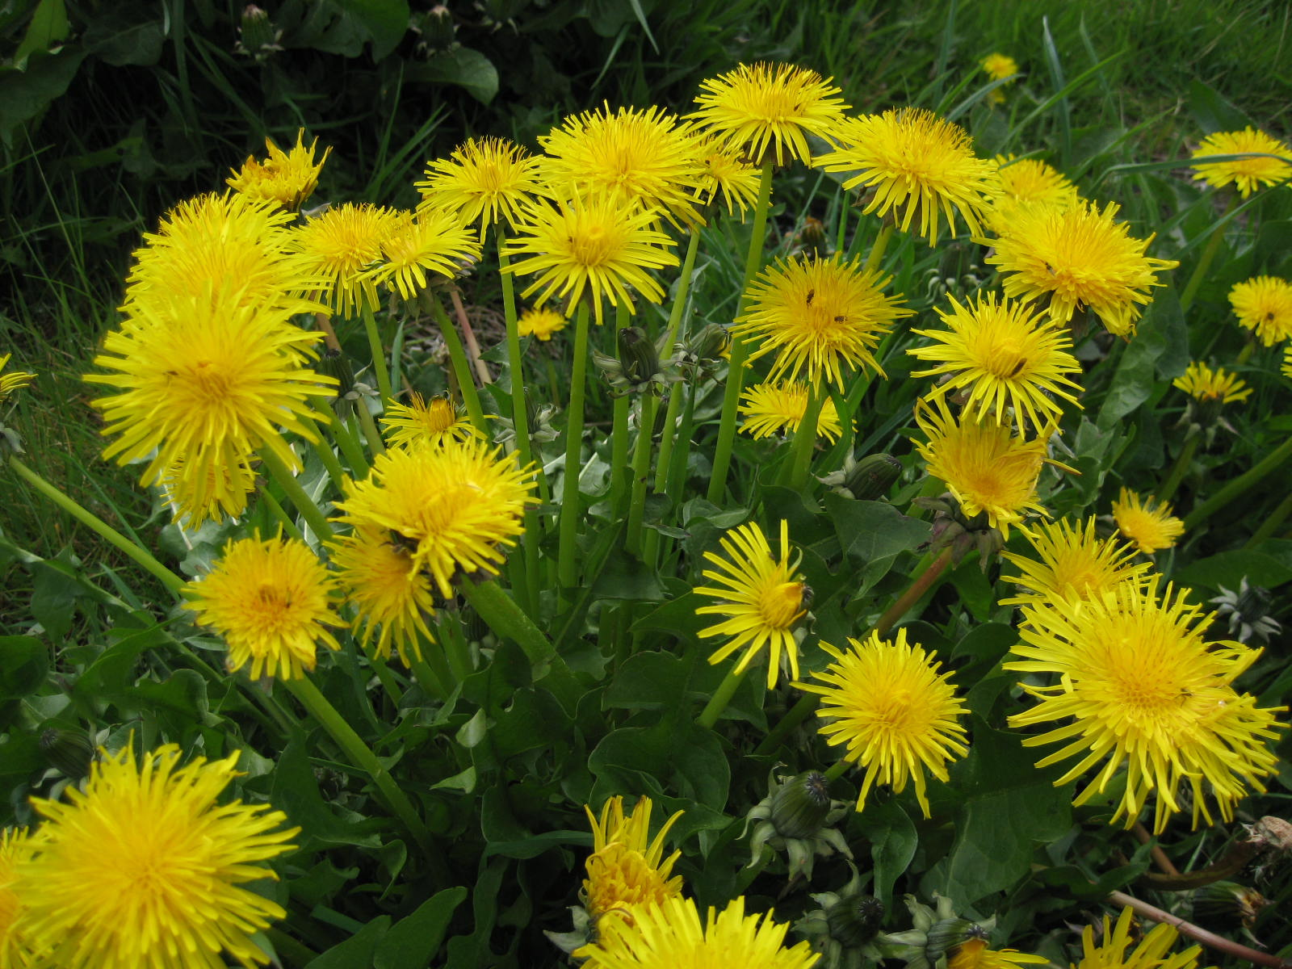
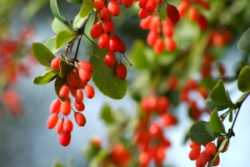
Extracts from Common Plants Can Treat Glyphosate Poisoning*
Roundup is toxic to hepatic and embryonic cells at doses far below those used in agriculture and at residue levels present in some GM food.
Extracts from common plants such as dandelions, barberry, and burdock can protect from damage, especially if administered prior to exposure.
*C Gasnier et al. Journal of Occupational Medicine and Toxicology 2011, 6:3

Slide 81
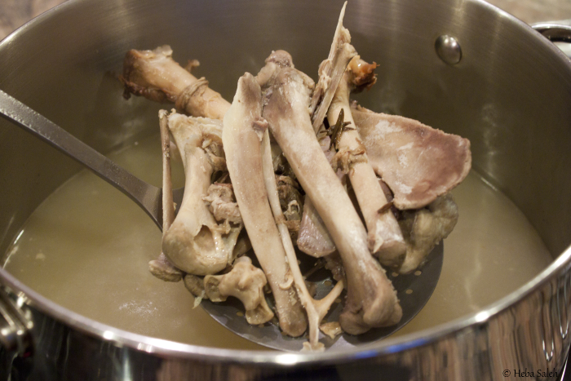
Making Bone Broth a Staple in Your Diet May Be the Key to Improving Your Health*
*articles.mercola.com/sites/articles/archive/2014/09/21/
hilary-boynton-mary-brackett-gaps-cookbook-interview.aspx
Notes:
./MercolaOnBoneBroth.pdf
http://articles.mercola.com/sites/articles/archive/2014/09/21/hilary-boynton-mary-brackett-gaps-cookbook-interview.aspx

Slide 82
Conclusions
We are at a crossroads where we can choose to get sicker and sicker while destroying the ecosystem, or we can choose to drastically change our agricultural methods towards renewable organic solutions
Grass roots bottom-up activities will institute a dramatic shift in food choices towards nutrient-dense organic whole foods instead of chemical-contaminated impoverished processed foods
A market-driven economy will force farmers to switch to organic methods if they want to sell their crops to informed and health-conscious consumers
This will lead to a dramatic reduction in health care costs and a vast improvement in the health of the population as a whole, of the nation, and of the earth

Slide 83
Conclusions
We are at a crossroads where we can choose to get sicker and sicker while destroying the ecosystem, or we can choose to drastically change our agricultural methods towards renewable organic solutions
Grass roots bottom-up activities will institute a dramatic shift in food choices towards nutrient-dense organic whole foods instead of chemical-contaminated impoverished processed foods
A market-driven economy will force farmers to switch to organic methods if they want to sell their crops to informed and health-conscious consumers
This will lead to a dramatic reduction in health care costs and a vast improvement in the health of the population as a whole, of the nation, and of the earth
This community has an opportunity to play a leadership role in transforming the way we grow food!

Slide 84
Thank You for Listening!

