Slide 1
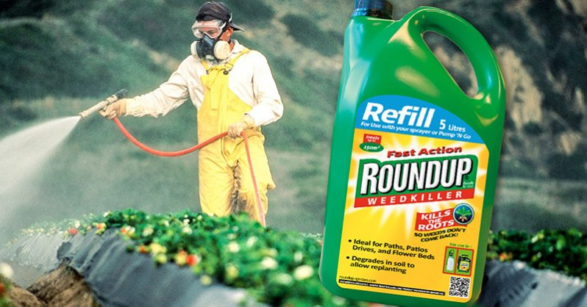
Glyphosate as a Glycine Analogue: Mechanisms of Toxicity
Stephanie Seneff
MIT CSAIL
TACA Workshop
March 22, 2019

Slide 2
Outline
Brief Introduction
Glyphosate as a Glycine Analogue
Glyphosate, Sulfate, Oxalate, Thyroid, Autism
Sulfate and Histamines
Glyphosate and Vaccines
Solutions
Summary

Slide 3
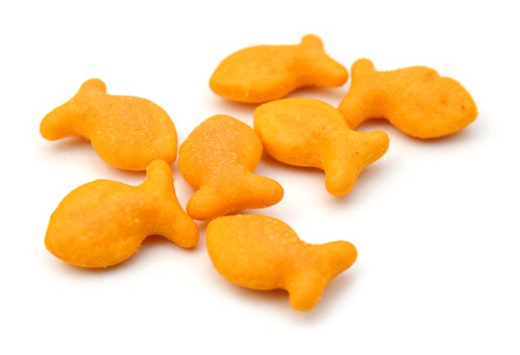
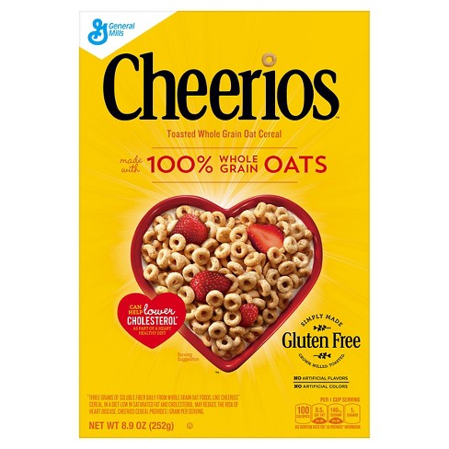
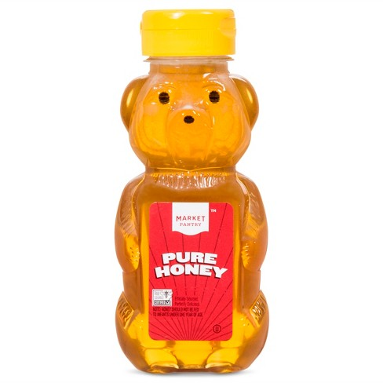
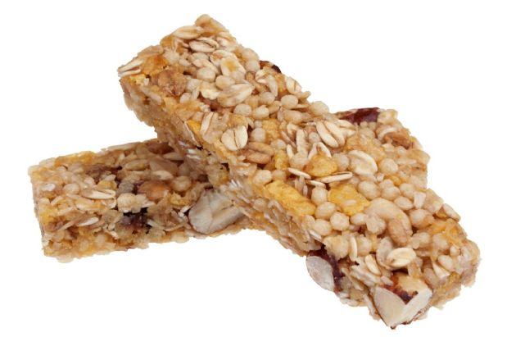
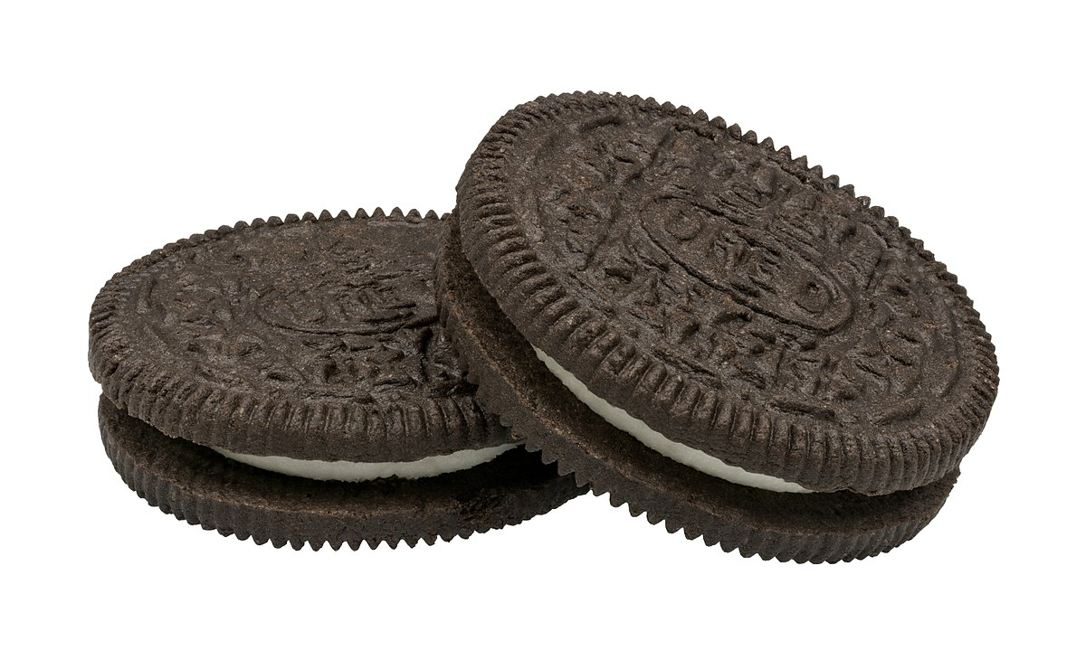
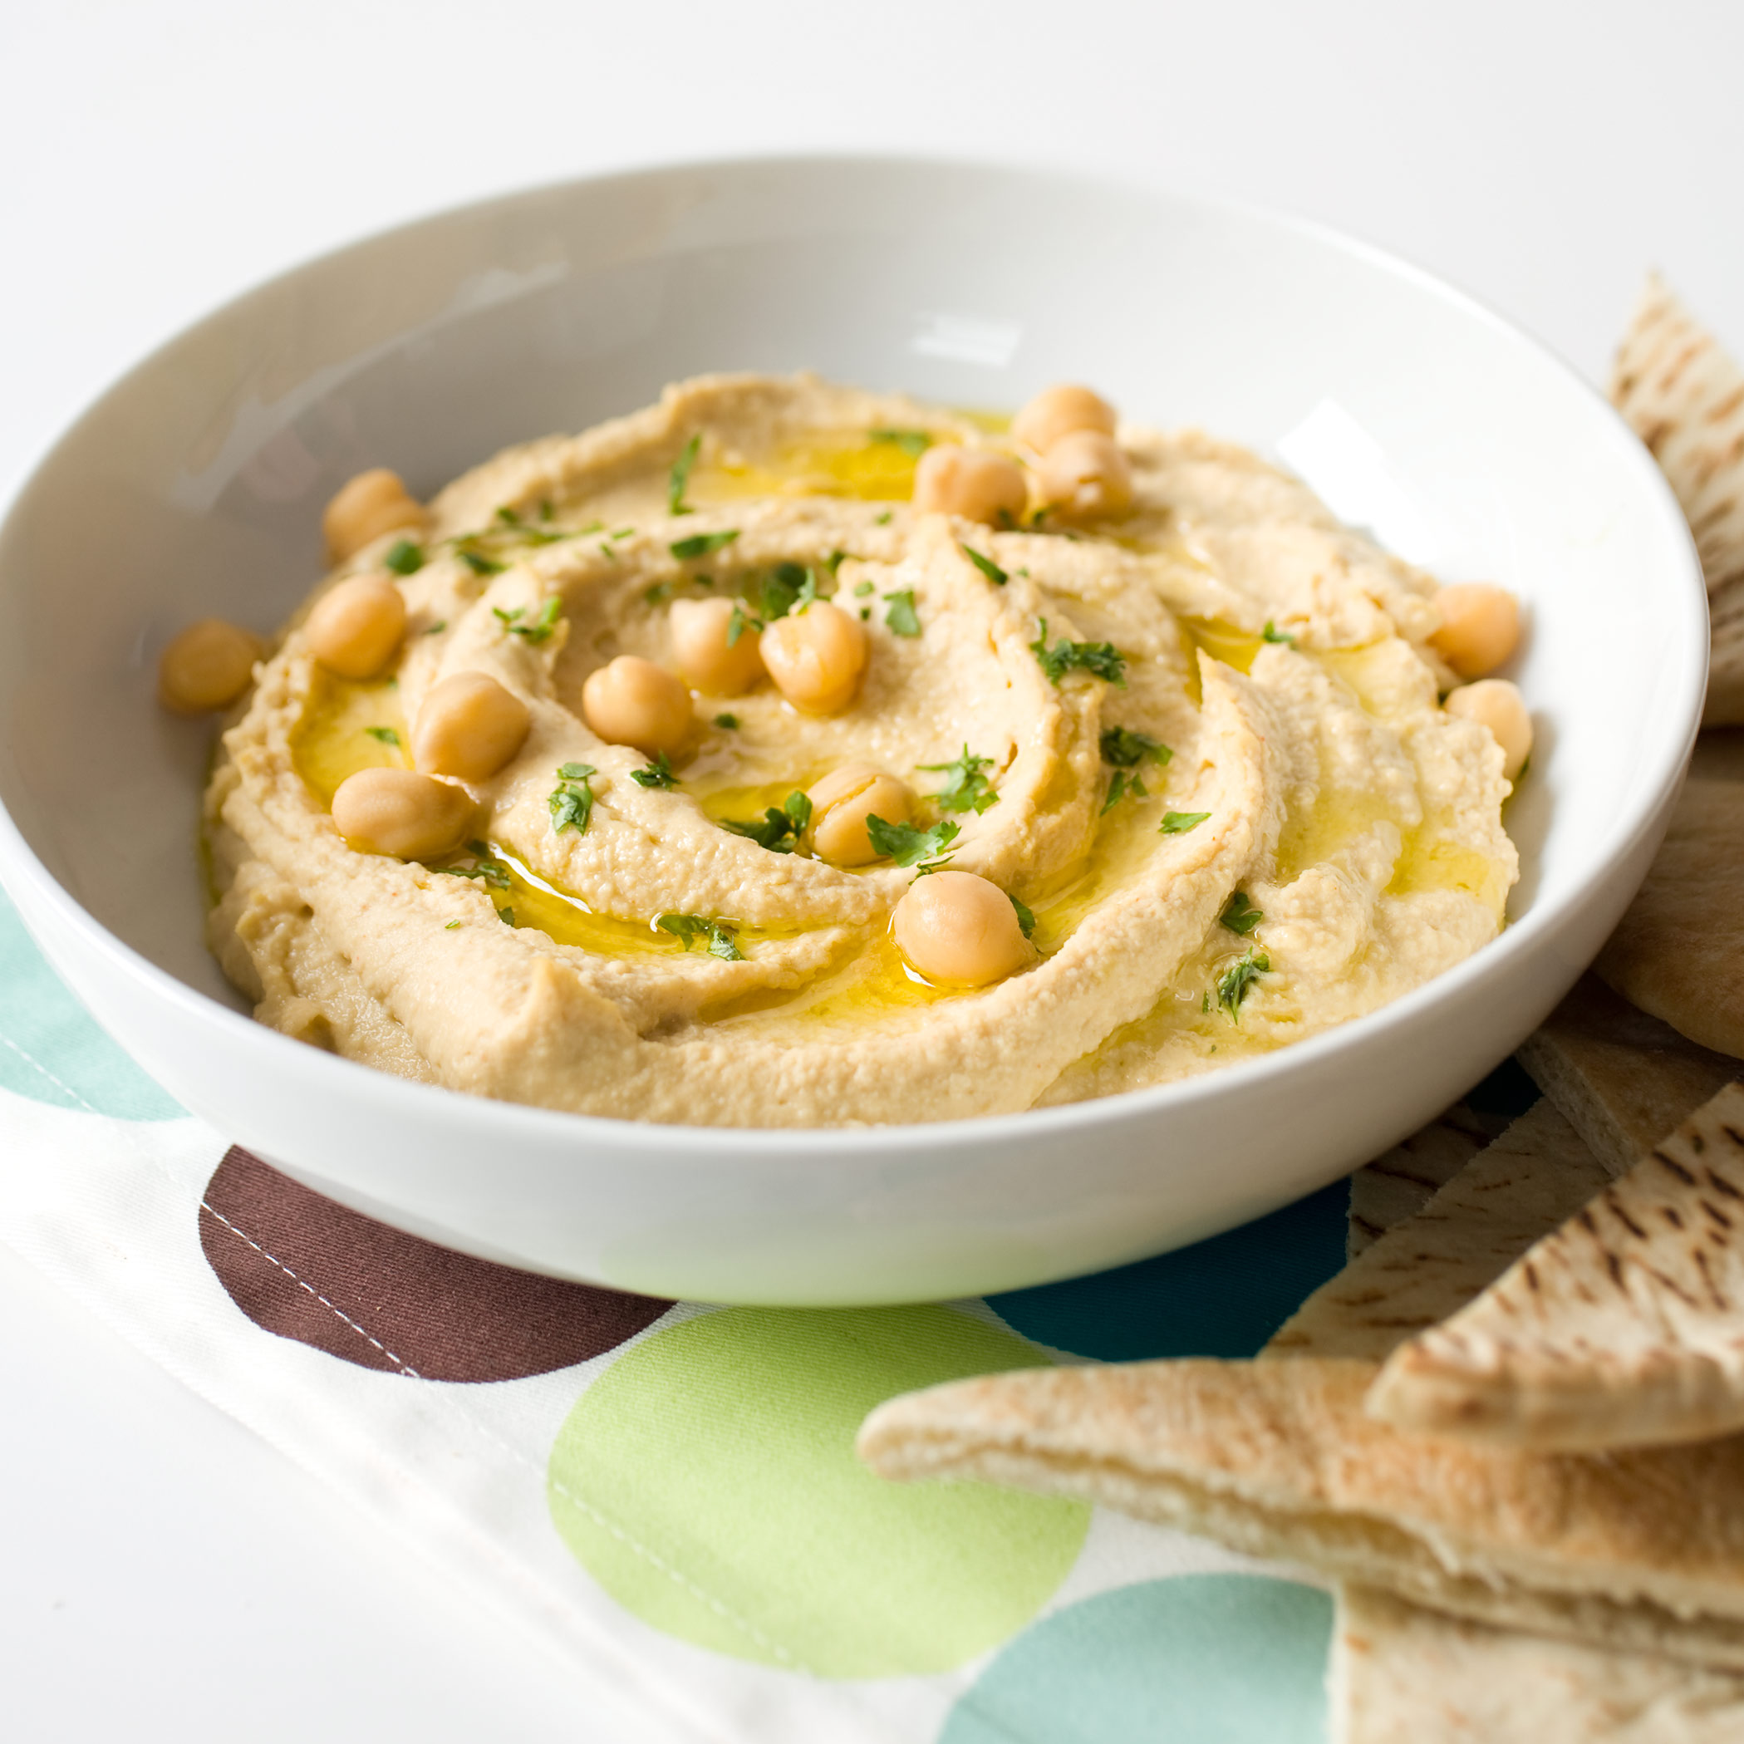
Some Foods Containing Glyphosate
Notes:
glyphosate_residues_in_honey_corn_soy_sauce_2014.pdf
Ten out of twenty eight (36%) soy sauce samples contained glyphosate at a concentration above the method LOQ (75 ng/mL) with a range between 88-564 ng /mL and a mean of 242 ng /mL

Slide 4
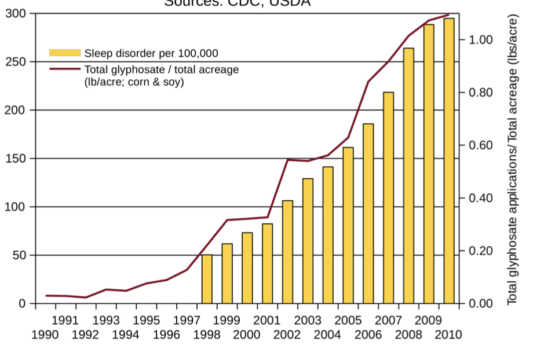
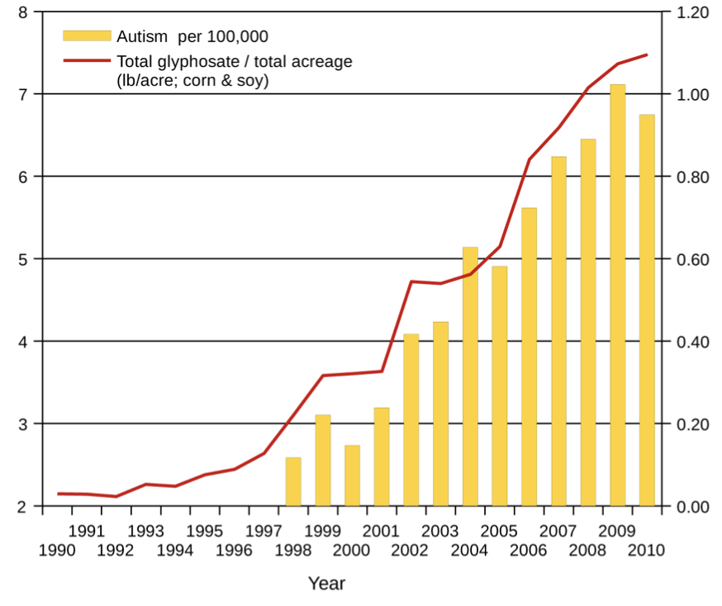
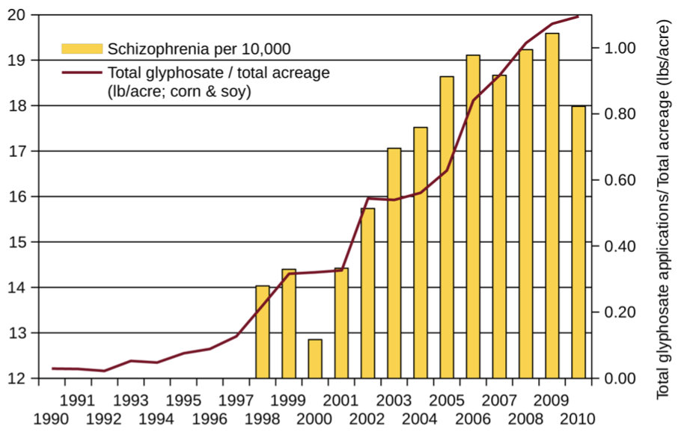
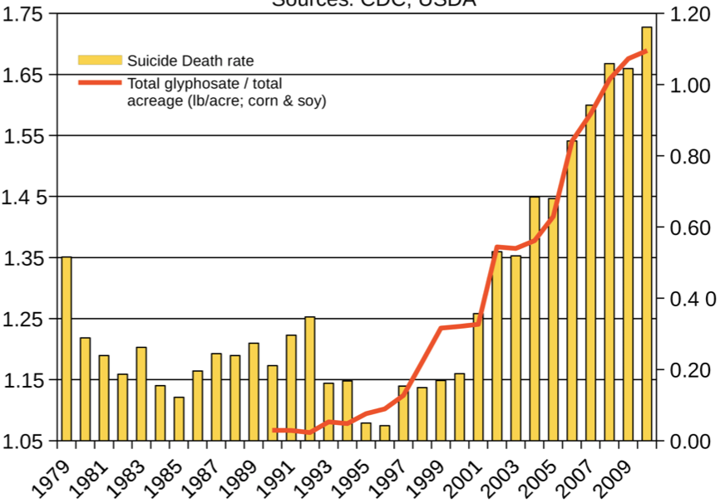
Autism
Sleep Disorder
Schizophrenia
Death by Suicide
*Seneff et al. Agricultural Sciences 2015; 6: 42-70.
Notes:
Hospital discharge diagnoses per 100,000

Slide 5
Glyphosate as a
Glycine Analogue

Slide 6
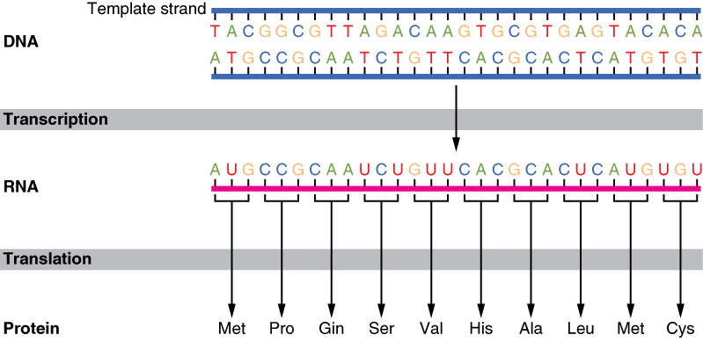
The Basics of Protein Synthesis
Glyphosate
Glycine

Slide 7
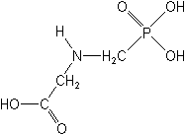
What if Glyphosate could Insert itself into Proteins during Synthesis???
glyphosate
Extra Stuff!
Code for Glycine
Glyphosate
GGC
Glycine
mRNA
. . .
. . .
Glyphosate
Alanine
Proline
-- Any proteins with conserved glycine residues are likely to be affected in a major way

Slide 8
Extra Piece Sticks Out at Active Site
Substrate no longer fits in active site
Active Site
Extra Stuff
Glyphosate
Alanine
Proline
glycine
Peptide chain

Slide 9
Extra Piece Sticks Out at Active Site
Substrate no longer fits in active site
This explains how glyphosate disrupts EPSPS in the shikimate pathway: Multiple bacteria have developed resistance by replacing active site glycine with alanine and this is the basis for GMO Roundup Ready crops*
Active Site
Extra Stuff
Glyphosate
Alanine
Proline
glycine
Peptide chain
*T Funke et al., Molecular basis for the herbicide resistance of Roundup Ready crops. PNAS 2006;103(35):13010-13015.

Slide 10
Inhibition of EPSPS by glyphosate: Resistant E coli mutant*
Mutant with alanine substituted for glycine 96
Wild type with glycine 96
*Figure 3, S Eschenburg et al. Planta 2002;216:129-135.

Slide 11
Only Glyphosate Works!*
“More than 1,000 analogs of glyphosate have been produced and tested for inhibition of EPSP synthase, but minor structural alterations typically resulted in dramatically reduced potency, and no compound superior to glyphosate was identified.”
Hypothesis:
These other molecules failed to work as an amino acid analogue of glycine, because they were not amino acids.
*T Funke et al. PNAS 2006; 103(35): 13010-13015.

Slide 12
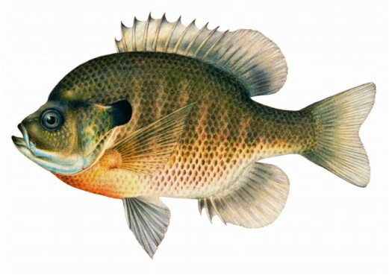
Quote from Monsanto Study (1989)*
Study exposed bluegill sunfish to carbon-14 radiolabelled glyphosate
Measured radiolabel in tissues greatly exceeded measured glyphosate levels
Proteolysis recovered more glyphosate
20% yield → 70% yield
"Proteinase K hydrolyses proteins to amino acids and small oligopeptides, suggesting that a significant portion of the 14C activity residing in the bluegill sunfish tissue was tightly associated with or incorporated into protein.”
*WP Ridley and KA Chott. Monsanto unpublished study. August, 1989.

Slide 13
Some Predicted Consequences*
Neural tube defects
Autism
Impaired collagen → osteoarthritis
Steatohepatitis (fatty liver disease)
Obesity and adrenal insufficiency
Hypothyroidism
Impaired iron homeostasis and kidney failure
Insulin resistance and diabetes
Cancer
*A. Samsel and S. Seneff. Journal of Biological Physics and Chemistry 2016;16:9-46.

Slide 14
Myosin in the Gut
Myosin is a motor protein found in high levels in skeletal muscles
Myosin is also essential for gut motility (peristalsis) and for release of bile acids into upper intestine
Myosin contains a highly conserved glycine at position 699*
If this is changed to alanine, the protein’s contractile ability is reduced to less than 1%.
Glyphosate has been shown to suppress myosin**
SIBO (Small Intestinal Bacterial Overgrowth) is associated with impaired peristalsis***
*F Kinose et al. The Journal of Cell Biology 1996;134(4): 895-909.
**Ana Paula Rezende dos Santos et al., Chemosphere 2017;168:933e943.
***AC Dukowicz et al. Gastroenterol Hepatol (N Y) 2007; 3(2): 112-122.
Notes:
Glyphosate/chemosphere_2017_glyphosate_histomorpholgical_changes_liver_guppies.pdf
Anthony/scleroderma/glycine_699_pivotal_for_motor_activity_skeletal_myosin.pdf

Slide 15
Glyphosate Disrupts Cytochrome P450 (CYP) Enzymes*
Glyphosate has been shown to severely suppress CYP enzymes in rat liver
CYP enzymes have a unique FXXGXRXCXG motif with two and sometimes three critical glycine residues**
CYP enzymes are needed to produce bile acids for digesting fats, to activate vitamin D and to detoxify many environmental toxicants
GLYCINES
*A Samsel and S Seneff. Entropy 2013; 15: 1416-1463.
**K Syed and SS Mashele. PLOS ONE 2014; 9(4):| e95616.

Slide 16
Glyphosate, Sulfate, Oxalate, Thyroid, Autism

Slide 17
Sulfate in Fetal Development*
Fetus depends on mother for sulfate supply
Sulfate is essential for transporting sterols (like estrogen and DHEA) and supplying extracellular matrix proteins everywhere with sufficient negative charge
Sulfate detoxifies xenobiotics like acetaminophen (tylenol) and is essential for excreting toxins like aluminum and mercury
Sulfate is severely deficient in autistic children (1/3 the normal level of free sulfate in blood stream)
* PA Dawson, “Sulfate in Fetal Development,”
Semin Cell Dev Biol 2011;22(6): 653-9.
Notes:
Cancer/sulfate_in_fetal_development.pdf
2011 Aug;22(6):653-9.
Dawson PA. Sulfate in fetal development. Semin Cell Dev Biol (2011), doi:10.1016/j.semcdb.2011.03.004

Slide 18
Thyroid and Sulfate
Autism is associated with disrupted sulfate management → systemic sulfate deficiency*
Glyphosate suppresses pituitary release of thyroid stimulating hormone (TSH) → hypothyroidism**
Hypothyroidism in mom is linked to autism in child***
Hypothyroidism causes sulfate loss in urine****
*RH Waring and LV Klovrza. J Nutr & Environ Med 2000; 10: 25-32.
**JS de Souza et al. Toxicology. 2017 Feb 15;377:25-37.
***GC Román, Ann Neurol 2013;74(5):733-42.
****K Sagawa et asl. Am J Physiol. 1999 Jan;276(1 Pt 2):F164-71.

Slide 19
Rosemary Waring on Autism (1990)*
“These results indicate that there may be a fault either in manufacture of sulphate or that sulphate is being used up dramatically on an unknown toxic substance these children may be producing .”
*p. 198, O’Reilly, B.A.; Waring, R.H. Enzyme and sulphur oxidation deficiencies in autistic children with known food/chemical intolerances. Xenobiotica. 1990, 20, 117–122.

Slide 20
Rosemary Waring Found Extremely Abnormal Urinary Sulfur Products in Autism*
* RH Waring and LV Klovrza. Journal of Nutritional &
Environmental Medicine 2000; 10: 25-32.
Notes:
book/sulfate/sulfate_oxalate_kidney_transport_Karen_Lyke.pdf

Slide 21
Glyphosate Disrupts Sulfur Enzymes
Sulfite oxidase*
Depends on molybdenum as catalyst (glyphosate chelates it making it unavailable)
Changing glycine at residue 473 with aspartate destroys enzyme activity
Leads to severe impairment in ability to bind sulfite and 5-fold reduction in catalysis
Aspartate has similar properties as glyphosate, being bulky and negatively charged
Defective SO leads to severe birth defects and neurological problems resulting in early death
The sulfotransferases**
GxxGxxG motif required for binding PAPS
*H.L. Wilson et al., Biochemistry 2006, 45, 2149-2160 2149.
**K. Komatsu et al., Biochemi and Biophys Res Comm 1994;204(3): 1178-1185.
Notes:
2016/Anthony/conserved_glycines_sulfotransferase_1994_WOW.pdf
./G473D_mutation_sulfite_oxidase_destroys_it_2006.pdf

Slide 22
Thyroid Deficiency and Glyphosate
Glyphosate exposure to rat dams led to thyroid deficiency in pups*
Attributed to suppressed release of thyroid stimulating hormone (TSH) from the dam’s pituitary
Glyphosate link to impaired TSH due to disruption of protein phosphatase 1 (PP1)**
PP1 is essential for TSH release
*JS deSouza et al., Toxicology To Appear, 2017.
**JE Beecham and S Seneff. Journal of Autism 2016;3:1.
Notes:
deSouza_glyphosate_suppresses_thyroid_stimulating_hormone_pituitary_2017.pdf
BeechamSeneff2_2016.pdf

Slide 23
Protein Phosphatase 1 Has Many Highly Conserved Glycines!*
Glycines!!
Protein Phosphatase I
*Figure 1, Y. Shi, Cell 2009;139: 468-484.
Notes:
serine_threonine_phosphatase_conserved_glycine_2009.pdf

Slide 24
PCOS, Autism, PAPS Synthase
PAPS synthase is essential for DHEA sulfate synthesis
Defective PAPS synthase → polycystic ovary syndrome (PCOS) in women, high androgen*
Glycine 270 → aspartate mutation
PCOS is a risk factor for autism in the woman and in her children**
*Cherskov et al. Translational Psychiatry 2018; 8:136.
**W Oostdijk et al. J Clin Endocrinol Metab. 2015;100(4):E672-80.
Notes:
Book/sulfate/./PCOS_and_autism_2018.pdf
./PAPS_synthase_glycine_mutation_PCOS_WOW_2015.pdf
101 different PAPS synthases all had glycine at 270

Slide 25
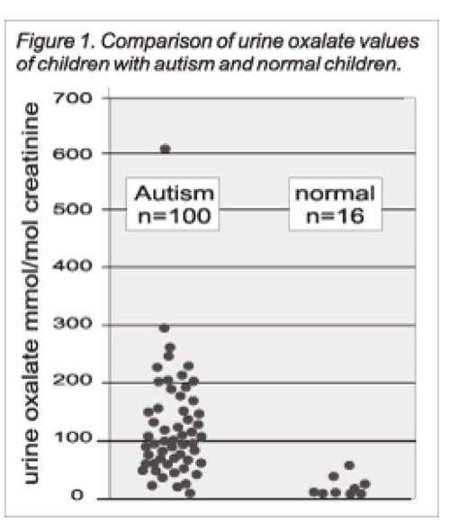
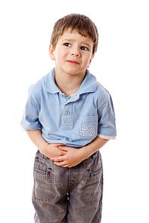
Autism Linked to Oxalate Crystals*
Crystals of oxalate form kidney stones and cause great discomfort
Study has shown at least 3-fold higher serum and urinary levels of oxalate in autistic kids**
*William Shaw, The Role of Oxalates in Autism and Chronic Disorders WAPF, March 26, 2010
**J Konstantynowicz et al., European Journal of Paediatric Neurology 16(5), 2012, 485-491.
Notes:
samantha/oxalates_in_autism.text
samantha/william_shaw_on_oxalates_autism.text
http://www.westonaprice.org/health-topics/the-role-of-oxalates-in-autism-and-chronic-disorders/
*http://www.greatplainslaboratory.com/home/span/oxalates.asp
“Oxalate crystals in the bone may crowd out the bone marrow cells, leading to anemia and immunosuppression”*

Slide 26
Oxalate Causes Sulfate Flushing through Urine*
Sulfate is essential for:
Synthesis of extracellular matrix glycoproteins
Synthesis of cerebroside sulfate, in myelin in nerve fibers
Detoxification of many environmental toxins
Sulfate is flushed in the urine (lost) when kidney oxalate levels are high
Oxalobacter microbes degrade oxalate but they are killed by antibiotics such as Cipro
Oxalate decarboxylase depends on manganese as catalyst**
*W Krick et al., Am J Physiol Renal Physiol 2009;297: F145-F154.
**A Tanner et al. J Biol Chem. 2001;276(47):43627-34
Notes:
book/autism/sulfate_oxalate_kidney_transport_Karen_Lyke.pdf
Book/autism/oxalate/Tanner_2001_oxalate_decarboxylase_requires_manganese_glycine_dependencies.pdf

Slide 27
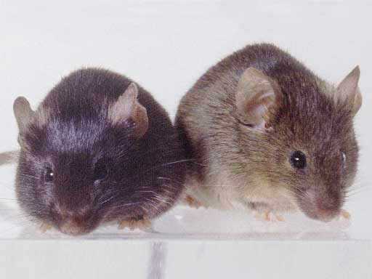
Autism-like socio-communicative deficits and stereotypies in mice lacking heparan sulfate*
Experiment with “designer” mice: blocked heparan sulfate synthesis in brain ventricles
Mice exhibited all the classic features of autism – both cognitive and social
"Fractone-associated N-sulfated heparan sulfate shows reduced quantity in BTBR T+tf/J mice: a strong model of autism." **
* F. Irie et al., PNAS Mar. 27, 2012, 109(13), 5052-5056.
**KZ Meyza et al., Behav Brain Res 2012;228:247–53.
Notes:
vitaminK/mice_no_heparan_sulfate_get_autism_2012.pdf
Samantha/heparan_sulfate_knockout_mice_get_autism.pdf

Slide 28
“Heparan sulfate deficiency in autistic postmortem brain tissue from the subventricular zone of the lateral ventricles”*
“Aberrant extracellular matrix glycosaminoglycan function localized to the subventricular zone of the lateral ventricles may be a biomarker for autism, and potentially involved in the etiology of the disorder.”
New neurons develop from stem cells in this zone through the action of “fractones” composed of heparan sulfate proteoglycans**
*BL Pearson et al., Behav Brain Res. 2013;243:138-45
**F. Mercier et al., Neuroscience Letters 506 (2012) 208–213
Notes:
Samantha/heparan_sulfate_deficiency_autism_postmortem_brain.pdf

Slide 29
Is Encephalopathy a Mechanism to Renew Sulfate in Autism?*
Abstract: “This paper makes two claims:
(1) autism can be characterized as a chronic low- grade encephalopathy, associated with excess exposure to nitric oxide, ammonia and glutamate in the central nervous system, which leads to hippocampal pathologies and resulting cognitive impairment, and
(2), encephalitis is provoked by a systemic deficiency in sulfate, but associated seizures and fever support sulfate restoration. …”
*S seneff et al., Entropy 2013; 15: 372-406.

Slide 30
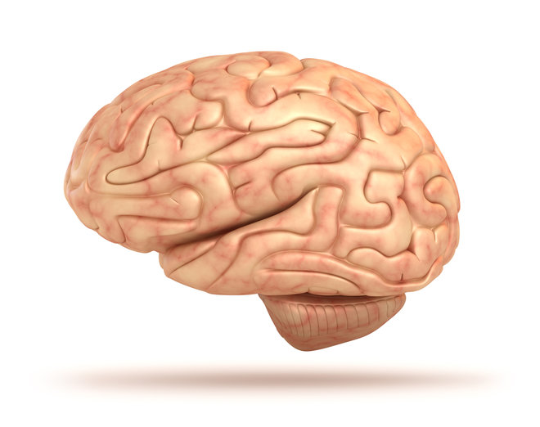
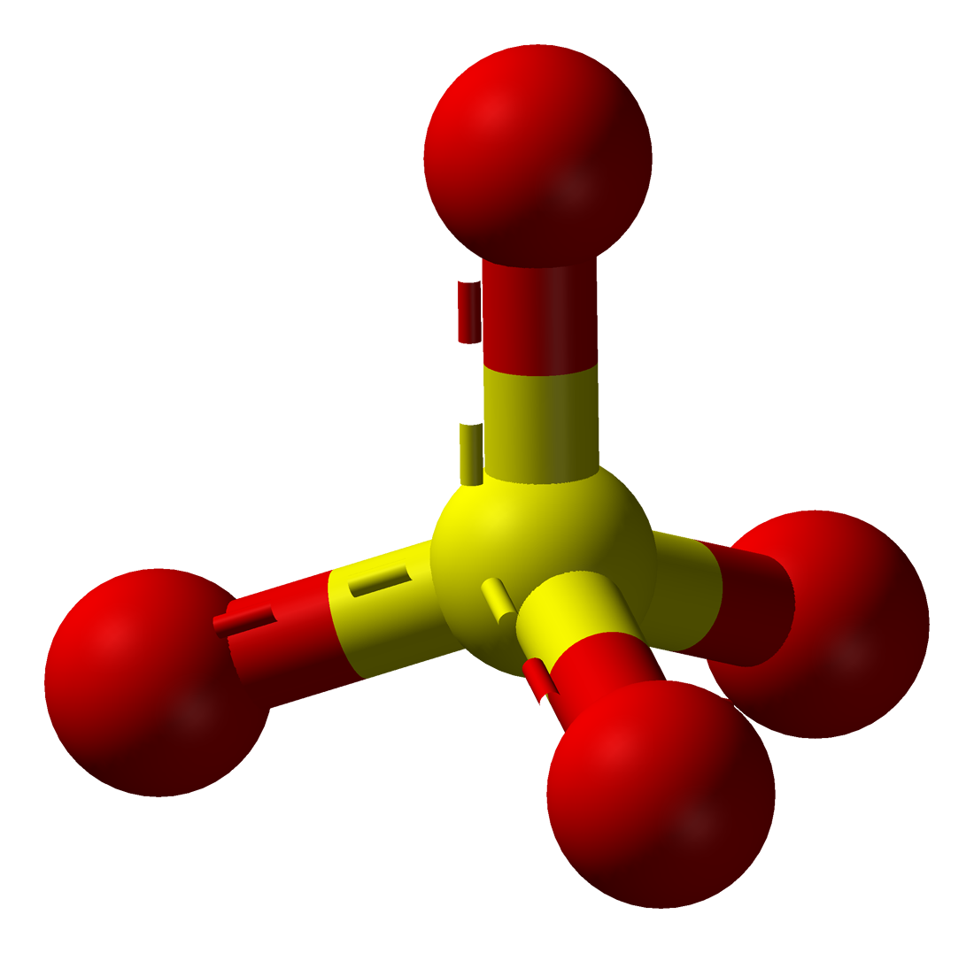
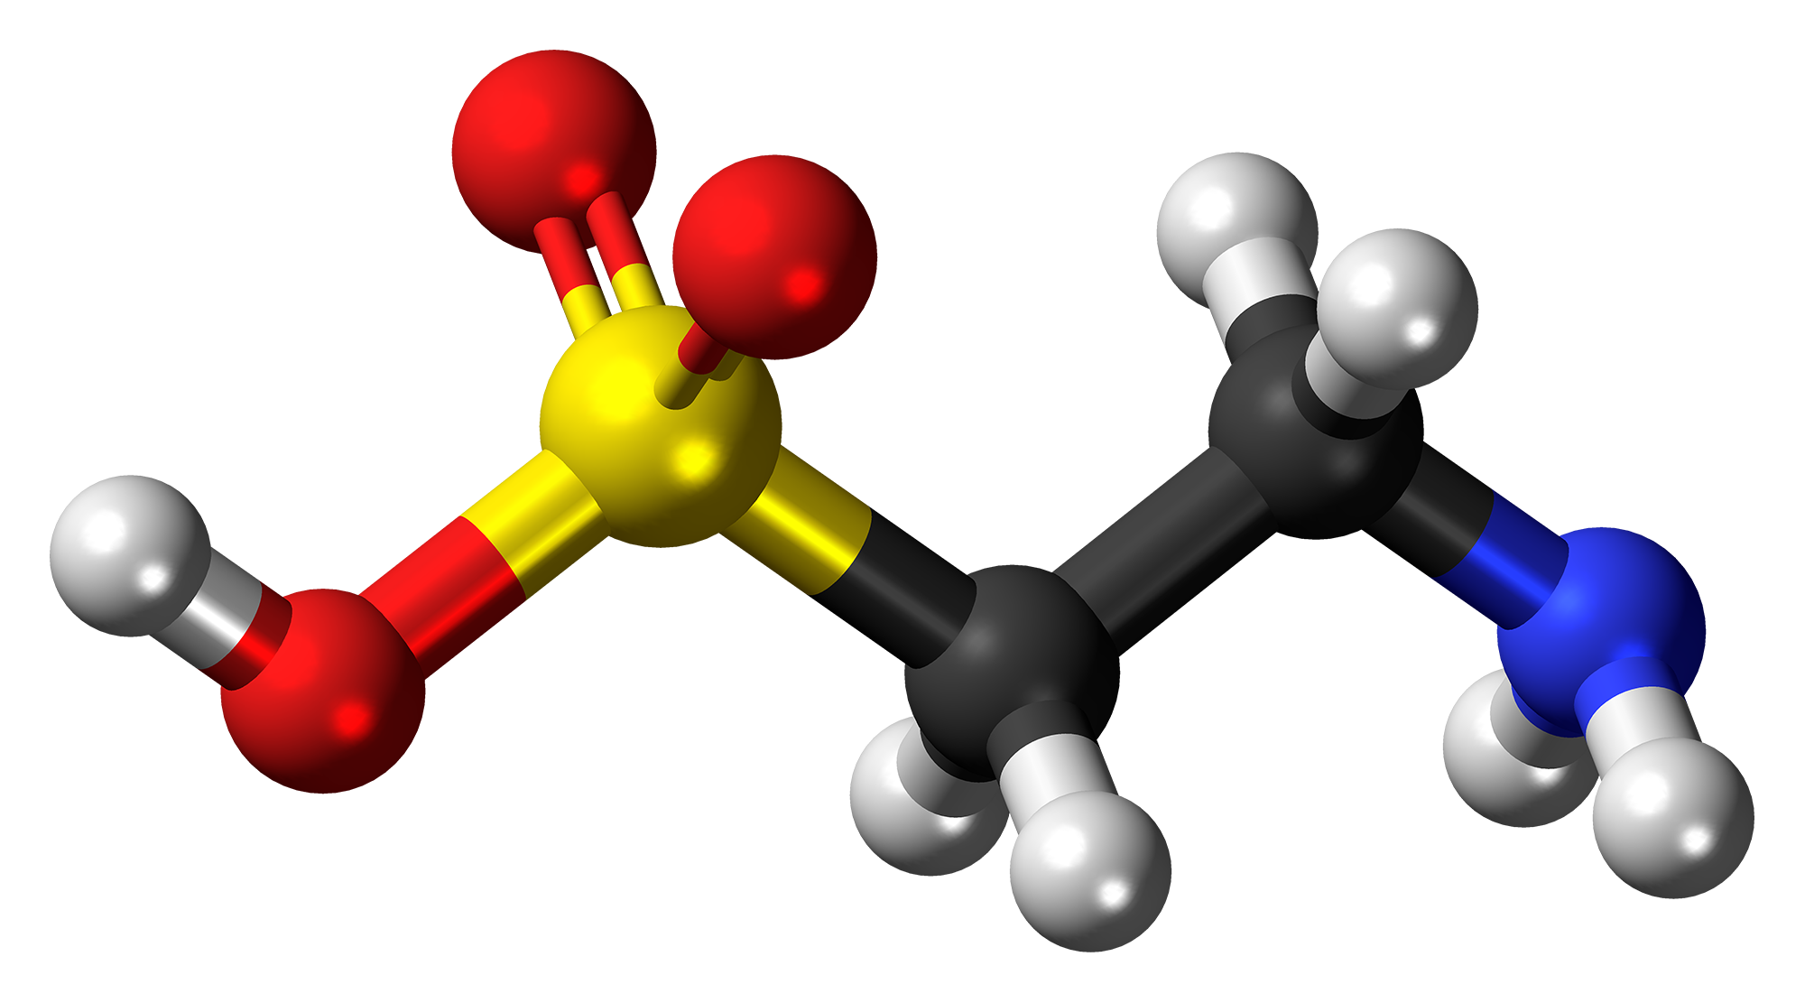
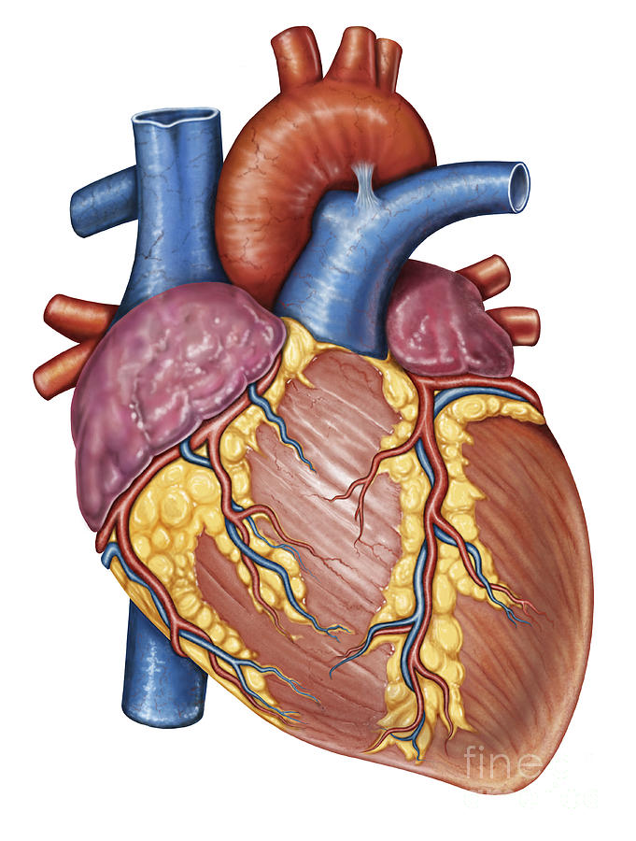
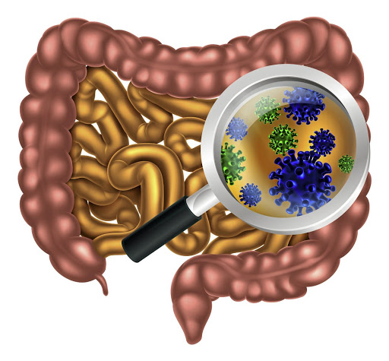
Gut Microbes to the Rescue!
Glyphosate blocks taurine uptake into E coli microbes*
sulfate
taurine
taurine
taurine
taurine
*W Lu et al. Mol BioSyst 2013; 9: 522-530.

Slide 31
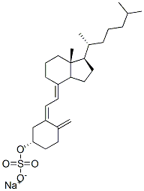
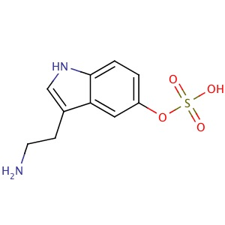
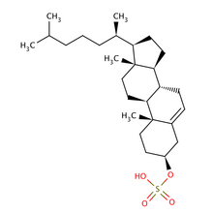
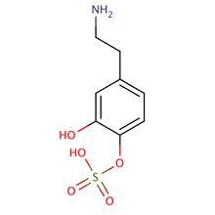
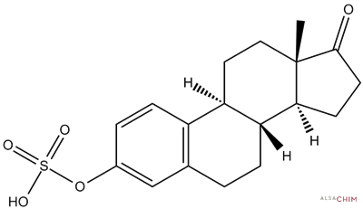
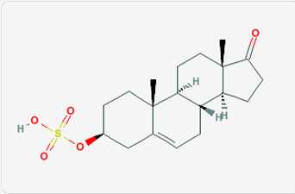
Safe Sulfate Transport: Carbon Rings
vitamin D sulfate
serotonin sulfate
cholesterol sulfate
Glyphosate depletes serotonin and dopamine and disrupts enzymes involved with sterol sulfation: Imperiled sulfate transport
dopamine sulfate
estrone
sulfate
DHEA sulfate

Slide 32
Recapitulation
Sulfate plays many essential roles in the body
Sulfate deficiency is a core feature of autism
Maternal hypothyroidism is a risk factor for autism in the fetus
Glyphosate interferes with stimulation of thyroid gland
Glyphosate exposure to pregnant rats induced thyroid deficiency in pups
Sulfate synthesis and transfer depend critically on both glycine residues and molybdenum
PCOS due to glycine mutation is risk factor for autism
Oxalate metabolism depends on microbial enzymes that are disrupted by glyphosate
High oxalate is linked to autism and causes sulfate flushing through urine
Heparan sulfate deficiency in the brain is associated with autism in both humans and mouse models
A low grade encephalopathy characterizes autism and may reflect the need to synthesize sulfate

Slide 33
Sulfate and Histamines

Slide 34
Heparan Sulfate Promotes Histamine Breakdown*
Intestinal diamine oxidase (DAO) is synthesized in the mature enterocytes of the villus tip and is then transported to the binding sites on the intestinal vasculature.
Heparin and heparan sulfate induce release of the bound DAO, so that it can break down histamine
Conclusion: deficiencies in heparan sulfate lead to build-up of histamines!
* L. D'Agostino et al., Biochim Biophys Acta 1989;993(2-3):228-32.
Notes:
Treasures/Diamine_oxidase_released_in_rats_by_heparan_sulfate.text
Treasures/DAGs_release_histamine_into_plasma.pdf

Slide 35
Symptoms Caused by Histamines*
*Figure 1, L. Maintz and N. Novak, Am J Clin Nutr 2007;85:1185–96.
Notes:
FIGURE 1. Summary of histamine-mediated symptoms. Adapted with permission from Maintz L et al. Dtsch Artzebl 2006;103:A3477-83
Treasures/histamine_intolerance_review_2007.pdf

Slide 36
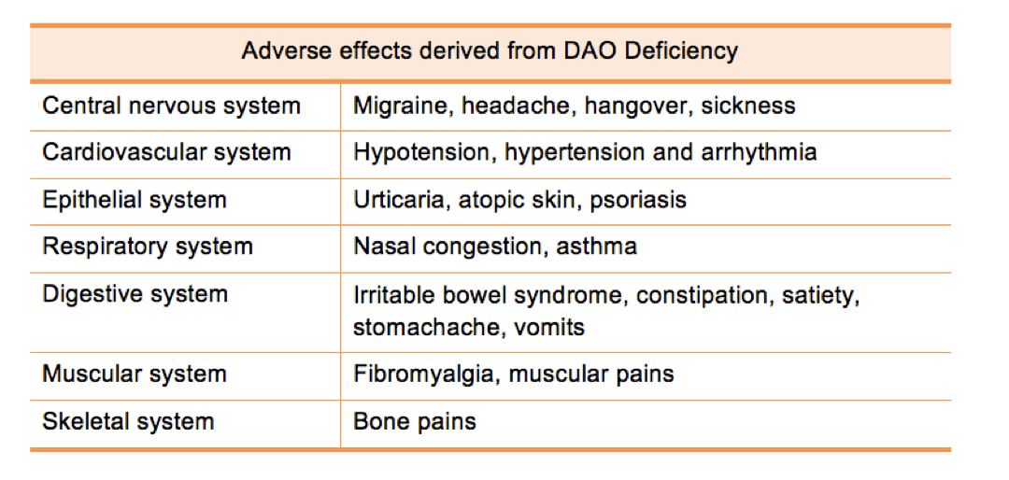
DAO Deficiency → Histamine Accumulation*
*www.deficitdao.org/dao-deficiency/#.VRWYtWZGqDc
Notes:
http://www.deficitdao.org/dao-deficiency/#.VRWYtWZGqDc
./DAO_deficiency.pdf

Slide 37
Glyphosate and Vaccines

Slide 38
Patreon – Microbiome Vaccine Safety Project*
"Gut microbiota have a significant effect on host response to vaccination where a reduced or absent population of commensal flora coupled with an overgrowth of pathogenic strains may become a microbial predisposition to adverse vaccine reaction. This may include reduced or absent protective microbiota such as Bifidobacteria, Lactobacillus and butyrate-producing Clostridia allowing immune dysregulating Bacteroides and Proteobacteria to be overgrown."
*thegutclub.org/patreon-microbiome-vaccine-safety-project/
Notes:
Book/gut//Patreon_micrbiome_vaccine_links.text
Deltaproteobacteria:
… contains most of the known sulfate- (Desulfovibrio, Desulfobacter, Desulfococcus, Desulfonema, etc.) and sulfur-reducing bacteria (e.g. Desulfuromonas spp.) alongside several other anaerobic bacteria with different physiology (e.g. ferric iron-reducing Geobacter spp.
Some members of the genus Bacteroides are opportunistic pathogens.

Slide 39
Glyphosate in Vaccines?
For MMR, flu vaccine, and rabies vaccine, live virus is grown on gelatin derived from ligaments of pigs
Pigs are fed GMO Roundup-Ready corn and soy feed
The main component of gelatin is collagen
By far the most common amino acid in collagen is glycine: glyphosate substitution is likely!
There is also a significant amount of glutamate
Excite NMDA receptors in the brain
Glyphosate’s known stimulation of NMDA receptors could cause neuronal burnout

Slide 40
Glyphosate Contamination in Vaccines (Parts Per Billion)*
Merck ZOSTAVAX 0.42 Shingles
Merck MMR-II 2.90 Measles, Mumps and Rubella
Merck VARIVAX 0.41 Varicella, Chicken Pox
MERCK PNEUMOVAX ND Pneumococcal 18
MERCK PROQUAD 0.43 Measles, Mumps, Rubella, Varicella
GSK ENERGIX-B 0.33 Heptatitis B
*A Samsel and S Seneff. Journal of Biological Physics and Chemistry 17 (2017) 8–32

Slide 41
Measles Virus and Hemagglutinin*
The measles virus synthesizes the protein hemagglutinin
Antibodies to hemagglutinin are essential following MMR vaccination to induce immunity
Hemagglutin bears a sequence resemblance to myelin basic protein (MBP) → potential for autoimmune reaction
MBP is essential for the formation of the myelin sheath surrounding nerve fibers
Children with a rare genetic defect involving deletion of MBP can suffer from microcephaly**
Autoantibodies to MBP along with excessive levels of antibodies to measles hemagglutinin are linked to autism***
*Oldstone, MBA, Ed. Molecular mimicry: Infection inducing autoimmune disease.
Springer Berlin Heidelberg; January 9, 2006.
**AD Kline et al., Am J. Hum. Genet. 1993;52:895-906.
***VK Singh et al., J Biomed Sci 2002;9(4):359-64.

Slide 42
Autism and Measles Hemagglutinin*
125 autistic children and 92 control children
60% of the children with autism had high levels of antibodies to measles hemagglutinin specific to the MMR vaccine
90% of these had autoantibodies to myelin basic protein (MBP)
0% of the control children had high antibody titers to either hemagglutinin or MBP
There were no elevations in antibodies detected against any proteins in the mumps or rubella viruses
*VK Singh et al., J Biomed Sci 2002;9(4):359-64.

Slide 43
Solutions

Slide 44
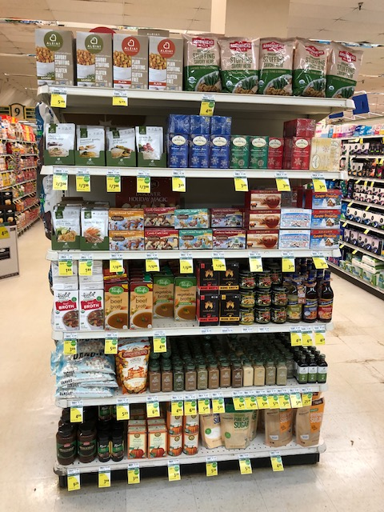
Go Organic!
Wholefoods:
Sign at Entrance
Foodland: organic shelf

Slide 45
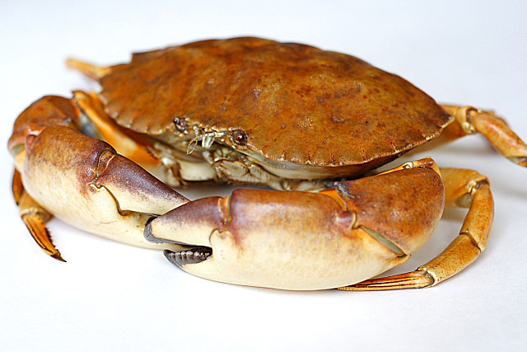
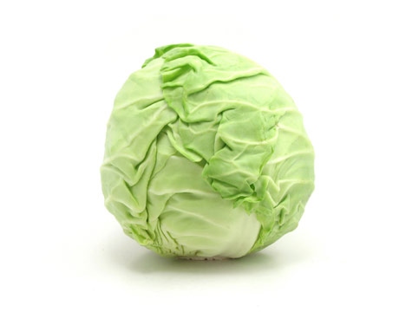
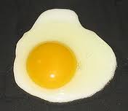
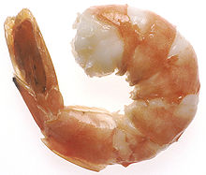
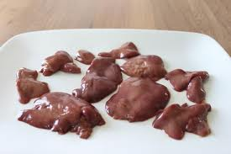
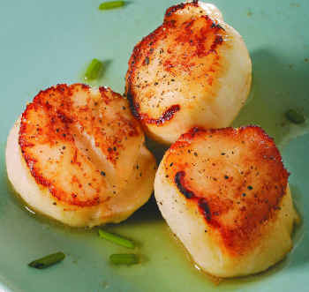
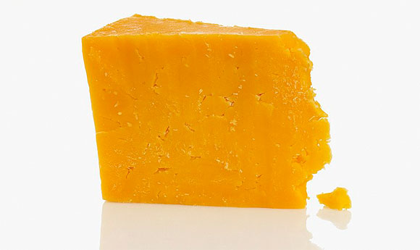
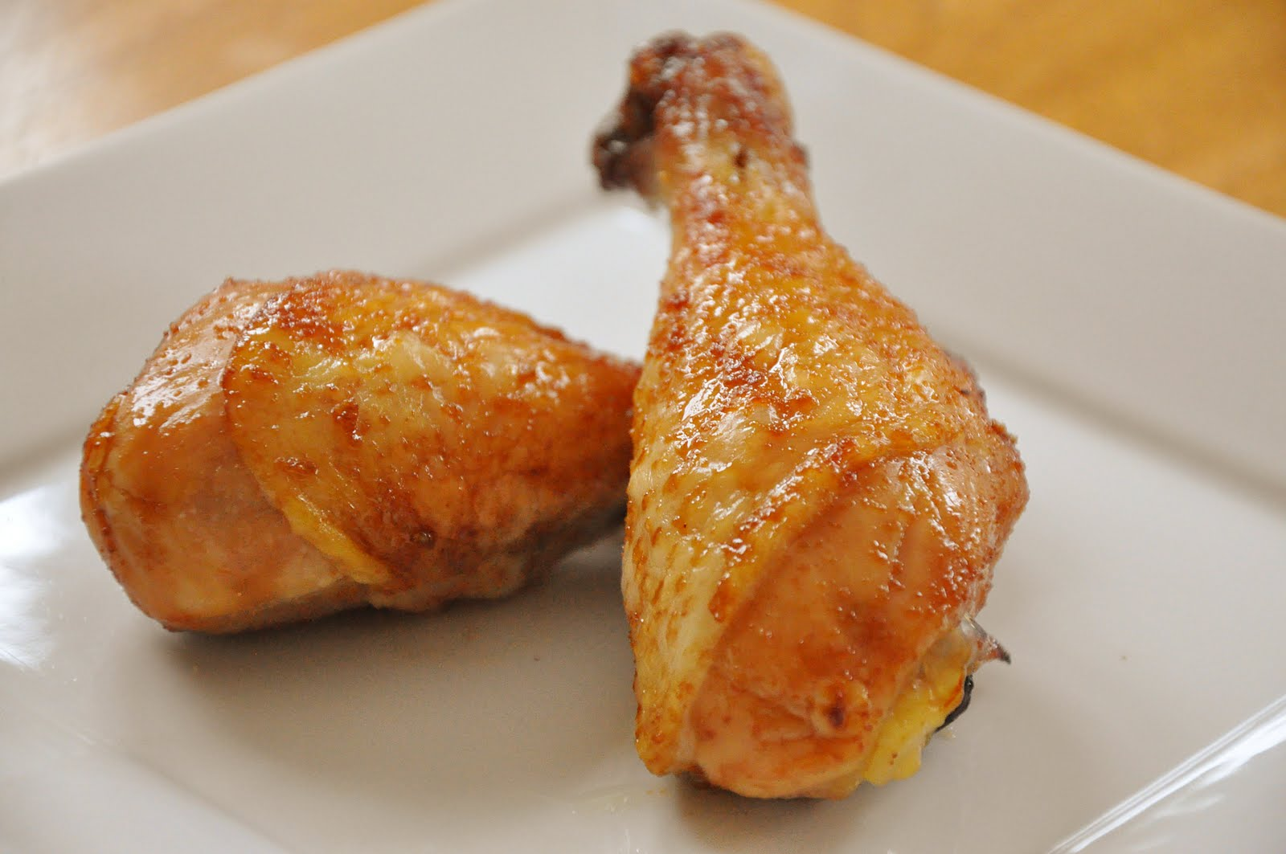
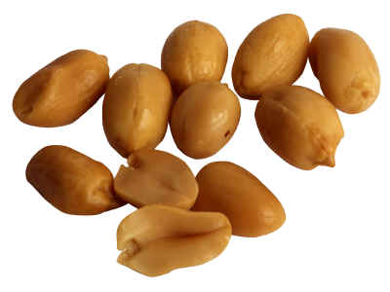
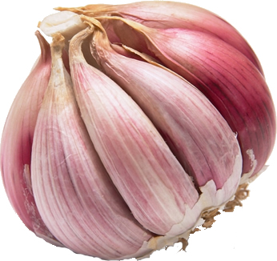
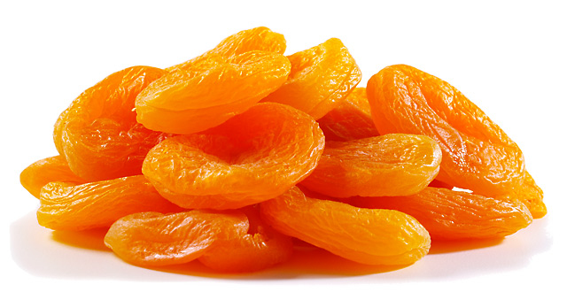
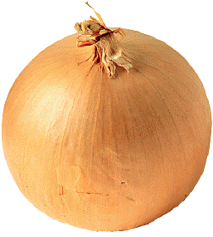
Eat Foods Containing Sulfur
Notes:
http://healthyeatingclub.com/info/books-phds/books/foodfacts/html/data/data5g.html

Slide 46
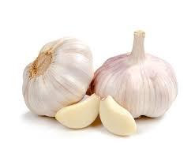
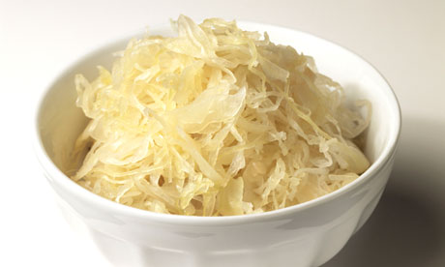
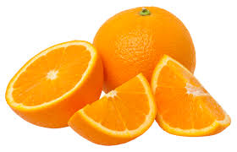
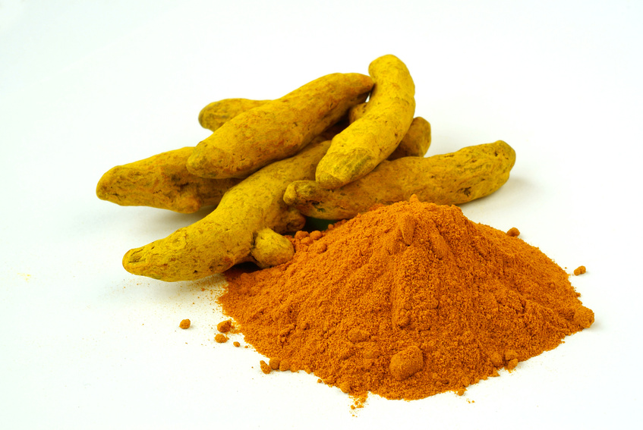
Some Important Nutrients
Curcumin
Garlic
Vitamin C
Probiotics
Methyl tetrahydrofolate
Cobalamin
Glutathione
Taurine
Epsom salt baths

Slide 47
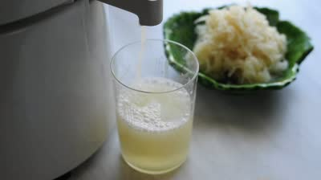
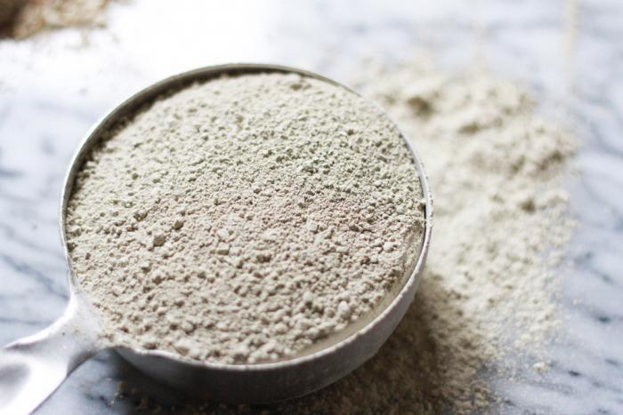
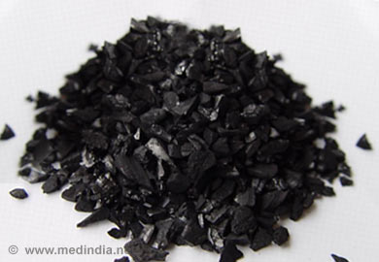
Treating Glyphosate Poisoning in Animals (e.g., cows) *
Activated charcoal, bentonite clay, humic and fulvic acids, and sauerkraut juice have been shown to be effective in reducing urinary levels of glyphosate and improving animal health
Sauerkraut
Juice
Fulvic Acid
Activated Charcoal
Bentonite Clay
*H Gerlach et al., J Environ Anal Toxicol 2014, 5:2
Notes:
Glyphosate/Monika_cows_humic_acid_fulvic_acid_treat_glyphosate.pdf
Activated charcoal
活性炭
clay
粘土
Niántǔ
Huóxìngtàn

Slide 48
Spend Time Outside in the Sunlight – Especially in the Ocean

Slide 49
Farming Solutions!*
Organic → agroecological → sustainable →
regenerative agriculture
Vive la France!
4. A tax for those farmers using glyphosate amounting to 1 Euro per Kilo of glyphosate used. This is referred to as a “phytosanitary” tax on the use of a pollutant. It is anticipated that this tax will generate $50 million euros ($57 million dollars) annually to help farmers transition away from pesticide use.
*www.independentsciencenews.org/health/how-france-and-germany-are-ousting-
glyphosate-in-a-search-for-healthy-soils-and-pesticide-free-crops/
Notes:
https://www.independentsciencenews.org/health/how-france-and-germany-are-ousting-glyphosate-in-a-search-for-healthy-soils-and-pesticide-free-crops/
The great news is that the recommendations include the use of cover crops, no or minimal tillage and other procedures that encourage healthy soils and discourage weeds and pathogens

Slide 50
Summary
Glyphosate is pervasive in our environment and it is causing an epidemic in autism as well as many other debilitating diseases
Hypothesis: Glyphosate has a unique mechanism of toxicity that involves substituting for glycine during protein synthesis
This leads to disruption of many biological pathways, most notably causing severe sulfate deficiency, systemically
This is a likely explanation for the strong correlations between glyphosate usage and autism rates
Organic food, sunlight exposure, fermented foods and high sulfur diet can be effective to protect from or treat autism
We need to go back to renewable organic agricultural methods to safeguard our families and the ecosystem

