Slide 1
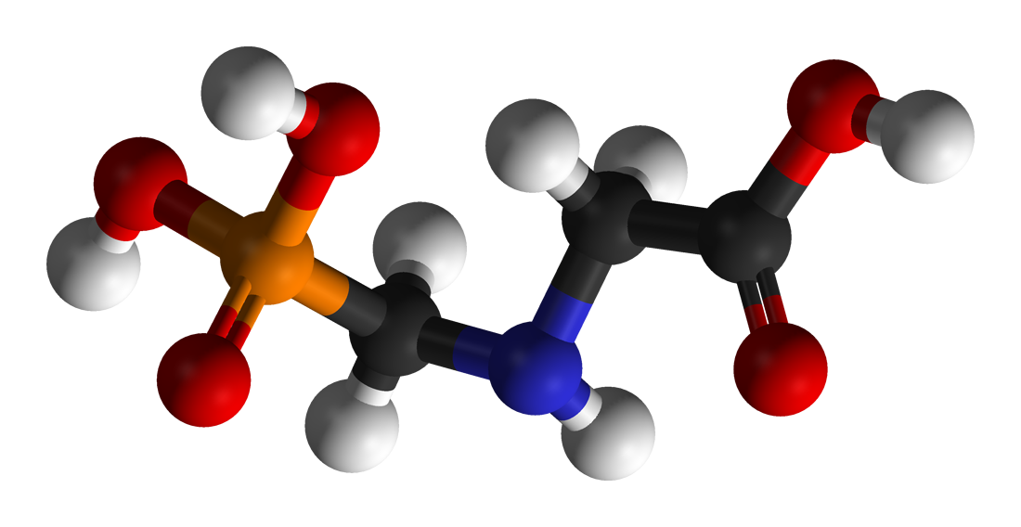
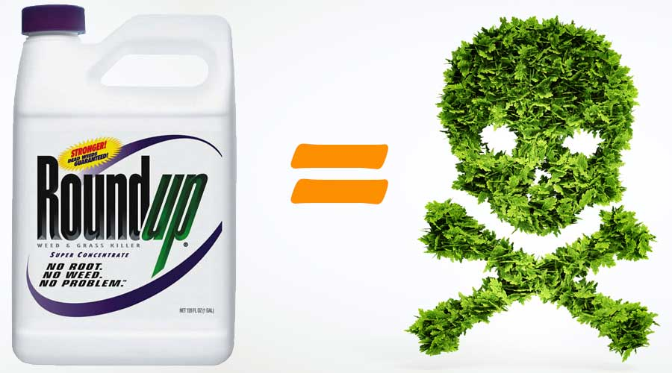
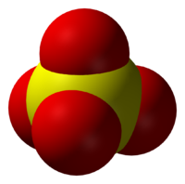
Glyphosate, Sulfate and Autism
Stephanie Seneff
MIT CSAIL
AutismOne
August 19, 2022

Slide 2
Download these slides!
https://people.csail.mit.edu/seneff/2022/AutismOne2022.pptx
Powerpoint slides
https://people.csail.mit.edu/seneff/2022/AutismOne2022.pdf
PDF file – two per page

Slide 3
Outline
Introduction
Glyphosate Disrupts Sulfate Supply
Autism and Sulfate
Sulfate and the Brain
Glyphosate, Autism and the Gut
Glyphosate, Sulfate and Reproductive Issues
How to Keep Your Family Healthy

Slide 4
Introduction

Slide 5
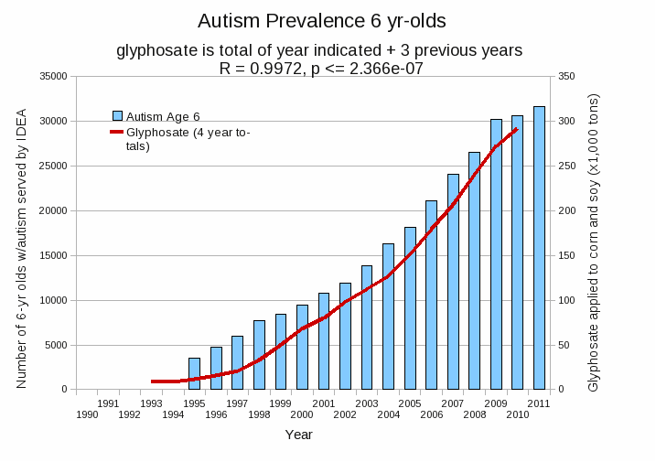
Autism Prevalence: 6-year-olds and Glyphosate Usage on Core Crops*
R = 0.9972
* Figure 15, Seneff et al., Agricultural Sciences, 2015, 6, 42-70
Notes:
Nancy/latest_plots/6-yr-old autism.gif
autism: USDE
oil consumption: USDA
glyphosate: USDA
GE crops: USDA
Mortality data: CDC

Slide 6
Glyphosate vs. Other Pesticides: Usage in the United States*
Glyphosate
*http://sustainablepulse.com/ wp-content/uploads/GMO-health.pdf

Slide 7
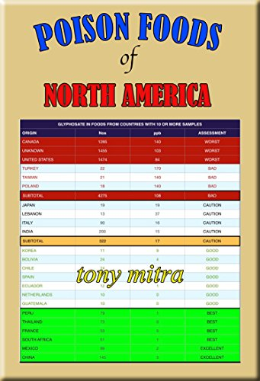
Glyphosate is Pervasive in Our Food Supply!

Slide 8
My New Book!
Released by Chelsea Green in July 2021
Presents extensive data on glyphosate toxicity to animals and humans
Shows how glyphosate interferes with sulfate homeostasis
Argues that glyphosate is insidiously, cumulatively toxic through its diabolical insertion into proteins by mistake in place of the coding amino acid glycine
This unique feature explains why it is causal in so many diseases

Slide 9
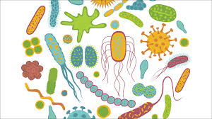
Shikimate Pathway Disruption
Phenylalanine, tryptophan, tyrosine
Gut Microbes
shikimate
Dopamine, adrenaline, serotonin, melatonin, melanin,
thyroid hormone
Glyphosate
chorismate
Vitamin K
Folate and niacin
Ubiquinone
Notes:
folate from chorismite
https://www.ncbi.nlm.nih.gov/pmc/articles/PMC1449997/

Slide 10
Main Toxic Effects of Glyphosate*
Kills beneficial gut bacteria and allows pathogens to overgrow
Interferes with function of cytochrome P450 (CYP) enzymes in the liver
These enzymes serve many important roles, including making bile acids, activating vitamin D, detoxifying many toxic chemicals and breaking down prescription drugs
Chelates (binds tightly to) important minerals like cobalt, manganese and zinc, making them unavailable to the cells
Interferes with the synthesis of aromatic amino acids and methionine
Disrupts sulfate synthesis and sulfate transport
*Samsel and Seneff, Entropy 2013, 15, 1416-1463

Slide 11
Main Toxic Effects of Glyphosate*
Kills beneficial gut bacteria and allows pathogens to overgrow
Interferes with function of cytochrome P450 (CYP) enzymes in the liver
These enzymes serve many important roles, including making bile acids, activating vitamin D, detoxifying many toxic chemicals and breaking down prescription drugs
Chelates (binds tightly to) important minerals like cobalt, manganese and zinc, making them unavailable to the cells
Interferes with the synthesis of aromatic amino acids and methionine
Disrupts sulfate synthesis and sulfate transport
*Samsel and Seneff, Entropy 2013, 15, 1416-1463

Slide 12
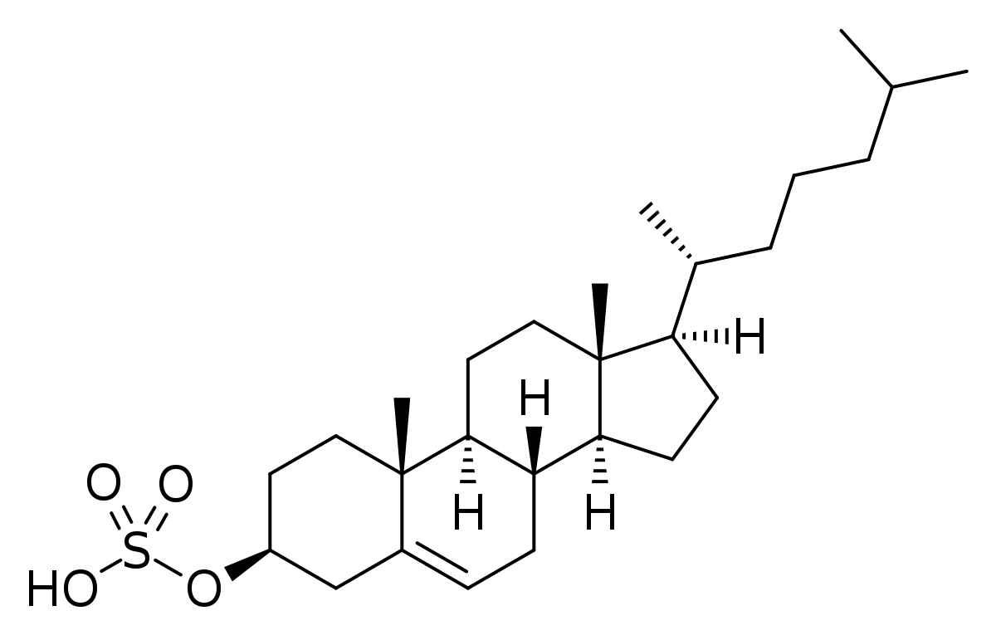
“The near universal presence of autism spectrum disorders in children with Smith-Lemli-Opitz syndrome”*
“SLOS is an autosomal recessive condition caused by a defect in cholesterol synthesis”
“SLOS appears to have the most consistent relationship with autism of any single gene disorder”
75% of the children with SLOS were diagnosed to be on the autism spectrum
“Therefore, a link between cholesterol metabolism and autism is suggested”
Cholesterol Sulfate
Hypothesis: Cholesterol sulfate synthesis in the skin is a major source of both cholesterol and sulfate to supply the brain
*Darryn M Sikora et al. Am J Med Genet A 2006; 140(14): 1511-8.
Notes:
https://pubmed.ncbi.nlm.nih.gov/16761297/
project/AutismMagazine/

Slide 13
The Importance of Cholesterol Sulfate
Cholesterol sulfate, produced in the skin, supplies cholesterol, sulfate, and protons to all the tissues
Sulfate is synthesized from sulfide in the skin and blood stream utilizing the energy in sunlight
Cholesterol sulfate from the skin goes into the blood and enters the membranes of red blood cells, platelets and lipid particles
It protects them all from glycation and oxidative damage
Sunscreen interferes with this process

Slide 14
Sulfated Glycosaminoglycans (GAGs)
Prominent in extracellular matrix of all cells
Controls uptake of nutrients and signaling molecules
Amount of sulfate depends on availability
Crucial for maintaining negative charge and gelled water
http://www.science-autism.org/sulphate.htm

Slide 15
Glyphosate Disrupts Sulfate Supply

Slide 16
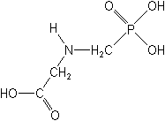
What If Glyphosate can get Inserted into Proteins by Mistake in Place of Glycine???
glyphosate
Code for glycine
GGC
mRNA
. . .
. . .
Glyphosate
Alanine
Proline
Any proteins with highly conserved glycine residues are likely to be affected in a major way

Slide 17
Multiple species of bacteria
and multiple species of weeds
have developed resistance to glyphosate
by swapping out a crucial glycine residue in
the enzyme EPSP synthase in the shikimate
pathway, replacing it with alanine.*
*S Seneff et al. J Bioinfo Proteomics Rev 2016; 2(3): 1-21.

Slide 18
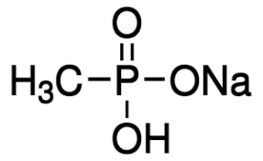
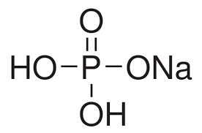
Hypothesis: Glyphosate Disrupts Proteins that Bind Phosphate
Glyphosate kills plants by suppressing EPSP synthase
Glyphosate blocks EPSP synthase binding to the phosphate in PEP
Glyphosate is a glycine molecule with a methylphosphonate unit attached to the nitrogen atom
The binding site for PEP has a highly conserved glycine residue
If this glycine is swapped out for alanine, the enzyme becomes completely insensitive to glyphosate
This is the basis for many GMO glyphosate-resistant crops*
Sodium Methyl-
phosphonate
Sodium Phosphate
*T Funke et al. Proc Natl Acad Sci U S A 2006; 103(35): 13010-13015
Notes:
From 2021/Toronto/BobMiller_shortened.pptx
https://pubmed.ncbi.nlm.nih.gov/16916934/

Slide 19
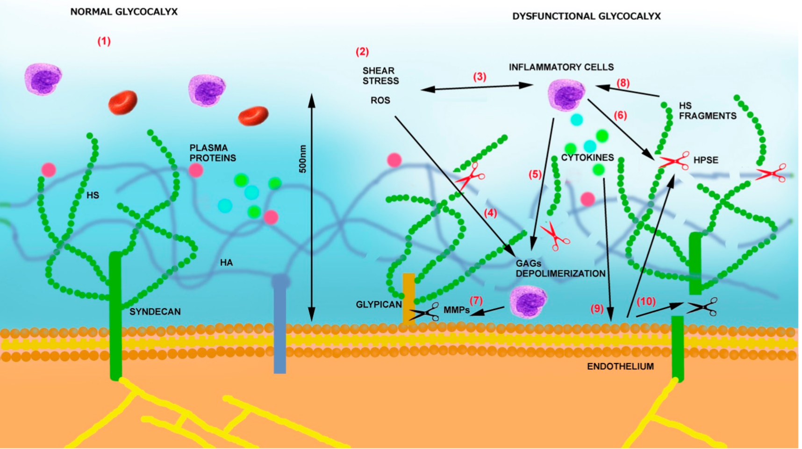
“Pathogenesis of COVID-19 described through the lens of an undersulfated and degraded epithelial and endothelial glycocalyx”*
"The undersulfated glycocalyx may not only increase susceptibility to SARS-CoV-2 infection, but would also result in a hyperinflammatory response, vascular permeability, and shedding of the glycocalyx components, giving rise to a procoagulant and antifibrinolytic state and eventual multiple organ failure."
Figure from: V Masola et al. Int J Mol Sci 2021; 22: 2996.
*Heidi N. du Preez et al. FASEB J. 2022; 36: e22052z
Notes:
2020/book/COVID/glycocalyx_undersulfated_in_severe_COVID19_2021_WOW.pdf
Figure:
SIRT1_endothelial_glycocalyx_fibrosis.pdf

Slide 20
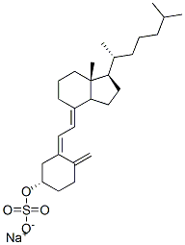
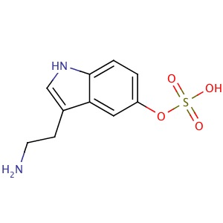
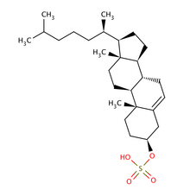
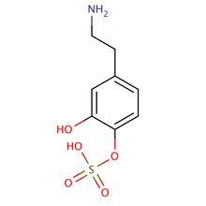
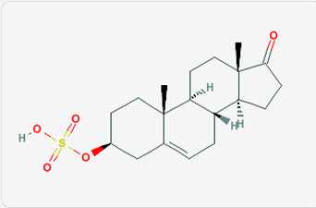
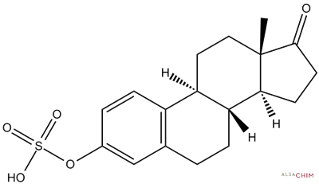
Safe Sulfate Transport: Carbon Rings
vitamin D sulfate
serotonin sulfate
cholesterol sulfate
dopamine sulfate
estrone
sulfate
DHEA sulfate

Slide 21
Safe Sulfate Transport: Carbon Rings
vitamin D sulfate
serotonin sulfate
cholesterol sulfate
Glyphosate depletes serotonin and disrupts enzymes involved with sterol sulfation:
Imperiled sulfate transport
dopamine sulfate
estrone
sulfate
DHEA sulfate

Slide 22
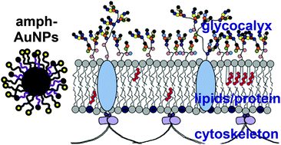
Sulfate’s Critical Role for Maintaining Exclusion Zone Water*
The glycocalyx which lines blood vessels generates electricity to supply the cells
The glycocalyx extrudes protons
Hypothesis:
Protons enter the cells along cytoskeletal “wires”
They fuel the mitochondrial intermembrane space
Sulfate is crucial for maintaining gelled water in the glycocalyx
Sulfated glycosaminoglycans (GAGs) become depleted in sulfate with chronic exposure to glyphosate
*S Seneff and G Nigh. Water 2019; 11: 22-42.
https://waterjournal.org/current-volume/seneff-summary/
Notes:
attached/SeneffNighSulfateWater2019.pdf

Slide 23
Autism and Sulfate

Slide 24
Sulfate in Fetal Development*
Fetus depends on mother for sulfate supply
Sulfate is essential for transporting sterols (like estrogen and DHEA) and supplying extracellular matrix proteins everywhere with sufficient negative charge
Sulfate detoxifies xenobiotics like acetaminophen (Tylenol) and is essential for excreting toxins like aluminum and mercury
Sulfate is severely deficient in autistic children (1/3 the normal level of free sulfate in blood stream)
*PA Dawson, “Sulfate in Fetal Development,”
Semin Cell Dev Biol 2011;22(6): 653-9.
Notes:
_in
2011 Aug;22(6):653-9.
Dawson PA. Sulfate in fetal development. Semin Cell Dev Biol (2011), doi:10.1016/j.semcdb.2011.03.004

Slide 25
Thyroid and Sulfate
Autism is associated with disrupted sulfate management → systemic sulfate deficiency*
Glyphosate suppresses pituitary release of thyroid stimulating hormone (TSH) → hypothyroidism**
Hypothyroidism in mom is linked to autism in child***
Hypothyroidism causes sulfate loss in urine****
*RH Waring and LV Klovrza. J Nutr & Environ Med 2000; 10: 25-32.
**JS de Souza et al. Toxicology. 2017 Feb 15;377:25-37.
***GC Román, Ann Neurol 2013;74(5):733-42.
****K Sagawa et asl. Am J Physiol. 1999 Jan;276(1 Pt 2):F164-71.

Slide 26
Rosemary Waring on Autism (1990)*
“These results indicate that there may be a fault either in manufacture of sulphate or that sulphate is being used up dramatically on an unknown toxic substance these children may be producing.”
Waring deduced that there must be a severe defect in the enzymes that are involved in attaching sulfate to organic molecules
*p. 198, O’Reilly, B.A.; Waring, R.H. Enzyme and sulphur oxidation deficiencies in autistic children with known food/chemical intolerances. Xenobiotica. 1990, 20, 117–122.

Slide 27
Rosemary Waring Found Extremely Abnormal Urinary Sulfur Products in Autism*
*RH Waring and LV Klovrza. Journal of Nutritional &
Environmental Medicine 2000; 10: 25-32.
Notes:
2019/book/sulfate/oxalatesulfate_oxalate_kidney_transport_Karen_Lyke.pdf

Slide 28
Rosemary Waring Found Extremely Abnormal Urinary Sulfur Products in Autism*
> 50-fold increase in urinary sulfite suggests a deficiency in sulfite oxidase
*RH Waring and LV Klovrza. Journal of Nutritional &
Environmental Medicine 2000; 10: 25-32.
Notes:
book/sulfate/sulfate_oxalate_kidney_transport_Karen_Lyke.pdf

Slide 29
Glyphosate Plausibly Disrupts Sulfur Enzymes
Sulfite oxidase (SuOx)*
Depends on molybdenum as catalyst (glyphosate chelation could make it unavailable)
Changing glycine at residue 473 with aspartate destroys enzyme activity
Leads to severe impairment in ability to bind sulfite and 5-fold reduction in catalysis
Aspartate has similar properties as glyphosate, being bulky and negatively charged
Defective SuOx leads to severe birth defects and neurological problems resulting. in early death
The sulfotransferases**
GxxGxxK motif required for binding PAPS (activated sulfate)
*H.L. Wilson et al., Biochemistry 2006, 45, 2149-2160 2149.
**K. Komatsu et al., Biochem and Biophys Res Comm 1994;204(3): 1178-1185.
Notes:
2016/Anthony/conserved_glycines_sulfotransferase_1994_WOW.pdf
./G473D_mutation_sulfite_oxidase_destroys_it_2006.pdf

Slide 30
Major Enzymes disrupted in Sulfation Pathways by Glyphosate?
Glyphosate?
Glyphosate?
Both PAPS synthetase and the class of sulfotransferases have highly conserved glycine residues at sites that bind phosphate
Notes:
2020/book/COVID/glycocalyx_undersulfated_in_severe_COVID19_2021_WOW.pdf
Figure:
SIRT1_endothelial_glycocalyx_fibrosis.pdf

Slide 31
GxxGxxK Motif in Sulfotransferases*
Sulfotransferases are crucial to attach sulfate ions to multiple bioactive molecules
Steroids (cholesterol, estrogen, testosterone, vitamin D, ...)
Glycosaminoglycans (chondroitin sulfate, heparan sulfate, ...)
Polyphenols, aromatics (curcumin, resveratrol, tryptophan, ...)
Neurotransmitters (dopamine, serotonin, melatonin, ...)
*H Chiba et al. Proc. Natl. Acad. Sci. USA 1995; 92:8176-8179.
Notes:
GxxGxxK_motif_sulfotransferases_1995.pdf

Slide 32
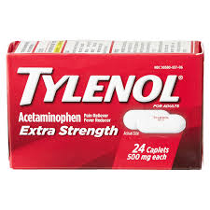
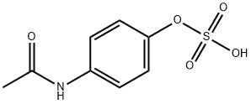
“Sulfation deficit in `low-functioning’ autistic children: a pilot study”*
Specifically looked at ability to metabolize acetaminophen
Found highly statistically significant result:
Autistic kids were unable to conjugate acetaminophen with sulfate! (p < .00002)
Glyphosate disrupts multiple enzymes involved in sulfation pathway in E coli**
acetaminophen sulfate
*AA Pirrone et al., Biol Psychiatry. 1999 Aug 1;46(3):420-4.
**W. Lu et al., Mol. BioSyst., 2013, 9, 522-530.
Notes:
Sulfation_deficit_autism.text
glyphosate_alters_expression_of_many_genes_E_coli_2013.pdf

Slide 33
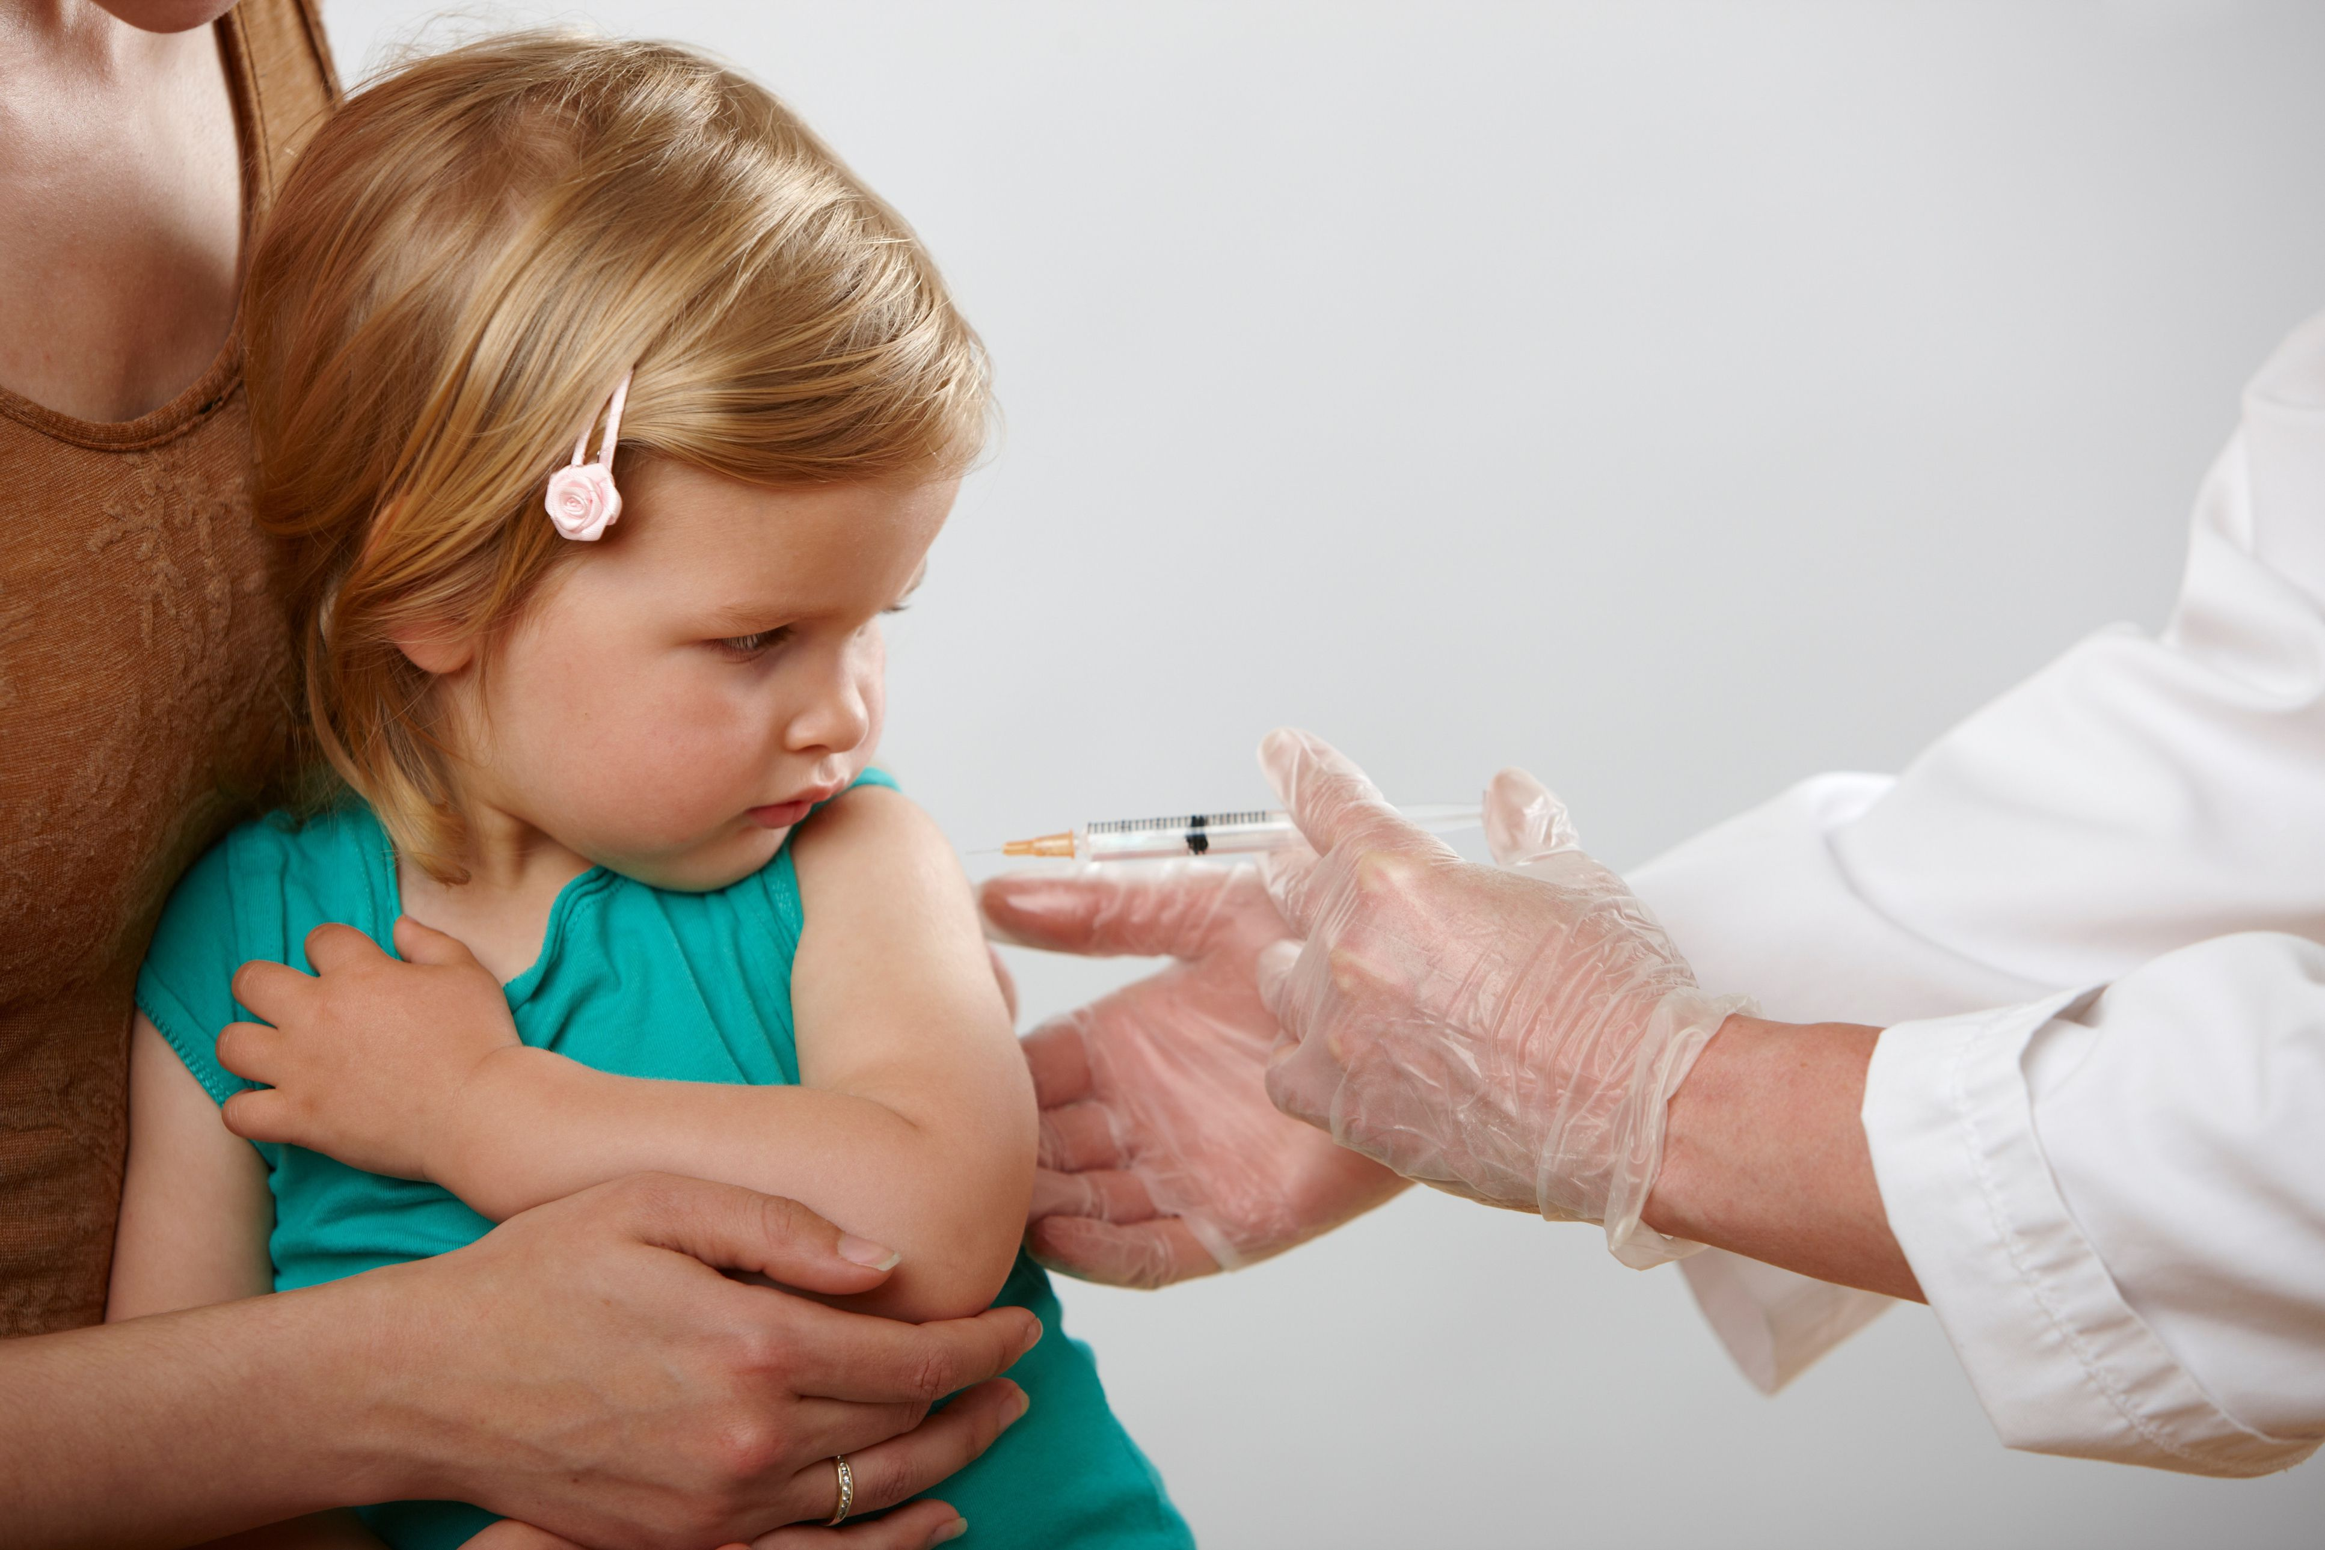
“Thimerosal Exposure and the Role of Sulfation Chemistry and Thiol Availability in Autism”*
"The purpose of the present critical review is to provide mechanistic insight regarding how limited thiol [organosulfur compound] availability, abnormal sulfation chemistry, and decreased GSH [glutathione] reserve capacity in children with an ASD could make them more susceptible to the toxic effects of TM [Thimerosal] routinely administered as part of mandated childhood immunization schedules."
*JK Kern et al. Int. J. Environ. Res. Public Health 2013, 10, 3771-3800.
Notes:
csail/2022/project/AutsimMagazine/thimerosal_exposure_sulfation_chemistry_autism_Geier.pdf

Slide 34
Sulfate and the Brain

Slide 35
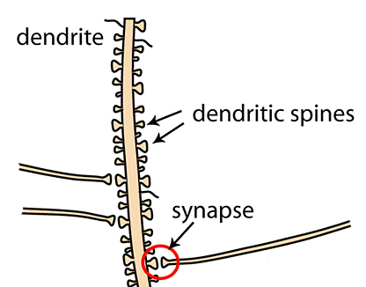
"The role of heparan sulfate deficiency in autistic phenotype”*
Austistic brains are structurally abnormal: too many dendritic spines and too few long-distance connections
Heparan sulfate plays a crucial role in neurodevelopment, regulating axonal guidance and dendritic spine formation
Heparan sulfate deficiency results in excess spine formation
long-distance connection
*Christine Pérez et al., Neural Development 2016; 11: 11.
Notes:
2022/AutismOne/role_of_heparan_sulfate_in_autism_dendrites.pdf

Slide 36
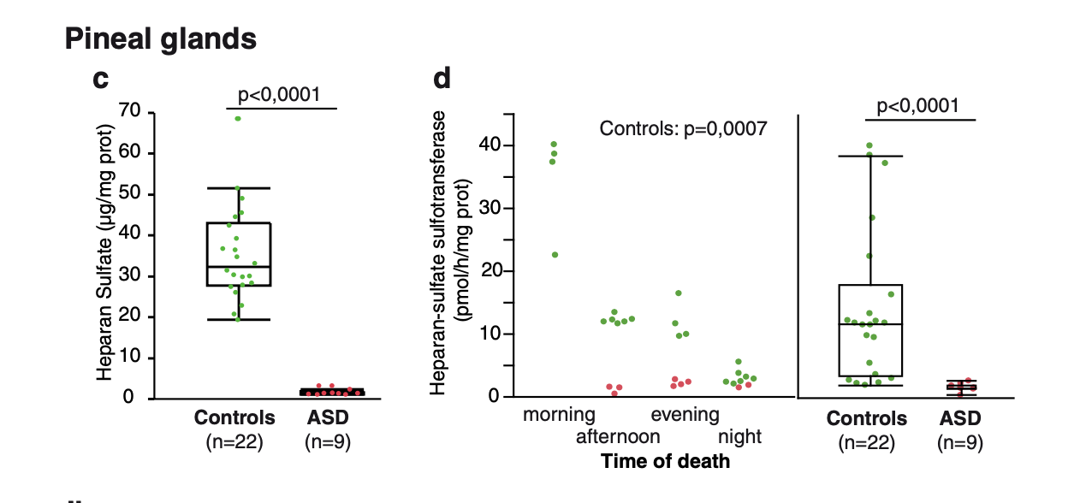
“Decreased phenol sulfotransferase activities associated with hyperserotonemia in autism spectrum disorders”*
*Pagan et al. Translational Psychiatry 2021; 11:23.
Notes:
2022/book_chapter/decreased_phenol_sulfotransferase_activity_autism_2021.pdf

Slide 37
The third ventricle is depleted in heparan sulfate in association with autism in both humans and mice*,**
*B.L. Pearson et al., Behav Brain Res. 2013 Apr 15;243:138-45.
**F Mercie et al., Neurosci Lett 506, 2012, 208-213.
Heparan sulfate depleted
Pineal Gland
Notes:
Where are they?

Slide 38
“Heparan sulfate deficiency in autistic postmortem brain tissue from the subventricular zone of the lateral ventricles”*
“Aberrant extracellular matrix glycosaminoglycan function localized to the subventricular zone of the lateral ventricles may be a biomarker for autism, and potentially involved in the etiology of the disorder.”
New neurons develop from stem cells in this zone through the action of “fractones” composed of heparan sulfate proteoglycans**
*BL Pearson et al., Behav Brain Res. 2013;243:138-45
**F. Mercier et al., Neuroscience Letters 506 (2012) 208–213
Notes:
2022/AutismOne/heparan_sulfate_deficiency_autism_postmortem_brain.pdf

Slide 39
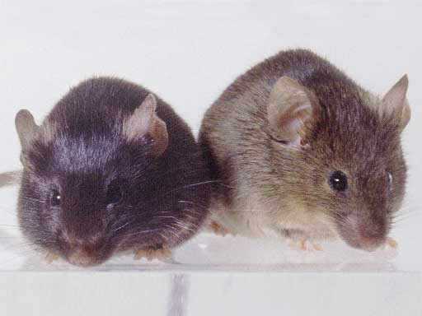
Autism-like socio-communicative deficits and stereotypies in mice lacking heparan sulfate*
Experiment with “designer” mice: blocked heparan sulfate synthesis in brain ventricles
Mice exhibited all the classic features of autism – both cognitive and social
"Fractone-associated N-sulfated heparan sulfate shows reduced quantity in BTBR T+tf/J mice: a strong model of autism."**
* F. Irie et al., PNAS Mar. 27, 2012, 109(13), 5052-5056.
**KZ Meyza et al., Behav Brain Res 2012;228:247–53.
Notes:
vitaminK/mice_no_heparan_sulfate_get_autism_2012.pdf
personal/Project/samantha/heparan_sulfate_knockout_mice_get_autism.pdf

Slide 40
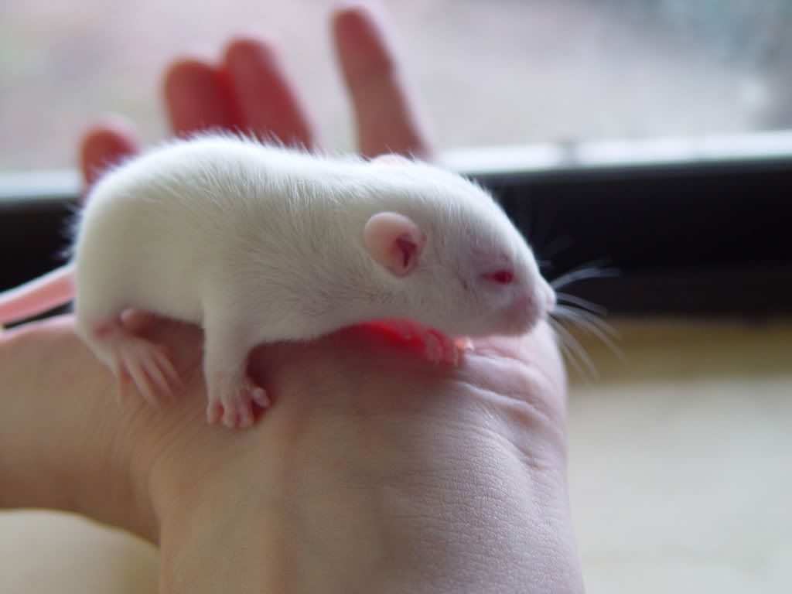
“Glyphosate exposure induces synaptic impairment in hippocampal neurons and cognitive deficits in developing rats”*
Glyphosate-treated hippocampal neurons in culture showed a decrease in dendritic complexity (fewer synaptic connections)
Rat pups were exposed to glyphosate (every two days from 7 days old to 27 days old)
Induced cognitive impairments
Reduced synaptic protein expression in hippocampus
Too few long-distance connections just as observed in autism in humans
*Sebastian Luna et al. Arch Toxicol 2021; 95(6): 2137-2150.
Notes:
where?
https://pubmed.ncbi.nlm.nih.gov/33837468/

Slide 41
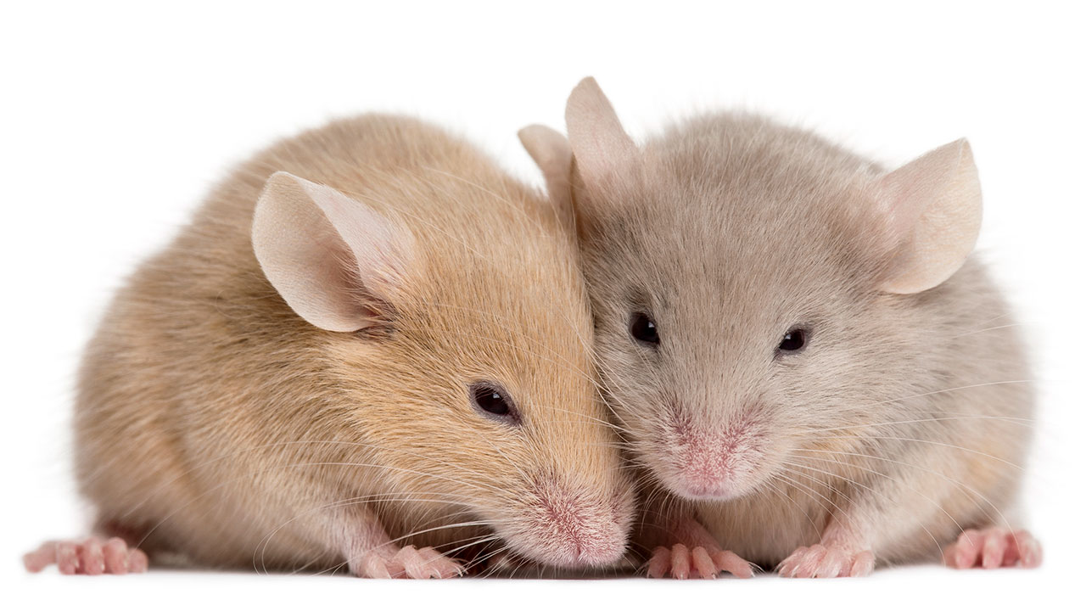
"Anxiety and Gene Expression Enhancement in Mice Exposed to Glyphosate-Based Herbicide”*
Mice exposed to low-dose glyphosate-based herbicide for six weeks exhibited increased anxiety-like behavior
Decreased serotonin expression in the amygdala. (the brain center for emotion)
Neuronal hyperactivity observed in the amygdala
Linked to anxiety behaviors
Serotonin inhibits glutamate release
Glutamate activates receptors that induce excessive excitation of neurons and can lead to neurotoxicity
*Yassine Ait bali et al. Toxics 2022; 10: 226.
Notes:
2022/AutismOne/anxiety_in_mice_exposed_to_glyphosate_2022.pdf

Slide 42
Glyphosate, Autism and the Gut

Slide 43
*
Lifelong exposure of mice to low doses of Roundup via drinking water
Increased repetitive behavior and impaired social interest
Evidence of increased gut permeability
Altered gut microbiome
*Ingrid Del Castilo et al. Int. J. Mol. Sci. 2022, 23, 5583
Notes:
https://pubmed.ncbi.nlm.nih.gov/35628394/

Slide 44
BTBR mice have low acetate, and glyphosate disrupts acetate synthesis in gut*
Children with autism had only 3.5 mg/ml acetate in stool samples compared to 5.1 in controls.**
BTBR mice
Glyphosate and pH
Glyphosate and Acetate
*LN Nielsen et al. Environmental Pollution 2018;233:364e376.
**JB Adams et al. BMC Gastroenterology 2011; 11:22.
Notes:
.csail/2022/project/AutismMagazine//low_acetate_gut_autism_2011.pdf
2018/AnthonySamsel/scleroderma/glyphosate_reduces_acetate_gut_2018.pdf
csail/2022/project/AutismMagazine/glyphosate_reduces_acetate_gut_2018.pdf
rats

Slide 45
BTBR mice have low acetate, and glyphosate disrupts acetate synthesis in gut*
Children with autism had only 3.5 mg/ml acetate in stool samples compared to 5.1 in controls.**
BTBR mice
Elevated pH linked to glyphosate exposure results in small intestinal bacterial overgrowth (SIBO)
Glyphosate and pH
Glyphosate and Acetate
*LN Nielsen et al. Environmental Pollution 2018;233:364e376.
**Adams et al. BMC Gastroenterology 2011; 11:22.
Notes:
./low_acetate_gut_autism_2011.pdf
scleroderma/glyphosate_reduces_acetate_gut_2018.pdf
rats

Slide 46
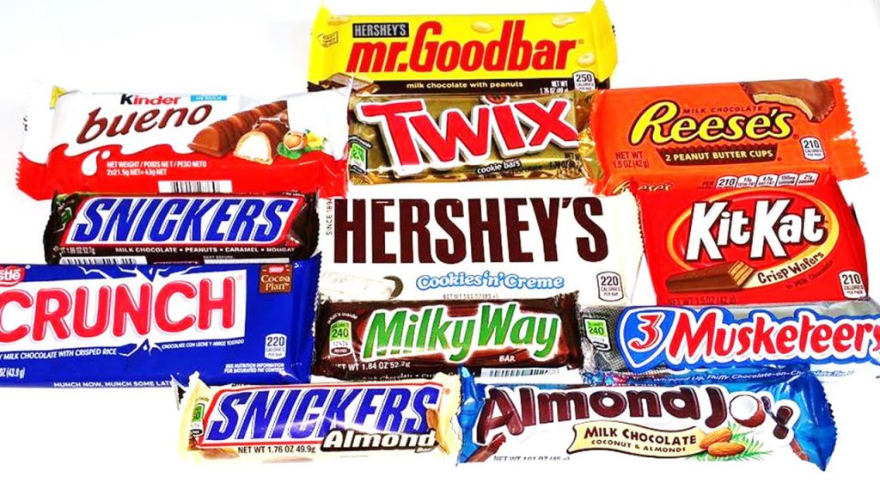
Sulfur Reducing Bacterial Overgrowth with Diet High in Simple Sugars and Fat*
Mouse study, two diets
High fat, high simple sugars
Low fat, high complex carbohydrates
Mice fed diet (1) had overgrowth of Desulfovibrio due to extraction of sulfate from host mucins
Associated with low levels of short chain fatty acids, acetate, and propionate
High levels of hydrogen sulfide (H₂S) led to suppression of cytochrome C oxidase in the mitochondria of host colonic cells
Lower metabolic activity; Reduced uptake of nutrients.
These results are consistent with observations of Desulfovibrio overgrowth, low acetate and propionate, and reduced nutrient uptake linked to autism
*FE Rey et al. Proc Natl Acad Sci U S A. 2013 Aug 13; 110(33): 13582-13587.
Notes:
2022/project/AutismMagazine/metabolic_niche_sulfate_reducing_bacteria_human_gut_2013.pdf

Slide 47
Sulfur Reducing Bacterial Overgrowth with Diet High in Simple Sugars and Fat*
Mouse study, two diets
High fat, high simple sugars
Low fat, high complex carbohydrates
Mice fed diet (1) had overgrowth of Desulfovibrio due to extraction of sulfate from host mucins
Associated with low levels of short chain fatty acids, acetate, and propionate
High levels of hydrogen sulfide (H₂S) led to suppression of cytochrome C oxidase in the mitochondria of host colonic cells
Lower metabolic activity; Reduced uptake of nutrients.
These results are consistent with observations of Desulfovibrio overgrowth, low acetate and propionate, and reduced nutrient uptake linked to autism
Cheap vegetable-based fats (corn oil, soybean oil, cottonseed oil, canola oil) and simple sugars (cane sugar, beet sugar, high fructose corn syrup) can all be expected to be contaminated with glyphosate
*FE Rey et al. Proc Natl Acad Sci U S A. 2013 Aug 13; 110(33): 13582-13587.
Notes:
./metabolic_niche_sulfate_reducing_bacteria_human_gut_2013.pdf

Slide 48
Dissimilatory sulfate reduction induced by glyphosate
Multiple enzymes involved in assimilatory sulfate reduction in E coli are disrupted by glyphosate (PAPS reductase, APS kinase, sulfite reductase)*
Causes deficiency in sulfur-containing amino acids
Leads to increase in Desulfovibrio and Bilophila wadsworthia species
Dissimilatory sulfate reduction → excessive hydrogen sulfide gas → brain fog
Disrupted sulfur assimilation leads to impaired iron absorption**
Iron deficiency anemia is an epidemic worldwide
*W Lu et al. Mol Biosyst. 2013 Mar;9(3):522-30.
**BH Hudson et al. PNAS 2018 ePub ahead of print.
Notes:
.From:
2018/May/May5.pptx
2022/project/AutismMagazine/sulfur_assimilation_defects_iron_deficiency_anemia.pdf
Downregulated paper

Slide 49
Is Encephalopathy a Mechanism to Renew Sulfate in Autism?*
Abstract: “This paper makes two claims:
(1) Autism can be characterized as a chronic low-grade encephalopathy, associated with excess exposure to nitric oxide, ammonia and glutamate in the central nervous system, which leads to hippocampal pathologies and resulting cognitive impairment, and
(2) Encephalitis is provoked by a systemic deficiency in sulfate, but associated seizures and fever support sulfate restoration. …”
*S Seneff et al., Entropy 2013; 15: 372-406.

Slide 50
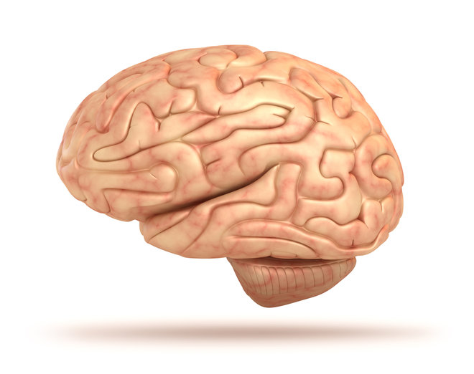
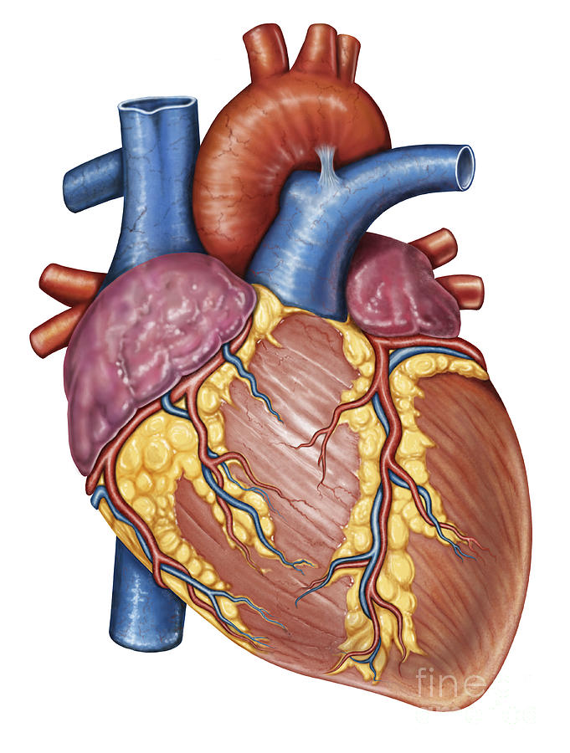
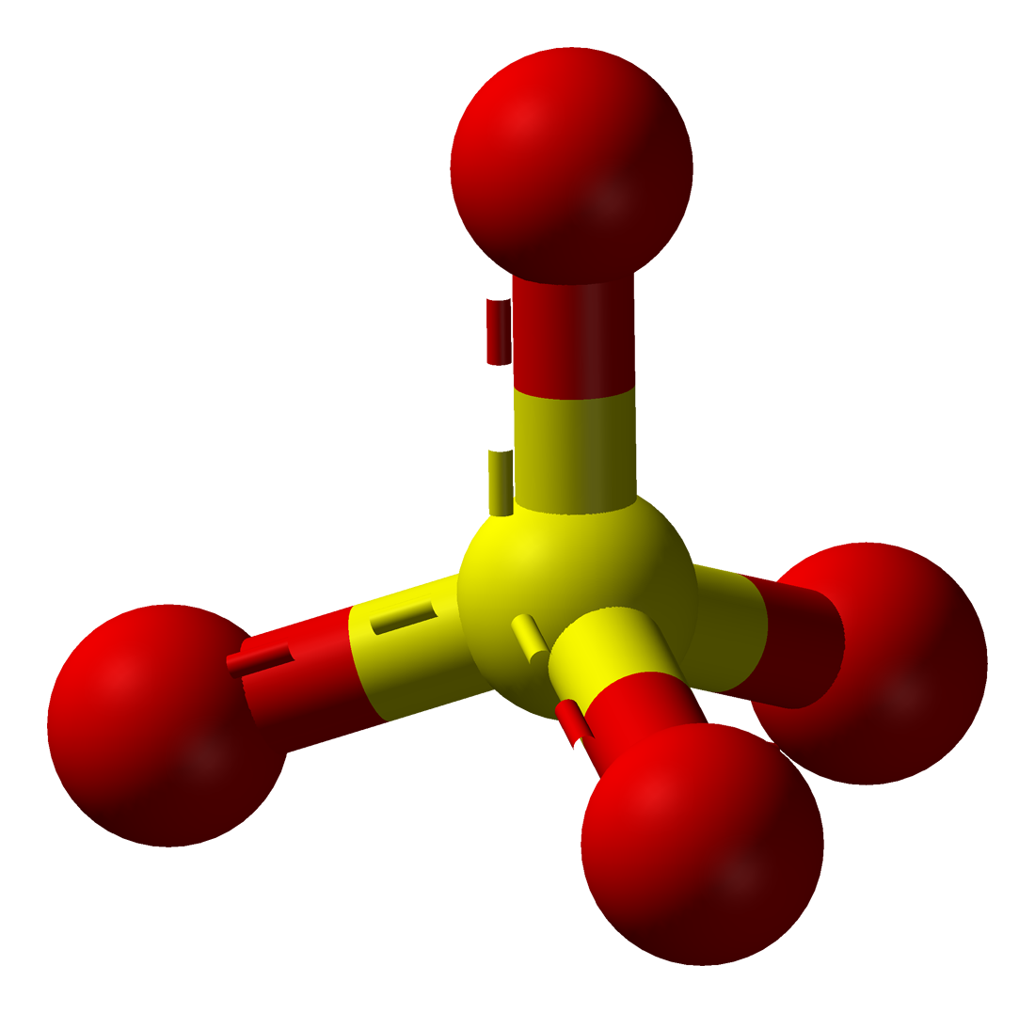
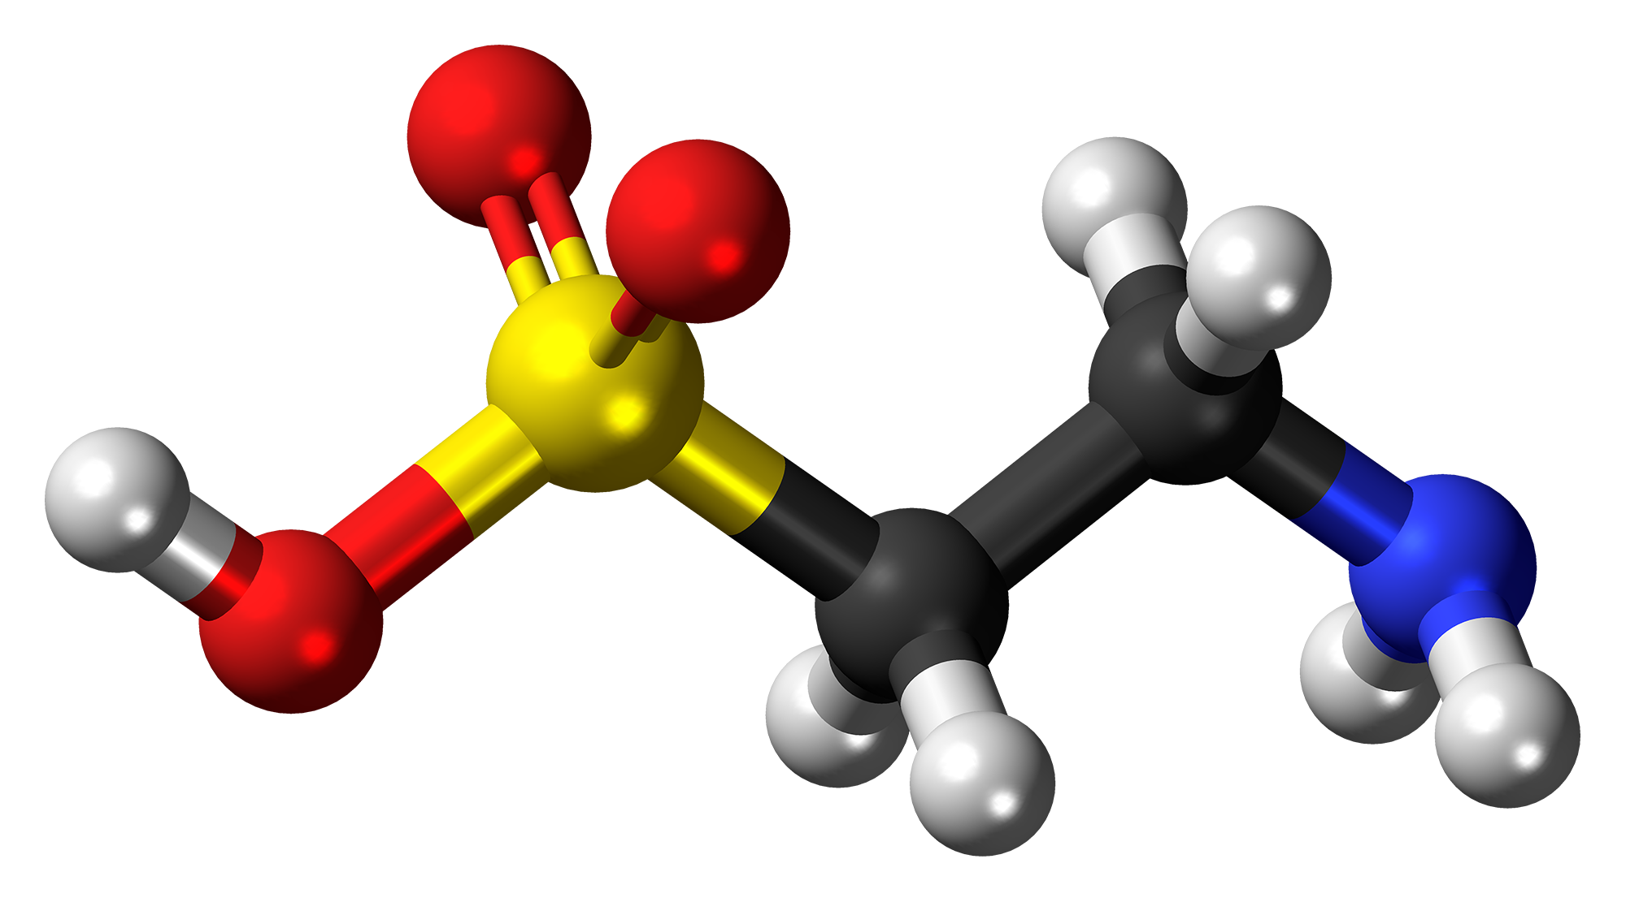
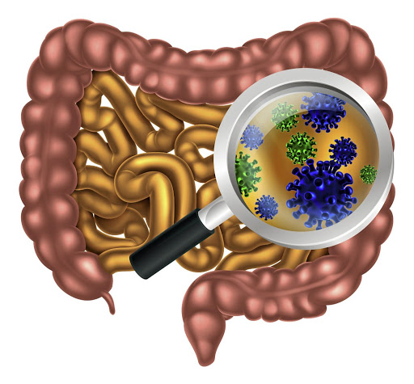
Gut Microbes to the Rescue!
BUT! Glyphosate blocks taurine uptake into E coli microbes*
sulfate
taurine
taurine
taurine
taurine
*W Lu et al. Mol BioSyst 2013; 9: 522-530.

Slide 51
Glyphosate, Sulfate and Reproductive Issues

Slide 52
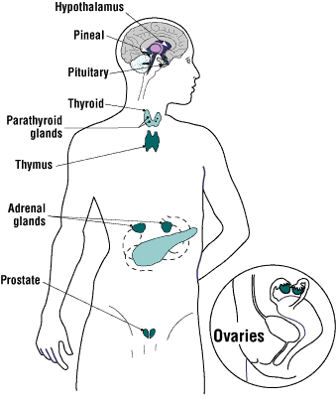
Glyphosate is an Endocrine Disruptor*
Glyphosate at parts per trillion triggers estrogen-sensitive breast cancer cells to proliferate
Glyphosate increases expression levels of estrogen and progesterone receptors
Glyphosate-based herbicides disrupt the hypothalamic-pituitary-thyroid (HPT) axis
Glyphosate alters circulating levels of hormones
Glyphosate induced hypothyroidism in female Wistar rats
Glyphosate-based formulations altered reproductive developmental parameters in animal models
Glyphosate induced malformation in zebrafish embryos
*Juan P. Muñoz et al. Chemosphere October 19, 2020 [Epub ahead of print]
Notes:
Munoz_et_al_Glyphosate_characteristics_endocrine_disruptor_2020.pdf .

Slide 53
Glyphosate and Premature Birth*
Study based in Puerto Rico
53 cases (premature birth); 194 controls
Models are adjusted for maternal age, education, pre-pregnancy BMI, and smoking
Measured both glyphosate and AMPA
AMPA is a breakdown product of glyphosate
Women who had high (> 0.65 micrograms/Liter) levels of AMPA in their urine at 26 weeks of gestation had a 4.5-fold increased risk of premature birth (p< 0.006). High urinary glyphosate was associated with a 3.77-fold increased risk.
*Monica K Silver et al. Environmental Health Perspectives 2021; 29(5): 057011.
Notes:
2021/glyphosate/Silver_et_al_prenatal_exposure_glyphosate_preterm_birth_EHP7295_2021.pdf

Slide 54
Glyphosate and Premature Birth*
Study based in Puerto Rico
53 cases (premature birth); 194 controls
Models are adjusted for maternal age, education, pre-pregnancy BMI, and smoking
Measured both glyphosate and AMPA
AMPA is a breakdown product of glyphosate
Women who had high (> 0.65 micrograms/Liter) levels of AMPA in their urine at 26 weeks of gestation had a 4.5-fold increased risk of premature birth (p< 0.006). High urinary glyphosate was associated with a 3.77-fold increased risk.
"Preterm birth is a national epidemic, costing the United States $26.2 billion each year"
-- American Psychological Association
*Monica K Silver et al. Environmental Health Perspectives 2021; 29(5): 057011.
Notes:
2021/glyphosate/Silver_et_al_prenatal_exposure_glyphosate_preterm_birth_EHP7295_2021.pdf
especially high in Puerto Rico

Slide 55
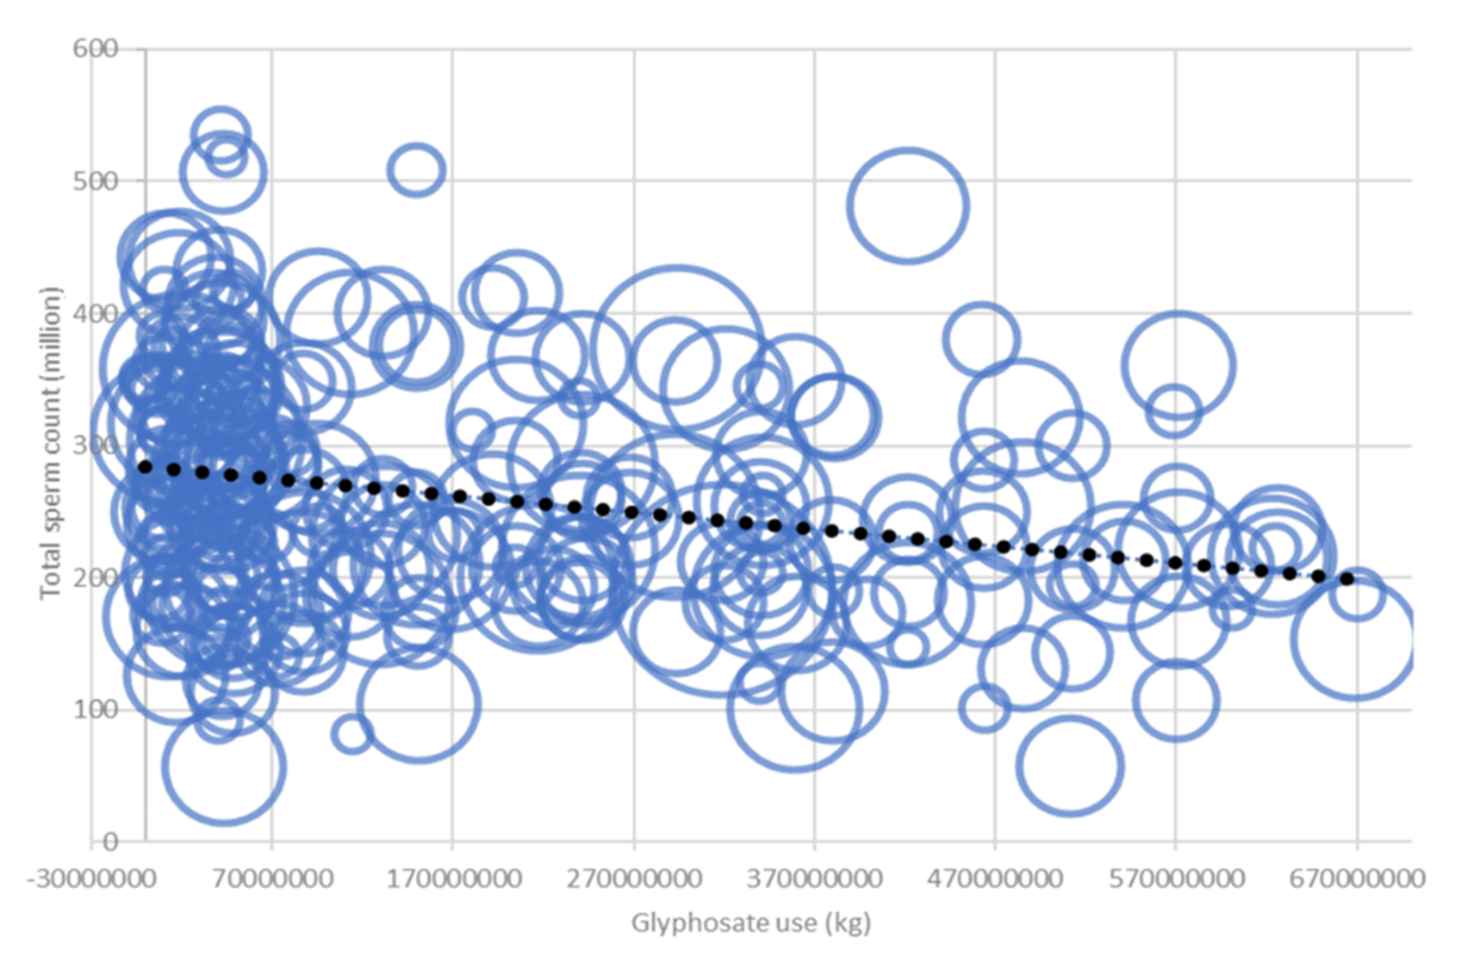
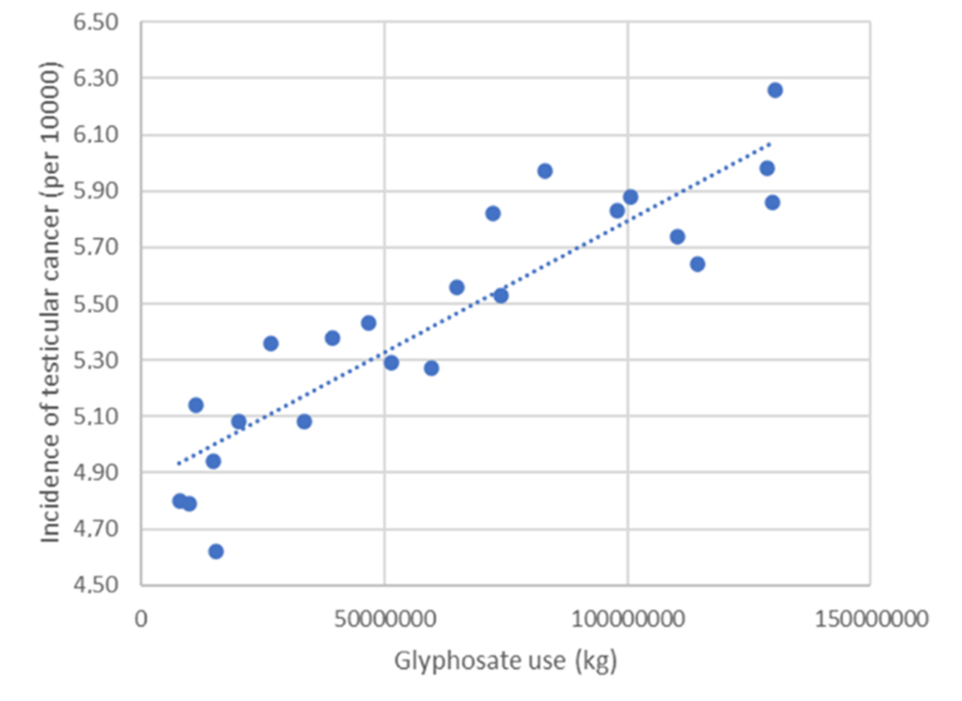
Glyphosate, Sperm Counts and Cancer*
sperm counts
testicular cancer
non-Hodgkin’s lymphoma
p < .000015
p < . 0.00000000039
p < 0.0053
Data were obtained from publicly available databases maintained by the US government
*B. Sopko et al., ACS Omega 2021; 6(23):14848–14857.
Notes:
2021/glyphosate/Czech_study_US_sperm_testicular_cancer.pdf

Slide 56
"Maternal urinary levels of glyphosate during pregnancy and anogenital distance in newborns in a US multicenter pregnancy cohort”*
Glyphosate in urine measured mid-pregnancy
Anogenital distance in girls was longer (more male typical) in association with higher urinary levels of glyphosate
An earlier study on rats found a similar result**
Glyphosate suppresses aromatase, which converts testosterone to estrogen
Confirms that glyphosate is an endocrine disruptor in humans
*Corina Lesseur et al. Environmental Pollution 2021; 280: 117002.
**Manservisi et al. Environmental Health 2019; 18: 15.
Notes:
2021/glyphosate/maternal_glyphosate_girls_anogenital_distance_testosterone.pdf

Slide 57
Longer anogenital distance in females is linked to infertility
Women in the highest tertile of anogenital distance had an 18-fold increased risk of having polycystic ovary syndrome (PCOS)*
Associated with irregular periods or no menstrual cycle, plus excess growth of hair
PCOS is the most common cause of female infertility, affecting as much as 20% of the world’s female population
Women with PCOS have an increased risk of being diagnosed with autism and of having progeny with autism**,***
*Yingchen Wu et al. Human Reproduction 2017 Apr 1;32(4):937-943.
**Maria Katsigianni et al. Molecular Psychiatry 2019 Dec;24(12):1787-1797**
***W Oostdijk et al. J Clin Endocrinol Metab 2015;100(4):E672-80.

Slide 58
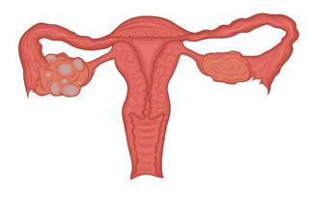
Polycystic Ovarian Syndrome (PCOS)*
PCOS is the most common reproductive disorder in the world
It affects 8-20% of women of reproductive age
40% of women with PCOS develop infertility
90-95% of women being treated in infertility clinics who have impaired ovulation suffer from PCOS
*medium.com/@drjasonfung/the-faces-of-polycystic-ovary-syndrome-pcos-4491740c69ae
Notes:
Glyphosate/G8_glycine_rich_domain_polycystic_kidney_disease_2006.pdf
Also:
PCOS.pdf

Slide 59
PCOS, Autism, PAPS Synthase and Sulfotransferase
PAPS synthase converts sulfate to the activated form of sulfate
It is essential for DHEA sulfate synthesis
Defective PAPS synthase → polycystic ovary syndrome (PCOS) in women, high androgen*
Glycine 270 → aspartate mutation
Aspartate, like glyphosate, is bulky and negatively charged
Glyphosate’s disruption of sulfotransferases also interferes with the synthesis of DHEA sulfate
*Cherskov et al. Translational Psychiatry 2018; 8:136.
Notes:
Book/sulfate/./PCOS_and_autism_2018.pdf
./PAPS_synthase_glycine_mutation_PCOS_WOW_2015.pdf
101 different PAPS synthases all had glycine at 270

Slide 60
How to Keep Your Family Healthy

Slide 61
Go Organic!

Slide 62
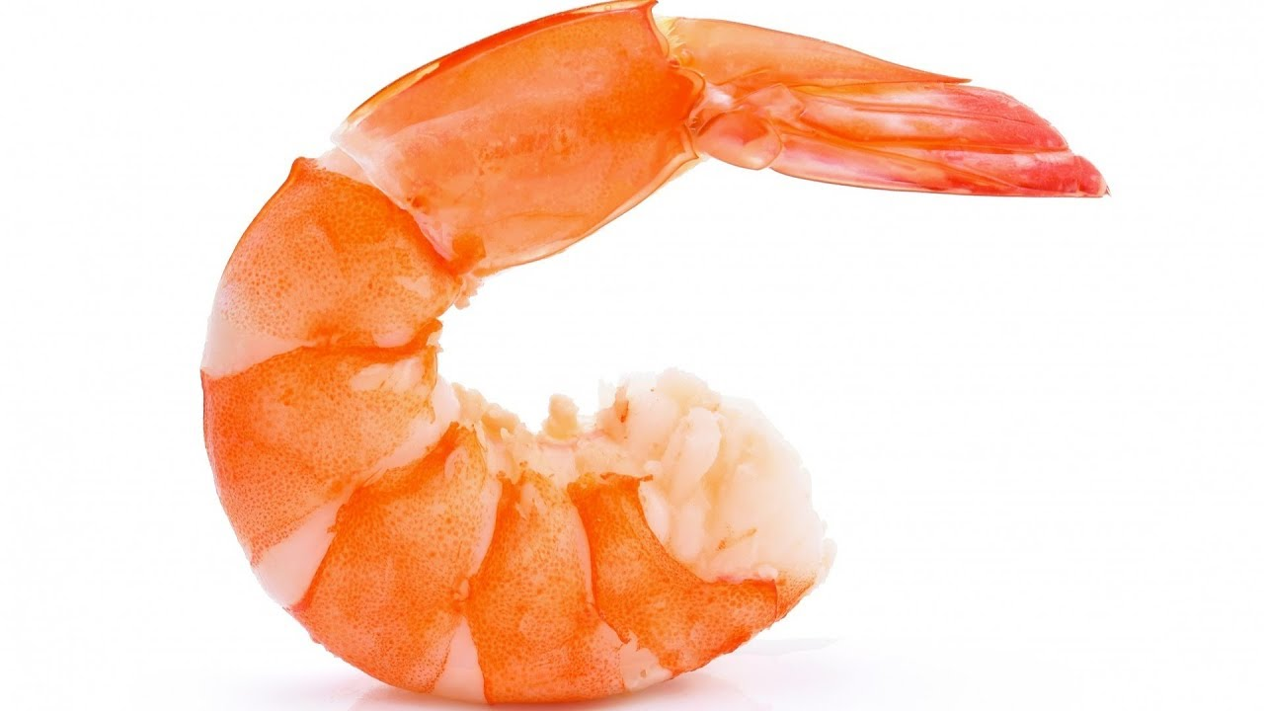
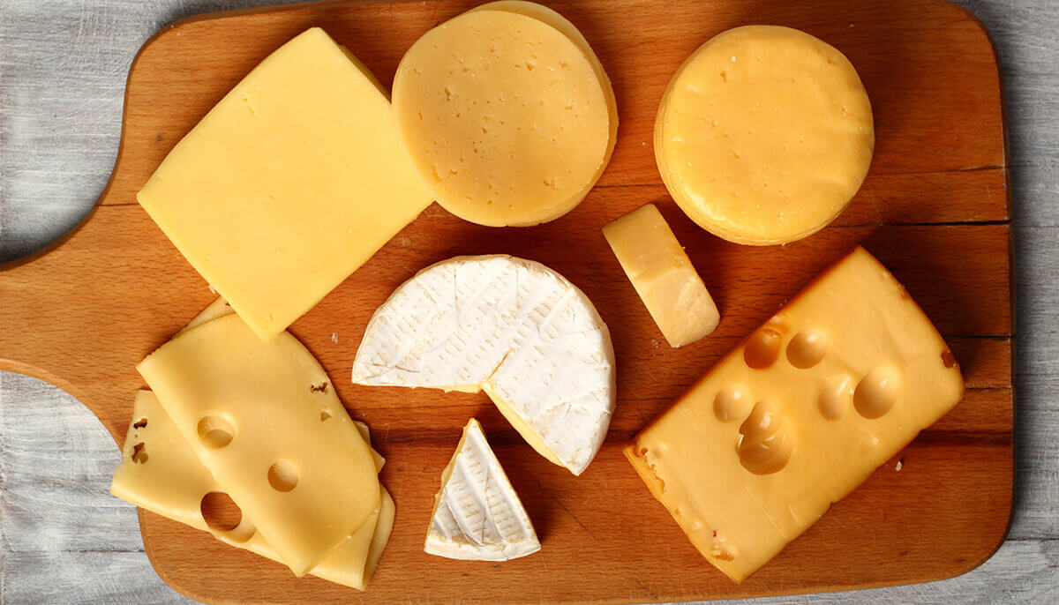
Eat Foods that are High in Cholesterol!

Slide 63
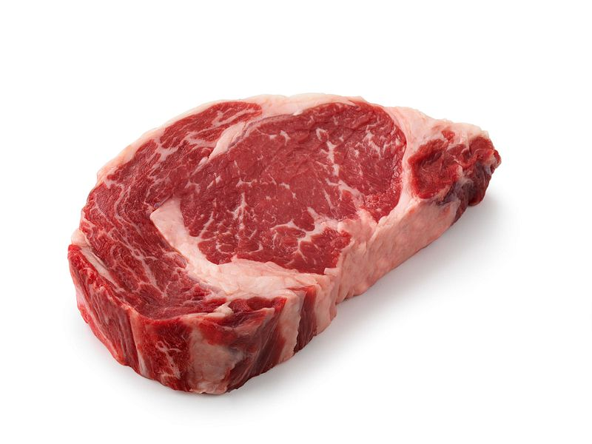
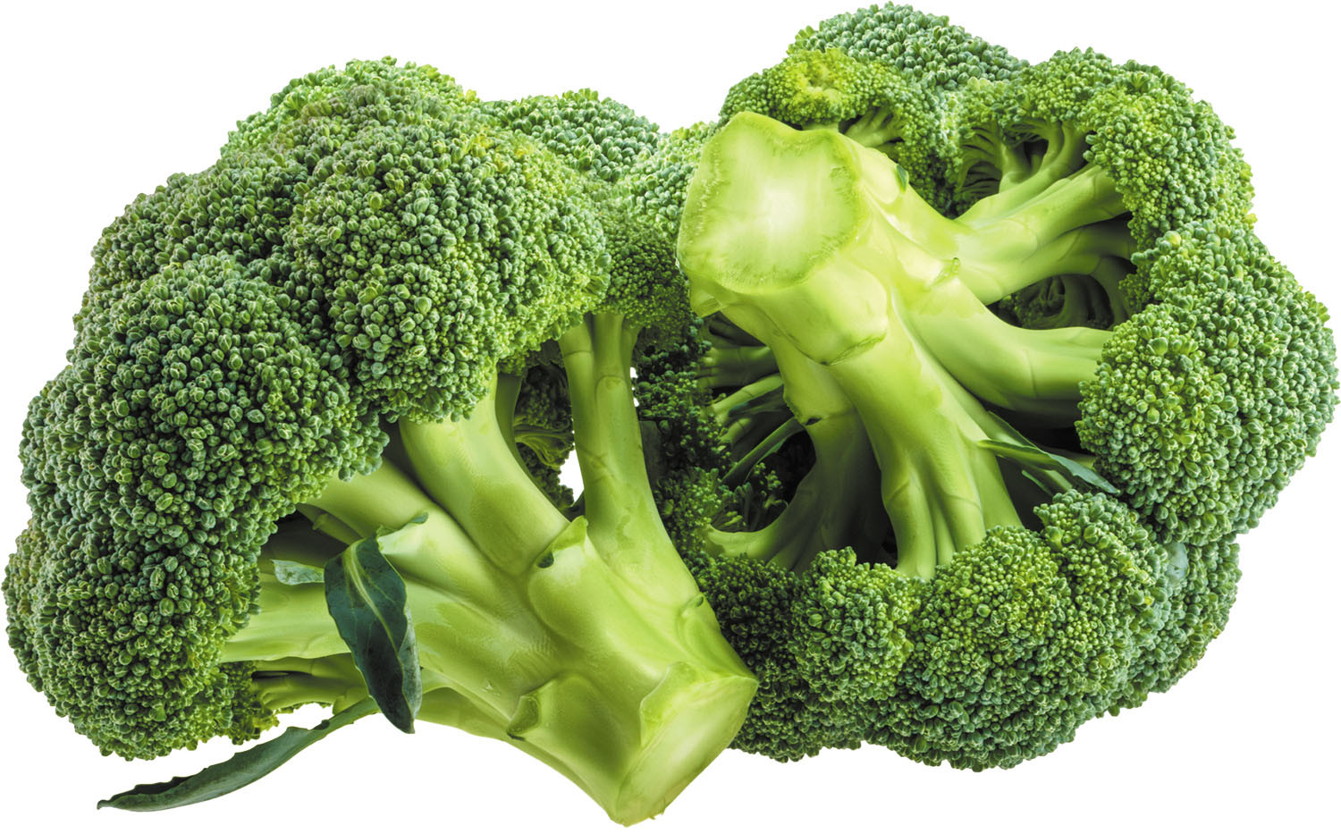
Eat Foods Containing Sulfur
Notes:
http://healthyeatingclub.com/info/books-phds/books/foodfacts/html/data/data5g.html

Slide 64
Supplemental Sources of Sulfur*
glucosamine sulfate
chondroitin sulfate
glutathione
N-acetylcysteine
alpha lipoic acid
taurine
DMSO, MSM
S-adenosylmethionine (SAMe)
Epsom salts (Mg-sulfate)
These can have many beneficial effects and are nearly nontoxic
My personal favorite is Epsom salt baths:
Magnesium sulfate uptake through the skin
*S Parcell, Alternative Medicine Review 7(1), 2002, 22-44
Notes:
Project/2014/Indianapolis./sulfur_in_human_nutrition_review.pdf

Slide 65
Let the Sun Shine In!

Slide 66
Summary
Sulfate plays many essential roles in the body
Sulfate dysbiosis is a core feature of autism
Heparan sulfate deficiency in the brain is associated with autism in both humans and mouse models
Sulfate synthesis and transfer depend critically on specific glycine residues in the enzymes that do this work
Glyphosate substitution for glycine would disrupt these enzymes
A low-grade encephalopathy characterizes autism, and it can induce a resupply of sulfate mediated by the amino acid taurine and the gut microbes
Glyphosate disrupts development in girls with a link to PCOS
PCOS is a major risk factor for female infertility and for autism
A high-sulfur certified organic diet and abundant sun exposure are keys to good health and longevity
Notes:
2022/glyphosate/glyphosate_mice_new_paper_2022.png

