Slide 1
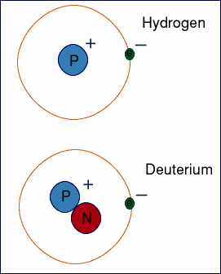
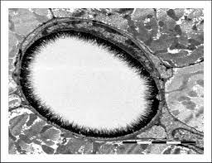
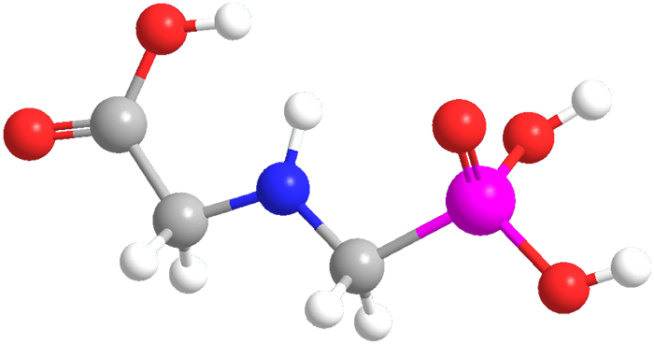
Deuterium, Glyphosate, and the Glycocalyx
Stephanie Seneff
CSAIL, MIT
Sunday, March 23, 2025

Slide 2


Slide 3
Outline
Introduction to Deuterium
Sulfate and the Glycocalyx
Glyphosate: a Pervasive Toxic Herbicide
Glyphosate Substitution for Glycine during Protein Synthesis
Colitis and Colon Cancer
Histamine Intolerance
Impaired Fatty Acid Metabolism
Summary

Slide 4
Introduction
to Deuterium

Slide 5
The Big Picture
Deuterium is a natural heavy isotope of hydrogen
  It is present in the blood at 5x the concentration of calcium
Deuterium breaks the ATPase pumps in the mitochondria, causing energy loss and generating reactive oxygen species (ROS)
Nicotinamide Adenine Dinucleotide (NAD) is a major carrier of deuterium-depleted hydrogen (as NADH)
Gut microbes synthesize deuterium-depleted nutrients for the host
Sulfation of mucins in the gut and the glycocalyx lining blood vessels supports trapping of deuterium in gelled water
Glyphosate suppresses many proteins involved in deuterium homeostasis

Slide 6

Deuterium = “Heavy” Hydrogen
Hydrogen has one proton and one electron
Deuterium has one proton, one electron and one neutron
  ~ Twice as heavy as hydrogen
  Present in ocean water at 155.8 ppm
  Has distinct physical and chemical properties compared to hydrogen
  Fats are low in deuterium compared to other foods
Deuterium management in the body involves trapping deuterium in gelled water outside the cell and invoking specialized enzymes that choose hydrogen over deuterium for their reaction in order to fuel the mitochondria with hydrogen rather than deuterium

Slide 7
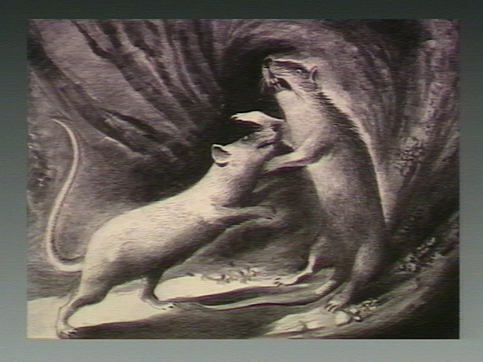
"The Pathologic Anatomy of Deuterium Intoxication"*
Mice received 5% dextrose solution in D₂O water
"Their appetites were voracious, and constant savage attacks upon each other were continually. in progress.”
“Eventually, at varying intervals, the animals became hypoactive, lethargic, and dramatically weak.”
“Death occurred in all cases within 6-10 days.”
*Paul Bachner et al. PNAS 1964; 51: 464-471.
Notes:
GregNigh/deuterium_intoxication_mice_1964.pdf

Slide 8
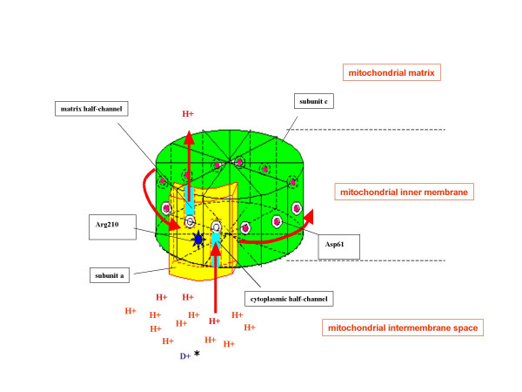
Deuterons Disrupt the
ATPase Pump*
There are around 15,000 ATPase pumps in a single mitochondrion
Proton force rotates the ATPase pumps at a rate of 1,000 cycles per second
Deuterons resist letting go and stall the pump, producing a stutter
Deuterons also disrupt proton-coupled electron transport (PCET) which is based on proton tunneling
This causes decreased production of ATP and increased production of reactive oxygen species, damaging the pumps
*Abdullah Olgun. Theoretical Biology and Medical Modelling 2007, 4: 9.
Notes:
LaszloBoros/2021/Olgun_deuterons_in_ATPase_pumps_WOW_2007.pdf

Slide 9
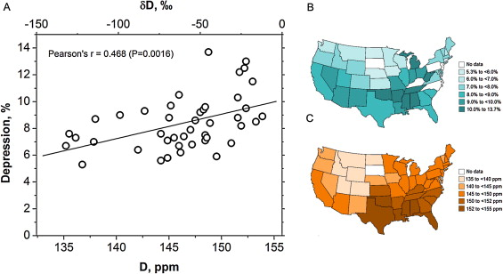
Deuterium in Water and Depression*
Prevalence of Depression
Deuterium levels in tap water
*Tatyana Strekalova et al. Behavioural Brain Research 277 (2015) 237–244.
Notes:
2020/GregNigh/deuterium_depression_US_water_2015.pdf
Fig. 1. Depression rates and deuterium content of tap water. (A) Correlation between reported rates of major depressive disorder in US states and content of deuterium in tap water in the USA. (B) The reported prevalence of individuals with depression in among adults aged ≥18 years in each US state [Centers for Disease Control and Prevention. Mental illness surveillance among adults in the United States. MMWR 2011;60 (Suppl):1–30]. (C) Geographical distribution of average deuterium content in the tap water in the continental USA from samples collected from each state for 2004–2013.

Slide 10
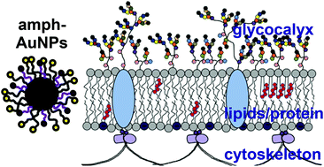
Sulfate’s Critical Role for Maintaining
Exclusion Zone Water*
The glycocalyx which lines blood vessels releases protons (H+) and creates a battery
(Hypothesis) The glycocalyx traps deuterium and extrudes D-depleted protons
  HDO ionizes mainly into H+ and OD-
Sulfate is crucial for maintaining gelled water in the glycocalyx
The sulfomucins lining the epithelium in the gut serve a similar purpose
Sulfated glycosaminoglycans (GAGs) become depleted in sulfate when chronically exposed to glyphosate
*S Seneff and G Nigh. Water 2019; 11: 22-42.
https://waterjournal.org/current-volume/seneff-summary/
Notes:
attached/SeneffNighSulfateWater2019.pdf

Slide 11

Deuterium Fractionation is Critical*
deupleted vascular water
deuterium-rich gelled water
endothelial glycocalyx
mitochondria
endothelial cell
deupleted metabolic water
*S. Seneff. Is Deuterium Fractionation a Major Controlling Factor in Human Metabolism and Cancer? An Essential Role for Proline? Preprints 2024, 2024061284.
Notes:
Graphical Abstract

Slide 12
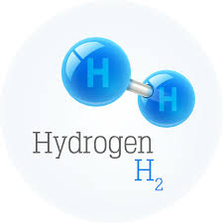
Hydrogen gas produced by microbes anaerobically from glucose or formate is depleted down to 30 ppm deuterium*
“Mass spectrometric analyses of the hydrogen produced by growing cells showed a deuterium content of about 30 ppm. (i.e., depleted by a factor of 4.4 to 5.1…).”
The same was true whether glucose or formate was the substrate.
The intracellular water and cellular hydrogen were not significantly depleted in deuterium.
*MI Krichevsky et al. JBC 1961 236(9): 2520-2525.
Notes:
Where?
csail/2020/lLaszlo_Boros/Krichevsky_1961_formate_formation_produces_deuterium_depleted_hydrogen.pdf

Slide 13
What happens to the hydrogen gas?
Hydrogen-producing bacteria
H₂
Sulfate-reducing bacteria
Methanogens
Acetogenic bacteria
Methane thiol
CH₃SH
Methane
CH₄
Acetate
CH₃COOH
Methionine
CO₂, H₂O, NADH
Acetyl-CoA
Hydrogen Cycling
Notes:
https://www.fixyourgut.com/sibo-methane-or-hydrogen-dominant-what-is-the-difference/

Slide 14

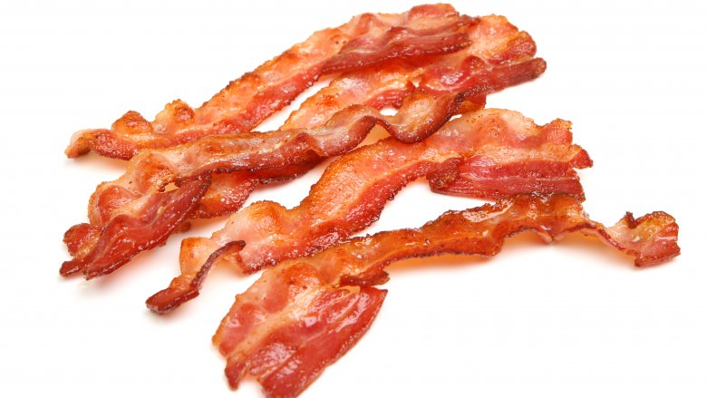
Ketogenic Diet and DDW: Health Benefits*
Deuterium depleted water (DDW) is essential for mitochondria to function properly
People whose water supply is naturally depleted in deuterium are healthier
Deuterium depletion maintains strong hydrogen bond networks in DNA (keeps it stable)
DDW inhibits tumor progression
A ketogenic diet is a deuterium-depleted diet
Glacial water is naturally depleted in deuterium because ice traps deuterium
*Laszlo G Boros et al. Medical Hypotheses 2016; 87: 69-74.
Notes:
Chemistry/Laszlo_Boros_Med_Hyp_deuterium_depleting_water_2016.pdf

Slide 15




Kettle Pond
Fog
Waterfall
Ocean Waves

Slide 16
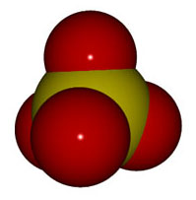
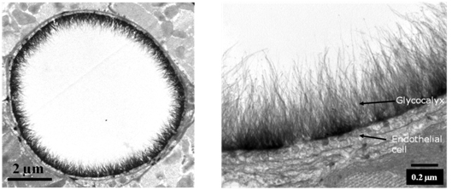
Sulfate and the Glycocalyx
Expanded View
Artery
Cross Section

Slide 17
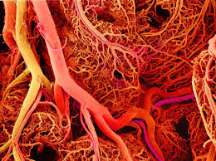
It’s All About the Blood
We are 2/3 water by mass and 99% by molecule count
Most of the water in the body is gelled
The big exception is the flowing blood!
Blood delivers nutrients to and removes waste from all the tissues
Gelled water lines the vessel wall and provides slick, frictionless passage of red blood cells through the capillaries
Sulfate keeps the water gelled along the border
Sulfate transport is problematic

Slide 18
Sulfate is Crucial to Maintain Structured Water
Most cells in the body maintain an extracellular matrix formed from proteins with complex sugar chains attached to them
Sulfate ions bind to the sugars at strategic locations in an irregular but non-random pattern
The “glycocalyx” that lines the walls of all blood vessels is formed from these sugar-protein complexes
The sulfomucins lining the interior of the gut barrier are another important example

Slide 19
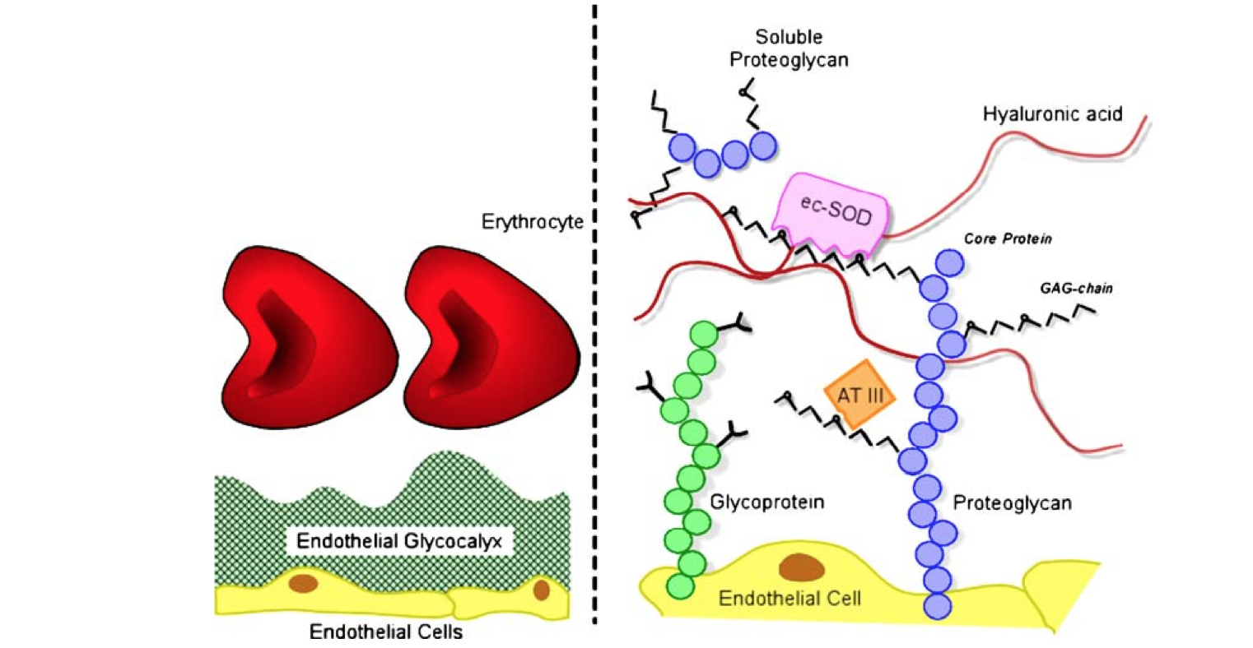
Endothelial Glycocalyx Schematic*
“GAG chain”:
GlycosAminoGlycan = Sugar-Amino-Chain
*S Reitsma et al., Pflugers Arch - Eur J Physiol (2007) 454:345–359
Notes:
treasures/endothelial_glycocalyx_review.pdf
Fig. 1 Schematic representation of the endothelial glycocalyx, showing its main components. Left: The endothelial glycocalyx can be observed in vivo as a red blood cell exclusion zone, located on the luminal side of the vascular endothelium. It consists of membrane- bound and soluble molecules. Right: Components of the endothelial glycocalyx. Bound to the endothelial membrane are proteoglycans, with long unbranched glycosaminoglycan side-chains (GAG-chain) and glycoproteins, with short branched carbohydrate side-chains. Incorporated in and on top of this grid are plasma and endothelium
derived soluble components, including hyaluronic acid and other soluble proteoglycans (e.g., thrombomodulin) and various proteins, such as extracellular superoxide dismutase (ec-SOD) and antithrombin III (AT III). Together, these components form the endothelial glycocalyx that functions as a barrier between blood plasma and the endothelium and exerts various roles in plasma and vessel wall homeostasis. Note that this figure is not drawn to scale; its purpose is to illustrate glycocalyx composition

Slide 20
Endothelial Glycocalyx Schematic*
Gel layer prevents attack of vessel wall by blood sugars and oxidizing agents.
Cellular signaling mechanisms (e.g., antioxidant ec-SOD and clot-protective AT III) depend on sulfates to work.
*S Reitsma et al., Pflugers Arch - Eur J Physiol (2007) 454:345–359
Notes:
treasures/endothelial_glycocalyx_review.pdf
Fig. 1 Schematic representation of the endothelial glycocalyx, showing its main components. Left: The endothelial glycocalyx can be observed in vivo as a red blood cell exclusion zone, located on the luminal side of the vascular endothelium. It consists of membrane- bound and soluble molecules. Right: Components of the endothelial glycocalyx. Bound to the endothelial membrane are proteoglycans, with long unbranched glycosaminoglycan side-chains (GAG-chain) and glycoproteins, with short branched carbohydrate side-chains. Incorporated in and on top of this grid are plasma and endothelium
derived soluble components, including hyaluronic acid and other soluble proteoglycans (e.g., thrombomodulin) and various proteins, such as extracellular superoxide dismutase (ec-SOD) and antithrombin III (AT III). Together, these components form the endothelial glycocalyx that functions as a barrier between blood plasma and the endothelium and exerts various roles in plasma and vessel wall homeostasis. Note that this figure is not drawn to scale; its purpose is to illustrate glycocalyx composition

Slide 21
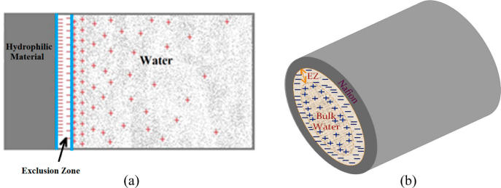
Exclusion Zone: Model of Capillary*
Battery!
Blood
Sulfated GAGs
Endothelium
*Figure 9, M. Rohani and G.H. Pollack, Langmuir 2013, 29, 6556−6561
Notes:
Langmuir_Pollack_flow_through_tube_protons_gather_2013.pdf
Images/Pollack1.jpg
Figure 9. (a) Distribution of charge in the exclusion zone and water beyond the exclusion zone as shown by electrical potential measurements and pH- sensitive dye studies. Protons spread in bulk water, although some cling to the negatively charged EZ. (b) Disposition of charge anticipated in a tubular configuration.

Slide 22
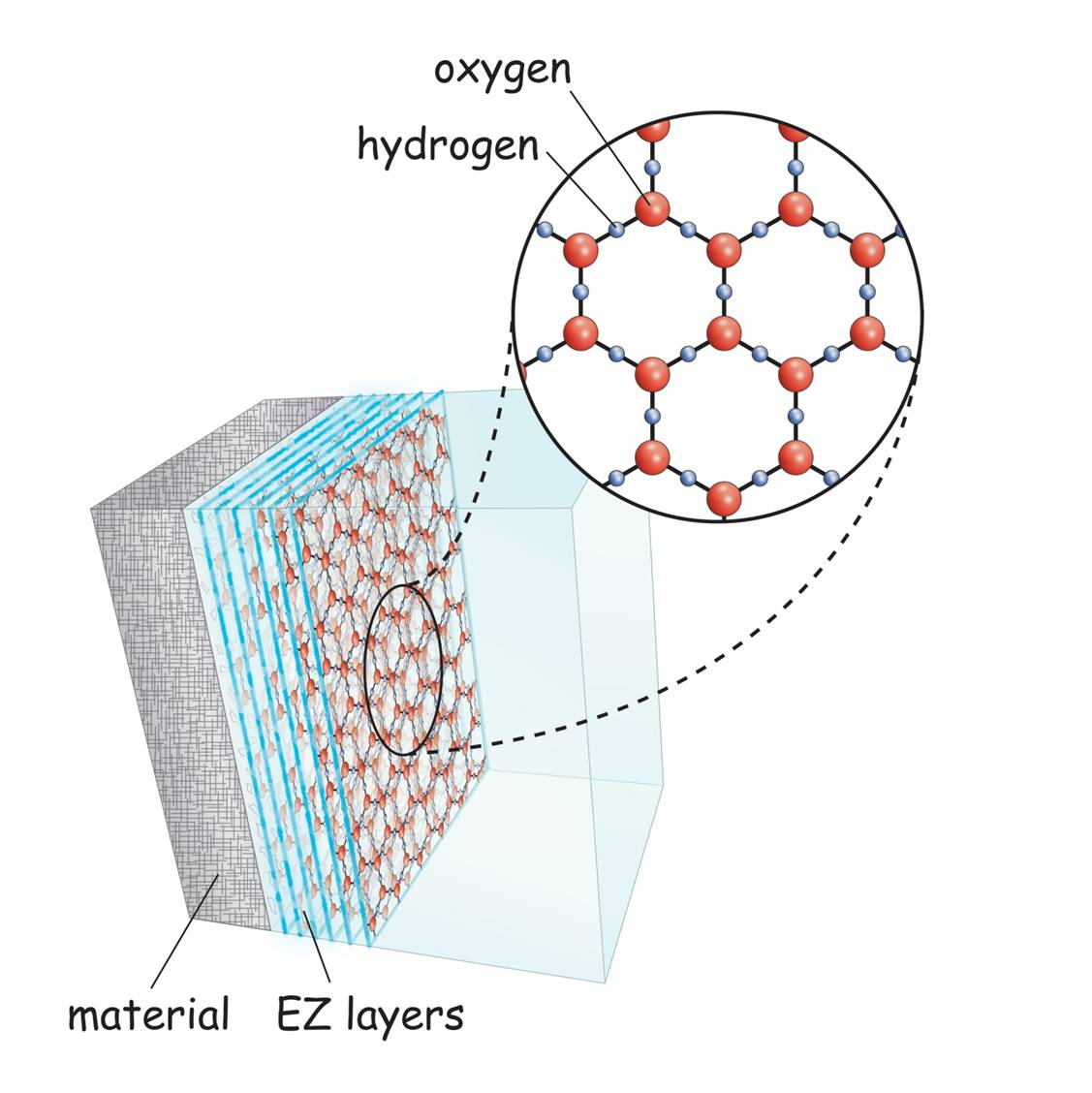
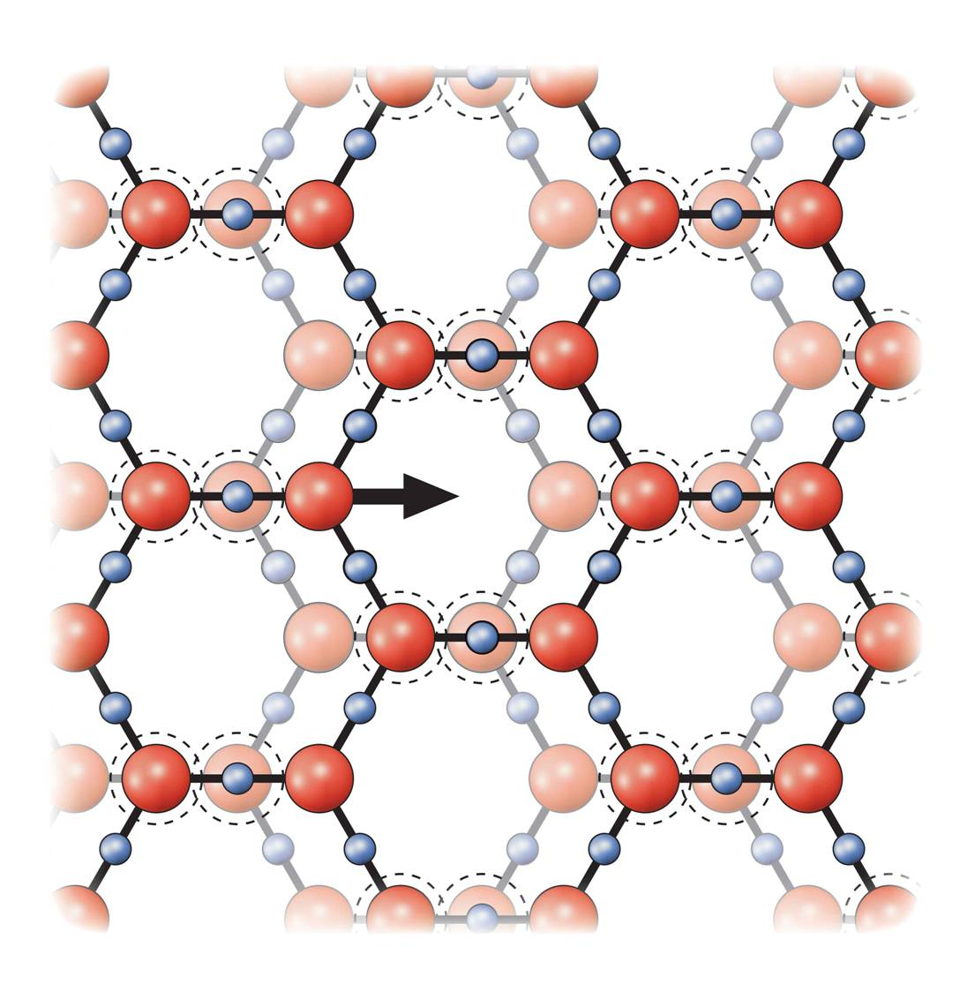
Exclusion Zone*
endothelial cells
+
+
+
Protons collect at the interface between
The exclusion zone and the bulk water in the blood
Negatively
Charged
Exclusion Zone
+
+
Unstructured water in blood
*http://doublehelixwater.eu/understanding-water-contents/exclusion-zone-form/

Slide 23
Exclusion Zone*
endothelial cells
the surface energy of water is a non-metabolic "fuel" source for the molecular motors of our bodies
+
+
+
Protons collect at the interface between
The exclusion zone and the bulk water in the blood
Negatively
Charged
Exclusion Zone
+
+
Unstructured water in blood
*http://doublehelixwater.eu/understanding-water-contents/exclusion-zone-form/

Slide 24
Glyphosate:
A Pervasive Toxic Herbicide

Slide 25
“Glyphosate Now the Most-Used Agricultural Chemical Ever”*
Glyphosate usage has increased 50-fold since 1996, when GMO glyphosate-resistant crops were introduced in the US.
Today, 50 times more glyphosate is allowed by the EPA on corn grain than in 1996
Half of the American farmers' fields have weeds that are resistant to glyphosate
New GMO crops offer dual resistance to glyphosate & 2,4-D → Enlist Duo
*Douglas Main, Feb 2, 2016 Newsweekwww.newsweek.com/
glyphosate-now-most-used-agricultural-chemical-ever-422419
Notes:
./Newsweek_on_glyphosate_overuse.text

Slide 26
Is Glyphosate Nontoxic?
Monsanto has argued that glyphosate is harmless to humans because our cells don’t have the shikimate biological pathway which is the pathway glyphosate disrupts to kill plants
However, our gut bacteria DO have this pathway
  We depend upon them to supply us with essential amino acids produced through that pathway, and with many other nutrients such as vitamins and short chain fatty acids
Other ingredients in Roundup greatly increase glyphosate’s toxic effects
Insidious effects of glyphosate accumulate over time
  Most studies are too short to detect damage
Three successful lawsuits claiming that glyphosate caused non-Hodgkin’s lymphoma are bringing public awareness to glyphosate’s toxicity

Slide 27
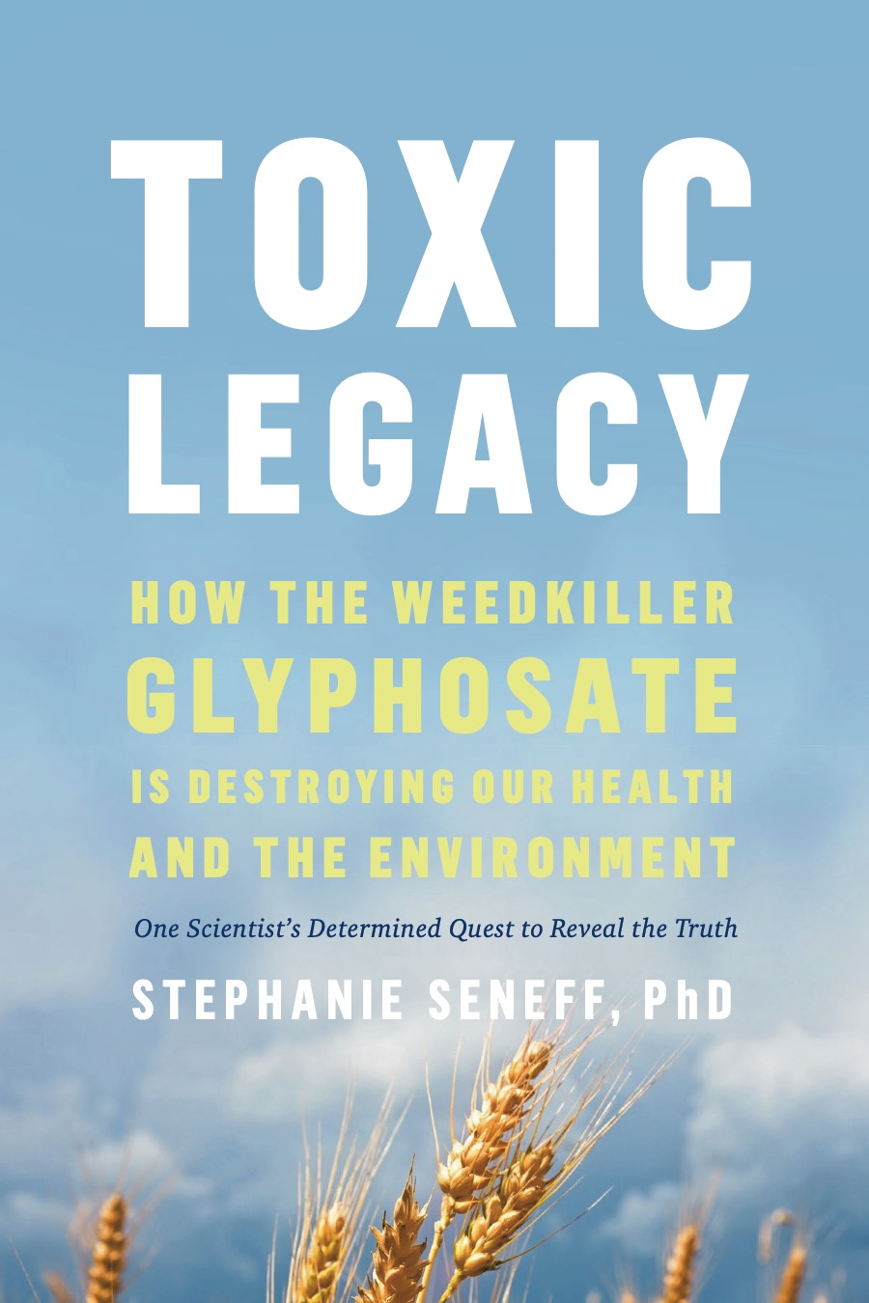
My Book on Glyphosate
Released by Chelsea Green in July 2021
Presents extensive data on glyphosate toxicity to animals and humans
Shows how glyphosate interferes with sulfate homeostasis
Argues that glyphosate is insidiously, cumulatively toxic through its diabolical insertion into proteins by mistake in place of the coding amino acid glycine
  This unique feature explains why it is causal in so many diseases
This book was selected by Kirkus Reviews as one of the top 100 non-fiction books of 2021

Slide 28
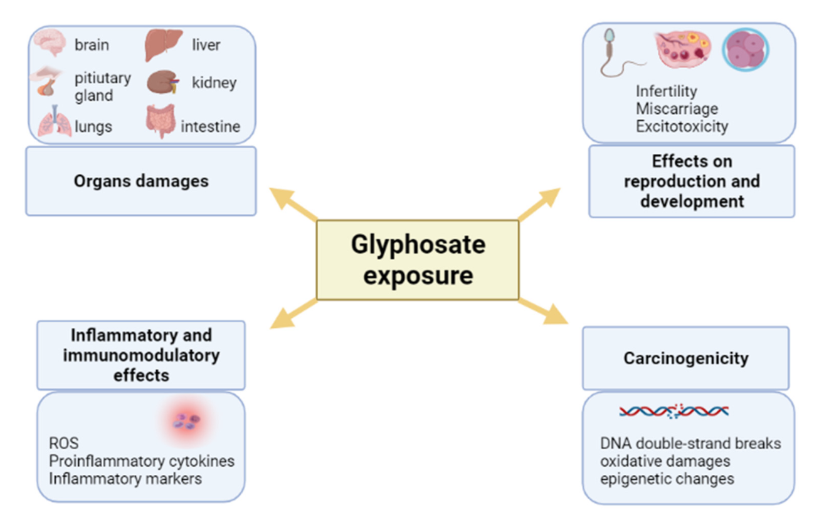
Glyphosate Toxicity: Summary Graphic*
*M Marino et al. Int J Mol Sci. 2021 Nov 22;22(22):12606.
Notes:
2025/glyphosate/Pleiotropic Outcomes of Glyphosate Exposure- From Organ Damage to Effects on Inflammation.pdf

Slide 29
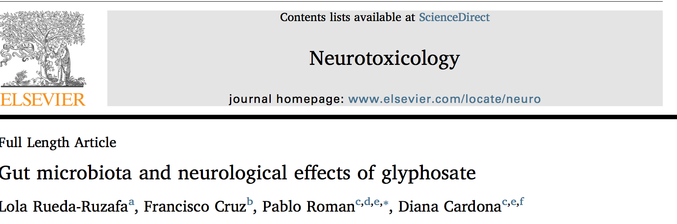
Neurotoxicology 2019; 75:1-8.
“In this work, we state a possible link between Gly[phosate]-induced dysbiosis and cognitive and motor aggravations in neurodegenerative and neurodevelopmental pathologies, such as autism spectrum disorder (ASD). Hence, we review the negative impact that Gly-induced dysbiosis may have on depression/anxiety, autism, Alzheimer’s and Parkinson’s diseases.”

Slide 30
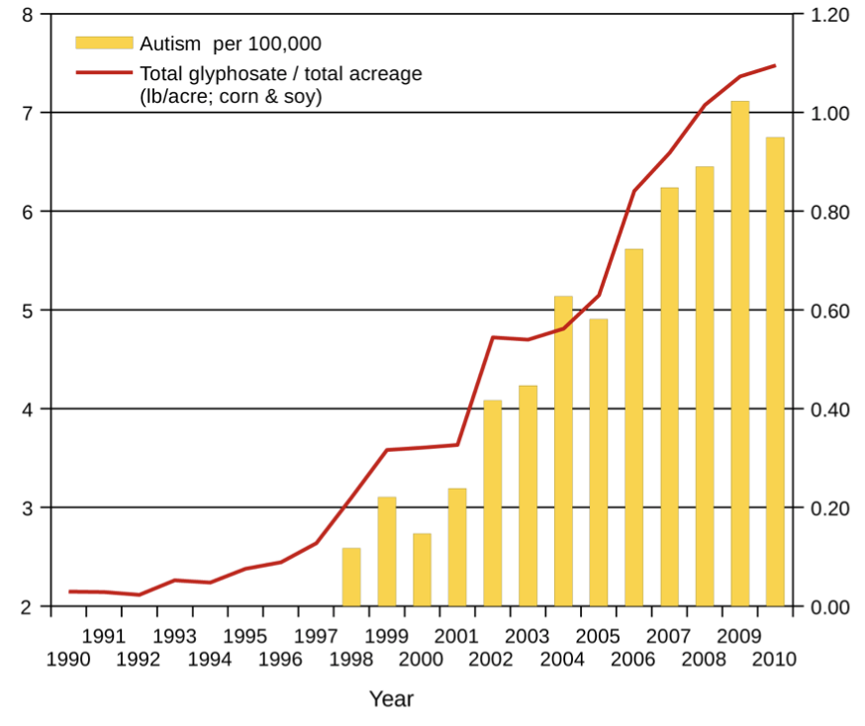
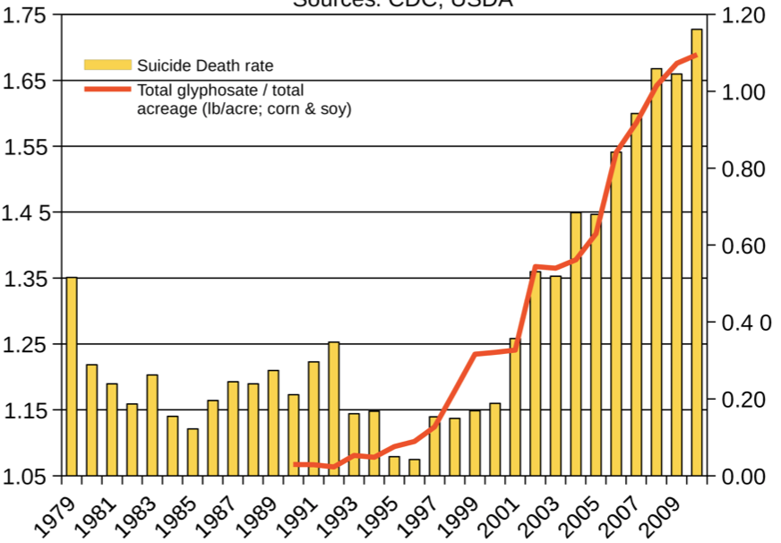
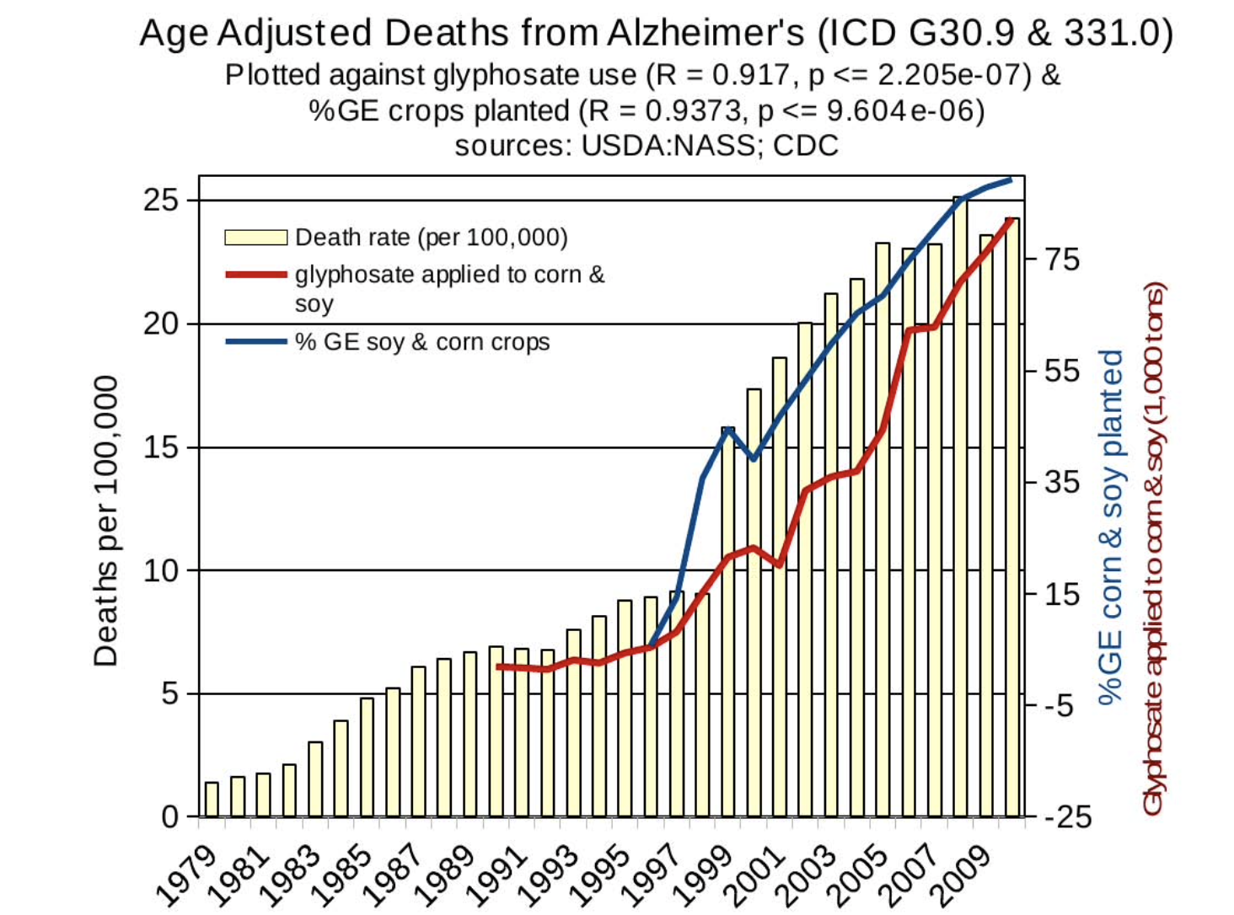
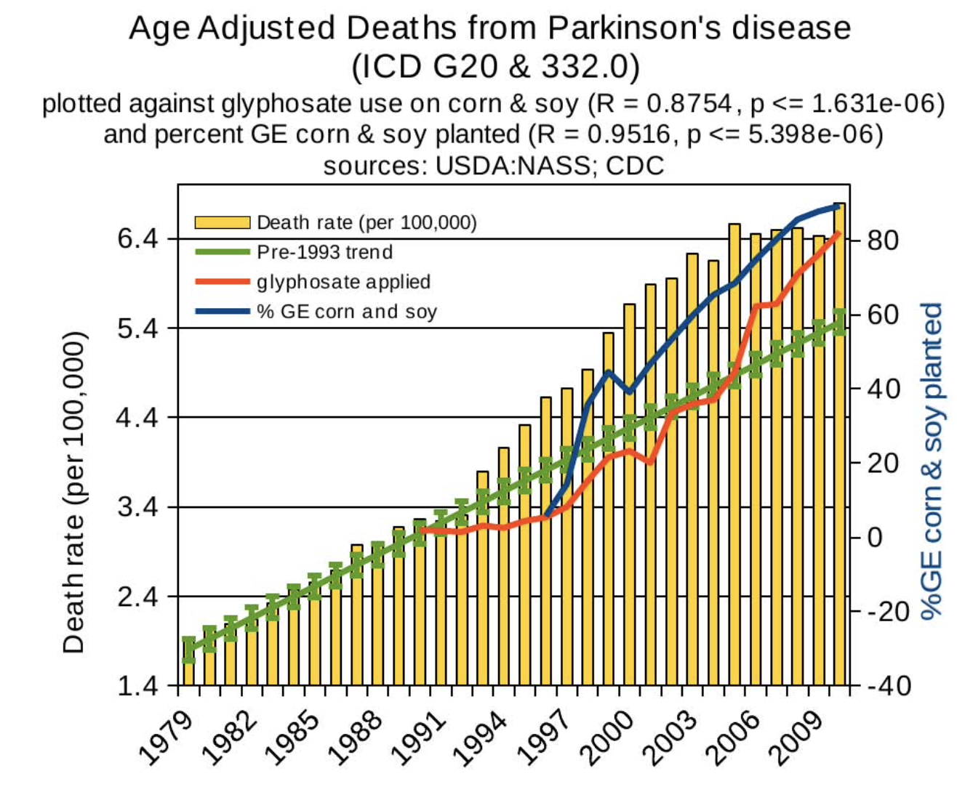
Autism
Death by Suicide
Parkinson’s disease
Alzheimer’s
Notes:
Hospital discharge diagnoses per 100,000

Slide 31
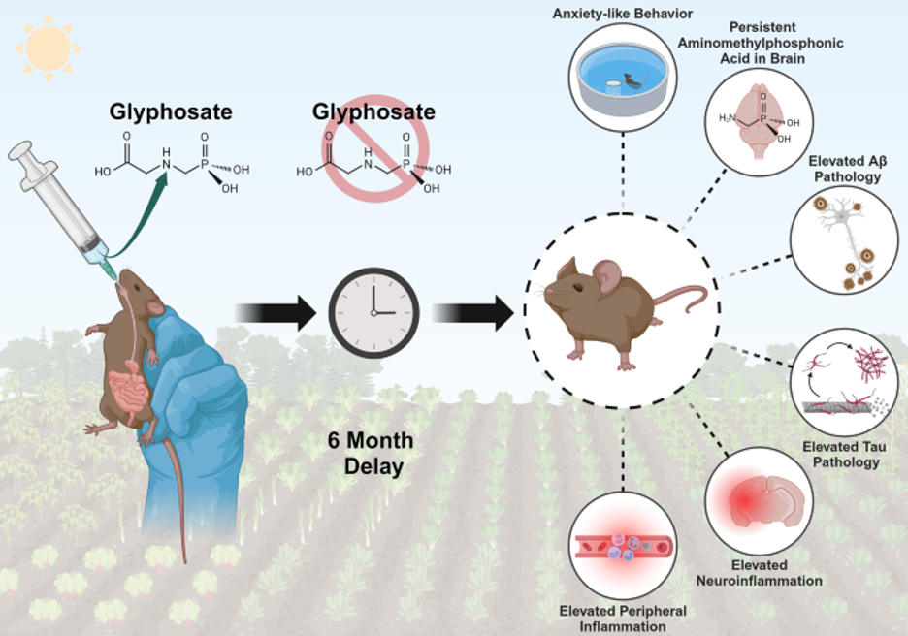
Glyphosate causes Alzheimer’s in mice*
A newly published paper (2024) shows that glyphosate induces neuroinflammation in the brain and an increase in phosphorylated tau and amyloid beta, indicators of Alzheimer’s disease
*SK Bartholomew et al., J Neuroinflammation 21, 316 (2024).
Notes:
2025/glyphosate/glyphosate_Alzheimers_like_mice_2024.pdf
2025/Bartholomew_glyphosate_Alzheimers_mice_2024.docx

Slide 32
Glyphosate Impairs NAD(P)(H) Pathways*
NAD(P)(H) is a major carrier of deuterium-depleted protons
NAD(P)(H) is derived from tryptophan
  Tryptophan is a major product of the shikimate pathway, blocked by glyphosate in plants and microbes
Glyphosate inhibits NADH dehydrogenase, which directly supplies deuterium-depleted protons to the ATPase pumps in the mitochondria
Glyphosate inhibits glucose 6 phosphate dehydrogenase (G6PD), which restores NADPH from NADP+
Glyphosate inhibits succinate dehydrogenase, the only enzyme that participates in both the citric acid cycle and oxidative phosphorylation in the mitochondria
  Succinate dehydrogenase deficiency is linked to many cancers
*S Seneff, Toxic Legacy, Chelsea Green Publishers, July 2021.

Slide 33
Glyphosate Substitution for Glycine during Protein Synthesis

Slide 34
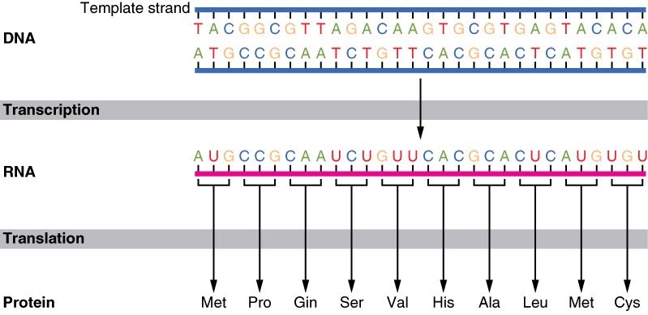


The Basics of Protein Synthesis
Glyphosate
Glycine

Slide 35
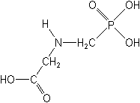
What if Glyphosate could Insert itself into Proteins during Synthesis???
glyphosate
Extra Stuff!
Code for Glycine
Glyphosate
GGC
Glycine
mRNA
. . .
. . .
Glyphosate
Alanine
Proline
-- Any proteins with conserved glycine residues are likely to be affected in a major way

Slide 36
Extra Piece Sticks Out at Active Site
Substrate no longer fits in active site
Active Site
Extra Stuff
Glyphosate
Alanine
Proline
glycine
Peptide chain

Slide 37
Extra Piece Sticks Out at Active Site
Substrate no longer fits in active site
This explains how glyphosate disrupts EPSPS in the shikimate pathway: Multiple bacteria have developed resistance by replacing active site glycine with alanine and this is the basis for GMO Roundup Ready crops*
Active Site
Extra Stuff
Glyphosate
Alanine
Proline
glycine
Peptide chain
*T Funke et al., Molecular basis for the herbicide resistance of
Roundup Ready crops. PNAS 2006;103(35):13010-13015.
Notes:
where????

Slide 38
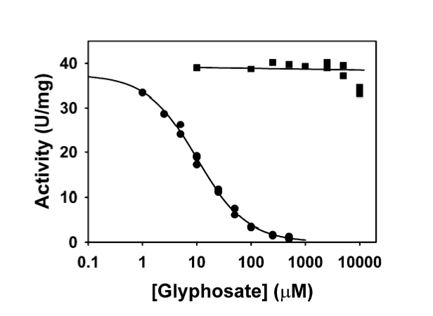
Inhibition of EPSPS by glyphosate:
Resistant E coli mutant*
Mutant with alanine substituted for glycine 96
Wild type with glycine 96
*Figure 3, S Eschenburg et al. Planta 2002;216:129-135.

Slide 39
Only Glyphosate Works!*
“More than 1,000 analogs of glyphosate have been produced and tested for inhibition of EPSP synthase, but minor structural alterations typically resulted in dramatically reduced potency, and no compound superior to glyphosate was identified.”
Hypothesis:
These other molecules failed to work as an amino acid analogue of glycine, because they were not amino acids
*T Funke et al. PNAS 2006; 103(35): 13010-13015.

Slide 40

Quote from Monsanto Study (1989)*
Study exposed bluegill sunfish to carbon-14 radiolabelled glyphosate
Measured radiolabel in tissues greatly exceeded measured glyphosate levels
Proteolysis recovered more glyphosate
  20% yield → 70% yield
"Proteinase K hydrolyses proteins to amino acids and small oligopeptides, suggesting that a significant portion of the 14C activity residing in the bluegill sunfish tissue was tightly associated with or incorporated into protein.”
*WP Ridley and KA Chott. Monsanto unpublished study. August 1989.

Slide 41
Some Predicted Consequences*
Impaired cholesterol sulfate synthesis → heart disease
Autism
Impaired collagen → osteoarthritis
Steatohepatitis (fatty liver disease)
Obesity and adrenal insufficiency
Hypothyroidism
Impaired iron homeostasis and kidney failure
Insulin resistance and diabetes
Cancer
*A. Samsel and S. Seneff. Journal of Biological Physics and Chemistry 2016;16:9-46.

Slide 42
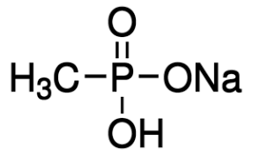
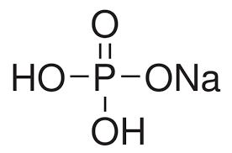
Hypothesis: Glyphosate Disrupts Proteins that Bind Phosphate
Glyphosate is a glycine molecule with a methylphosphonate unit attached to the nitrogen atom
Glyphosate kills weeds by suppressing EPSP synthase in the shikimate pathway
Glyphosate blocks EPSP synthase binding to the phosphate in PEP
The binding site for PEP has a highly conserved glycine residue
Sodium Methyl-
phosphonate
Sodium Phosphate
Notes:
From 2021/Toronto/BobMiller_shortened.pptx

Slide 43
Hypothesis: Glyphosate Disrupts Proteins that Bind Phosphate
Glyphosate is a glycine molecule with a methylphosphonate unit attached to the nitrogen atom
Glyphosate kills weeds by suppressing EPSP synthase in the shikimate pathway
Glyphosate blocks EPSP synthase binding to the phosphate in PEP
The binding site for PEP has a highly conserved glycine residue
Many enzymes that glyphosate has been shown to suppress contain a “glyphosate susceptibility motif”: they bind phosphate at a site where there is at least one highly conserved glycine residue
Sodium Methyl-
phosphonate
Sodium Phosphate
Notes:
From 2021/Toronto/BobMiller_shortened.pptx

Slide 44
Does Glyphosate Disrupt FAD Binding in Dehydrogenases?
Dehydrogenases play a major role in supplying deupleted protons to the mitochondrial ATPase pumps
Many dehydrogenases are flavoproteins. They bind flavin-adenine dinucleotide (FAD) at a site with at least one highly conserved glycine residue. FAD facilitates the transfer of protons and electrons
A region near the carboxyl-terminal segment of FAD-binding dehydrogenases contains a highly conserved glycine-aspartate pair
Mutation of Gly-478 to alanine in a Bacillus NADH dehydrogenase caused complete loss of activity, due to loss of binding capacity to FAD*
Gly-478 is preceded by alanine, a small amino acid, leaving room for glyphosate's methylphosphonate unit
*Masato Shiraki and Noriyuki Kayama. Current Microbiology 2003; 46: 432–434.

Slide 45
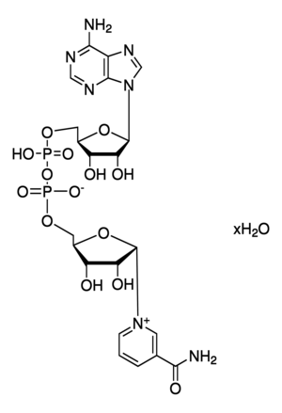
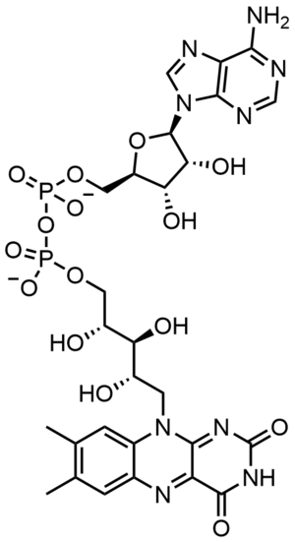
NAD and FAD
Adenine
Adenine
Phosphate
Phosphate
These dinucleotides are major carriers of deupleted protons and they support proton tunneling in enzymes
Phosphate
Phosphate
Flavin
Nicotinamide
NAD
FAD

Slide 46
Colitis and Colon Cancer

Slide 47
The Big Picture
Sulfate homeostasis involves three critical enzymes:
  Sulfite oxidase converts sulfite to sulfate
  Phosphoadenosyl phosphosulfate (PAPS) is the universal sulfate donor
  PAPS synthase is the enzyme that synthesizes PAPS from sulfate and ATP
  Sulfotransferases transfer sulfate from PAPS to many other molecules
Glyphosate likely suppresses all of them
Decreased PAPSS expression is associated with colon cancer
In a mouse model of colitis, PAPSS deficiency was associated with inflammation in the gut and a leaky gut barrier
Glyphosate usage on core crops over time correlates strongly with inflammatory bowel disease

Slide 48
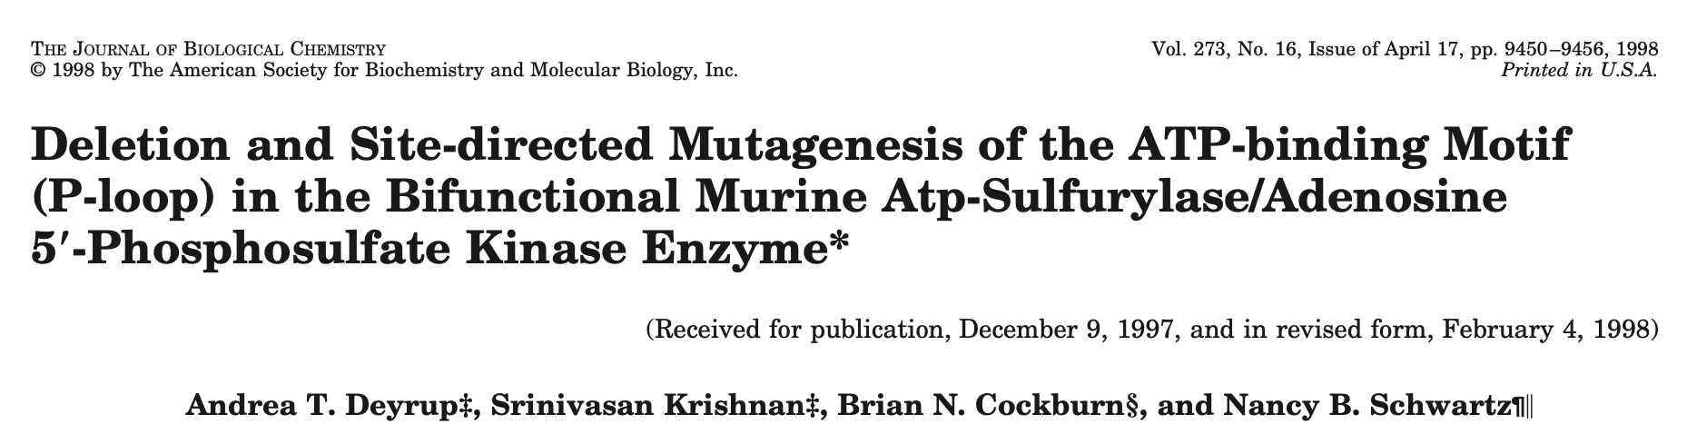
Phosphadenosyl phosphosulfate (PAPS) is the universal sulfate donor
PAPS synthase carries out two catalytic reactions: it is both a sulfurylase and a kinase
It binds to two ATP molecules (three phosphates in each)
  Its P-loop is a common motif found in proteins that bind to ATP and GTP
The sequence "GLSGAGKT" from 59 to 66 in the P loop of human PAPS synthase matches the GxxGxGKT motif characteristic of binding to ATP
  When G59 (the first glycine) is mutated to alanine, sulfurylase activity is reduced to 8% residual activity
  Substituting alanine for G64 reduced kinase activity down to only 6% residual activity

Slide 49
Sulfite Oxidase and the Sulfotransferases
Sulfite oxidase (SuOx)*
Depends on molybdenum as catalyst (glyphosate chelation could make it unavailable)
Changing glycine at residue 473 with aspartate destroys enzyme activity
  Leads to severe impairment in ability to bind sulfite and 5-fold reduction in catalysis
  Aspartate has similar properties as glyphosate, being bulky and negatively charged
Defective SuOx leads to severe birth defects and neurological problems resulting in early death
The sulfotransferases**
GxxGxxK motif required for binding PAPS (activated sulfate)
*H.L. Wilson et al., Biochemistry 2006, 45, 2149-2160 2149.
**K. Komatsu et al., Biochemi and Biophys Res Comm 1994;204(3): 1178-1185.
Notes:
2016/Anthony/conserved_glycines_sulfotransferase_1994_WOW.pdf
./G473D_mutation_sulfite_oxidase_destroys_it_2006.pdf

Slide 50
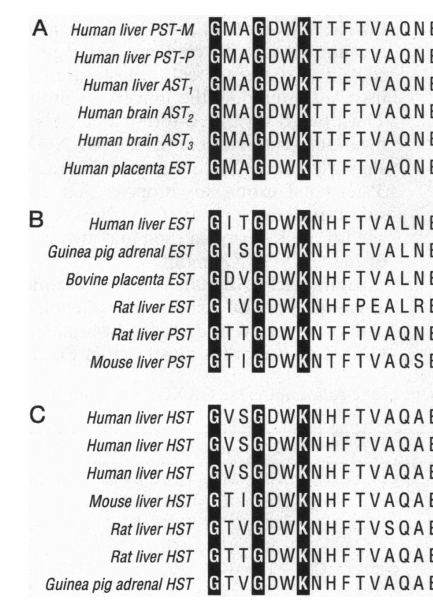
GxxGxxK Motif in Sulfotransferases*
Sulfotransferases are crucial to attach sulfate ions to multiple bioactive molecules
Steroids (cholesterol, estrogen, testosterone, vitamin D, ...)
Glycosaminoglycans (chondroitin sulfate, heparan sulfate, ...)
Polyphenols, aromatics (curcumin, resveratrol, tryptophan, ...)
Neurotransmitters (dopamine, serotonin, melatonin, ...)
*H Chiba et al. Proc. Natl. Acad. Sci. USA 1995; 92:8176-8179.
Notes:
GxxGxxK_motif_sulfotransferases_1995.pdf

Slide 51
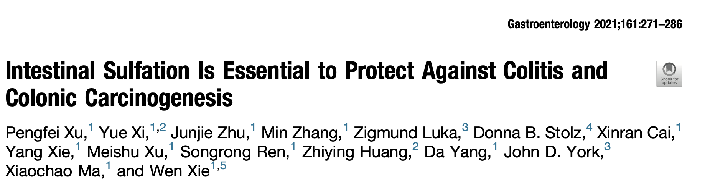
Colon cancer is the third most common cancer and the third leading cause of death due to cancer
PAPSS expression is decreased in both mice and humans with colon cancer, and is correlated with higher mortality
Associated with:
  Reduced intestinal sulfomucin content
  Deficiency in the formation of bile acid sulfates

Slide 52
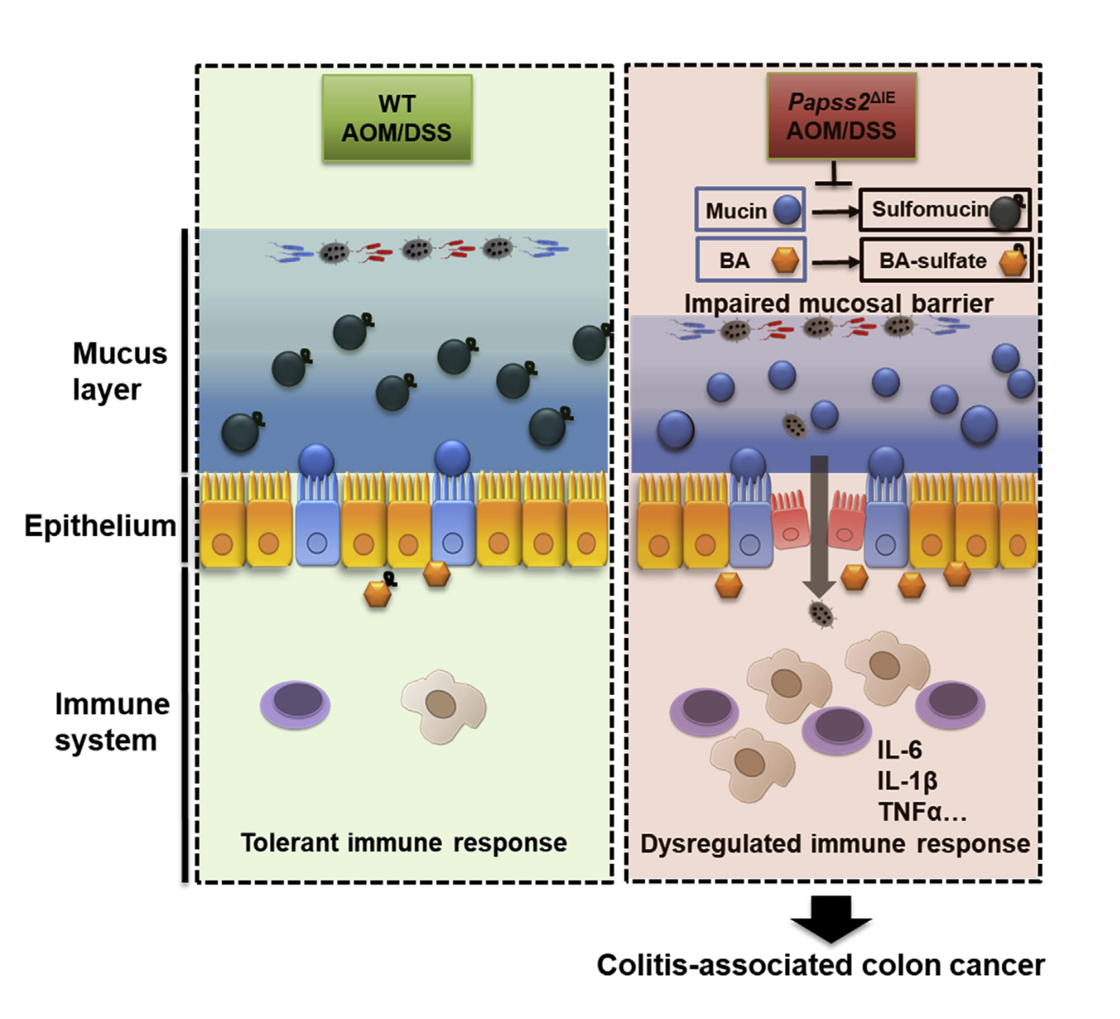
Mouse model of colitis:
Mice with deficiency in PAPSS had a leaky gut barrier and an acute inflammatory response
AOM/DSS = azoxymethane/dextran sodium sulfate
*Pengfei Xu et al.,
Gastroenterology 2021; 161: 271-286.
Notes:
csail/2025/glycocalyx/intestinal_sulfation_essential_protect_colitis_2021.pdf

Slide 53
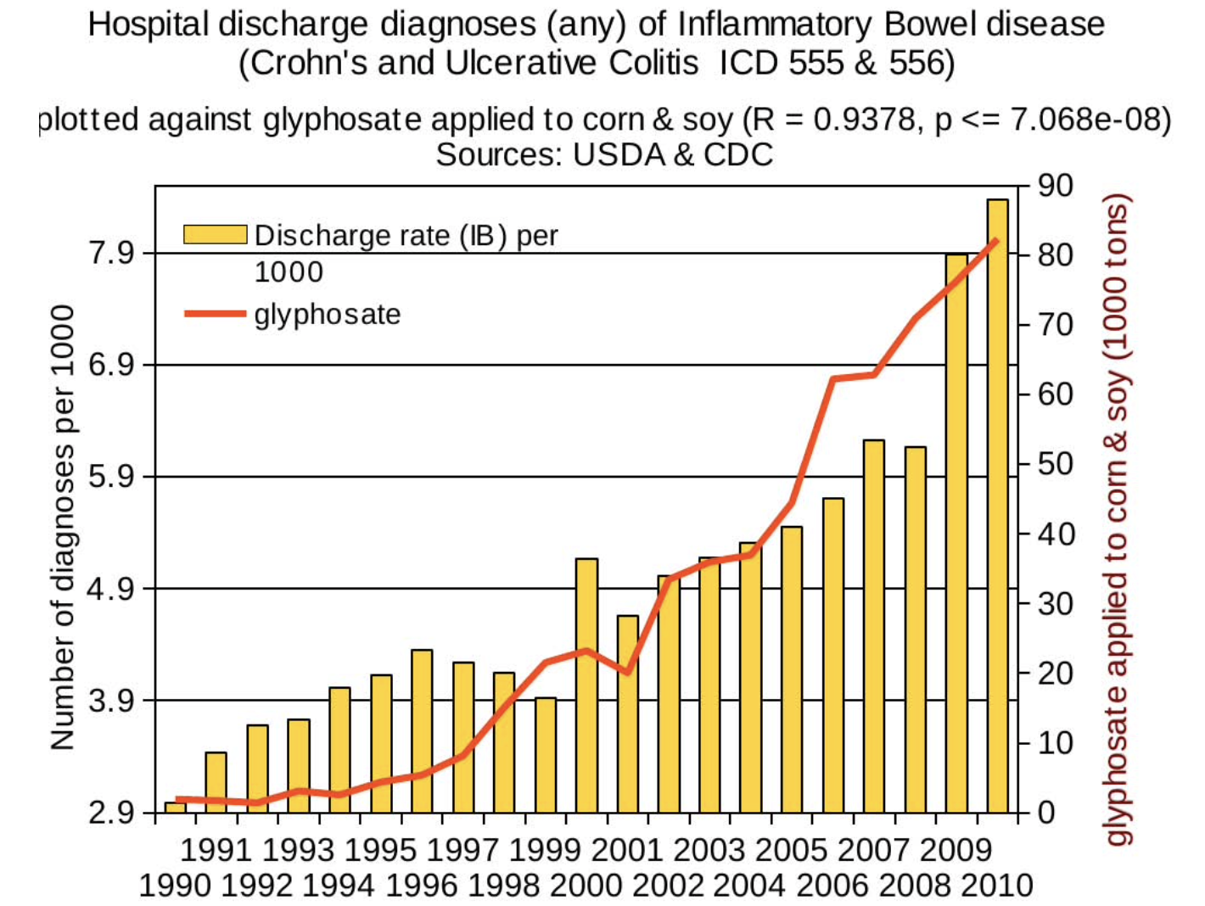
Correlation between inflammatory bowel disease and glyphosate usage on core crops*
*Figure 20
N Swanson et al. Journal of Organic Systems, 9(2), 2014.

Slide 54
Histamine Intolerance

Slide 55
The Big Picture
Mast cells release histamines in response to allergens
Histamines are metabolized primarily by histaminase in the gut
Histamine sensitivity results when histaminase is defective (suppressed)
  A large number of uncomfortable symptoms arise from histamine intolerance
  Glyphosate likely suppresses histaminase
Hypothesis: Mast cell activation is induced when the gut lumen contains too much deuterium due to insufficient sulfate in the sulfomucins
Hypothesis: The metabolites of histamine can trap deuterium and permanently sequester it

Slide 56
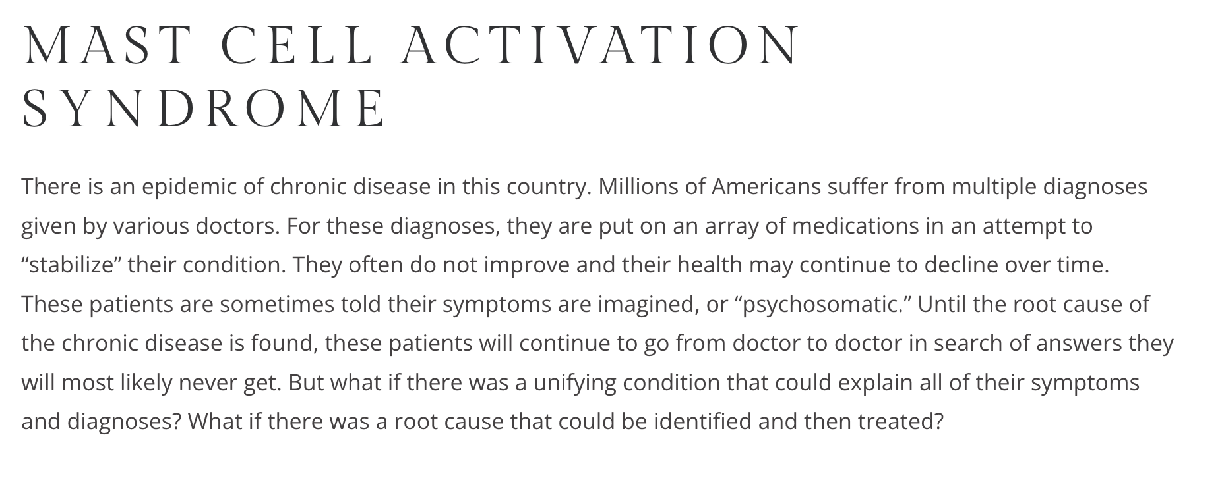
Dr. Tania Dempsey
https://drtaniadempsey.com/mast-cell-activation-syndrome-mcas-a-hidden-epidemic/

Slide 57
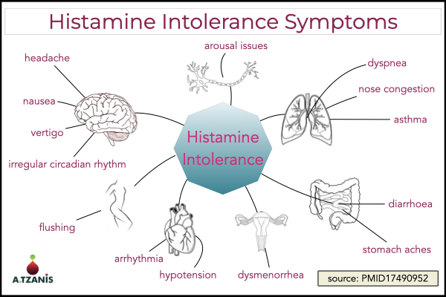
*https://www.atzanis.com/fix-histamine-intolerance/

Slide 58
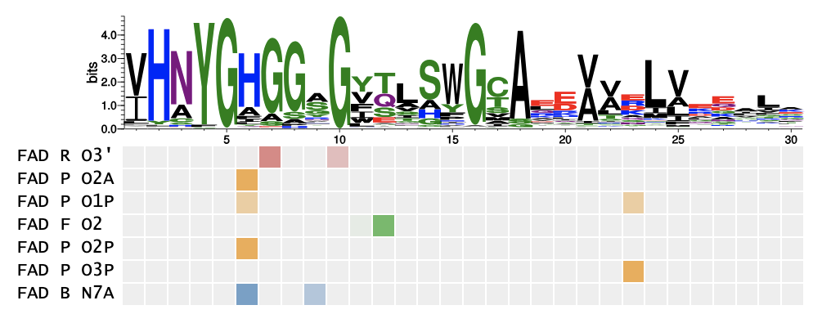
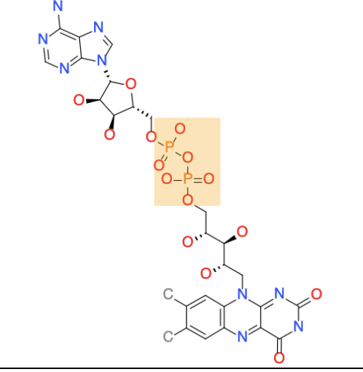
Histamine! YGHGGGWG Motif in Histaminase
Histaminase has a fantastic “glyphosate susceptibility motif”
  It contains 5 glycine residues
  It is a motif known to be found in proteins that bind flavin adenine dinucleotide (FAD)
… IHNYGHGGYGLTIHWG…
YGHGG G WG
Flavin. Adenine
Dinucleotide
(FAD)
FAD R
FAD P
FAD P
FAD F
FAD P
FAD P
FAD B

Slide 59
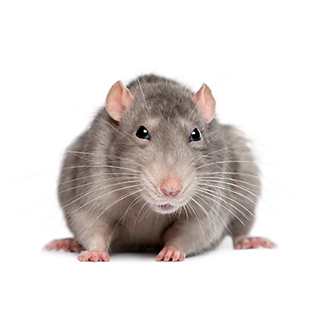
Histaminase: Rat Study*
Diamine oxidase (DAO; histaminase) is found in high concentrations in the intestinal mucosa
The intestinal mucosa are the primary source of plasma DAO
A decrease in plasma DAO reflects an increase in mucosal damage
  Circulating levels of DAO can serve as a marker of mucosal damage
A deficiency in histaminase is a primary cause of histamine intolerance **
Heparin infusion increases expression of DAO
  Heparin is the most highly sulfated molecule in the body
*GD Luk et al. J Clin Invest. 1980 Jul;66(1):66-70.
**L Maintz and N Novak. Am J Clin Nutr. 2007 May;85(5):1185-96.
Notes:
2025/glycocalyx/histamine_mucosa_rats_1980.pdf
2025/glycocalyx/histamine_and_histamine_intolerance.pdf

Slide 60
Histaminase: Rat Study*
"The ingestion of histamine-rich food or of alcohol or drugs that release histamine or block DAO may provoke diarrhea, headache, rhinoconjunctival symptoms, asthma, hypotension, arrhythmia, urticaria, pruritus, flushing, and other conditions in patients with histamine intolerance.”**
Diamine oxidase (DAO; histaminase) is found in high concentrations in the intestinal mucosa
The intestinal mucosa are the primary source of plasma DAO
A decrease in plasma DAO reflects an increase in mucosal damage
  Circulating levels of DAO can serve as a marker of mucosal damage
A deficiency in histaminase is a primary cause of histamine intolerance **
Heparin infusion increases expression of DAO
  Heparin is the most highly sulfated molecule in the body
*GD Luk et al. J Clin Invest. 1980 Jul;66(1):66-70.
**L Maintz and N Novak. Am J Clin Nutr. 2007 May;85(5):1185-96.
Notes:
2025/glycocalyx/histamine_mucosa_rats_1980.pdf
2025/glycocalyx/histamine_and_histamine_intolerance.pdf
https://www.sciencedirect.com/science/article/pii/S0002916523280533
Histamine and histamine intolerance

Slide 61
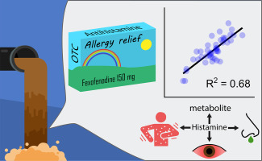
Histamine metabolite MIAA in wastewater*
Authors found a high correlation between the amount of fexofenadine (Alleve) in wastewater and the amount of MIAA (metabolite of histamine)
Technique allows researchers to assess disease risk for allergic diseases in the population served by the sewer system
*Phil M Choi et al. Environment International 120 (2018) 172–180.
Notes:
C10/histamine_metabolite_in_wastewater_2018.pdf

Slide 62
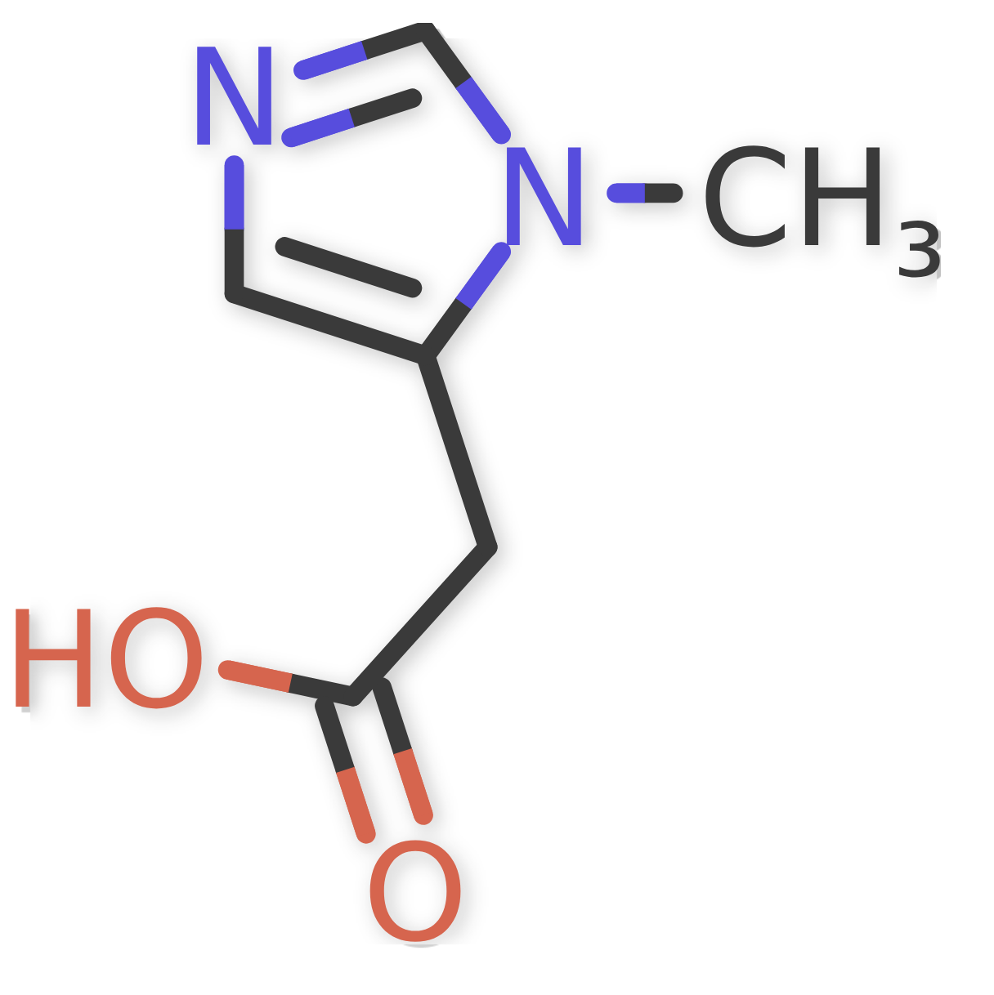
MIAA: methylimidazole acetic acid
H
C
This carbon atom (C2) in the imidazole ring easily picks up deuterium from the water, due to its neighboring two nitrogen atoms
Once it has trapped deuterium, it doesn’t let go

Slide 63
MIAA: methylimidazole acetic acid
D
C
This carbon atom (C2) in the imidazole ring easily picks up deuterium from the water, due to its neighboring two nitrogen atoms
Once it has trapped deuterium, it doesn’t let go
Elevated levels in the urine are associated with mastocytosis, urticaria, atopic dermatitis, and allergic rhinitis

Slide 64
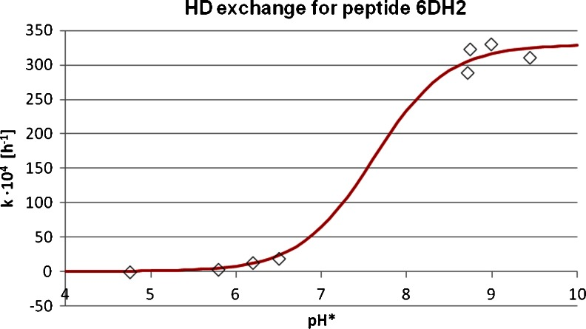
pH dependence of H-D exchange in imidazole ring*
6DH2 = Asp-Ala-Ala-His-Ala-Phe-OH
*M Cebo et al. Anal Bioanal Chem. 2014 Dec;406(30):8013-20.
Notes:
https://pubmed.ncbi.nlm.nih.gov/25354888/
C10./H-D_exchange_in_imidazole_histidine_phosphorylation_2014.pdf

Slide 65
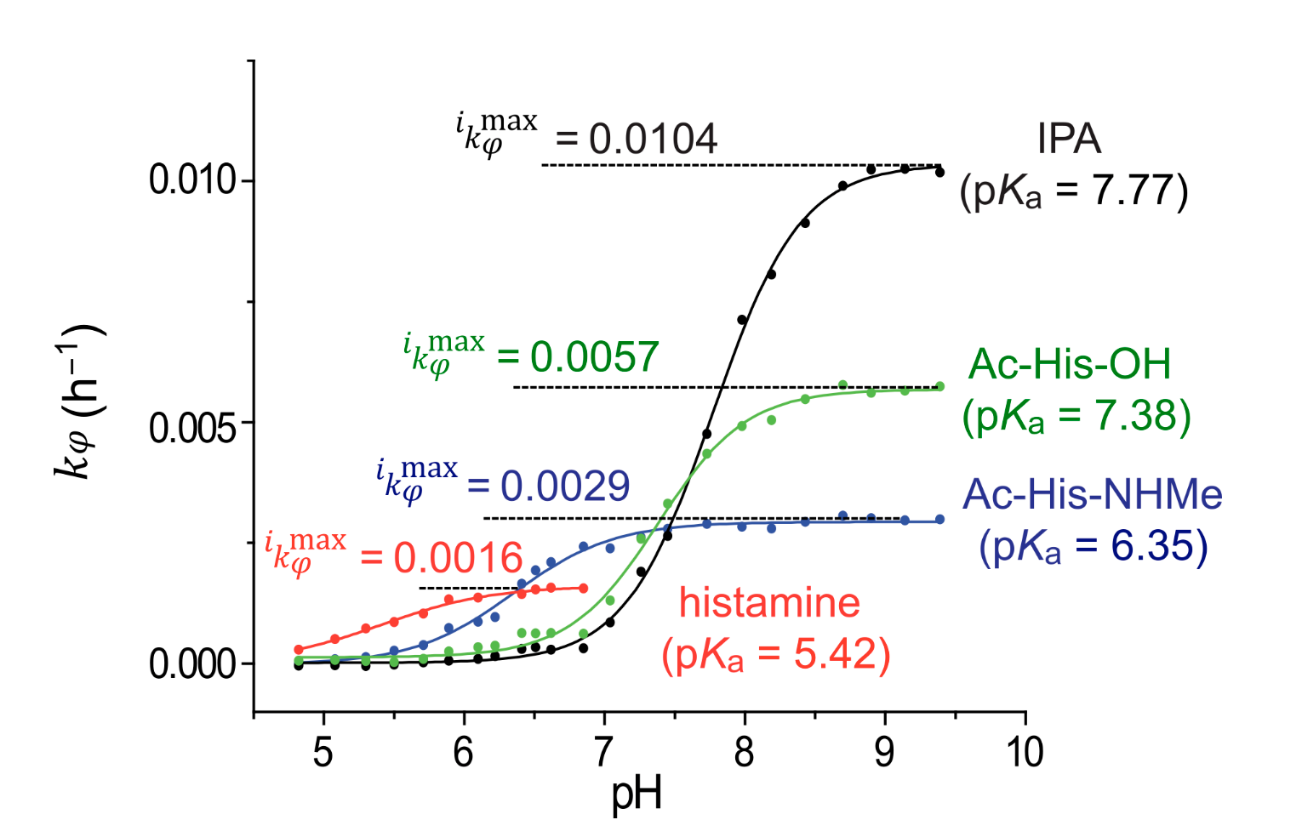
HDX (Hydrogen/Deuterium Exchange) for various metabolites of histamine/histidine*
IPA = Imidazole Propionate
Hypothesis: Histamine metabolites can trap deuterium when the gut lumen becomes too basic. They essentially trap and remove deuterium “landmines”
*M Miyagi et al. Biology (Basel). 2024 Jan 9;13(1):37.
Notes:
2025/Antonis/C10/Miyagi_histidine_HDX_2024
https://pmc.ncbi.nlm.nih.gov/articles/PMC10813008/
Chart showing IPA best at trapping deuterium at high pH.
C10/images/histamine_HDX_data_Miyagi_2024.png

Slide 66
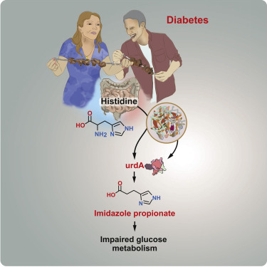
Microbially Produced Imidazole Propionate Impairs Insulin Signaling through mTORC1*
Imidazole propionate (IPA) levels are increased in association with type 2 diabetes
It is produced by certain gut microbes that are increased in diabetic patients
It inhibits insulin signaling by activating the mTORC pathway
*A Koh et al. Cell 2018 Nov 1;175(4):947-961.e17.
Notes:
https://pubmed.ncbi.nlm.nih.gov/30401435/
C10/imidazole_propionate_gut_microbes_diabetes_2018.pdf

Slide 67
Explanation of Gut Disruption Leading to IPA Overproduction
"In addition, because UrdA [the enzyme that produces IPA] is active at neutral pH (Bogachev et al., 2012) and the proximal colon has an acidic pH, increases in pH, possibly resulting from decreased production of short-chain fatty acids and increased protein fermentation in the gut (Windey et al., 2012), may increase production of imidazole propionate.”*
Glyphosate causes an increase in the pH of the gut, which greatly reduces the production of short chain fatty acids by acid-loving microbes**
Glyphosate also increases the production of ammonia (which raises the pH) from protein fermentation**
*A Koh et al. Cell 2018 Nov 1;175(4):947-961.e17
**Stephanie Seneff, Toxic Legacy, 2021, Chapter 3.
Notes:
2025/glycocalyx/IPA_diabetes_mTORC_2018.pdf
https://pmc.ncbi.nlm.nih.gov/articles/PMC5910003/

Slide 68
Microbes Supply Butyrate to Colonocytes*
Dietary Fiber
(HMOs, inulin,
starch, pectin)
Butyrate
SCFAs
(acetate, propionate, butyrate)
Butyryl-CoA
Acetyl-CoA
Primary Degraders
(E.g., Bifidobacteria, Lactobacilli and Bacteroides)
TCA Cycle
CO₂
Oxidative Phosphorylation
CO₂
H₂ gas (deupleted)
O₂
H₂O (DDW)
ADP
ATP
Monosaccharides (e.g., glucose,
fructose)
Secondary Degraders
(E.g., A. caccae, E. halllii and F. prausnitzii)
Mitochondrion
*S Seneff and AM Kyriakopoulos.
Endocrine and Metabolic Science 2025; 17: 100215.
Colonocyte

Slide 69
Microbes Supply Butyrate to Colonocytes*
Dietary Fiber
(HMOs, inulin,
starch, pectin)
Butyrate
SCFAs
(acetate, propionate, butyrate)
Butyryl-CoA
Butyrate is probably very deupleted, and it is the favorite fuel source of the colonocytes lining the colon
Acetyl-CoA
Primary Degraders
(E.g., Bifidobacteria, Lactobacilli and Bacteroides)
TCA Cycle
CO₂
Oxidative Phosphorylation
CO₂
H₂ gas (deupleted)
O₂
H₂O (DDW)
ADP
ATP
Monosaccharides (e.g., glucose,
fructose)
Secondary Degraders
(E.g., A. caccae, E. halllii and F. prausnitzii)
Mitochondrion
*S Seneff and AM Kyriakopoulos.
Endocrine and Metabolic Science 2025; 17: 100215.
Colonocyte

Slide 70
Recapitulation
Mast Cell Activation Syndrome was first recognized as a disease in 2007
  Associated with excessive inflammation and allergic reactions
  Mast cells release abundant histamines into the gut lumen
  Histamines act as signaling molecules to induce diarrhea, abdominal pain, and nausea
Histaminase metabolizes histamines into metabolic products that may be able to trap deuterium and remove it from the gut
  Suppressed histaminase causes histamine intolerance
  Histaminase has a very strong glyphosate susceptibility motif
Gut microbes metabolize histidine to imidazole propionate (IPA), and elevated levels are linked to diabetes
Glyphosate induces an environment in the gut that is conducive to IPA-producing bacteria

Slide 71
Impaired Fatty Acid Metabolism

Slide 72



Why So Many Picky Eaters?
Observation: Many children in America, especially autistic children, are very picky eaters.
Question: Are there enzymes that could be suppressed by glyphosate to cause this condition?

Slide 73
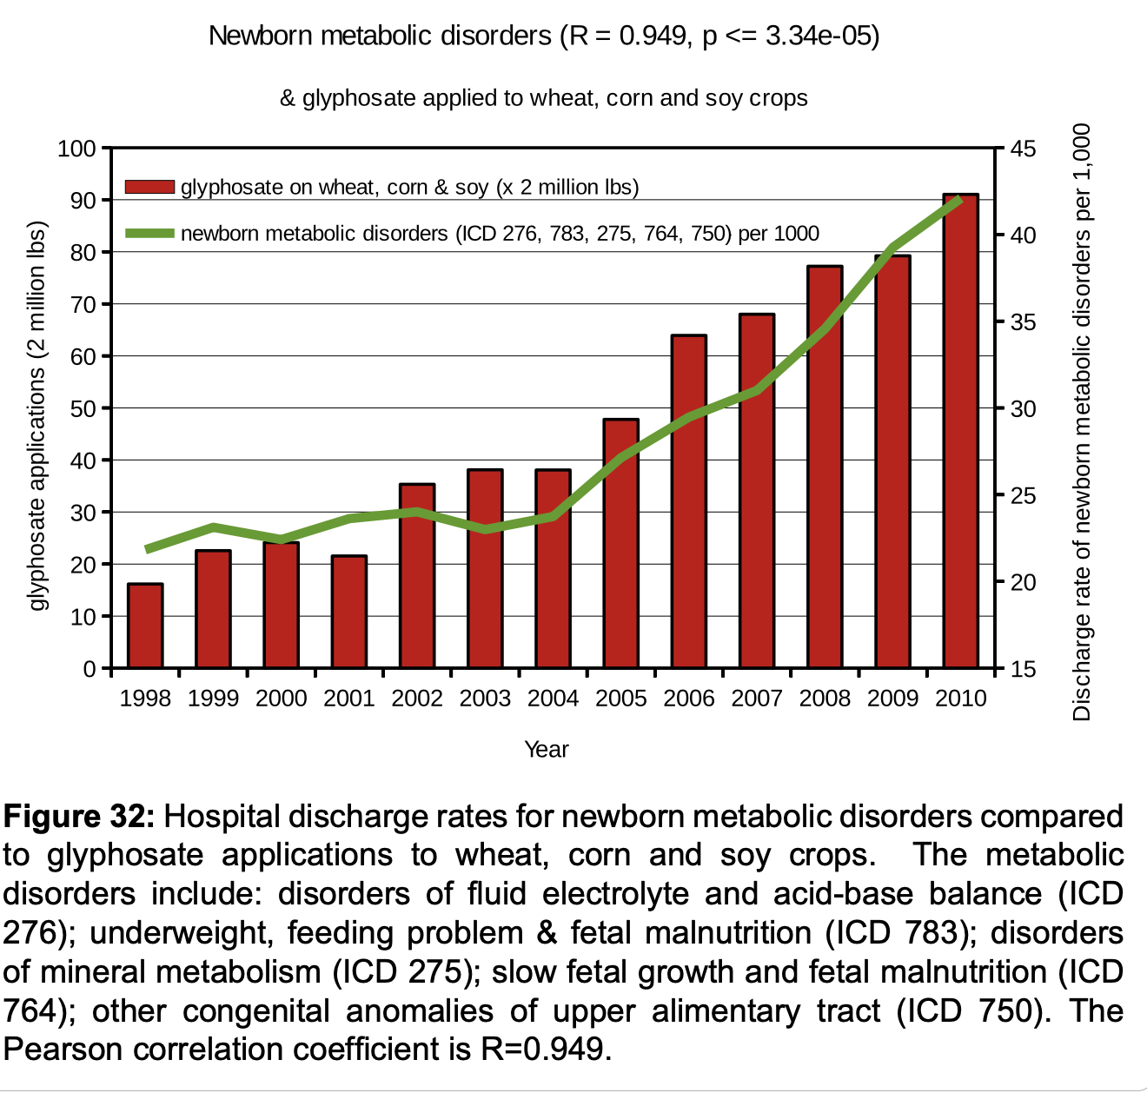
Trends in newborn metabolic disorders over time compared to the rise in glyphosate usage on core crops*
Includes feeding problems, poor weight gain, slow fetal growth, congenital anomalies in the gut, and fetal malnutrition
p < 0.0000334
*J Hoy et al. Poult Fish Wildl Sci 2015; 3: 132.
Notes:
Hoy_wildlife_2015.pdf
The High Cost of Pesticides: Human and Animal Diseases

Slide 74
Long-chain 3-hydroxyacyl-CoA dehydrogenase (LCHAD) deficiency*
This dehydrogenase plays an essential role in the metabolism of long chain fatty acids
Deficiencies in this enzyme lead to severe disease
  Feeding difficulties; dislikes of many foods; nausea and vomiting; lack of energy; low blood sugar; weak muscle tone; delayed development; liver problems; light sensitivity
  Neonates with the severe phenotype present within a few days of birth with hypoglycemia (low blood sugar), hepatomegaly (enlarged liver), encephalopathy (brain dysfunction), and often cardiomyopathy (heart problems)
Glyphosate has been shown to suppress dehydrogenase enzymes in many studies on human cells, E coli and soil bacteria
*medlineplus.gov/genetics/condition/long-chain-3-hydroxyacyl-coa-dehydrogenase-deficiency
Notes:
2024/glyphosate/images
deuterium/fatty_acids.text
https://www.ncbi.nlm.nih.gov/books/NBK583531/
Uniprot:
https://www.uniprot.org/uniprotkb/F0P0Y1/entry

Slide 75
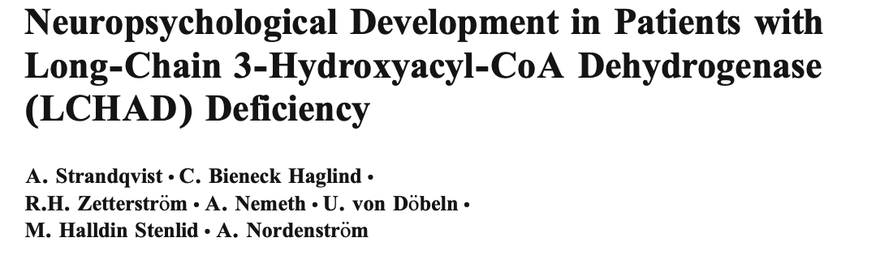
Conclusion:
“Patients with an LCHAD deficiency appear to have a specific cognitive pattern, presenting as intellectual disability and specific autistic deficiencies or a normal IQ with weaknesses in auditive verbal memory and adaptive and executive functions.” *
*A Strandqvist et al. JIMD Rep. 2016;28:75-84.
Notes:
https://www.ncbi.nlm.nih.gov/pmc/articles/PMC5059195/

Slide 76
“Human serum lipidomics analysis revealed glyphosate may lead to lipid metabolism disorders and health risks”*
Glyphosate production workers from three chemical factories in China were compared to controls
Lipidomics analysis revealed significantly elevated levels of acylcarnitines in the workers
Elevated acylcarnitines are an indicator of impaired fatty acid oxidation in the mitochondria
A critical enzyme in long chain fatty acid oxidation is LCHAD (long chain 3-hydroxyacyl CoA dehydrogenase)
*Feng Zhang et al. Environment International 171 (2023) 107682
Notes:
2024/glyphosate//glyphosate_lipidomics_profile_China_study_WOW_2023.pdf

Slide 77
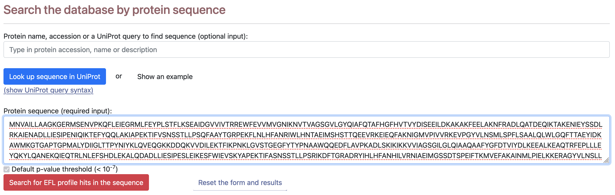
Nucleotide Binding Database*
sequence for LCHAD
Free for academic, commercial and non-commercial use.
*Zheng, Z., Goncearenco, A., Berezovsky, I.N. 2015. TBD
Bioinformatics Institute (BII), A*STAR, Singapore

Slide 78
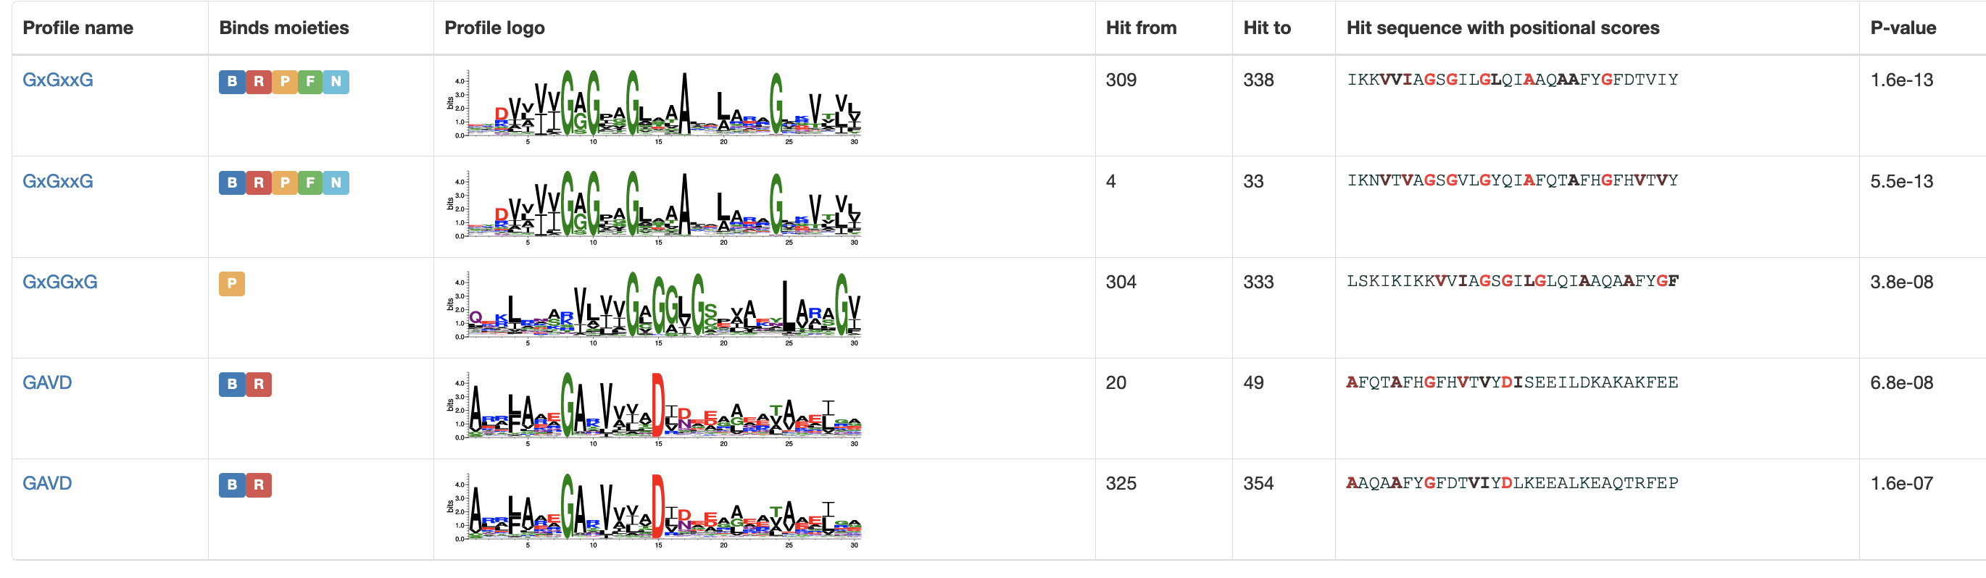
Many glycine residues in LCHAD bind to phosphate!!
GxGxxG
Notes:
sequence logo

Slide 79


GxGxxG Sequence Motif binds to many phosphate-containing molecules
NAD
Glyphosate suppresses EPSP synthase at a site that binds phosphate where glycine is highly conserved

Slide 80

LCHAD is Essential for Fatty Acid Oxidation
Fatty acids are naturally low in deuterium
Each round through this pathway peels off two carbons from the fatty acid chain to release acetyl-CoA
LCHAD deficiency blocks long chain fatty acid oxidation in the mitochondria

Slide 81
“Glyphosate Excretion is Associated With Steatohepatitis and Advanced Liver Fibrosis in Patients With Fatty Liver Disease”*
Non-alcoholic fatty liver disease (NAFLD) is the most common chronic liver disease in developed countries, and it can progress to a more severe form, non-alcoholic steatohepatitis (NASH)
Fatty liver disease increases risk to cirrhosis and liver cancer
Rats develop fatty liver disease after low-dose exposure to glyphosate
"We report that glyphosate excretion is significantly higher in patients with NASH compared to patents without NASH. In addition, we also report a significant dose-dependent increase of glyphosate exposure with increase in fibrosis stages."
*Paul J Mills et al. Clin Gastroenterol Hepatol. 2020 Mar;18(3):741-743.
Notes:
Dietrich_Klinghardt./Mills_fatty_liver_disease_glyphosate_2020.pdf

Slide 82
Recapitulation
LCHAD is essential for metabolizing long chain fatty acids
Genetic defects in LCHAD are associated with severe developmental problems and autism-like behaviors
LCHAD has four sequences containing glycine where the protein binds phosphate (high glyphosate susceptibility)
Glyphosate has been shown experimentally to disrupt fatty acid metabolism in the mitochondria
Non-alcoholic fatty liver disease (NAFLD) is an epidemic today and is associated with high levels of glyphosate in the urine
Fatty acids are a low-deuterium nutrient, so impaired metabolism leads to excessive mitochondrial deuterium & mitochondrial dysfunction

Slide 83
Summary
Deuterium (heavy hydrogen) is a natural element with biophysical and biochemical properties distinctly different from hydrogen
Hypothesis: Deuterium management in the body involves sequestering D in gelled water lining the gut and the vascular barrier
  Deupleted protons are released into the gut lumen and the circulating blood
Glyphosate suppresses many dehydrogenases and enzymes involved in sulfation, impairing gel formation and derailing deuterium homeostasis
Colitis and colon cancer are associated with defective sulfomucins
Hypothesis: Histamine release may be a mechanism to defuse deuterium “land mines” in the gut
Peer-reviewed papers show that lipid oxidation in mitochondria is suppressed by glyphosate
  Lipids are low-deuterium nutrients

