Slide 1


4. Autism, Depression and Alzheimer's disease
Stephanie Seneff
Wise Traditions Workshop
Weston Price Foundation
Nov. 8, 2013
people.csail.mit.edu/seneff/WAPF_Slides_2013/4_autism.pdf

Slide 2
“Alzheimer's disease is at epidemic proportions, with 5.4 million Americans—including one in eight people aged 65 and over—living with the disease. In the next 20 years, it is projected that Alzheimer's will affect one in four Americans, rivaling the current prevalence of obesity and diabetes.”
-- Dr. Mercola*
*http://articles.mercola.com/sites/articles/archive/2013/09/29/dr-perlmutter-gluten.aspx

Slide 3
Outline
Introduction
Demographic Study of 50 States
Pineal Gland and Sulfate
Sulfated Sterols and Lipids
Vaccines and Aluminum
Summary

Slide 4
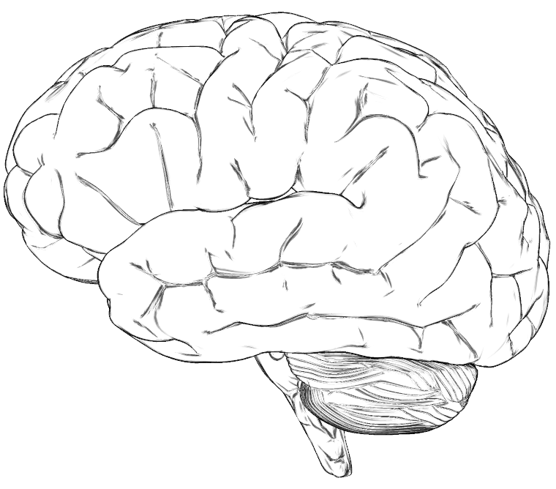
A Hypothesis
Many neurological diseases of the brain have a common origin:
  Insufficient supply of cholesterol and sulfate to the brain (cholesterol sulfate deficiency)
  Powerful additional burden of toxic metal exposure (e.g., aluminum, mercury) due to impaired ability to detoxify and eliminate them
  Toxic metals interfere with sulfate synthesis

Slide 5


The Autism Epidemic in the U.S.
One in 50 kids diagnosed on Autism Spectrum in Mar. 2013
One in 150 kids diagnosed on Autism Spectrum in 2007
One in 100 kids diagnosed on Autism Spectrum in 2009

Slide 6

One in Two in 2025?
The rate was 1 in 10,000 in 1970

Slide 7
Comorbidities with Autism*
"chronic inflammation of gastrointestinal tract, dysbiosis, maldigestion, malabsorption, malnutrition, food intolerance, allergies, chronic viral, fungal and bacterial infections, impaired kidney function, impaired detoxification of endo- and exotoxins, disorders of metal ion transportation."
* M. Cubala-Kucharska, Acta Neurobiol Exp (Wars). 2010 ;70 (2):141-6.

Slide 8
Factors We Have Identified to be Causative in Autism
Insufficient sunlight exposure to the skin and eyes
Excess exposure to environmental toxins, especially glyphosate, aluminum, nitrogen oxides and mercury
Nutritional deficiencies, especially in sulfur
I have recently published 7 journal articles in the biomedical literature with various collaborators on factors influencing autism

Slide 9
Demographic Studies of 50 States

Slide 10
Demographic Studies on 50 States
Public schools in U.S. keep track of # students enrolled in each grade and # students enrolled in programs specifically targeting autism
  Ratio becomes a measure for autism rate in the state
We can obtain statistics for many other factors
  Weather-related, population density, industrial pollution, fluoride, vaccination rate, …
Pearson’s correlation coefficient can be used to detect correlations (ranges from -1.0 to 1.0)
  Correlation does not necessarily mean causation
Notes:
Say pearson’s coefficient

Slide 11
Demographics of 50 States
Demographic | Pearson Rating | Explanation
Rank, population density | 0.50 | Car exhaust?
Rank, # clear days | -0.40 | Sunlight exposure
Latitude | 0.22 | Sunlight exposure
Annual rainfall | 0.16 | Sunlight exposure
RMS (rainfall, latitude) | 0.34 | Sunlight exposure
Temperature | -0.16 | Sunlight exposure
Elevation | -0.28 | Sunlight exposure
% vaccinated | 0.33 | Aluminum, mercury
Per child funding | 0.25 | Funding constraints
Obesity rates | -0.28 | Toxin Sequestering?
Industrial pollution | 0.01 | Not significant factor
% water fluoridation | -.03 | Not significant factor

Slide 12
1. Lack of Sunlight

Slide 13

Demographics of 50 States
Demographic | Pearson Rating | Explanation
Rank, population density | 0.50 | Car exhaust?
Rank, # clear days | -0.40 | Sunlight exposure
Latitude | 0.22 | Sunlight exposure
Annual rainfall | 0.16 | Sunlight exposure
RMS (rainfall, latitude) | 0.34 | Sunlight exposure
Temperature | -0.16 | Sunlight exposure
Elevation | -0.28 | Sunlight exposure
% vaccinated | 0.33 | Aluminum, mercury
Per child funding | 0.25 | Funding constraints
Obesity rates | -0.28 | Toxin Sequestering?
Industrial pollution | 0.01 | Not significant factor
% water fluoridation | -.03 | Not significant factor

Slide 14
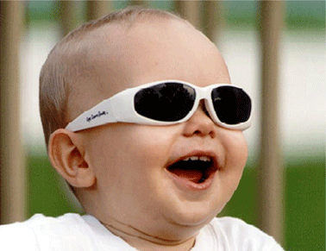
A Really Bad Idea!

Slide 15

Blue Light!*
``The two flavins in eNOS absorb light in the blue range (peaks at 443 and 475 nm) and emit light in the green range (~525 nm) when oxidized.’’
*E. Stroes et al., FEBS Letters 438 (1998) 161-164.

Slide 16
Demographics of 50 States
Demographic | Pearson Rating | Explanation
Rank, population density | 0.50 | Car exhaust?
Rank, # clear days | -0.40 | Sunlight exposure
Latitude | 0.22 | Sunlight exposure
Annual rainfall | 0.16 | Sunlight exposure
RMS (rainfall, latitude) | 0.34 | Sunlight exposure
Temperature | -0.16 | Sunlight exposure
Elevation | -0.28 | Sunlight exposure
% vaccinated | 0.33 | Aluminum, mercury
Per child funding | 0.25 | Funding constraints
Obesity rates | -0.28 | Toxin Sequestering?
Industrial pollution | 0.01 | Not significant factor
% water fluoridation | -.03 | Not significant factor

Slide 17

Take Off the Sunglasses and Look at the Blue Sky!

Slide 18

World's oldest person dies at 116 in Japan*
116-year-old Jiroemon Kimura in Japan died on Wednesday, June 12, 2013
He attributed his longevity to getting out in the sunlight:
"I am always looking up towards the sky. That is how I am."
*http://news.yahoo.com/worlds-oldest-person-dies-116-japan-040710488.html

Slide 19
2. Aluminum in Vaccines

Slide 20
Demographics of 50 States
Demographic | Pearson Rating | Explanation
Rank, population density | 0.50 | Car exhaust?
Rank, # clear days | -0.40 | Sunlight exposure
Latitude | 0.22 | Sunlight exposure
Annual rainfall | 0.16 | Sunlight exposure
RMS (rainfall, latitude) | 0.34 | Sunlight exposure
Temperature | -0.16 | Sunlight exposure
Elevation | -0.28 | Sunlight exposure
% vaccinated | 0.33 | Aluminum, mercury
Per child funding | 0.25 | Funding constraints
Obesity rates | -0.28 | Toxin Sequestering?
Industrial pollution | 0.01 | Not significant factor
% water fluoridation | -.03 | Not significant factor
This correlation is detected despite the fact that the range is very narrow:
From 63% in the least vaccinated state to 80% in the most vaccinated state (Massachusetts!!)

Slide 21
“Our studies demonstrate that, in contrast to magnesium-, iron- and zinc-sulfate, aluminum-sulfate has an unusual and significant ability to induce ROS, NF-κB signaling, and … down-regulating the important inflammation inhibitor CFH.”*
Aluminum induces inflammation
*AI Pogue et al., Journal of Inorganic Biochemistry 103 (2009) 1591–1595
Notes:
Aluminum/Pogue_2009_metal_sulfate_stressed_human_brain_cells.pdf

Slide 22
Recent Publication
C.A. Shaw, S.D. Kette, R.M. Davidson, and S. Seneff. Aluminum’s role in CNS-immune system interactions leading to neurological disorders. Immunome Research, To Appear, 2013.

Slide 23
Figure from Our Paper
ASIA = Autoimmune Syndrome Induced by Adjuvants

Slide 24
Aluminum Exposure and Memory, Depression*
25 symptomatic workers from the same aluminum smelting plant
  22 (88%) reported frequent loss of balance
  21 (84%) reported memory loss
  21 (84%) showed physical signs of incoordination
19 were tested for depression on the Minnesota Multiphasic Personality Inventory
  17 (89%) tested positive for depression
*White et al., Arch Intern Med. 152(7):1443-1448, 1992.

Slide 25
Our Studies with VAERS Database on Aluminum & Depression
VAERS: Vaccine Adverse Event Reporting System, maintained by CDC
Tabulate word frequencies for mentions of "depression" in adverse reactions to aluminum-containing vaccines versus non-aluminum-containing vaccines.
  231 mentions in aluminum-containing vaccines versus 85 in age-matched controls
  Highly significant result (p = 0.005)

Slide 26
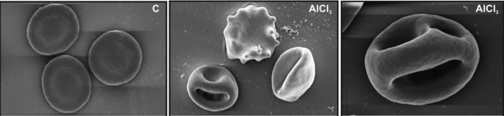
Aluminum’s effect on Red Blood Cells*
Aluminum causes microcytic anemia
  Induces severe morphological changes in RBCs
  Leads to eryptosis – cell dies
N-acetyl cysteine (a source of sulfur) affords some protection
Normal
With Aluminum
* D.M. Vota et al., Journal of Cellular Biochemistry 113:1581–1589, 2012.
Notes:
vitaminK/aluminum_eryptosis_2012.pdf

Slide 27
Aluminum’s effect on Red Blood Cells*
Aluminum causes microcytic anemia
  Induces severe morphological changes in RBCs
  Leads to eryptosis – cell dies
N-acetyl cysteine (a source of sulfur) affords some protection
Anemia is an adverse reaction to aluminum-containing vaccines
Normal
With Aluminum
* D.M. Vota et al., Journal of Cellular Biochemistry 113:1581–1589, 2012.
Notes:
vitaminK/aluminum_eryptosis_2012.pdf

Slide 28
3. Nitrogen Oxides in Pollution

Slide 29
Demographics of 50 States
Demographic | Pearson Rating | Explanation
Rank, population density | 0.50 | Car exhaust?
Rank, # clear days | -0.40 | Sunlight exposure
Latitude | 0.22 | Sunlight exposure
Annual rainfall | 0.16 | Sunlight exposure
RMS (rainfall, latitude) | 0.34 | Sunlight exposure
Temperature | -0.16 | Sunlight exposure
Elevation | -0.28 | Sunlight exposure
% vaccinated | 0.33 | Aluminum, mercury
Per child funding | 0.25 | Funding constraints
Obesity rates | -0.28 | Toxin Sequestering?
Industrial pollution | 0.01 | Not significant factor
% water fluoridation | -.03 | Not significant factor

Slide 30
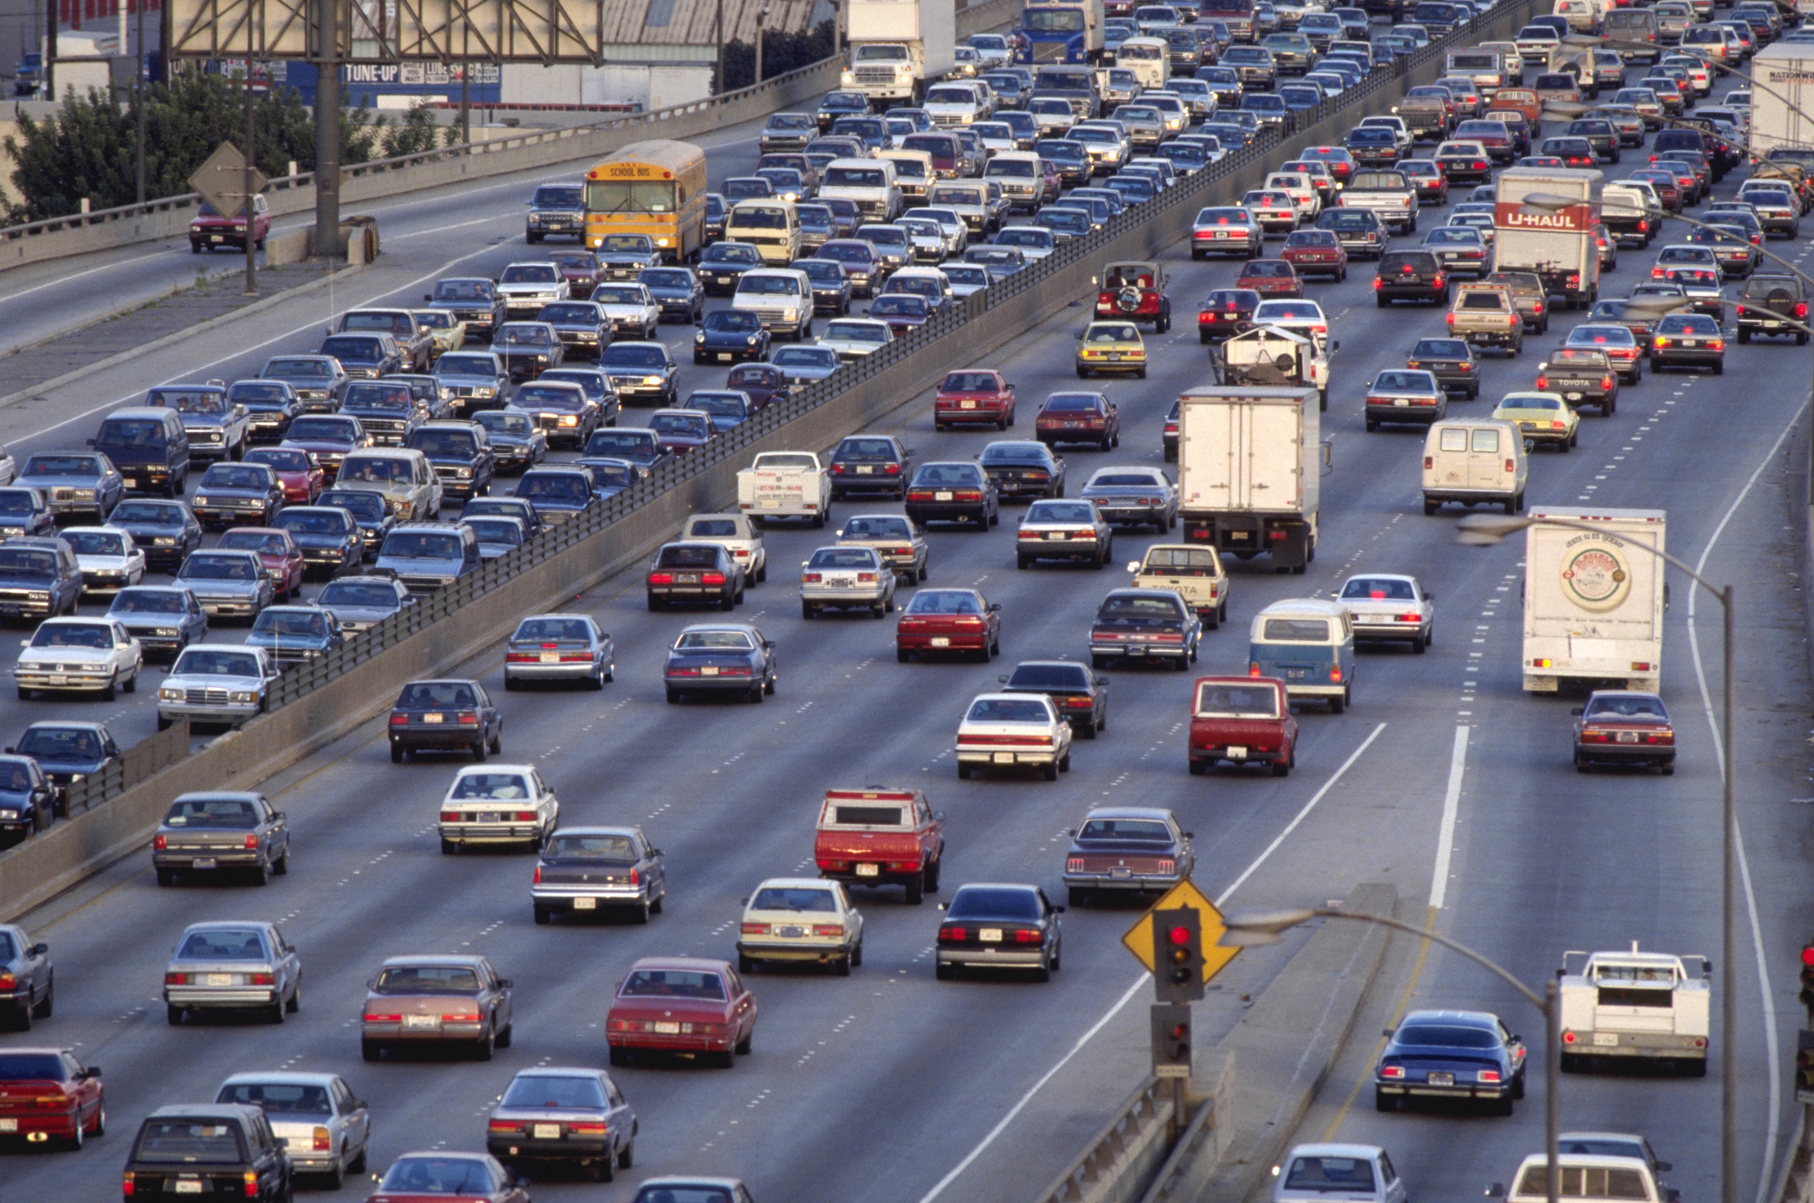
Residential Proximity to Freeways and Autism in the CHARGE Study*
259 normal children compared with 304 children with autism
Children with autism were 1.86x more likely to live near a freeway
Living near freeway during third trimester yielded 2.22 fold increase in autism
There was no correlation with living near other major roads
* H.E. Volk et al., Environmental Health Perspectives 119(6), 2011, 873-877.
Notes:
Project/2013/living_near_freeway_increases_autism_risk.pdf

Slide 31
A Role for Nitrogen Oxides??*
Oxides of nitrogen are a major contaminant in car exhaust
  Autism is associated with excess serum nitric oxide/nitrate and insufficient serum sulfate
Excess nitric oxide can lead to excess ammonia via metabolism of intermediary, GSNO
  Excess ammonia in brain is implicated in autism
*S. Seneff, A. Lauritzen, R. Davidson, and L. Lentz-Marino.
Is Encephalopathy a Mechanism to Renew Sulfate in Autism?
Entropy 2013, 15, 372-406.

Slide 32
Nitric Oxide and Autophagy
Autophagy is a natural mechanism by which cells clean up debris and dysfunctional organelles
Excess nitric oxide inhibits autophagy
Switchover to nitric oxide by eNOS leads to autophagy dysfunction and accumulation of garbage in the cell
Long-term autophagy inhibition leads to cellular dysfunction and cell death

Slide 33
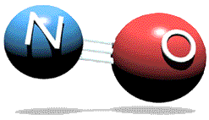
Some Effects of Excess NO on the Brain*
Impairs autophagy
Damages lipids in cell membranes
Disrupts mitochondrial synthesis of ATP
Interferes with reuptake of serotonin, dopamine, and epinephrine
*O. Akyol et al., In Vivo 18: 377-390, 2004
Notes:
Samantha/nitric_oxide_in_neuropsychiatric_disorders.pdf

Slide 34
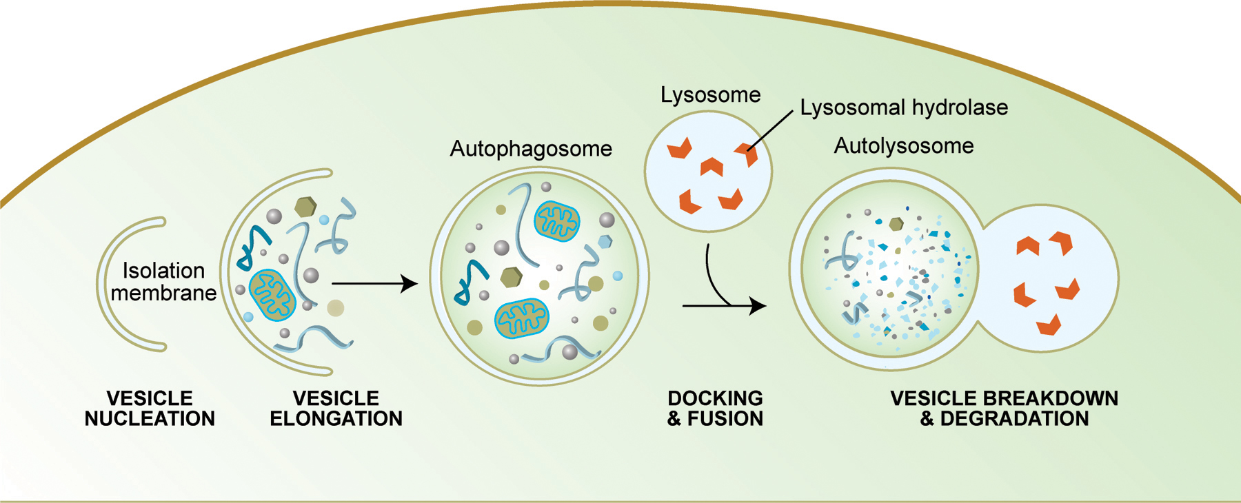
Autophagy
Allows cell to recycle damaged goods
Both damaged mitochondria and damaged endoplasmic reticulum are absorbed into the lysosome and broken down
Autophagy depends on sulfates in HSPGs
http://www.wormbook.org/chapters/www_autophagy/autophagy.html
Notes:
http://www.wormbook.org/chapters/www_autophagy/autophagy.html
Figure 1: Schematic diagram of the steps of autophagy. Autophagy begins with the formation of the phagophore or isolation membrane (vesicle nucleation step). The concerted action of the autophagy core machinery proteins at the phagophore assembly site (PAS) is thought to lead to the expansion of the phagophore into an autophagosome (vesicle elongation). The autophagosome can engulf bulk cytoplasm nonspecifically, including entire organelles, or target cargos specifically. When the outer membrane of the autophagosome fuses with an endosome (forming an amphisome before fusing with the lysosome) or directly with a lysosome (docking and fusion steps), it forms an autophagolysosome. Finally, the sequestered material is degraded inside the autophagolyosome (vesicle breakdown and degradation) and recycled.

Slide 35
4. Glyphosate!

Slide 36
Demographics of 50 States
Demographic | Pearson Rating | Explanation
Rank, population density | 0.50 | Car exhaust?
Rank, # clear days | -0.40 | Sunlight exposure
Latitude | 0.22 | Sunlight exposure
Annual rainfall | 0.16 | Sunlight exposure
RMS (rainfall, latitude) | 0.34 | Sunlight exposure
Temperature | -0.16 | Sunlight exposure
Elevation | -0.28 | Sunlight exposure
% vaccinated | 0.33 | Aluminum, mercury
Per child funding | 0.25 | Funding constraints
Obesity rates | -0.28 | Toxin Sequestering?
Industrial pollution | 0.01 | Not significant factor
% water fluoridation | -.03 | Not significant factor

Slide 37

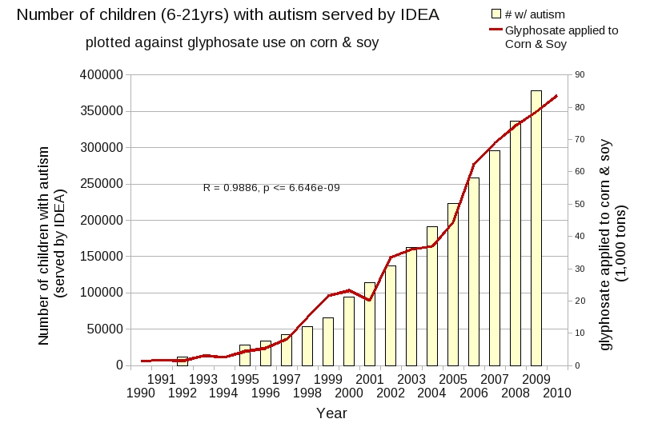
Glyphosate and Autism*
R = 0.9898; p <= 2.6e-06
*http://www.examiner.com/article/
data-show-correlations-between-increase-neurological-diseases-and-gmos
Notes:
Nancy Swanson – I have a fanclub account for her.

Slide 38
Rosemary Waring on Autism in 1990*
“These results indicate that there may be a fault either in manufacture of sulphate or that sulphate is being used up dramatically on an unknown toxic substance these children may be producing” (p. 198).
This was a very clairvoyant statement
*O’Reilly, B.A.; Waring, R.H. Enzyme and sulphur oxidation deficiencies in autistic children with known food/chemical intolerances. Xenobiotica. 1990, 20, 117–122.

Slide 39
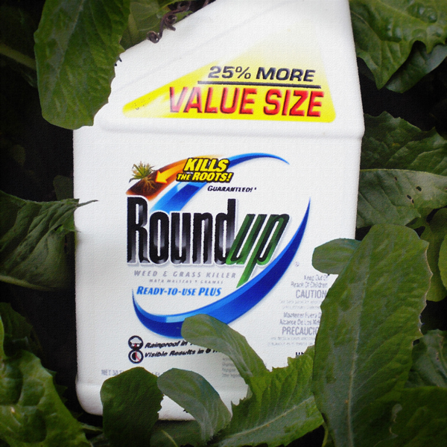
Glyphosate*
Glyphosate is the active ingredient in the weed killer, Roundup
Glyphosate disrupts gut bacteria
  Disrupted gut bacteria is a key feature of autism
Glyphosate disrupts Cytochrome P450 enzymes
  eNOS is a P450 enzyme – disrupted sulfate synthesis
Glyphosate impairs sulfate transport through competition (Jones-Ray effect)
  Toxic phenols in gut needed to transport sulfate
GMO crops → much more glyphosate present in food sources
* A. Samsel and S. Seneff, Entropy 2013, 15(4), 1416-1463

Slide 40
I’ll have much more to say about glyphosate in the next section!

Slide 41
Recapitulation
Demographic studies on the 50 states suggest several factors related to autism:
  Insufficient sunlight exposure to the skin and eyes
  Exposure to aluminum from vaccines and other sources
  Exposure to nitrogen oxides in air pollution from automobile exhaust
  Exposure to glyphosate (Roundup) and other chemical pesticides

Slide 42
Pineal Gland and Sulfate

Slide 43
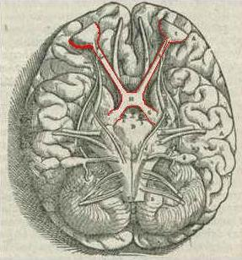
Sunlight and the Pineal Gland
Pineal Gland
“The Third Eye”

Slide 44
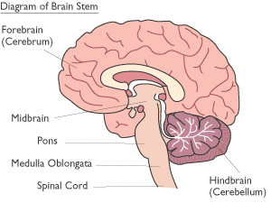
The Brain
Limbic System
Ventricles
Pineal Gland
Notes:
http://corticalchauvinism.files.wordpress.com/2013/03/locus_coeruleus.gif

Slide 45
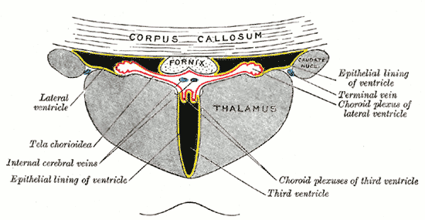
Third Ventricle and Pineal Gland
Pineal gland is attached to the third ventricle
The third ventricle is depleted in heparan sulfate in association with autism in both humans and mice*,**
Heparan sulfate depleted
Pineal Gland
*B.L. Pearson et al., Behav Brain Res. 2013 Apr 15;243:138-45.
**F Mercie et al., Neurosci Lett 506, 2012, 208-213.
Notes:
Where are they?

Slide 46
“Melatonin Enters the Cerebrospinal Fluid through the Pineal Recess”*
The tip of the third ventricle is encased in the pineal gland
The pineal gland delivers melatonin to the third ventricle and it diffuses to all the cerebrospinal fluid
I propose that a key purpose of melatonin is to deliver sulfate to the neurons at night.
*H. Tricoire et al., Endocrinology 143(1):84–90
Notes:
Wendy/melatonin_cerebrospinal_fluid_pineal_recess_DYNAMITE.pdf

Slide 47
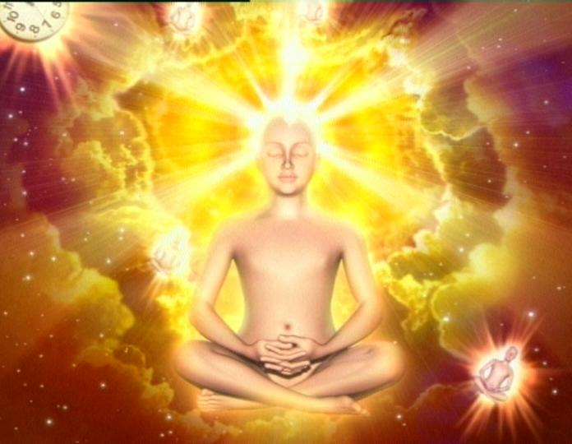
“The cerebrospinal fluid is considered by bioenergy workers to be the carrier of information and life energy that is received by the organism and is then distributed throughout the body*
*A. Axt, Farmakoterapia w Psychiatrii i Neurologii 98(1), 112-134.

Slide 48
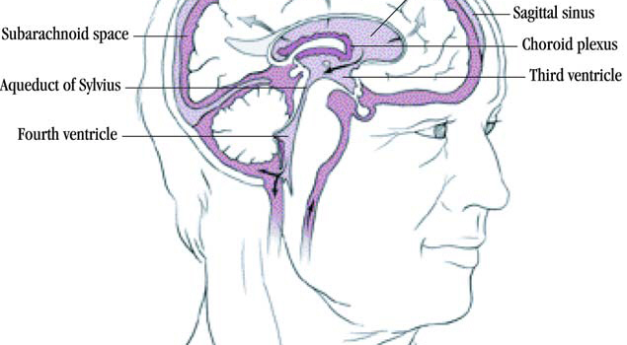

Sulfate!!!
Pineal Gland

Slide 49
“Light-induced 3-O-Sulfotransferase Expression Alters Pineal Heparan Sulfate Fine Structure : A SURPRISING LINK TO CIRCADIAN RHYTHM”*
Pineal gland builds up heparan sulfate supplies by day
Melatonin is sulfated in transport at night
  Highly lipophilic molecule needs sulfate to make it water-soluble
  This allows it to move through the cerebrospinal fluid
When melatonin is delivered, sulfate is released!
Melatonin is a sulfate-delivery system!!
*B. Kuberan et al., J. Biol. Chem. 2004, 279:5053-5054.
Notes:
Samantha/light_sulfotransferase_pineal_gland_heparan_sulfate.pdf

Slide 50

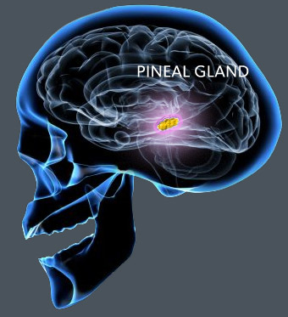
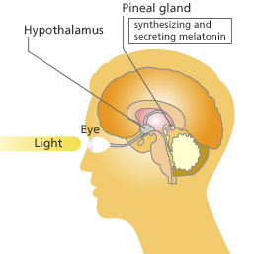
Pineal Gland: “Seat of the Soul”
The pineal gland produces sulfate by day (responding to light) and stores it in heparan sulfate molecules
The pineal gland produces melatonin in the evening and transports it as melatonin sulfate to various parts of the brain

Slide 51
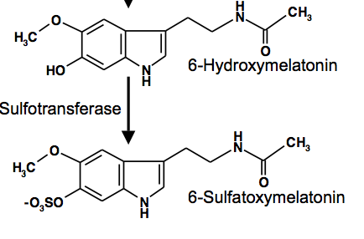
Pineal Gland: “Seat of the Soul”
Pineal gland produces melatonin
  Induces REM sleep
Alzheimer’s is associated with reduced REM sleep cycle AND calcified pineal gland*
  Pineal gland calcification correlates inversely with REM sleep**
  DHEA SULFATE but not DHEA injections increase melatonin production in rats***
*R. Mahlberg et al., Neurobiol Aging. 2008 Feb;29(2):203-9
**R. Mahlberg et al., Sleep Med. 2009 Apr;10(4):439-45.
***Y. Djeridane et al., Steroids. 2004 May;69(5):343-9.
Notes:
Alzheimers/pineal_calcification_alzheimers.text
Treasures/pineal_calcification_melatonin_sleep.pdf
Treasures/DHEA_sulfate_boosts_melatonin.text
melatonin_review_2012.pdf

Slide 52
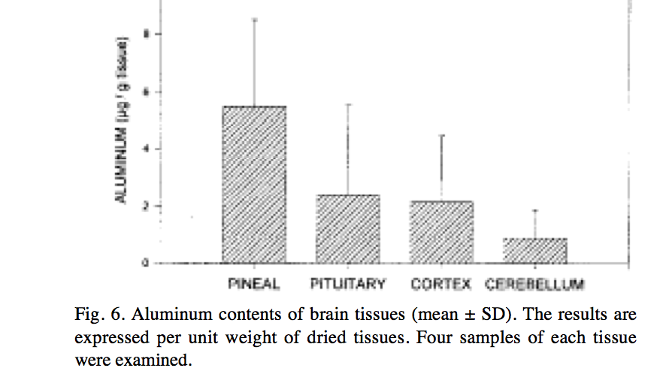
Aluminum in the Pineal Gland*
*S.B. Lang et al./Bioclectrochemistry and Bioenergetics 41(1996)191—195
Notes:
Csail/2013/ChrisShaw/piezoelectricity_aluminum_pineal_gland.pdf

Slide 53
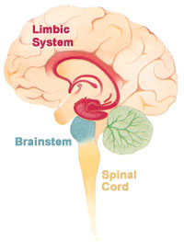
Limbic System
Includes hippocampus, olfactory bulbs, amygdala, thalamus, etc.
Controls emotion, behavior, motivation, long-term memory, and olfaction
Surrounds the ventricles

Slide 54
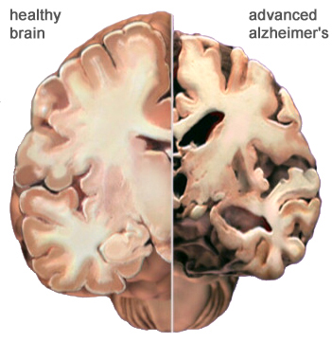
Changes Associated with Alzheimer’s
Ventricles expand in size while brain tissues shrink

Slide 55
Habenula! Mission Control!
Involved in pain processing, reproductive behavior, nutrition, sleep-wake cycles, stress responses, and learning.
Divided into limbic and motor parts.
Noradrenergic inputs from the locus ceruleus
Ships acetylcholine to the pineal gland
Sends control signals to midbrain nuclei that release dopamine, norepinephrine, and serotonin.
All of these neurotransmitters are sulfated in transit

Slide 56
Habenula! Mission Control!
Involved in pain processing, reproductive behavior, nutrition, sleep-wake cycles, stress responses, and learning.
Divided into limbic and motor parts.
Noradrenergic inputs from the locus ceruleus
Ships acetylcholine to the pineal gland
Sends control signals to midbrain nuclei that release dopamine, norepinephrine, and serotonin.
All of these neurotransmitters are sulfated in transit
Habenula is closely connected to the pineal gland

Slide 57
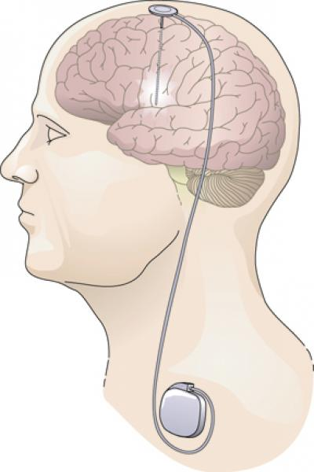
Habenula and Depression*
Habenula is tiny: It covers an area only about 1-2 mm across.
Neurons in habenula are hyperactive in mouse-models of depression.
  Inhibits dopamine and serotonin receptors downstream.
Deep brain stimulation reversed the effect.
*B. Li et al. Nature 2011, 470(7335): 535–539.
Notes:
Treasures/habenula_in_depression_mouse_model_Nature.pdf
http://www.news-medical.net/news/20110224/Scientists-suggest-that-lateral-habenula-can-be-a-prime-locus-of-human-depression.aspx

Slide 58
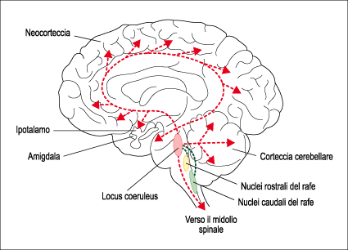
Locus coeruleus
Supplies adrenalin throughout the nervous system
Controls experience-dependent alterations in neural function and behavior
Pathology associated with ADHD, sleep disorders, post-traumatic stress disorder
Notes:
http://corticalchauvinism.files.wordpress.com/2013/03/locus_coeruleus.gif

Slide 59
Novel role for Noradrenaline and Dopamine?
Locus coerulius (source of noradrenaline)
  Is colored blue due to neuromelanin formed by polymerization of noradrenaline
Substantia nigra (source of dopamine)
  is colored black due to dopamine-based neuromelanin
Both of these may need the melanin to protect from UV exposure (melanin production causes suntan)

Slide 60
Recapitulation
The pineal gland behind the eyes produces melatonin sulfate
  Shipped via the cerebral spinal fluid to all parts of the brain
  Regulates the wake/sleep cycle
  Sulfate synthesis in pineal gland depends on sunlight
The habenula is "mission control" for neurotransmitter regulation in the brain involved with pain management, wake/sleep cycle, stress, learning and nutrition
  Closely connected to the pineal gland
The limbic system surrounds the pineal gland and produces neurotransmitters like serotonin, dopamine, and norepinephrine
  These are also sulfated in transit
I hypothesize that an important role served by all of these molecules is maintenance of sulfate supplies to the brain

Slide 61
Sulfated Sterols and Lipids

Slide 62
Cholesterol Sulfate Deficiency Explains Autistic Correlates
Autism is associated with several health issues:
  Eczema, asthma, digestive problems (leaky gut)
  Increased susceptibility to infection
Cholesterol sulfate in skin stimulates filaggrin synthesis*
  Filaggrin deficiency leads to eczema and asthma
Sulfate protects cells in blood from bacteria
Sulfate deficiency leads to leaky gut syndrome **
* Nakae et al. The FASEB Journal 22:782.2, 2008
** Waring and Klovrza, J Nutr & Environ Medicine 10, 25-32, 2000.
Notes:
RH WARING PAPER 2000.pdf in robert_davidson/ThePaper/
Gastrointestinal FunctionSulphation capacity also affects the gastrointestinal tract. The mucins which line the gut, providing both protective and adhesive properties, are sulphated glycoproteins which rely on the degree of sulphation and the addition of negative charges to maintain their structures in an extended con􏲵guration [30]. Reduced sulphation has been associated with in􏲶 ammation and gut dysfunction, coupled with a breakdown in the protective properties of the mucins and an increase in permeability [31]. Many children with autism also have digestive problems and 9 out of 20 (42%) in one survey had increased gut permeability when challenged by the mannitol/lactulose test [32]. This 􏲵 nding has led to the idea that a “leaky” gut may be more permeable to dietary proteins and peptides. Groups working in two separate laboratories have found diet-derived peptides in urine from children with autism [33,34] which were attributed to incomplete hydrolysis of casein and gluten proteins from milk and wheat respectively [35]. Peptides of this type can show “opioid” activity, crossing the gut wall and penetrating the blood–brain barrier to act on the central nervous system [36]. They may be responsible for the social withdrawal, insensitivity to pain and altered responses to sensory stimuli which are commonly described in autism. Use of naloxone and other opiate antagonists has been reported to reduce the levels of self-injury, again suggesting that “opioid excess” may be a factor in autistic behaviour [37].

Slide 63
Recent Papers
“Might cholesterol sulfate deficiency contribute to the development of autistic spectrum disorder?”
Stephanie Seneff, Robert Davidson, Luca Mascitelli
Medical Hypotheses 2012, 78, 213–217
“Impaired Sulfate Metabolism and Epigenetics: Is There a Link in Autism?”
Samantha Hartzell and Stephanie Seneff Entropy 2012, 14, 1953-1977

Slide 64
Sulfate in Fetal Development*
Fetus depends on mother for sulfate supply
Sulfate is essential for transporting sterols (like estrogen and DHEA) and supplying extracellular matrix proteins everywhere with sufficient negative charge
Sulfate detoxifies xenobiotics like acetaminophen (tylenol) and is essential for excreting toxins like aluminum and mercury
Sulfate is severely deficient in autistic children (1/3 the normal level of free sulfate in blood stream)
* Dawson, “Sulfate in Fetal Development,” Semin Cell Dev Biol 2011
Notes:
Cancer/sulfate_in_fetal_development.pdf
Dawson PA. Sulfate in fetal development. Semin Cell Dev Biol (2011), doi:10.1016/j.semcdb.2011.03.004

Slide 65
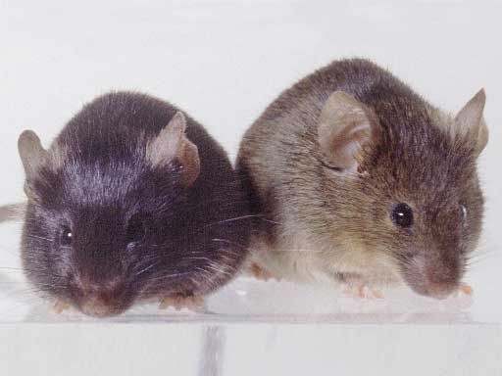
Heparan Sulfate Deficiency and Autism*
Experiment with “designer” mice: impaired heparan sulfate synthesis in brain
Mice exhibited all the classic features of autism – both cognitive and social
* F. Irie et al., Autism-like socio-communicative deficits and stereotypies in mice lacking heparan sulfate. PNAS Mar. 27, 2012, 109(13), 5052-5056.
Notes:
vitaminK/mice_no_heparan_sulfate_get_autism_2012.pdf

Slide 66
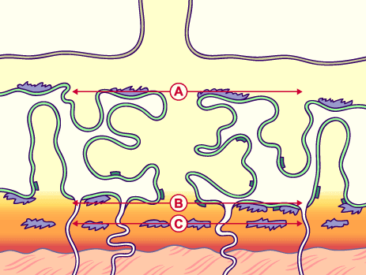
Cholesterol Sulfate in Placental Villi*
Placental villi are highly enriched in cholesterol sulfate, especially in third trimester of pregnancy
Mother’s serum cholesterol sulfate steadily rises through pregnancy
In third trimester, villi contain 24 pmol/mg of cholesterol sulfate, compared to only 1.5 in blood serum of a non-pregnant woman
* Lin et al., Journal of Chromatography B, 704 (1997) 99–104

Slide 67
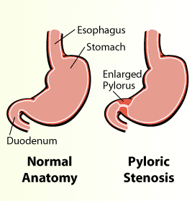
Pyloric Stenosis and Autism
Affects 2 out of 1000 births
  Pyloric valve at base of stomach is enlarged, constricting flow
  Severe projectile vomiting and dehydration, with electrolyte imbalance.
  Corrective surgery is often required
Pyloric stenosis is associated with low serum cholesterol*
Autism is associated with increased risk to pyloric stenosis**
*Feenstra B, et al. JAMA 2013; 310(7): 714-721.
**M.L. Wier et al., Med Child Neurol 2006;48(6):500-507.

Slide 68
Parkinson’s and Low LDL
Low serum levels of LDL (the "bad" blood lipid measure) are associated with increased risk to Parkinson's disease
Men at the 80th percentile had less than half the incidence of Parkinson's compared to men at the 20th percentile
*X Huang et al., Mov Disord. 2008 May 15;23(7):1013-8.
Notes:
For_vic/low_LDL_high_risk_PD.text

Slide 69
Mouse Experimental Model of Parkinson’s Disease*
Testosterone is produced from cholesterol in the testes
  Statin drugs lower testosterone levels
  Low testosterone is found in Parkinsonian men
Castration in mice activated microglia and astrocytes in substantia nigra
  leads to sharp increase in nitric oxide synthesis
  Dopaminergic cells die
  Produces Parkinson’s-like symptoms
*S. Khasnavis et al., J. Biol Chem. 2013 Jul 19;288(29):20843-55
Notes:
For_vic/statins_testosterone_parkinsons.text
For_vic/castrated_mice_parkinsons.pdf

Slide 70
Hypothesis
Testosterone sulfate normally supplies sulfate to the brain
When testosterone is deficient, dopamine must replace testosterone for this role
Dopamine induces nitric oxide synthesis by iNOS in glial cells*
  Dopamine sulfate delivers sulfate to brain
  Nitrate can compensate for sulfate to balance Hofmeister effects
Neurons die from exposure to ONOO⁻
*S.C. Cunningham et al., Eur J Neurosci. 2005 Apr;21(8):2199-208.
Notes:
http://www.ncbi.nlm.nih.gov/pubmed/15869516
Eur J Neurosci. 2005 Apr;21(8):2199-208.
Nitric oxide release is induced by dopamine during illumination of the carp retina: serial neurochemical control of light adaptation.
Sekaran S, Cunningham J, Neal MJ, Hartell NA, Djamgoz MB.

Slide 71
High Serum Cholesterol
Beneficial in Elderly*
“In this study, we found marginally significant associations of a higher LDL-C level and a lower TG/HDL-C ratio with better memory function among community dwelling, functionally independent dementia-free older adults aged 80 years and older, even after controlling for demographic characteristics and use of lipid-lowering drugs.”
*Y. Katzumata et al., J Alzheimers Dis. 2013 January 1; 34(1): 273–279.
Notes:
For_vic/high_LDL_better_memory_elderly.pdf

Slide 72
Alzheimer’s and Serum Glucose Levels*
Analyzed 35,264 measures of glucose levels from 2067 participants
  Mean age at baseline was 76 years old
  Median follow-up of 6.8 years
Dementia developed in 524 people (>25%)
  Among participants with diabetes, higher levels of glucose correlated strongly with increased risk to dementia (P=0.002)
  Dementia was also correlated with higher blood sugar levels in people without diabetes (P=0.01)
*P.K. Crane et al., N Engl J Med 2013; 369:540-548
Notes:
./glucose_and_alzheimers.text
high_blood_sugar_linked_to_dementia_NYtimes.pdf
high_blood_sugar_linked_to_dementia.pdf

Slide 73
Alzheimer’s and Serum Glucose Levels*
Analyzed 35,264 measures of glucose levels from 2067 participants
  Mean age at baseline was 76 years old
  Median follow-up of 6.8 years
Dementia developed in 524 people (>25%)
  Among participants with diabetes, higher levels of glucose correlated strongly with increased risk to dementia (P=0.002)
  Dementia was also correlated with higher blood sugar levels in people without diabetes (P=0.01)
Sulfate deficiency leads to impaired sugar metabolism
*P.K. Crane et al., N Engl J Med 2013; 369:540-548
Notes:
./glucose_and_alzheimers.text
high_blood_sugar_linked_to_dementia_NYtimes.pdf
high_blood_sugar_linked_to_dementia.pdf

Slide 74
“Alzheimer's research breakthrough”*
Researchers in New Zealand are synthesizing a form of heparan sulfate to be administered as a treatment for Alzheimer’s disease
  “may play a part in determining the type of cell a stem cell will form into, and producing stem cells that proliferate and do not show normal signs of ageing”
  Quote from Dr. Richard Furneaux, manager of project
*http://www.stuff.co.nz/national/health/9007969/Alzheimers-research-breakthrough

Slide 75
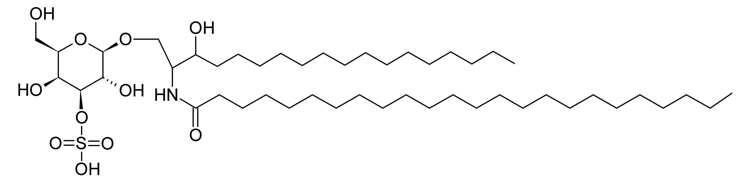
Sulfatide

Slide 76
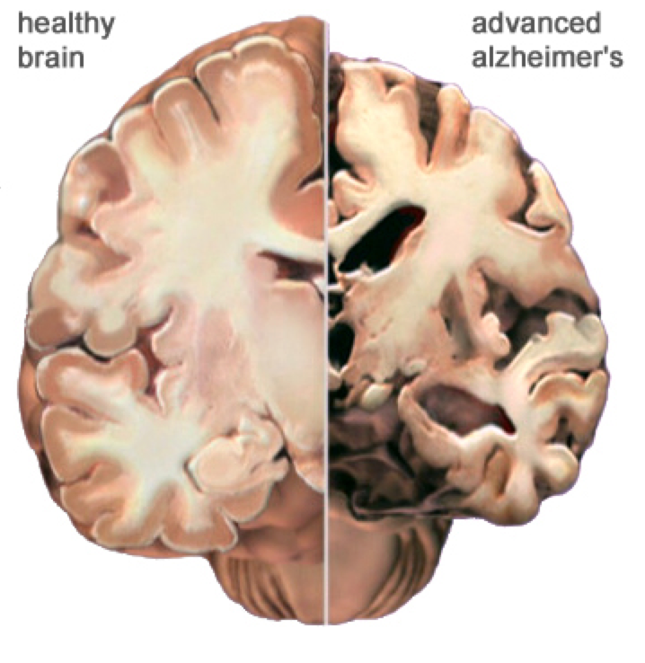
Sulfatide Depleted in Alzheimer’s Brain*
Study of Alzheimer's brains postmortem
Sulfatide was found depleted up to 93% in the gray matter.
*X Han et al., J Neurochem 82(4): 809-18.
Notes:
From our paper w/ Chris: csail/2013/project/ChrisShaw/

Slide 77
WIKI on Sulfatides*
Sulfatides are a class of sulfated galactosyl-ceramides. … Sulfatides are thought to play a major role in myelin function and stability, as evidenced by the fact that mice lacking the enzyme … have thinner myelin sheaths, and experience progressive hindlimb paralysis as a result of demyelination of their lower spinal cords.
*http://en.wikipedia.org/wiki/Sulfatide

Slide 78
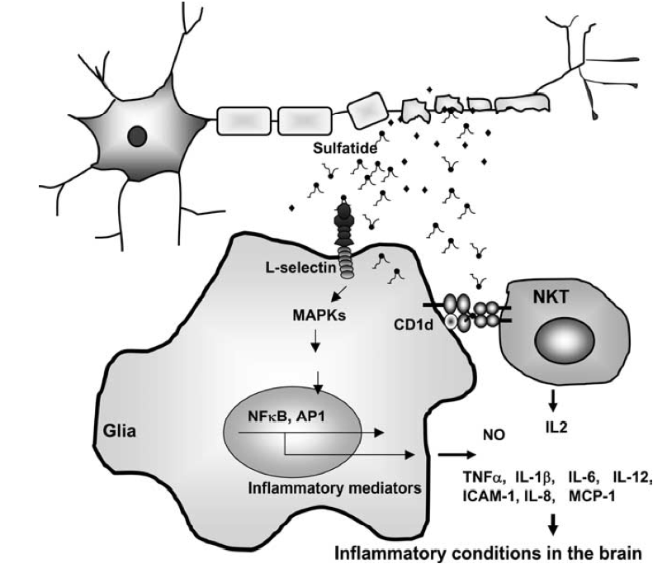
Sulfatide Breakdown Induces Inflammation*
Inflammatory Agents
*S-B Jeon et al., The Journal of Immunology, 2008, 181: 8077–8087.
Notes:
Treasures/sulfatide_induces_inflammation.pdf
FIGURE 10. Schematic diagram depicting possible mechanisms for sulfatide-triggered inflammation in the brain. Sulfatides are released at sites of injured and/or inflamed brain lesions accompanying myelin destruction, which can activate brain-resident immune cells, thus contributing to patho- logical conditions in the brain.

Slide 79
TNFα and Multiple Sclerosis*
“These studies illustrate that while TNFα accelerates the process of acute demyelination, its presence in the CNS may be necessary for remyelination to occur. “
TNFα induces both synthesis and degradation of the myelin sheath
I propose that sulfatide in myelin is a source of sulfate to supply the blood stream
*M.D. Magnano et al., Clin Exp Rheumatol 2004; 22 (Suppl. 35): S134-S140.
Notes:
./TNF_alpha_inhibition_induces_demyelnation.pdf
Surprisingly, the TNF- deficient mice displayed profound neurologic impairment and high mortality.
TNFα signaling through TNFR2 pro- motes the accumulation of proliferating oligodendrocyte progenitors, which then develop into mature oligodendro- cytes required for remyelination."
Specifically, the authors reported that anti-TNFα therapy administered to adult NOD mice inhibits T-cell apoptosis, increas- es antigen presenting cell (APC) func- tion and increases T-cell signaling. These results suggest that chronic TNFα inhi- bition may actually increase the T-cell response to a specific antigen (29).
Therefore, it is possible that peripheral administration of anti- TNFα agents has more than one effect: (1) local anti-inflammatory effects in tissues with adequate drug penetration, (2) systemic pro-inflammatory effects in tissues protected from drug entry
Keane et al. reported a markedly increased rate of tuberculosis in patients treated with in- fliximab compared to background rates and suggested that TNFα was a key contributor to control of latent infec- tions (35).

Slide 80
Recapitulation
Sulfate plays an essential role in fetal development
  Heparan sulfate deficiency in the brain is linked to autism
Parkinson's disease is associated with:
  Low serum LDL
  Testosterone deficiency
    Statins cause reduced testosterone synthesis
High LDL improves cognition in elderly
High blood sugar is a risk factor for dementia
Heparan sulfate is a new treatment for Alzheimer's
Sulfatide breakdown causes neurological disease

Slide 81
Vaccines and Aluminum

Slide 82
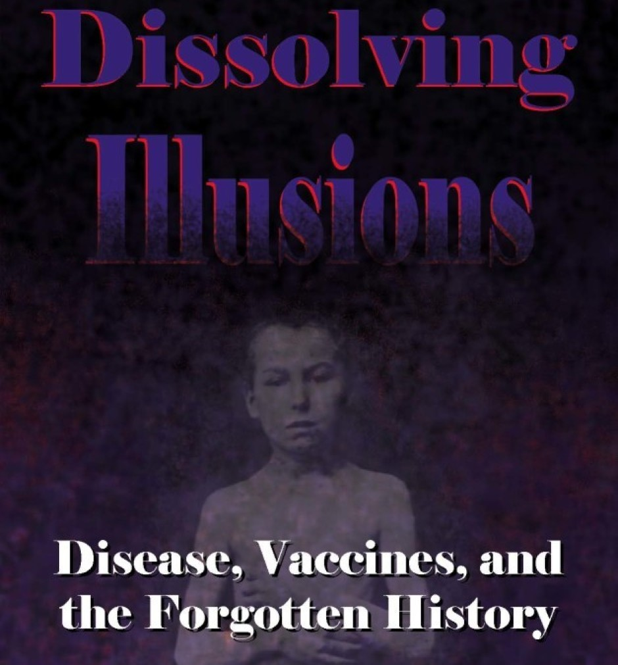
Book by Suzanne Humphries, MD

Slide 83
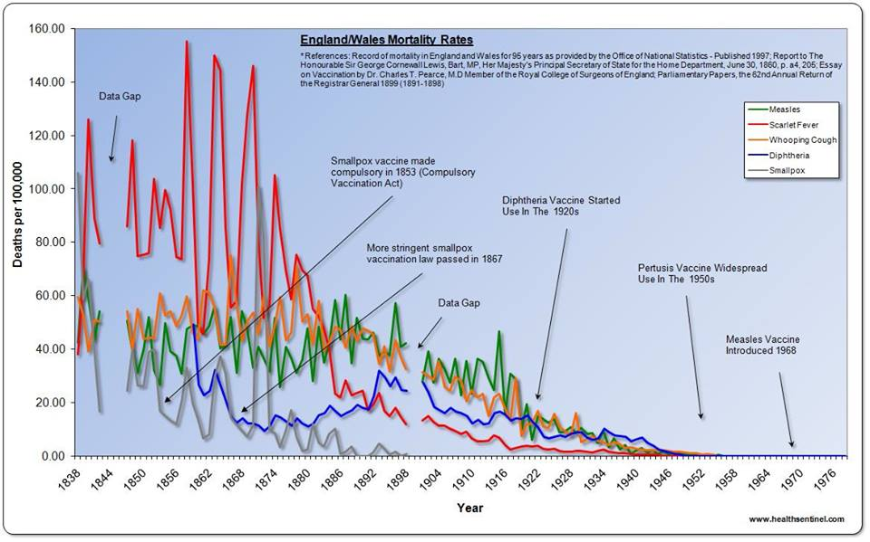
History of Death from Various Infectious Diseases in England/Wales
http://vactruth.com/2013/08/02/dissolving-illusions/
Notes:
http://vactruth.com/2013/08/02/dissolving-illusions/

Slide 84
“The United States has the highest number of mandated vaccines for children under 5 in the world (36, double the Western world average of 18), the highest autism rate in the world (1 in 150 children, 10 times or more the rate of some other Western countries), but only places 34th in the world for its children under 5 mortality rate. What’s going on?”*
50
50th
* Vaccine Schedules, Autism Rates, and Under 5 Mortality, Generation Rescue, Inc. 2009
Notes:
Robert_davidson/MortalityRateschildren.pdf

Slide 85
Mortality under 5 Years Old vs.
Number of Required Vaccines*
Most vaccines,
Highest Mortality
Fewest vaccines,
Lowest Mortality
If vaccines are protecting our children from death due to infection, they’re not doing a very good job!
* Vaccine Schedules, Autism Rates, and Under 5 Mortality, Generation Rescue, Inc. 2009
Notes:
Per 10,000 children

Slide 86
"Aluminum is not perceived, I believe, by the public as a dangerous metal and, therefore, we are in a much more comfortable wicket in terms of defending its presence in vaccines”
-- Dr. John Clement, World Health Organization, San Juan, Puerto Rico, May 11th - 12th, 2000, p. 64

Slide 87
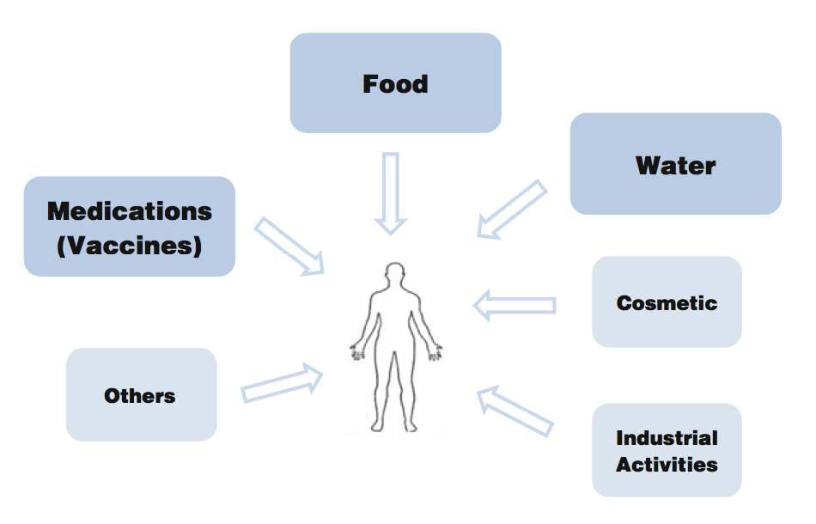
We live in the age of aluminum*
*C.A. Shaw and L. Tomljenovic, Immunol. Res. Epub ahead of print, 2013
Notes:
Tomljenovich/ShawTomljenovichAluminumWorld.pdf

Slide 88
Recapitulation
Disease incidence had already plummeted before vaccines were introduced
Contrary to widely held beliefs, vaccines are not safe
  Key problems are mercury and aluminum
  US has highest infant mortality rate among developed nations along with highest vaccination rates
Aluminum is also found in many other everyday items
Aluminum is neurotoxic

Slide 89
Summary
Autism rates have reached an alarming level of 1/50.
  Related to Alzheimer’s and depression, which are also highly on the rise
Hypothesis: Autism is caused by a severe system-wide deficiency in sulfate supplies
Pineal gland can synthesize sulfate stimulated by sunlight
  This supplies sulfate to multiple neurotransmitters and hormones that deliver It to the neurons and muscle cells
Aluminum and glyphosate are two pervasive environmental toxins contributing to our health problems

