Slide 1


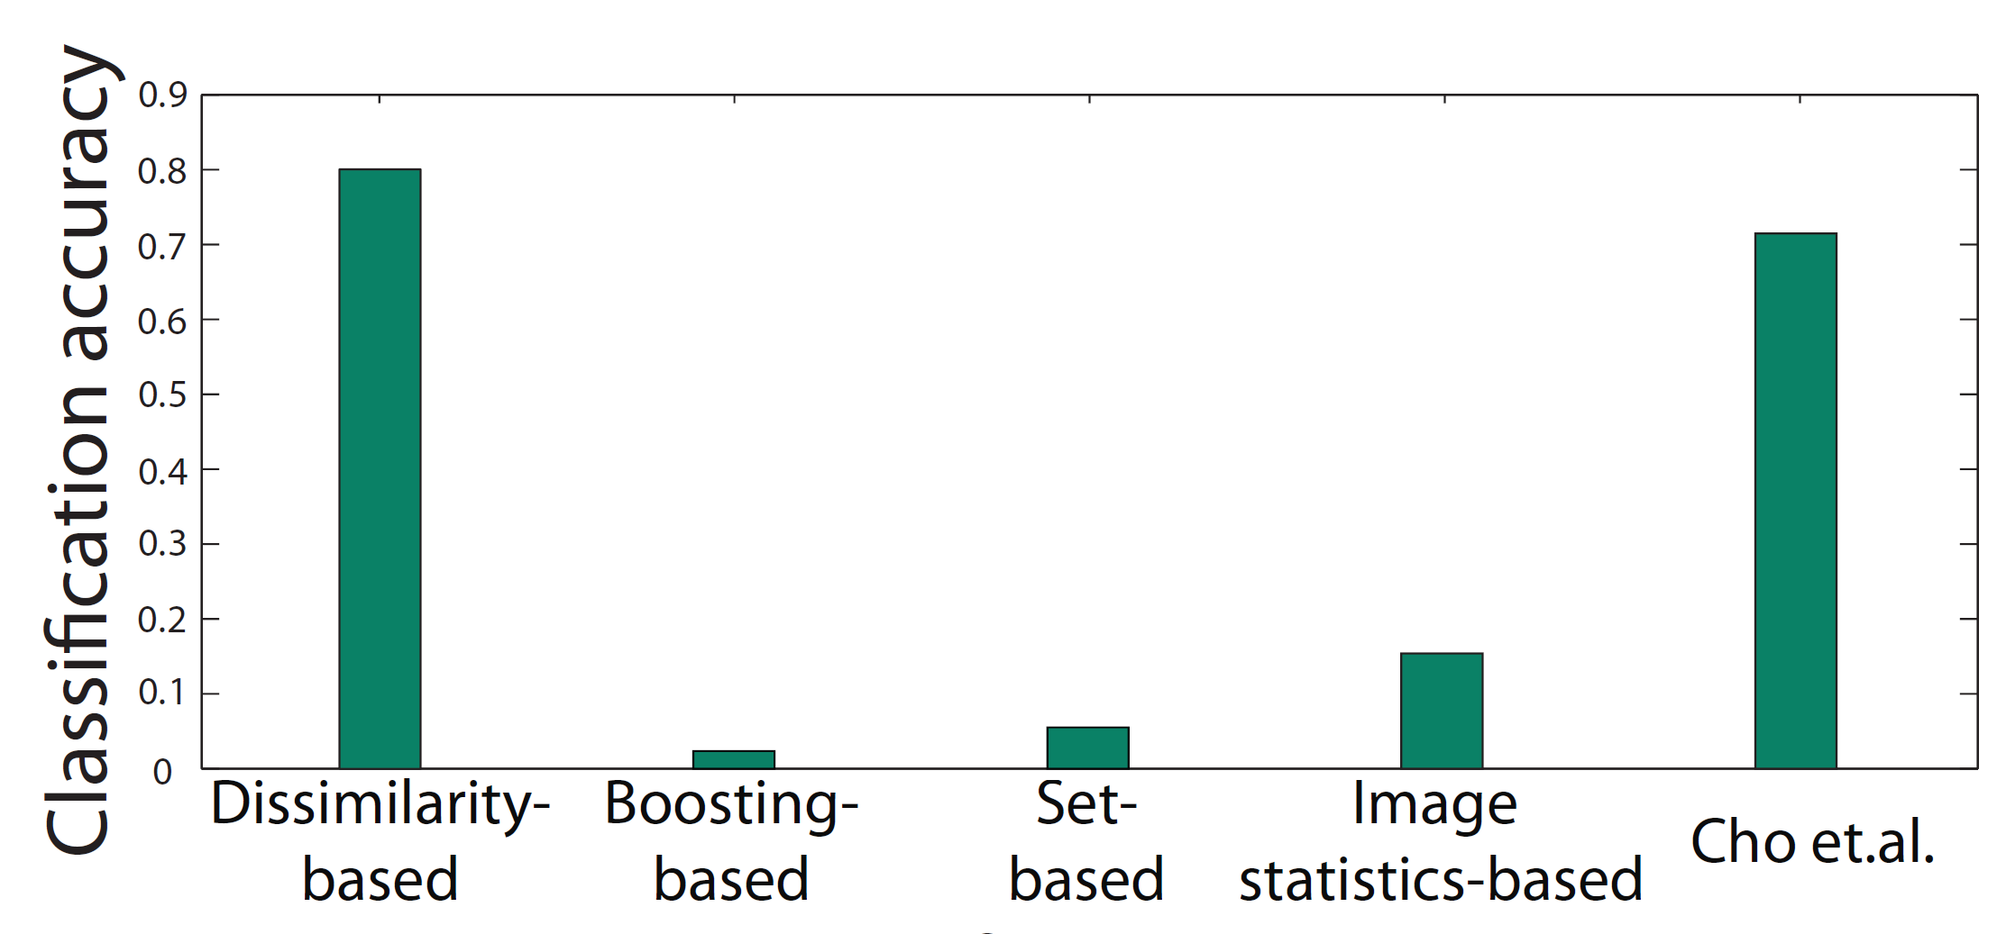
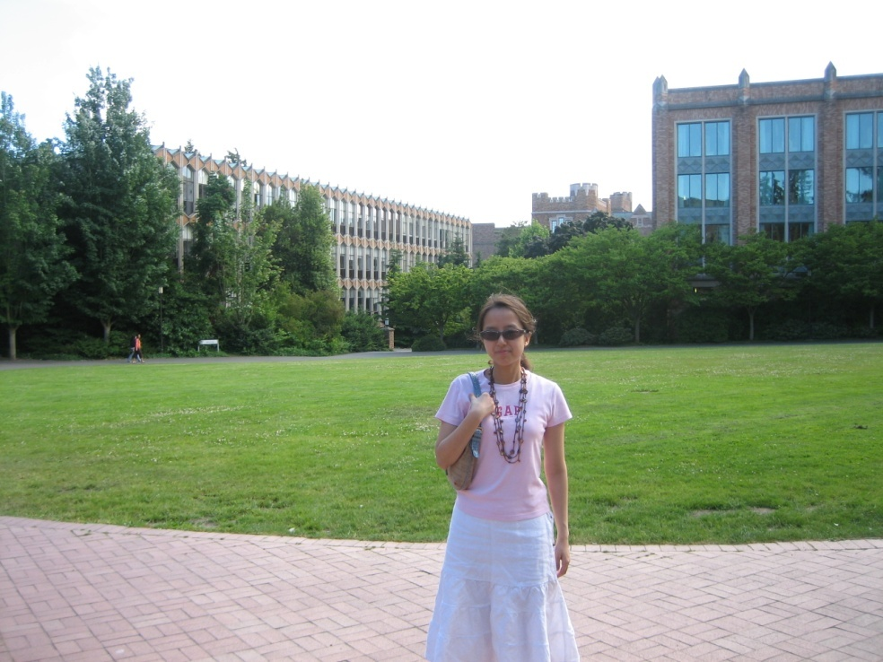
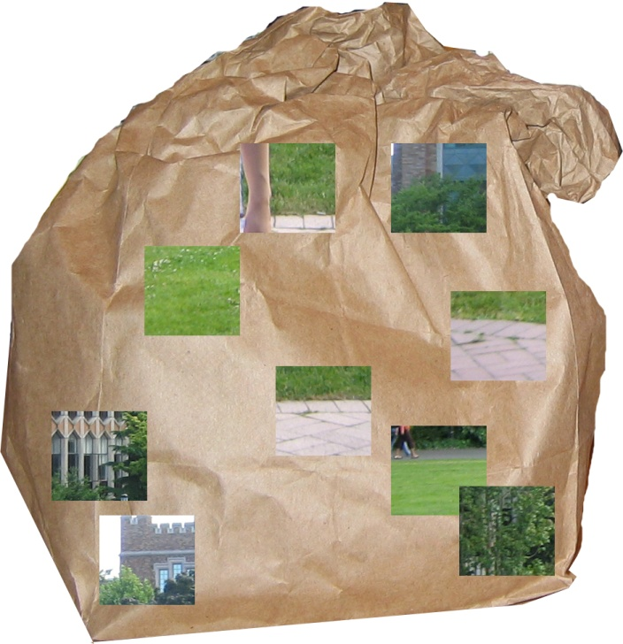
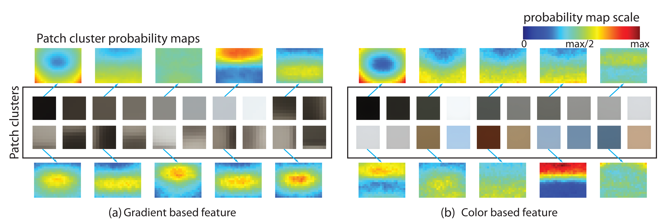
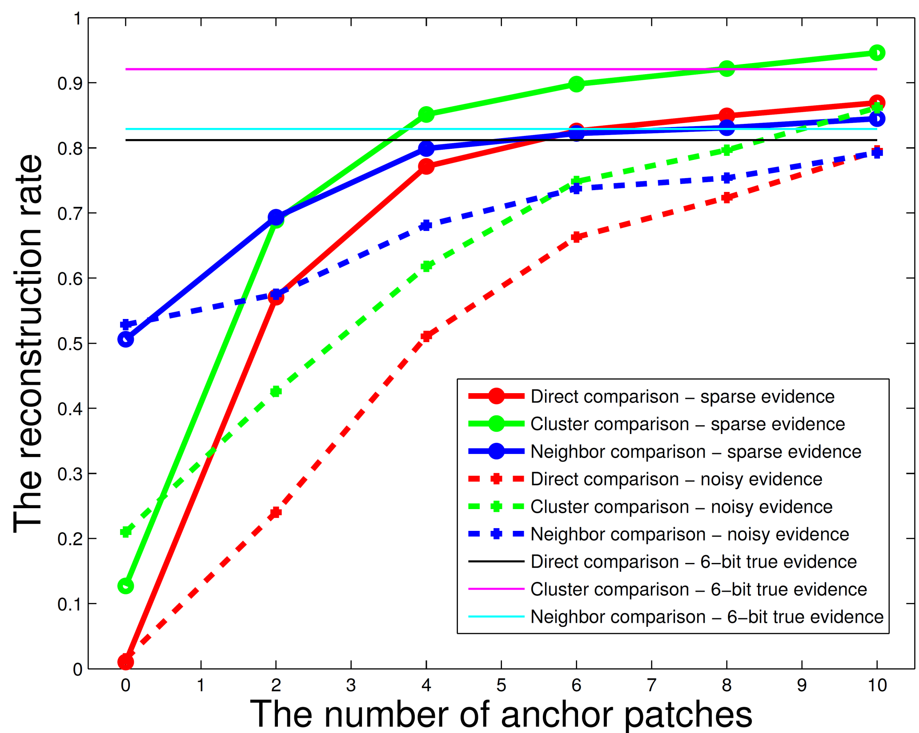
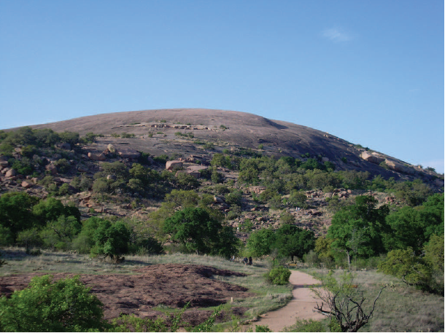
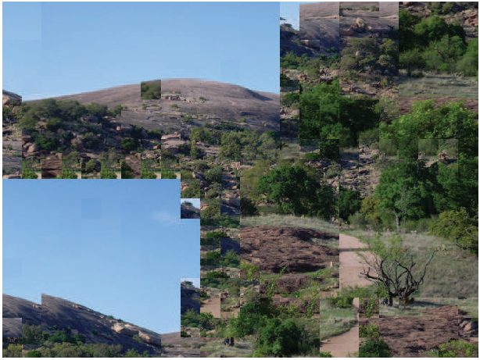
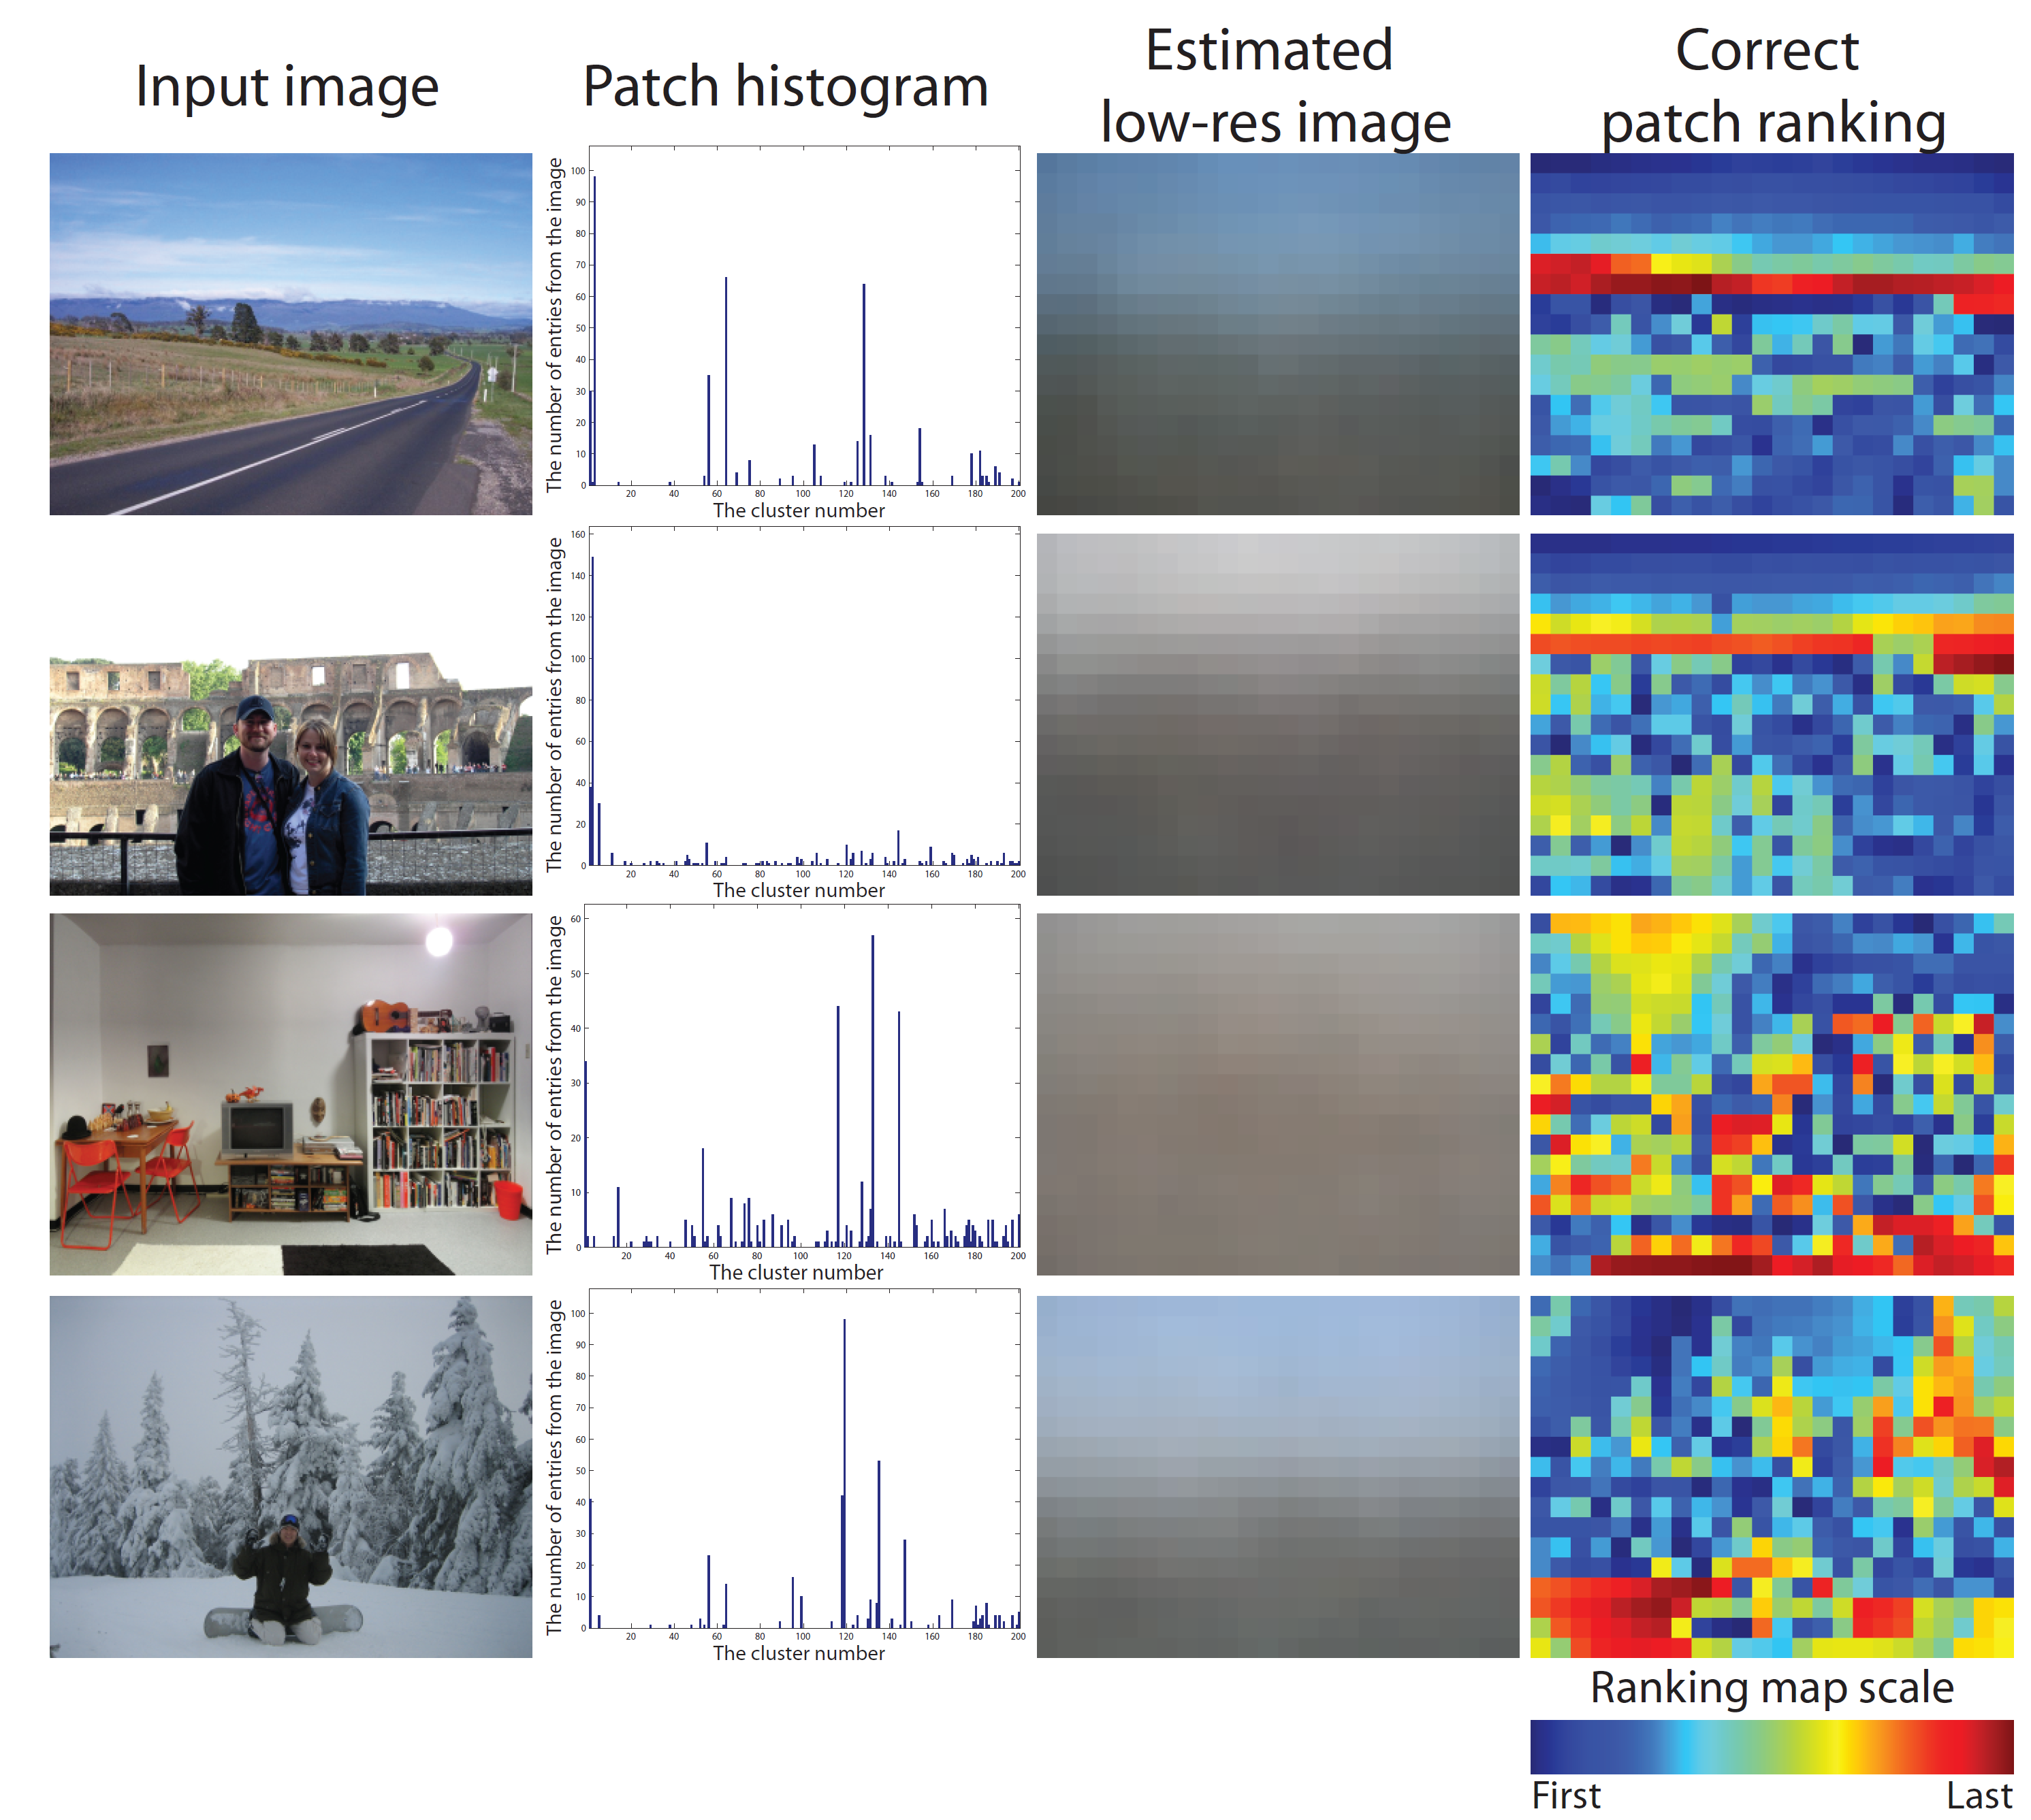
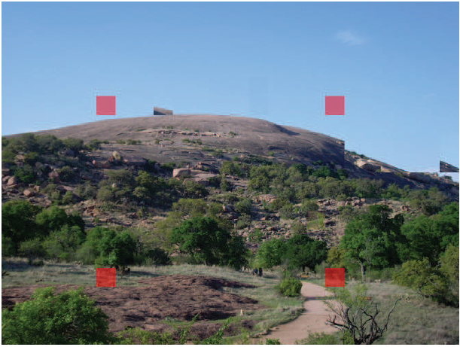
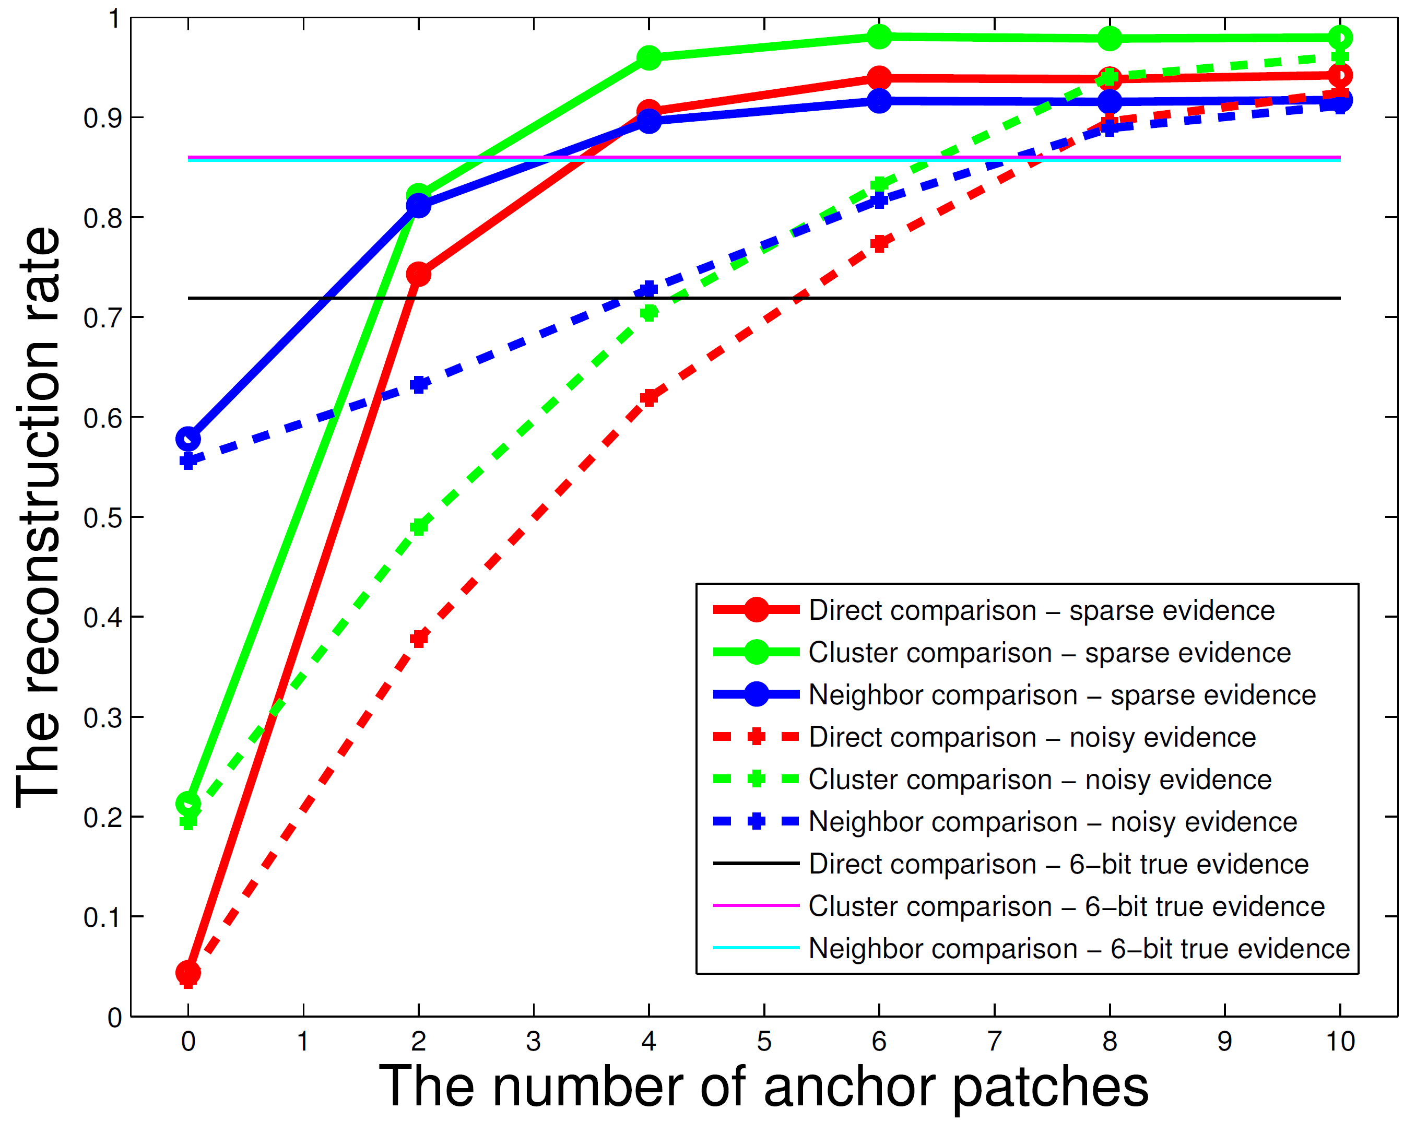
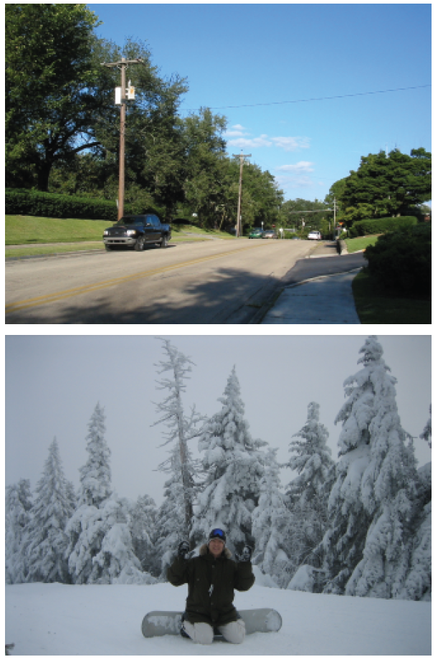
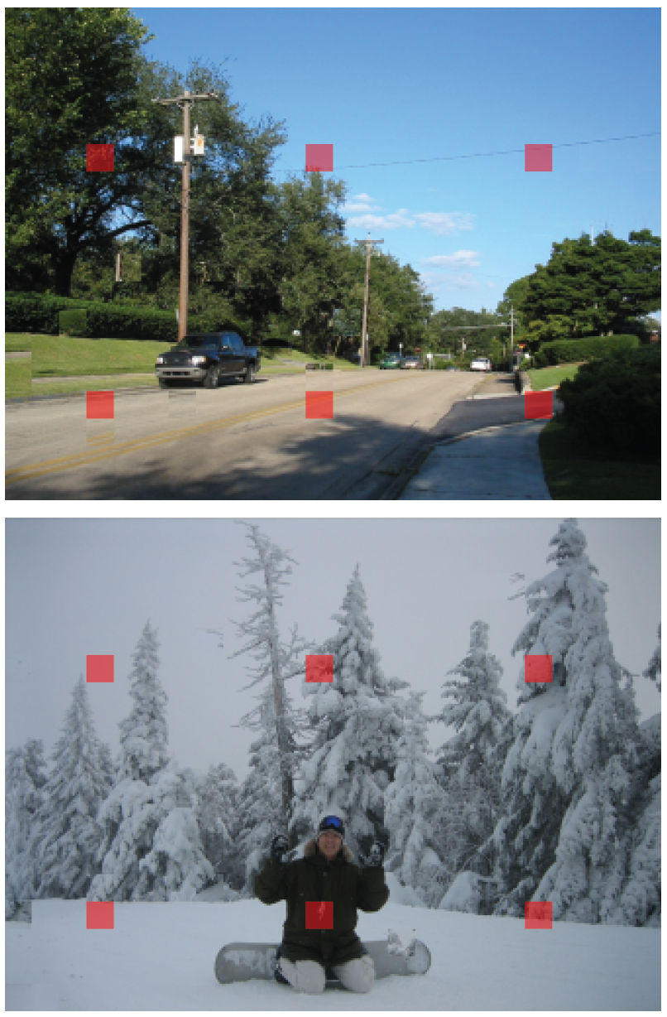
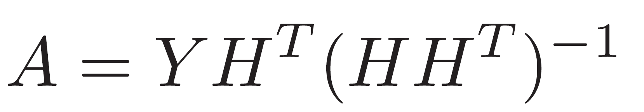

A probabilistic jigsaw puzzle solver
Taeg Sang Cho¹, Shai Avidan^{2,3}, William Freeman^{1,3}
MIT¹, Tel Aviv Univ.², Adobe Inc.³
Problem
The image model
Compatibility
From a set of non-overlapping patches from an image, can we reconstruct the image?
Pair-wise Compatibility
Exclusivity term
The fraction of correct patch pairs that have the
highest compatibility among other candidates
Easy!
Local evidence
Patch prior
Solving jigsaw puzzle is NP-complete!
[Cho et. al. CVPR 2008]
Adjacent patches should plausibly fit next to each other.
Each patch should not be used more than once
(we name it the exclusivity term.)
The local evidence and user’s constraints should be satisfied.
?????
Local evidence & patch prior
Reconstruction results
Patch vocabulary
Reconstruction rate
under three metrics
432 patches
Hierarchically cluster 8.5 million natural
image patches
Original image
Patch cluster probability maps can be used as
patch priors
Local evidence
Strategy I.
Local evidence
Strategy II.
Estimating
the low resolution image
Fix a few patches
at correct locations
221 patches
We use a linear
regressor to estimate a
low resolution image from
the patch histogram

