Slide 1
A content-aware prior
Taeg Sang Cho¹ Neel Joshi² C. Lawrence Zitnick²
Sing Bing Kang² Richard Szeliski² Bill Freeman¹
¹Massachusetts Institute of Technology
² Microsoft Research

Slide 2
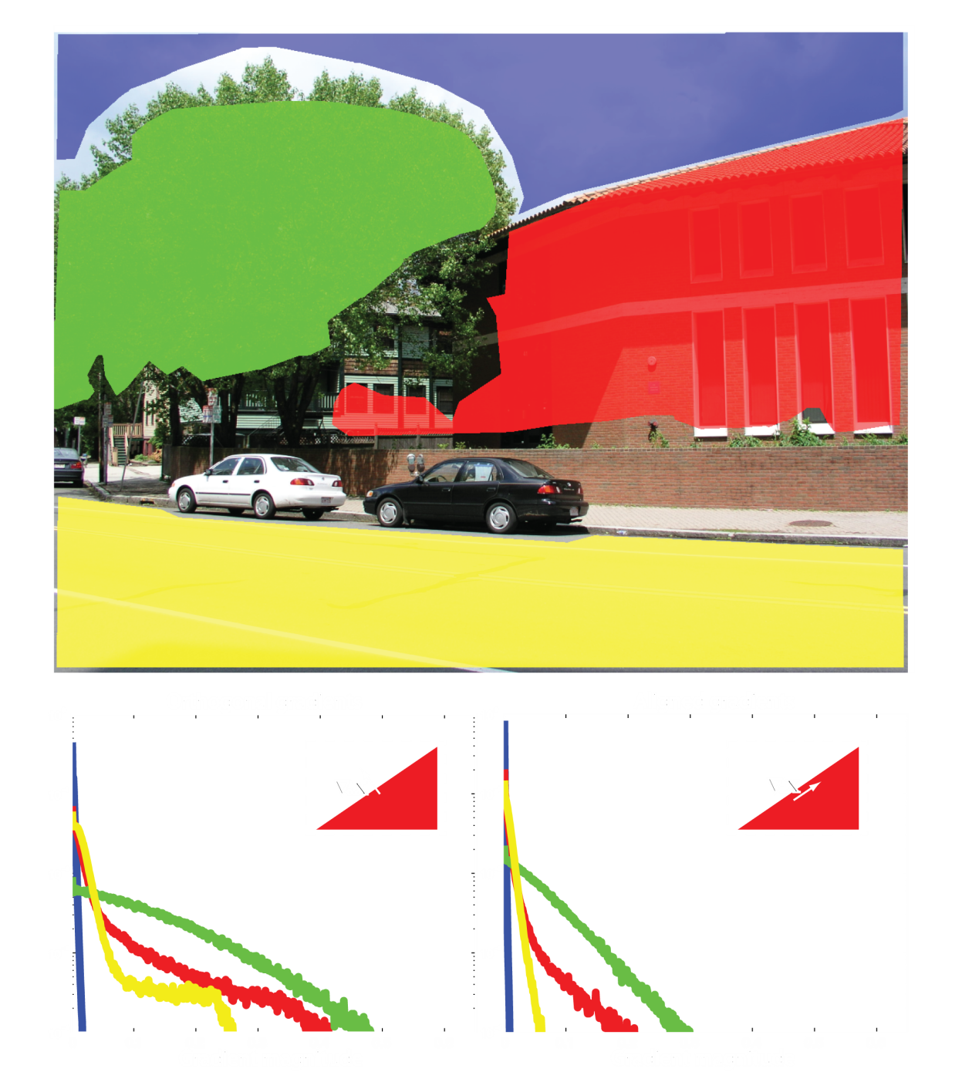
Spatially varying texture
Notes:
2
2

Slide 3
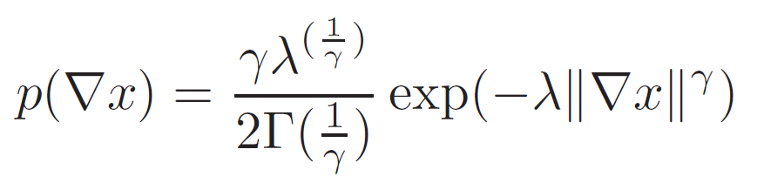
Gradient profile parametrization
Notes:
3
3

Slide 4
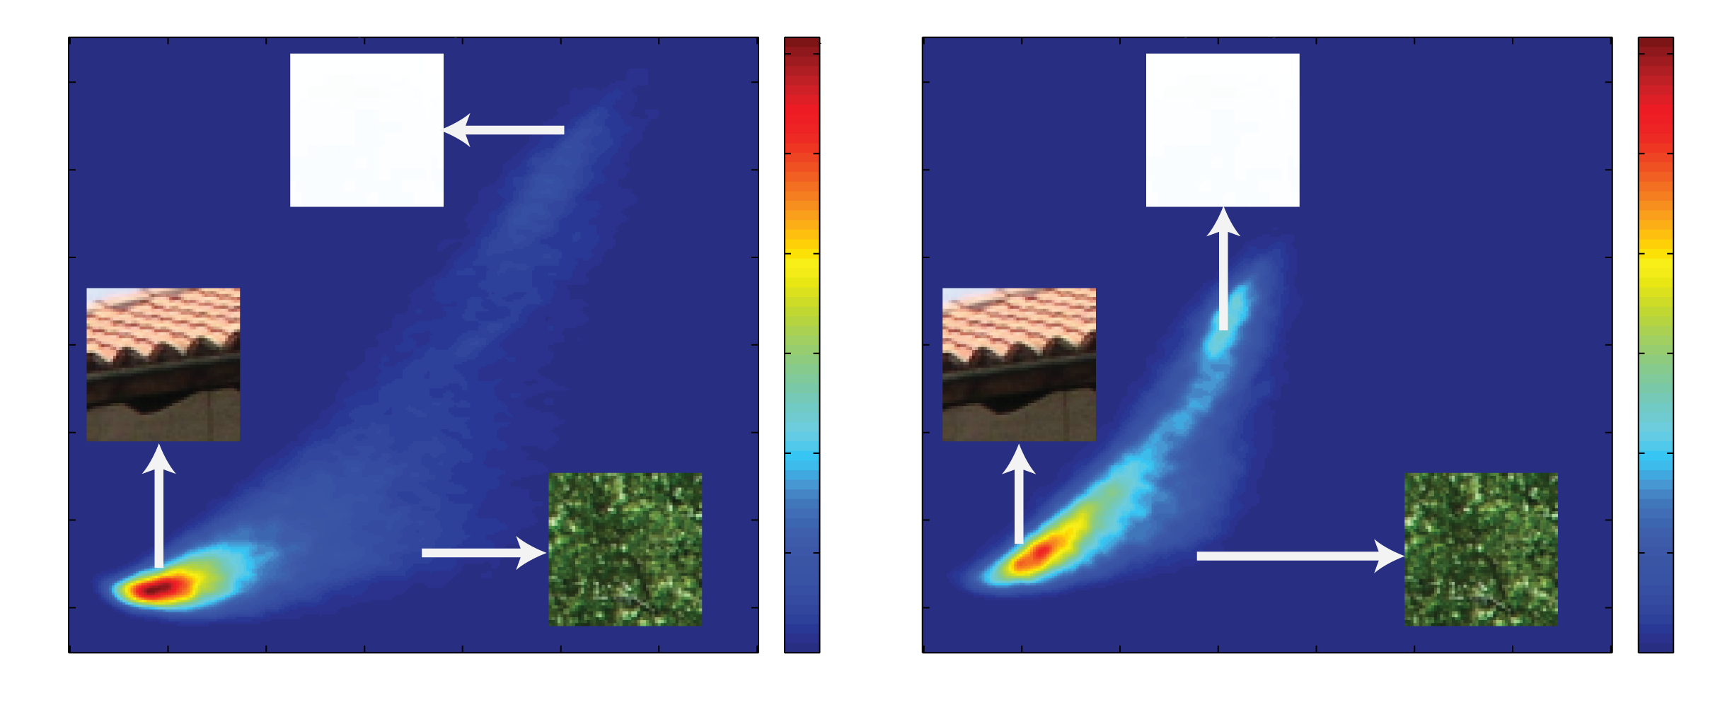
Distribution of parameters
Notes:
4
4

Slide 5
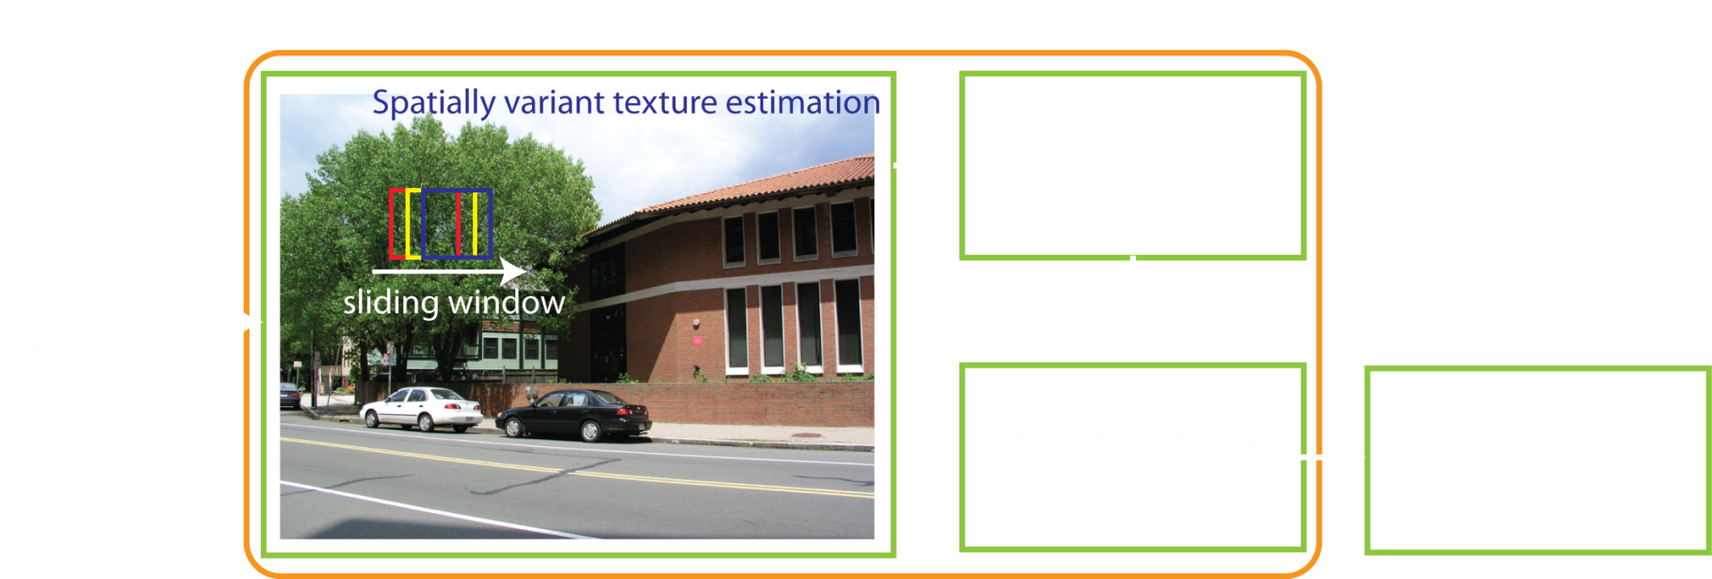
Pipeline
Notes:
5
5

Slide 6
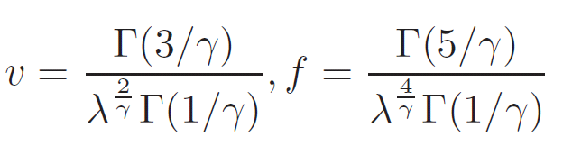
Texture descriptor
Notes:
6
6

Slide 7
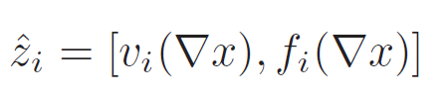
Texture descriptor
Notes:
7
7

Slide 8
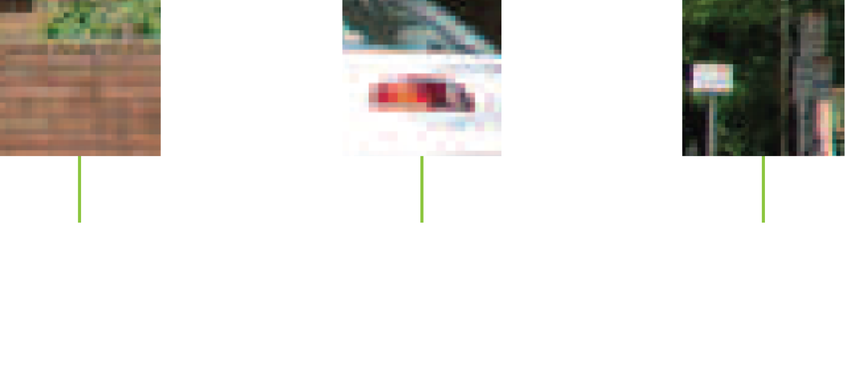
Learning a regression function
Notes:
8
8

Slide 9

Learning a regression function
Notes:
9
9

Slide 10
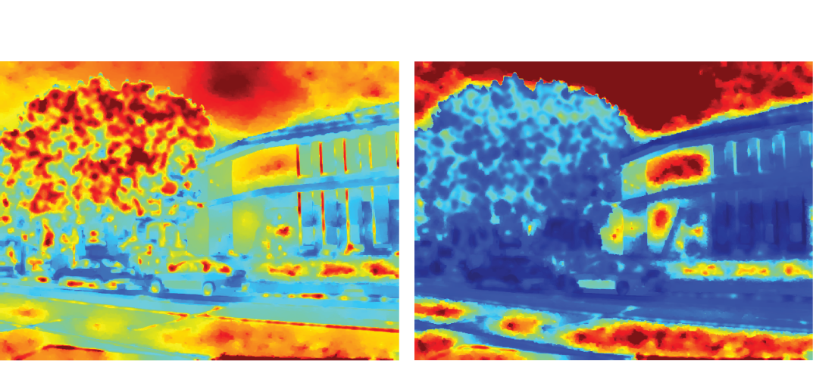
Estimated parameters
Notes:
10
10

Slide 11
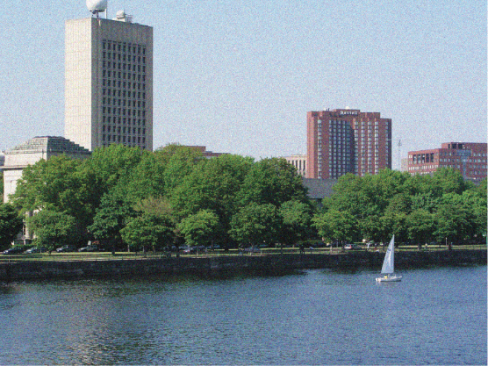
Denoising – 10% noise
Notes:
11
11

Slide 12
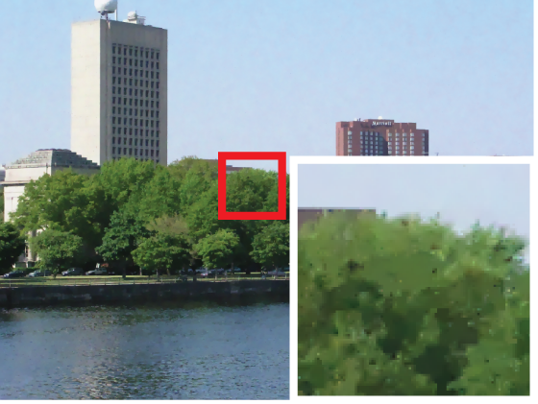
Denoising – sparse prior
Notes:
12
12

Slide 13

Denoising – steerable random field
Notes:
13
13

Slide 14

Denoising – content-aware image prior
Notes:
14
14

Slide 15
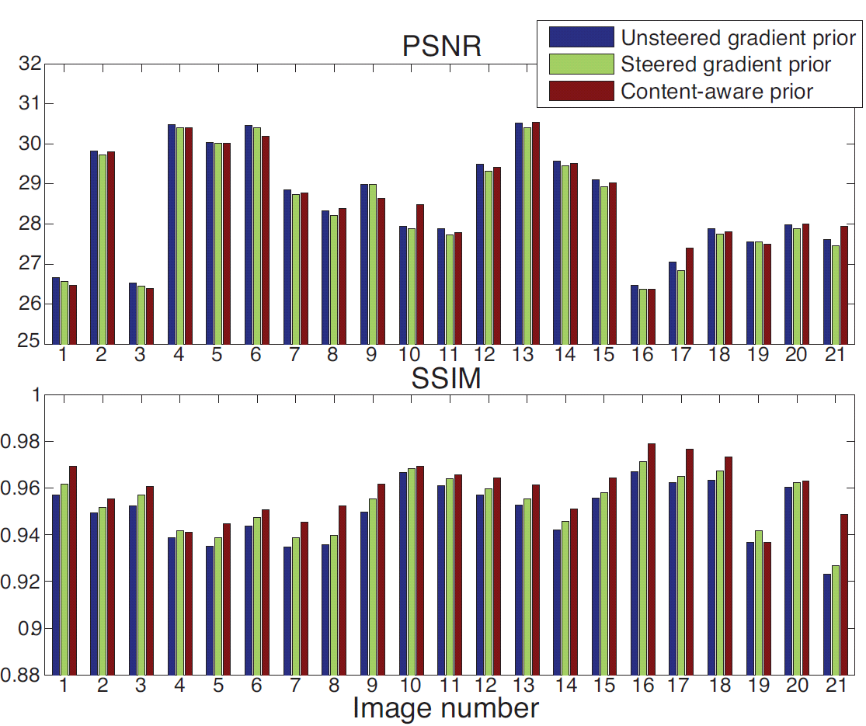
Denoising – performance comparisons
Notes:
15
15

Slide 16
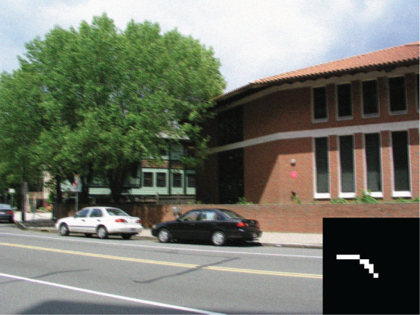
Deblurring – 5% noise
Notes:
16
16

Slide 17
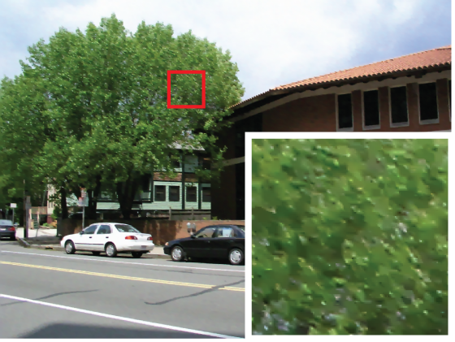
Deblurring – sparse prior
Notes:
17
17

Slide 18

Deblurring – steerable random field
Notes:
18
18

Slide 19

Deblurring – content-aware prior
Notes:
19
19

Slide 20
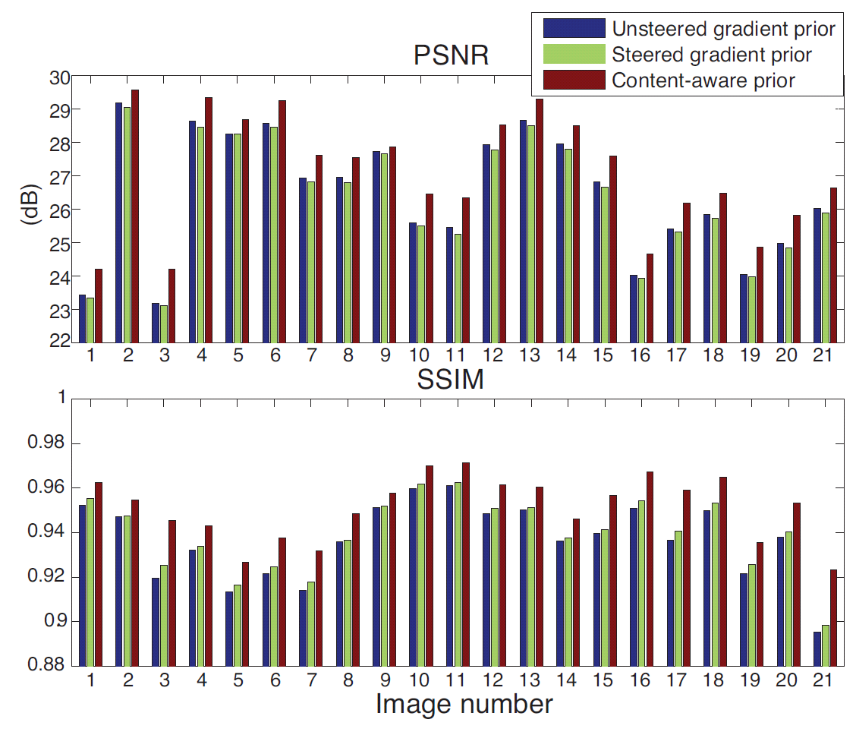
Deblurring – performance comparisons
Notes:
20
20

Slide 21
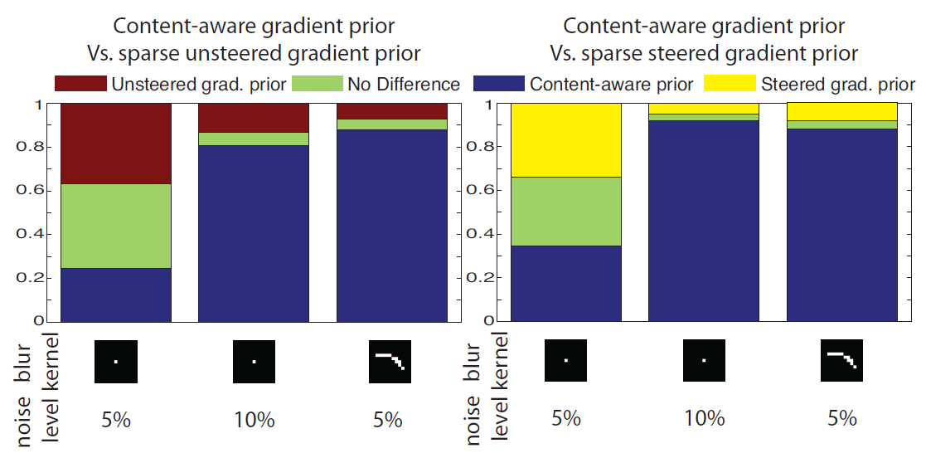
User study result
Notes:
21
21

Slide 22
A content-aware prior
http://people.csail.mit.edu/~taegsang
Taeg Sang Cho¹ Neel Joshi² C. Lawrence Zitnick²
Sing Bing Kang² Richard Szeliski² Bill Freeman¹
¹Massachusetts Institute of Technology
² Microsoft Research

