Slide 1
Removing motion blur
from photographs
Taeg Sang Cho
Massachusetts Institute of Technology
Aug. 12, 2010
Notes:
Thank you for coming. I am sure all of you would have taken at least one blurry photo in your lifetime. My thesis deals with combating such blur computationally.

Slide 2
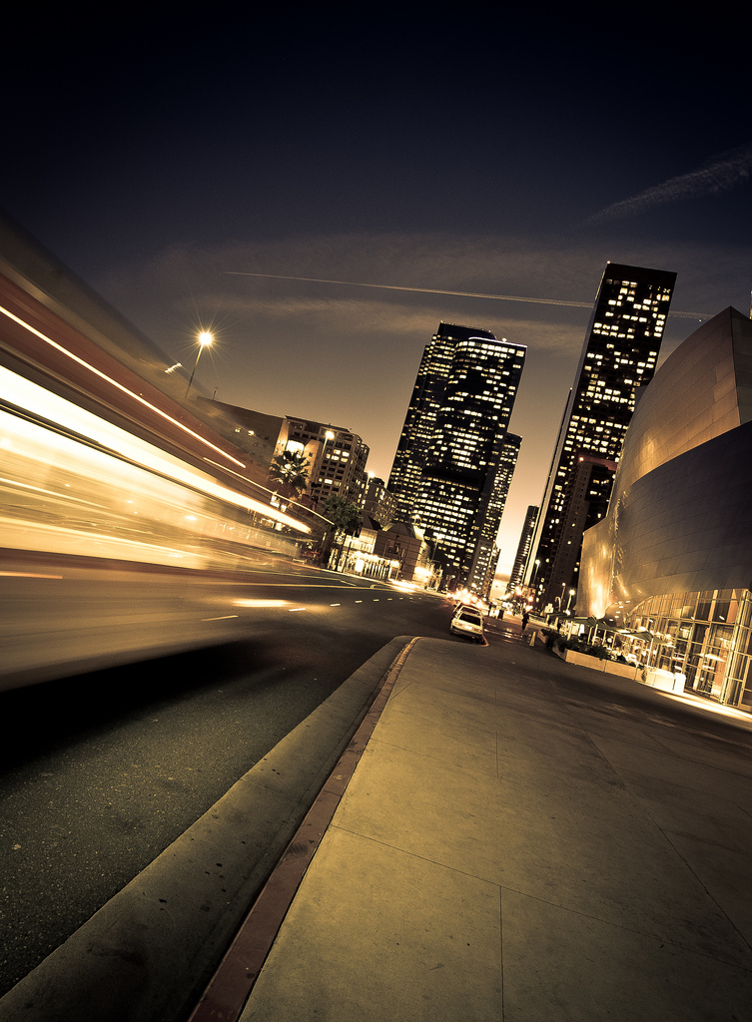
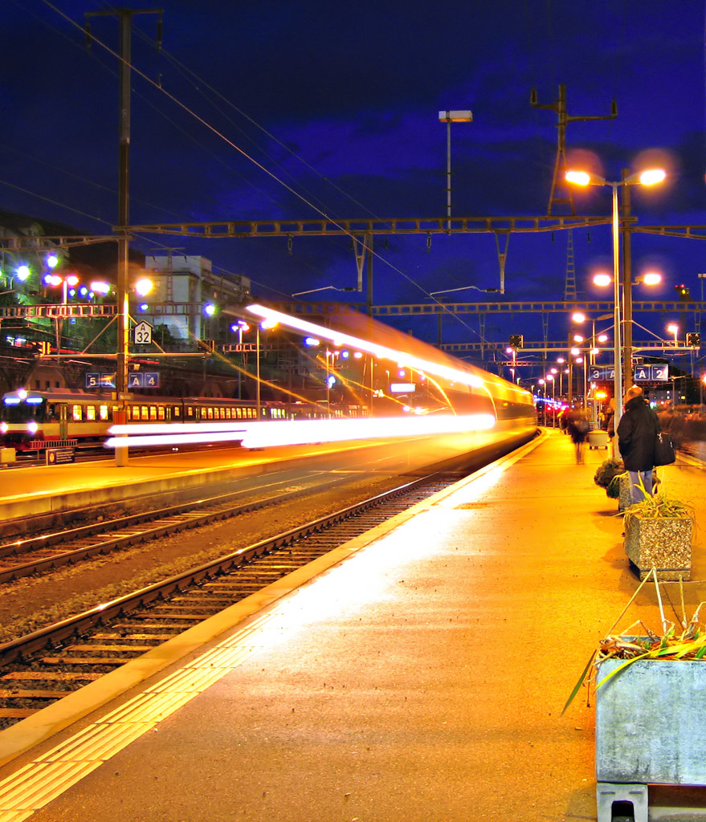
Motion blur
Blur can be desirable
Notes:
2
2
1. Blur is a smearing of pixels in photographs. Blur can sometimes be desirable for artistic purposes, but

Slide 3
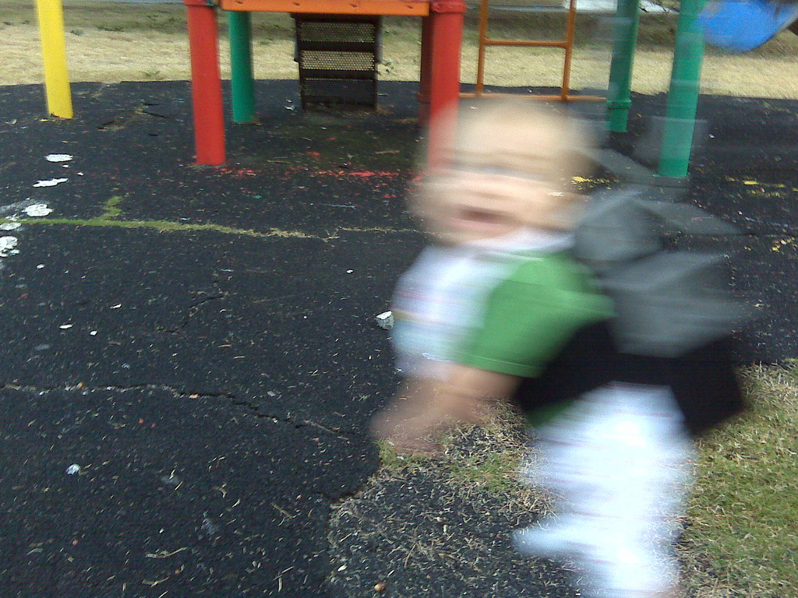
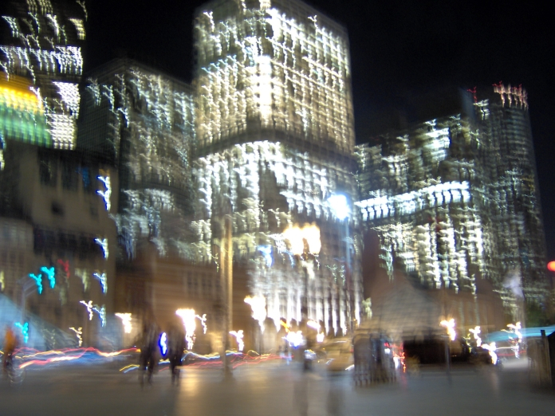
Motion blur
But…
Notes:
3
3
Oftentimes blur degrades the image quality.

Slide 4
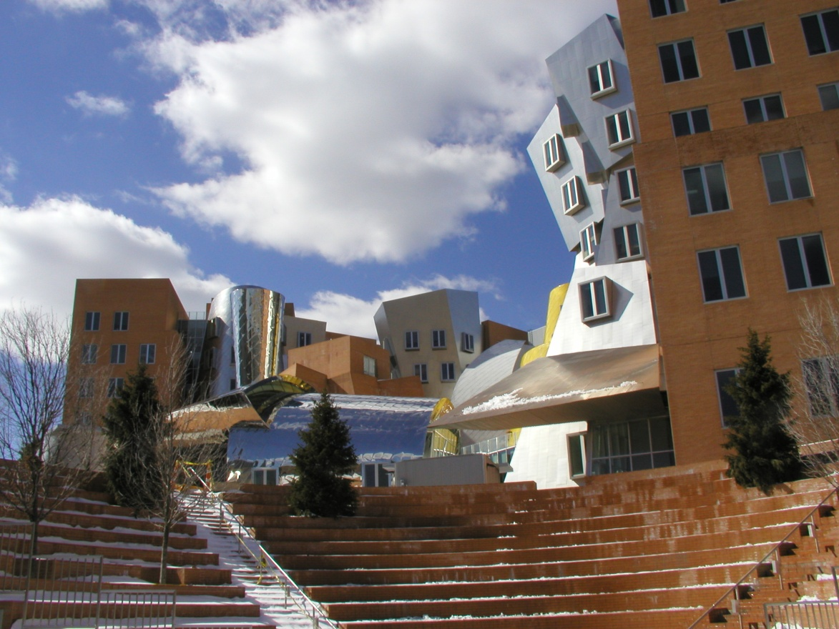

Where does the blur come from?
Notes:
4
4
But where does the blur come from and how can we reduce the blur? Blur is induced by a relative motion between a camera and a scene during exposure.
Let’s consider taking a photo of the stata center.
If you hand hold your camera, but you happen to move your camera frantically during exposure,

Slide 5
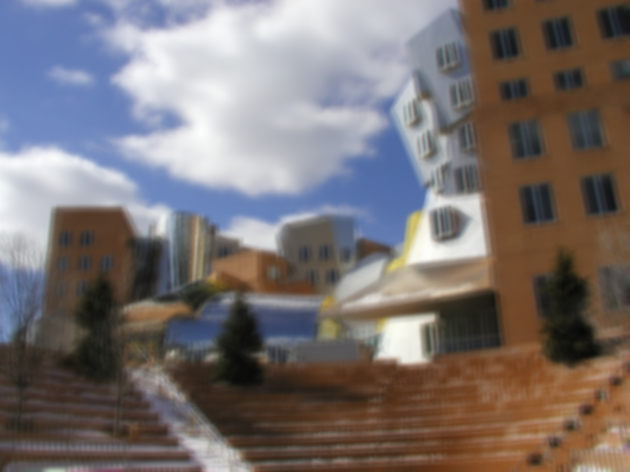
Where does blur come from?
Notes:
5
5
You would end up with a blurry photograph as this one.
We could reduce the blur by reducing the exposure time and increasing the gain setting of your sensor, but it comes at a price of more noise.

Slide 6
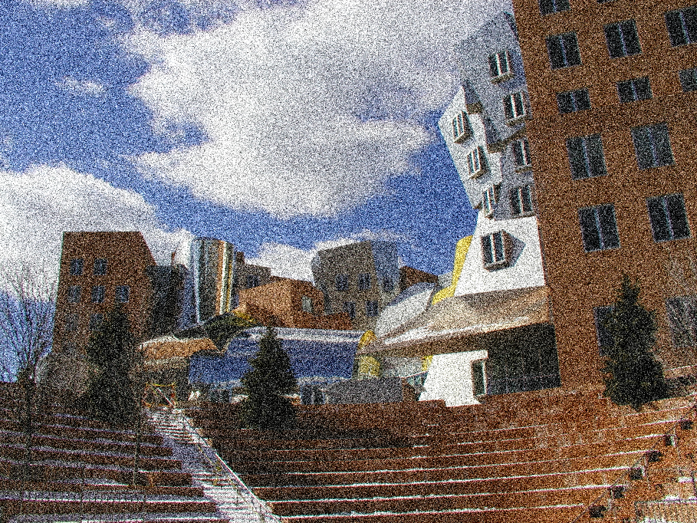
Where does blur come from?
Notes:
6
6
So it’s desirable to remove blur computationally.

Slide 7
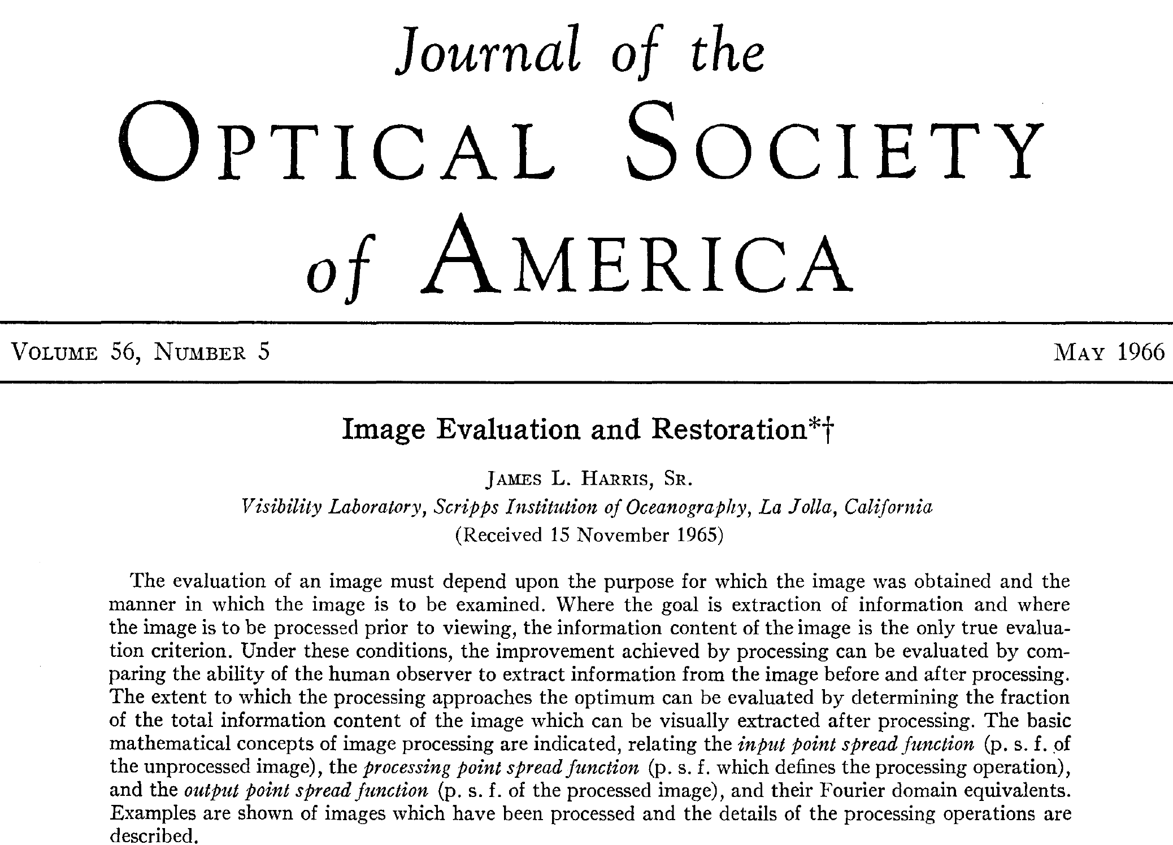
Notes:
7
7
This problem has been explored for almost 50 years, but it’s still considered largely unsolved.
So why exactly is this problem so challenging?

Slide 8
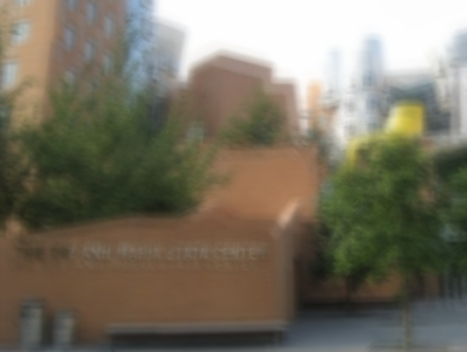
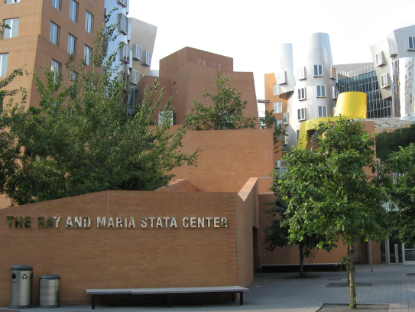
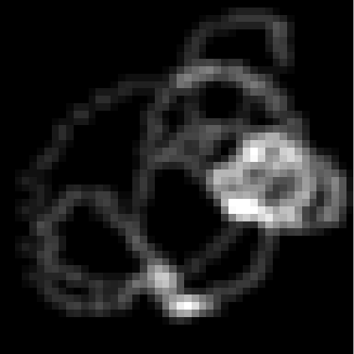
Why is motion blur removal challenging
1. Blur estimation is severely under-constrained
Sharp image
Blur kernel
=
⊗
=
⊗
Blurry image
=
⊗
[Courtesy: Rob Fergus]
Notes:
8
8
Well, the first challenge of deblurring is estimating how the image has been blurred,. The blur pattern is called a point-spread function or a blur kernel.
This problem is hard many blur – image pairs can explain a blurry input image. For instance, we can explain this blurry image as a blurry rendition of a sharp scene, but we could also explain this same photograph as a sharp rendition of a blurry scene. And there are even more solutions that can explain this blurry image, and our task is to pick the correct image – blur pair among all candidates that can explain the blurry image.

Slide 9
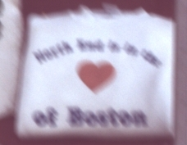
Why is motion blur removal challenging
2. Blur attenuates image information.
Notes:
9
9
But even if we could perfectly estimate the blur, restoring a natural looking image is still challenging because blur attenuates high frequency information of the underlying image. Therefore we need a mechanism to hallucinate such lost information.

Slide 10
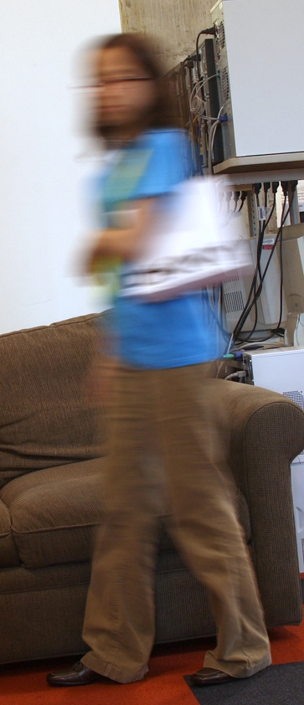
Why is motion blur removal challenging
3. Blur can be spatially variant
Notes:
10
10
And all these problems are aggravated when we consider subject motion blur. When we take an image of a scene with moving objects, the blur in moving parts would be different from that of the static parts. In this scenario, the image restoration algorithm has to take this into account.

Slide 11
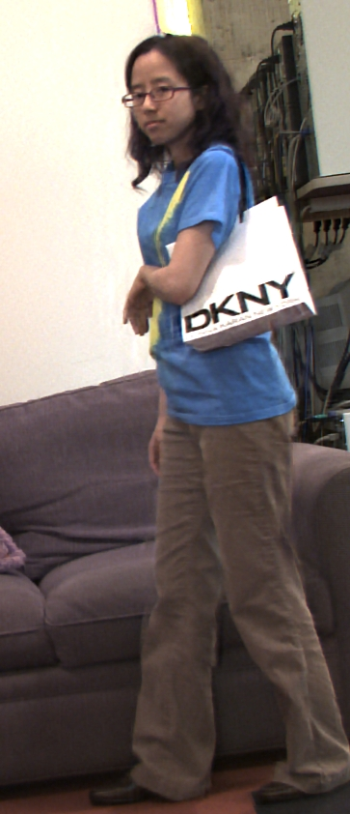
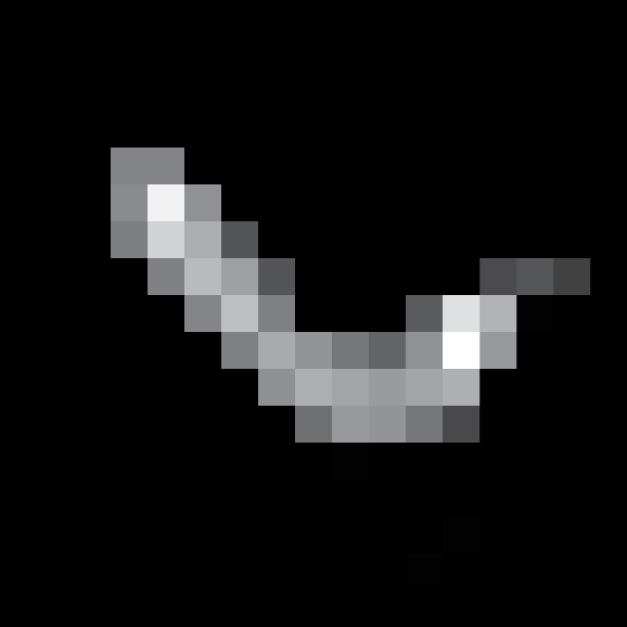
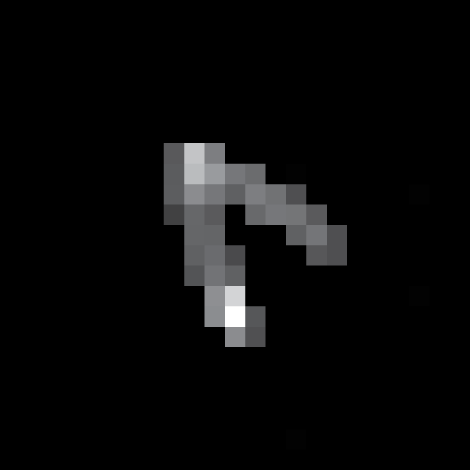

Contributions
Notes:
11
11
In this thesis, we investigate particular aspects of these challenges and provide new insights and solutions.

Slide 12
Contributions
Blur kernel estimation
- Using the inverse Radon transform to estimate blur kernels
from blurred edge profiles
Deconvolution
  - Adaptive image restoration algorithms for
  improved texture rendition.
Subject motion removal
  Spatially variant motion blur estimation.
  Information loss reduction using orthogonal parabolic motion.
Notes:
12
12
First, we show that we can analyze blurred edge profiles to reconstruct camera-shake blur kernels using the inverse Radon transform.
Second, we introduce an adaptive deconvolution algorithm that improves the rendition of texture in restored images.
Third, we present a computational camera that is capable of addressing a spatially variant subject motion blur.

Slide 13
Contributions
Blur kernel estimation
- Using the inverse Radon transform to estimate blur kernels
from blurred edge profiles
Deconvolution
  - Adaptive image restoration algorithms for
  improved texture rendition.
Subject motion removal
  Spatially variant motion blur estimation.
  Information loss reduction using orthogonal parabolic motion.
Notes:
13
13
Due to time constraints, we will focus on two projects: the blur kernel estimation project and the subject motion removal project, but I will be happy to discuss our deconvolution algorithm offline.

Slide 14
Blur kernel estimation from blurred edge profiles
Taeg Sang Cho¹, Sylvain Paris²,
William T. Freeman¹, Berthold Horn¹
Massachusetts Institute of Technology
Adobe Systems Inc.
Notes:
So let us start with blur estimation work.

Slide 15


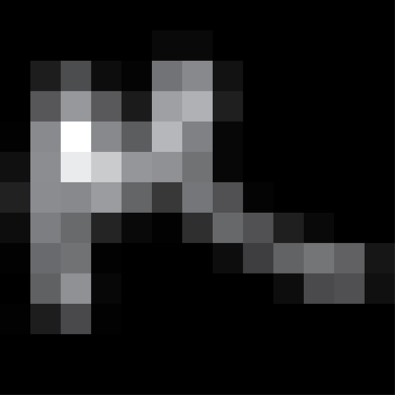
A blurry photograph
=
⊗
+ n
Notes:
15
15
We often model a blurry image as a convolution of the underlying sharp image and the blur kernel, which is degraded with additive noise n.

Slide 16
Camera shake removal
From a blurry photograph, estimate its sharp image.
=
⊗
+ n
Notes:
16
16
In a camera shake removal problem, our goal is to estimate a sharp image from its blurry version.

Slide 17
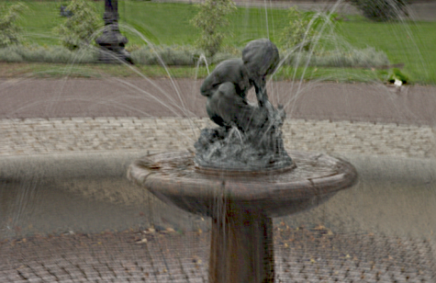
Related work
Variational inference
[Chan et al. 98][Miskin et al. 00]
[Fergus et al. 06][Babacan et al. 08]
Notes:
17
17
This problem has been investigated for quite a while now. One of the most famous methods in our community is Rob Fergus’s variational inference method. Rob’s work was sensational in that it demonstrated it is indeed possible to remove blur from consumer photographs. Rob’s method first estimates the blur kernel using a variational inference algorithm, and uses a non-blind deconvolution technique to restore a blur free image.

Slide 18
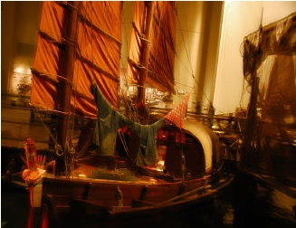
Related work
Variational inference
[Chan et al. 98][Miskin et al. 00]
[Fergus et al. 06][Babacan et al. 08]
Joint estimation of blur and sharp image
[Lagendijk et al. 90][Lay et al. 90]
[Shan et al. 08][Cai et al. 08]
Notes:
18
18
Instead of first recovering the blur kernel and then restoring a blur free image in two separate steps, we can jointly estimate the blur and the sharp image by minimizing a single energy function. These methods tend to be quite sensitive to parameter values.

Slide 19
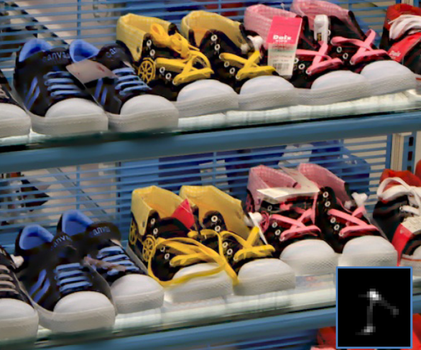
Related work
Variational inference
[Chan et al. 98][Miskin et al. 00]
[Fergus et al. 06][Babacan et al. 08]
Joint estimation of blur and sharp image
[Lagendijk et al. 90][Lay et al. 90]
[Shan et al. 08][Cai et al. 08]
Using edges
[Jia 07][Joshi et al. 08]
[Money et al. 08][Cho et al. 09]
Notes:
19
19
And there exists a class of algorithms that explicitly uses blurred edges for blur estimation. For instance, Neel’s work predicts where sharp edges should line up, and uses the predicted location of edges to recover the blur kernel in a non-blind manner.

Slide 20
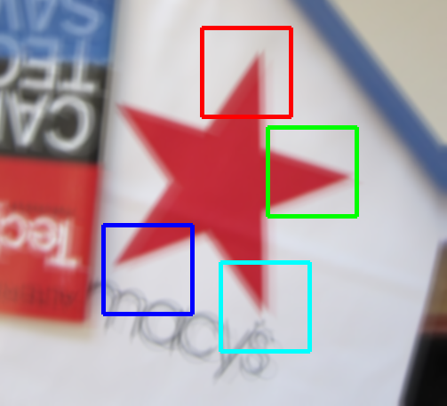




Observation
Edges are affected differently by blur
Notes:
20
20
In our work, we also exploit blurred edges, but we key on a different insight. Specifically, we exploit an observation that edges in different orientations are affected differently by blur, as shown on this slide. We use these signatures of the blur kernel to estimate it.

Slide 21
Outline
Blur kernel estimation using blurred edge profiles
  The Radon transform and blur
  Using blurred edges for blur identification
  Deblurring pipeline
  Experimental results
Orthogonal parabolic exposures for motion deblurring
  2D motion optimal spectral bound
  Camera design
  Blur estimation
  Experimental results
Notes:
21
21
Here is a brief outline. We will first review how the Radon transform is related to blur, and how we can use blurred edges for blur estimation. Then we discuss our system and the experimental results.

Slide 22
Outline
Blur kernel estimation using blurred edge profiles
  The Radon transform and blur
  Using blurred edges for blur identification
  Deblurring pipeline
  Experimental results
Orthogonal parabolic exposures for motion deblurring
  2D motion optimal spectral bound
  Camera design
  Blur estimation
  Experimental results
Notes:
22
22
So, the Radon transform.

Slide 23
The Radon transform
The Radon transform is a set of integrals of
a signal f along straight lines
[Toft 96]
Notes:
23
23
The radon transform is defined as a set of integrals of a signal f along straight lines in different orientations.

Slide 24

The Radon transform
The Radon transform is a set of projections of a signal f
projection
[Toft 96]
Notes:
24
24
Following the definition, if we integrate a blur kernel along the yellow lines, we get a projection of that blur kernel. In other words, the Radon transform of a signal is a set of projections of a signal.

Slide 25
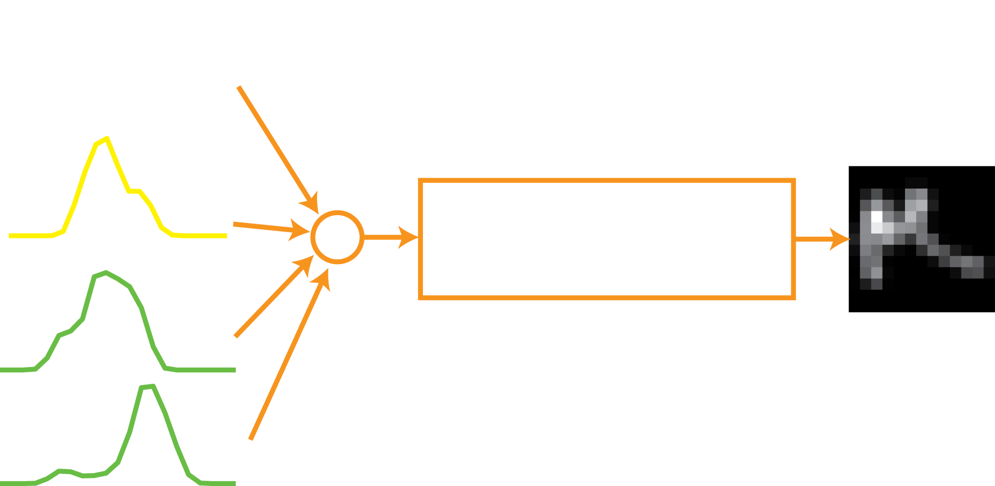
The inverse Radon transform
Notes:
25
25
Once we have projections of a blur kernel in different orientations, we can use the inverse Radon transform to recover the blur kernel from the projections. This is how the CT scan works.

Slide 26
The Radon Transform and blur estimation
⊗
An orthogonal slice of a blurred line is a projection of the blur kernel in the line’s orientation.
Notes:
26
26
Then how is the Radon transform related to blur? I argue that a perpendicular slice of a blurred line is equivalent to the projection of the blur kernel in the line’s orientation.
I will illustrate this idea graphically by convolving a vertical line with a blur kernel.

Slide 27
The Radon Transform and blur estimation
⊗
=
⊗
An orthogonal slice of a blurred line is a projection of the blur kernel in the line’s orientation.
Notes:
27
27
Since convolution is bilinear, we can swap the operands,

Slide 28
The Radon Transform and blur estimation
T = T₁
Notes:
28
28
Following the definition of convolution, we compute the sum of products between the line and the kernel to compute the value of the convolved image at the orange dot. At this time instance, there is one crossing; therefore the value at the orange dot is 1.

Slide 29
The Radon Transform and blur estimation
T = T₂
Notes:
29
29
In the next time instance, we shift the line by one pixel, and do the same operation.

Slide 30
The Radon Transform and blur estimation
T = T₃
Notes:
30
30
And so on.

Slide 31
The Radon Transform and blur estimation
T = T₄
Notes:
31
31
Here we have two crossings, so the value at the orange dot is 2.

Slide 32
The Radon Transform and blur estimation
T = T₅
Notes:
32
32
And here three. You may have realized by now that when we compute the sum of products between the line and the kernel, we are in fact taking the projection of the blur kernel along the line.

Slide 33
The Radon Transform and blur estimation
T = T_{N}
Notes:
33
33
In other words, by the end of convolution,

Slide 34
The Radon Transform and blur estimation
T = T_{N}
Notes:
34
34
When we take a perpendicular slice of the blurred line, we would get a blurred line profile, and this is equivalent to the projection of the blur kernel.

Slide 35
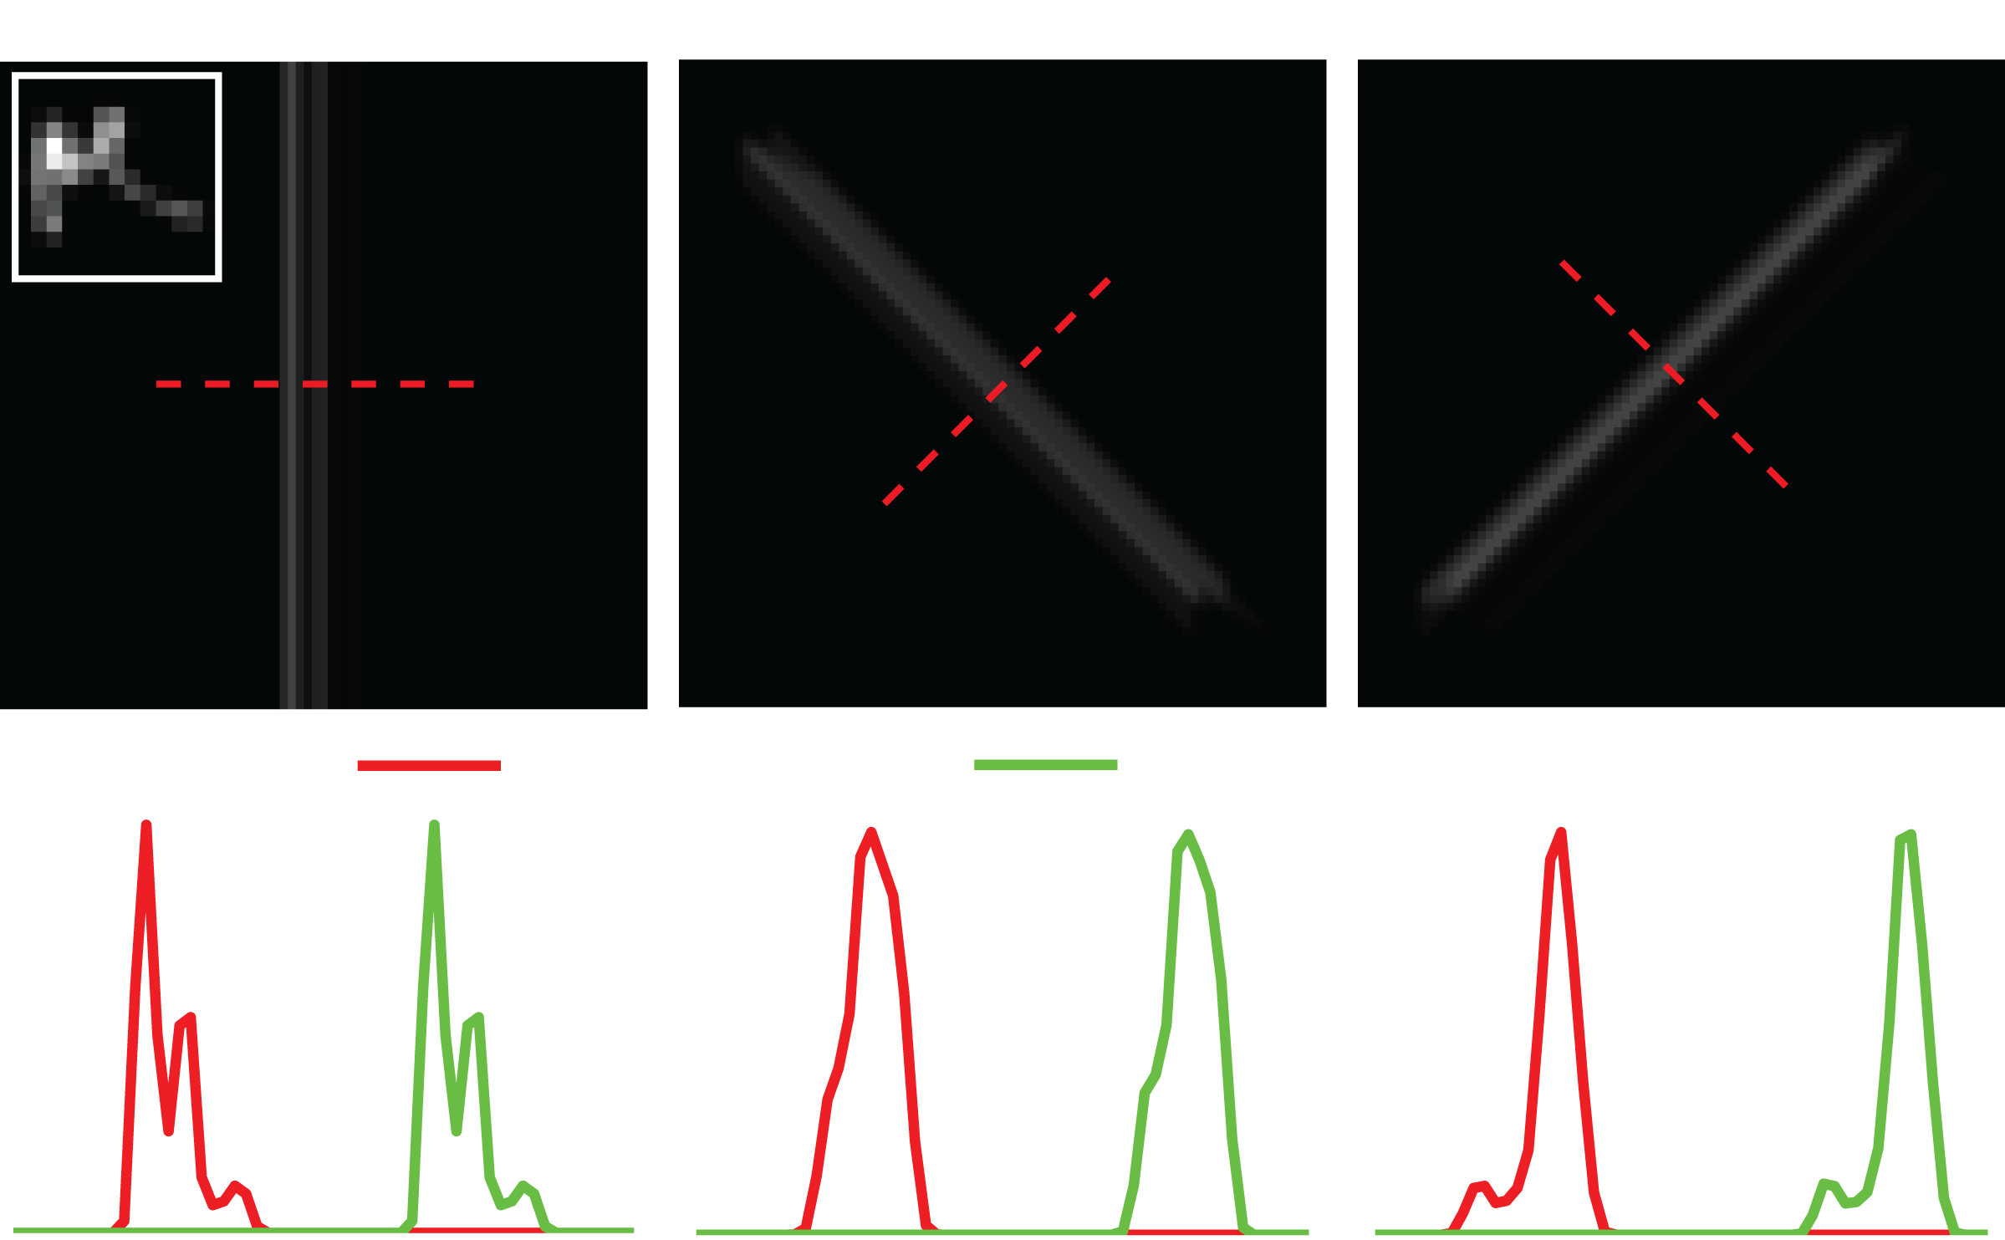
The Radon Transform and blur estimation
Notes:
35
35
We can experimentally show that it is indeed the case. We blur the lines in different orientations and compare a perpendicular slice of each blurred line to explicit projections of the blur kernel. And we see that the two are equivalent.

Slide 36
Why is this useful for blur estimation?
We can estimate the blur kernel from blurred line profiles
if we could reliably detect impulse-like lines from the blurred image!
Notes:
36
36
This observation implies that if we could reliably detect impulse-like structures from blurred images, we can estimate the blur kernel from them by taking perpendicular slices of blurred impulse lines and using the inverse Radon transform.

Slide 37
Why is this useful for blur estimation?
We can estimate the blur kernel from blurred line profiles
if we could reliably detect impulse-like lines from the blurred image
However …
Detecting lines reliably is difficult.
Most lines are not an impulse, but have finite widths.
Notes:
37
37
But detecting lines reliably from an image is a challenging task by itself, and

Slide 38
Why is this useful for blur estimation?
We can estimate the blur kernel from blurred line profiles
if we could reliably detect impulse-like lines from the blurred image
However …
Detecting lines reliably is difficult.
Most lines are not an impulse, but have finite widths.
Notes:
38
38
And even if we could detect all the lines reliably, most lines are in fact not an impulse, but have finite widths and complicated profiles. Therefore, we cannot use most of them.

Slide 39
Outline
Blur kernel estimation using blurred edge profiles
  The Radon transform and blur
  Using blurred edges for blur identification
  Deblurring pipeline
  Experimental results
Orthogonal parabolic exposures for motion deblurring
  2D motion optimal spectral bound
  Camera design
  Blur estimation
  Experimental results
Notes:
39
39
But fortunately we can use blurred edges.

Slide 40

Use blurred edges!
Edge
Matted edge
Line
matting
Notes:
40
40
An interesting property of an edge is that we can process it to derive a line from it. For instance, let’s consider an edge consisting of two dominant colors. We can matte this edge to recover a binary edge and we can differentiate the binary edge to recover the line.

Slide 41
Use blurred edges!
Edge
Matted edge
Line
matting
matting
⊗
+
⊗
Notes:
41
41
1. What’s interesting is that we can process the blurred edge the same was to recover blurred lines. This property holds because every operation is linear.

Slide 42
Use blurred edges!
⊗
=
We can estimate the blur kernel projections
by differentiating blurred edge profiles
Notes:
42
42
In other words, we can recover the blur kernel projections by differentiating blurred edge profiles. Since detecting edges from a natural image is quite stable, we can devise an automatic deblurring system using this idea.

Slide 43
Outline
Blur kernel estimation using blurred edge profiles
  The Radon transform and blur
  Using blurred edges for blur identification
  Deblurring pipeline
  Experimental results
Orthogonal parabolic exposures for motion deblurring
  2D motion optimal spectral bound
  Camera design
  Blur estimation
  Experimental results
Notes:
43
43
I will illustrate how to use this idea for deblurring.

Slide 44



System
Edge detection /
Blur projection estimation
Inverse
Radon transform
Deconvolution
Notes:
44
44
Our system comprises of three subblocks. First we detect reliable step edges from the input blurry photograph. At selected edge samples, we use blurred edges to estimate blur kernel projections. Then we use the inverse Radon transform to reconstruct the blur kernel. Given the blur kernel, we use a standard MAP deconvolution method to remove blur from the blurry photograph.
We look into these sub blocks in more detail.

Slide 45
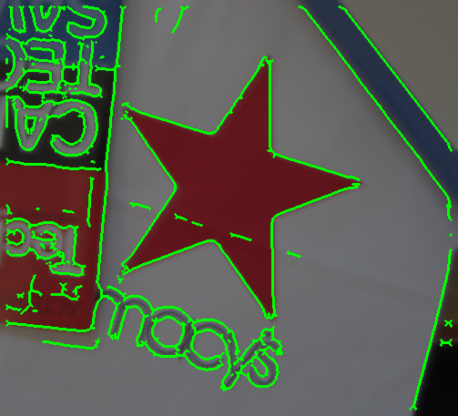
Edge detector
Standard edge detector output
Notes:
45
45
We use a standard edge detector to detect edges for blur estimation. Before we run the edge detector, we first down-sample the image to ensure that a single edge is not interpreted as a line due to blur. Unfortunately, we cannot use all the edges detected using the edge detector because they sometimes correspond to lines, not step edges, or they sometimes correspond to curved structures and not straight edges, or sometimes the color difference on either side of the edge is too small.
We have a number of heuristics to select reliable edges that correspond to straight step edges with enough color difference on either side of the edge.

Slide 46
Edge detector
Our algorithm
Notes:
46
46
This heuristic sieves edges that are reliable enough for our technique.
We take edge profiles at these locations and compute their derivatives to estimate the blur kernel projections.

Slide 47
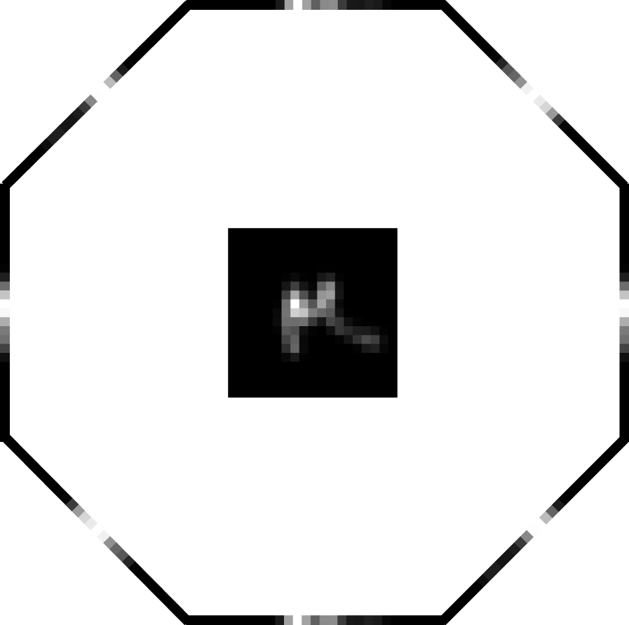
The inverse Radon transform – Back projection
Notes:
47
47
Given the blur projections our next task is to invert them using the inverse Radon transform.
The inverse Radon transform has been studied extensively in the past in the context of computed tomography. One of the simplest method is called backprojection.

Slide 48
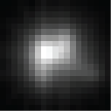
The inverse Radon transform – Back projection
Notes:
48
48
If we use a lot more projections in a lot more directions, we get a rather smoothed version of the blur kernel. This is one undesirable characteristic of back projection.

Slide 49
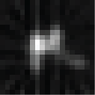
The inverse Radon transform
- Filtered back projection
Notes:
49
49
To address that, we could pre-filter the projections to accentuate the high frequency contents of the restored blur, but we still observe somewhat noisy inaccurate rendition of the blur.

Slide 50

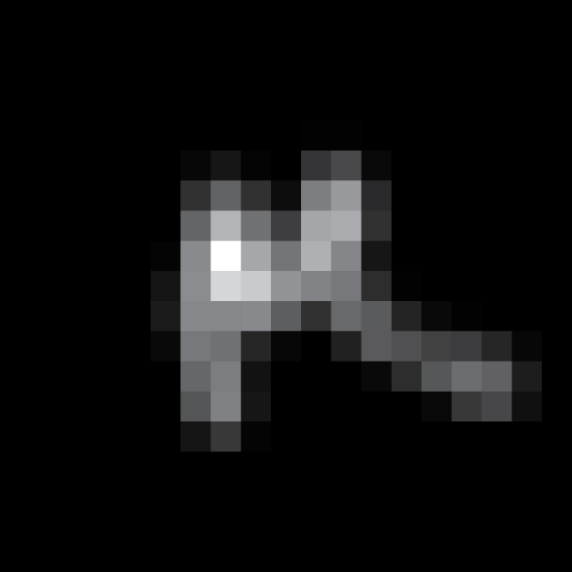
The inverse Radon transform
- incorporating the sparse prior
Kernel projection
constraints
Sparse prior
on kernels
Ground truth
blur kernel
Notes:
50
50
We can address this issue by exploiting some prior knowledge about blur kernels. In particular, most pixels in a blur kernel have zero intensity and most gradients in a blur kernel is small. We can represent such constraints using a sparse prior term.
We minimize the energy function consisting of two terms: kernel projection constraints and the sparse prior.
Kernel projection constraints ensures that the reconstructed kernel respects the projections estimated from blurred edges, while the sparse prior term ensures that the restored kernel respects our prior knowledge about blur kernels.

Slide 51
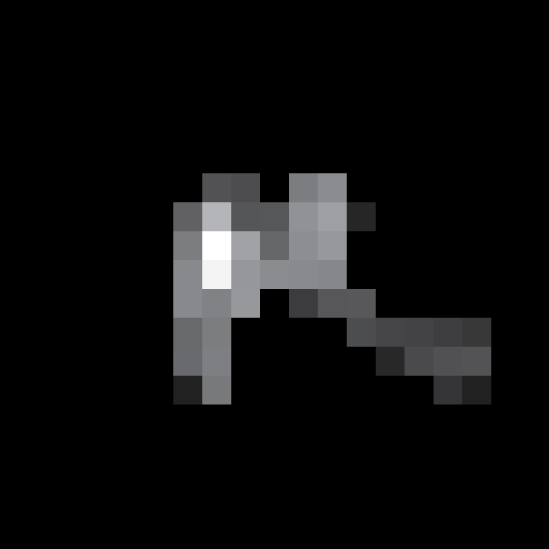
The inverse Radon transform
- incorporating the sparse prior
Kernel projection
constraints
Sparse prior
on kernels
Ground truth
blur kernel
Estimated
blur kernel
Notes:
51
51
And here is the restored blur kernel, along with the ground-truth. The estimated blur kernel is quite an accurate reproduction of the original blur kernel

Slide 52
The inverse Radon transform
- incorporating the sparse prior
Kernel projection
constraints
Sparse prior
on kernels
Ground truth
blur kernel
Filtered
Back projection
Ours
Back projection
Notes:
52
52
Here we show kernels reconstructed using other methods.

Slide 53

Deconvolution
Maximum – a – posteriori estimator
Observation
constraint
Sparse prior
on images
[Bouman et al. TIP 1993, Levin et al. SIGGRAPH 2007]
Notes:
53
53
Now, we can plug in the estimate blur kernel to a conventional MAP deconvolution method.

Slide 54
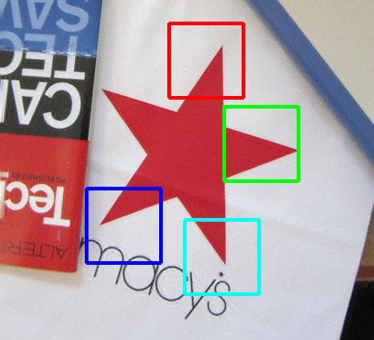




Deblurred image
Notes:
54
54
And recover this blur-free image.

Slide 55
Input blurry image
Notes:
55
55
And here we show the blurry image for comparison.

Slide 56
Outline
Blur kernel estimation using blurred edge profiles
  The Radon transform and blur
  Using blurred edges for blur identification
  Deblurring pipeline
  Experimental results
Orthogonal parabolic exposures for motion deblurring
  2D motion optimal spectral bound
  Camera design
  Blur estimation
  Experimental results
Notes:
56
56
We show a few experimental results. We compare our work to two algorithms that are considered the state of the art : Rob’s variational inference algorithm, and Cho’s algorithm presented at SIGGRAPH asia last year. To compare just the blur kernel estimation performance, we take the estimated blur kernels and use the same deconvolution method to restore the image.

Slide 57

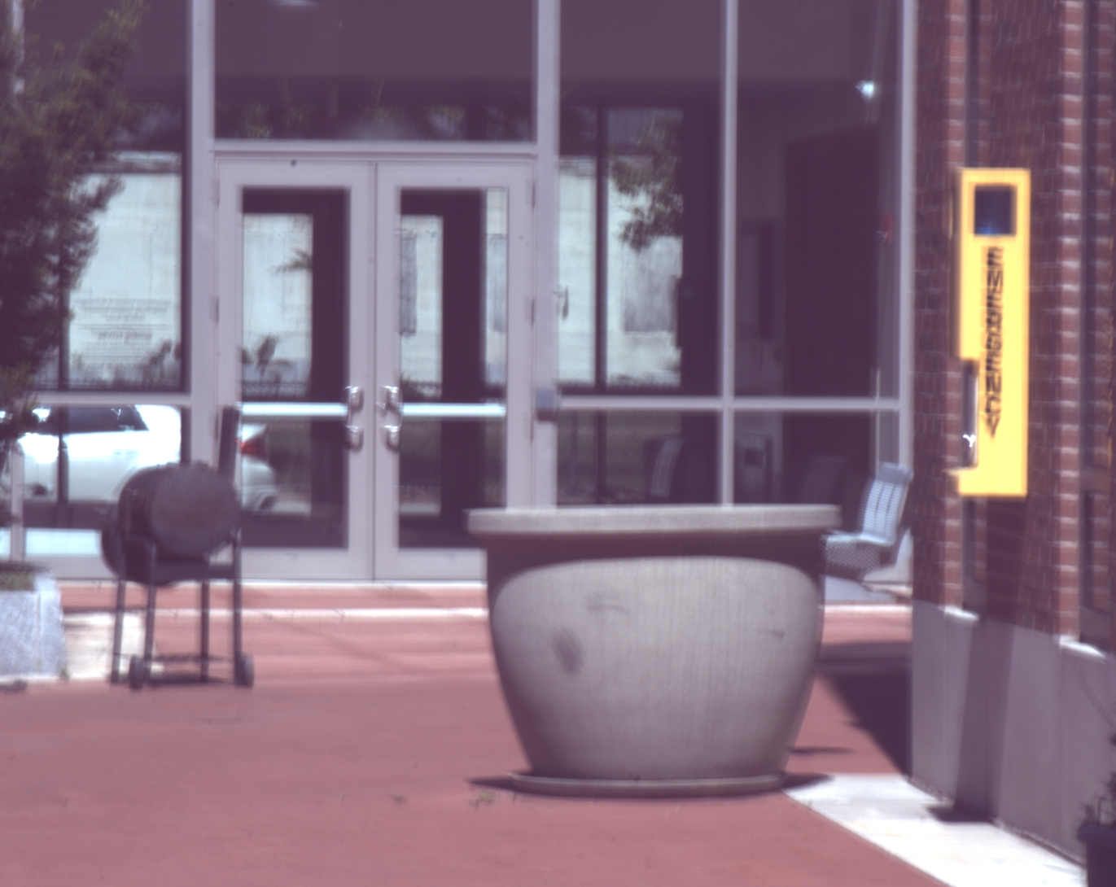
Experimental results
Blurred image
Notes:
57
57
Here is a blurry photograph. We can sometimes guess the shape of the blur kernel by looking at saturated streaks in the photograph. Here, we do have a saturated streak on the right hand side, so I show a blown up version of it. So if our algorithm does a good job in estimating the kernel, it should have a shape similar to this saturated streak.

Slide 58
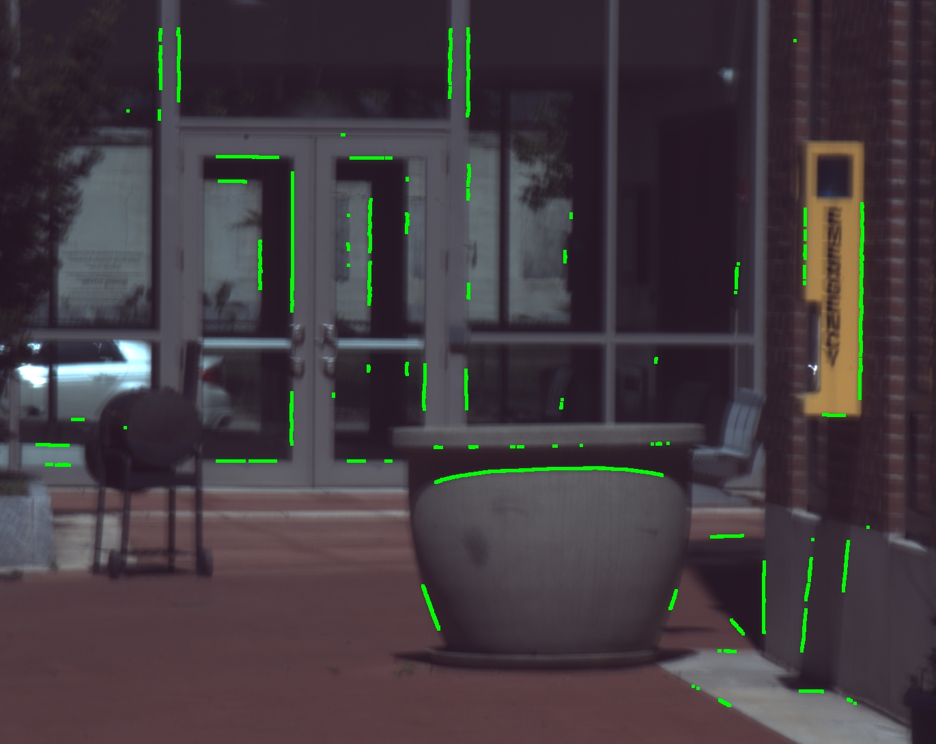
Experimental results
Selected edges
Notes:
58
58
Here are detected edges. We have many edges in different orientations.

Slide 59
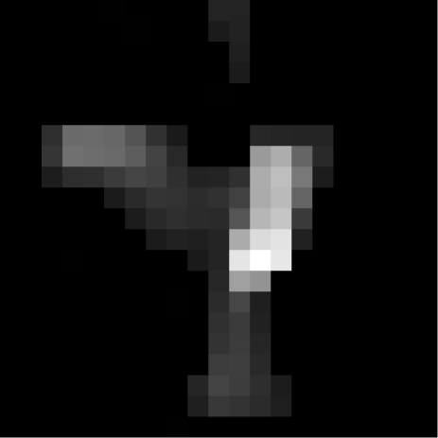
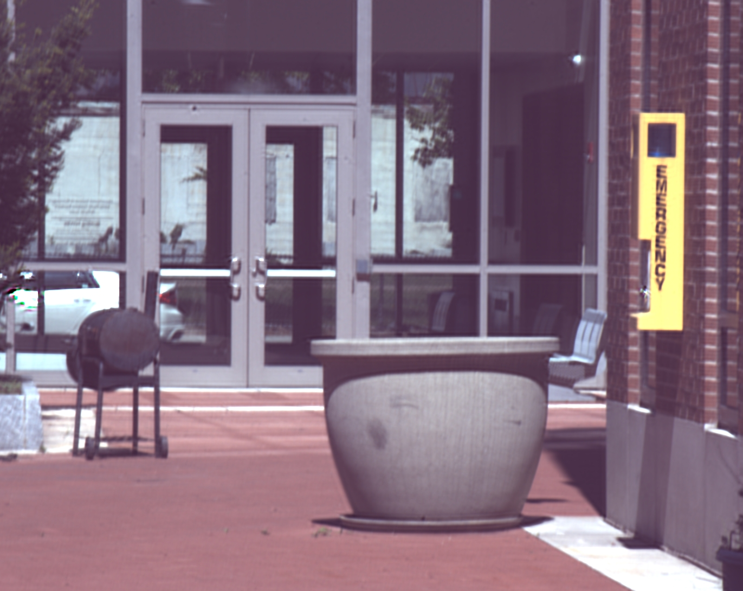
Experimental results
Deblurred image
Notes:
59
59
And here is the estimated blur kernel along with the deblurred image. The restored image is quite clean and is free of blur.

Slide 60
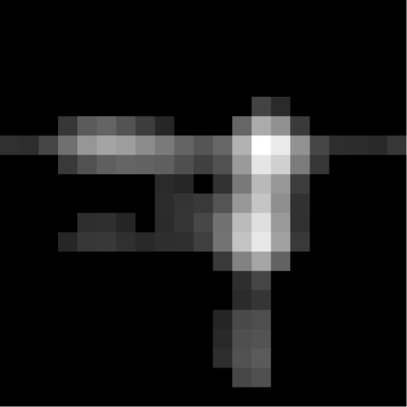

Experimental results
Fergus et al. SIGGRAPH 2006
Notes:
60
60
Here is the blur kernel estimated using Rob Fergus’s variational inference algorithm. Although the blur kernel is less accurate, the restored image is still quite plausible.

Slide 61
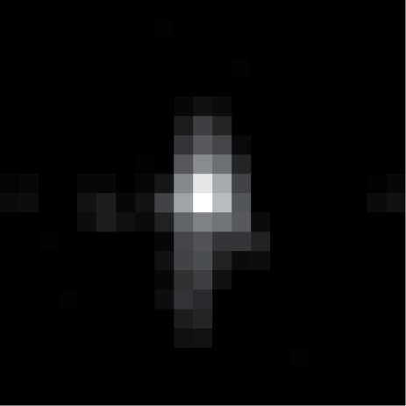

Experimental results
Cho et al. SIGGRAPH Asia 2009
Notes:
61
61
Here we show the result of using the fast motion deblurring algorithm presented at SIGG Asia last year. In this particular example, the algorithm did a poor job estimating the blur kernel, and is unable to remove the blur.

Slide 62
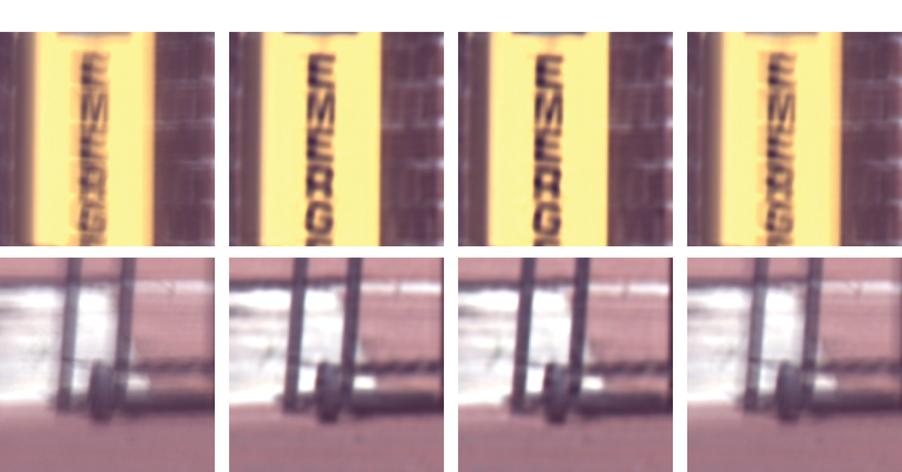
Experimental results
Notes:
62
62
Here are some zoom-in comparisons. Our algorithm and Rob’s algorithm performs comparably, whereas Cho’s algorithm is unable to remove the blur.

Slide 63
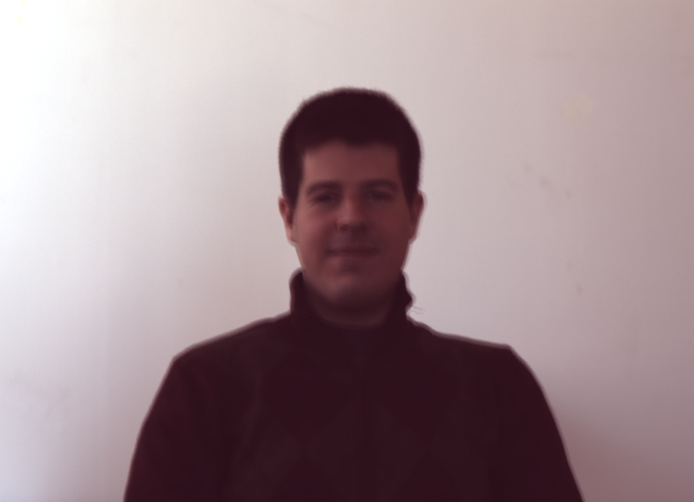
Experimental results
Blurred image
Notes:
63
63
Here is another experiment.

Slide 64
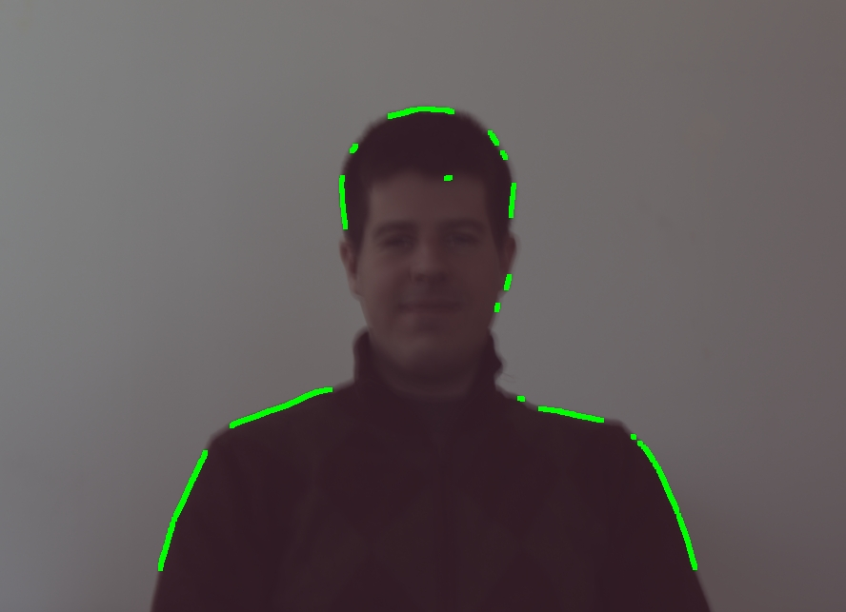
Experimental results
Selected edges
Notes:
64
64
These are selected edges at which we estimate the blur kernel projections

Slide 65
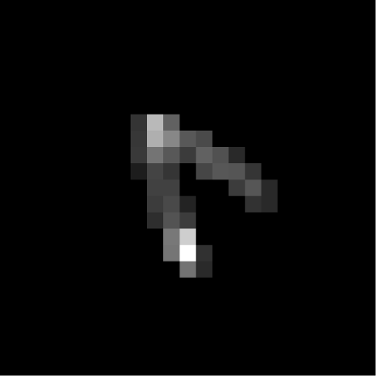

Experimental results
Deblurred image
Notes:
65
65
And here is the estimated blur kernel and the restored image.
Although we see some ringing on the right shoulder of Roger, overall the restored image is quite pleasing.

Slide 66
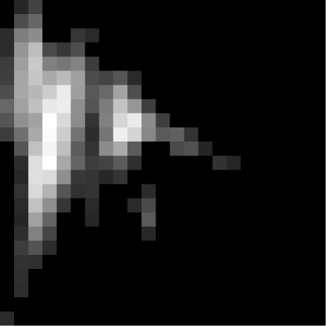
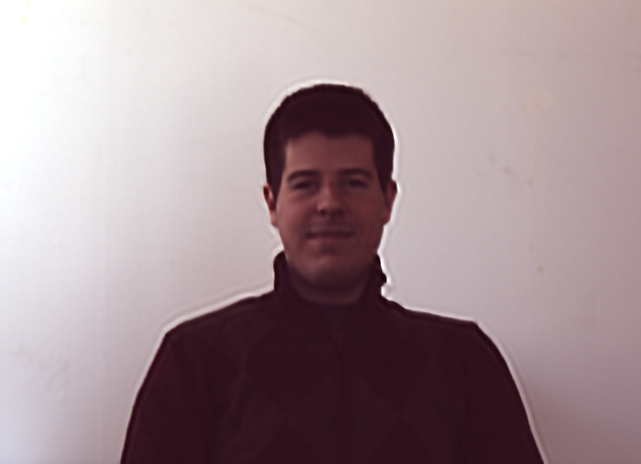
Experimental results
Fergus et al.
Notes:
66
66
Here is the result from Rob’s algorithm. The restored blur kernel is quite inaccurate, and the restored image has noticeable ringing.

Slide 67
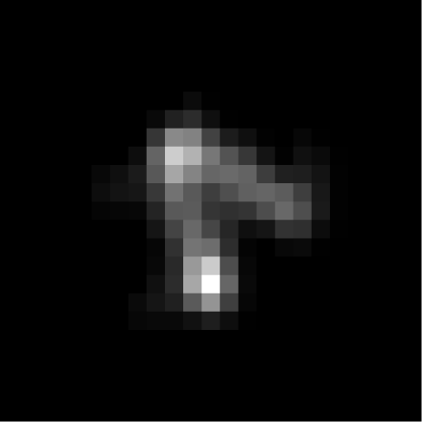

Experimental results
Cho et al.
Notes:
67
67
Here we show the results from Cho’s algorithm. This time, the algorithm accurately estimated the kernel and restored a blur free image.

Slide 68
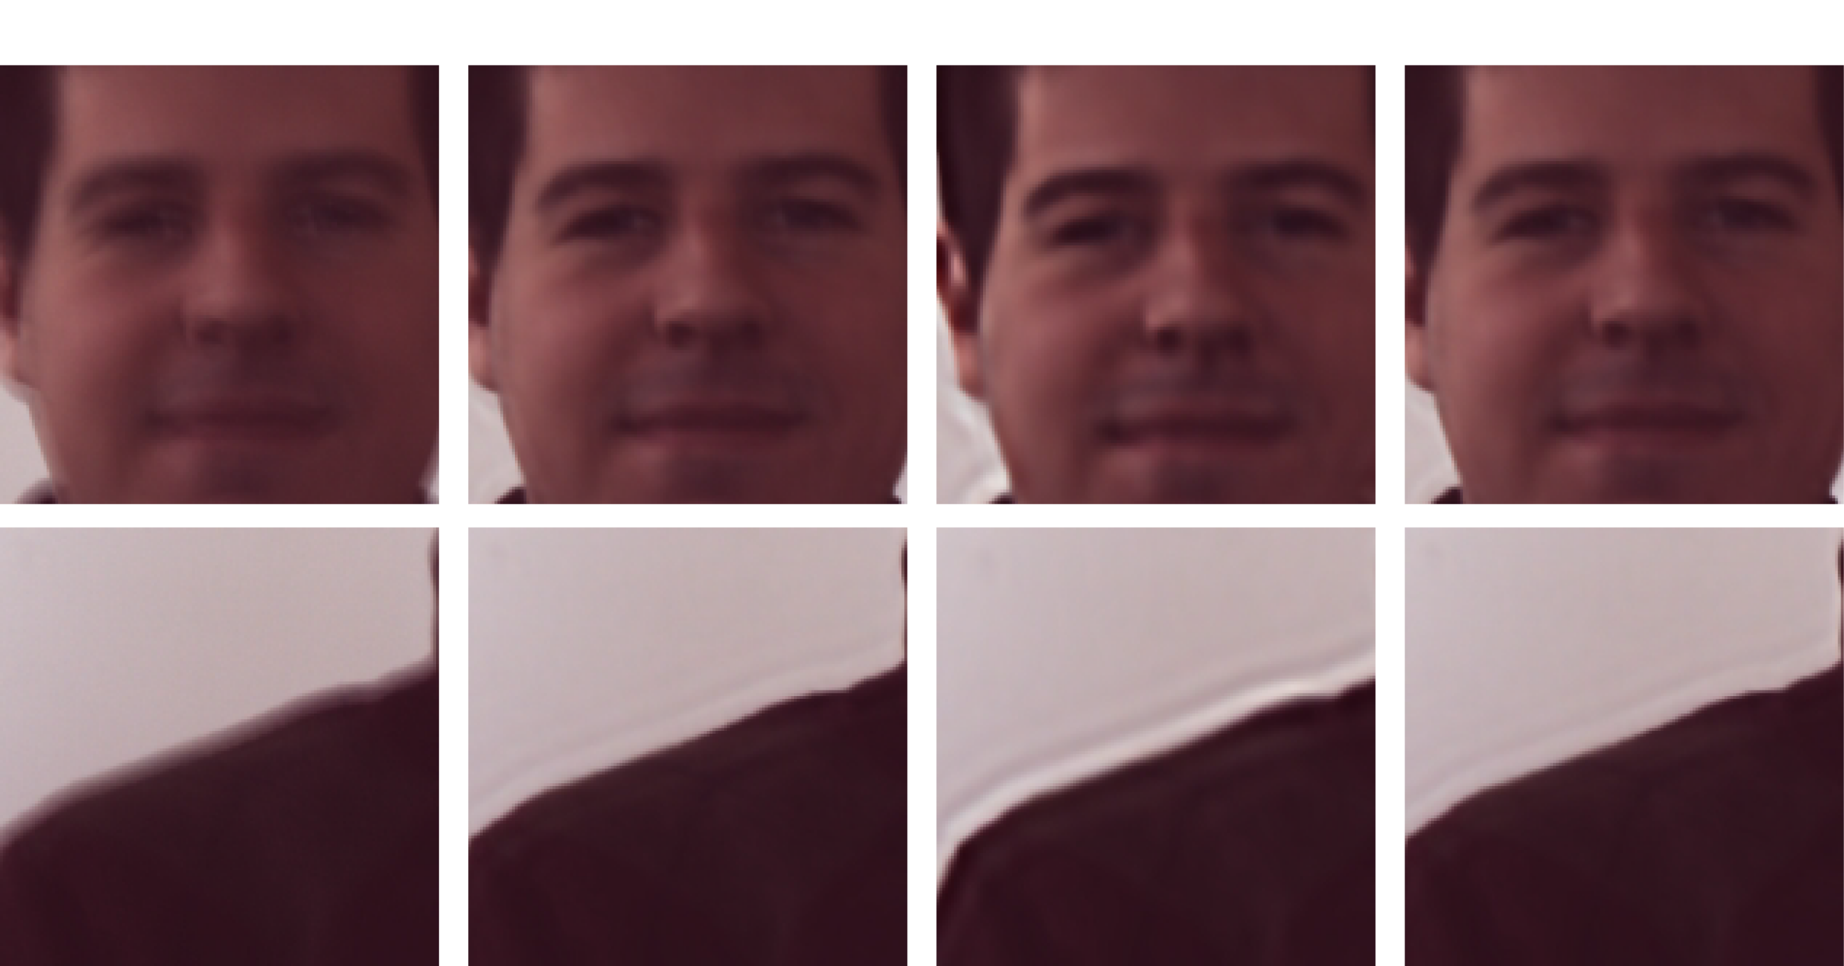
Experimental results
Notes:
68
68
Here are some zoom-ins. Again our algorithm and Cho’s algorithm performed well, whereas Rob’s algorithm generated noticeable ringing.
From these two examples, we can see that as long as we can reliably estimate blur kernel projections in many orientations, our algorithm restores an accurate blur kernel.

Slide 69
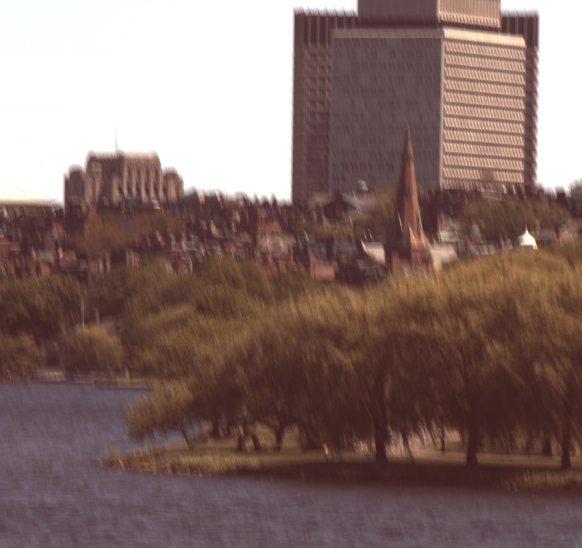
Experimental results
Blurred image
Notes:
69
69
When the blurred image does not have enough edges in many orientations, our algorithm is unstable. Consider this blurred image.

Slide 70
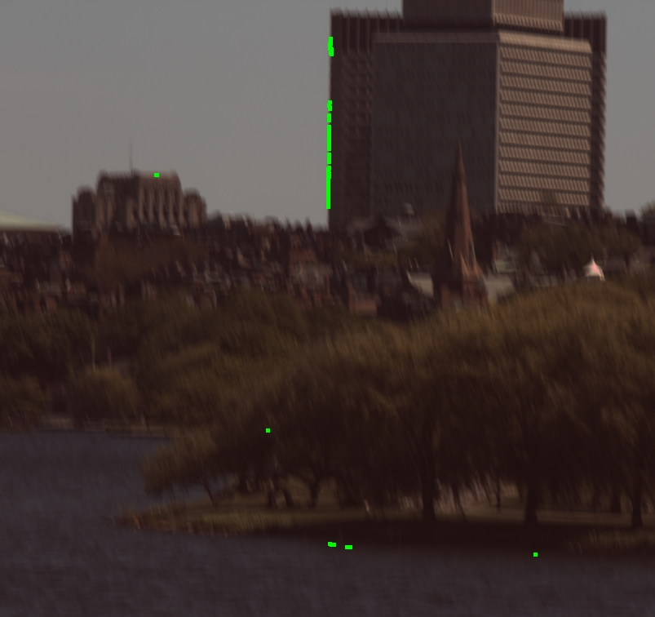
Experimental results
Selected edges
Notes:
70
70
Our edge selection algorithm returned these edge samples. Notice that most of the edges are vertical.

Slide 71
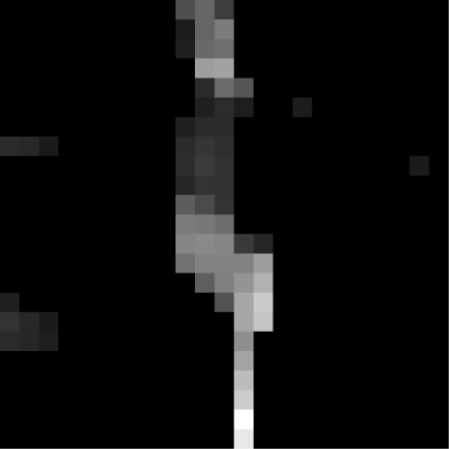
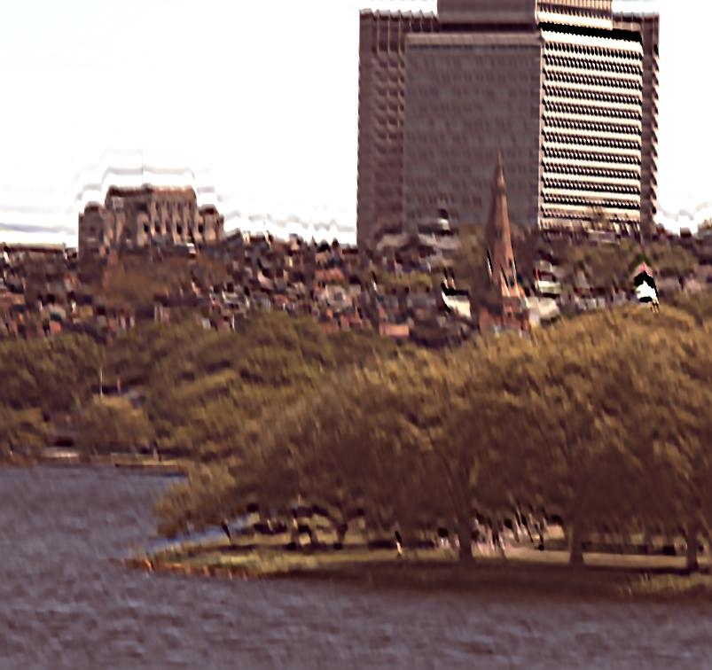
Experimental results
Deblurred image
Notes:
71
71
Here is the restored image. The restored image contains many ringings and is visually disturbing.

Slide 72
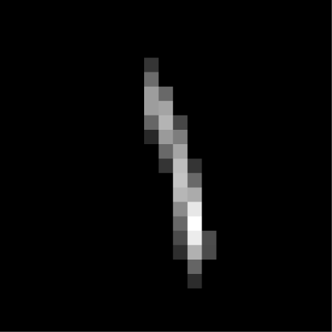

Experimental results
Fergus et al.
Notes:
72
72
Here is the blur kernel and the restored image using Rob’s algorithm. The algorithm did a good job in estimating the vertical blur structure.

Slide 73
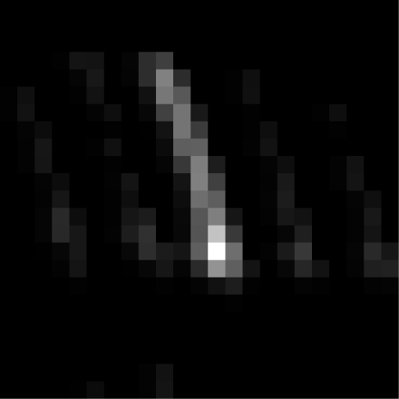

Experimental results
Cho et al.
Notes:
73
73
Here is the result from Cho’s algorithm. Cho’s algorithm has spurious artifacts in the kernel, which manifest themselves as slightly sharpened edges / ringing.

Slide 74

Experimental results
Notes:
74
74
Here are zoom-in versions.

Slide 75
A dominant source of error
Performance is sensitive to
the number of edge orientations in the image.
Notes:
75
75
From experiments, we realized that our technique is quite sensitive to the number of edges as well as the distribution of edge orientation. If there is only one dominant orientation among selected edges, the restored blur kernel tends to be inaccurate.
In order to overcome this issue, we developed a technique that can refine the blur kernel at the expense of computational complexity.

Slide 76


Integrating projection constraints
Joint estimation of k and I
[Shan et al. SIGGRAPH 2008]
Likelihood:
Observation
constraint
Notes:
76
76
Our strategy is to integrate the blur kernel projection constraints to existing blur estimation method. In particular, we consider a maximum-a-posteriori estimation method to jointly estimate the blur and image. In this formulation, we want to find a pair of blur kernel and image that maximizes the posterior probability. The likelihood term is often defined using the observation model, which states that if we blur the latent image I using the estimated blur kernel k, it should be similar to the observed image B .
Although intuitive, this likelihood term is a source of ambiguity. For instance, as mentioned earlier, an observed image B can be a sharp rendition of a blurry scene, in which case the blur is an impulse and the restored image is the same as the observed image. But B could also be a blurry rendition of a sharp scene, in which case blur is not an impulse but still satisfy the likelihood term.

Slide 77

Integrating projection constraints
RadonMAP algorithm
Likelihood:
Observation
constraint
Projection constraints
Notes:
77
77
We can fix such ambiguity using the blur kernel projection constraints.
Under this likelihood term, the estimated blur kernel should satisfy the projection constraints in addition to satisfying the observation constraints. In other words, if the observed image B is a blurry version of a sharp scene, the projection constraints would penalize an impulse blur solution.

Slide 78
Experimental results
Inverse Radon transform
Notes:
78
78
We illustrate the performance of the RadonMAP algorithm through an experiment.
Here is an image shown previously, which is deblurring using the inverse radon transform. This image contains a lot of ringing and noise, and is visually disturbing.

Slide 79


Experimental results
RadonMAP
Notes:
79
79
Here is an image restored using RadonMAP. Notice that the restored image is virtually free of ringing and noise.

Slide 80

Experimental results
Notes:
80
80
Here are cropped zoom-ins. The RadonMAp algorithm performs favorably to other methods. [explain the algorithms. 1. computation. 2. reliability]

Slide 81

Quantitative evaluation
Notes:
81
81
Until now we have only qualitatively compared different blur removal algorithms. In the next couple of slides, we would like to compare different algorithms quantitatively.
Anat provides a set of images and blur kernels to compare different algorithms, but those images are grayscale and is actually quite small with respect to the size of blur kernels, so her dataset may give somewhat of a biased result.
So I have hand-selected 6 images of different contents, each with about 1 mega pixels,

Slide 82

Quantitative evaluation
[Levin et al. CVPR 2008]
Notes:
82
82
And used Anat’s blur kernels to compare differnet algorithms. Each algorithm would deblur 48 images.

Slide 83

Error ratio
I : Ground-truth image
D_{est} : Deconvolved image – estimated blur kernel
D_{gt} : Deconvolved image – ground-truth blur kernel
[Levin et al. CVPR 2008]
Notes:
83
83
To measure the quality of restored images, Anat uses what’s called an error ratio.
Error ratio compares the degradation level of images restored using the estimated blur kernel and the ground-truth blur kernel.
Dest is the image restored using the estimated blur kernel, and Dgt is the image resored using the ground-truth blur kernel. Therefore the lower the error ratio, the better.

Slide 84

Cumulative error ratio
Cumulative error ratio
Cf. [Levin et al. CVPR 2008]
Notes:
84
84
As in Anat’s paper, we show a cumulative error ratio across 48 different blurred images. An algorithm with a larger portion of images with small error ratio wins.
Under this measure, Cho’s algorithm performs the best, closely followed by our RadonMAP algorithm. RadonMAP algorithm improves the inverse radon transform based algorithm, and both are better than Rob’s and Shan’s algorithms.

Slide 85


Cumulative error ratio
Notes:
85
85
To gain more insights from this experiment, I have computed CER for images 1—3 and images 4—6 separately. Images 1—3 contain many edges in dfferent orientations, whereas images 4—6 do not contain many isolated edges.
Interestingly, when images contain many edges in different orientations, our algorithms outperform all others by a large margin. Other algorithms heavily rely on the observation constraint, which is weak when images are textureless. Because our algorithms key on edges, we can handle images with textureless surface.
On the other hand, if images contain a lot of textures and not enough isolated edges, Cho’s algorithm performs better than others by a large margin. Still, even in this case our algorithm performs comparably to other work.

Slide 86


Cumulative error ratio
Notes:
86
86
We have also observed that our algorithm’s performance depends on the blur kernel size. So I have plotted the CER for small blur kernels and large blur kernels separately. Interestingly, when the blur kernel size is small, our algorithm performs well, even better than Cho’s algorithm. However, when the blur kernel size is large, our algorithm performs poorly. We can attribute this to edge detection. Detecting step edges in heavily blurred images is a challenging problem, so the algorithm sometimes discards well isolated step edges or selects edges may contain textures conducive to error.
We could improve our edge detection algorithm in a multi-scale manner to improve these results. [ change the resolution of kernels]

Slide 87
Discussions
Computationally attractive.
– In MATLAB, about 30 seconds for a 1 mega-pixel image.
Performance depends on the number of edge orientations in the image.
– About 5 dominant orientations is sufficient.
– Can be integrated into existing blur estimation algorithm.
Notes:
87
87
There are a few characteristics of our algorithm that need mentioning.
The inverse radon transform based kernel estimation algorithm is computationally attractive because bulk of the computation is performed at the size of blur kernels, which is much smaller than the image. In MATLAB, blur kernel estimation takes about 30 seconds for a 1 MP image.
A drawback of our method is that the performance depends quite heavily on the number of edge orientations in the image. Experimentally, we observe that about 5 orientations with sufficient number of edges is enough to estimate the blur kernel reliably. By integrating the edge profile information to existing algorithms, however, we can improve the deblurring performance.

Slide 88
Questions
?
Notes:
88
88
Questions?

Slide 89
Motion blur removal with orthogonal parabolic exposures
Taeg Sang Cho, Anat Levin,
Fredo Durand, William T. Freeman
Massachusetts Institute of Technology
Notes:
Now, we are going to switch gears to discuss a computational camera that addresses a subject motion blur.

Slide 90

Motion blur removal
Notes:
90
90
Dealing with subject motion blur is quite challenging because the blur is spatially variant. But if we can take multiple photos of the scene, this problem can be significantly simplified.

Slide 91






Deblurring and information loss
Original image
(reference)
Blurred input
Deblurred output
Notes:
91
91
1. Even if we could estimate the blur kernel without any error, blur destroys high frequencies. Inverting the blur is a numerically sensitive process and the quality of the deblurred output is never equal to the quality of the original sharp image. We could exploit prior knowledge about natural images to improve restored images, but in this project, we explore a different approach to this problem. In particular, we are interested in reducing the information loss due to blur.

Slide 92
A flutter shutter camera
Flutter shutter camera
[Raskar et al. SIGGRAPH 2006]
Notes:
This problem was first addressed in Raskar et al.’s paper in 2006. They present a flutter shutter camera that opens and closes the camera aperture multiple times during a single exposure. This technique reduces the loss of information in moving parts and makes the blur more invertible.

Slide 93


A parabolic camera
Time t
Captured image
Sensor position x
Parabolic camera
[Levin et al. SIGGRAPH 2008]
Reconstructed image
Notes:
93
93
In 2008 Levin et al proposed the motion invariant camera. They move the camera horizontally during exposure but change the velocity in a linear way. One advantage of this camera was that the PSF is invariant to motion velocity. Another important advantage is that the PSF is easy to invert. In fact, they proved that this is the best PSF one can hope to get for motions aligned with the camera motion. There is a bound on the maximal amount of information we can hope to preserve when we capture an image, and the parabolic motion achieves this bound.

Slide 94
Time t
Not all desirable characteristics
are valid for 2D motions!
Captured image
Sensor position x
Parabolic camera
[Levin et al. 2008]
Reconstructed image
Notes:
94
94
However, all these good properties are true only for a 1D motion. When the object moves in a different direction the blur is no longer invariant to motion. Also, the blur is no longer easy to invert.

Slide 95










Deblurring performance comparisons
Object motion
Static camera
Flutter Shutter
Vertical parabola
Original image
Object motion
Notes:
95
95
In this simulation, we have two scenes. In one of them, the object is moving horizontally and in the other, the object is moving vertically. We capture the moving object with 3 different cameras: a static camera, a flutter shutter camera and a parabolic camera which is moving along the vertical axis. The deblurred output of the parabolic camera is good when the object is moving vertically, but is poor when the object is moving horizontally. That is, the deblurring performance of the parabolic camera is good when the direction of the object motion is the same as the direction of the parabolic camera motion . However, the deblurring performance is bad if the object moves in a different direction.

Slide 96
Deblurring performance comparisons
Object motion
Static camera
Flutter Shutter
Vertical parabola
Original image
Object motion
Notes:
96
96
In this simulation, we have two scenes. In one of them, the object is moving horizontally and in the other, the object is moving vertically. We capture the moving object with 3 different cameras: a static camera, a flutter shutter camera and a parabolic camera which is moving along the vertical axis. The deblurred output of the parabolic camera is good when the object is moving vertically, but is poor when the object is moving horizontally. That is, the deblurring performance of the parabolic camera is good when the direction of the object motion is the same as the direction of the parabolic camera motion . However, the deblurring performance is bad if the object moves in a different direction.

Slide 97
Deblurring performance comparisons
Object motion
Static camera
Flutter Shutter
Vertical parabola
Original image
Object motion
Notes:
97
97
In this simulation, we have two scenes. In one of them, the object is moving horizontally and in the other, the object is moving vertically. We capture the moving object with 3 different cameras: a static camera, a flutter shutter camera and a parabolic camera which is moving along the vertical axis. The deblurred output of the parabolic camera is good when the object is moving vertically, but is poor when the object is moving horizontally. That is, the deblurring performance of the parabolic camera is good when the direction of the object motion is the same as the direction of the parabolic camera motion . However, the deblurring performance is bad if the object moves in a different direction.

Slide 98
Deblurring performance comparisons
Object motion
Static camera
Flutter Shutter
Vertical parabola
Original image
Object motion
Notes:
98
98
For the vertical motion the best results are obtained with the parabolic camera. However, for the horizontal motion we actually get better results from the flutter shutter camera.

Slide 99
Deblurring performance comparisons
Object motion
Static camera
Flutter Shutter
Vertical parabola
What is the best image quality we can hope to achieve?
Original image
Object motion
Notes:
99
99
The main question that we want to address in this work is, what is the best image quality we can hope to achieve if the object moves in 2 dimensions? We want to extend the results of the parabolic camera from 1D to 2D. Can we design a camera which guarantees the optimal deblurring performance for 2D motions?

Slide 100
In this work
What is the best we can do for 2D motions?
A new camera for near-optimal information capture
Time t
Time t
+
Sensor
position y
Sensor
position y
Sensor
position x
Sensor
position x
Notes:
100
100
In this work, we derive a criteria for the optimal deblurring camera. Then we present a prototype camera that near-optimally captures the image information of moving objects.

Slide 101

Our technique
Key characteristics
Takes two shots in
orthogonal parabolic paths
Allows near-optimal
information capture
Notes:
101
101
In a nutshell, we take two images of the moving scene, with a camera sensor undergoing orthogonal parabolic motions: one horizontally and another vertically. The scene can contain multiple objects moving in linear velocity in any 2D direction.

Slide 102

Our technique
Key characteristics
Takes two shots in
orthogonal parabolic paths
Allows near-optimal
information capture
Notes:
102
102

Slide 103


Our technique
Color map of motion
Key characteristics
Takes two shots in
orthogonal parabolic paths
Allows near-optimal
information capture
Notes:
103
103
From these two images, we locally estimate the subject motion, and use the estimated velocity to deblur local regions separately. To represent the motion, we use the color coding scheme shown in the bottom left. For instance, if the pixel is sky blue, the object moves to the left. The color map shows that the person on the left was moving vertically and the person on the right was moving horizontally.

Slide 104



Our deblurring result
Notes:
104
104
Using the estimated motion map, we recover a sharp image from the two blurry photos.

Slide 105
Disclaimer
In this work, we assume that:
Motion is constant-velocity
-> i.e. relatively short exposure time
Notes:
105
105
In this work, we assume that the object moves at a constant-velocity motion parallel to the image plane. This assumption is often satisfied when the exposure time is relatively short.

Slide 106
Outline
Blur kernel estimation using blurred edge profiles
  The Radon transform and blur
  Using blurred edges for blur identification
  Deblurring pipeline
  Experimental results
Orthogonal parabolic exposures for motion deblurring
  2D motion optimal spectral bound
  Camera design
  Blur estimation
  Experimental results
Notes:
106
106
We will start the discussion by deriving the optimal worst-case bound on the amount of information we can hope to capture for moving objects.

Slide 107
Imaging model
Blurry image
=
PSF
Sharp image
Noise
B
=
k
⊗
I
+
n
s
Notes:
107
107
As before, we model the observation process as a *LOCAL* convolution of a point spread function with a latent sharp image, which is degraded by additive noise.

Slide 108
Imaging model
Blurry image
=
PSF
Sharp image
Noise
B
=
k
⊗
I
+
n
s
Notes:
108
108
The blur kernel depends on the type of camera. The subscript s, where s is an object velocity, is there to denote that the point spread function also depends on object motions.

Slide 109
Imaging model
Blurry image
=
PSF
Sharp image
Noise
B
=
k
⊗
I
+
n
s
Frequency domain
^
ω
=
^
ω
^
ω
^
B
(
)
k
(
)
I
(
)
+
ω
n
(
)
x
,
y
s
x
,
y
x
,
y
x
,
y
Notes:
109
109
Convolution in a spatial domain is multiplication in the Fourier domain.

Slide 110
Imaging model
Blurry image
=
PSF
Sharp image
Noise
B
=
k
⊗
I
+
n
s
Frequency domain
^
ω
^
ω
B
(
)
n
(
)
^
ω
=
x
,
y
−
x
,
y
I
(
)
x
,
y
^
^
k
(
ω
)
k
(
ω
)
s
x
,
y
s
x
,
y
^
ω
k
(
)
How high can we make ?
s
x
y
Notes:
110
110
To recover a sharp image I, we can divide the equation by the blur kernel k. When the power spectrum of the blur kernel is low, the noise contribution is amplified in the deblurring process. This equation tells us that in order to maximize the signal to noise ratio of the reconstructed image I, we want to maximize the power spectrum of the blur kernel. Then the question is, how high can we make k for all possible motions?

Slide 111
3-D space-time motion
Camera motion path
Camera motion path
φ
t
y
x
Notes:
111
111
Different camera motions generate different blur kernels

Slide 112
3-D space-time motion
Camera motion path
Camera motion path
φ
t
T
y
x
Notes:
112
112
We can represent the camera motion as a curve in the 3D space time volume. The curve value at time instance t indicates the displacement of the camera at this instance of the exposure. To analyze the performance of the camera, we assume that the exposure time budget is limited to T.

Slide 113
3-D space-time motion static camera
Camera motion path
φ
t
T
y
x
Notes:
113
113
The motion path of a static camera is a straight line, because it doesn’t move. The displacement is zero at all time instances during the exposure

Slide 114
3-D space-time motion flutter shutter camera
Camera motion path
φ
t
T
y
x
Notes:
114
114
A flutter shutter camera has a discontinuous straight line as a motion path, the holes in the line correspond to time instances in which the shutter is closed.

Slide 115
3-D space-time motion parabolic camera
Camera motion path
φ
t
T
y
x
Notes:
115
115
And a parabolic camera moves in a parabolic displacement path. Here, we show a parabolic motion in the y direction.

Slide 116
3-D space-time motion parabolic camera
Camera motion path
φ
t
T
y
x
Notes:
116
116
And here is a parabolic motion in the x direction

Slide 117

Frequency analysis of 3-D space-time motion
φ
^
Camera motion path
3D Fourier Transform
φ
t
3D Fourier transform
T
y
x
Notes:
117
117
So far we have expressed the motion path in the primal domain. However, since convolution reduces to multiplication in the Fourier domain, it is easier to study blur in the frequency domain. To that end, we think of the motion path as a 3D kernel phi, which is a delta on the curve and zero everywhere else. We then take the 3D fourier transform of this kernel phi. The Fourier slice theorem tells us that the spectra of blur kernels of different motion velocities are slices from this 3D Fourier transform.

Slide 118

3-D space-time motion – Fourier domain
^
ω
=
^
^
^
B
(
)
k
(
ω
)
I
(
ω
)
+
ω
n
(
)
x
,
y
s
x
,
y
x
,
y
x
,
y
Object velocity
Notes:
118
118
Blur kernels corresponding to different object velocities slice the 3D Fourier transform of the motion path at differing angles. This figure shows a slice for a y-directional motion.

Slide 119

3-D space-time motion – Fourier domain
^
ω
=
^
^
^
B
(
)
k
(
ω
)
I
(
ω
)
+
ω
n
(
)
x
,
y
s
x
,
y
x
,
y
x
,
y
Object velocity
Notes:
119
119
The angle at which we slice increases as sy increases.

Slide 120

3-D space-time motion – Fourier domain
^
ω
=
^
^
^
B
(
)
k
(
ω
)
I
(
ω
)
+
ω
n
(
)
x
,
y
s
x
,
y
x
,
y
x
,
y
Object velocity
Increasing s_{y}
[Ng SIGGRAPH 2005]
[Levin et al. SIGGRAPH 2008]
Notes:
120
120

Slide 121

3-D space-time motion – Fourier domain
^
ω
=
^
^
^
B
(
)
k
(
ω
)
I
(
ω
)
+
ω
n
(
)
x
,
y
s
x
,
y
x
,
y
x
,
y
Object velocity
Increasing s_{y =} s_{x}
Notes:
121
121
If the motion direction changes, the orientation in which we take the slice also changes

Slide 122

3-D Fourier Transform of 2D motions
3D Fourier space
Wedge of revolution
Notes:
122
122
If we sum up all slices that correspond to 2D constant velocity motions, they occupy an outer volume of the inverted double cones. We call this region a wedge of revolution. The slope of this inverted double cone is equal to the maximum object speed in the scene. Now, to have blur kernels which are easy to invert at all motion directions and all velocities, we want to have a high spectrum content all over the wedge of revolution. That is, we want to find a motion path whose spectrum is high within the wedge of revolution. We don’t care that much about zeros outside the wedge of revolution, because these zeros do not occur in blur kernels corresponding to motions of interest. In order to maximize the worst-case spectral power, we need to find a motion path that maximizes the worst-case spectral power within the wedge of revolution.

Slide 123


Optimal spectral bound
3D Fourier space
Notes:
123
123
But there exists an upper bound on the worst-case spectral power. The amount of energy captured within a finite exposure time T is bounded. We can use Parseval theorem to show that the norm of the motion spectrum at a fixed spatial frequency is bounded by T. In other words, for any motion path, if we integrate the energy along any column, the maximal power we can have is T.

Slide 124
Optimal spectral bound
3D Fourier space
Notes:
124
124

Slide 125
Optimal spectral bound
3D Fourier space
Notes:
125
125

Slide 126

Optimal spectral bound
3D Fourier space
No energy outside of the wedge of revolution
Spread the energy uniformly on this segment
Notes:
126
126
If we want to maximize the worst case spectral power within each column, the best way is to distribute the bounded budget uniformly over the column within the wedge of revolution. If we distribute energy outside of the wedge of revolution, we would be wasting energy on motions we do not care about. So we should spread the energy only on the segment within the wedge of revolution, and this gives us the upper bound shown above.

Slide 127
Goal:
Design camera paths φ whose
power spectrum approaches the upper bound
Notes:
127
127
Given this analysis, the goal of a camera design is to find a camera motion path phi that would guarantee the spectral performance as close to the optimum as possible.

Slide 128
Outline
Blur kernel estimation using blurred edge profiles
  The Radon transform and blur
  Using blurred edges for blur identification
  Deblurring pipeline
  Experimental results
Orthogonal parabolic exposures for motion deblurring
  2D motion optimal spectral bound
  Camera design
  Blur estimation
  Experimental results
Notes:
128
128
We show how our camera performs in light of this analysis.

Slide 129


x-parabolic camera
Characteristics:
Provides optimal spectrum coverage
for 1-dimensional motion
Motion path
3D Fourier space
t
y
x
[Levin et al. 2008]
Notes:
129
129
We first analyze a single parabolic camera moving along the x- axis. The motion spectrum of a parabolic camera motion occupies the 3D wedge as shown on the right.

Slide 130

x-parabolic camera
Point spread function
Power spectrum
s_{y}
s_{y}
Zeros
High spectra
y
x
s_{x}
s_{x}
Optimal spectrum coverage for x-directional motion
Zeros along for non x-directional motion
Notes:
130
130
Here we show the blur kernels corresponding to different velocities, and their power spectrums. We can see that for x-directional motions, the power spectrum does not contain any zeros and is in fact optimal, but for y directional motions, the spectrum contains zeros along the w_y axis, which means that these blur kernels do not capture information along w_y axis.

Slide 131


y-parabolic camera
Characteristics:
Orthogonal spectrum from x-parabolic camera
Motion path
3D Fourier space
t
y
x
Notes:
131
131
On the other hand, a y-directional parabolic camera covers the orthogonal wedge spectrum.

Slide 132

y-parabolic camera
Point spread function
Power spectrum
High spectra
Zeros
Optimal spectrum coverage for y-directional motion
Zeros along for non y-directional motion
Notes:
132
132
And the informational capture is optimal for y directional motions , but contains zeros for x-directional motions.

Slide 133

Orthogonal parabolic cameras
x-parabolic camera spectrum
The joint spectrum
y-parabolic camera spectrum
Notes:
133
133
In our design we capture 2 images. In the first image we move the camera along a horizontal parabolic path and in the second image along a vertical parabolic path. The idea is that when we use two orthogonal parabolas, the sum of their spectra covers all frequencies without zeros for all velocity, therefore we can deblur all directions well.

Slide 134

Orthogonal parabolic cameras
x-parabolic camera
+
=
y-parabolic camera
Joint Fourier spectrum
Notes:
134
134
This can also be seen in the 3D Fourier space. We can show that when the maximum sensor speed durng the parabolic motion is at least sqrt(2) times faster than the maximum object speed, the sum of the 3D wedges subsumes the wedge of revolution, so we can cover the entire wedge of revolution without zeros.

Slide 135

Orthogonal parabolic cameras – optimality
Worst-case spectral power
Optimal bound
Spectral power > const x optimal bound
Notes:
135
135
IN this case, we can show that the worst-case spectrum is bounded below by 2sqrt(2) times the optimal bound. This is the first imaging method that provides a performance bound for 2D motions.

Slide 136

Comparisons with previous designs
40.00dB
* Synthetic experiments – known motion
Notes:
136
136
We show the deblurring performance of our camera compared to other designs. We consider a pair of static cameras, a pair of flutter shutter cameras, a single horizontal parabola, and a pair of orthogonal parabolas. For static and flutter shutter camera pairs, we break the exposure time budget T between two shots, and optimize the split assuming that the object motion is known, which is not often the case. In all simulation results, we assume that we know the correct object motion. For a static object motion, we can see that a static camera pair performs the best. This is intuitively correct since the static camera optimizes the image capture for static objects.

Slide 137

Comparisons with previous designs
27.66dB
* Synthetic experiments – known motion
Notes:
137
137
When there is a small motion, however, the static camera degrades the reconstruction quality and the other cameras do better. The orthogonal parabolic pair performs the best.

Slide 138

Comparisons with previous designs
25.16dB
* Synthetic experiments – known motion
Notes:
138
138
And when the motion is large, an orthogonal parabolic camera pair performs significantly better than other designs.

Slide 139
Outline
Blur kernel estimation using blurred edge profiles
  The Radon transform and blur
  Using blurred edges for blur identification
  Deblurring pipeline
  Experimental results
Orthogonal parabolic exposures for motion deblurring
  2D motion optimal spectral bound
  Camera design
  Blur estimation
  Experimental results
Notes:
139
139
Until now, we have assumed in our analysis that we know the underlying object motion. In the next few slides, I will illustrate our blur estimation process.
Taking two images makes the motion estimation problem much simpler.

Slide 140

Blur kernel estimation – Hypothesis testing
Notes:
140
140
We approach the kernel estimation problem using hypothesis testing.
We sample the motion space, and evaluate the likelihood of each motion at each pixel.

Slide 141


Blur kernel estimation
Horizontal parabolic
Vertical parabolic
Notes:
141
141
To illustrate the process, let us consider that we have taken a photo of this moving balloon.

Slide 142

Blur kernel estimation
Deblur
Horizontal parabolic
Vertical parabolic
Notes:
142
142
We deblur the captured images using each motion candidate, and

Slide 143
Blur kernel estimation
Deblur
Horizontal parabolic
Vertical parabolic
Reblur
Horizontal parabolic
Vertical parabolic
Notes:
143
143
twe re-blur the deblurred image using the same blur kernels

Slide 144
Blur kernel estimation
Deblur
Horizontal parabolic
-
Vertical parabolic
Reblur
Horizontal parabolic
Vertical parabolic
Notes:
144
144
We then take the difference of the reblurred image pairs and the captured images.

Slide 145




Blur kernel estimation
Deblurred image
Residual - hor
Residual - ver
Correct
motion
Incorrect
motion
Notes:
145
145
If the guessed motion is the correct one, the difference between the captured images and the reblurred images would be just residual noise, whereas if the motion is incorrect, the difference would contain halos, as shown.

Slide 146
Blur kernel estimation
Deblurred image
Residual - hor
Residual - ver
Find the motion candidate that minimizes the residual
Correct
motion
Incorrect
motion
Notes:
146
146
So in order to estimate spatially varying blur, we find motion that results in minimum residual locally. We provide a Bayesian interpretation of this method in the thesis.

Slide 147
Outline
Blur kernel estimation using blurred edge profiles
  The Radon transform and blur
  Using blurred edges for blur identification
  Deblurring pipeline
  Experimental results
Orthogonal parabolic exposures for motion deblurring
  2D motion optimal spectral bound
  Camera design
  Blur estimation
  Experimental results
Notes:
147
147
We now show some experimental results.

Slide 148

Experiments – Camera setup
Diagram
Camera setup
Notes:
148
148
We built a camera prototype to demonstrate the concept. We mounted the camera sensor on two actuators, which move the sensor in parabolic paths while keeping the lens static. The entire exposure time is 500 ms. The exposure time for each shot is 200ms with 100 ms delay in the middle.

Slide 149


Experiments
Horizontal parabolic
200ms shot
Vertical parabolic
200ms shot
Notes:
149
149
We take two images with this camera

Slide 150



Experiments
Color map of motion
Deblurred image
Notes:
150
150
We use the two input images from our camera to estimate the motion locally. The color coding on the right demonstrate the spatially varying motion we have estimated, and the image on the right is the deblurred image using the estimated motion. There are some boundary regions that are seen in only one of the two images. To remove ringing artifacts in such regions, we use only one of the two captured images to deblur the boundary regions. These regions are denoted using a black bounding box.

Slide 151
Experiments
Static camera reference
500ms
Deblurred image
Notes:
151
151
To see the motion, we show here an image taken with a static camera with 500ms exposure.

Slide 152



Experiments - zoomed
Horizontal parabolic
200ms shot
Vertical parabolic
200ms shot
Deblurred Image
Notes:
152
152
Here is a zoomed version of the two images taken and the deblurred image.

Slide 153


Experiments – more examples
Static camera reference
500ms
Deblurred image
Notes:
153
153
We show another example here.

Slide 154


Experiments – more examples
Static camera reference
500ms
Deblurred image
Notes:
154
154
Even for a forward motion that does not really satisfy our assumption about the motion, we can recover a relatively sharp image.

Slide 155
Discussions
Our camera improves the image capture process to reduce information loss.
– Our design provides a spectral performance guarantee.
Taking two images improves the blur kernel estimation.
– Phase information from two images is important.
Notes:
155
155
To summarize, our camera design improves the image capture process to reduce information loss due to subject motion blur. By modeling subject motion as constant-velocity, we provide a spectral performance guarantee of our camera.
Taking two images also helps estimate the blur kernel by using spatial shift as an additional cue for velocity estimation.

Slide 156
Contributions
Notes:
156
156
We have presented two main contributions of my thesis. The first contribution is a new way to analyze blurred edge profiles for blur kernel estimation. We showed that (i) it is possible to estimate blur kernel projections from blurred edge profiles (ii) we can use the inverse Radon transform to reconstruct blur kernels (iii) we can integrate the Radon transform constraints to existing blur estimation methods to improve performance.
In the second part, we presented a computational camera that is capable of estimating and removing motion blur. Our camera reduces the information loss due to subject motion blur and provides guarantee on its performance.

Slide 157




















Acknowledgments
Notes:
157
157
This is one slide I had the most pleasure making.

Slide 158
Removing motion blur
from photographs
http://people.csail.mit.edu/~taegsang
Taeg Sang Cho
Massachusetts Institute of Technology
Notes:
Thank you!

Slide 159
Supplemental slides
Notes:
Thank you!

Slide 160
Motion boundary handling
A region seen in one image may not be present in the other image
Notes:
160
160
Because we take two images of the scene and because objects move during exposure, there are some motion boundary regions that are seen in one of the images, but not in the other. Those regions can generate ringing artifacts.

Slide 161
Motion boundary handling
A region seen in one image may not be present in the other image
Notes:
161
161

Slide 162
Motion boundary handling
Use only one of the images to fill in such regions – shown by black boundary
Notes:
162
162
In order to remove ringing at motion boundaries, we use an image deblurred from one of the two captured images to fill in such regions, and we show those regions using the black bounding box.

