Slide 1
Motion blur removal with orthogonal parabolic exposures
Taeg Sang Cho¹ Anat Levin²
Frédo Durand¹ Bill Freeman¹
¹Massachusetts Institute of Technology
² Weizmann Institute of Science

Slide 2
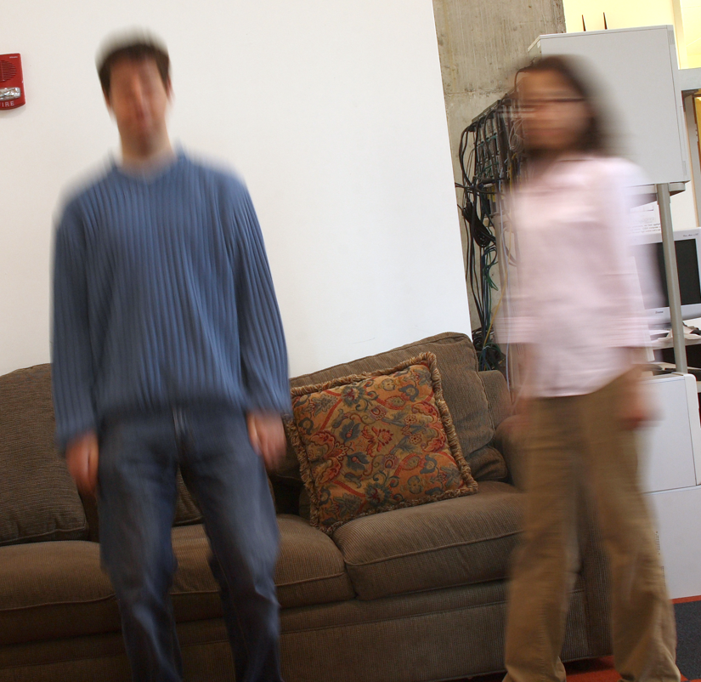
Challenges with motion deblurring
Challenges:
Need to segment image
Need to estimate motion
Spatially variant motion
Notes:
2
2
Subject motion blur removal is challenging. 1. Need to estimate motion locally. 2. Need to segment the image accordingly

Slide 3
Challenges with motion deblurring
Information loss
due to averaging
Challenges:
Need to segment image
Need to estimate motion
Need to minimize
information loss
Spatially variant motion
Notes:
3
3
Even if the motion estimation is perfect, sometimes a sharp image recovery fails due to information loss. Need to minimize information loss.

Slide 4
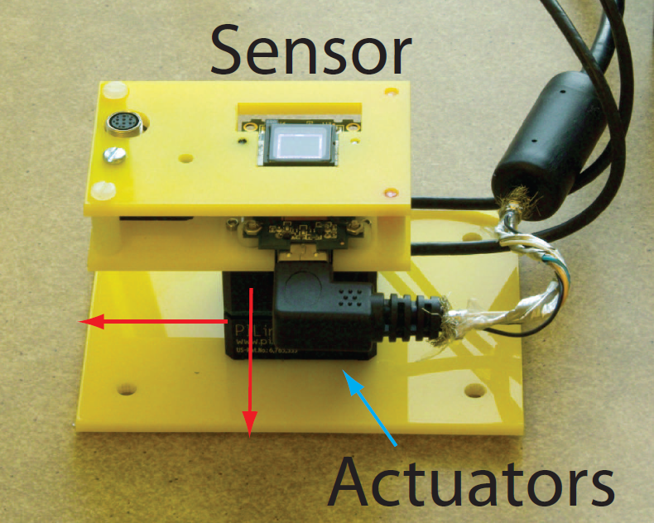
In this talk
What is the optimal worst-case spectral bound for
2D motions?
A new camera for near-optimal information capture
Notes:
4
4
In this paper, we address all these questions.
1. We derive the optimal worst-case spectral bound.
2. Present a camera that near-optimally captures image information
3. Present blur estimation techniques.

Slide 5
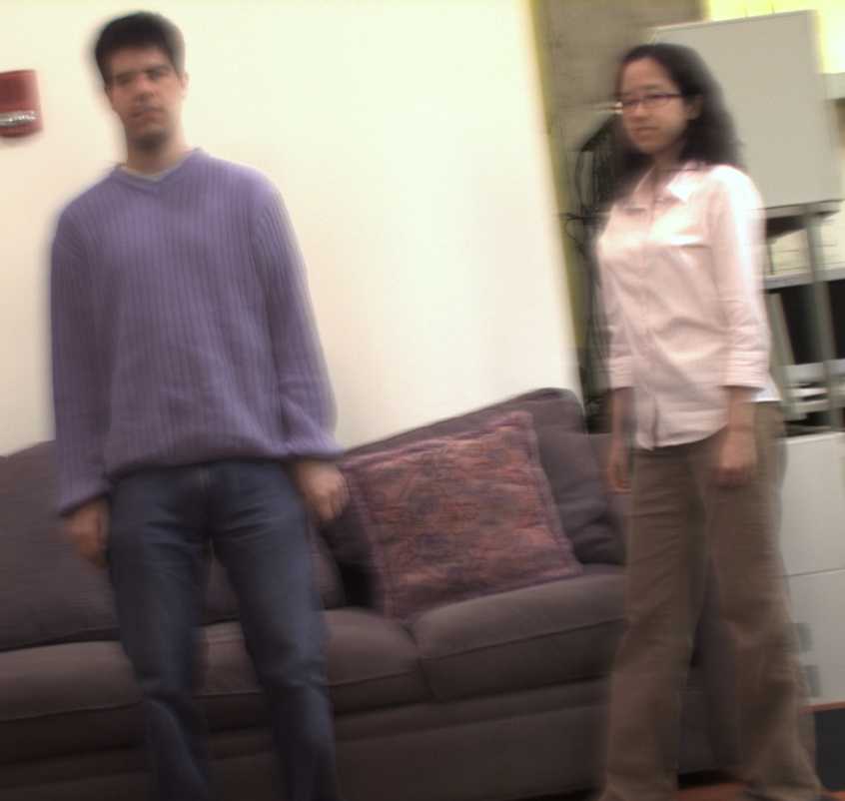
Our technique
Key characteristics
Takes two shots with
parabolic camera
Handles 2D constant-
velocity motions
Allows near-optimal
information capture
Notes:
5
5
In a nutshell, we take two images with orthogonal parabolic cameras.

Slide 6
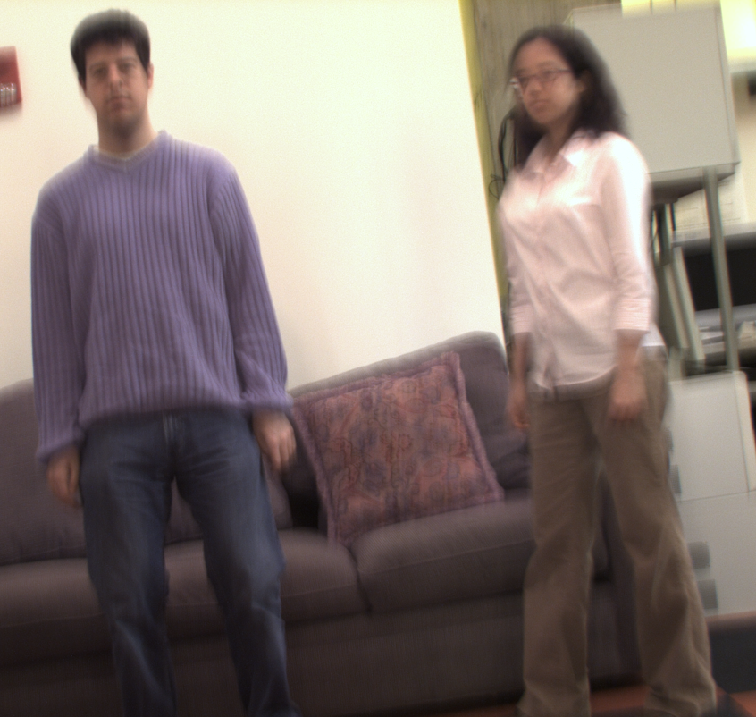
Our technique
Key characteristics
Takes two shots with
parabolic camera
Handles 2D constant-
velocity motions
Allows near-optimal
information capture
Notes:
6
6

Slide 7
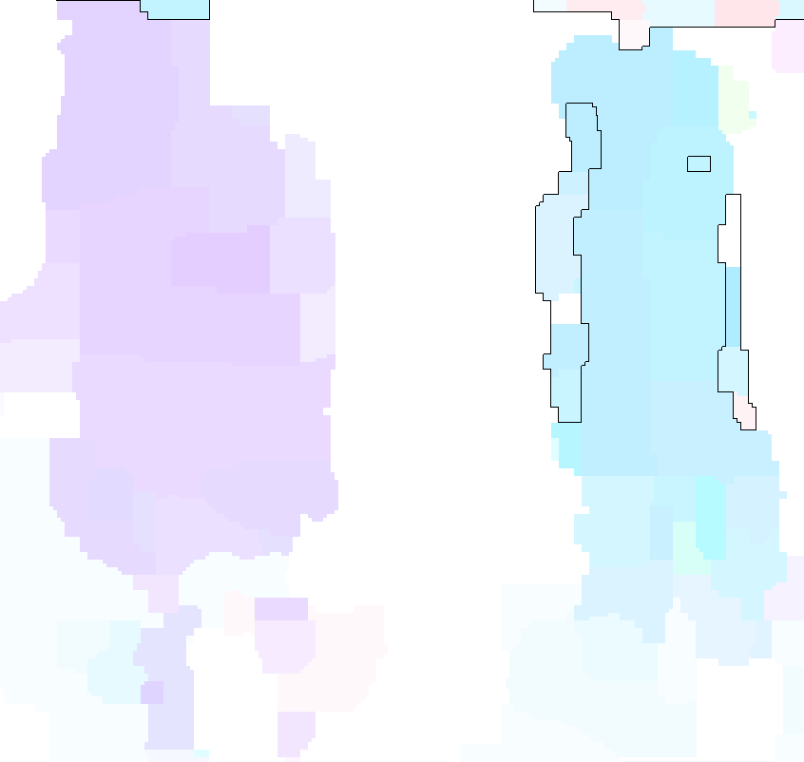
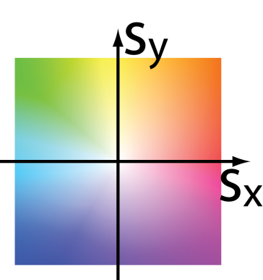
Our technique
Key characteristics
Takes two shots with
parabolic camera
Handles 2D constant-
velocity motions
Allows near-optimal
information capture
Notes:
7
7
We estimate motion locally using both images

Slide 8
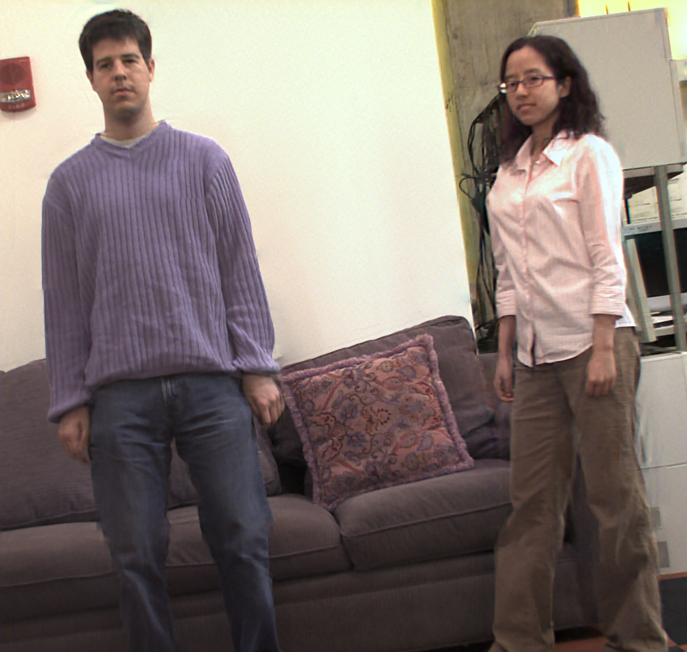
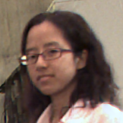
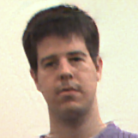
Our deblurring result
Notes:
8
8
Then we deblur the image according to the estimated motion

Slide 9
Outline
Related work
2D motion optimal spectral bound
Camera design
Spatially variant motion estimation
Experimental results
Notes:
9
9

Slide 10
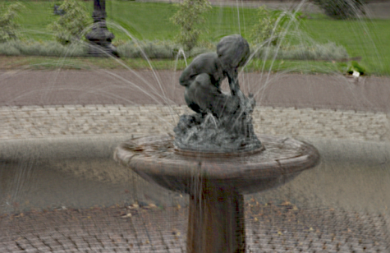
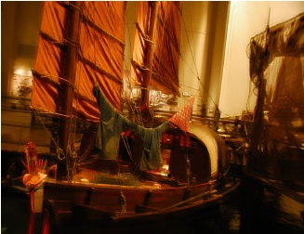
Related Work
Spatially invariant blur removal
[Rav-Acha & Peleg 05] [Fergus et al. 06] [Shan et al. 08]
Notes:
10
10
Spatially invariant blur removal -> cannot handle spatially variant blur

Slide 11
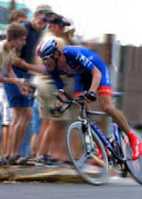
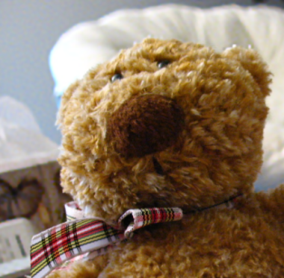
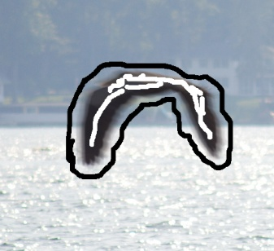
Related Work
Spatially invariant blur removal
[Rav-Acha & Peleg 05] [Fergus et al. 06] [Shan et al. 08]
Spatially variant blur removal
[Ben-Ezra & Nayar 04] [Levin 06] [Cho et al. 07] [Jia 07]
[Joshi et al. 08] [Tai et al. 08] [Dai & Wu 09] [Agrawal et al. 09]
Notes:
11
11
Spatially variant blur – somewhat unstable. For better blur estimation, user input, multiple images, or additional hardware is required

Slide 12
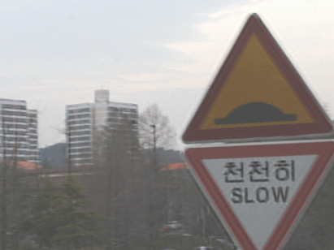
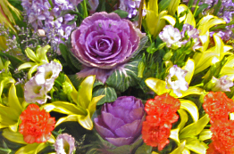
Related Work
Spatially invariant blur removal
[Rav-Acha & Peleg 05] [Fergus et al. 06] [Shan et al. 08]
Spatially variant blur removal
[Ben-Ezra & Nayar 04] [Levin 06] [Cho et al. 07] [Jia 07]
[Joshi et al. 08] [Tai et al. 08] [Dai & Wu 09] [Agrawal et al. 09]
Multi-image deblurring
[Rav-Acha & Peleg 05] [Cho et al. 07] [Yuan et al. 07]
[Chen et al. 08] [Tai et al. 08] [Agrawal et al. 09]
Notes:
12
12
Multi-image deblurring helps blur estimation

Slide 13
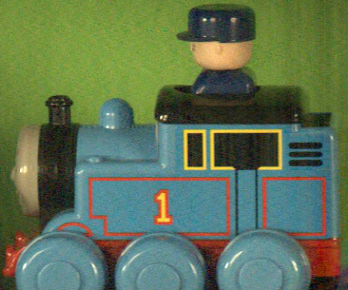
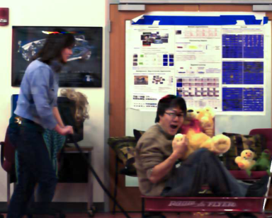
Related Work
Spatially invariant blur removal
[Rav-Acha & Peleg 05] [Fergus et al. 06] [Shan et al. 08]
Spatially variant blur removal
[Ben-Ezra & Nayar 04] [Levin 06] [Cho et al. 07] [Jia 07]
[Joshi et al. 08] [Tai et al. 08] [Dai & Wu 09] [Agrawal et al. 09]
Multi-image deblurring
[Rav-Acha & Peleg 05] [Cho et al. 07] [Yuan et al. 07]
[Chen et al. 08] [Tai et al. 08] [Agrawal et al. 09]
Improving information sensing
[Raskar et al. 06] [Levin et al. 08] [Agrawal et al. 09]
Notes:
13
13
Prior work for improving the image information sensing. But performance is not guaranteed, or only guaranteed for 1D motion.

Slide 14
Related Work
Spatially invariant blur removal
[Rav-Acha & Peleg 05] [Fergus et al. 06] [Shan et al. 08]
Prior works do not provide
worst-case spectral guarantees for 2D motions
Spatially variant blur removal
[Ben-Ezra & Nayar 04] [Levin 06] [Cho et al. 07] [Jia 07]
[Joshi et al. 08] [Tai et al. 08] [Dai & Wu 09] [Agrawal et al. 09]
Multi-image deblurring
[Rav-Acha & Peleg 05] [Cho et al. 07] [Yuan et al. 07]
[Chen et al. 08] [Tai et al. 08] [Agrawal et al. 09]
Improving the information sensing
[Raskar et al. 06] [Levin et al. 08] [Agrawal et al. 09]
Notes:
14
14
None of the prior works provide performance guarantees for 2D motions

Slide 15
Disclaimers
In this work, we assume that:
Motion is constant-velocity parallel to the image plane
-> i.e. relatively short exposure time
Deblurring error from kernel estimation is negligible
-> by using two-images, this is generally true
Notes:
15
15
We make assumptions
Motion is a constant velocity motion parallel to the image plane
Artifacts from kernel estimation is negligible

Slide 16
Outline
Related work
2D motion optimal spectral bound
Camera design
Spatially variant motion estimation
Experimental results
Notes:
16
16

Slide 17
3-D space-time motion static camera
Relative motion path
t
T
y
x
Notes:
17
17
We can represent 2D constant velocity motions in a 3D space-time volume. The blur kernel is a projection of the motion path along t axis. The slope represents the object velocity.

Slide 18

3-D space-time motion static camera
Motion path
t
T
y
x
Notes:
18
18
Another way to represent blur kernels for different velocities is to project the camera motion path, in this case a static camera, at different angles along the time axis.

Slide 19
3-D space-time motion arbitrary camera motion
Motion path
t
T
y
x
Notes:
19
19
In fact, for arbitrary camera motion paths, we can get the blur kernel for different object velocities by projecting at different angles along the time axis.

Slide 20
3-D space-time motion – Fourier domain
Notes:
20
20
In the Fourier domain, blur kernels corresponding to different object velocities correspond to different slices of 3D Fourier transform motion path. For y directional motions, the angle at which we slice increases as sy increases.

Slide 21
3-D space-time motion – Fourier domain
Notes:
21
21

Slide 22
3-D space-time motion – Fourier domain
Increasing s_{y}
[Ng SIGGRAPH 2005]
[Levin et al. SIGGRAPH 2008]
Notes:
22
22

Slide 23
3-D space-time relative motion
t
Motion path
T
y
x
Notes:
23
23
For motions along x=y direction,

Slide 24
3-D space-time motion – Fourier domain
Increasing s_{x} =s_{y}
Notes:
24
24
Slices rotate around wt axis.

Slide 25


3-D Fourier Transform of 2D motions
Motion path spectrum
Wedge of revolution
Notes:
25
25
The sum of all slices for all 2D motions occupy the outer volume of an inverted double-cone. We call this a wedge of revolution.

Slide 26

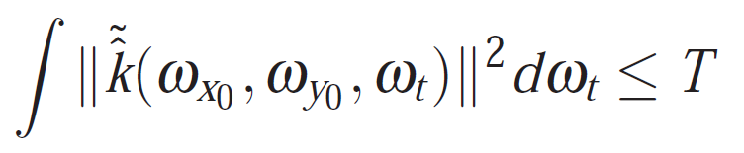
Optimal spectral bound
Motion path spectrum
Notes:
26
26
A fixed time budget limits the total energy of a spectral line at fixed, wx, wy along wt.

Slide 27
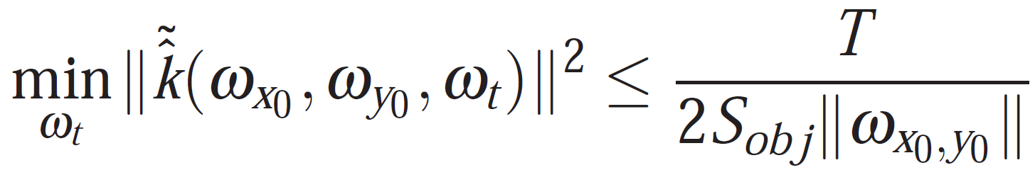
Optimal spectral bound
Motion path spectrum
Notes:
27
27
To maximize the minimum of spectrum k, we need to equally distribute the energy -> we get this bound.

Slide 28
Camera design objective
Design camera paths k such that the worst-case spectral power is as close to the optimal bound as possible
Notes:
28
28
The problem of designing camera motion can be formulated as maximizing the worst-case spectral power.

Slide 29
Outline
Related work
2D motion optimal spectral bound
Camera design
Spatially variant motion estimation
Experimental results
Notes:
29
29

Slide 30


x-parabolic camera
Characteristics:
Provides optimal spectrum coverage
for 1-dimensional motion
Motion path
Motion spectrum
t
y
x
[Levin et al. SIGGRAPH 2008]
Notes:
30
30
We present a solution that takes two images of the scene using two orthogonal parabolic shots. An x-directional parabolic camera optimally captures

Slide 31
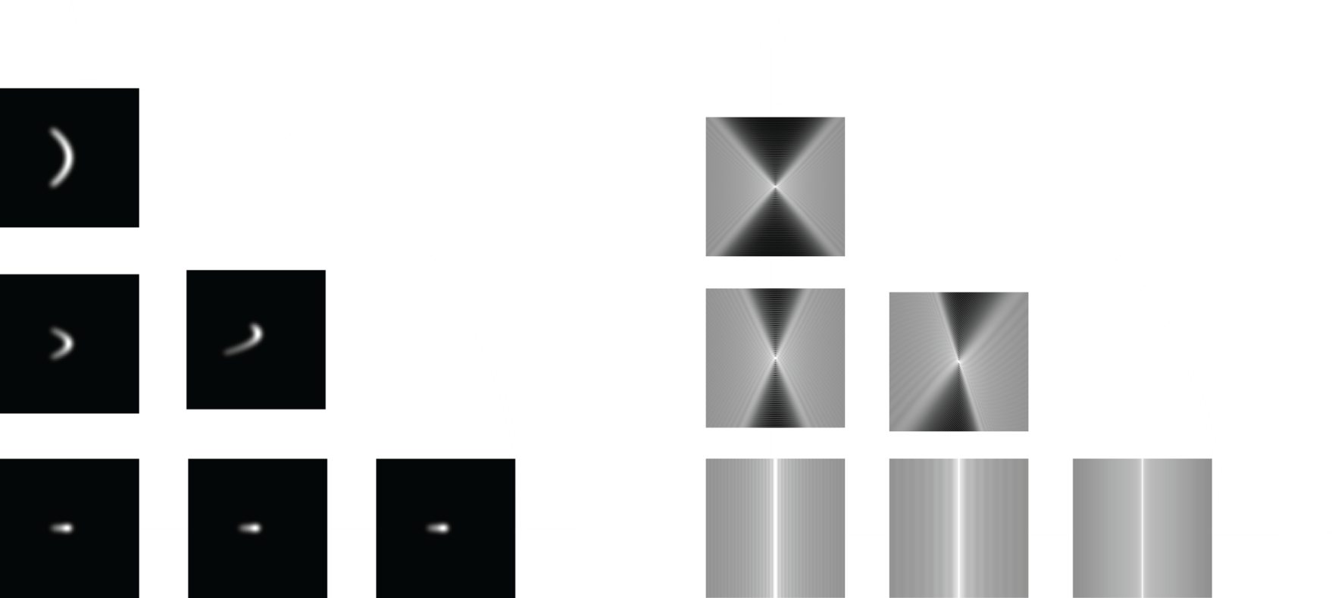
x-parabolic camera
Point spread function
Power spectrum
s_{y}
s_{y}
y
x
s_{x}
s_{x}
Optimal spectrum coverage for x-directional motion
Zeros along for non x-directional motion
Notes:
31
31
We can project the motion path to get the point spread function. The power spectra of these point spread functions are slices of the 3D motion spectrum. We can see that the spectral coverage is perfect for x-directional motions, but the spectrum contains zeros for once there are y-directional components in the motion.

Slide 32


y-parabolic camera
Characteristics:
Orthogonal spectrum from x-parabolic camera
Motion path
Motion spectrum
t
y
x
Notes:
32
32
Now, if we look at y-directional parabolic camera, everything is orthogonal.

Slide 33
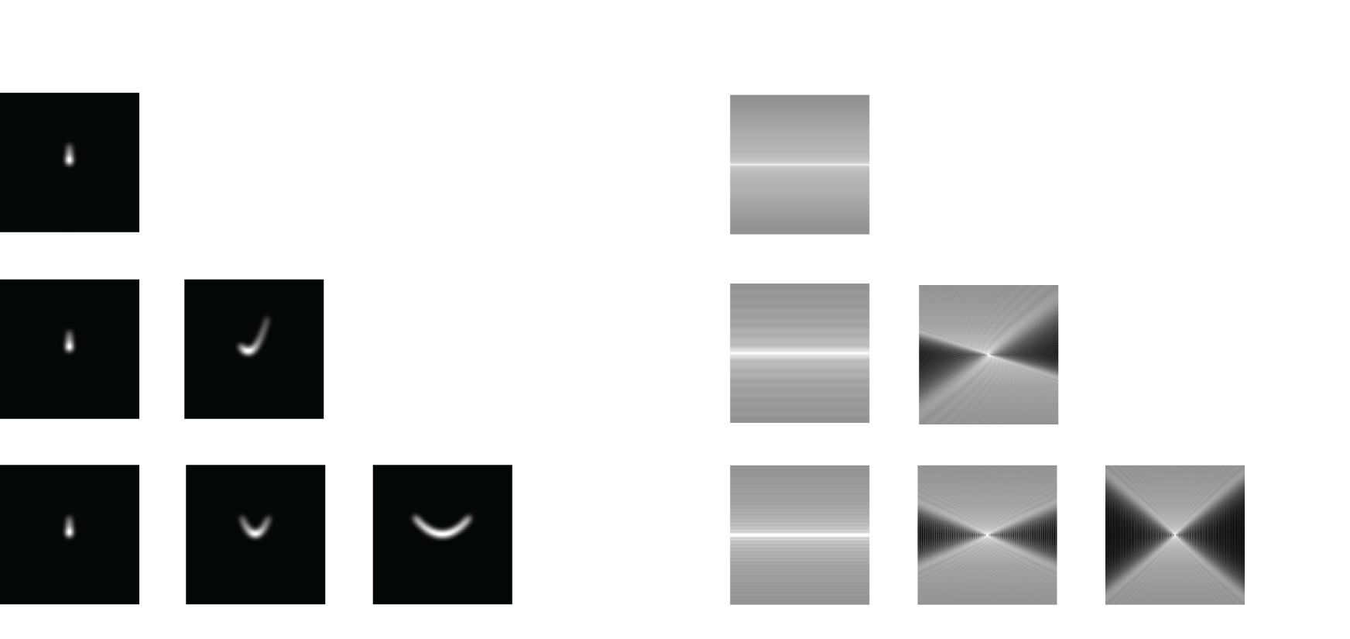
y-parabolic camera
Point spread function
Power spectrum
Optimal spectrum coverage for y-directional motion
Zeros along for non y-directional motion
Notes:
33
33
y-directional motions are captured perfectly, but x-directional components are not.

Slide 34
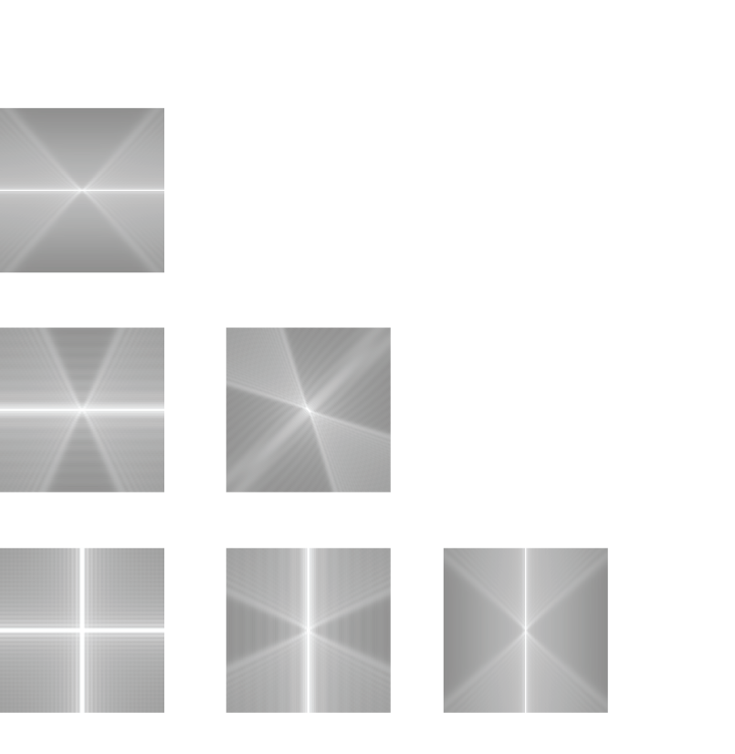
Orthogonal parabolic cameras
Power spectrum
Notes:
34
34
If we use both x-directional parabolic camera and y-directional parabolic camera, we can cover the entire spectrum without zeros (!) for motions in arbitrary directions.

Slide 35

Orthogonal parabolic cameras
+
=
Notes:
35
35
In fact, the sum of 3D motion spectrums subsumes the wedge of revolution.

Slide 36
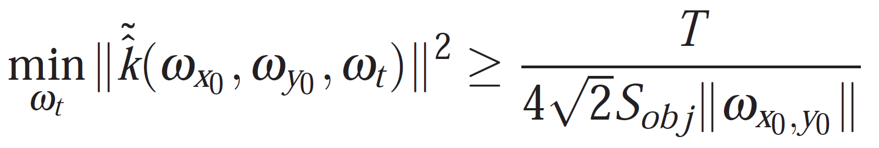
Orthogonal parabolic cameras – optimality
Worst-case spectral power of orthogonal parabolic cameras is at least 2^{-1.5} of the optimum
Notes:
36
36
We can also show that the worst-case power spectrum coverage is 2^(-1.5) factor away from the optimal bound. This is the first imaging methodology that provides the worst-case spectral power guarantee.

Slide 37
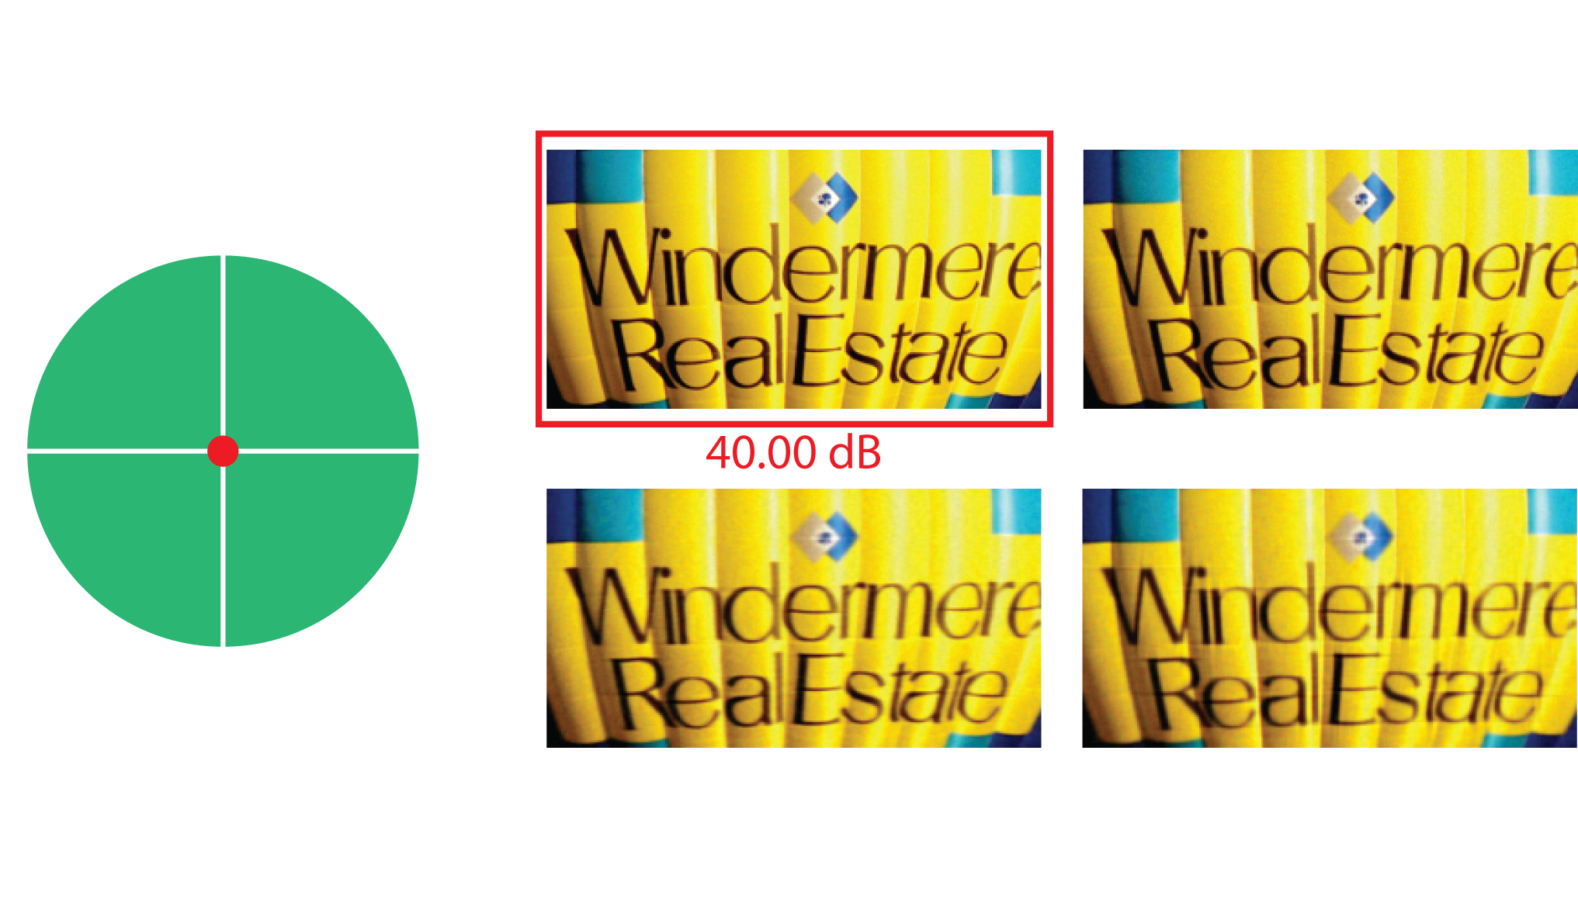
Comparisons with previous designs
* Synthetic experiments – known motion
Notes:
37
37
We compare this imaging method with prior art. We consider a pair of static camera, a pair of flutter shutter camera, one parabolic shot, and orthogonal parabolic shots. For static and flutter shutter camera pairs, we break the exposure time budget T between two shots, and optimize the split. In all simulation results, we assume that we know the correct object motion. For a static object, a static camera pair performs the best.

Slide 38
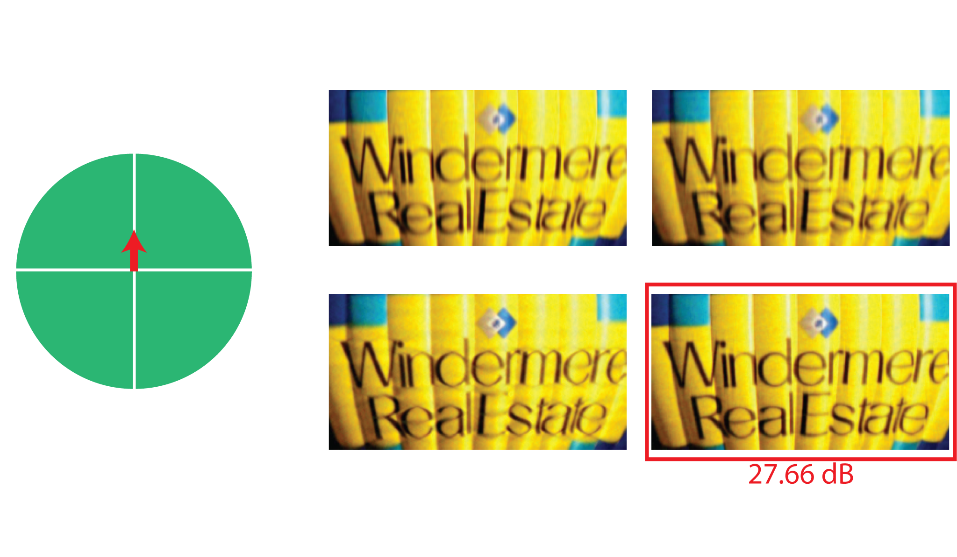
Comparisons with previous designs
* Synthetic experiments – known motion
Notes:
38
38
As the object moves, orthogonal parabolic cameras start performing better.

Slide 39
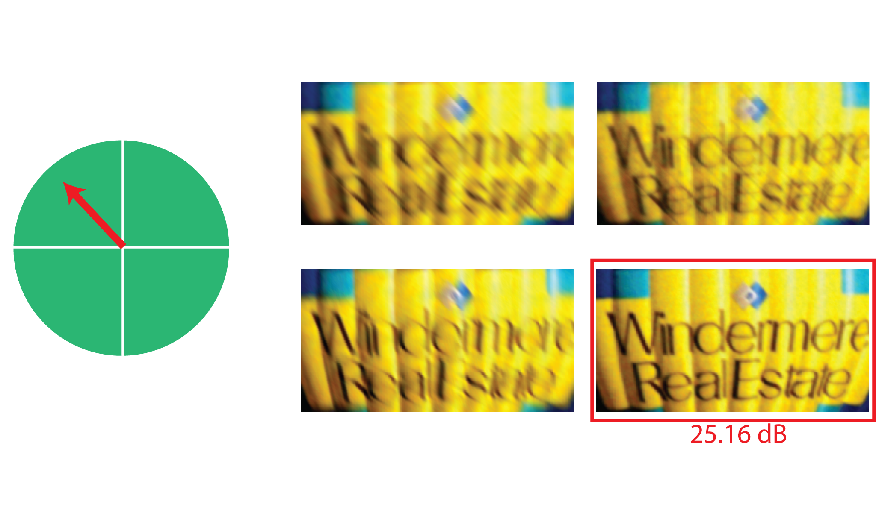
Comparisons with previous designs
* Synthetic experiments – known motion
Notes:
39
39
At a fast speed, orthogonal parabolic cameras certainly do the best. Other designs cannot provide the worst-case spectral bound, whereas we can.

Slide 40
Outline
Related work
2D motion optimal spectral bound
Camera design
Spatially variant motion estimation
Experimental results
Notes:
40
40

Slide 41
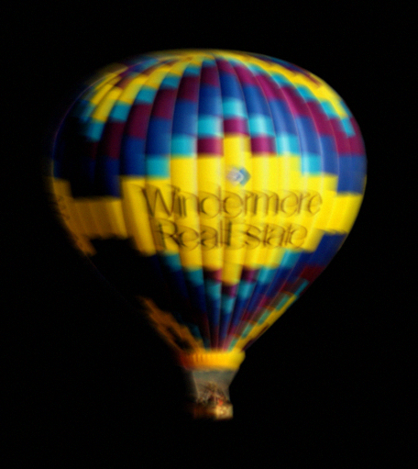
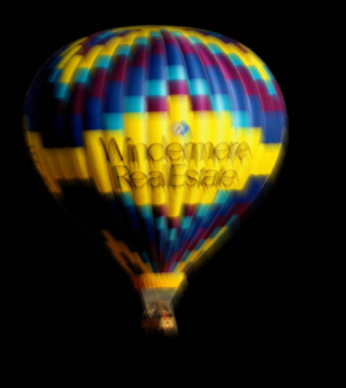
Blur kernel estimation
Horizontal parabolic
Vertical parabolic
Notes:
41
41
We illustrate how to estimate blur kernel from two images.

Slide 42
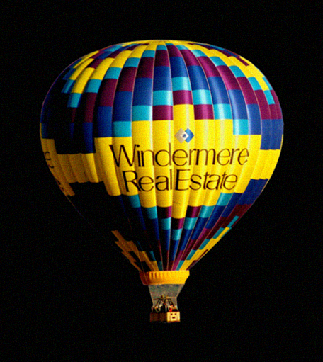
Blur kernel estimation
Deblur
Horizontal parabolic
Vertical parabolic
Notes:
42
42
Given two images, guess a motion and deblur using the kernel pairs that correspond to the guessed motion.

Slide 43
Blur kernel estimation
Deblur
Horizontal parabolic
Vertical parabolic
Reblur
Horizontal parabolic
Vertical parabolic
Notes:
43
43
Then we re-blur the deblurred image using the same blur kernels

Slide 44
Blur kernel estimation
Deblur
Horizontal parabolic
-
Vertical parabolic
Reblur
Horizontal parabolic
Vertical parabolic
Notes:
44
44
And take the difference of the reblurred image pairs with the captured images.

Slide 45

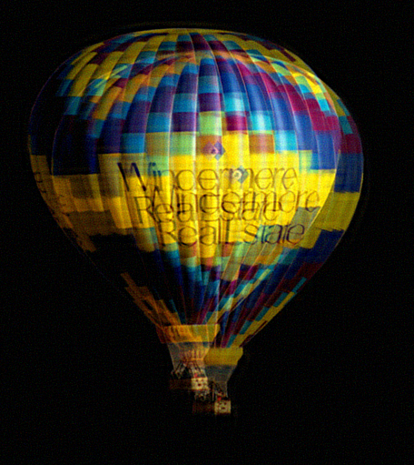
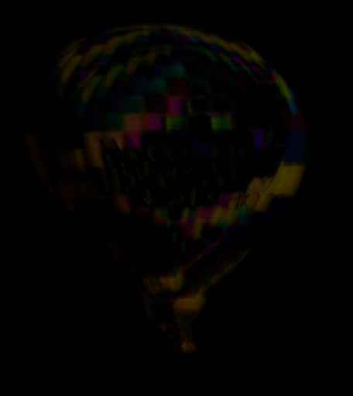
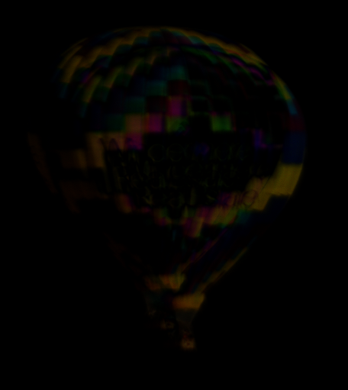
Blur kernel estimation
Deblurred image
Residual - hor
Residual - ver
Correct
motion
Incorrect
motion
Notes:
45
45
We can see that when we use the correct motion, the difference between the captured images and the reblurred images is just noise; whereas when the motion is incorrect, the difference image contains halos.

Slide 46
Blur kernel estimation
Deblurred image
Residual - hor
Residual - ver
Correct
motion
Find motion velocity that locally minimizes the residual
Incorrect
motion
Notes:
46
46
So in order to estimate spatially varying blur, for each pixel find motion that results in minimum residual locally.

Slide 47
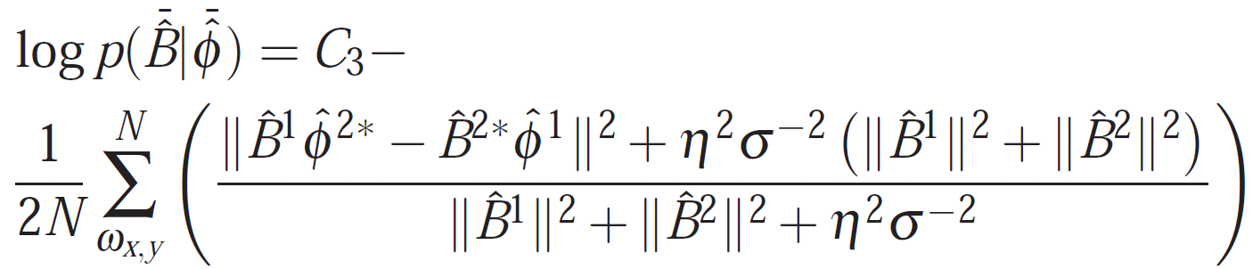
Blur kernel estimation from two images
Notes:
47
47
This kernel estimation strategy can be derived in a Bayesian manner, assuming a Gaussian prior on image gradients. This is not computationally friendly;

Slide 48
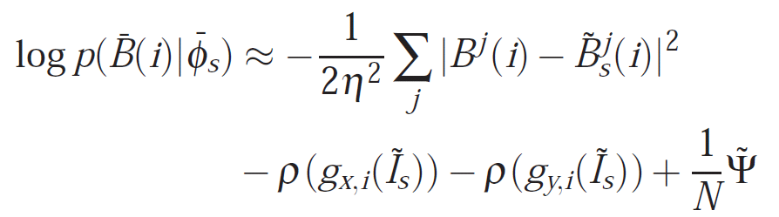
Blur kernel estimation from two images
Local Laplace representation
Notes:
48
48
We can represent the kernel estimation measure by representing it using a Laplace representation. This corresponds to the procedure outline earlier.

Slide 49
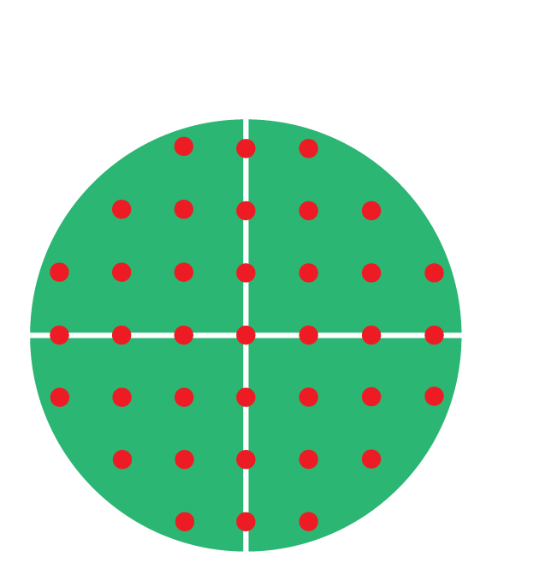
Blur kernel estimation - Multiscale
Coarse scale
Notes:
49
49
Evaluating this measure for each motion at each pixel can be computationally expensive. We search for motion in a multiscale manner. First, at each pixel, we find the best motion at a coarse velocity grid. We perform this operation at a coarser spatial resolution as well

Slide 50
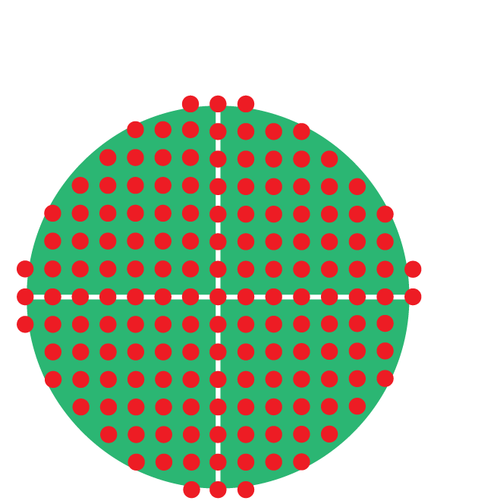
Blur kernel estimation - Multiscale
Coarse scale
Fine scale
Notes:
50
50
Once we have estimates at a coarse scale at each pixel, we search over the neighborhood of the coarser scale “velocity” estimate to refine the motion.

Slide 51
Motion boundary handling
A region seen in one image may not be present in the other image
Notes:
51
51

Slide 52
Motion boundary handling
A region seen in one image may not be present in the other image
Notes:
52
52

Slide 53
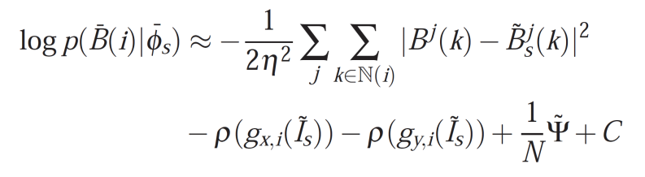
Motion boundary handling
Use only one of the images to fill in such regions – shown by black boundary
Notes:
53
53
We use only one of the two captured images to fill in such regions.

Slide 54
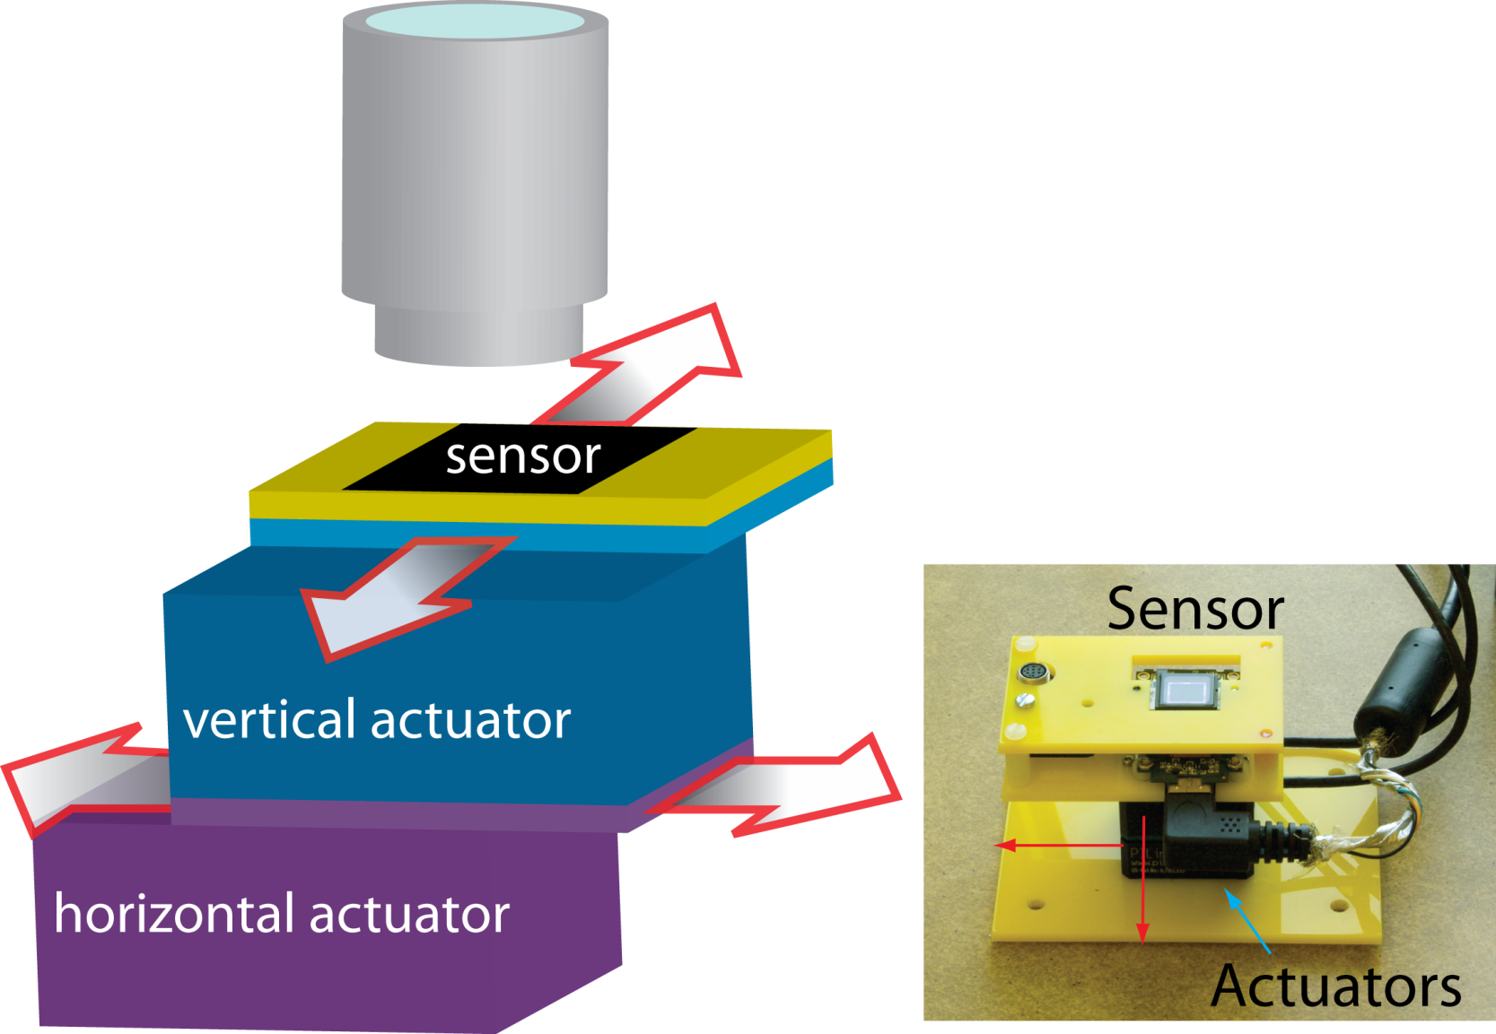
Experiments – Camera setup
Diagram
Camera setup
Notes:
54
54
We built a camera prototype to demonstrate the concept. Two actuators move the sensor in parabolic paths while keeping the lens static. The entire exposure time is 500 ms, 200ms for each shots and 100 ms delay in the middle.

Slide 55
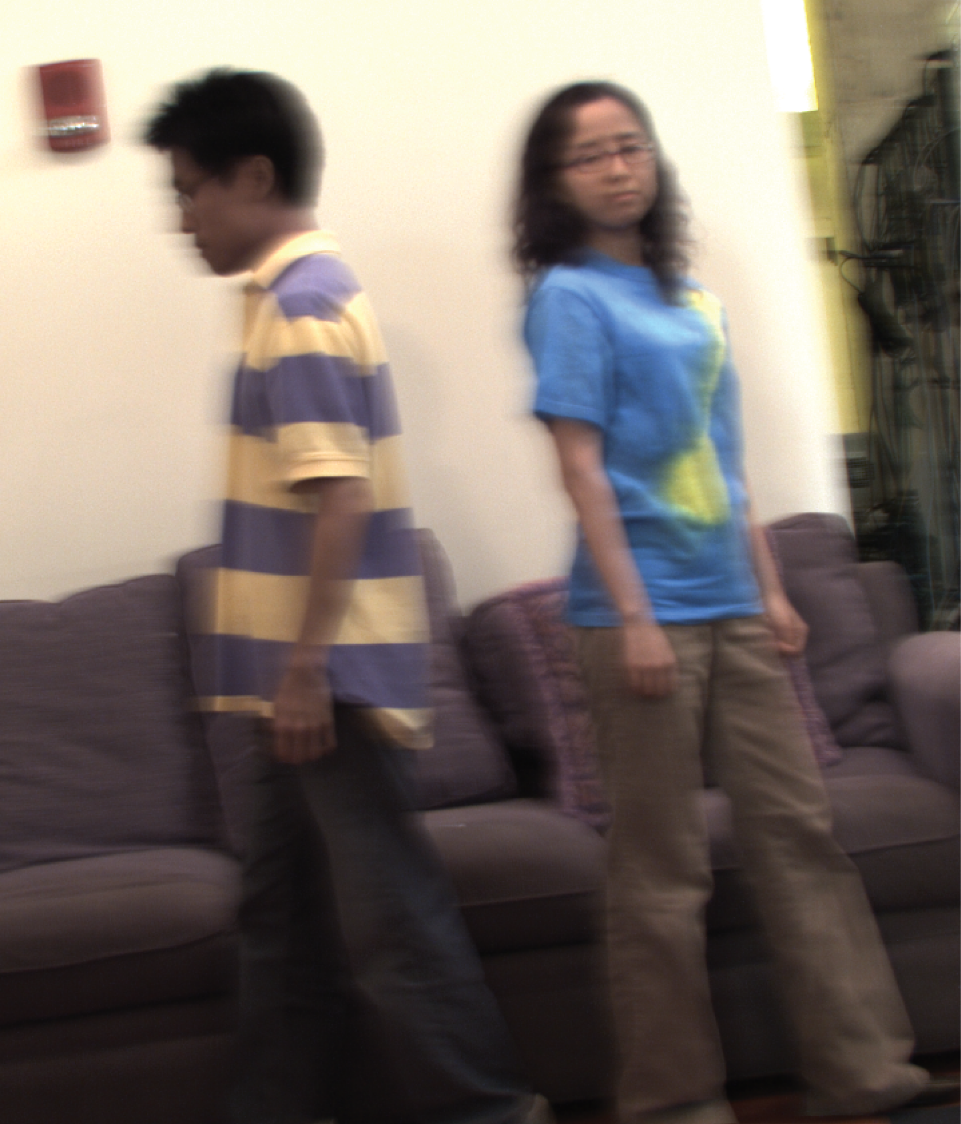
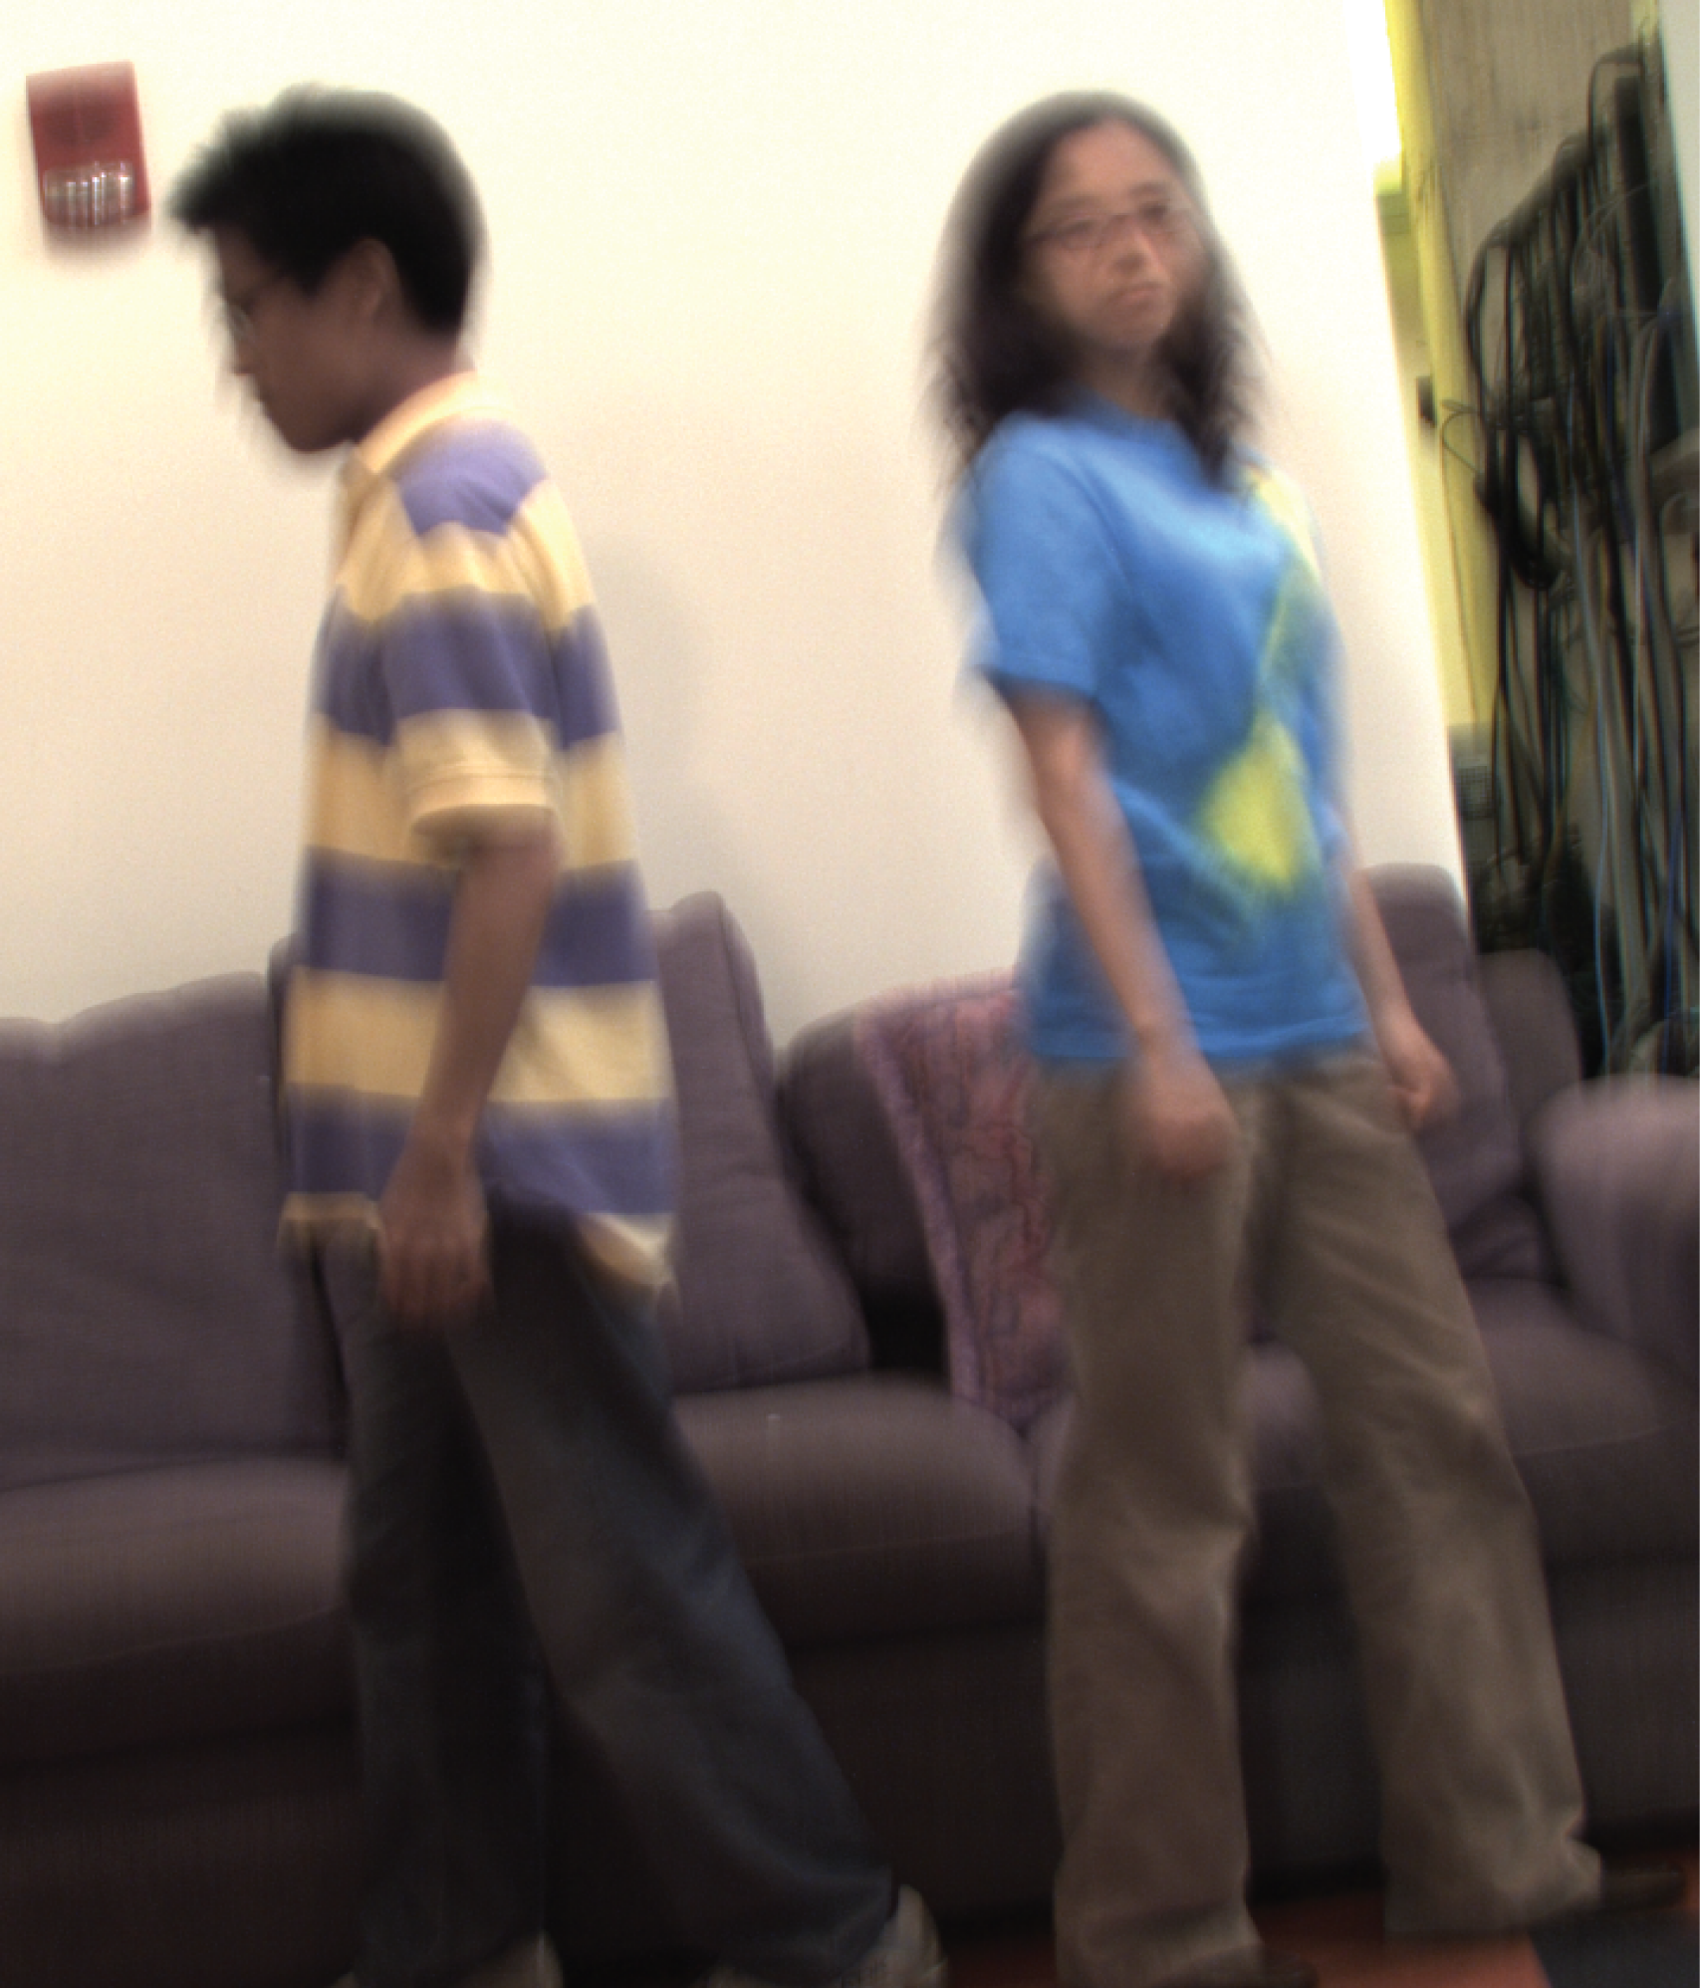
Experiments
Horizontal parabolic
200ms shot
Vertical parabolic
200ms shot
Notes:
55
55
We take two images with this camera

Slide 56
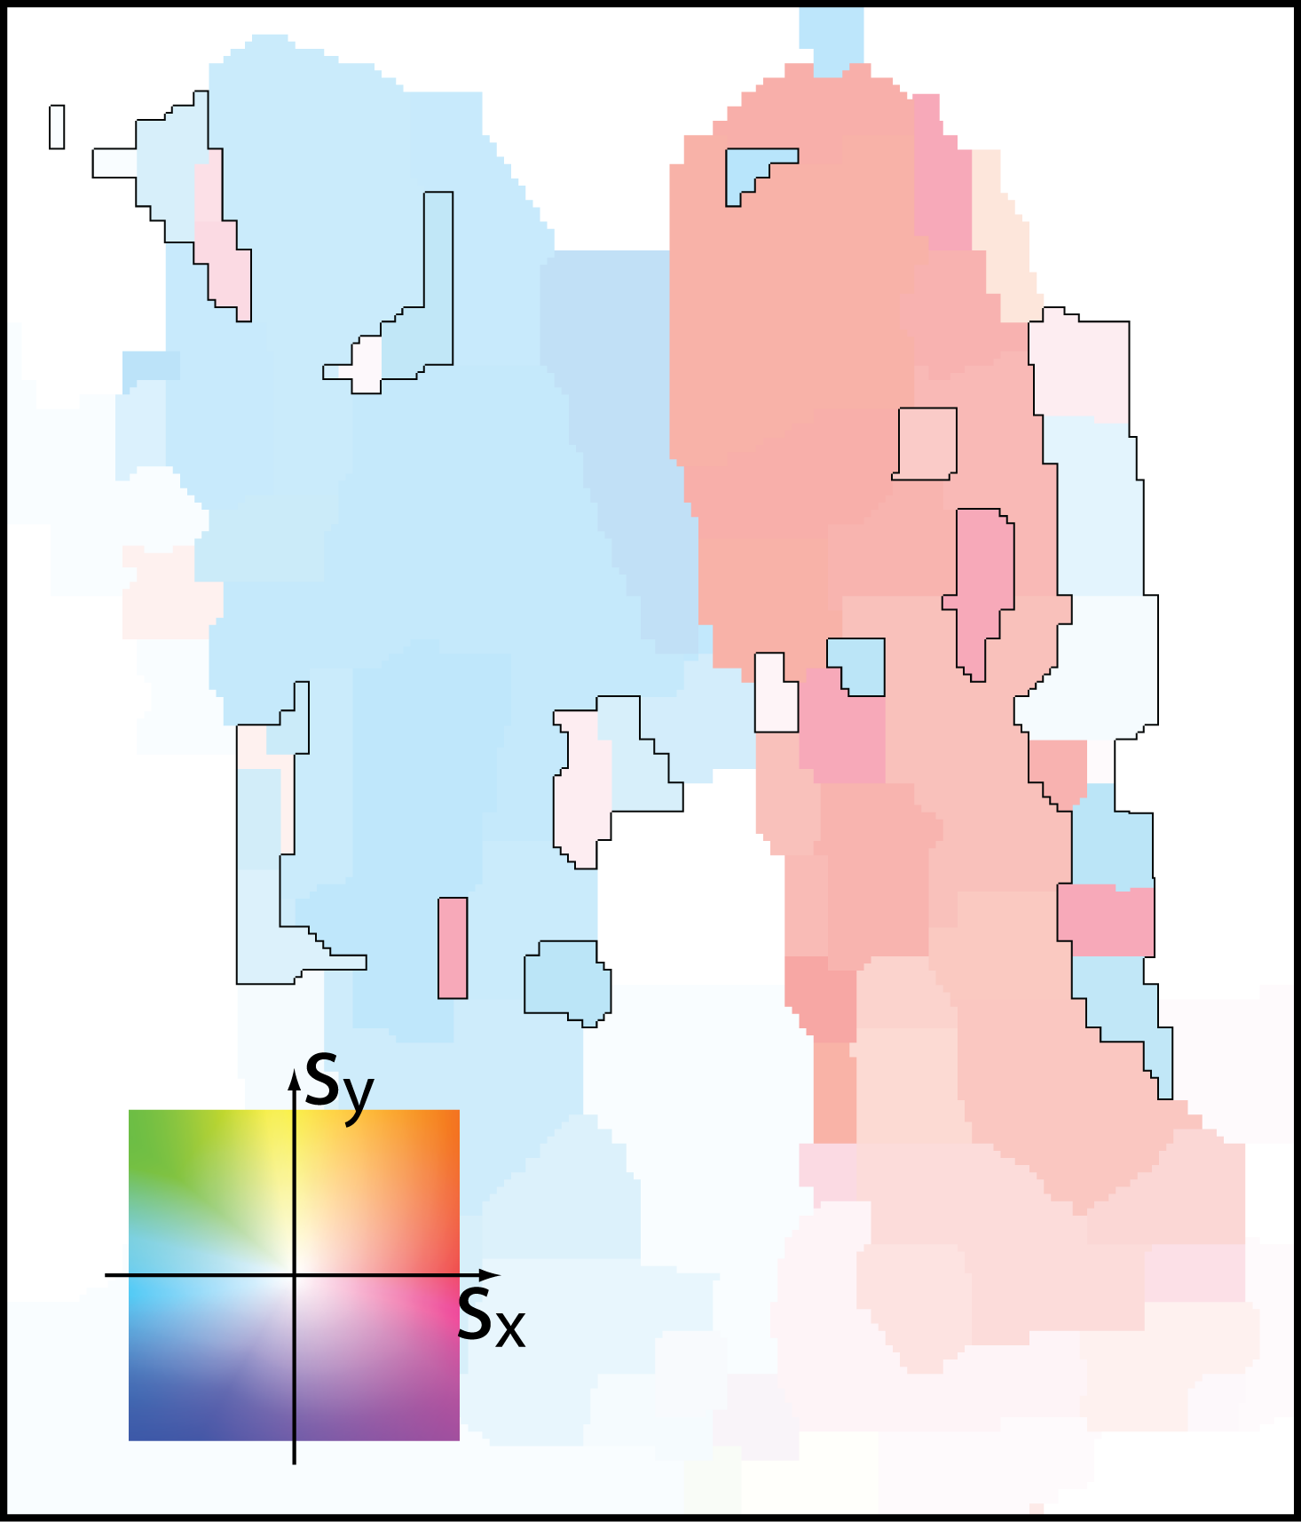
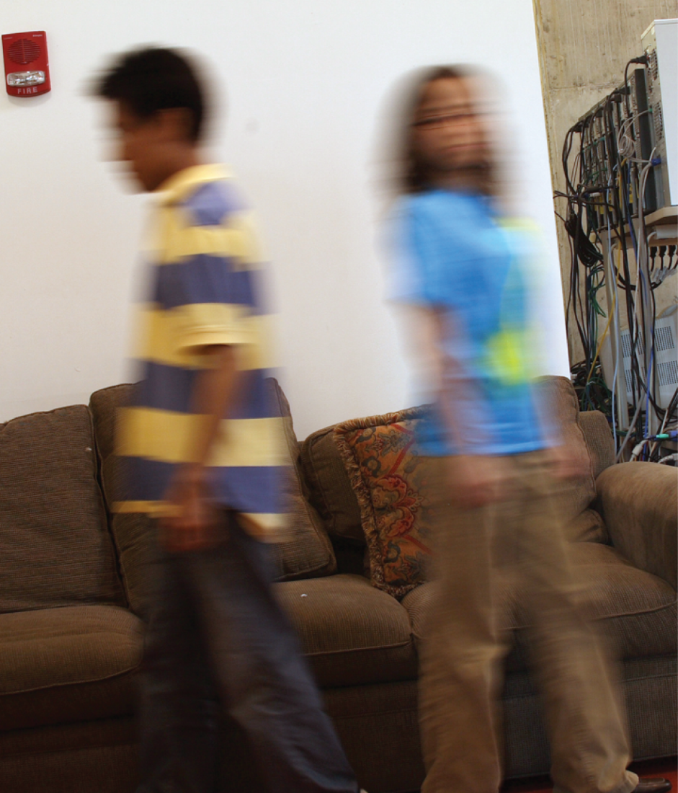
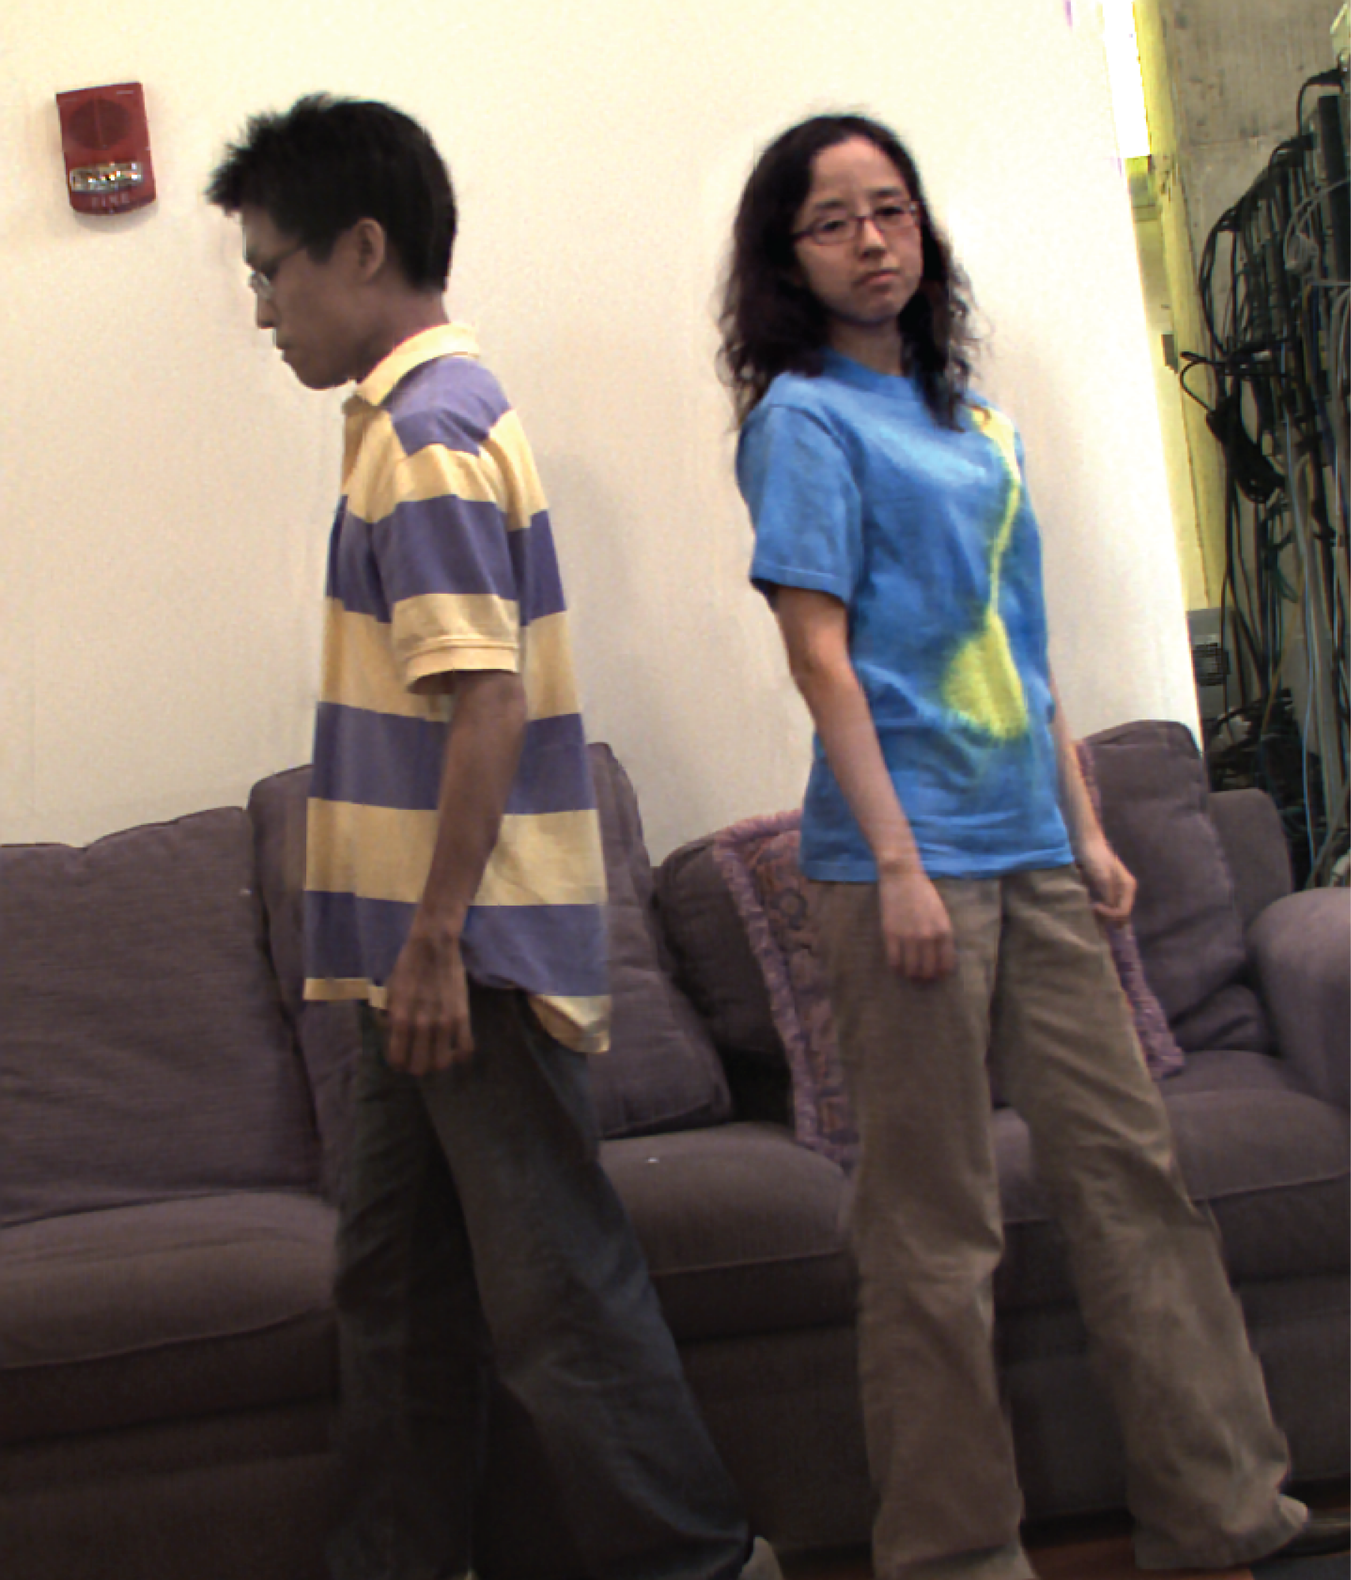
Experiments
Estimated motion
Deblurred image
Notes:
56
56
Estimate motion with these two shots and recover a blur free image.

Slide 57
Experiments
Static camera reference
500ms
Deblurred image
Notes:
57
57
To see the motion, we show here an image taken with a static camera with 500ms exposure.

Slide 58
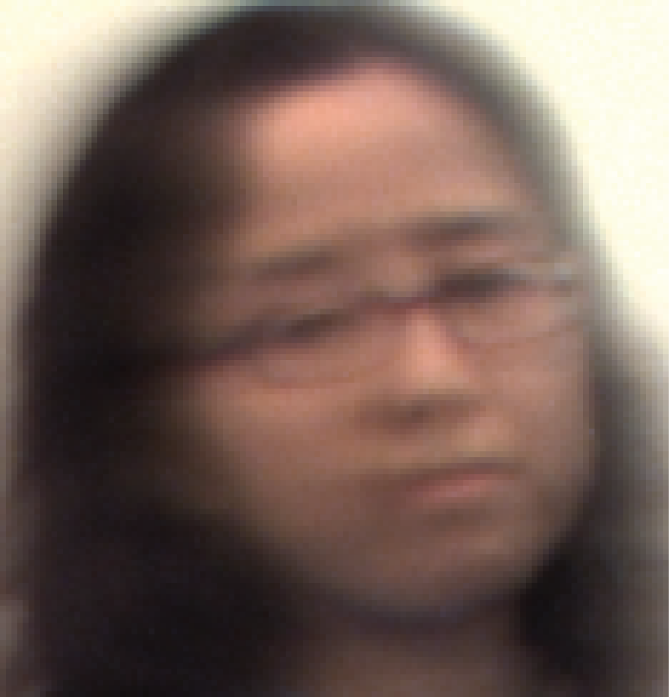
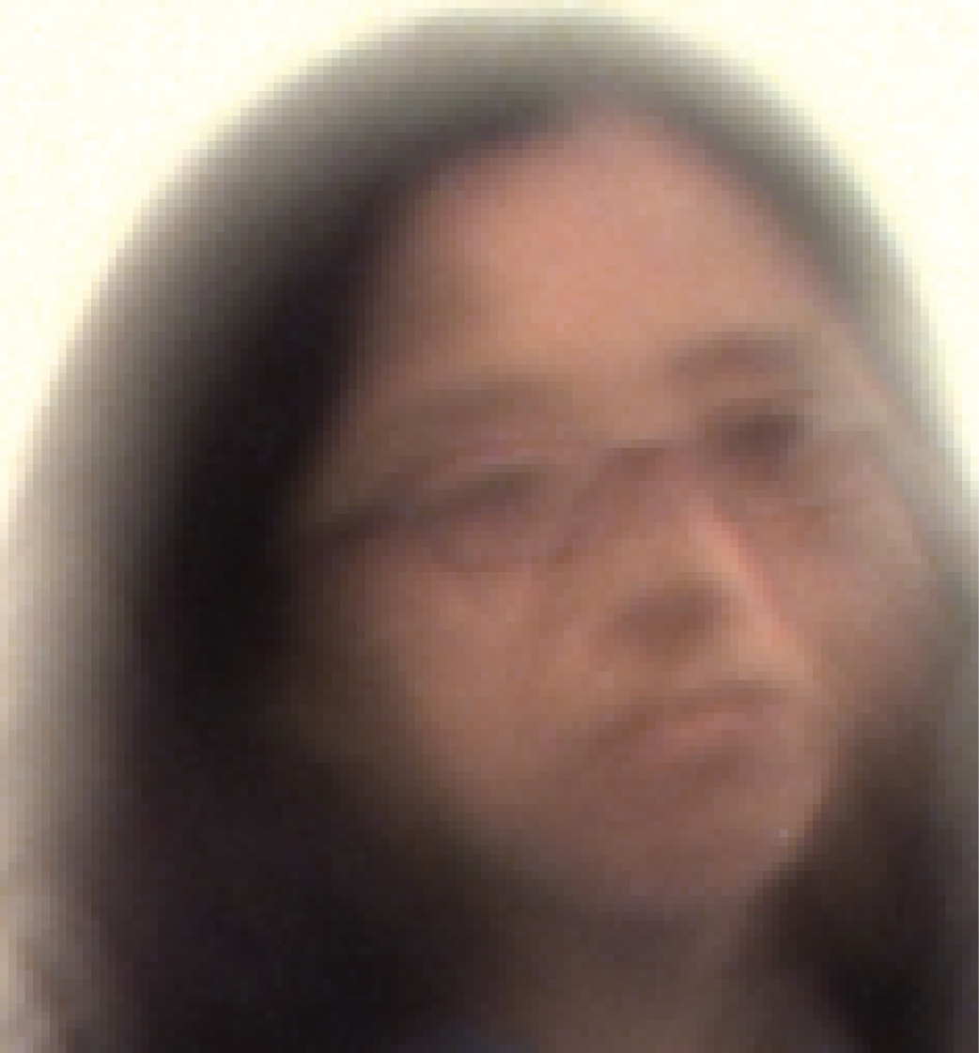
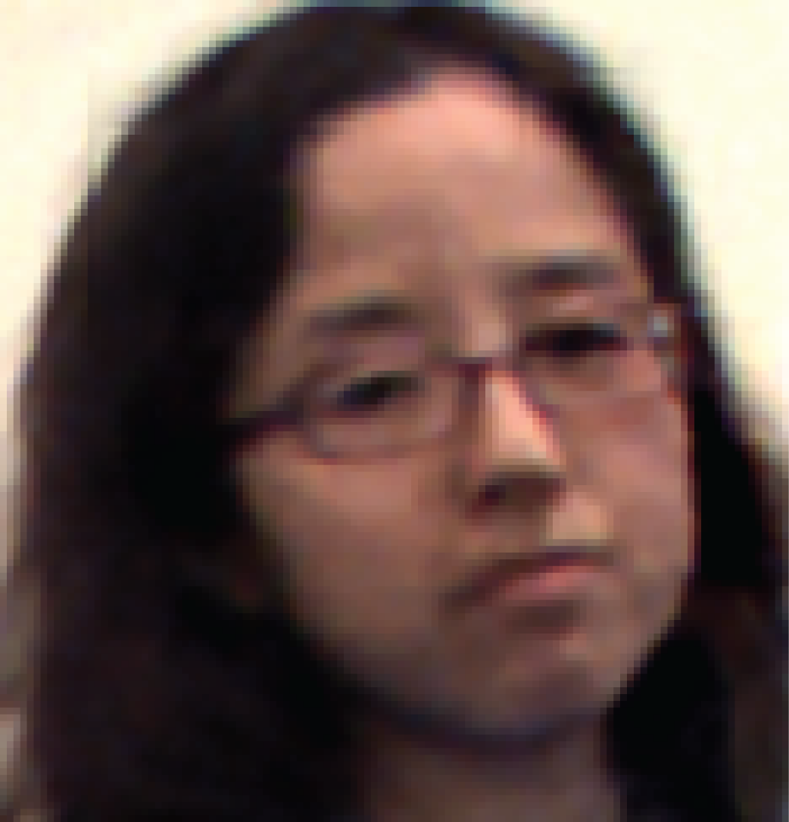
Experiments - zoomed
Horizontal parabolic
200ms shot
Vertical parabolic
200ms shot
Deblurred Image
Notes:
58
58
Here is a zoomed version of the two images taken and the deblurred image.

Slide 59
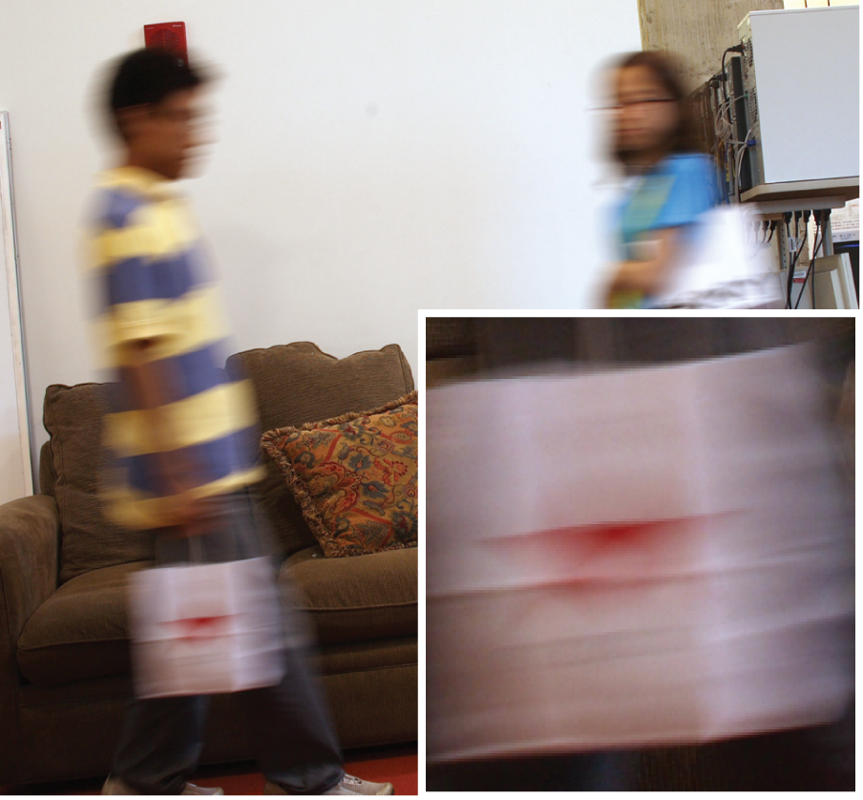

Experiments – more examples
Static camera reference
500ms
Deblurred image
Notes:
59
59
We show more examples here

Slide 60
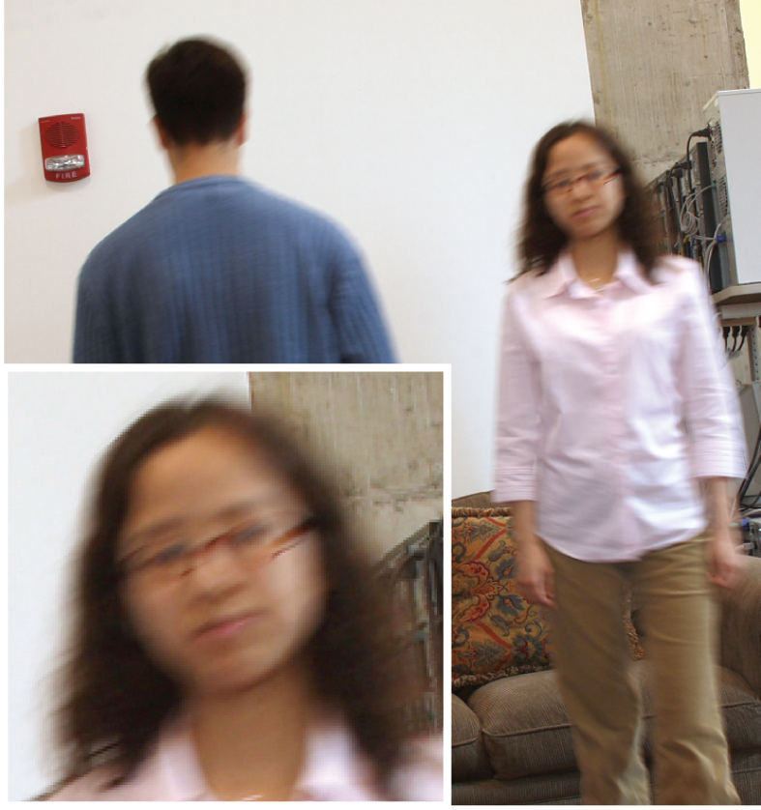
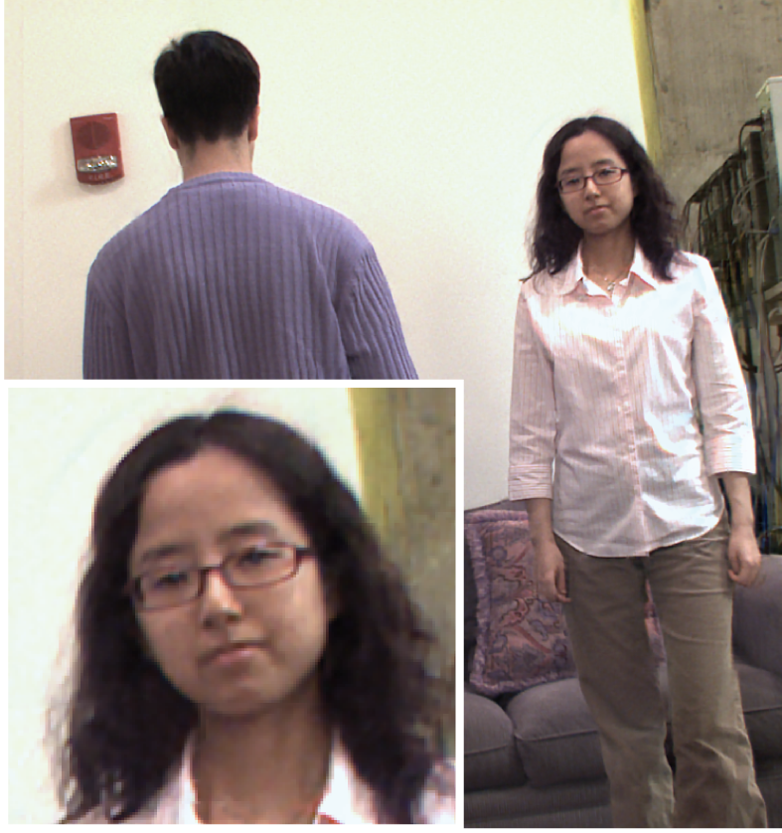
Experiments – more examples
Static camera reference
500ms
Deblurred image
Notes:
60
60
Even for a forward motion that does not really satisfy our assumption about the motion, we can recover a relatively sharp image.

Slide 61
Contributions
Optimal worst-case bound for 2D motions
-
Blur estimation method
Prototype camera
Notes:
61
61

Slide 62
Motion blur removal with orthogonal parabolic exposures
http://people.csail.mit.edu/~taegsang
Taeg Sang Cho¹ Anat Levin²
Frédo Durand¹ Bill Freeman¹
¹Massachusetts Institute of Technology
² Weizmann Institute of Science

