Slide 1
Motion blur removal with orthogonal parabolic exposures
Taeg Sang Cho¹ Anat Levin²
Frédo Durand¹ Bill Freeman¹
¹Massachusetts Institute of Technology
² Weizmann Institute of Science
Notes:
In this talk, we present a imaging method to reduce the loss of image information of moving objects, and show a prototype camera that demonstrates this imaging strategy.

Slide 2
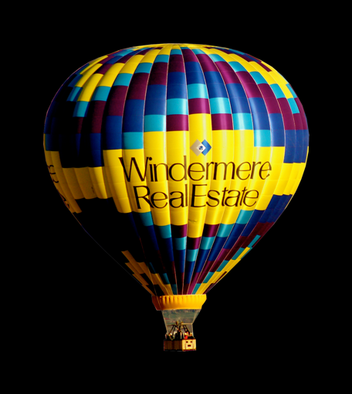
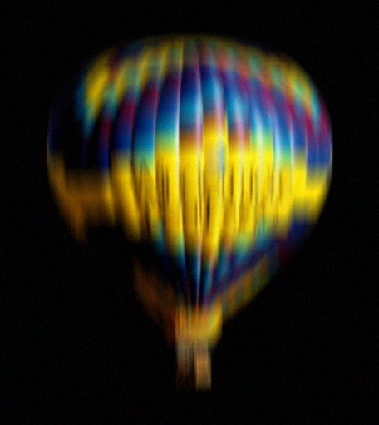
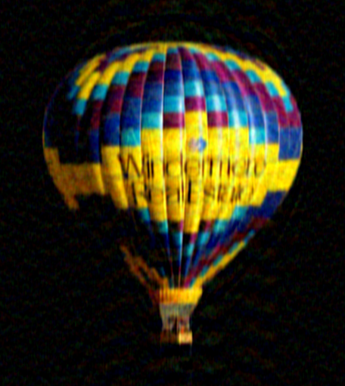



Deblurring and information loss
Original image
(reference)
Blurred input
Deblurred output
Notes:
2
2
Removing motion blur is hard. The first challenge is that we need to estimate the exact blur kernel at every image location. However, even if we could estimate the blur kernel without any error, blur destroys high frequencies. Inverting the blur is a numerically sensitive process and the quality of the deblurred output is never equal to the quality of the original sharp image.

Slide 3
A flutter shutter camera
Flutter shutter camera
[Raskar et al. 2006]
Notes:
This problem was first addressed in Raskar et al.’s paper in 2006. They present a flutter shutter camera that opens and closes the camera aperture multiple times during a single exposure. This technique reduces the loss of information in moving parts and makes the blur more invertible.

Slide 4



Deblurring performance comparisons
Original image
Static camera
Flutter Shutter
Notes:
4
4
The flutter shutter camera preserves image information much better than a static camera a static camera. On this slide (show square here) we show that the deblurring quality from the flutter shutter camera (show next square here) is better than from the static camera.

Slide 5
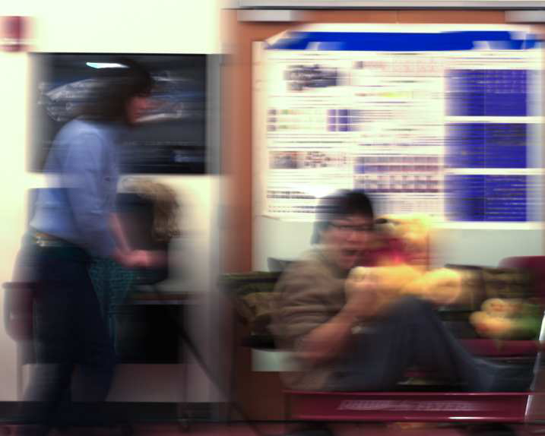
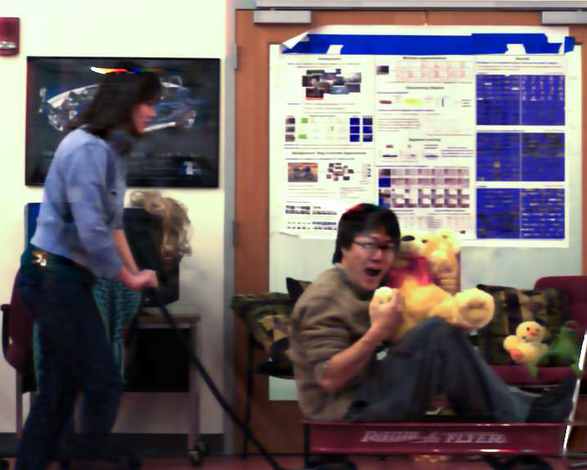
A parabolic camera
Time t
Captured image
Sensor position x
Parabolic camera
[Levin et al. 2008]
Reconstructed image
Notes:
5
5
In 2008 Levin et al proposed the motion invariant camera. They move the camera horizontally during exposure but change the velocity in a linear way. One advantage of this camera was that the PSF is invariant to motion velocity. Another important advantage is that the PSF is easy to invert. In fact, they proved that this is the best PSF one can hope to get for motions aligned with the camera motion. There is a bound on the maximal amount of information we can hope to preserve when we capture an image, and the parabolic motion achieves this bound. However, all these good properties are true only for a 1D motion. When the object moves in a different direction the blur is no longer invariant to motion. Also, the blur is no longer easy to invert.

Slide 6








Deblurring performance comparisons
Object motion
Static camera
Flutter Shutter
Vertical parabola
Original image
Object motion
Notes:
6
6
In this simulation, we have two scenes. In one of them, the object is moving horizontally and in the other, the object is moving vertically. We capture the moving object with 3 different cameras: a static camera, a flutter shutter camera and a parabolic camera which is moving along the vertical axis. The deblurred output of the parabolic camera is good when the object is moving vertically, but is poor when the object is moving horizontally. That is, the deblurring performance of the parabolic camera is good when the direction of the object motion is the same as the direction of the parabolic camera motion . However, the deblurring performance is bad if the object moves in a different direction.

Slide 7
Deblurring performance comparisons
Object motion
Static camera
Flutter Shutter
Vertical parabola
Original image
Object motion
Notes:
7
7
For the vertical motion the best results are obtained with the parabolic camera. However, for the horizontal motion we actually get better results from the flutter shutter camera.

Slide 8
Deblurring performance comparisons
Object motion
Static camera
Flutter Shutter
Vertical parabola
What is the best image quality we can hope to achieve?
Original image
Object motion
Notes:
8
8
The main question that we want to address in this talk is, what is the best image quality we can hope to achieve if the object moves in 2 dimensions? We want to extend the results of the parabolic camera from 1D to 2D. Can we design a camera which guarantees the optimal deblurring performance for 2D motions?

Slide 9
In this talk
What is the best we can do for 2D motions?
A new camera for near-optimal information capture
Time t
Time t
+
Sensor
position y
Sensor
position y
Sensor
position x
Sensor
position x
Notes:
9
9
In this presentation, we derive the optimal worst-case bound of the amount of information that can be captured for 2-dimensional motions. Then we present a prototype camera that near-optimally captures the image information of moving objects.

Slide 10
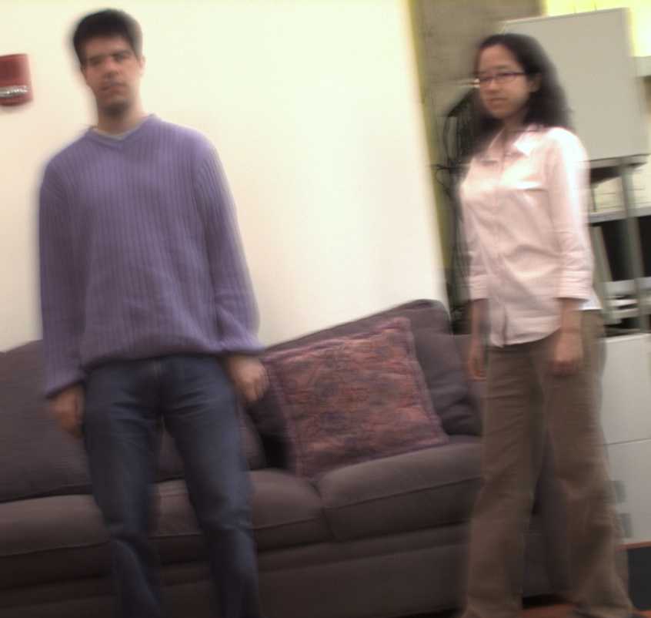
Our technique
Key characteristics
Takes two shots in
orthogonal parabolic paths
Allows near-optimal
information capture
Notes:
10
10
In a nutshell, we take two images of the moving scene, with a camera sensor undergoing orthogonal parabolic motions: one horizontally and another vertically. The scene can contain multiple objects moving in linear velocity in any 2D direction.

Slide 11
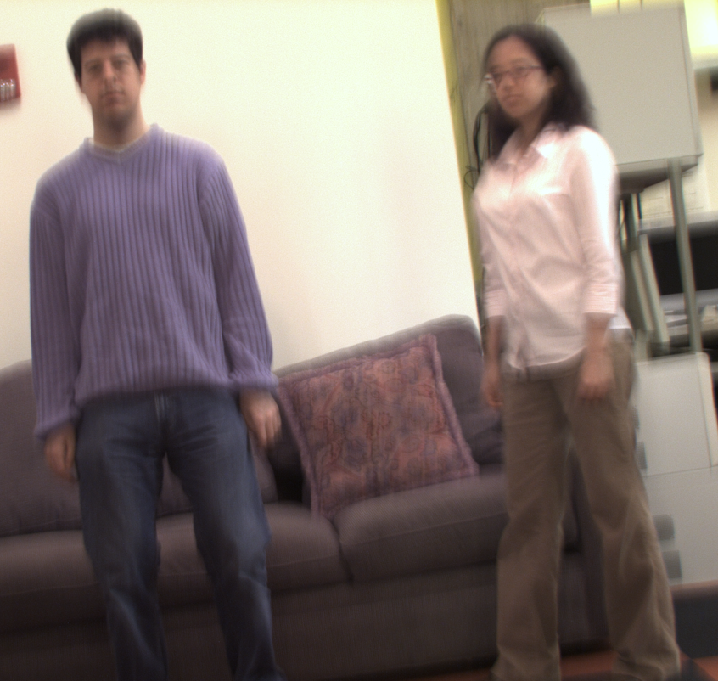
Our technique
Key characteristics
Takes two shots in
orthogonal parabolic paths
Allows near-optimal
information capture
Notes:
11
11

Slide 12
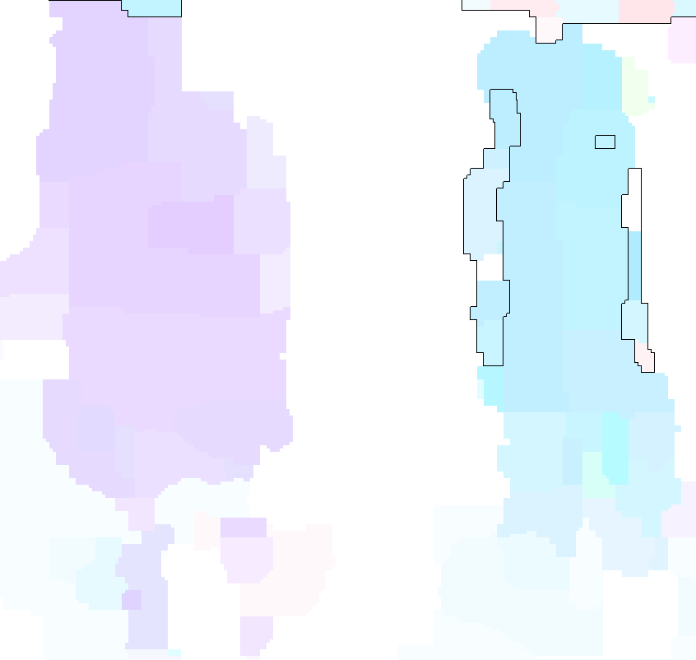
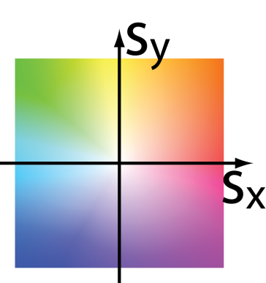
Our technique
Color map of motion
Key characteristics
Takes two shots in
orthogonal parabolic paths
Allows near-optimal
information capture
Notes:
12
12
From these two images, we locally estimate the subject motion, and use the estimated velocity to deblur local regions separately. To represent the motion, we use the color coding scheme shown in the bottom left. For instance, if the pixel is sky blue, the object moves to the left. The color map shows that the person on the left was moving vertically and the person on the right was moving horizontally.

Slide 13
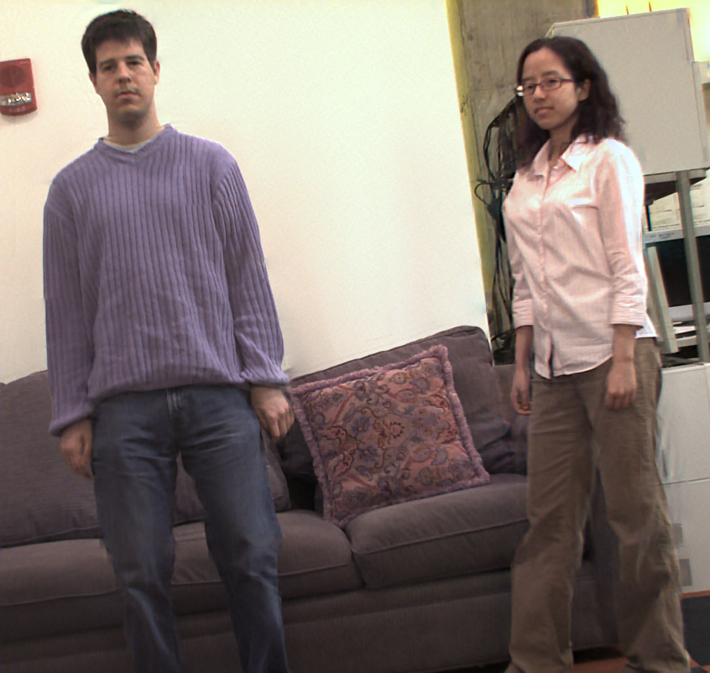
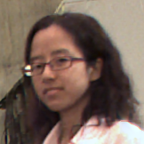
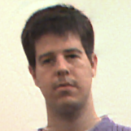
Our deblurring result
Notes:
13
13
Using the estimated motion map, we recover a sharp image from the two blurry photos.

Slide 14
Disclaimer
In this work, we assume that:
Motion is constant-velocity parallel to the image plane
-> i.e. relatively short exposure time
Notes:
14
14
In this work, we assume that the object moves at a constant-velocity motion parallel to the image plane. This assumption is often satisfied when the exposure time is relatively short.

Slide 15
Outline
2D motion optimal spectral bound
Camera design
Experimental results
Notes:
15
15
Now, we would like to derive an optimal bound on the amount of information that can be captured. This performance bound is applicable for any camera.

Slide 16
Imaging model
Blurry image
PSF
Sharp image
Noise
B
=
φ
⊗
I
+
n
s
Notes:
16
16
We model the observation process as a *LOCAL* convolution of a point spread function with a latent sharp image, and we assume that the captured image is tainted with noise.

Slide 17
Imaging model
Blurry image
PSF
Sharp image
Noise
B
=
φ
⊗
I
+
n
s
Notes:
17
17
The blur kernel phi depends on the type of camera. The subscript s, where s is an object velocity, is there to denote that the point spread function also depends on object motions.

Slide 18
Imaging model
Blurry image
PSF
Sharp image
Noise
B
=
φ
⊗
I
+
n
s
Frequency domain
^
ω
=
^
^
^
B
(
)
φ
(
ω
)
I
(
ω
)
+
ω
n
(
)
x
,
y
s
x
,
y
x
,
y
x
,
y
Notes:
18
18
Convolution in a spatial domain is multiplication in the Fourier domain.

Slide 19
Imaging model
Blurry image
PSF
Sharp image
Noise
B
=
φ
⊗
I
+
n
s
Frequency domain
^
ω
^
ω
B
(
)
n
(
)
^
ω
=
x
,
y
−
x
,
y
I
(
)
x
,
y
^
^
φ
(
ω
)
φ
(
ω
)
s
x
,
y
s
x
,
y
^
φ
(
ω
)
How high can we make ?
s
x
y
Notes:
19
19
To recover a sharp image I, we can divide the equation by the blur kernel phi. When the blur spectrum is low, the noise contribution is amplified in the deblurring process. This equation tells us that in order to maximize the signal to noise ratio of the reconstructed image I, we need the power spectrum of the blur kernel to be as high as possible. Then the question is, how high can we make phi for all possible motions?

Slide 20


3-D space-time motion
Camera motion path
Camera motion path
t
y
x
Notes:
20
20
Different camera motions generate different point spread functions. We can model the camera motion in a 3D space-time volume.

Slide 21
3-D space-time motion
Camera motion path
Camera motion path
t
T
y
x
Notes:
21
21
We describe the camera motion as a curve in the 3D space time space. The curve value at time instance t denotes the displacement of the camera at this instance of the exposure. To analyze the performance of the camera, we assume that the exposure time budget is limited to T.

Slide 22
3-D space-time motion static camera
Camera motion path
t
T
y
x
Notes:
22
22
The motion path of a static camera is a straight line, because it doesn’t move. The displacement is zero at all time instances during the exposure

Slide 23
3-D space-time motion flutter shutter camera
Camera motion path
t
T
y
x
Notes:
23
23
A flutter shutter camera has a discontinuous straight line as a motion path, the holes in the line correspond to time instances in which the shutter is closed.

Slide 24
3-D space-time motion parabolic camera
Camera motion path
t
T
y
x
Notes:
24
24
And a parabolic camera moves in a parabolic displacement path. Here, we show a parabolic motion in the y direction.

Slide 25
3-D space-time motion parabolic camera
Camera motion path
t
T
y
x
Notes:
25
25
And here is a parabolic motion in the x direction

Slide 26
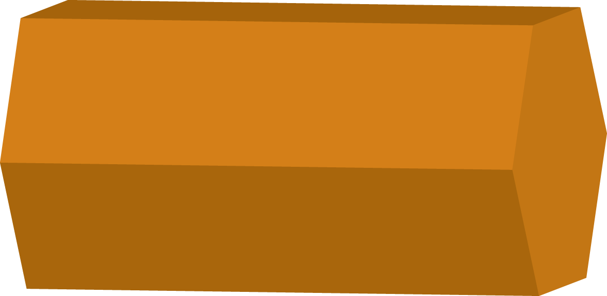
Frequency analysis of 3-D space-time motion
^
Camera motion path
Motion spectrum
t
3D Fourier transform
T
y
x
Notes:
26
26
So far we have expressed the motion path in the primal domain. However, since convolution reduces to multiplication it is better to study blur in the frequency domain. Therefore we think of the motion path as a 3D kernel k, which is a delta on the curve and zero everywhere else. We then take the 3D fourier transform of this kernel k. The Fourier slicing theorem tells us that the spectra of blur kernels of different motion velocities are slices from this 3D Fourier transform.

Slide 27
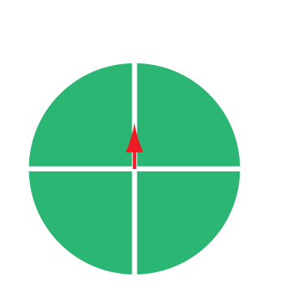
3-D space-time motion – Fourier domain
^
ω
=
^
^
^
B
(
)
φ
(
ω
)
I
(
ω
)
+
ω
n
(
)
x
,
y
s
x
,
y
x
,
y
x
,
y
Object velocity
Notes:
27
27
Blur kernels corresponding to different object velocities slice the 3D Fourier transform of the motion path at differing angles. This figure shows a slice for a y-directional motion.

Slide 28

3-D space-time motion – Fourier domain
^
ω
=
^
^
^
B
(
)
φ
(
ω
)
I
(
ω
)
+
ω
n
(
)
x
,
y
s
x
,
y
x
,
y
x
,
y
Object velocity
Notes:
28
28
The angle at which we slice increases as sy increases.

Slide 29

3-D space-time motion – Fourier domain
^
ω
=
^
^
^
B
(
)
φ
(
ω
)
I
(
ω
)
+
ω
n
(
)
x
,
y
s
x
,
y
x
,
y
x
,
y
Object velocity
Increasing s_{y}
[Ng SIGGRAPH 2005]
[Levin et al. SIGGRAPH 2008]
Notes:
29
29

Slide 30
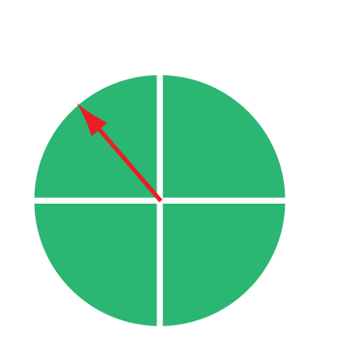
3-D space-time motion – Fourier domain
^
ω
=
^
^
^
B
(
)
φ
(
ω
)
I
(
ω
)
+
ω
n
(
)
x
,
y
s
x
,
y
x
,
y
x
,
y
Object velocity
Increasing s_{y =} s_{x}
Notes:
30
30
If the motion direction changes, the orientation in which we slice the 3D spectrum also changes

Slide 31


3-D Fourier Transform of 2D motions
Motion path spectrum
Wedge of revolution
Notes:
31
31
If we sum up all slices that correspond to 2D constant velocity motions, they occupy an outer portion of the inverted double cones. We call this region a wedge of revolution. The slope of this inverted double cone is equal to the maximum object speed in the scene. Now, to have blur kernels which are easy to invert at all motion directions and all velocities, we want to have a high spectrum content all over the wedge of revolution. That is, we want to find a motion path whose spectrum is high within the wedge of revolution. We don’t care that much about zeros outside the wedge of revolution, because these zeros do not occur in blur kernels corresponding to motions of interest. In order to maximize the worst-case spectral power, we need to find a motion path that maximizes the worst-case spectral power within the wedge of revolution.

Slide 32

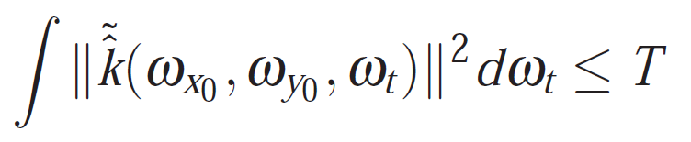
Optimal spectral bound
Motion path spectrum
Notes:
32
32
The amount of energy captured within a finite exposure time T is bounded. We can use Parseval theorem to show that the norm of the motion path spectrum at a fixed spatial frequency is bounded by T. In other words, for any motion path, if we integrate the energy along any column, the maximal power we can have is no more than T.

Slide 33
Optimal spectral bound
Motion path spectrum
Notes:
33
33

Slide 34
Optimal spectral bound
Motion path spectrum
Notes:
34
34

Slide 35
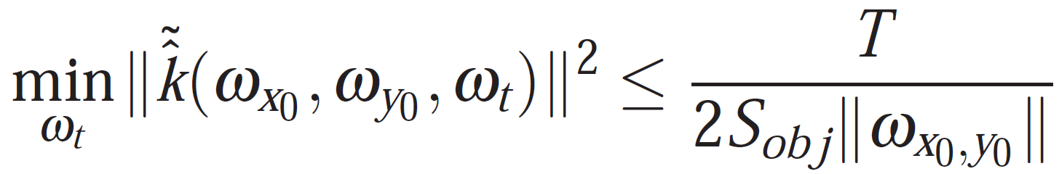
Optimal spectral bound
Motion path spectrum
No energy outside of the wedge of revolution
Spread the energy uniformly on this segment
Notes:
35
35
If we want to maximize the worst case spectral power within each column, the best way is to distribute the bounded budget uniformly over the column within the wedge of revolution. If we distribute energy outside of the wedge of revolution, we would be wasting energy on motions we do not care about. So we should spread the energy only on the segment within the wedge of revolution, and this gives us the upper bound shown above.

Slide 36
Goal:
Design camera paths k whose
power spectrum approaches the upper bound
Notes:
36
36
Given this analysis, the goal of a camera design is to find a camera motion path k that would guarantee a spectral performance as close to the optimum as possible.

Slide 37
Outline
2D motion optimal spectral bound
Camera design
Experimental results
Notes:
37
37
We present our solution to this problem and show that this design provides a performance guarantee that is close to the optimum. This is the first design that guarantees any performance bound on 2D motions.

Slide 38
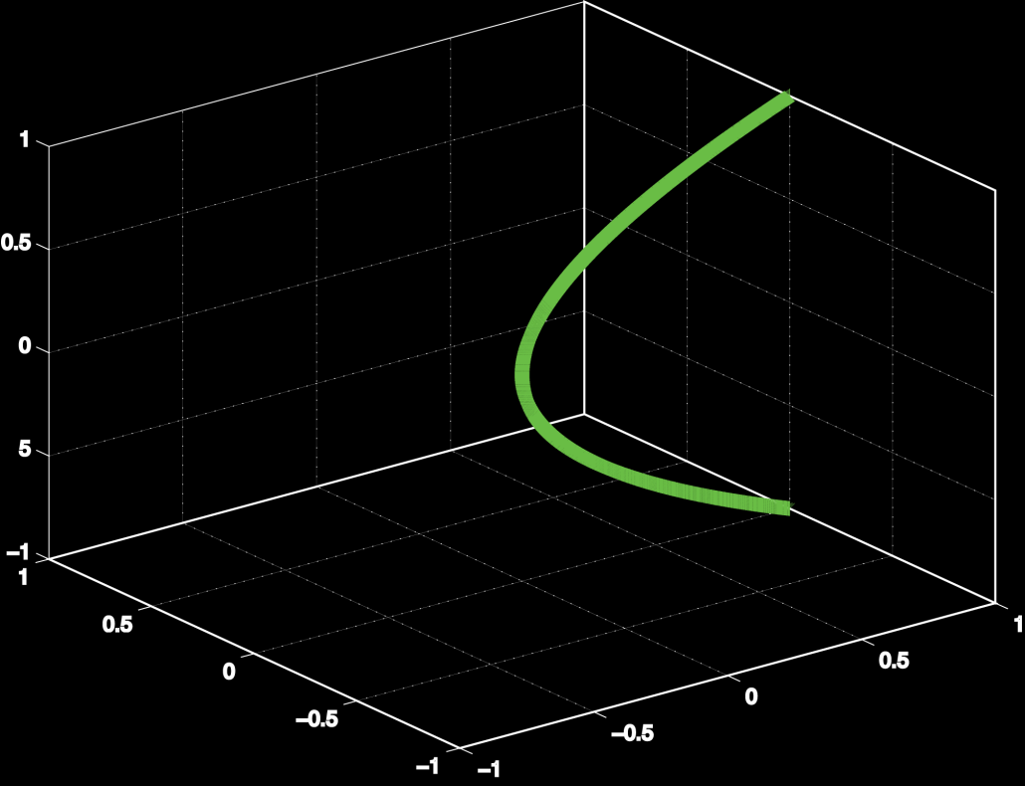

x-parabolic camera
Characteristics:
Provides optimal spectrum coverage
for 1-dimensional motion
Motion path
Motion spectrum
t
y
x
[Levin et al. 2008]
Notes:
38
38
We first analyze a single parabolic camera moving along the x- axis. As Levin et al. presents, this camera motion is optimal for capturing 1-dimensional constant velocity motions. The motion spectrum of a parabolic camera motion occupies the 3D wedge as shown on the right.

Slide 39
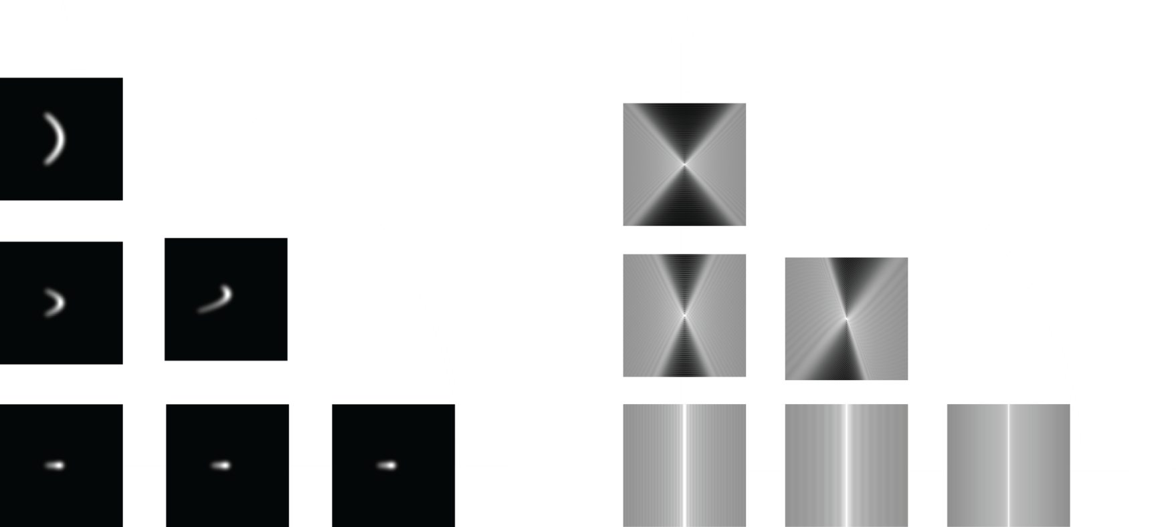
x-parabolic camera
Point spread function
Power spectrum
s_{y}
s_{y}
Zeros
High spectra
y
x
s_{x}
s_{x}
Optimal spectrum coverage for x-directional motion
Zeros along for non x-directional motion
Notes:
39
39
Here we show the blur kernels corresponding to different velocities, and their power spectrums. We can see that for x-directional motions, the power spectrum does not contain any zeros and is in fact optimal, but for y directional motions, the spectrum contains zeros along the w_y axis.

Slide 40


y-parabolic camera
Characteristics:
Orthogonal spectrum from x-parabolic camera
Motion path
Motion spectrum
t
y
x
Notes:
40
40
On the other hand, a y-directional parabolic camera covers the orthogonal wedge spectrum.

Slide 41
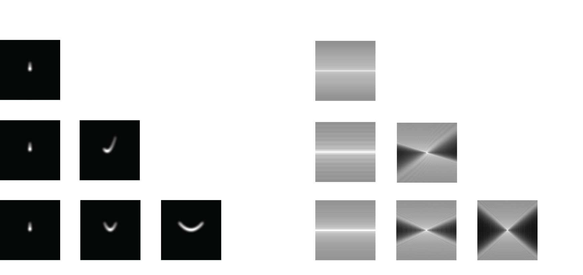
y-parabolic camera
Point spread function
Power spectrum
High spectra
Zeros
Optimal spectrum coverage for y-directional motion
Zeros along for non y-directional motion
Notes:
41
41
And the informational capture is optimal for y directional motions , but contains zeros for x-directional motions.

Slide 42
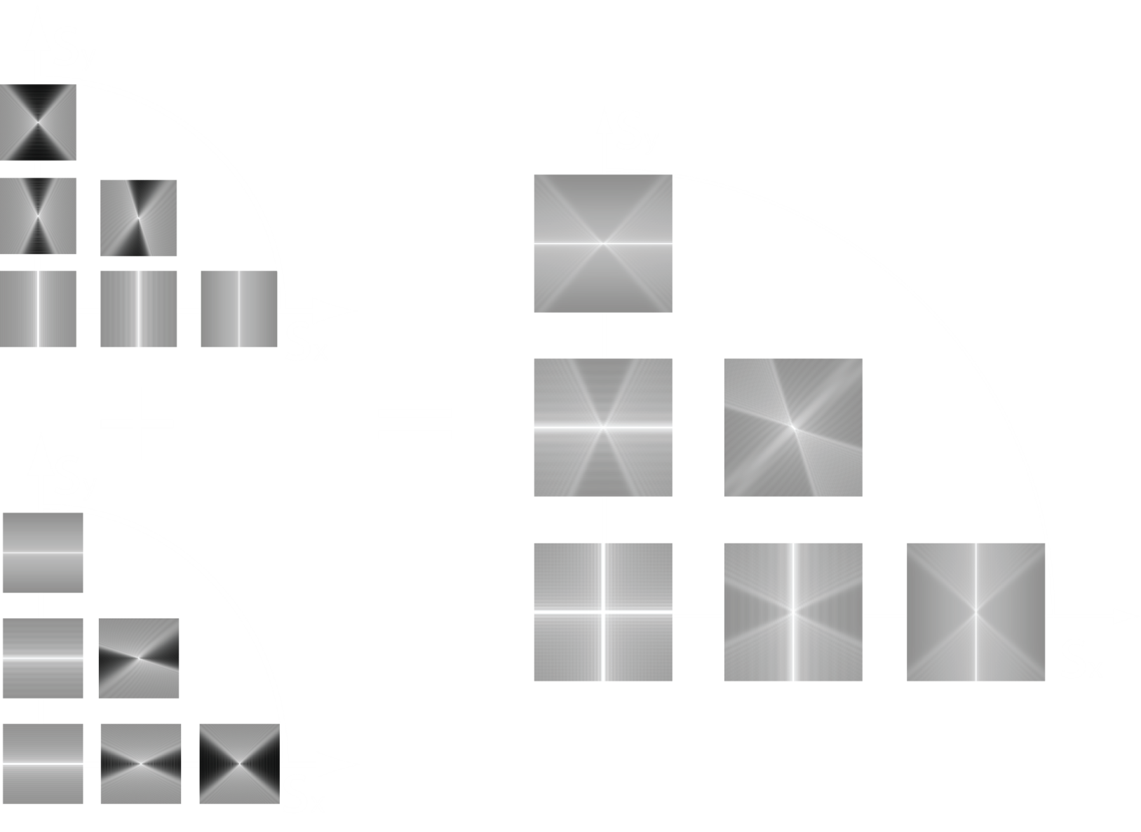
Orthogonal parabolic cameras
x-parabolic camera spectrum
The joint spectrum
y-parabolic camera spectrum
Notes:
42
42
In our design we capture 2 images. In the first image we move the camera along a horizontal parabolic path and in the second image along a vertical parabolic path. The idea is that when we use two orthogonal parabolas, the sum of their spectrums covers all frequencies without zeros for all velocity. Because the parabolic paths complements each other, we do not have any zeros in the joint spectrum.

Slide 43
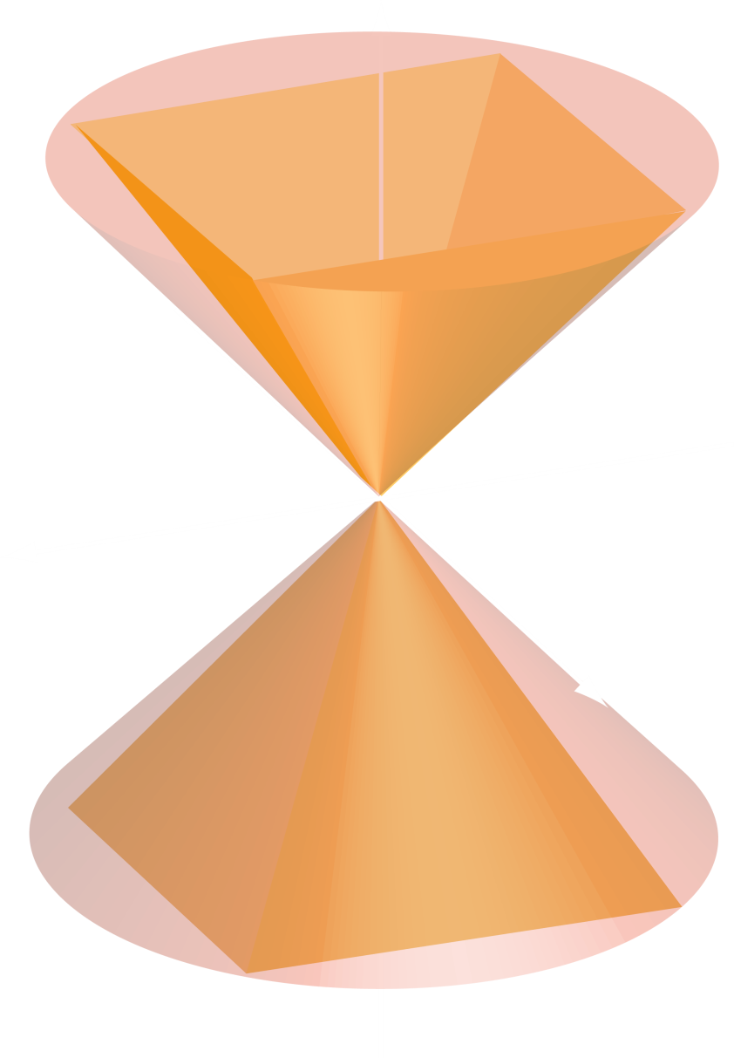
Orthogonal parabolic cameras
x-parabolic camera
+
=
y-parabolic camera
Joint Fourier spectrum
Notes:
43
43
This can also be seen in the 3D Fourier space. We can show that when the maximum sensor speed durng the parabolic motion is at least sqrt(2) times faster than the maximum object speed, the sum of the 3D wedges subsumes the wedge of revolution, so we can cover the entire wedge of revolution without zeros.

Slide 44
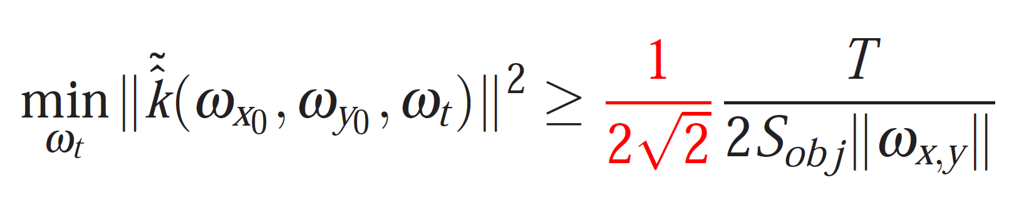
Orthogonal parabolic cameras – optimality
Worst-case spectral power
Optimal bound
Spectral power > const x optimal bound
Notes:
44
44
IN this case, we can show that the worst-case spectrum is bounded below by 2sqrt(2) times the optimal bound. This is the first imaging method that provides a performance bound for 2D motions.

Slide 45
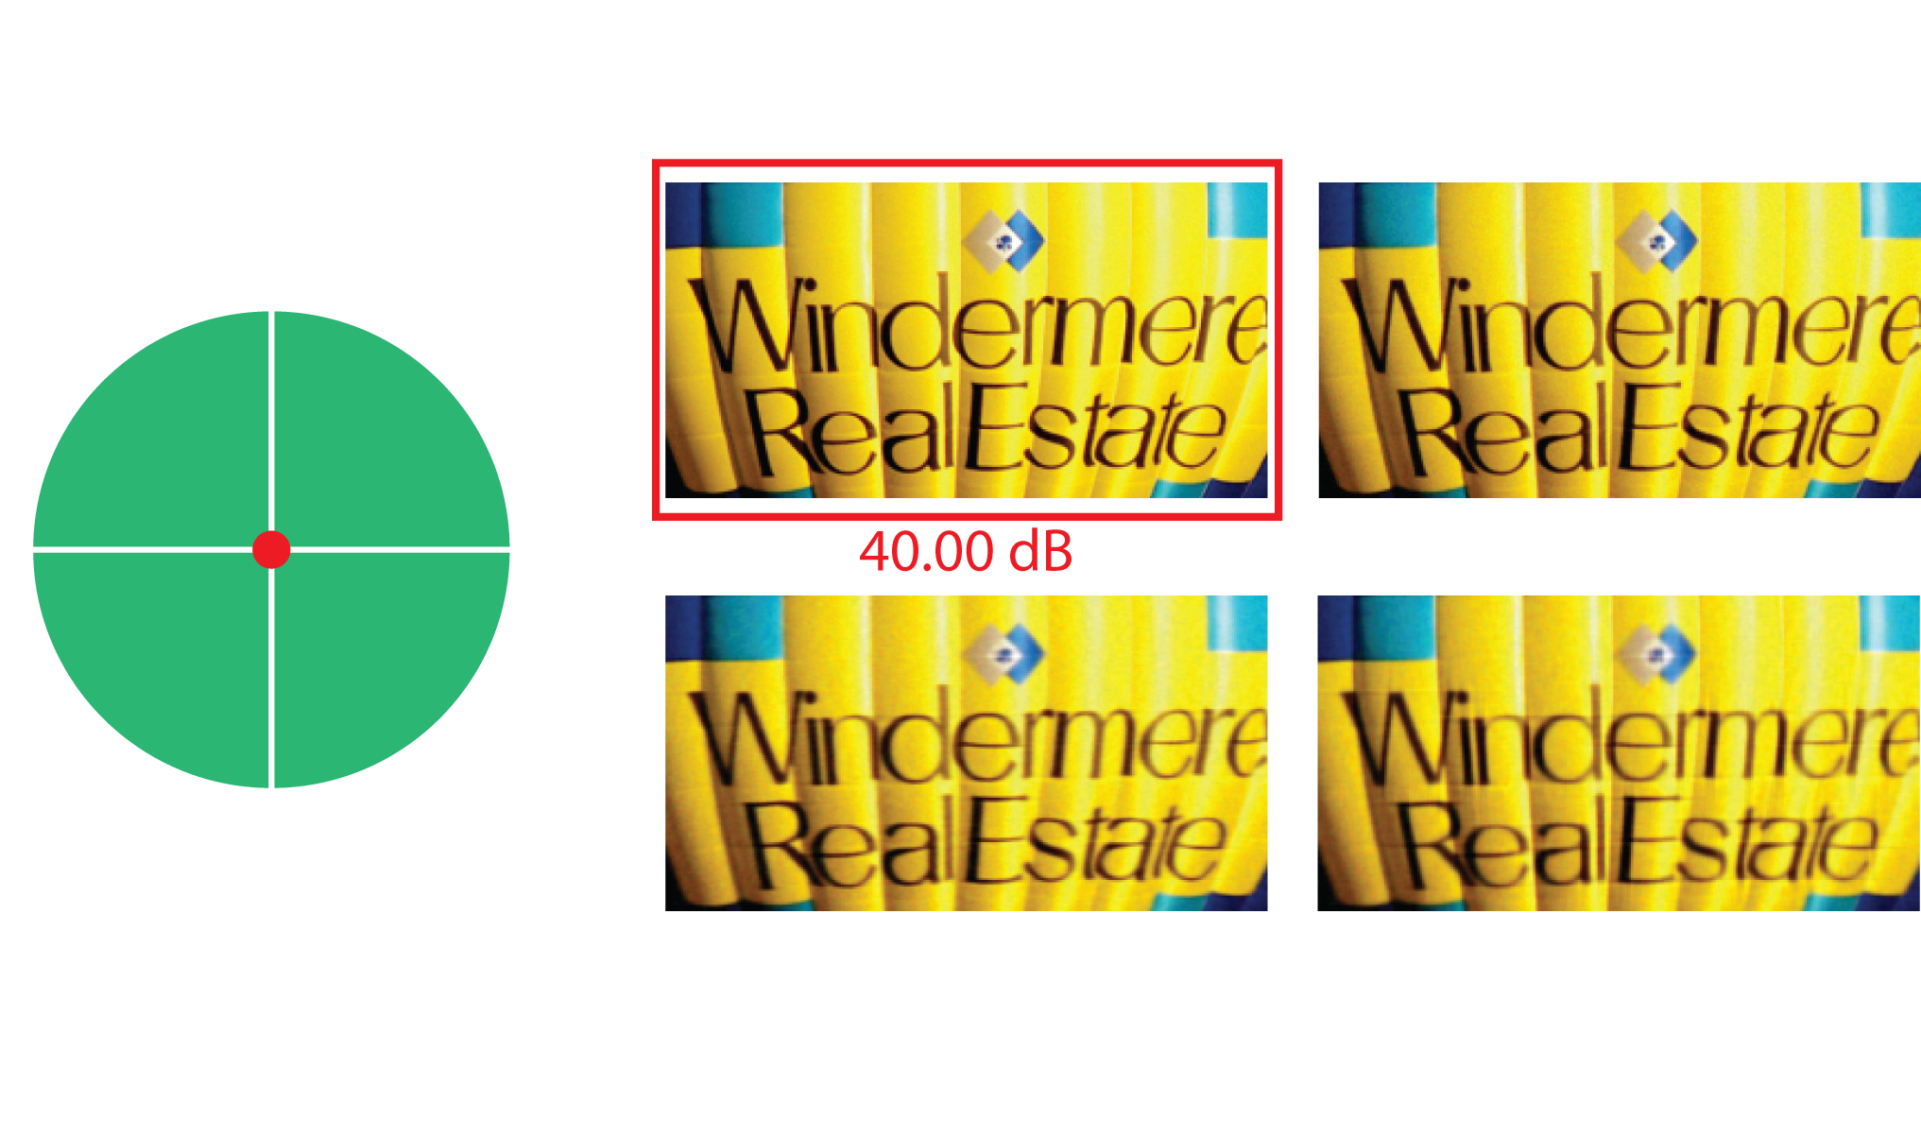
Comparisons with previous designs
40.00dB
* Synthetic experiments – known motion
Notes:
45
45
We show the deblurring performance of our camera compared to other designs. We consider a pair of static cameras, a pair of flutter shutter cameras, a single horizontal parabola, and a pair of orthogonal parabolas. For static and flutter shutter camera pairs, we break the exposure time budget T between two shots, and optimize the split assuming that the object motion is known, which is not often the case. In all simulation results, we assume that we know the correct object motion. For a static object motion, we can see that a static camera pair performs the best. This is intuitively correct since the static camera optimizes the image capture for static objects.

Slide 46
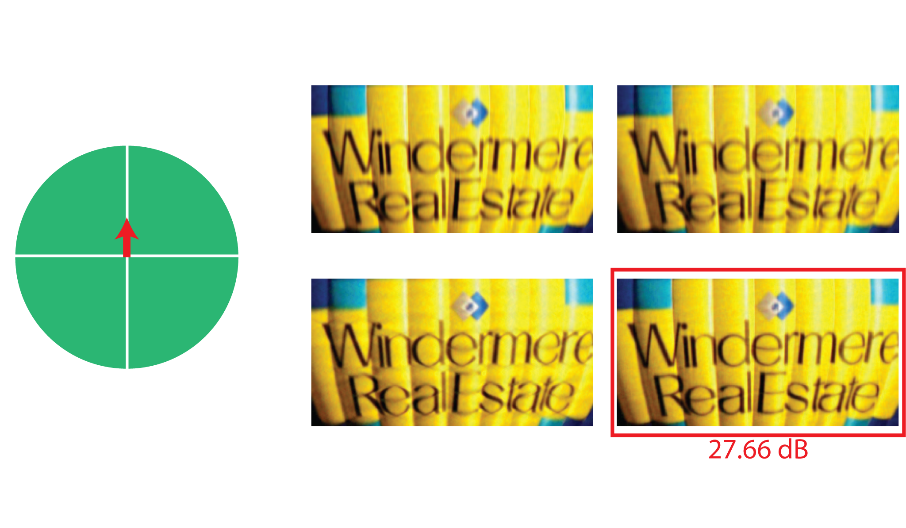
Comparisons with previous designs
27.66dB
* Synthetic experiments – known motion
Notes:
46
46
When there is a small motion, however, the static camera degrades the reconstruction quality and the other cameras do better. The orthogonal parabolic pair performs the best.

Slide 47
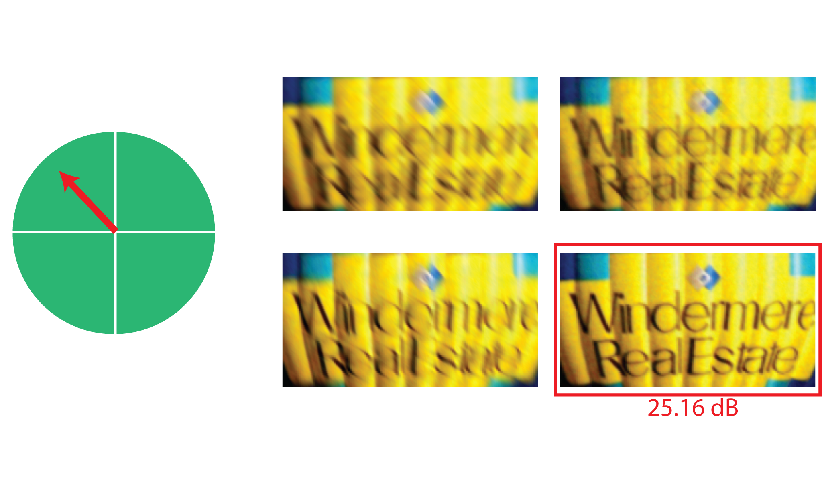
Comparisons with previous designs
25.16dB
* Synthetic experiments – known motion
Notes:
47
47
And when the motion is large, an orthogonal parabolic camera pair performs significantly better than other designs.

Slide 48
Outline
2D motion optimal spectral bound
Camera design
Experimental results
Notes:
48
48
We now show some experimental results.

Slide 49
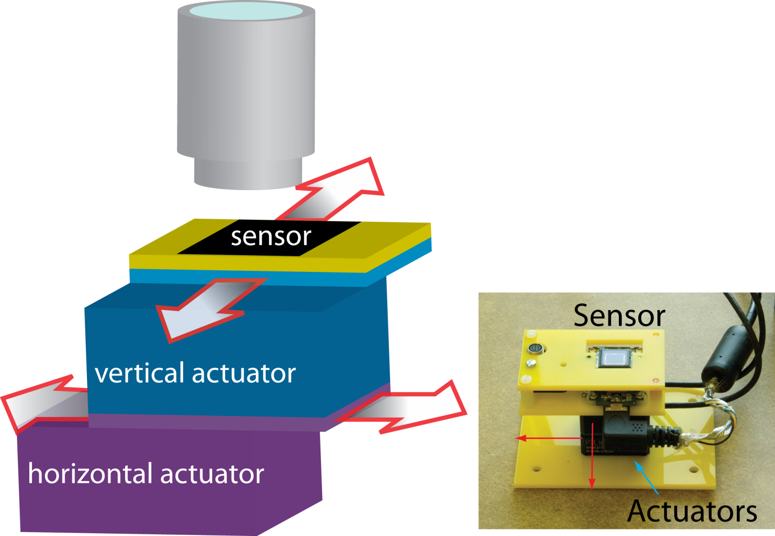
Experiments – Camera setup
Diagram
Camera setup
Notes:
49
49
We built a camera prototype to demonstrate the concept. We mounted the camera sensor on two actuators, which move the sensor in parabolic paths while keeping the lens static. The entire exposure time is 500 ms. The exposure time for each shot is 200ms with 100 ms delay in the middle.

Slide 50
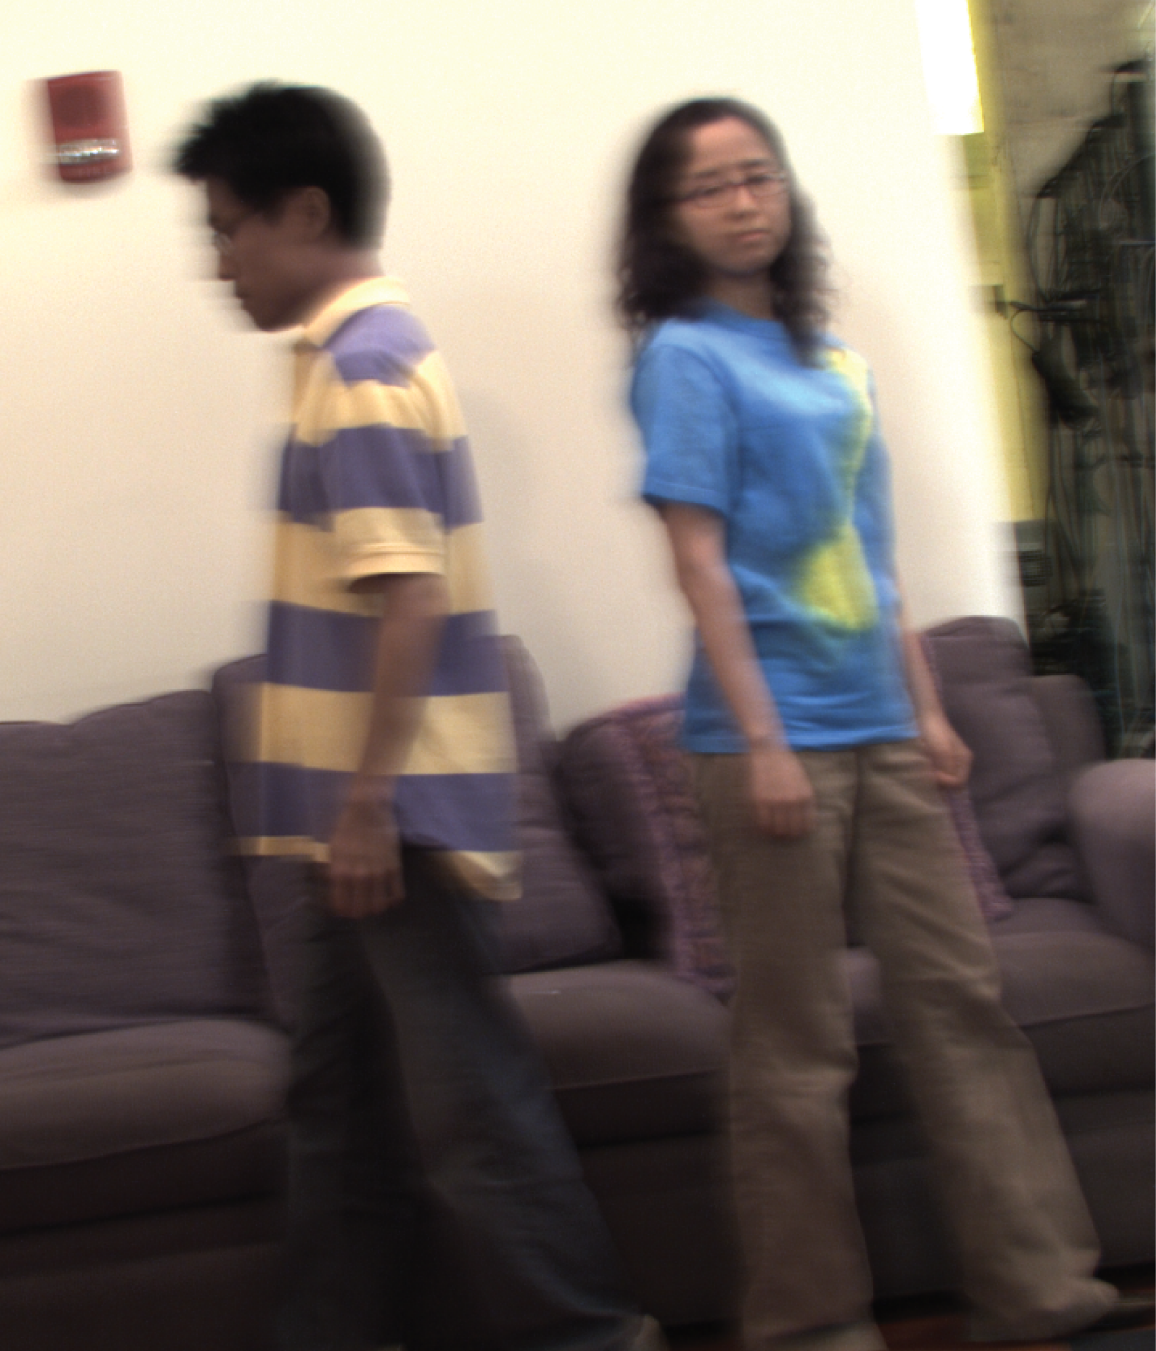
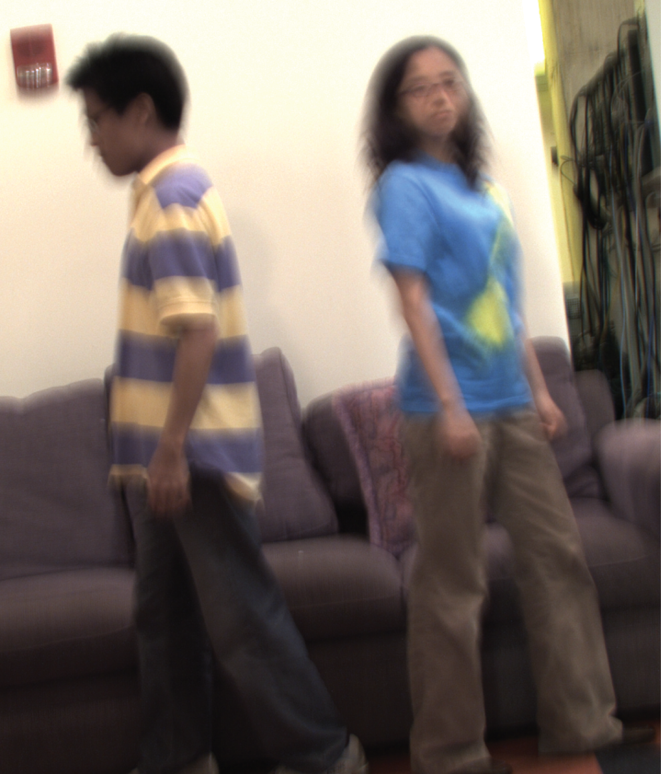
Experiments
Horizontal parabolic
200ms shot
Vertical parabolic
200ms shot
Notes:
50
50
We take two images with this camera

Slide 51
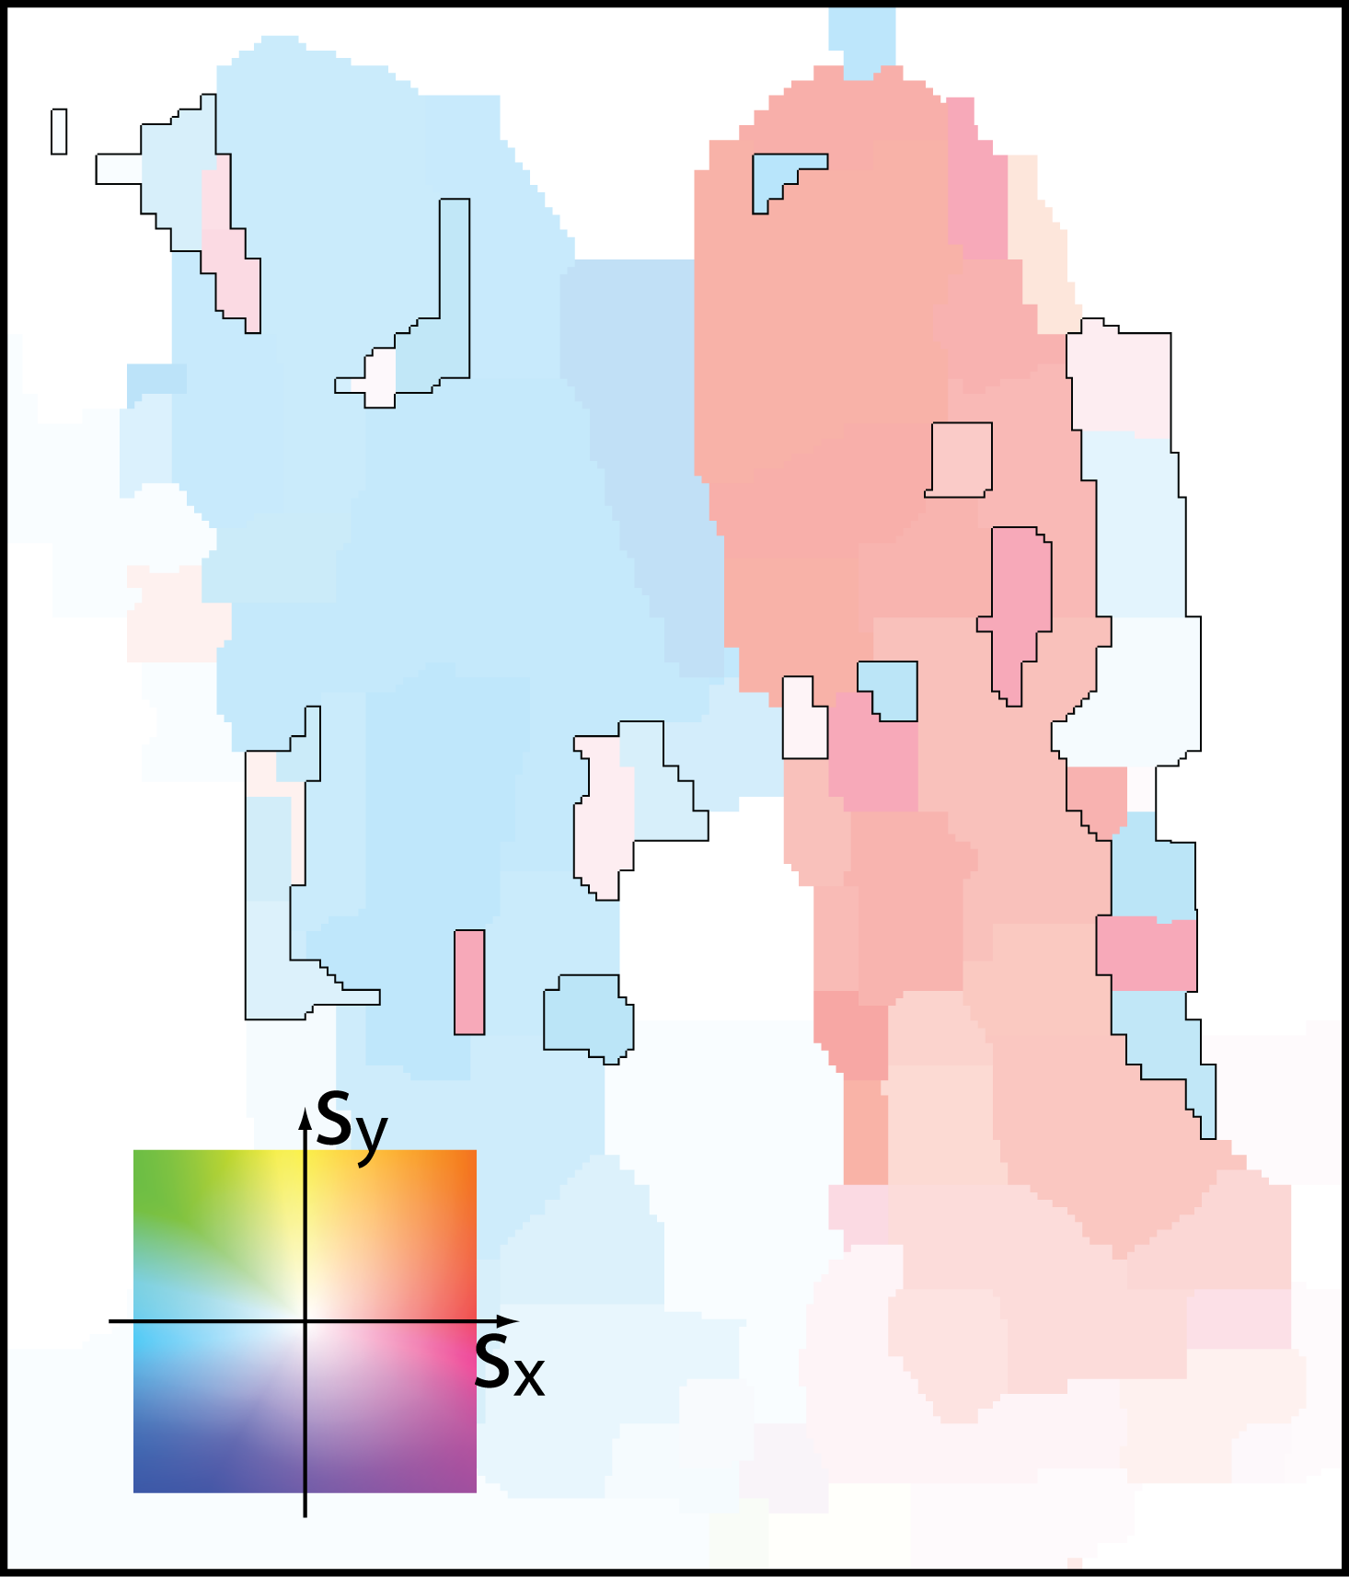
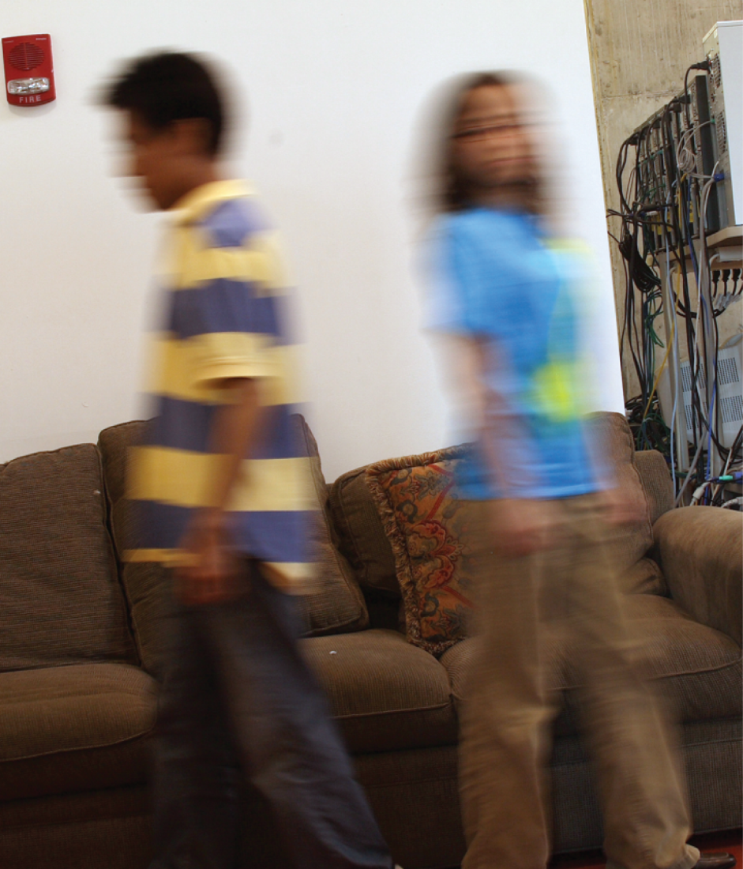
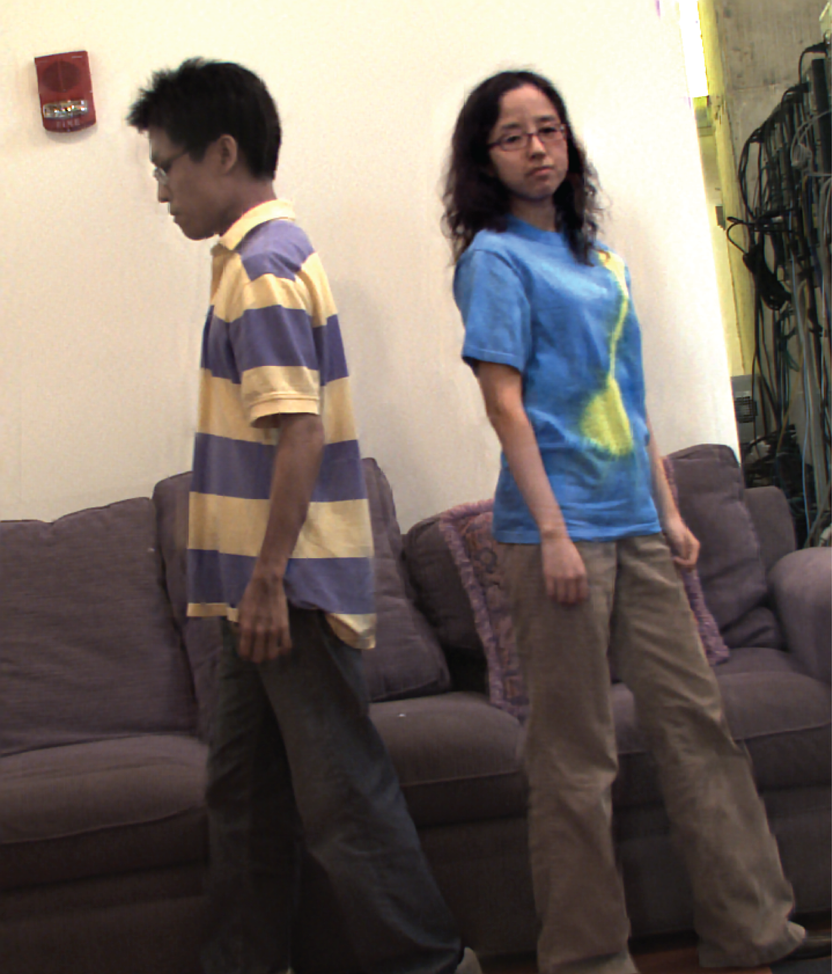
Experiments
Color map of motion
Deblurred image
Notes:
51
51
We use the two input images from our camera to estimate the motion locally. The color coding on the right demonstrate the spatially varying motion we have estimated, and the image on the right is the deblurred image using the estimated motion. There are some boundary regions that are seen in only one of the two images. To remove ringing artifacts in such regions, we use only one of the two captured images to deblur the boundary regions. These regions are denoted using a black bounding box.

Slide 52
Experiments
Static camera reference
500ms
Deblurred image
Notes:
52
52
To see the motion, we show here an image taken with a static camera with 500ms exposure.

Slide 53
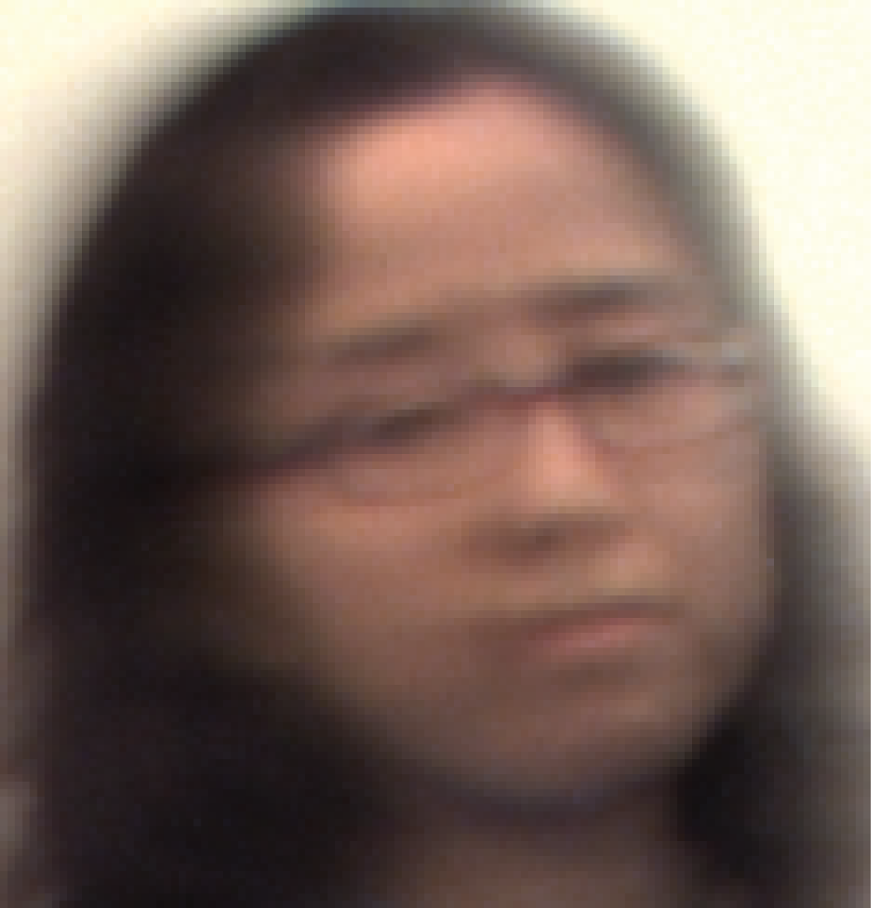
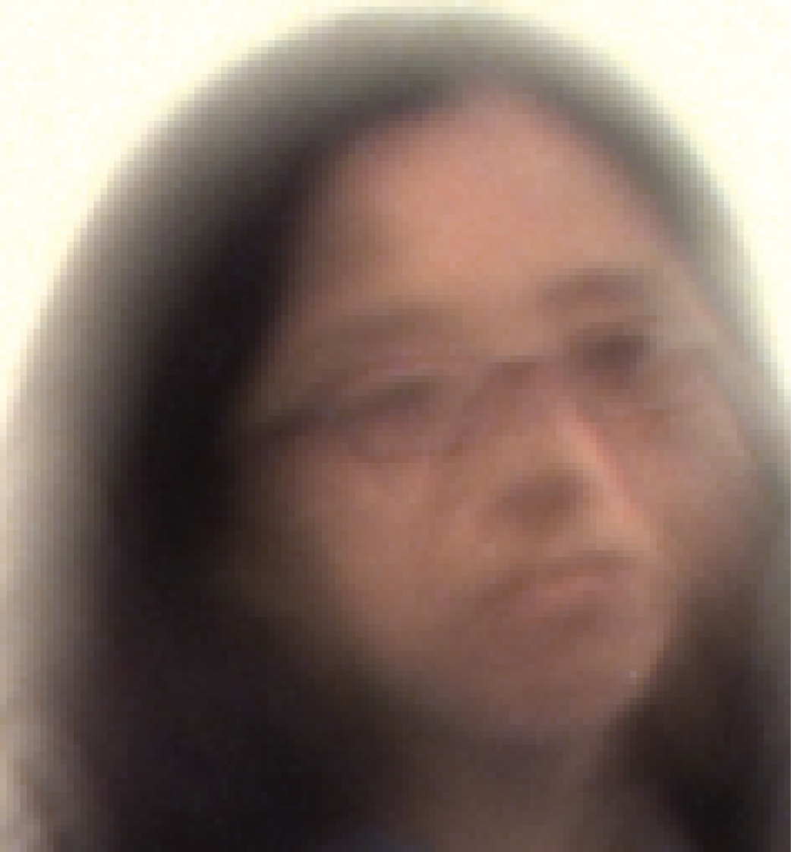
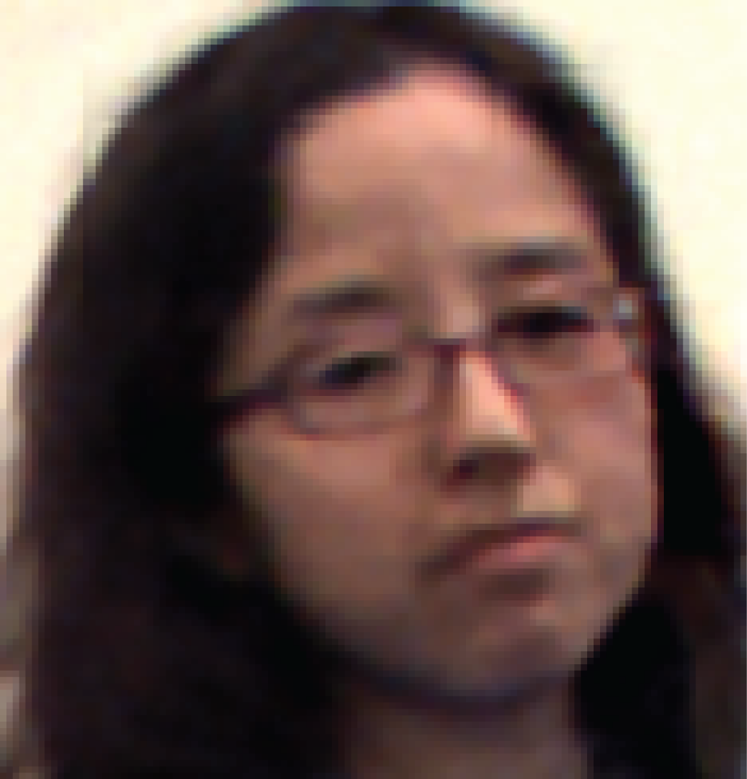
Experiments - zoomed
Horizontal parabolic
200ms shot
Vertical parabolic
200ms shot
Deblurred Image
Notes:
53
53
Here is a zoomed version of the two images taken and the deblurred image.

Slide 54
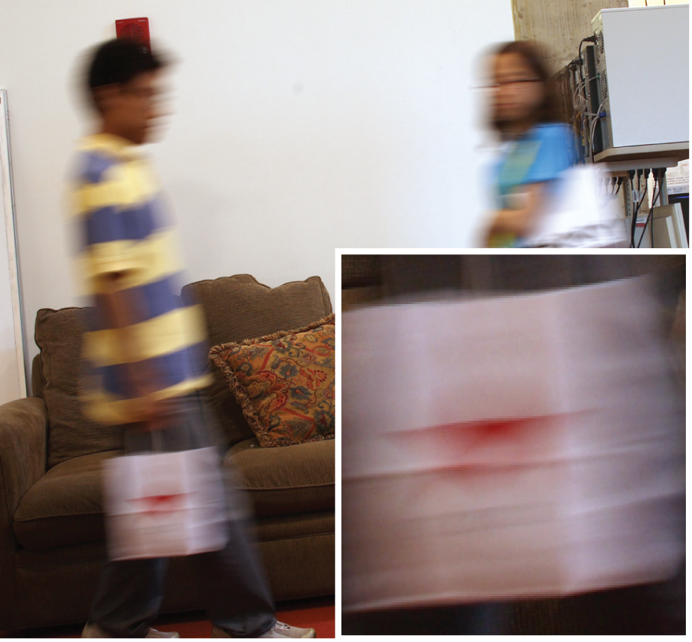
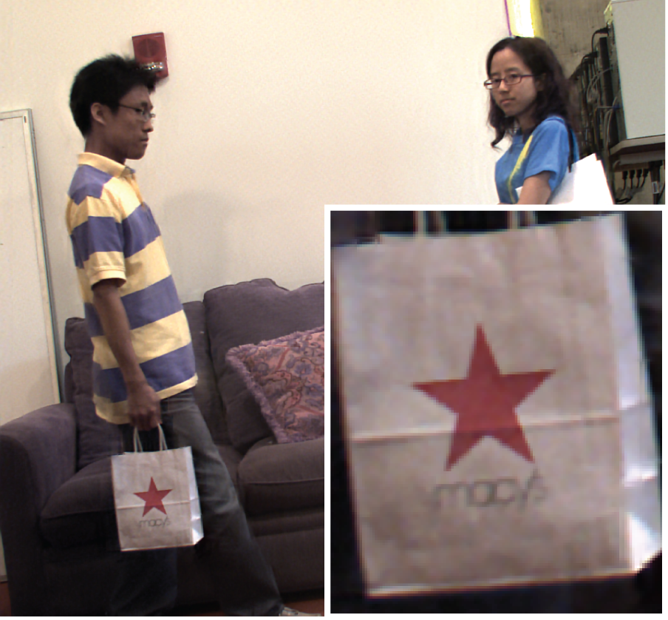
Experiments – more examples
Static camera reference
500ms
Deblurred image
Notes:
54
54
We show another example here.

Slide 55
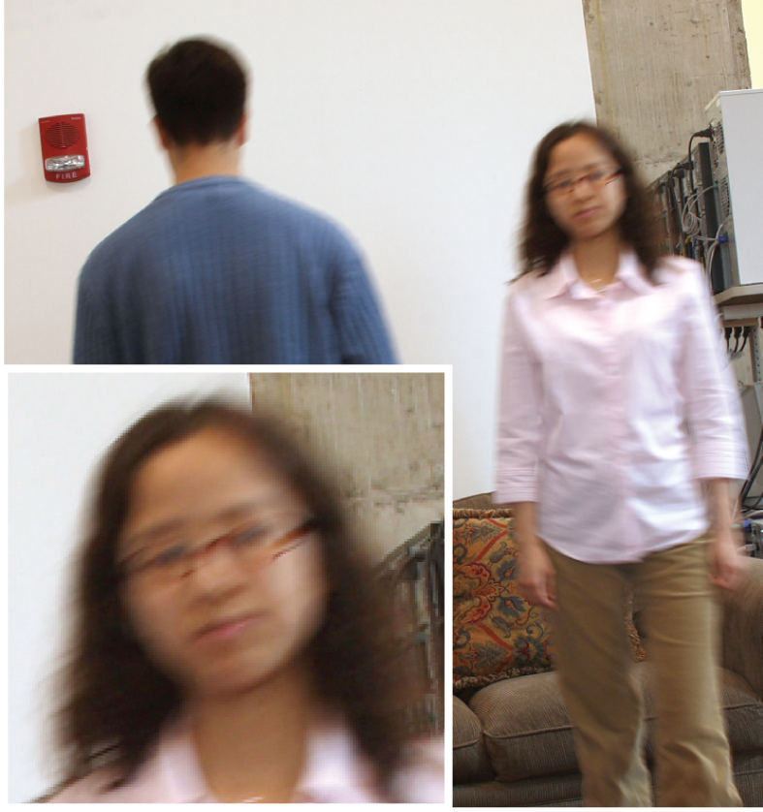
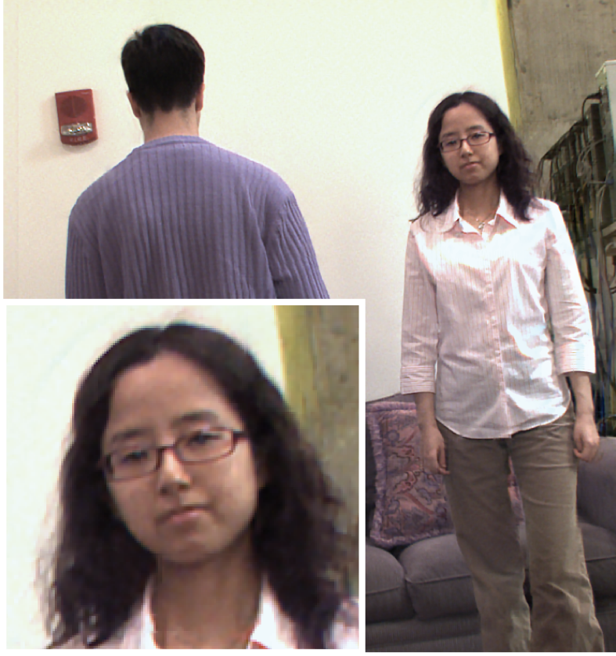
Experiments – more examples
Static camera reference
500ms
Deblurred image
Notes:
55
55
Even for a forward motion that does not really satisfy our assumption about the motion, we can recover a relatively sharp image.

Slide 56
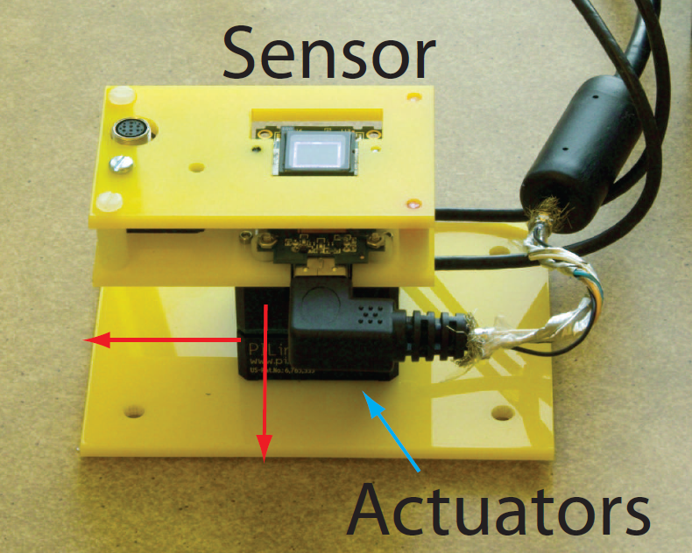
Contributions
Optimal worst-case bound for 2D motions
Prototype camera
Notes:
56
56
In this work, we have derived optimal performance bound on 2D constant-velocity object motions, and illustrated imaging methods to recover a sharp image tainted with 2D subject motions.

Slide 57
Motion blur removal with orthogonal parabolic exposures
http://people.csail.mit.edu/~taegsang
Taeg Sang Cho¹ Anat Levin²
Frédo Durand¹ Bill Freeman¹
¹Massachusetts Institute of Technology
² Weizmann Institute of Science
Notes:
Thank you!

Slide 58
Extra slides
Notes:
Thank you!

Slide 59
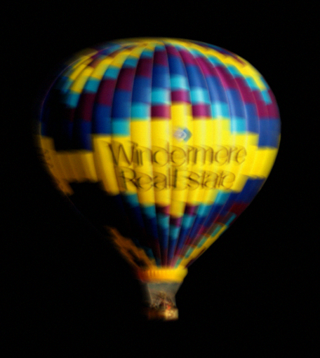
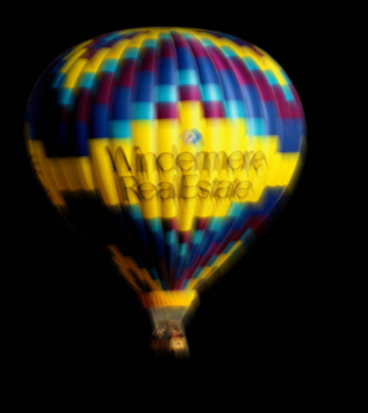
Blur kernel estimation
Horizontal parabolic
Vertical parabolic
Notes:
59
59
We illustrate how to estimate blur kernel from two images.

Slide 60

Blur kernel estimation
Deblur
Horizontal parabolic
Vertical parabolic
Notes:
60
60
Given two images, guess a motion and deblur using the kernel pairs that correspond to the guessed motion.

Slide 61
Blur kernel estimation
Deblur
Horizontal parabolic
Vertical parabolic
Reblur
Horizontal parabolic
Vertical parabolic
Notes:
61
61
Then we re-blur the deblurred image using the same blur kernels

Slide 62
Blur kernel estimation
Deblur
Horizontal parabolic
-
Vertical parabolic
Reblur
Horizontal parabolic
Vertical parabolic
Notes:
62
62
And take the difference of the reblurred image pairs with the captured images.

Slide 63

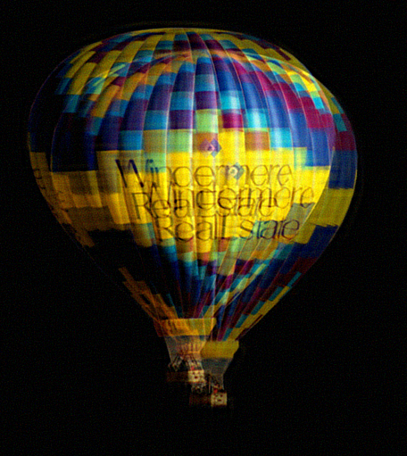
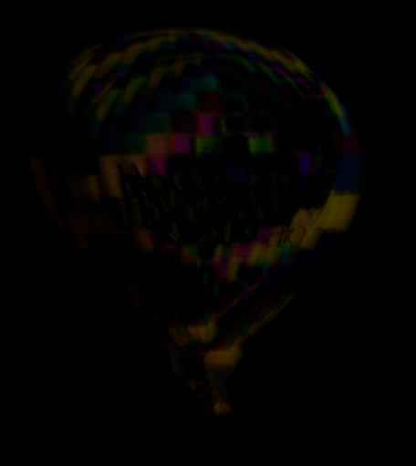
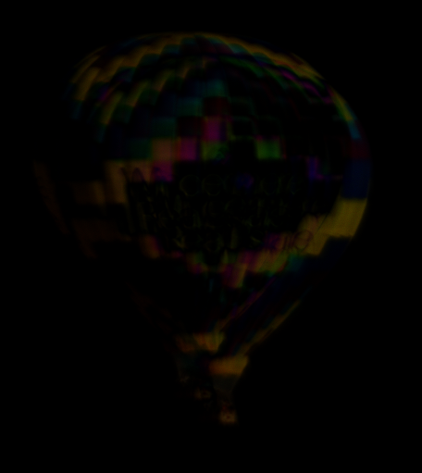
Blur kernel estimation
Deblurred image
Residual - hor
Residual - ver
Correct
motion
Incorrect
motion
Notes:
63
63
We can see that when we use the correct motion, the difference between the captured images and the reblurred images is just noise; whereas when the motion is incorrect, the difference image contains halos.

