Slide 1
Rapidly-exploring Random Trees (RRTs) for Efficient Motion Planning
RSS Lecture 10
Monday, 10 March 2014
Prof. Seth Teller
(Thanks to Sertac Karaman for animations)

Slide 2
Recap of Previous Lectures:
Recall the motion planning problem:
We discussed:
Cell decomposition
Guided search using A*
Potential fields
Configuration space
Probabilistic Road Maps

Slide 3
Recap: PRMs [Kavraki et al. 1996]
C-space
Roadmap Construction (Pre-processing)
goal
1. Randomly generate robot configurations (nodes)
- Discard invalid nodes (how?)
C-obst
C-obst
2. Connect pairs of nodes to form roadmap edges
- Use simple, deterministic local planner
- Discard invalid edges (how?)
C-obst
C-obst
C-obst
Plan Generation (Query processing)
start
1. Link start and goal poses into roadmap
2. Find path from start to goal within roadmap 3. Generate motion plan for each edge used
Primitives Required:
Method for sampling C-Space points
Method for “validating” C-space points and edges

Slide 4
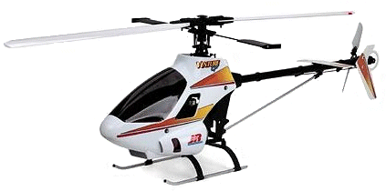
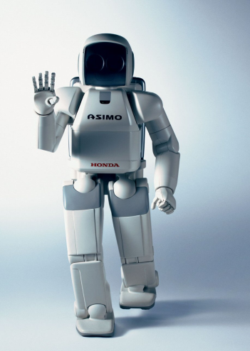
Today’s Focus
Retain assumptions:
Perfect map
Perfect localization
Incorporate additional elements:
Unstable dynamics
Cars, helicopters, humanoids, …
Agile maneuvering aircraft
High-dimensional configuration space
Real-time and online
Trajectory design & execution
Notes:
Dynamics:
Think about a car, which can not move sideways. In the earlier methods, we either connected edges with straight lines, or we had assumed a local planner. But some systems, such as cars or airplanes, can not go straight lines, or it is hard to find such precise local planners that exactly connect two points in c-space.
When the system is unstable, that is a bigger challenge, since we can not let go off the controls; we have to plan frequently.

Slide 5
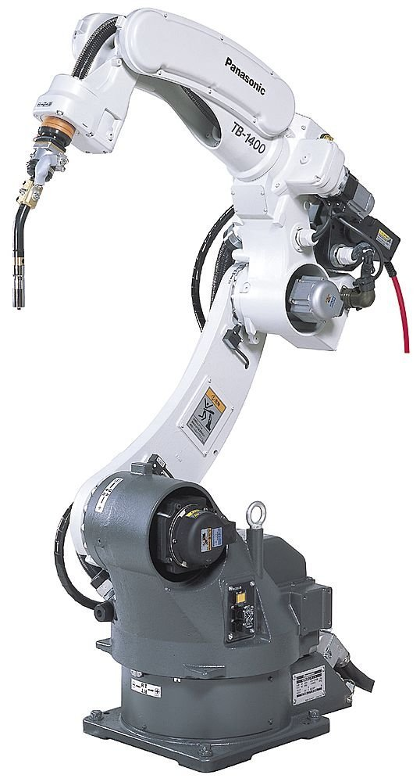
Today’s Focus
Retain assumptions:
Perfect map
Perfect localization
Incorporate additional elements:
Unstable dynamics
Cars, helicopters, humanoids, …
Agile maneuvering aircraft
High-dimensional configuration space
Real-time and online
Trajectory design & execution
Notes:
High-dimensional configuration space:
Think about a point that can move in x-y directions. It has a 2 dimensional c-space. How about a robot arm? Many robotic arms have up to 6-12 DOFs, which amounts to 6-12 dimensional c-spaces. What if we had a few of these manipulators managing a cooperative task (e.g., simultaneous welding in a factory)? What would be the dimension of the c-space?
Why is this a challenge?
- Computational requirements grow rapidly with the number of dimensions (why?)

Slide 6
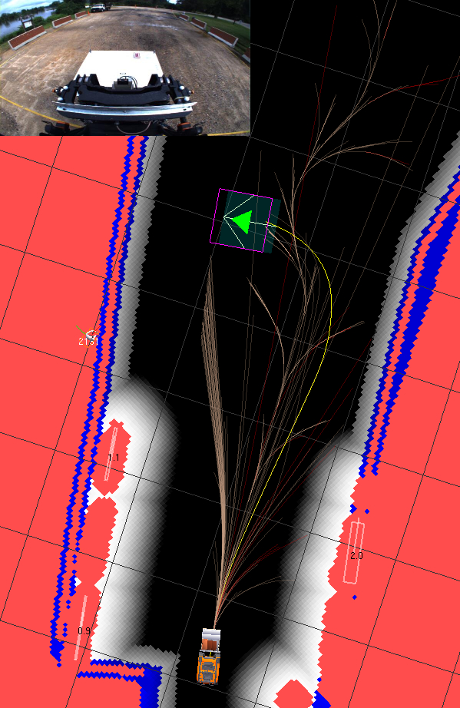
Today’s Focus
Retain assumptions:
Perfect map
Perfect localization
Incorporate additional elements:
Unstable dynamics
Cars, helicopters, humanoids, …
Agile maneuvering aircraft
High-dimensional configuration space
Real-time and online
Trajectory generation & execution
Notes:
Real-time and online trajectory generation and execution
Real-time: motion have to get planned quickly, since the robot has to execute the motion immediately. Minimal offline processing (What are some examples?)
Online: The map of the environment is discovered as the motion is implemented. Some obstacles are not known a priori (What are some examples?)

Slide 7
Today’s Focus
Retain assumptions:
Perfect map
Perfect localization
Incorporate additional elements:
Unstable dynamics
Cars, helicopters, humanoids, …
Agile maneuvering aircraft
High-dimensional configuration space
Real-time and online
Trajectory generation & execution
Notes:
Real-time and online trajectory generation and execution
Real-time: motion have to get planned quickly, since the robot has to execute the motion immediately. Minimal offline processing (What are some examples?)
Online: The map of the environment is discovered as the motion is implemented. Some obstacles are not known a priori (What are some examples?)

Slide 8
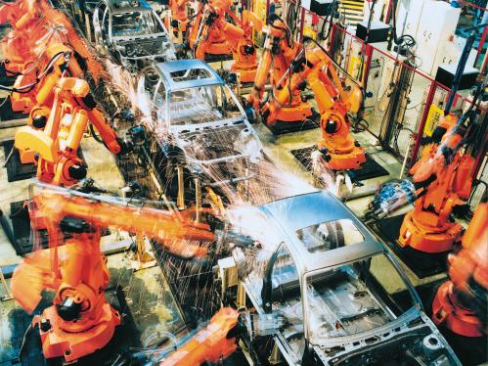
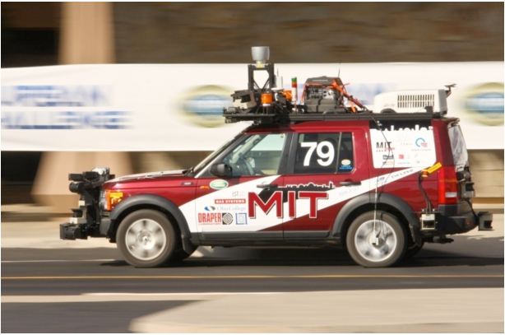
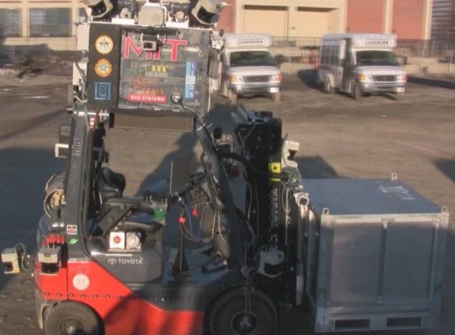
Motion Planning Revisited
Given:
Robot's dynamics
A map of the environment
(perfect information, but discovered online)
Robot's pose in the map
A goal pose in the map
Find a sequence of
Actuation commands
(such as steer, gas/brake, transmission)
In real time (requires efficient algorithms)
… that drive system to the goal pose
Problem is essential in almost all robotics applications irrespective of size, type of actuation, sensor suite, task domain, etc.
Notes:
Let’s revise the motion planning problem we defined before:
We now have:
Dynamics
A map that is discovered online
We would like to come up with
A sequence of inputs to the dynamical system or the control systems
And we would like to do this in real-time.
The motion planning problem is very important and essential in robotics, independently from what kind of a robot you are looking at. In almost any robotics application, the robot has to figure its way out to a goal pose.
Today, we will study this problem in a more realistic setting, look through its challenges, and study a state-of-the-art algorithm called the Rapidly-exploring Random Trees.

Slide 9
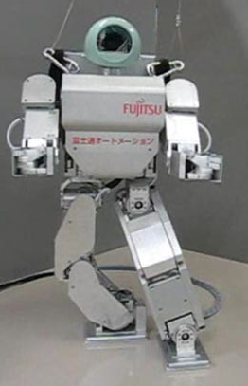
Practical Challenges
Safety: do not collide with anything;
ensure that system is stable; etc.
Computational effectiveness: problem is (provably) computa- tionally very challenging
Optimize: fuel, efficiency etc.
Social challenges (in human-occupied environments): motion should seem natural; robot should be accepted by humans
Notes:
Arguably, the biggest challenge in almost all real-world challenges is the safety. No matter what the application is, safety has to come first. It is even more important when the robots work in human-occupied environments. And even more, when the system dynamics are unstable such as this robot, which actually us about to fall down while trying this ``turn around’’ maneuver.

Slide 10
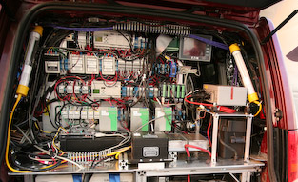
Practical Challenges
Safety: do not collide with anything;
ensure that system is stable; etc.
Computational effectiveness: problem is (provably) computa- tionally very challenging
Optimize: fuel, efficiency etc.
Social challenges (in human-occupied environments): motion should seem natural; robot should be accepted by humans
Notes:
An other challenge is computational effectiveness of the algorithms. Even the most basic version of the motion planning problem (just finding a solution, no optimizations) is a hard problem. You can prove this! You can prove that there is no efficient algorithm that will fully solve the problem.
However, clearly, in a setting where the algorithm has to work in real-time, the motion plans have to be generated quickly enough so that the system implements these as soon as it is available. If the dynamics are unstable this is a bigger issue. The picture is a supercomputer (40 cpu cores, 40 GB of RAM) running Talos, our robotic car in the Urban Challenge. One of the cores was completely devoted to motion planning but nothing else. The motion planning algorithm we will talk about today was one of the few processes that would occupy one core itself.

Slide 11
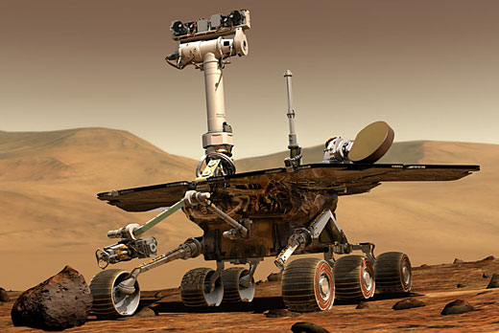
Practical Challenges
Safety: do not collide with anything;
ensure that system is stable; etc.
Computational effectiveness: problem is (provably) computa- tionally very challenging
Optimality: fuel, efficiency etc. (alternative framing: not a gross waste of resources)
Social acceptability (in human-occupied environments): motion should seem natural; robot’s presence should not be rejected by humans
Notes:
Despite all these computational issues, not only we would like to find a plan, but also we would like to optimize several performance measures.
What are some measures we would like to optimize?
Power (why? - look at the picture on the slide)
Shortest paths (why?)
Time of operation… etc.

Slide 12
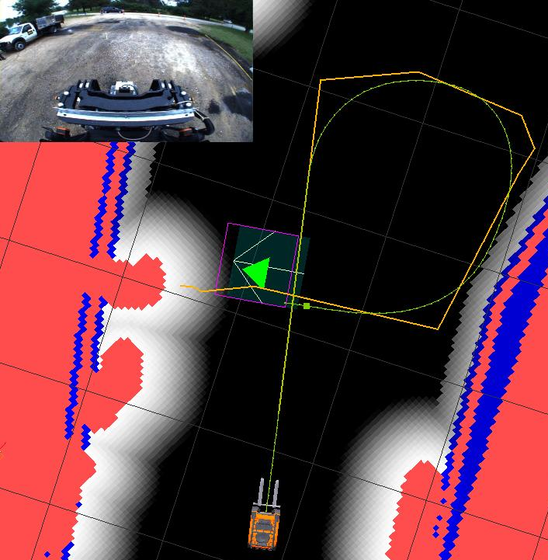
Practical Challenges
Safety: do not collide with anything;
ensure that system is stable; etc.
Computational effectiveness: problem is (provably) computa- tionally very challenging
Optimize: fuel, efficiency etc. (alternative framing: not a gross waste of resources)
Social acceptability (in human-occupied environments): motion should seem natural; robot’s presence should not be rejected by humans
Notes:
Sometimes finding just a motion is not enough. The motion also has to look natural, instead of, for instance, a zig-zag path that would make the people around the robot not trust robot. Also, the path should look somewhat smart. Should do the task like a human would do it.

Slide 13
Practical Challenges
Safety: do not collide with anything;
ensure that system is stable; etc.
Computational effectiveness: problem is (provably) computa- tionally very challenging
Optimize: fuel, efficiency etc. (alternative framing: not a gross waste of resources)
Social acceptability (in human-occupied environments): motion should seem natural; robot’s presence should not be rejected by humans
Notes:
Sometimes finding just a motion is not enough. The motion also has to look natural, instead of, for instance, a zig-zag path that would make the people around the robot not trust robot. Also, the path should look somewhat smart. Should do the task like a human would do it.

Slide 14
Different Approaches
Algebraic Planners
Cell Decomposition
Potential Fields
Sampling-Based Methods
Notes:
Let’s look at some different motion planning algorithms and discuss how they fit into this revised motion planning problem.

Slide 15
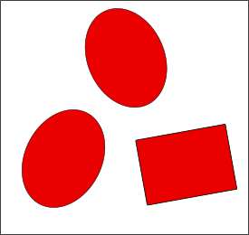
Motion Planning Approaches
Algebraic Planners
Explicit (algebraic) representation of obstacles
Use algebraic expressions (of visibility comp- utations, projections etc.) to find the path
Complete (finds a solution if one exists, otherwise reports failure)
Computationally very intensive – impractical
Cell Decomposition
Potential Fields.
Sampling-Based Methods
1. Represent with polynomial inequalities
2. Transform inequalities to c-space
3. Solve inequalities in c-space
to check feasibility and find a plan
Notes:
Despite its hardness, the motion planning problem can be solved exactly using (advanced) algebra.
First, the obstacles are represented as polynomial inequalities (how?)
Second, the robot is also represented as a polynomial inequality
Third, all these are mapped to the configuration space using algebraic projections.
Fourth, the inequalities are solved to find a solution to the problem.
This method is computationally very expense, although it finds the solution if one exists. Due to its running time, it is impractical even for a few obstacles and a two link manipulator. This will definitely not fit our real-time constraints. Besides online planning is very hard too; each time the environment changes slightly, we will need to re plan from the beginning.

Slide 16
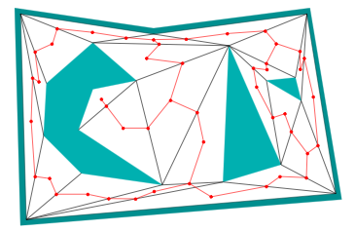
Motion Planning Approaches
Algebraic Planners
Cell Decomposition
Analytic methods don’t scale well with dimension (too many cells in high d)
Gridding methods are only “resolution complete” (i.e., will find a solution only if the grid resolution is fine enough, and if enough grid cells are inspected)
Potential Fields.
Sampling-Based Methods
Analytic subdivision
Gridded subdivision
Notes:
Cell decomposition methods that are complete as well as gridding methods suffer from computational complexity as well. What would be the number of grid points in a 2 dim c-space, if each axis has 10 grid points? What if the dimension was 10? How about 10 cooperating robots each with 10 DOF: 10^100 grid points – more than the atoms in the universe (an estimate is 10^80).
Moreover, notice that gridding is not even complete. If there is a narrow passage, and there is not enough grid points around it, the gridding will tell us that the problem is infeasible, when it clearly is.

Slide 17
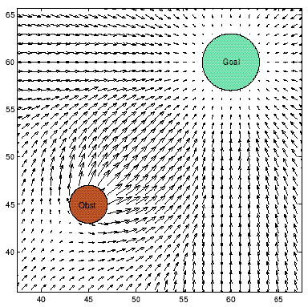
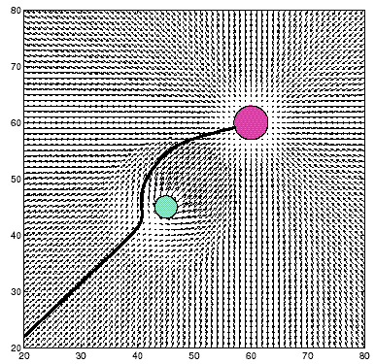
Motion Planning Approaches
Algebraic Planners
Cell Decomposition
Potential Fields
No completeness guarantee (can get stuck in local minima)
Of intermediate efficiency; don’t handle dynamic environments well
Sampling-Based Methods
Notes:
We also studied motion planning methods. These are definitely more efficient than gridding or exact/approximate cell decomposition.
But, there are two major drawbacks:
1.They are not complete (they can get stuck in a local minima)
2. Moreover there is no safety guarantee

Slide 18
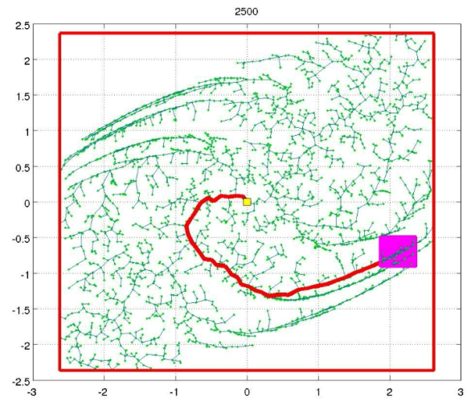
Motion Planning Approaches
Algebraic Planners
Cell Decomposition
Potential Fields
Sampling-Based Methods
(Randomly) construct a set of feasible (that is, collision-free) trajectories
“Probabilistically complete” (if run long enough, very likely to find a solution)
Quite efficient; methods scale well with increasing dimension, # of obstacles
goal
C-obst
C-obst
C-obst
C-obst
C-obst
start
goal
Notes:
Sampling-based motion planning algorithms we have seen so far are somewhat more effective that other computationally.
They provide probabilistic completeness: it is very likely to find a solution if run long enough. If there is no solution, it will run forever without giving any answer.
These methods avoid constructing obstacles in the c-space, which eliminates the computational problems of, for instance, the algebraic methods. Instead, they use more simple probes: such as check whether a sample is feasible, or whether a trajectory is feasible (these can be done efficiently).

Slide 19
Sampling Strategies
How can we draw random samples from within c-space?
Normalize all c-space dimensions to lie inside [0..1]
Then, simple idea:
Generate a random point in d-dimensional space
Independently generate d random numbers between 0 and 1
Aggregate all d numbers into a single point in c-space
2. Check whether sample point (i.e., robot pose) lies within any obstacle

Slide 20
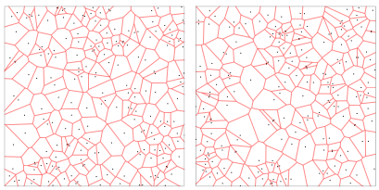
Example Sample Sets
Uniform sampling:
From a given axis, sample each coordinate with equal likelihood
(200 random samples)
(200 random samples)
Observe:
Significant local variation, but sample sets are globally consistent (Later, we’ll see that this yields consistent performance across runs)
Notes:
Here is an example of two uniform sets of samples. Observe two things:
Locally each set is very different. Look at, for instance, a sparse part of the first sample set (left side), observe that it is very dense in the other sample set.
Observe, however, that looking at these from a distance the global properties are similar, e.g., the size of the largest and smallest regions, the distance between the closest points, average distance between the neighboring points etc.
These type of phenomenon is observed in any random continuous sampling scheme.
These two properties will come very handy later. Why? For instance, in PRMs it will allow us to have consistent properties across many runs.

Slide 21
Sampling-based Motion Planning
Basic idea:
Randomly sample n points from c-space
Connect them to each other (if no collision with obstacles)
Recall the two primitive procedures:
Check if a point is in the obstacle-free space
Check if a trajectory lies in the obstacle-free space
This is the Probabilistic Road Map (PRM) algorithm
goal
C-obst
C-obst
C-obst
PRM is a multiple-query algorithm (can reuse the roadmap for many queries)
C-obst
C-obst
start
goal
Notes:
Now recall the PRM method. Recall that we used two primitives.
Observe that it is multiple query.
PRM is the most basic sampling-based method.
Let’s extend this to deal with online real-time planning in a realistic setting.

Slide 22
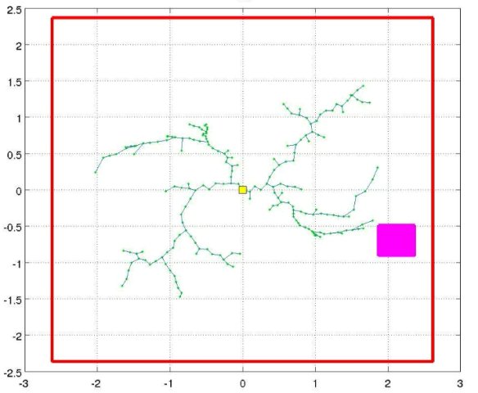
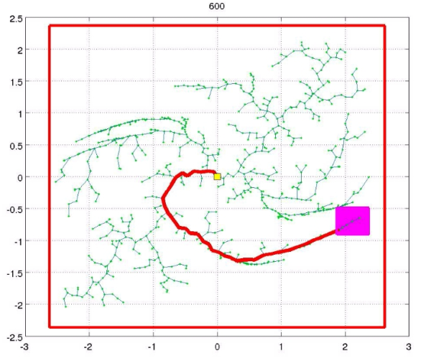
Incremental Sampling-based Motion Planning
Sometimes building a roadmap a priori might be inefficient (or even impractical)
Assumes that all regions of c-space will be utilized during actual motions
Building a roadmap requires global knowledge
But in real settings, obstacles are not known a priori; rather, they are discovered online
We desire an incremental method:
Generate motion plans for a single start, goal pose
Expending more CPU yields better motion plans
The Rapidly-exploring Random Tree (RRT) algorithm meets these requirements
Notes:
But, sometimes we just can not build a roadmap a priori because, e.g.
We just do not know the environment (think about a robotic car – Urban Challenge)
Incremental methods are those that build the roadmap incrementally. That is, instead of batch sampling (sampling the nodes all at once and then connecting them), let us do incremental sampling: sample a node and connect it to the roadmap.
This will allow us to
Have the algorithm terminate as soon as a motion plan is found (why is this useful? – recall the real-time requirements)
Given more CPU time we can search other parts of the state space to find a better solution.
Deal better with online requirements (e.g., if the obstacles move around we will still have trajectories)
Let us introduce a new sampling-based method called the RRT.

Slide 23
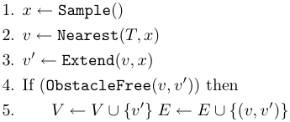
RRT Data Structure, Algorithm
T = (nodes V, edges E): tree structure
Initialized as single root vertex (the robot’s current pose)
RRT root
// Sample a node x from c-space
// Find nearest node v in tree
// Extend nearest node toward sample
// If extension is collision-free
;
// Add new node and edge to tree
Notes:
Here is how the algorithm works.
Notice that incremental sampling idea (instead of batch sampling).

Slide 24
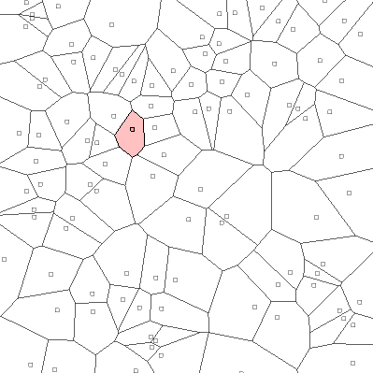
Digression: Voronoi Diagrams
Given n sites in d dimensions,
the Voronoi diagram of the
sites is a partition of R ^{d} into
regions, one region per site,
such that all points in the
interior of each region lie
closer to that region’s site
than to any other site
(AKA Dirichlet tesselations, Wigner-Seitz
regions, Thiessen polygons, Brillouin zones, …)
Notes:
To discuss why it works nicely, let us study voronoi diagrams for a minute.
This is a voronoi diagram of many points sampled independently uniformly at random from the plane.

Slide 25
Rapidly-exploring Random Trees: Clearly random! Why rapidly-exploring?
RRTs tend to grow toward unexplored portions of the state-space
Unexplored regions are (in some sense) more likely to be sampled
This is called a Voronoi bias
For an RRT at a given iteration, some nodes are associated with large Voronoi regions of c-space, some with smaller Voronoi regions
The unexplored areas of c-space tend to coincide with the larger Voronoi regions
(Uniform) samples will tend to fall into relatively larger Voronoi regions
Thus unexplored regions will tend to shrink!
Main advantage of RRT: Samples “grow” tree toward unexplored regions of c-space!
Notes:
Think about the sites as the nodes of an RRT in some given iteration.
Notice that some of the nodes have bigger voronoi regions, some have small.
Where is the next sample most likely to fall? – into a big voronoi region.
Then, what is the nearest neighbor? – the site that lies in this region.
Well, then we will extend the node towards a big Voronoi region, which was unexplored. Hence, the tree is “grown’’ into unexplored regions.
This is called the Voronoi bias.

Slide 26
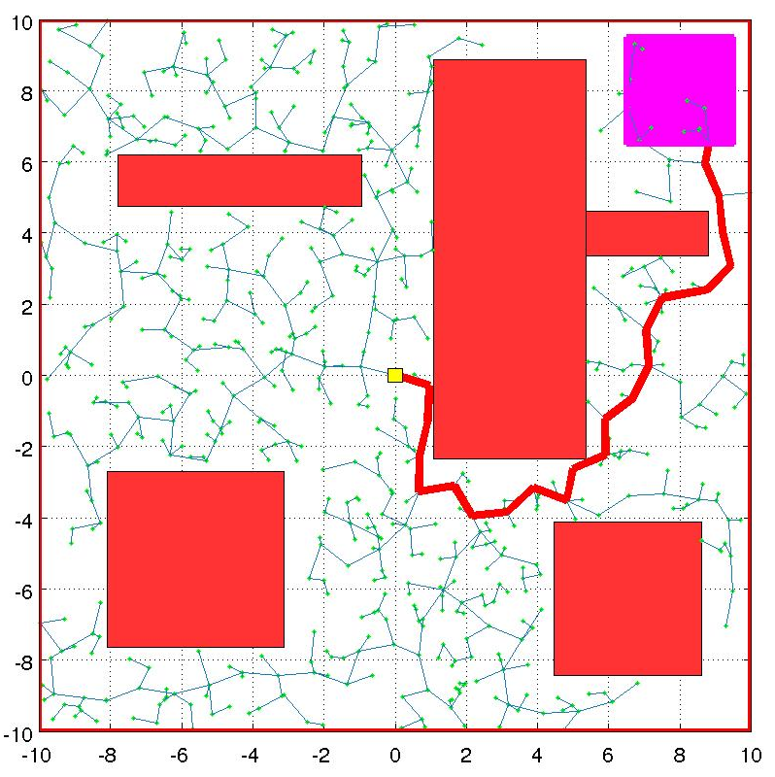
Rapidly-exploring Random Trees in simulation
Goal pose region
Initial pose
Obstacles
The tree
Best path in the tree (identified through search)
Notes:
Let’s look at some simulation examples.

Slide 27
Rapidly-exploring Random Trees in simulation
Movie shows the RRT exploring empty c-space
Goal pose region
Notes:
Notice that the RRT first explores the environment, i.e., reaches to the sides. Then, it fill in the empty gaps. As the iterations go by, the tree gets finer and finer.

Slide 28
Rapidly-exploring Random Trees in simulation
Exploration amid obstacles, narrow passages:
Notes:
Notice that some obstacles, small passages may block the RRT growth for sometime. We will study this in the next slide.

Slide 29
Performance of Sampling-based Methods
Why do the PRM and RRT methods work so well?
Probabilistic Completeness:
The probability that the RRT will find a path approaches 1 as the number of samples increases — if a feasible path exists.
The approach rate is exponential — if the environment has good “visibility’’ properties
ϵ-goodness:
A point is ϵ-good if it “sees” at least an ϵ fraction of the obstacle-free space
An environment is ϵ-good if all freespace points in it are ϵ-good
Good performance of PRMs and RRTs has been tied to the fact that, in practice, most
applications feature environments with good visibility guarantees (Latombe et al., IJRR ’06).
Notes:
So, how does the RRT solve the motion planning problem so magically, when all the other methods can not. What is the reason?
We said that the RRT is probabilistically complete and it turns out the rate of convergence really depends more on the visibility properties of the environment other than, for instance, number of dimensions in the state space.
A measure of good visibility is this notion of epsilon goodness.
Recall the small passage in the previous example now. Note that the visibility of one region was not very good and the algorithm had a relatively hard time getting through that passage. But once it passes through it, it was easy to explore inside it, since the visibility inside that small region is actually quite good when the region is isolated.

Slide 30
Example: Unmanned Driving
Tree of trajectories is grown by sampling configurations randomly
Rapidly explores several configurations that the robot can reach.
Many test trajectories generated (tens of thousands per second)
Safety of any trajectory is “guaranteed”…
… as of instantaneous world state at the time of trajectory generation
Choose best one that reaches the goal, e.g.,
Maximizes minimum distance to obstacles
Minimizes total path length
Supports dynamic replanning; if current trajectory becomes infeasible:
Choose another one that is feasible
If none remain, then E-stop
Goal pose
Obstacle infeasible
Lane divider undesirable
Road infeasible
Vehicle

Slide 31
Real-world Implementation
A few details:
CPU limitations and sampling method
Dynamical feasibility constraints
Grid map with local obstacle awareness
Stop nodes for safety
Legend for images, videos you’ll see next:
Instantaneous vehicle pose
Reaching, low cost
Obstacle
Reaching, high cost
Goal pose
High-cost regions
Non-reaching

Slide 32
RRT at work: Urban Challenge

Slide 33
Successful Parking Maneuver

Slide 34
RRT at work: Autonomous Forklift

Slide 35
Summary
The Rapidly-exploring Random Tree (RRT) algorithm
Discussed challenges for motion planning methods in real-world applications
Intuition behind good performance of sampling-based methods
Two applications:
Urban Challenge vehicle, Agile Robotics forklift

Slide 37
For next year
Better image choices pp. 29-32
Make grid scaling discussion more explicit
Notes:
Let’s look at some different motion planning algorithms and discuss how they fit into this revised motion planning problem.

Slide 38
System Architecture
System has 40 CPUs, 70+ processes
Processes communicate with each other only via message passing
The core planning and control processes and some components that they are directly connected to
Checkpoints
Road network
Navigator
Obstacle Map
Planner (RRT)
Controller
Vehicle

Slide 39
Dynamical Feasibility
Vehicle (car, forklift) is modeled as a dynamical system with 5 states:
X
Y
Theta (heading)
Speed
Sideslip – not used for planning
A closed-loop controller is designed to stabilize the system in
Position/orientation (X, Y, Theta)
Speed control
The RRT samples controller setpoints (which a lower-level controller then tracks)
This process ensures dynamical feasibility (i.e. generates only trajectories that can indeed be executed by the vehicle)

Slide 40
Grid Map and Moving Obstacles
The RRT uses the grid map data structure, which provides one efficient query:
Check whether a specified hypothetical trajectory collides with any (dilated) obstacle
The perception subsystem also detects moving obstacles and predicts their future trajectories
Checkpoints
Road network
Navigator
Obstacle Map
Planner (RRT)
Controller
Vehicle

Slide 41
Stop Nodes
Remember the safety requirement.
All leaf nodes constrained to have speed=0
The RRT attempts to maintain a path from every internal node to some leaf node
If, due to some newly discovered obstacle, no such trajectory exists in the tree, the robot “E-stops” (i.e., slams on the brakes)
Safety is perhaps the most important requirement in real-time motion planning for robotic vehicles.

Slide 42
Advanced Topics in Sampling

Slide 43
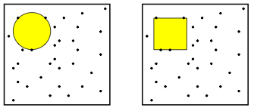
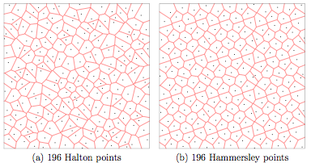
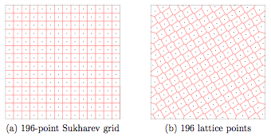
Sampling Strategies
No labels for last two images??
Measuring the “quality” of samples:
Dispersion methods
How good is uniform sampling?
How about deterministic methods?

Slide 44
Advanced Topics in Dynamics

Slide 45
Rapidly-exploring Random Trees in simulation
A linear dynamical system with 2 states and drift:

Slide 46
Advanced Topics in Optimization

Slide 47
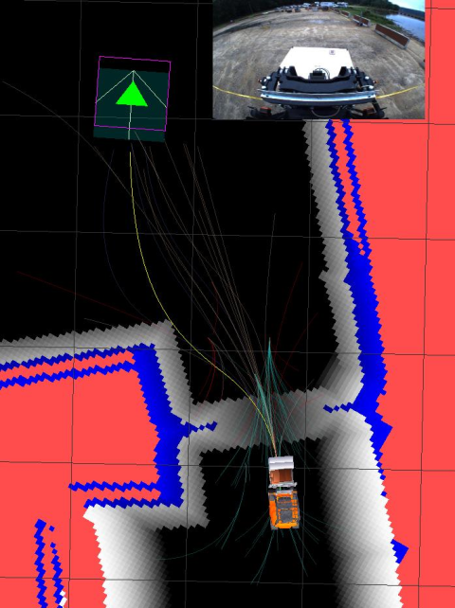
Limitations of RRT
RRT algorithm is tailored to find a feasible solution very quickly.

Slide 48
Limitations of RRT
RRT algorithm is tailored to find a feasible solution very quickly.
However, our simulation results suggest that, if kept running, the solution is not improved in terms of quality.

Slide 49
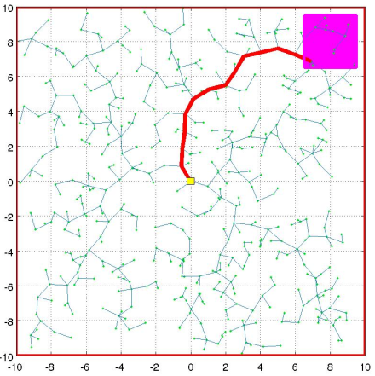
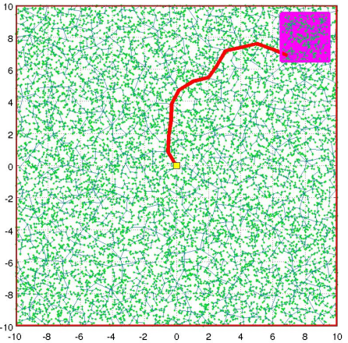
Limitations of RRT
RRT algorithm is tailored to find a feasible solution very quickly.
However, our simulation results suggest that, if kept running, the solution is not improved in terms of quality.
Can we formalize this claim?
Let s* be an optimal path and c* denote its cost.
Let X_{n} be a random variable that denotes the cost of the best path in the RRT at the end of iteration n.
That is, the probability that RRT will get closer to an optimal solution is zero.
In other words, the RRT will get stuck.

Slide 50
Limitations of RRT
That is, the probability that RRT will get closer to an optimal solution is zero.
In other words, the RRT will get stuck.
Why?
The RRT greedily explores the c-space exponentially fast.
Once a path is found, the RRT traps itself because of
fast greedy exploration.
How about:
running the RRT multiple times?
deleting parts of the tree and rebuilding?
new sampling strategies, better nearest neighbor?
All these may improve the performance,
but they will not make the RRT optimal.
For optimality, we need to rethink the RRT algorithm…

Slide 51
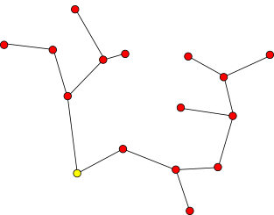
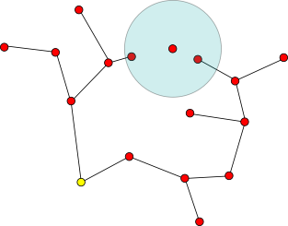
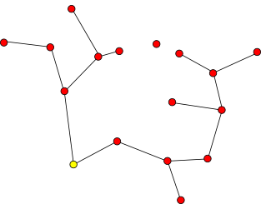
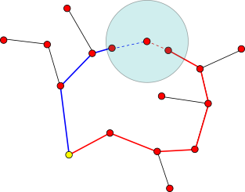
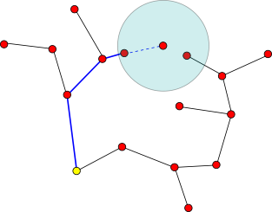
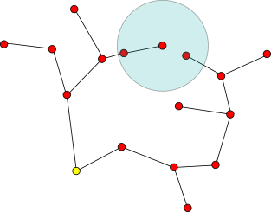
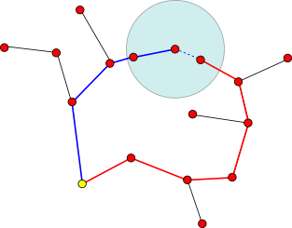
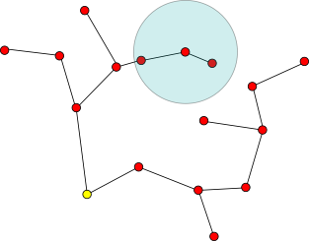
Extension to RRT* (Karaman, Frazzoli, RSS’10)
Intuitively,
Run an RRT
Consider rewiring for all the nodes that are inside a ball of radius r_{m} centered at the new sample
Volume of the ball:

Slide 52
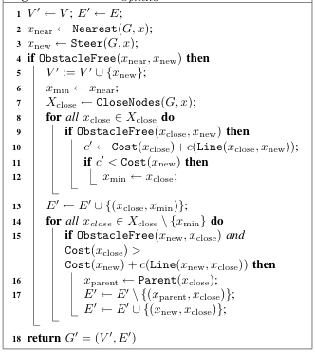
Extension to RRT*
The body of the algorithm is
very similar to the RRT.
Extend the nearest
If obstacle-free segment,
Then add the node to the tree
Compute the nodes inside the ball
Determine the closest node to the sample
in terms of the cost
Extend back to the tree – extend to
all the nodes inside the balls

Slide 53
RRT* on simulation examples
The obstacle-free case:

Slide 54
RRT* on simulation examples
With some obstacles

Slide 55
RRT* on simulation examples
With some obstacles
Cost color coded:

Slide 56
RRT* on simulation examples
Upper rectangle is high cost
Lower rectangle is low cost

Slide 57
Summary
Studied the Rapidly-exploring Random Tree (RRT) algorithm
Discussed challenges for motion planning methods in real-world applications
Discussed magic behind sampling-based methods
Looked at two applications:
Urban Challenge vehicle, Agile Robotics forklift
Studied the optimality properties of the RRT and the RRT* algorithm.

Slide 58
RRT*: why it works? And how much time does it take to run?
It can be shown that the RRT* converges to the optimum cost with probability one, that is
Then, how about computational complexity?
The number of nodes in the ball is around log(m), where m is the number of nodes.
Hence, we need to do log(m) more extensions at each iteration.
However, finding the nearest neighbor in a tree with m nodes takes around log(m) time anyway
RRT
RRT*
Nearest neighbor
O(log m)
O(log m)
Close Nodes
-
O(log m)
Number of extensions
1
O(log m)
Total:
O(log m)
O(log m)

Slide 59
RRT*: why does it work? And how much time does it take to run?
RRT* converges to the optimum cost with probability one
RRT* has the same asymptotic computational complexity with the RRT.
Some experimental evidence for the theoretical claims:
Running time of the RRT* / running time of the RRT vs. number of iterations

