Slide 1
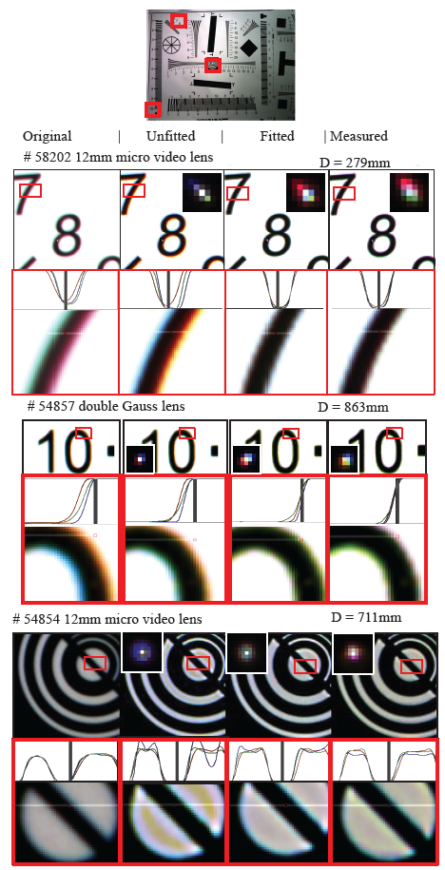
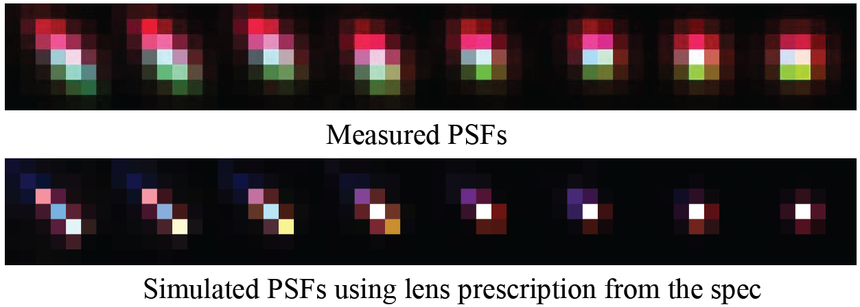
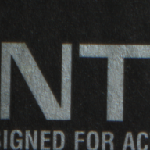
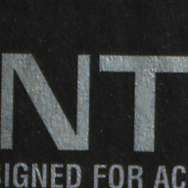
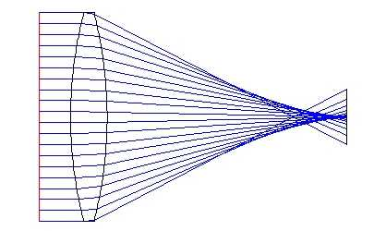
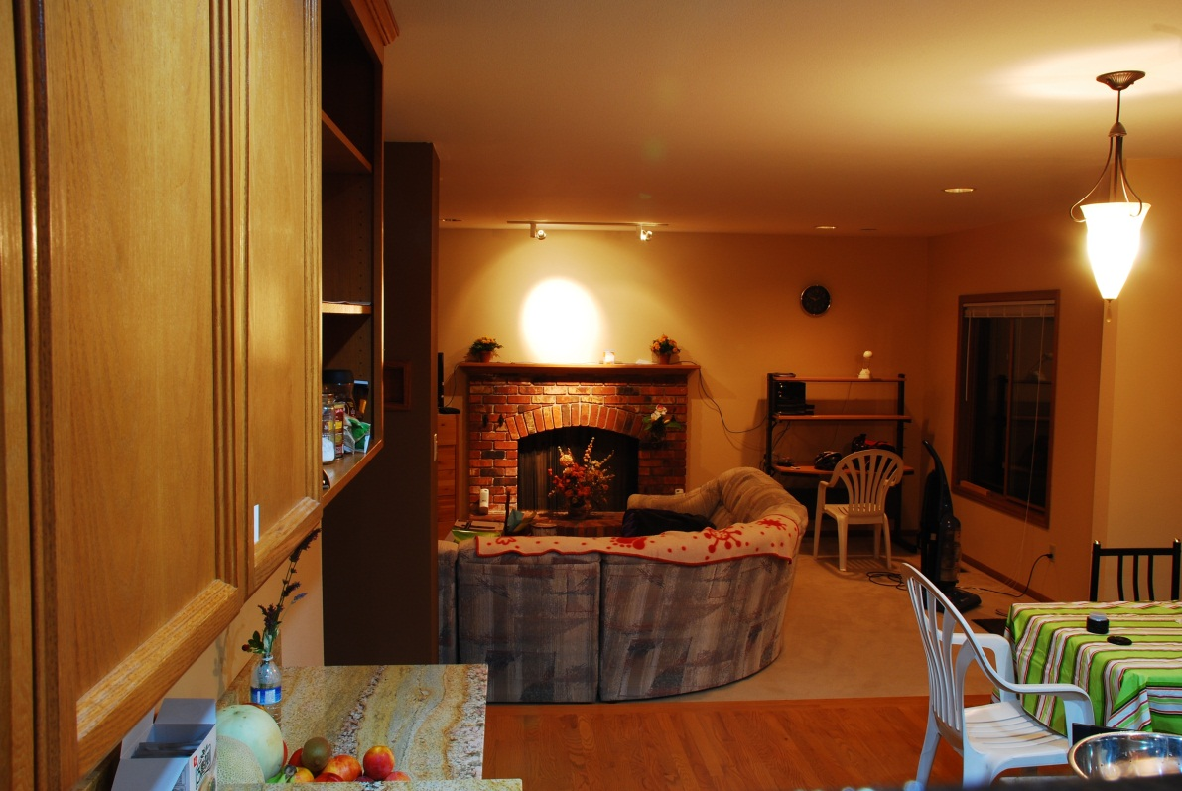
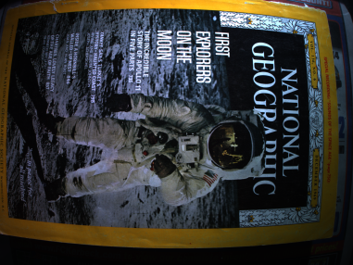
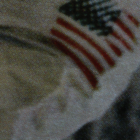
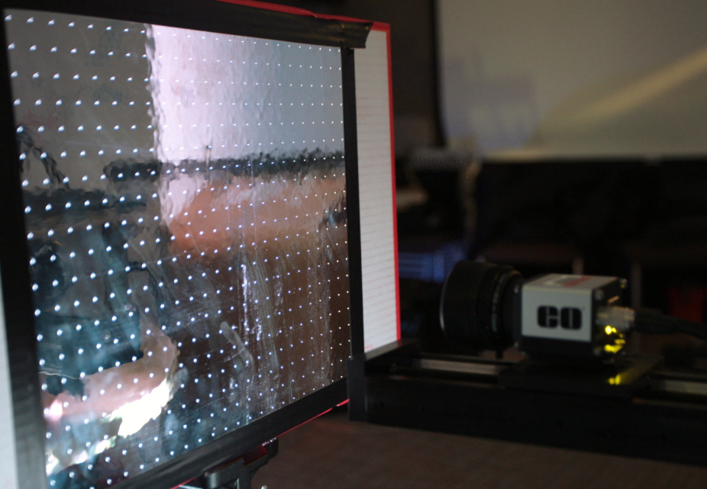
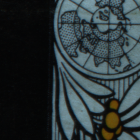
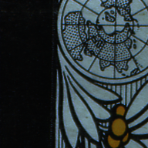
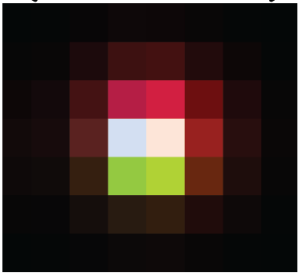
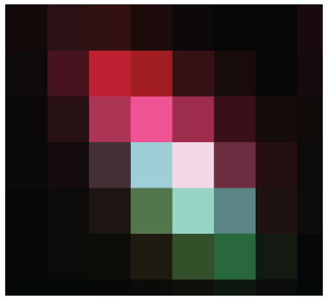
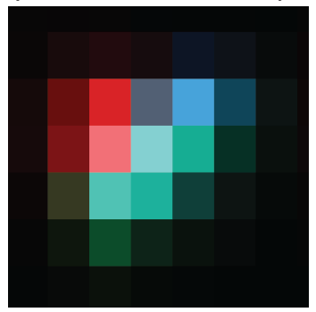
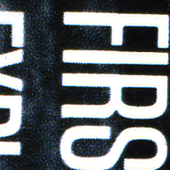
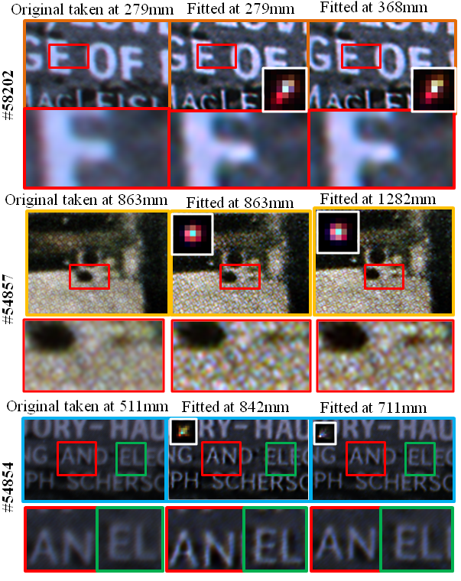
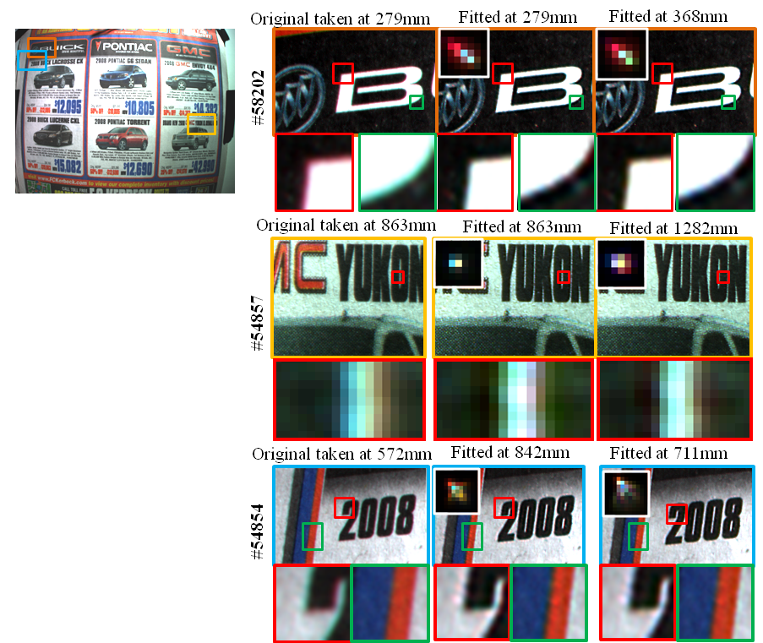
Image Enhancement Using Calibrated Lens Simulations
Yichang Shih¹, Brian Guenter², Neel Joshi²
MIT CSAIL¹, Microsoft Research²
Goal: Remove optical aberrations
Challenge
Results
Deconvolution result
All lenses have optical aberrations [Seidel, 1856]
The simulation is different from the measurement
Fitted | measured | unfitted
unfitted | fitted
Spherical aberration
Chromatic aberration
PSF
PSF
PSFs measurement
The aberrations can be restored by deconvolution, but requires accurate lens point spread functions (PSFs) info
Pinhole arrays (light sources) 20x20 holes
We use a monochromatic camera and exposure under r/g/b different lighting instead of demosaicing
Lens
PSFs are spatially-variant, and changing with focal distance. Measuring all PSFs is expensive
Camera
279mm
279mm
368mm
The lens manufacturing tolerance can cause the actual lens prescription different from the spec
Our Method
We compute PSFs using the lens CAD model, called lens prescription, by geometric-wave hybrid ray tracing
Fitting using measurement at 279 mm, and synthesize PSFs at 368 mm
Fitted
Measure
Unfitted
Our solution: taking the spec and measured PSFs at a single distance as input, calibrate the accurate lens prescription for image enhancement
We can predict PSFs at any positions and focal distances
The model includes - Number of glasses - Dispersion function - Radius, xyz positions of each glass - Dispersion coefficients (C₁…C₆)
n:refraction index)
n² - 1 = C₁λ²/(λ²-C₂) + C₃λ²/(λ²-C₄) +… C₅λ²/(λ²-C₆)
Every lens needs to be calibrated once
Calibration (Optimization)
Objective function: L2 norm between measured & synthetic PSFs
We target at mobile phone cameras - Small lenses (diameter 6~18mm) - Prime lenses
Variables: parameters in lens prescription
Optimization: gradient descent
Initial parameters: provided lens prescription from the manufacturer
Applications
Image enhancement on cloud - The server keeps an lens prescription for each lens
Remove chromatic aberrations, distortions, and sharpen the image
Acknowledgement
We would like to thank Edmund Optics for providing the lens prescriptions. Thank Fredo Durand for helpful discussion

