Slide 1

Pensieve:
Microarchitectural Modeling for Formal Security Evaluation
Yuheng Yang, Thomas Bourgeat, Stella Lau, Mengjia Yan
To appear at ISCA’23
Notes:
Hello everyone, I’m Yuheng Yang. Today I will talk about our recent work, Pensieve: Microarchitectural Modeling for Formal Security Evaluation.
Basically, the security is targeting speculative execution attacks.
It is a joint work by me, Thomas, Stella, and Mengjia.
I am very happy to present this work to our post-quantum side-channel analysis workshop.
Because I hope can give you a sense why the microarchitecutre, the speculation scheme would play such an important role to achieve side-channel free, or to achieve constant-time cryptography program.
To start, what is the role of the microarchitecture here?
Isn’t all programmers’ job to guarantee the program runs in constant time?

Slide 2
“Constant-time Program” might not run in Constant-time in Hardware
Constant-time
on Sequential Machine
Not Constant-time
Speculative Machine
for i in range(n):
if sec[i] == 0:
// side-effects-1
else:
// side-effects-2
Never branch on
Secrets
for i in range(n):
if pub[i] == 0:
// side-effects-1
else:
// side-effects-2
Pub[n] can be leaked!
Notes:
Actually, yes, programmer definitely should write constant-time program.
But when we run these program that supposed to be constant-time from programmers’ perspective.
Run them on real hardware, they might not be constant time anymore.
Let me show you how this could happen.
Originally, we have this very bad non-constant-time program.
They can execute different branches based on the secret and lead to side effects.
For example, the RSA algorithm, everyone know it right.
People realized the problem.
And now, when people design new algorithms, they introduce some rules like we should never branch on secrets.
And change the software design to achieve the constant-time property.
For example, this new program only branches on public value.
… And it seems to be constant time.
But be careful that this constant time is on a sequential machine that executes the instructions one by one.
This sequential machine is basically how programmers view the hardware.
But in reality, there is a mis-match.
The hardware can execute instructions speculatively and introduce some new vulnerabilities.
For example, when we execute through this for loop in the code block, we will actually execute some extra iterations, like when i equals to n.
And this will introduce an out-of-bound memory access to the public array.
For example, this access to the public array with index n, which can be a secret and leaked through the side channel.
Such instruction sequences that look like constant-time to the programmer, but can still leak secret speculatively are basically Spectre gadgets.
It is almost impossible for software designer alone to avoid all possible Spectre gadget in their program.
Because the speculation schemes in hardware can be very complex and people even do not know how Spectre gadget would look like in many cases.
And also, the spectre gadget can be different in different hardware.
Thus, it is really hardware designers’ job to make sure that speculation is not a problem and provide a secure hardware for constant-time execution.
And yet, this is not an easy task to provide secure hardware.

Slide 3





Problem: the Cat-and-Mouse Game
2018
Spectre
2019
InvisiSpec
Delay-on-Miss …
Spectre rewind
Speculative interference
2020
2021
GhostMinion
Notes:
During the last few years, hardware design came across this cat-and mouse game that we always fail to provide a secure hardware.
In 2018, we discovered this scary Spectre gadget and wow, all constant programs do not make sense anymore as I explained in the last slide.
And people quicky come up with defenses like invisiSpec and Delay-on-Miss.
But just one year after that, two papers just come up with these new vulnerable gadget called Spectre rewind and Speculative interference that break the defense.
Then, people quickly fix the problem again with a new defense called GhostMinion, which has pretty complicated schemes like evicting in-flight requests, special priorities among requests.
But, at this stage, how do we know this new GhostMinion is secure? Given that the last defenses were broken just in one year.

Slide 4

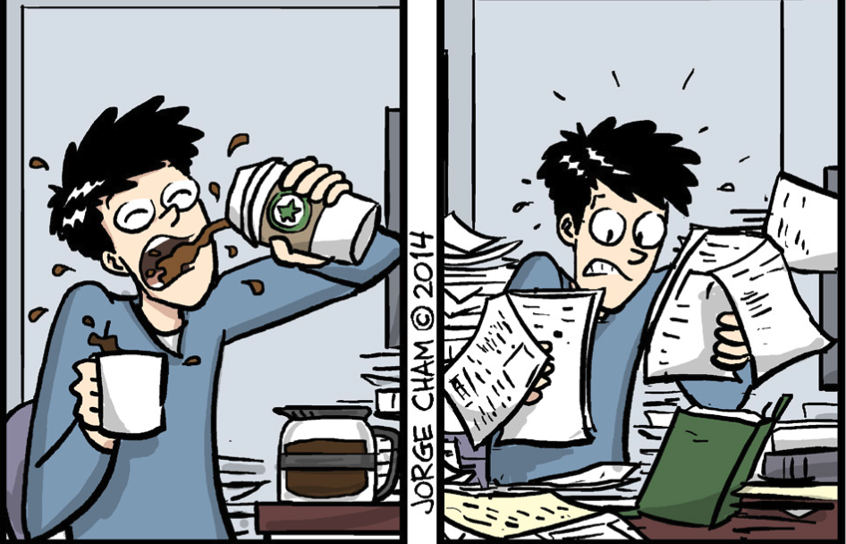


Problem: Weak Security Evaluation
Step 1:
Step 2:
The defense works for all possible Spectre gadget.
Defense
Proposal
Spectre Gadget
We need a principled, trustworthy
security evaluation tool!
Notes:
The real reason of the short lifetime of defenses is that the community has very weak security evaluation procedure.
What people are doing here is basically two steps of evaluation.
Step one, we implemented these defenses in Gem5 simulator.
Run the spectre gadget.
And see nothing bad happens.
Then, people move on to more comprehensive evaluation and want to argue the defense works for all possible Spectre gadgets.
How to do that?
Unfortunately, the current state is you ask PhD students to check all the details. Students need to keep all defense details in mind, search for related work, and hope getting a correct answer.
But who knows.
And this is why we want to find a principled, trustworthy security evaluation tool for these spectre defenses.
So that we can be confident that when you run a constant program on the hardware, the speculation will not turn it into non-constant execution time.
This topic of formal evaluation of Spectre defenses has been very popular in the hardware security community.
An important work has been done toward this direction is that we have formalized the security property.

Slide 5
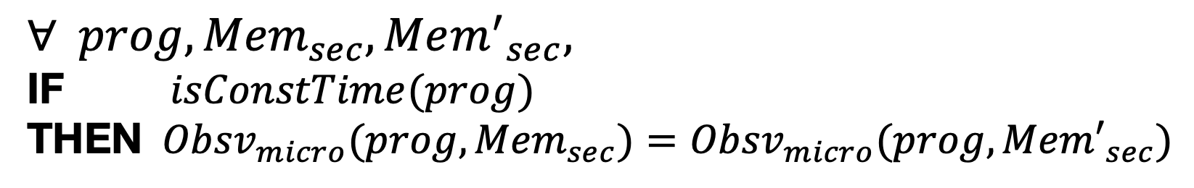
Background: Formal Security Property
Only consider constant-time program
Avoid secret affecting
  Execution Time
  Cache footprint
  …
Speculative Non-Interference Property:
Observation Models
$$∀ prog,{Mem}_{sec}, {Mem^{′}}_{sec},$$
IF $isConstTime(prog)$
THEN ${Obsv}_{micro}(prog,{Mem}_{sec})={Obsv}_{micro}(prog,{Mem′}_{sec})$
IF ${Obsv}_{seq} \left(prog,{Mem}_{sec}\right)={Obsv}_{seq} (prog,{Mem′}_{sec})$
Notes:
Let me explain the security property for you.
First, I will give you some sense about how the property would look like, then I will go to the final formalization of it.
First, our security definition only consider the constant-time program.
Because, if the program is not constant time from the beginning, it could never be secure no matter how we design the hardware.
And second, for these constant-time programs, how do we say it is secure or not?
The definition focuses on avoiding the secret having side effect to affect the, …, execution time, for example, or the cache footprint.
We characterize all these side-effects using an observation model, meaning that when we say what we can observe from the hardware, we mean these execution time and cache footprint.
So here is our security property, called speculative non-interference property.
We will evaluate the hardware with any program and any two different secret memory.
First, we say if this program is constant time,
Then, we want to make sure that when we simulate the program under a microarchitectural model, we should observe the same trace independent from the two different secrets.
For example, observe the same trace of the commit time of each instruction.
This basically means the secret will not interfere the observation.
Finally, let us be more concrete about what we mean by saying the program is constant time, this if condition.
We actually mean that in software designers’ mind, they simulate the program under a sequential machine, and say the program is constant if we can observe the same side effects independent from the secret on this sequential machine.
So, if you have a final look at the whole property, you can see the difference between this if and then, is only about whether it is sequential simulation or a microarchitectural simulation that includes speculation.
And what we want to express from this property is that, with this speculation in the microarchitecture, it will not allow secret to have extra interference on the observation.
OK, let me pause a little here and see whether there are any questions about this property.
Now that we have this precise security property, we can start to verify the hardware against it.

Slide 6

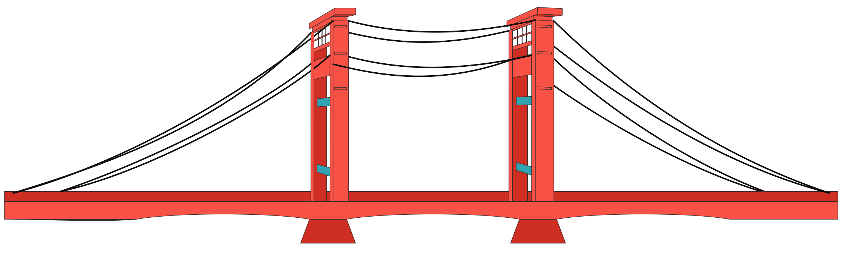
Challenge: Bridge the Gap
Defenses
Evaluation Tools
Model
Delay-on-Miss
Rosette
SafeSpec
JasperGold
invisiSpec
CVC5
Muontrap
Boolector
Coq
z3
GhostLoads
Isabelle/HOL
GhostMinion
ACL2
Aligned with architectural design flow.
Notes:
We can actually leverage many existing formal evaluation tools.
They can precisely model a defense and formally prove the security property.
But why computer architects still did not use these tools to evaluate the defenses.
There are many reasons, like the biggest problem we think is that these tools require a lot formal verification expertise, like do some crazy mathematical abstraction, which architects generally do not have.
So, our work tries to bridge the gap between defenses and formal evaluation tools.
The high-level idea is that we provide a way for defense designers, for architects to model their defenses and send the model to these tools for security evaluation.
We make our modeling process very available to architects by making it aligns with how architects come up with these defenses.
Align with the architectural design flow.
To understand our models.
Let’s start with this architectural design flow.

Slide 7


Defense Design flow
Fetch
Decode & Rename
Example: delay speculative requests
Dispatch
Memory
Commit
An architecture modeling method should be
Modular
Precise on describing timing behaviors
Represent a space of designs
Notes:
Basically, the defense design flow is a top-down view of the micro-architecture.
You have high-level modules like Fetch, decode, dispatch, memory, and commit.
Then, you want to add some defense scheme into it.
You probably will take out a module.
Do some modification, maybe on the timing behavior, like delay speculative requests, to make it secure.
And plug it back with the rest of the system and hope it will work.
Meanwhile, other modules might have been modified by different groups of people for different purposes like performance.
For example, there can be a new fetch module with a more precise branch predictor, larger caches, etc.
And you hope your defense on the memory module should work on all these different modifications on the rest of the system.
To summarize, this design flow has these three features.
First, be modular.
Second, the defenses are mostly modifying timing behavior, and thus modules should be precise on describing the timing behaviors, like when a memory request is sent and replied.
And finally, each module should be able to represent a space of designs because you want your defense to work with all different, say, branch predictors, caches, etc.
These three features actually guide us to design our modeling approach for security evaluation.
Let’s take a look on our model.

Slide 8


Pensieve Modeling
Decouple timing and functionality using the hand-shaking interface
Represent a space of timing behavior
in_valid
Time
out_valid
in_ready
out_ready
Func
addr
M[addr]
M[addr]
timing signals
functional signals
Memory System
An architecture modeling method should be
Modular
Precise on describing timing behaviors
Represent a space of designs
Notes:
The first thing we do in our model is to decouple the timing and functionality using the hand-shaking interface.
Let me describe this process with this memory system example.
You can imagine in this memory system, there can be multiple level caches, DRAM, Network-on-Chip etc.
And we will cover all of these detailed structures after this modeling process.
First, all these possible internal structures achieve one functionality.
It takes the address and return the data.
And from the outside of the module, all the different implementation details in the memory system are exposed as different timing behavior.
We adopt hand-shaking signals to represent the timing behavior.
This is quite standard but still let me quickly go through the hand-shaking signals.
Basically, it adds a pair of valid and ready signals at both input channel and output channel.
Let’s take the output channel as an example, the output valid signal indicates whether the memory finishes a request and wants to reply the data.
And output ready signal means whether the consumer of the memory, probably the cpu side can accept a data, or might have back pressure to the memory.
So, they literately describing the timing behavior between modules.
And with these interface, we have already satisfied the first two requirements, modular and precise on timing.
But the key of this modeling approach is really how we deal with the third requirement, represent a space of designs.
As I said, the space of the memory systems we are targeting is different cache organization and DRAM technologies.
And if you look at these detailed structures from the outside world, from the module level, they are really different timing behaviors, while achieving a same functionality.
So, what we really want to do is to represent a space of timing behaviors.
To achieve this, we first put a concrete functionality submodule to simulate the same functionality.
Then, we use a kind of abstract timing submodule with this cloud, which I will explain in next slide, to represent a space of timing behaviors.
And what is this cloud?
It is actually …

Slide 9
Uninterpreted Function (UF)
A UF represents space of functions with the same input/output types
  Example: Bool UF(Bool, Bool)
UF helps us
  state “what” affects the output,
  abstract away the details on “how” the input affects the output
represents
AND
…
Unspecified
function
body
OR
Notes:
Uninterpreted function.
We use Uninterpreted function to represent a space of timing behavior.
Uninterpreted function or UF is basically a primitive from the programming language community.
It is used to represent a space of functions with the same input/output types.
For example, this formula defines a UF with two Boolean inputs and one Boolean output.
The function body is unspecified, like a cloud.
This UF can be used to represent a space of binary operators like and logic, or logic, etc.
One interesting way to understand how UF can help us is that it helps us state
what affects the output, basically the two inputs affect the output, but not other value.
However, it abstracts away the details on how the input affects the output, meaning the detailed schemes that these cloud uses can be arbitrary, we do not really care.
These properties of UF are very nice to help us model a space of timing behaviors.
Let me give some concrete examples on this.

Slide 10
Pensieve Modeling: Using UFs
Examples:
Multiply_req_latency = UF(historyOf(in_valid))
Multiply_req_latency = UF(historyOf(in_valid, in_operands))
Memory_req_latency = UF(historyOf(in_valid, in_addr))
Pensieve can use simple models to cover
space of microarchitectures with complex timing behaviors
Notes:
Here is a multiplier request latency, basically how long a request will take, and we use a UF to generate this latency for this request.
To do so, the UF takes in the history of input valid signals.
You can imagine this representation can cover a lot of multipliers who decide the latency based on when it received all requests.
Such as 1-cycle multiplier, which replies after 1 cycle, 10-cycle multiplier, pipeline, or non-pipeline multipliers.
They all decide the latency based on the input history and this representation with UF can cover all of them.
You can even increase the coverage of this representation by adding more signals into the UF inputs.
For example, this UF takes in an extra history of input operands and can further cover multipliers which decide the latency based on operands.
Such as a multiplier with zero-skip optimization, meaning if it sees a zero operand, it reply immediately. Otherwise, it takes a longer path.
Just to give you more examples, here is a memory request latency represented with UF.
It can have different latencies based on the input valid and input address.
It actually covers an extremely large space of designs with different cache hierarchy, different Network-on-Chip designs, different DRAM details.
All with this simple UF representation.
The takeaway from all these examples is that Penseive use these simple models with UF to cover space of microarchitectures with complex timing behaviors.

Slide 11
Pensieve Modeling
Decouple timing and functionality using the hand-shaking interface
Represent a space of timing behavior with uninterpreted functions
in_valid
Time
out_valid
UF
in_ready
out_ready
Func
addr
M[addr]
M[addr]
timing signals
functional signals
Memory System
Notes:
With this uninterpreted function, this cloud UF being explained, we now finish our introduction of Pensieve modeling approach, and it indeed can represent a space of timing behavior with uninterpreted functions.
Here, we only use the memory module to demonstrate, but we also use uninterpreted functions to represent a space of timing behavior in other modules in our microarchitecture, and also use uninterpreted functions to represent a space of functionality such as different branch predictor, different issuing policies, etc.
Any questions about this modeling approach before I move on?

Slide 12

Pensieve Security Evaluation Framework
Security Property
(Speculative Non-interference)
Micro-Arch Model
Model
Checker
FAIL: Attack Program
PASS: Security for k Cycles
Pensieve finds unknown security vulnerabilities in the latest speculative execution defense, i.e., GhostMinion [2021]
Notes:
With the modeling approach I have been introducing, we further design a whole Pensieve security evaluation framework that finally, bridge the gap between spectre defenses and formal evaluation tools.
The framework takes the microarchitecture models of defenses and a security property
and send them to a model checker.
The model checker will do an automatic, push-botton model checking process.
And generate result that is either fail, giving an attack program violating the security property.
Or prove the security for a bounded number of cycles.
And finally, with all these work, Pensieve also finds unknow security vulnerabilities in the latest speculative execution defense, namely GhostMinion.
In the next few slides, I will go through the GhostMinion defense scheme, and show you how the new vulnerability looks like.

Slide 13

GhostMinion
#1: Invisible Speculation
Insecure Baseline
Invisible Speculation
Spectre v1
Core
Core
if (false)
ld sec //transmitter
s
s
L1
L1
Invisible Buffer
Rest of Memory System
Rest of Memory System
Notes:
The first defense scheme used in GhostMinion is called Invisible Speculation.
To show how it work, let me use this Spectre v1 as an example.
Basically, on the insecure baseline microarchitecture, there will be a speculative load using a secret value as the address.
The load is sent to the memory system and leave some footprint in them.
The footprint is some state update that depends on the value of the secret.
For example, the data stored in the memory entry whose address is secret is moved from DRAM to caches.
This footprint will be observable by later instructions.
How does invisible speculation defend it?
The key idea is to hide the footprint of speculative loads in an extra structure called invisible buffer, that is placed in parallel with L1 cache.
When a speculative load sends to the memory system, it will only leave the footprint on the invisible buffer and will not affect the state of the rest of the system.
We say this footprint in the invisible buffer is hidden because if load secret turns out to be squashed later, those footprint will also be discarded.
Only when load secret is committed, its state change in the invisible buffer will be merged in to L1.
That’s all about the invisible speculation.
Actually, in the first generation of Spectre defenses, there are defenses using invisible speculation, … and they only use invisible speculation, which turns out to be insufficient by an attack called speculative interference attack.

Slide 14
Speculative Interference Attack
Younger speculative loads interfere with older bound-to-commit loads.
Many other contention structures: non-pipelined ALU, cache port, bank contention, network-on-chip, etc.
Invisible Speculation
y
Core
x
y = …… //delay
ld y // transmitter
if (false)
ld sec // interfere
s
L1
Invisible Buffer
MSHR
s
x
Rest of Memory System
Notes:
The key idea of the speculative interference attack is to let younger speculative loads to interfere with older bound-to-commit loads.
Let’s look at this attack example and
how it bypasses the invisible speculation defense.
It utilize a special structure in the microarchitecture that is call MSHR.
The function of MSHR is that if one request misses at L1 cache or the invisible buffer, such as this load x request.
It will take an MSHR entry to remember it address.
When the request comes back from the lower level of caches, the MSHR entry will be freed.
Let’s just assume we only have one MSHR entry for simplicity.
Now let’s go back to this attack program and see how it will be executed.
We can see a load y comes first, but the instruction to compute value y is being delayed.
So, a younger speculative load using secret as address will be issued to the memory system first and will use up the MSHR entry.
Then, when we issue load y, an older bound-to-commit load, it will be stalled due to the contention at the MSHR.
And such stall will eventually leave some footprint on the L1 cache, because the request is delayed.
This is how the younger load secret will interfere with the older load y.
Even though the speculative load secret will not directly leave a footprint on the L1 cache, thanks to the invisible speculation.
But it will still interfere with the bound-to-commit load y and indirectly leave some footprint on the L1 cache.
In addition to MSHR, there are many other structures can introduce contention to be targeted by this attack such as non-pipelined ALU, cache port, etc.
After this attack came out, GhostMinion is designed specifically to block such attack with extra defense scheme.

Slide 15

GhostMinion
#1: Invisible Speculation
#2: Prioritize Older Instructions through Timestamps
y
Timestamp
(based on decode time)
Core
speculative interference attack
y = …… //delay
ld y //transmitter
if (false)
ld sec //interfere
1
s
0
1
2
3
3
L1
Invisible Buffer
y
MSHR
s
1
3
Rest of Memory System
Notes:
This extra defense is to prioritize older instructions through Timestamps.
Specifically, it assigns a timestamp to each instruction based their decode time.
And now, when we send the younger, speculative load secret to the memory and use up the MSHR entry, there will be a timestamp 3 on the MSHR entry.
Later, when the older instruction load y tries to use the MSHR entry, it will not be stalled.
Instead, by comparing the timestamp, we know load y is older and GhostMinion will prioritize it and evict the load secret back to the core.
With this scheme, the older, bound-to-commit instruction will not be interfered by younger speculative instructions.

Slide 16
So Far …
2018
Spectre
2019
InvisiSpec
Delay-on-Miss …
Spectre rewind
Speculative interference attack
2020
2021
GhostMinion
Use Pensieve
Notes:
So far, we have been at the stage that GhostMinion came out.
It fixes the attack.
But it is hard to say whether there are still new attacks or not.
Then, we use Penseive framework to evaluate it and we actually got a new attack.

Slide 17
Pensieve Found A New Attack Variant
Timestamp
(before squash)
Timestamp
(after squash)
if (true)
ld y // transmitter
else
ld sec // interfere
mispredict
0
0
2
1
1
squash
Speculative load is older this time!
→ Speculative load can interfere with bound-to-commit load
Notes:
The new attack is basically a variant of the speculative interference attack.
But because of some problem of the GhostMinion timestamp scheme, it can bypass GhostMinion.
Let’s have a look at how the attack work.
We have a misprediction at the branch
and start to execute the speculative load secret instruction.
Then, the misprediction squash happens and we start to execute the correct branch load y.
And assign it with a larger timestamp.
Note that even the speculative load secret instruction is squashed it can still contend with the load y.
The reason is that the speculative load’s corresponding memory request already sent into the memory system and cannot be immediately squash.
This memory request will use some resources in the memory system for a long time.
This will contend with load y because load y also want to use the memory resources.
But this time, the speculative load secret is older.
And since GhostMinion will always prioritize older instructions,
the speculative load can interfere the bound-to-commit load.
So, the attack works again and bypass the defense.

Slide 18
New Attack on GhostMinion Summary
speculative interference attack
new attack variant
y = ……
ld y // transmitter
if (false)
ld sec // interfere
if (true)
ld y // transmitter
else
ld sec // interfere
Older
No Order
Younger
Takeaway: Manual evaluation can easily be unsound,
we need Pensieve, a trustworthy evaluation tool
Notes:
To summarize the new attack on GhostMinion.
Let’s put the original attack and our new attack side-by-side.
The original attack on the left has a specific pattern that the speculative instruction is younger in the program order.
GhostMinion actually uses this pattern to defend it with the timestamp scheme by saying that, aha, the older instruction is probably less speculative and should have higher priority.
However, when the program changes a little bit in our new attack, GhostMinion didn’t consider this case that two load instructions are on the two sides of the branch
and is not ordered in the sequential execution.
This case study gives us the lesson that manually study the attack pattern can easily be unsound, and we need Pensieve, a trustworthy evaluation tool.
Any question about this new attack variant?

Slide 19
Checking Time and Scalability
Microarchitecture Setup
  5 types of instructions
  4-entry register file
  4-entry data memory
  16-entry instruction memory
  8-entry ROB
  GhostMinion defense
Problem: Checking time increases exponentially as the number of simulated cycles increases
Future work: Combine Penseive with more powerful formal verification backend
Notes:
Now, let me show you some performance result, meaning how long it takes for Pensieve to find a counterexample.
The setup of the microarchitecture is that we have 5 types of instructions.
We have a 4-entry register file, 4-entry data memory, 16-entry instruction memory, and an 8-entry ROB to re-order instructions.
And we augment the insecure baseline microarchitecture with GhostMinion defense.
You might feel the microarchitecture is too simple, but it is actually enough to find interesting new attacks as we have explained with GhostMinion attack.
Here is the performance result.
The y axis is the checking time in minutes and in log scale.
The x axis is the number of simulated cycle during the model checking.
Note that we are using bounded model checking here, so it only checks a bounded number of cycles.
The dot point means there is not counterexample and is secure.
The x point means there exists a counterexample.
You might already realize that there exists a serious scalability problem that checking time increases exponentially as the number of simulated cycles increases.
How to deal with it?
Actually, this is mostly because of the verification tool we are using, which is the bounded model checking.
And we can actually combine Penseive with more powerful formal verification backend, to solve the scalability problem.
We leave this as a future work.

Slide 20
Pensieve Summary
Pensieve provides a modeling principle that aligns with architecture design flow, and links computer architects to accessible formal-methods tools.
Security Property
(Speculative Non-interference)
Micro-Arch Model
Model
Checker
FAIL: Attack Program
PASS: Security for k Cycles
“Constant-time Program” WILL run in Constant-time in Hardware
Notes:
OK. Now let me use this final slide to summarize this talk.
Originally, we were facing a problem that it is hard to formally evaluate the security of a microarchitecture because we do not have very good microarchitectural models.
But Pensieve provides a modeling principle that aligns with architecture design flow, and links computer architects to accessible formal-methods tools.
We build up this whole evaluation framework and find new attacks on GhostMinion.
Eventually, we hope this framework can help people to design secure hardware and make sure that constant-time program will run in constant time in the hardware.
This concludes my talk.

