Slide 1
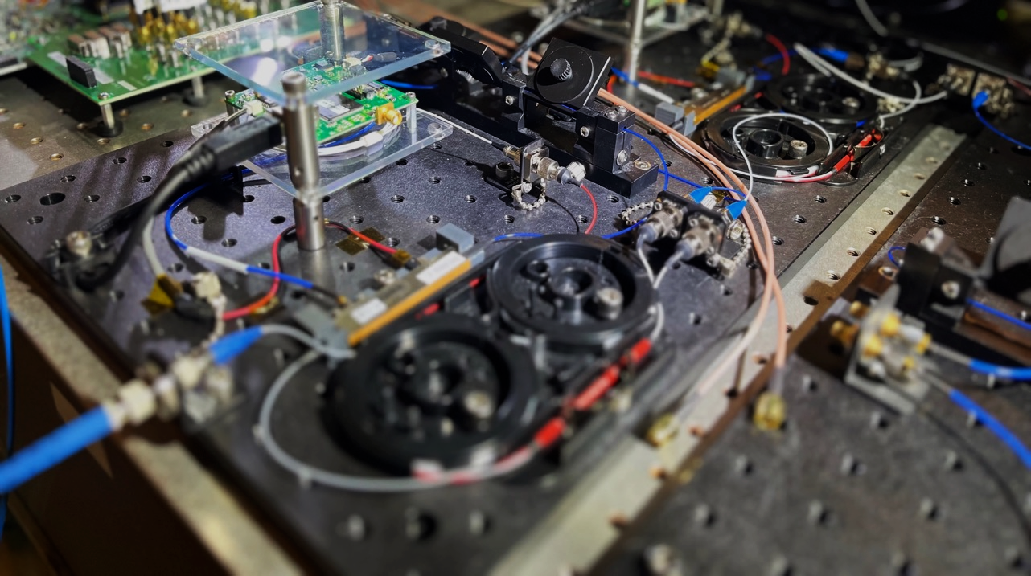
Lightning: a Reconfigurable Photonic-Electronic SmartNIC for Fast and Energy-Efficient Inference
Zhizhen Zhong
MIT CSAIL
Mingran Yang Jay Lang Christian Williams Liam Kronman Alexander Sludds
Homa Esfahanizadeh Dirk Englund Manya Ghobadi
Notes:
Good afternoon everyone. I am Zhizhen Zhong from MIT.
Today I am going to talk about our work, Lightning, a reconfigurable photonic-electronic smartNIC for fast and energy-efficient inference.

Slide 2
The machine learning (ML) storm
^{[1]}: fastest growing online application ever
In just one month, ChatGPT served 100 million unique visitors.
(Instagram took 2 years)
ML inference empowers a wide-range of applications.
As a result, billions of ML inference packets are flooding data centers.
Massive implications for rethinking our networks and systems.
[1] https://www.theguardian.com/technology/2023/feb/02/chatgpt-100-million-users-open-ai-fastest-growing-app

Slide 3
Requirements for serving real-time inference packets
Latency:
Live inference query response time should be less than 100 ms^{[2]}.
Energy consumption:
ChatGPT’s monthly electricity consumption is more than a 175,000 people^{[3]}.
[2] https://learn.microsoft.com/en-us/azure/cloud-adoption-framework/innovate/best-practices/ml-deployment-inference
[3] https://towardsdatascience.com/chatgpts-electricity-consumption-7873483feac4

Slide 4
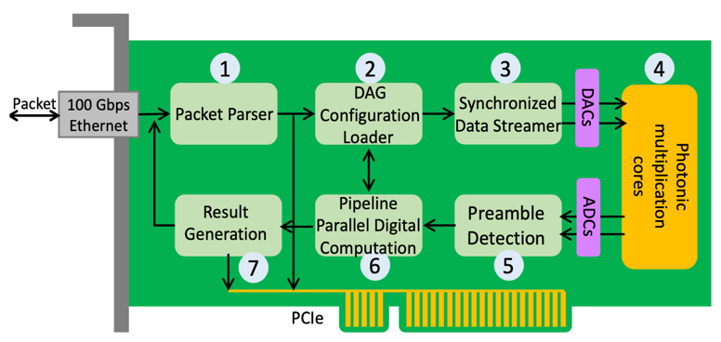
This talk: Lightning
The first smartNIC system to serve real-time inference packets using photonic computing.

Slide 5
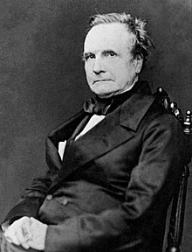
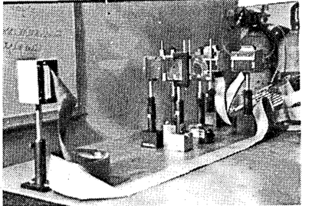
What is photonic computing?
Use light waves to perform computation in the analog domain.
Computers were born analog.
Charles Babbage conceptualized computers in 1840s as analog devices.
Optical neural network accelerator
Psaltis et al., Opt. Lett. 1985^{[3]}
[3] Demetri Psaltis, and Nabil Farhat. "Optical information processing based on an associative-memory model of neural nets with thresholding and feedback." Optics Letters 10, no. 2 (1985): 98-100.

Slide 6
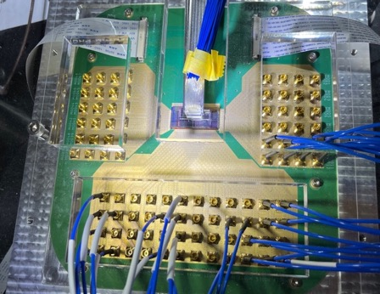
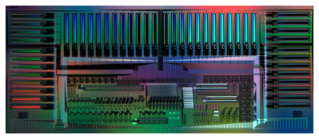
Photonics can revolutionize computing
Computes at 100 GHz.
Tens of times faster than electronics.
Consumes 40 atto Joules (10⁻¹⁸) per multiply-accumulate operation^{[4].}
Hundreds of times more energy efficient than electronics.
[4] Alexander Sludds, Saumil Bandyopadhyay, Zaijun Chen, Zhizhen Zhong, et al.
"Delocalized photonic deep learning on the internet’s edge." Science 378, no. 6617 (2022): 270-276.
Silicon photonic computing chip at MIT^{[4]}
But photonic computing has never gained practical traction!

Slide 7
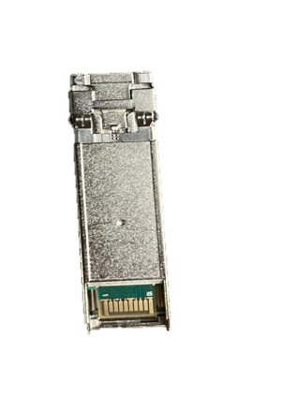
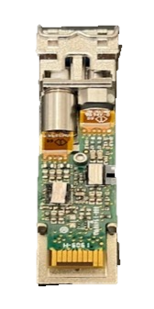
Photonic computing: modulating light intensities as it propagates
$\sum{a_{i}b_{i}}$(electrical result)
$\vec{a}$(electrical data)
$\vec{b}$(electrical data)
$a_{i}b_{i}$(electrical result)
0.8
0.7
0.85
1
0.6
0.6
0.48
0.51
0.1
0.05
0.1
0.035
1
1
1
1
0.8
Voltage
0.6
0.7
Voltage
0.48
0.51
Voltage
0.1
0.035
0.1
Laser
Optical
Modulator
Optical
Modulator₂
Photo-
detector
Carrier light
Modulated light
Double-modulated light
Optical modulators and photodetectors are passive devices, which perform the computation naturally as light propagates through the system.

Slide 8
Challenge: photonic operations are mixed with electronic ones in real-world ML inference
Photonic domain
Photonic domain
Photonic domain
Pkt processing
Flatten
Multiply
Accumulate
ReLU
Mul.
Acc.
ReLU
Mul.
Acc.
Softmax
Pkt processing
$$x_{1}$$
$$x_{1}w_{1,1}$$
$$x_{2}w_{2,1}$$
$$x_{2}$$
$$x_{i}w_{i,1}$$
6
$$x_{i}$$
$$x_{784}w_{784,1}$$
$$x_{784}$$
A control logic is needed to coordinate the operations across electronics and photonics.

Slide 9
Even harder challenge: reconfigure photonic-electronic operations for different ML inference
Diverse ML inference packets require a runtime reconfigurable system:
ML models have relatively small number of computing “templates”: fully-connected layers, convolutions, ReLU, etc.
Diverse number of combinations of “templates”: e.g., 30 convolution layers.
model #1
Photonic
multiply-accumulate
Digital compute
Photonic
multiply
Pkt processing
model #2
Photonic
multiply-accumulate
Digital compute
… 30 layers…
Photonic
multiply-accumulate
Digital compute
How to achieve reconfigurable control from packets to photonics?

Slide 10
Strawman approach: Stop-and-go data movement between digital & photonics
Slow!
Control plane logic
Packet processing
Flatten
Photonic
multiply-accumulate
Digital accumulate
ReLU
Photonic
MAC
Acc.
ReLU
Photonic
MAC
Acc.
Softmax
Data plane pipelined operations
To achieve reconfigurability, the control plane logic is deeply coupled with the data plane operations.
Slows down the critical data plane latency, increases energy consumption
How to achieve reconfigurability at runtime without compromising latency?

Slide 11
Our solution: co-design photonics and digital systems
Key innovation: a hardware programming abstraction to make control decisions on the data plane.
Control plane logic
Packet processing
Flatten
Photonic multiply-accumulate
Digital Accumulate
ReLU
Abstraction
Abstraction
Abstraction
Abstraction
Abstraction
Ph. MAC
Acc.
ReLU
Ph. MAC
Acc.
Softmax
Abstraction
Abstraction
Abstraction
Abstraction
Abstraction
Design goal: simple, yet effective and powerful to cover a wide range of DNNs.

Slide 12
Lightning’s reconfigurable count-action abstraction
module datapath_module {
counts: {
// variables to be counted
}
targets: {
// a set of target results
}
actions: {
// actions to be triggered
// when the result is
// equivalent to the target
}
};
result < target
variable
Count
result == target
Action
High-level idea: Trigger an action whenever the count result reaches the target.

Slide 13
Putting it all together: Lightning SmartNIC
1
2
3
4
DAG
Configuration
Loader
Packet
100 Gbps Ethernet
Synchronized Data Streamer
DACs
Packet Parser
Photonic
computing
cores
Result Generation
Pipeline Parallel Digital Computation
Preamble Detection
ADCs
7
6
5
PCIe

Slide 14
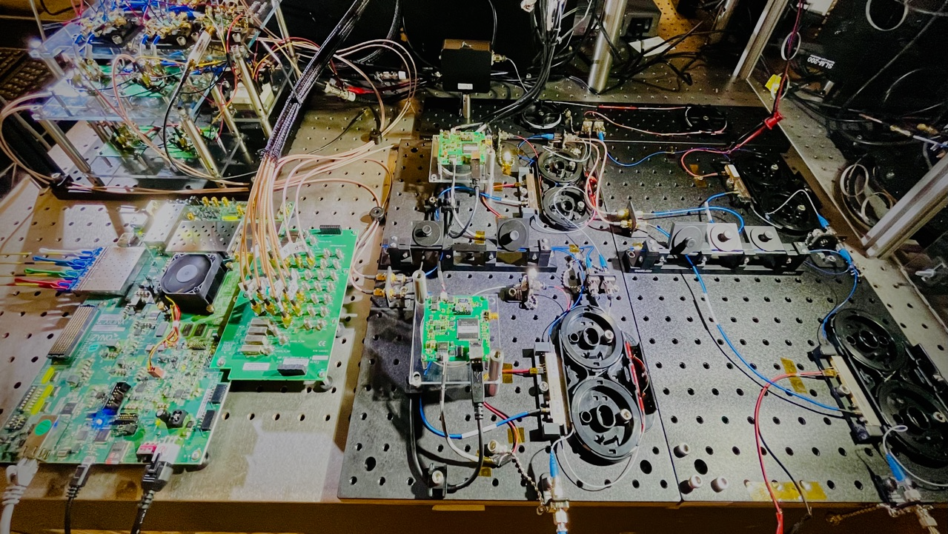
Photodetector
Lightning prototype at MIT
Modulator
Modulator
ADC ports
Modulator
100 Gbps
Ethernet interface
Lightning datapath on FPGA
DAC ports
Modulator
Laser input wavelength #1
Laser input wavelength #2
Notes:
We spent about past two years building the first fully-functional Lightning smartnic hardware prototype in our optics lab at MIT. Our hardware prototype contains an 100 Gbps ethernet interface, and a lightning datapath implemented on FPGA with RF DACs and ADCs. In the photonics side, we have four modulators and one photodetector capable of running two multiply-accumulate operations in parallel at 4 GHz.

Slide 16
Photodetector
Lightning prototype at MIT
Modulator
Modulator
ADC ports
Modulator
100 Gbps
Ethernet interface
Lightning datapath on FPGA
DAC ports
Modulator
Laser input wavelength #1
Laser input wavelength #2
Notes:
We realize building such a experimental setup presents a high bar of entry for the SIGCOMM community. So we consolidate our setup and presents an open-source developer kit.

Slide 17
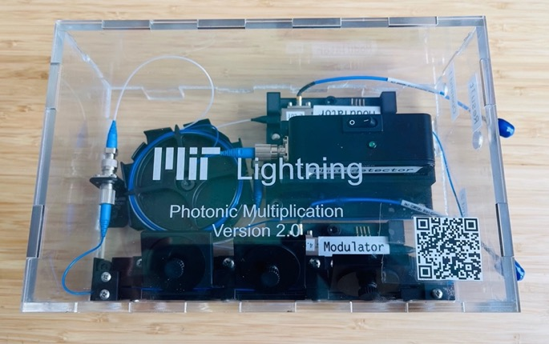
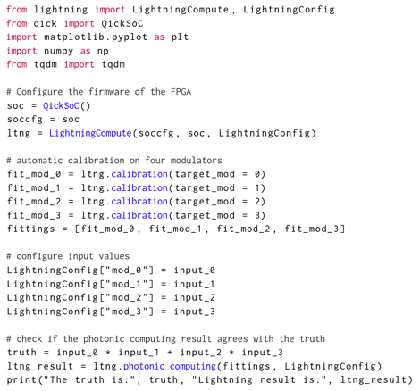
Lightning open-source developer kit
If you’re interested, please sign up for a kit at https://lightning.mit.edu.

Slide 18
Large-scale simulations: latency and energy gains
Inference Latency Speedup
Energy Savings
Lightning improves the average inference serve time by 42× - 337× while reducing the energy consumption by 54× - 419×.

Slide 19
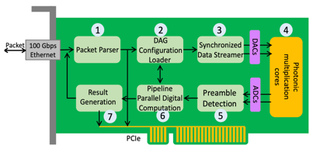
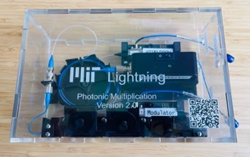
Concluding summary
Lightning is the first photonic-electronic smartNIC to serve real-time inference packets.
result < target
Our count-action abstraction enables runtime control and reconfiguration of photonic-electronic computation tasks without interrupting the dataflow.
variable
Count
result == target
Action
Open-source hardware and software available at https://lightning.mit.edu.

Slide 20
More resources
SIGCOMM 2023 full paper: https://people.csail.mit.edu/zhizhenzhong/papers/2023_SIGCOMM_Lightning.pdf
SIGCOMM 2023 Demo abstract: https://people.csail.mit.edu/zhizhenzhong/papers/2023_SIGCOMM_Lightning_Demo.pdf
SIGCOMM 2023 talk recordings: https://youtu.be/h169d_0JZWE?si=TO-MfFu0b0TByKDH&t=55

